Slide 1
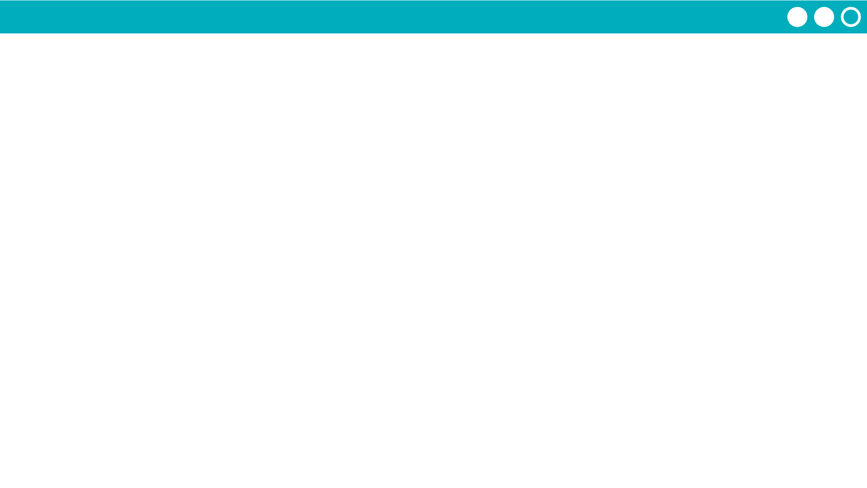
Unit 9 Lesson 3 - Activity
Do This:
Navigate to Level 1 on Code Studio
Open the data tab
Familiarize yourself with the imported table
Open the Data Visualizer
Make charts:
Average Hours of Sleep
Favorite Subject

