Slide 1

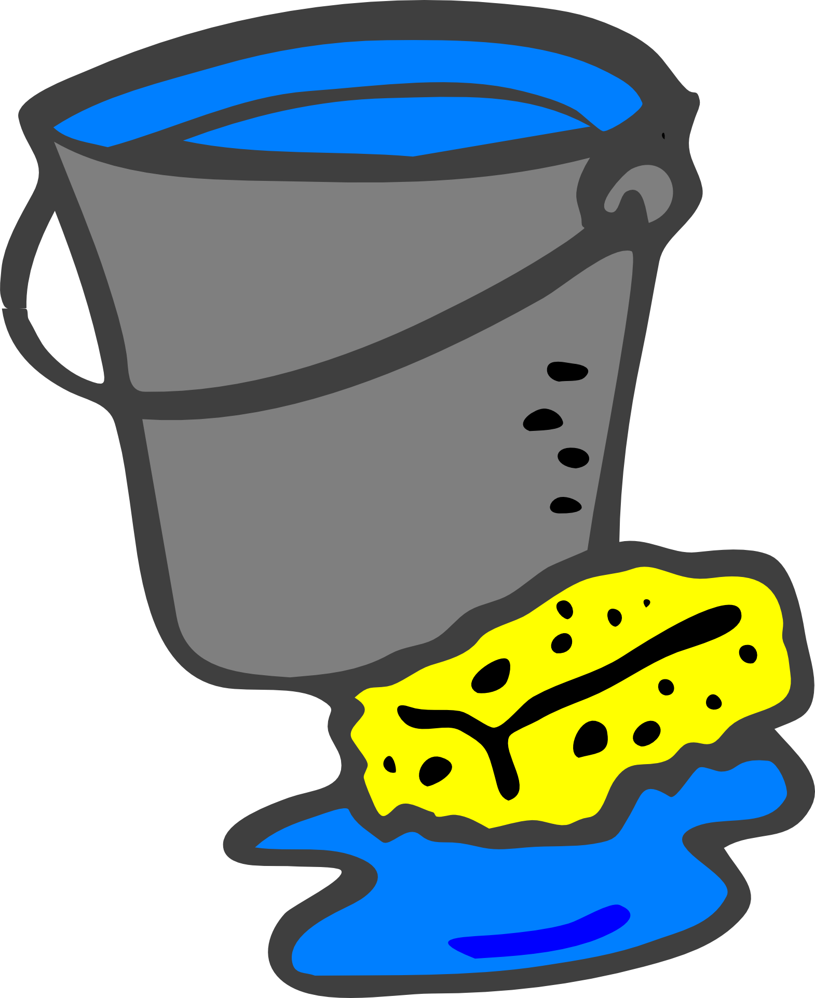
Unit 9 Lesson 3 - Activity
Cleaning Data
When does data need to be cleaned?
Data is incomplete
Data is invalid
Multiple tables are combined into one
What leads to "messy" data?
Users enter in different types of data ("two", 2)
Users use different abbreviations to represent the same information ("February", "Feb", "Febr")
Data may have different spellings ("color", "colour") or inconsistent capitalization ("spring", "Spring")

