Slide 1

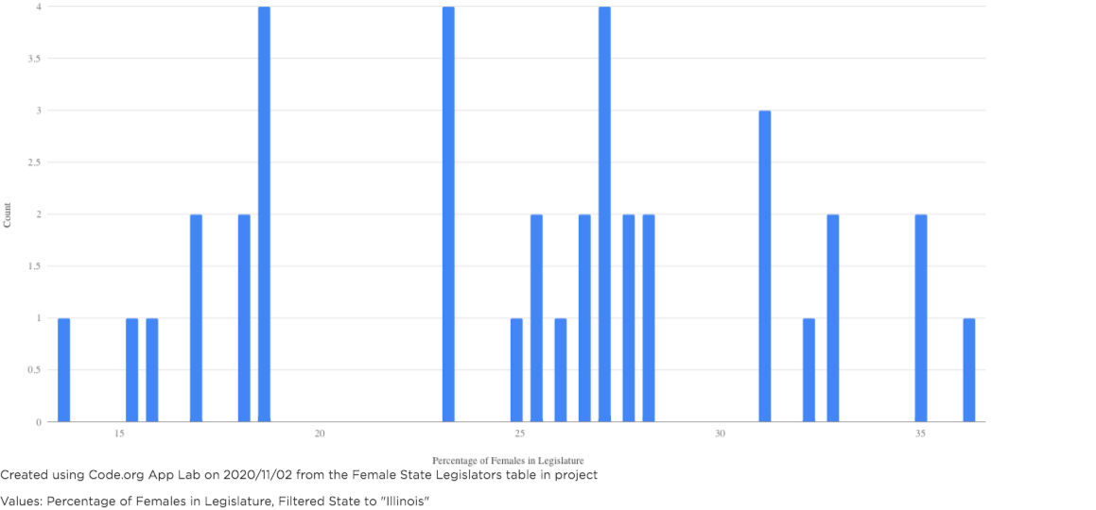
Unit 9 Lesson 3 - Activity
Demo:
This example graph is for the state of Illinois, your state’s graph may look different.

