Slide 1

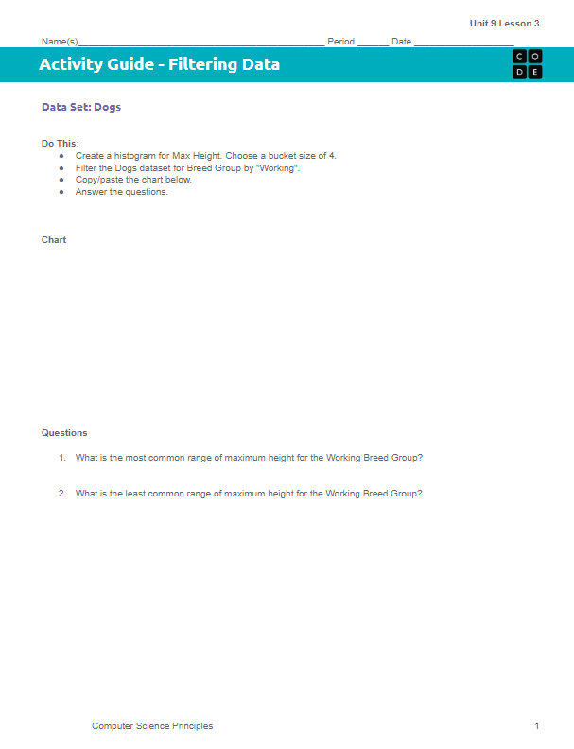
Unit 9 Lesson 3 - Activity
Do This:
Navigate to Level 2
Work through the Activity Guide
Copy/Paste the charts you make into the Activity Guide

