Slide 1

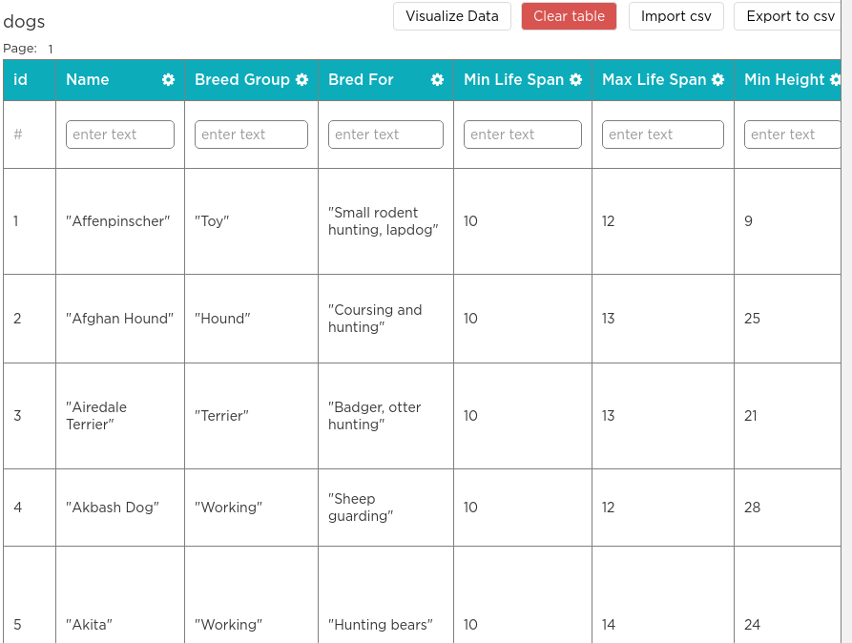

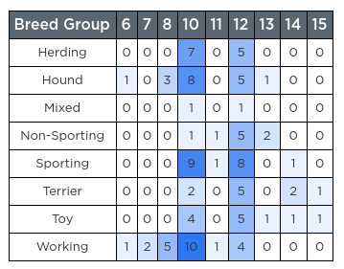

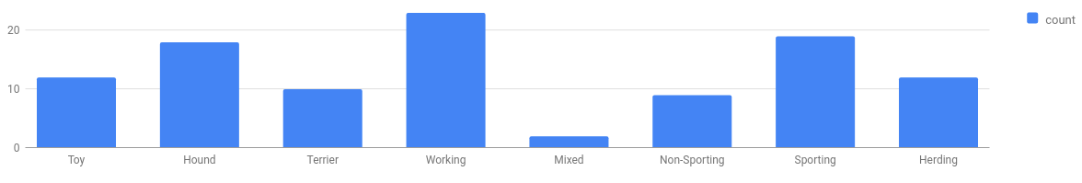
Unit 9 Lesson 3 - Wrap Up
The Data Analysis Process
Clean and/or Filter
Collect or Choose Data
Visualize and Find Patterns
New Information
Prompt: Why is "Clean and/or Filter" an important part of the Data Analysis Process?
What are situations when you would filter vs. clean your data?

