Slide 1

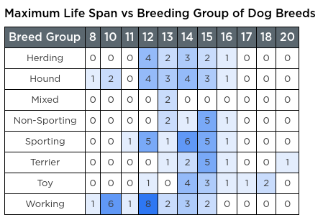
Unit 9 Lesson 4 - Activity
Breed Group | Max Life Span
"Working" | 12
"Toy" | 12
"Working" | 12
"Mixed" | 13
"Working" | 10
"Non-sporting" | 15
"Mixed" | 13
Prompt:
How many "Herding" breeds live a maximum of 12 years?
What is the most common maximum life span for "Working" breeds?
Which breed group lives the shortest?
Which breed group lives the longest?
How do you know? How confident are you in your answers?
A crosstab chart counts how many times combinations of values appear. Arrows show where that row in the data table would be counted in the chart.

