Slide 1

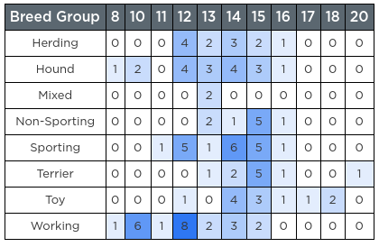
Unit 9 Lesson 4 - Activity
Cross Tab: Counts how often pairs of values in two columns appear.
Useful for:
Finding the most / least common combinations of values in two columns
Finding patterns across two columns
Exploring two columns when one or both are strings.
Not useful:
If either column has too many values (the chart would be enormous)

