Slide 1

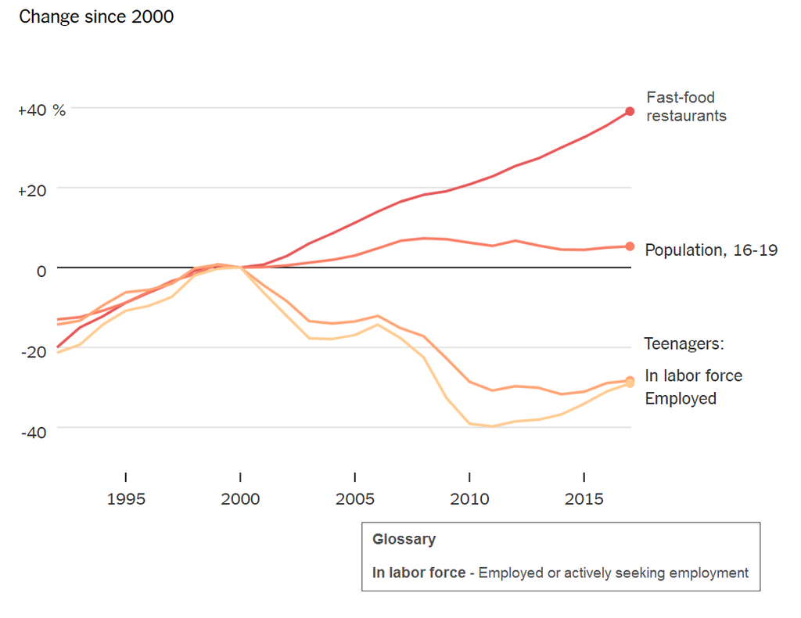
Unit 9 Lesson 1 - Activity
What do you notice?
What do you wonder?
What might be going on in this graph?

