Slide 1
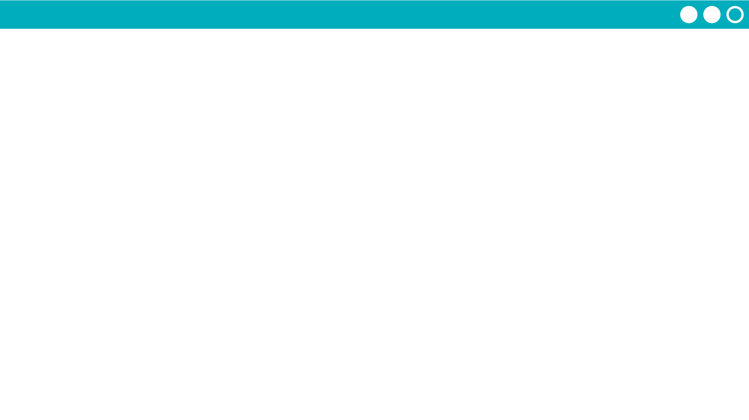
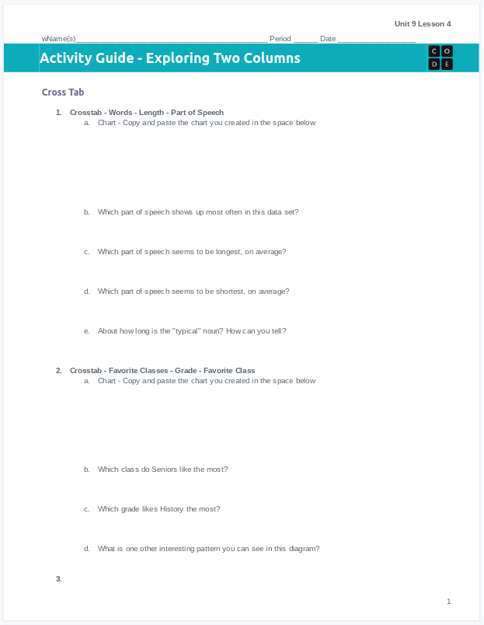
Unit 9 Lesson 4 - Activity
Let's practice making more crosstabs ourselves!
You'll need your activity guide, ideally in digital form.

