Slide 1

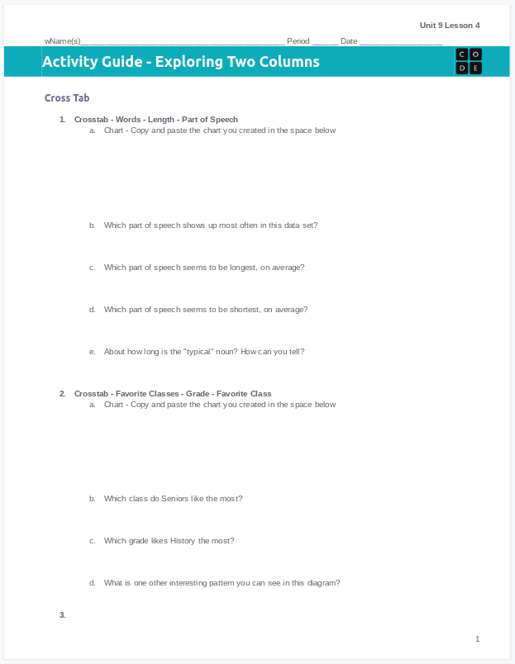
Unit 9 Lesson 4 - Activity
Do This: Fill out page 1 of your activity guide
Make the two different crosstab charts indicated on this sheet
Answer the questions for each chart

