Slide 1

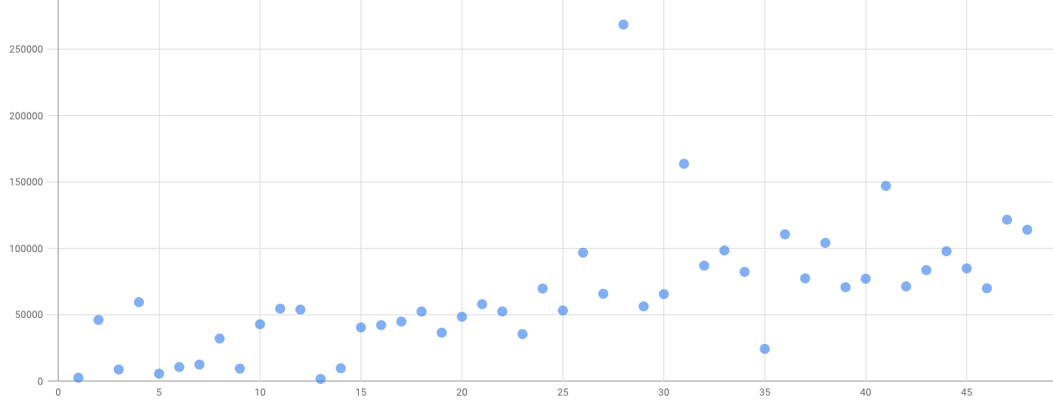
Unit 9 Lesson 4 - Activity
This table has a dot for each of the first 48 states. It shows the size of the states in square miles vs. the order it was added to the USA.
Prompt: Is there a pattern? How can you tell?
Area (mi²)
Admission Number

