Slide 1

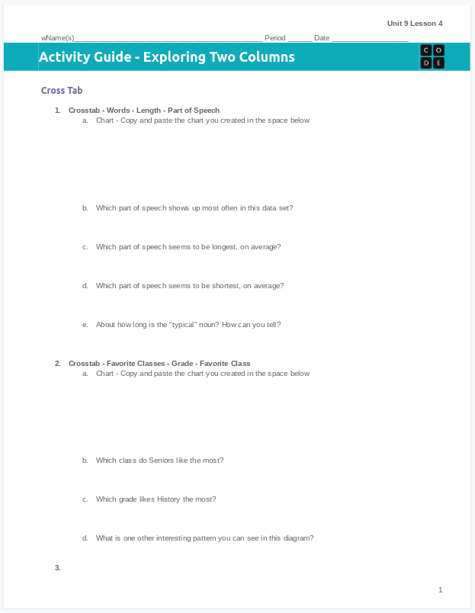
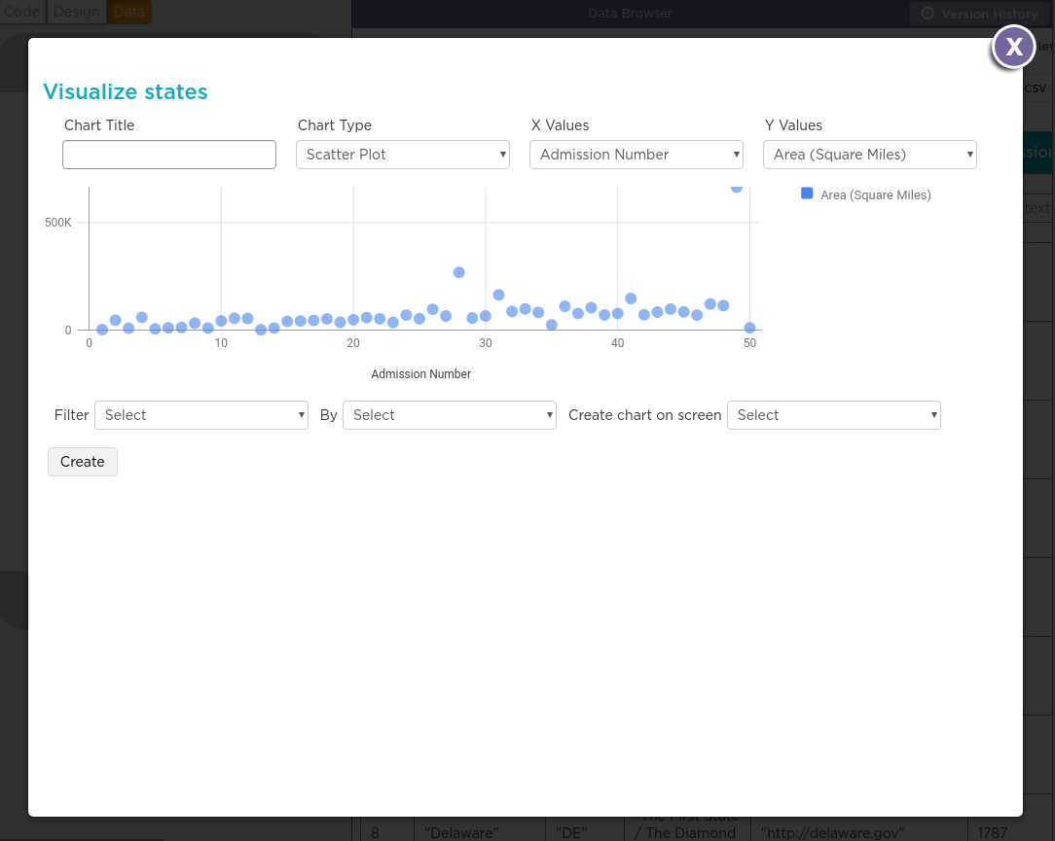
Unit 9 Lesson 4 - Activity
Do This: Complete both sides of your activity guide
Use Lesson 4 Level 1
Practice making crosstab and scatter charts to answer different questions. Fill in the information you collect in activity guide.

