Slide 1

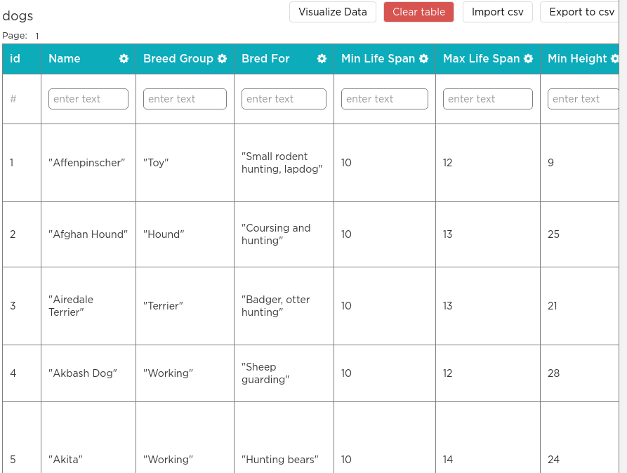

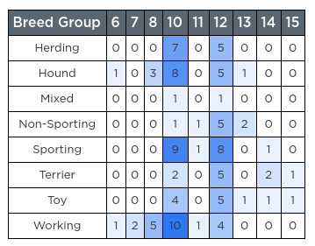

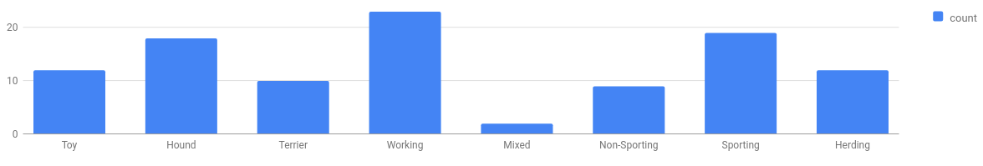
Unit 9 Lesson 4 - Wrap Up
We now know a lot of different ways to Visualize and Find Patterns
The Data Analysis Process
Clean and/or Filter
Collect or Choose Data
Visualize and Find Patterns
New Information

