Slide 1

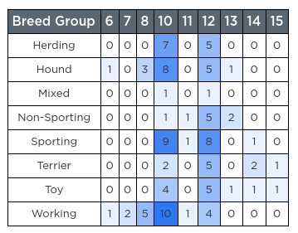
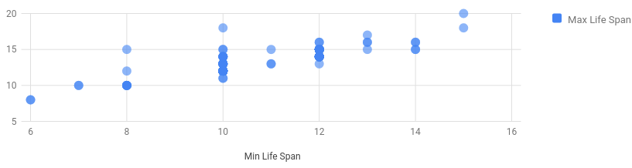
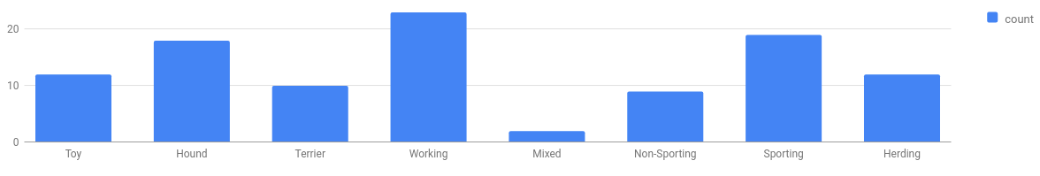
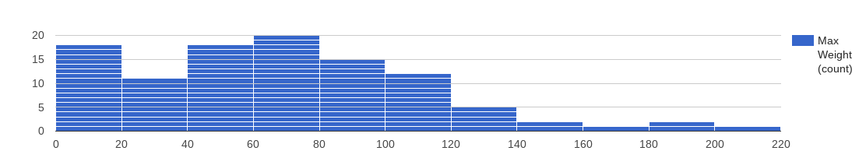
Unit 9 Lesson 4 - Wrap Up
How many columns?
This side is good for finding relationships and patterns across different columns. You might start being able to see how changes to one value impact another.
This side is good for knowing what's in your dataset at all. What values are present, what's their range, where are the clusters of values, and so on.
1 column
2 columns
Are the values strings?
How many values?
No
Yes
How many values?
Few
Many
Few
Many
Bar chart
Histogram
Crosstab
Scatter Plot

