Slide 1

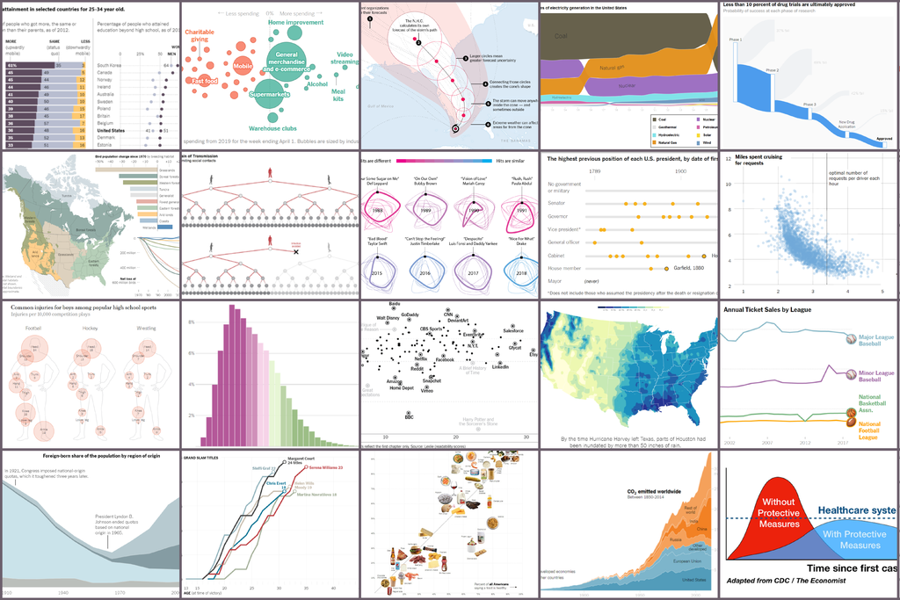
Unit 9 Lesson 1 - Activity
Let's explore “What’s Going On in This Graph?” together!
https://www.nytimes.com/2020/06/10/learning/over-60-new-york-times-graphs-for-students-to-analyze.html
What can we do with this site?
View different graphs (by topic or by type)
Look for patterns in the data
Read about where the data comes from

