Slide 1

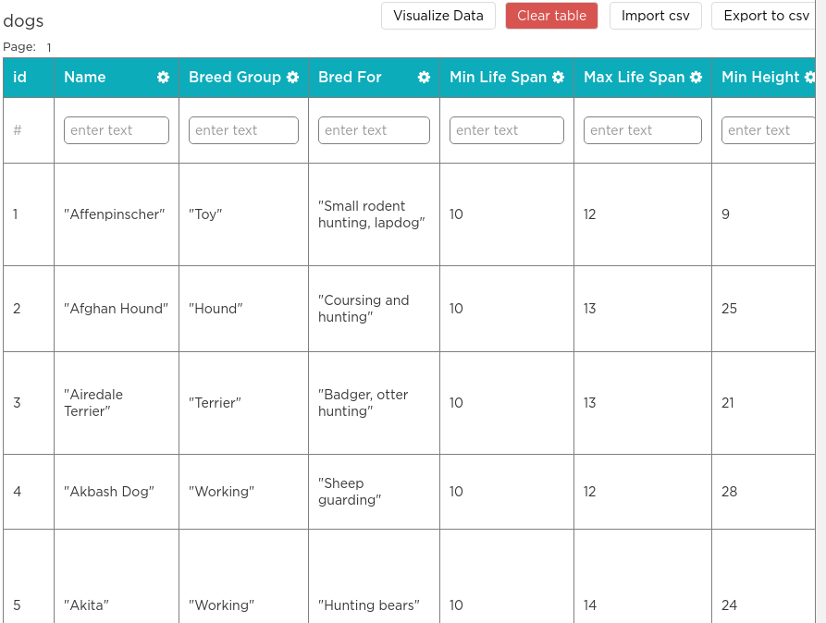

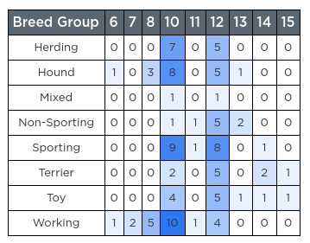

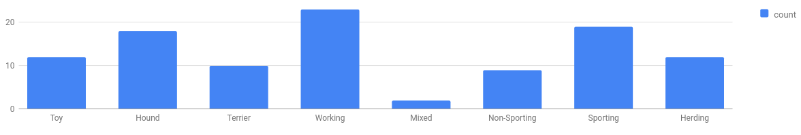
Unit 9 Lesson 5 - Warm Up
The Data Analysis Process
Clean and/or Filter
Collect or Choose Data
Visualize and Find Patterns
New Information
Prompt: With a partner review the data analysis process and for each step talk through:
What is this step and why is it important?
Where have we done this step together?
What could go wrong if you do this step poorly.

