Slide 1

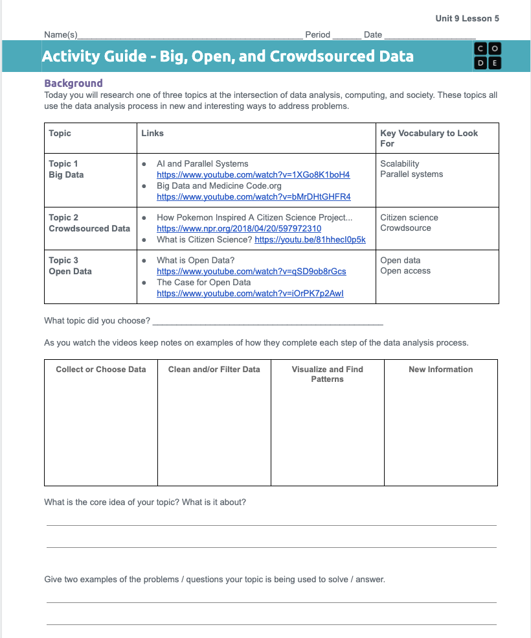
Unit 9 Lesson 5 - Activity
Prompt: With a partner
Choose one of the topics
Watch the related videos / listen to the podcasts
Take notes and be ready to share responses to the three questions below

