Slide 1

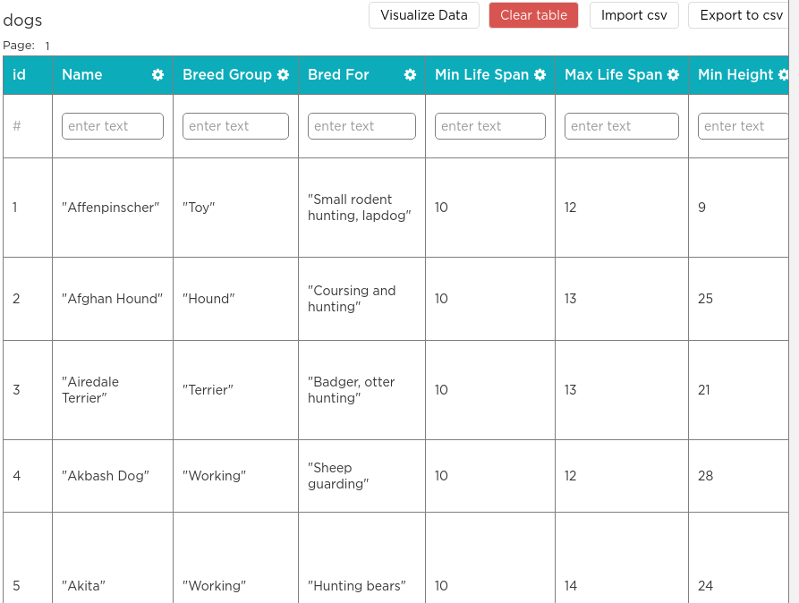

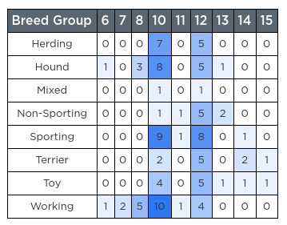

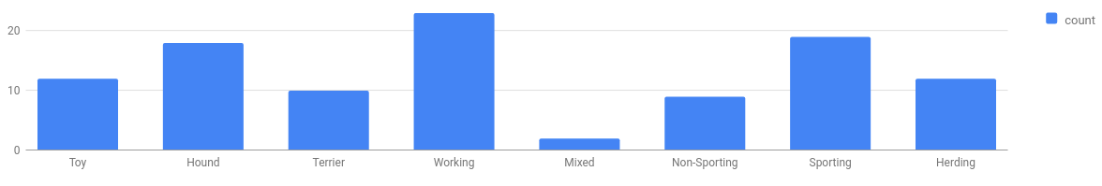
Unit 9 Lesson 5 - Activity
Discuss: Multiple members of each group should present on
What the topic is
The key vocabulary you were responsible for
How this concept uses or modifies the data analysis process
Examples of the problems this technique is being used to solve
The Data Analysis Process
Clean and/or Filter
Collect or Choose Data
Visualize and Find Patterns
New Information

