Slide 1

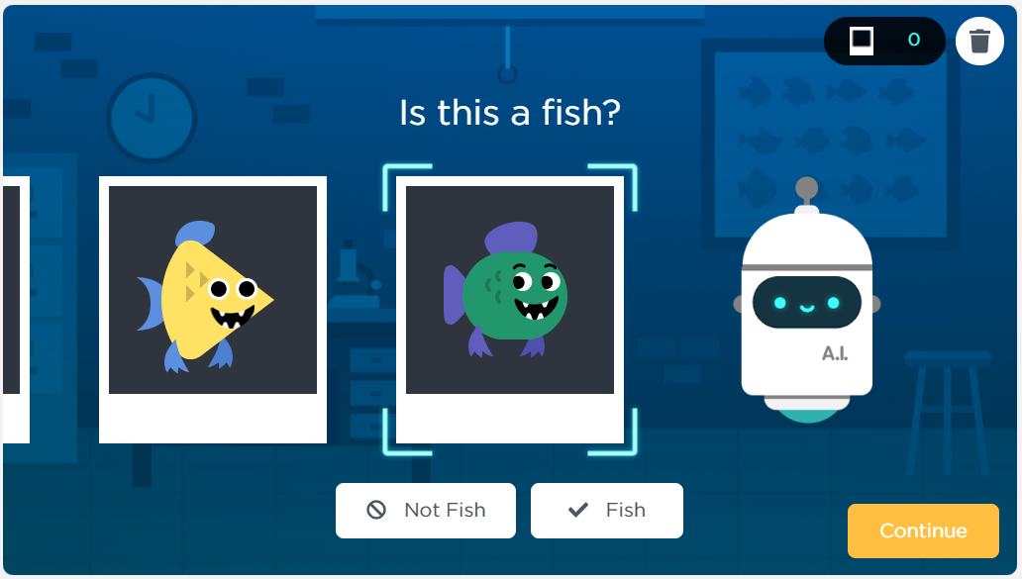

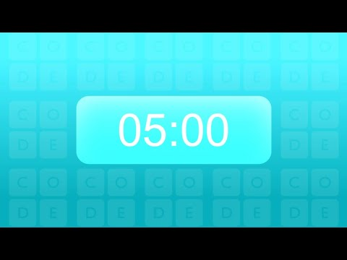
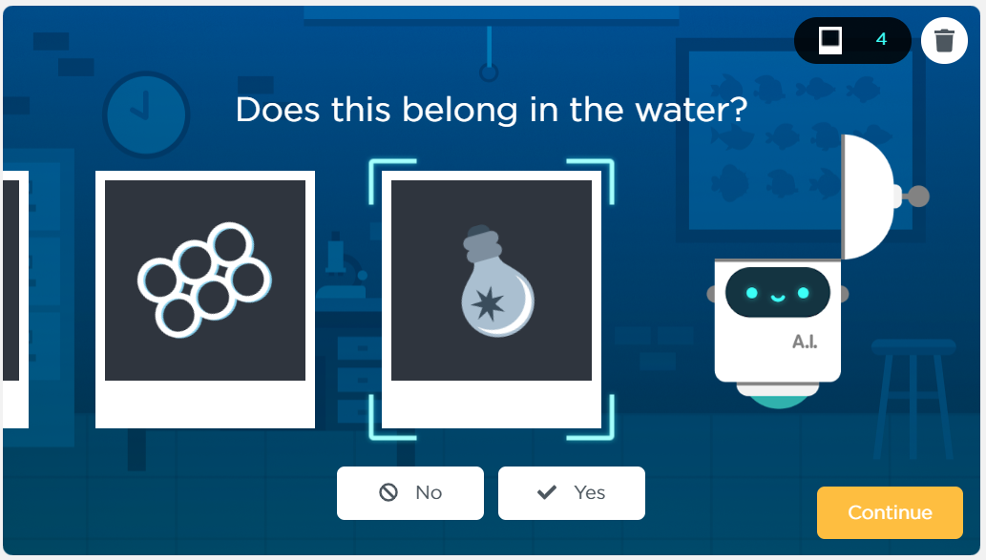
Unit 9 Lesson 6 - Activity
Do This: Complete
Levels 2-4
Consider: What potential problems do you think come up when creating training sets?

