Slide 1

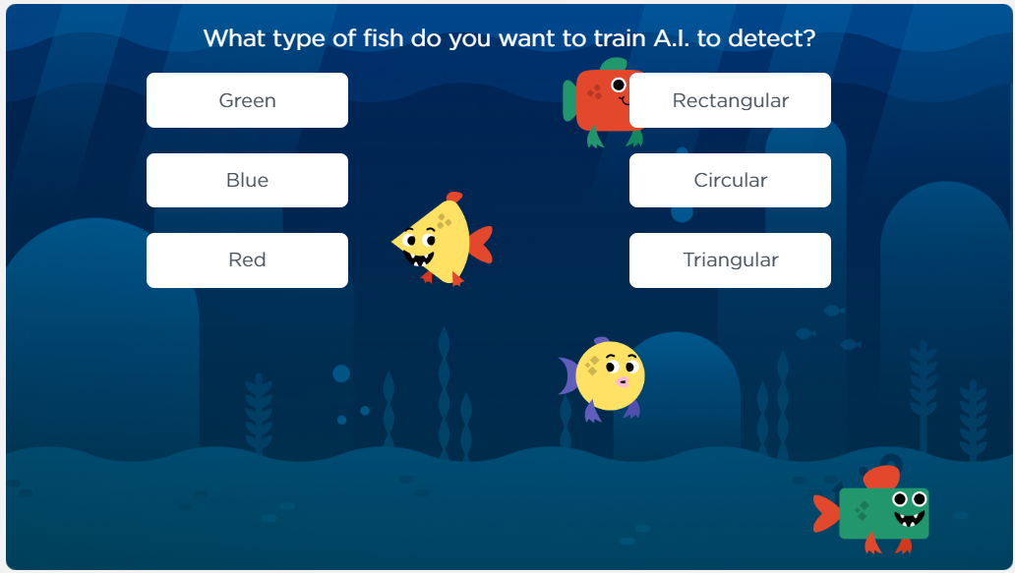
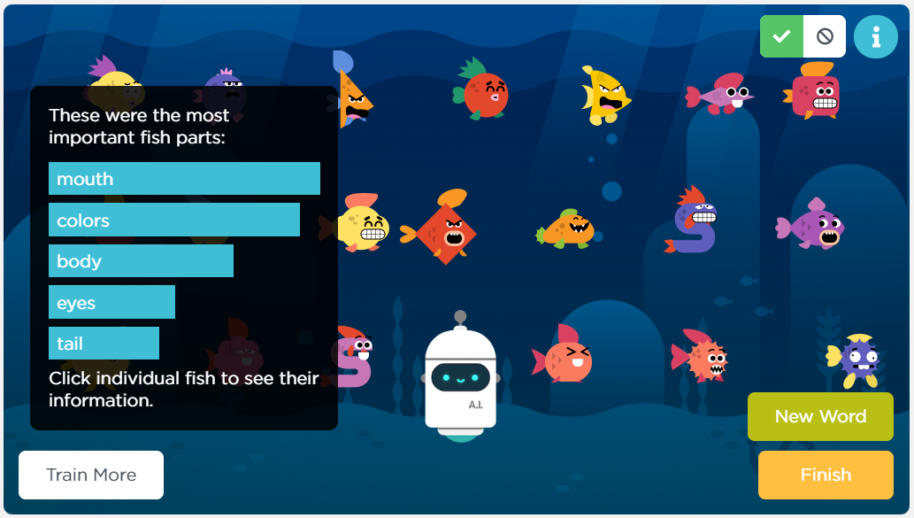
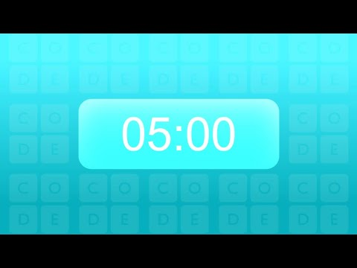
Unit 9 Lesson 6 - Activity
Do This: Complete
Levels 6-7
Consider: Is it fair to use AI to judge something by looks? What unintended bias could this cause?

