Slide 1

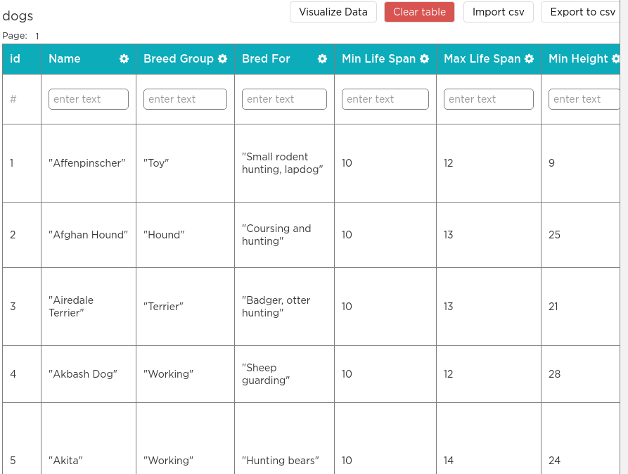


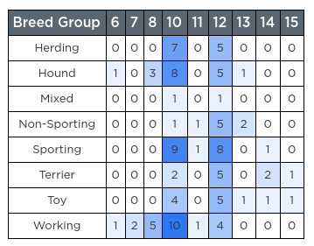
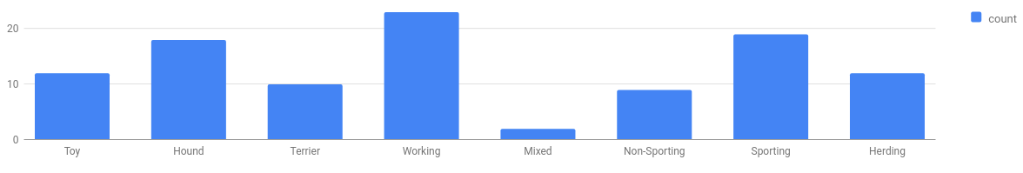
Unit 9 Lesson 6 - Wrap Up
Prompt: Which steps of this process do you think have to be done by humans? Would you be concerned if any of them were automated?
The Data Analysis Process
Clean and/or Filter
Collect or Choose Data
Visualize and Find Patterns
New Information

