Slide 1

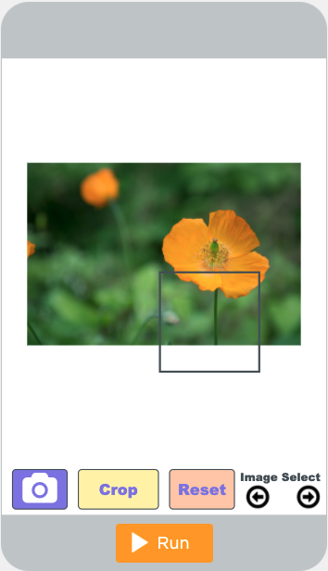
Unit 9 Lesson 7 - Activity
Do This: Crop the images as if you were uploading them to social media.
Consider: Which images are challenging for you to decide how to crop?

