Slide 1
Image processing using OpenCV and Python
Dustin Spicuzza
May 7, 2013

Slide 2
Agenda
Image processing
Why OpenCV+Python?
What can you do with OpenCV+Python?
hello_world.py
In-depth practical example:
Target detection for 2013 FIRST Robotics Competition

Slide 3
Why OpenCV?
Originally developed by Intel
It has thousands of image processing related algorithms and functions available
Highly optimized and reliable
Has building blocks that fit together
Let’s you do complex image processing without needing to understand the math
If you understand the math, it helps!

Slide 4
Why OpenCV?
Bindings for multiple languages
C/C++
Java
Python
Multiple platforms supported
Windows
Linux
OSX
Android

Slide 5
What OpenCV provides
Image I/O:
Read/Write images from disk
Use native OS functionality to interface with cameras
Image Segmentation
Edge finding
Contour detection
Thresholding

Slide 6
What OpenCV provides
Face detection
Motion tracking
Stereo vision support
Support for GPU acceleration
Machine learning operations
Classifiers
Neural networks

Slide 7
What OpenCV provides
Distributed with lots of samples
Face detection
Edge finding
Histograms
Square finder
Lots and lots and lots of stuff…

Slide 8
Why Python+OpenCV?
Simple syntax, rapid prototyping, etc…
Most of the compute intensive work is implemented in C/C++
Python is just glue, realtime operation is possible
NumPy is awesome

Slide 9
What is NumPy?
Multiple image processing libraries use it to hold images, so you can mix and match
Simple, intuitive, fast operations on multidimensional arrays
Example: masking, array indexing
>>> img, mask = get_image_and_mask()
>>> img[mask != 0] = 0 >>>
>>> img[x,y,z] = 4
>>>

Slide 10
Install Requirements
OpenCV Python Bindings
cv2.pyd comes with the binary distribution
Python 2.7
No python 3 support in OpenCV yet
NumPy 1.7

Slide 11
Hello World!
Create an image, show it using the GUI
import cv2
import numpy as np
# create a numpy array to hold the data
# -> w=200, h=100, channels=3
img = np.zeros(shape=(100,200,3), dtype=np.uint8)
# write red text to image (note BGR, not RGB!)
cv2.putText(img, "Hello World!", (50,50),
cv2.FONT_HERSHEY_PLAIN, 1, (0,0,255))
cv2.imshow('Image', img)
cv2.waitKey(0)

Slide 12
Practical Example
Every year, the FIRST Robotics Competition has a game for teams to build a robot to compete in
Every year, there is an image processing task as part of the game

Slide 13
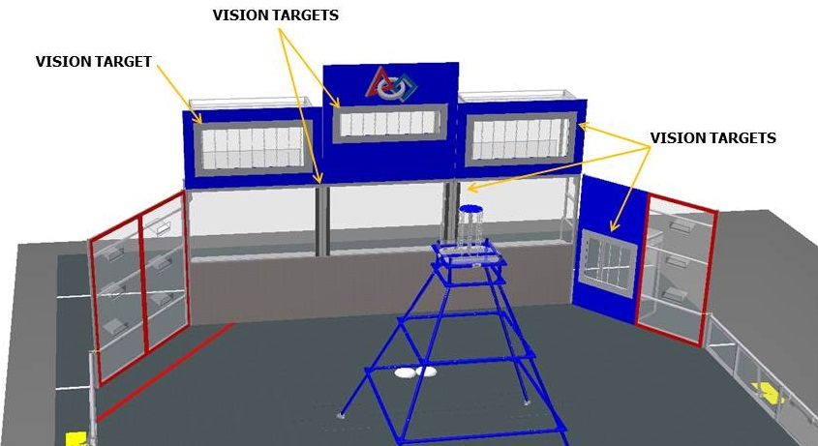
Practical Example
This year’s challenge: shoot frisbees into targets that are surrounded by retroreflective tape
The tape reflects light directly back at source
Src: http://frc-manual.usfirst.org

Slide 14
Practical Example
Finding gray tape at a distance isn’t particularly easy
Key part of image processing is removing as much non-essential information from image
We can do better!
Shine bright LEDs at the target, tape “lights up” with that color
Many teams have found that green light works best
Reduce exposure of camera so only bright light sources are seen

Slide 15
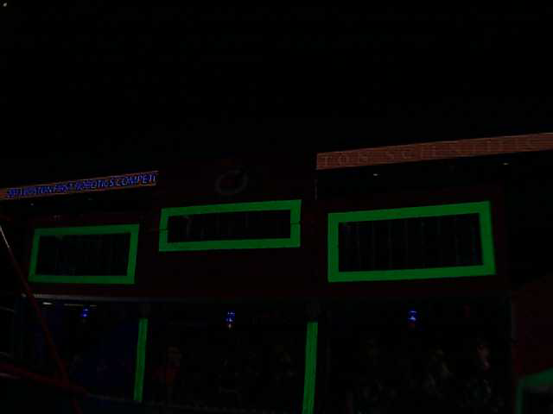
Practical Example
Result:

Slide 16
Practical Example
Processing steps
Convert to HSV, threshold image to find green
Find contours w/ hierarchy
Contour analysis to determine targets

Slide 17
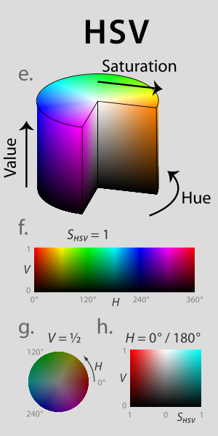
Practical Example
Convert to HSV
Hue: the color
Saturation: Colorfulness
Value: Brightness
This makes it easier to differentiate between colors without brightness affecting the results
http://en.wikipedia.org/wiki/File:Hsl-hsv_models.svg

Slide 18
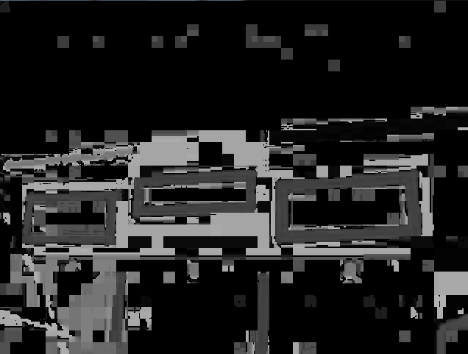
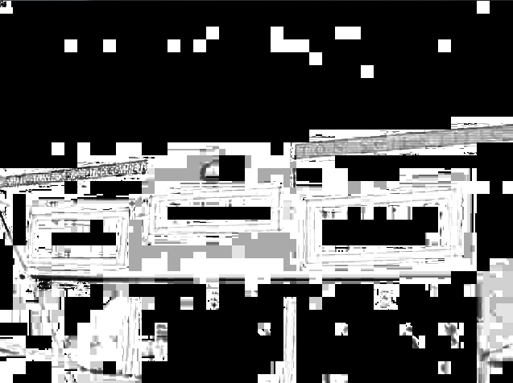
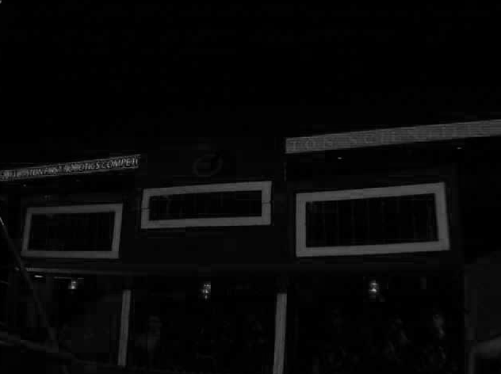
Practical Example
H
Split view of converted image (H, S, V)
Compression artifacts are clearly present
S
V

Slide 19
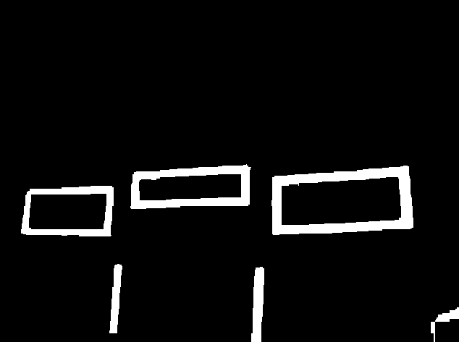
Practical Example
Threshold each channel, combine the results

Slide 20
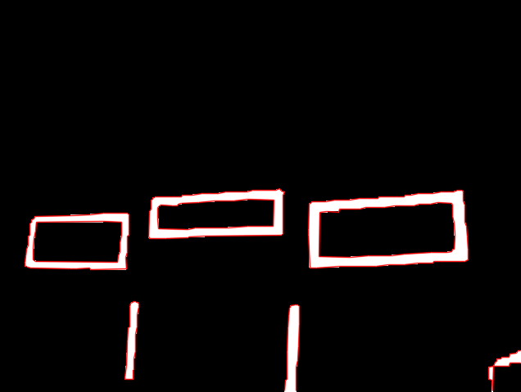
Practical Example
Use findContours() to find regions of interest
Returns a list of points bounding each contour
Also returns a hierarchy, so you can determine whether a contour is entirely inside another contour

Slide 21
Practical Example
Contour analysis
Discard non-convex contours
Convert to polygon approximation (approxPolyDP)
Discard polygons that aren’t rectangles
Find a minimal rotated bounding rectangle to perform analysis on (minAreaRect)

Slide 22
Practical Example
Target analysis
Determine ratio of rectangle sides to see if they match target sizes
Ensure rectangles have at least one horizontal line and two nearly vertical lines
Remove duplicates (inner part of rectangle)

Slide 23
Practical Example
Target analysis
Determine from ratio (w/h) whether it’s a top/middle/low target
Targets at each level are a different size
Determine from relative position whether it’s the left or right target we’re looking at
The left middle target will always be the target left of a top target, etc..

Slide 24
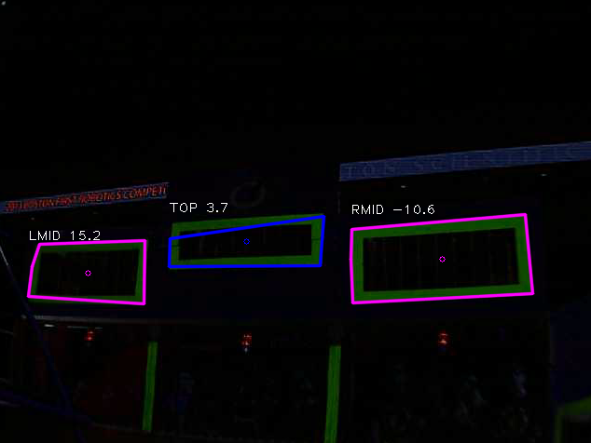
Practical Example
Draw pretty pictures and labels, and we’re done!

Slide 25
Live Demo
Unfortunately, in last week’s lab cleanup, the extra camera and LEDs were misplaced. ☹
I’ll show you images from the competition instead!

Slide 26
Questions?

Slide 27
Thanks to
FRC Team 341, whose image processing code was the base for our code this year
Sam Rosenblum and Stephen Rawls

