Slide 2
Designing an Intelligent Navigation Algorithm with LabVIEW Robotics
Notes:
Presentation Title: Designing an Intelligent Navigation Algorithm with LabVIEW Robotics
Presentation Abstract: A discussion on implementing Robotic Navigation, Mobility, and Localization using LabVIEW. The presentation focuses on topics discussed in Peter Corke's Robotics, Vision & Control that are solved using LabVIEW.

Slide 3
Introduction

Slide 4
Presenter
Tim Ancarrow
BS Mechanical Engineering
Virginia Tech
NI Applications Engineer
Real-Time Software
Model Based Design
Picture of me
Notes:
Introduce myself.

Slide 5








History of Robotics
Notes:
**history of robotics
**focus on the challenges we currently face with robotics
http://www.prweb.com/releases/service_robotics/professional_robots/prweb4240924.htm
http://tommytoy.typepad.com/tommy-toy-pbt-consultin/2011/06/outlook-for-robotics-and-automation-for-2011-and-beyond-are-excellent-says-expert-.html
1495 – Leonardo de Vinci Humanoid
1900 - Nikolai Tesla RC
1921 - ROBOT (forced labour) Czech Karel Capek

Slide 6
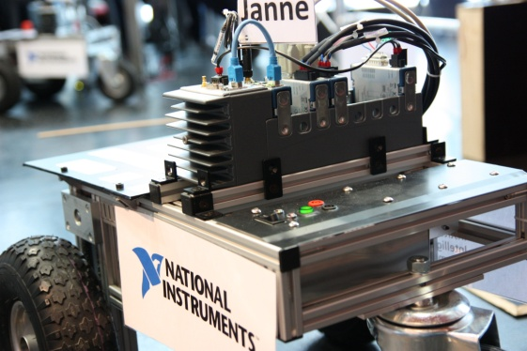
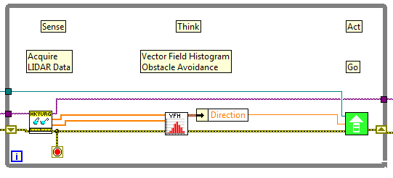
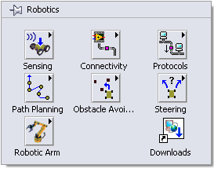
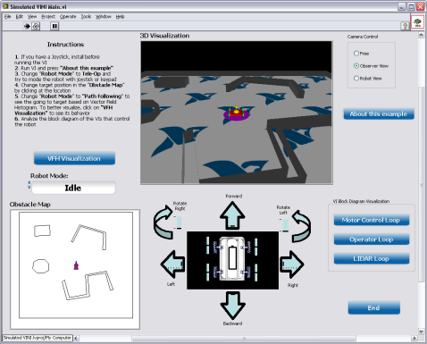
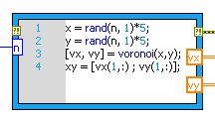
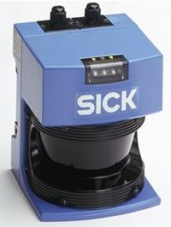
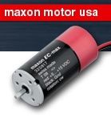
LabVIEW Robotics Module
Graphical system design software framework
IP for navigation, steering, kinematics, and more
Deployment to Real-Time and FPGA hardware
Tools for integrating text-based algorithms
Connectivity to various sensors and actuators
Physical Simulation of real-world applications
Notes:
- As many of you I’m sure are aware, our flagship software LabVIEW has enabled engineers to overcome many challenging tasks
- The LabVIEW Robotics toolkit, specifically, has introduced IP that helps make robotic integration with software even easier
However, no matter how many powerful tools you have in the shed, it doesn’t mean you know how to best take advantage of them.
------------
Within LabVIEW, there is a specialized toolkit called the LabVIEW Robotics Module.
It follows the same graphical system design framework so if you know LabVIEW already, you will be able to utilize this module immediately.
It allows integration with text-based algorithm/language such as .m files, but what makes the Robotics Module unique is the following features.
It contains various IP for autonomous navigation, steering, and kinematics. In fact, we work with Prof. Peter Corke and integrate his robotics toolbox into LabVIEW
It provides drivers for various sensors and actuators to help to get started with your application. These drivers are very unique and we will talk more about them in a little bit.
Of course, everything that you’ve developed can be deployed to Real-time and FPGA embedded hardware
3. Lastly, with LabVIEW Robotics 2012, we introduced the Robotics Simulator that allows you to import your CAD model and create dynamic simlation of your robotics system. You can modify the environment and see how robust your algorithm is in different scenarios.

Slide 7
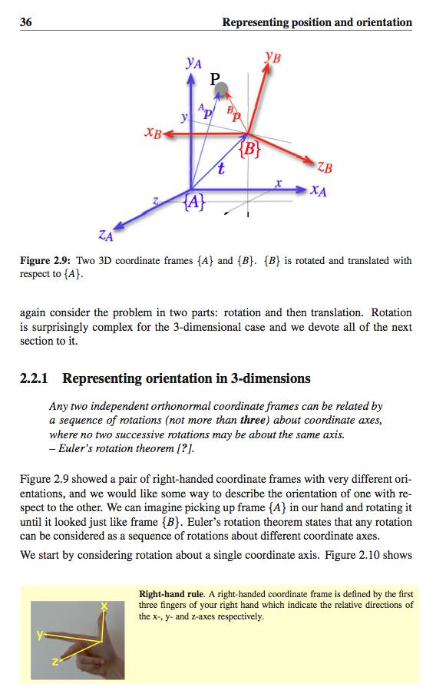
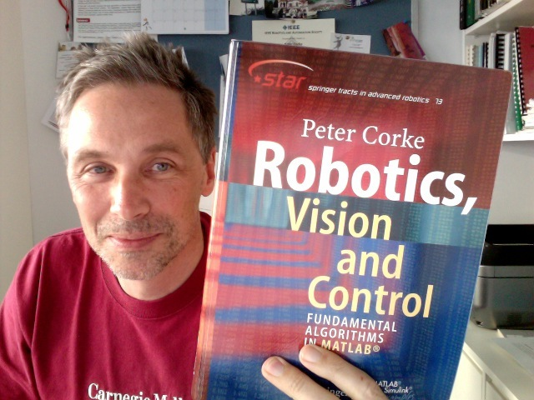
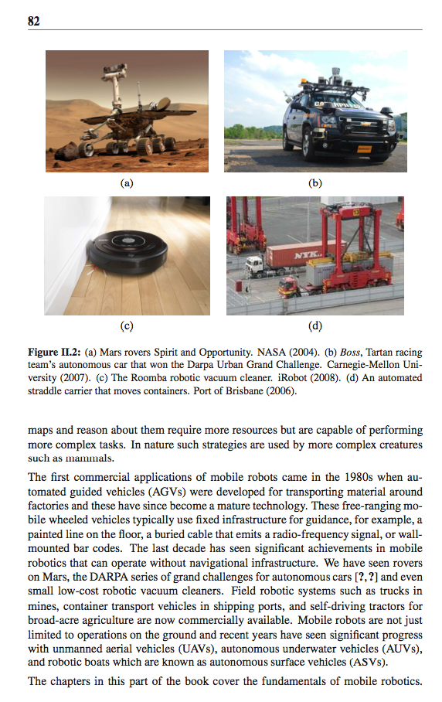
Robotics, Vision and Control
Prof. Peter Corke, QUT
Editor in Chief, IEEE Robotics and Automation Magazine
IEEE Fellow
Notes:
So, how is it that you approach these challenges and best utilize your tools? Well, you must first have a fundamental understanding of the task at hand.
Peter Corkes Robotics, Vision and Control textbook is a leading resource in the field of robotics. One of the major strengths of Corkes RVC is that it not only discusses theory but it also focuses heavily on real world considerations and implementation.
http://staff.qut.edu.au/staff/corkep/

Slide 8
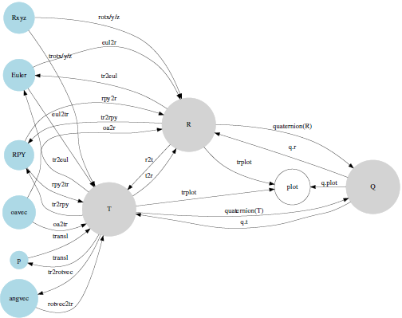
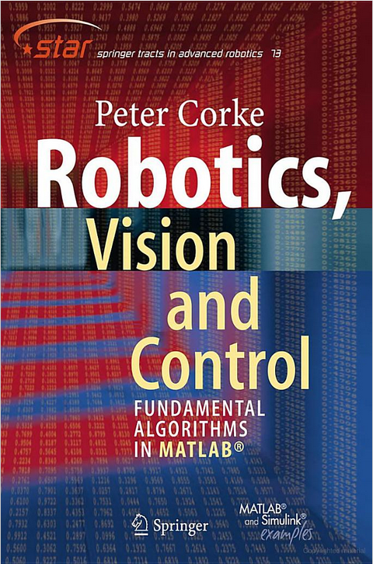

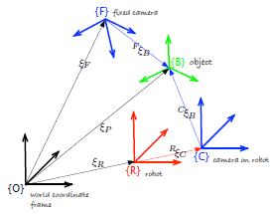
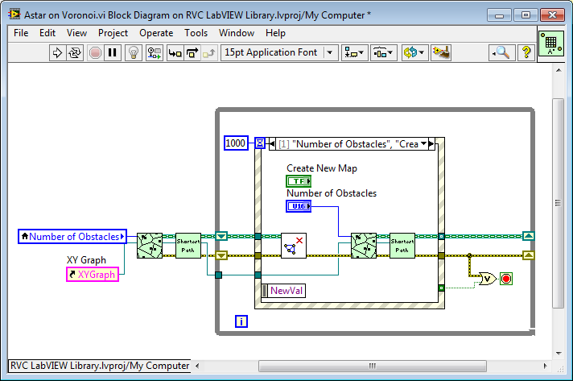
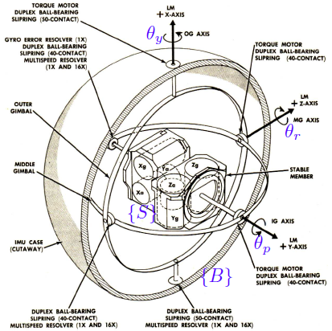
Robotics, Vision and Control and LabVIEW
Notes:
- Our goal is to marry the two components together.
Take the pragmatic approach that RVC provides and show how LabVIEW can be used as a tool to solve complex robotics problems.
<button press for animation>
- Together, these resources will help prepare scientists and engineers to approach the grand challenges that we face in robotics.

Slide 9
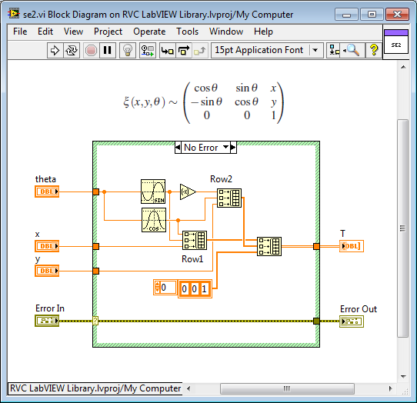
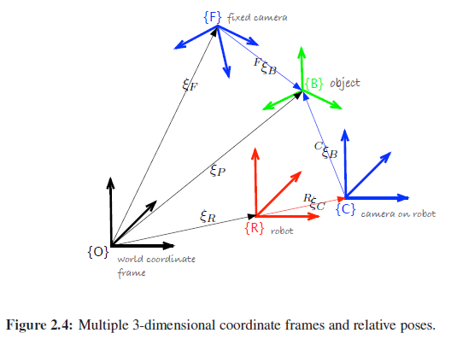
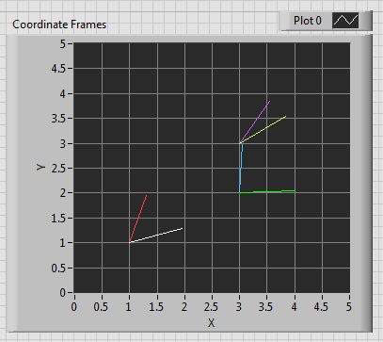
RVC LabVIEW Library
Library of LabVIEW Functions and Examples
Reusable/Extensible Functions
Completed Examples that match the textbook
Notes:
So what is our approach and what do we plan to develop?

Slide 10
Todays Session Topic
RVC Content
Introduction
Position / Orientation
Time and Motion
Mobile Vehicles
Navigation
Localization
Notes:
- RVC covers a wide range of topics.
However, today I want to focus specifically on the Navigation section. First I will walk through the theory and techniques presented in the book, and then show you how we then implement the discussed algorithms in LabVIEW.

Slide 11
Robotic Navigation

Slide 12
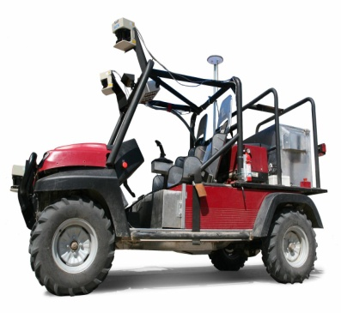
Navigation for Mobile Robots
“the process of directing a vehicle so as to reach the intended destination”
- IEEE Standard 172-1983
Think
Act
Sense
Notes:
It is natural for us to approach navigation from a human perspective. We build maps, landmarks, signs and carry references to the world around us. However, in robotics this technique
Navigation for robots does not match

Slide 13
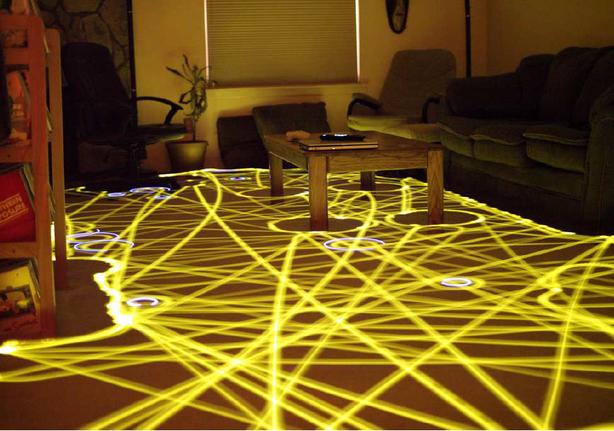
Navigation – Reactive
Reactive Navigation
“a goal oriented machine that can sense, plan and act”
Algorithms Examples:
Bug1
Bug2
Heading toward light
Line follow
Wall follow
Notes:
Algorithm Examples –
*Line following
*Heading toward a light – use a senseor to guide a vehicle toward a light source
*Heading toward a sound – use sensors to guide the vehicle to a sound source. Following intensity
*Wall follow – Follow a wall until you reach your goal
*Bug1 -
*Bug2 -
Physical Examples-
*Roomba

Slide 14
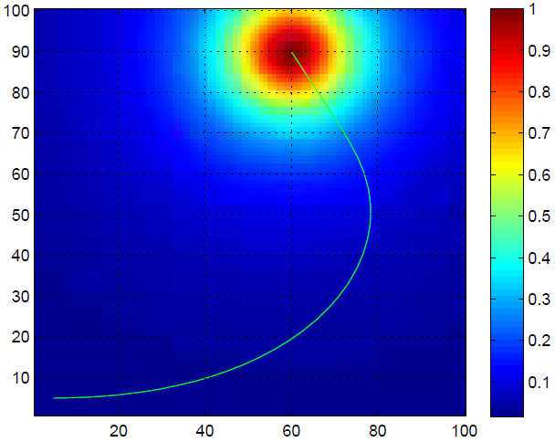




Navigation – Reactive example
Braitenberg Vehicles
Direct connection between sensor and motor
No internal map or planning
Notes:
Braitenberg vehicles are a classification of autonomous vehicles that navigate simply based on sensorimotor behavior. The system stores no internal map of the environment it traverses but simply reacts to the intensity of sensor measurements.
A good example of this is a robot that searches for a light intensity, chemical concentration, or sound source.

Slide 15
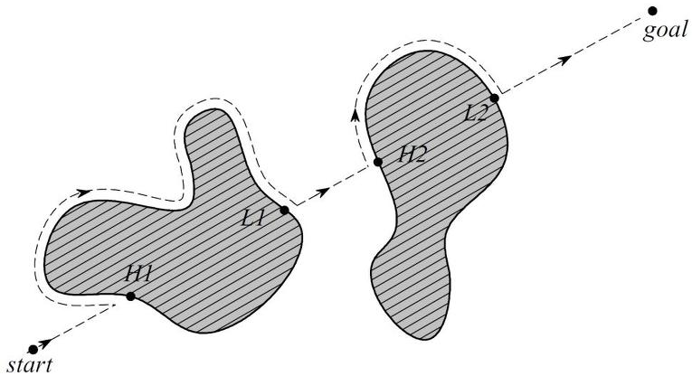
Navigation – Reactive example
Bug Vehicles
Sense goal proximity, like Braitenberg
But use state logic and have memory
Bug2 Algorithm
Add bug search on
Corke’s MAP

Slide 16
Navigation – Reactive
ug Vehicles
Sense goal proximity, like Braitenberg
But use state logic and have memory
Bug2 Algorithm
Add bug search on
Corke’s MAP

Slide 17
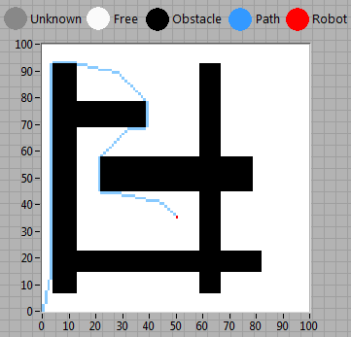
Navigation – Map-based Planning
Map-based Navigation
“a goal oriented machine that can sense, plan and act”
Key Concepts
Occupancy Grid
Start & Goal
Cost
Assumptions
Robot occupies 1 cell and can move to any neighbor cell
Robot knows goal and map and can compute its pat
Notes:
The second type of navigation technique is called map-based planning. Now, instead of only sensing and acting to reach our goal, we are planning as well.

Slide 18
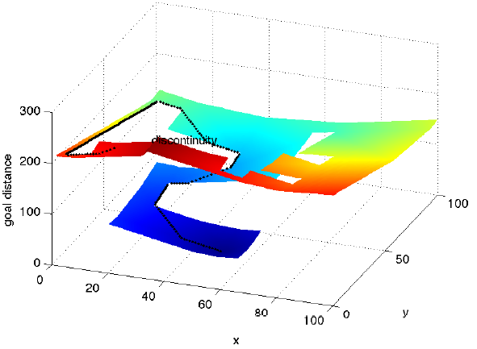
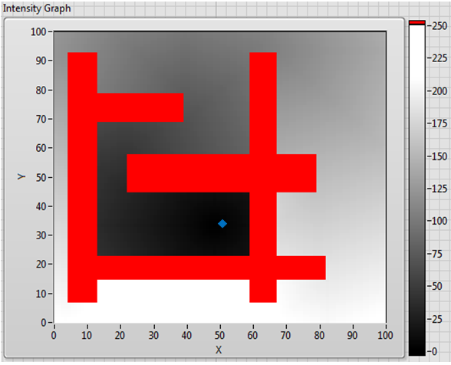
Navigation – Map Planning Distance Transform
Distance Transform:
Notes:
Distance Transform –
The distance transform, is a representation of the distance from the goal point to any other point on the map. The color gradient represents the total number of steps or distance to the goal.
<button press for animation>
Another helpful way to view the distance transform is to actually view the 3rd dimensional gradient as transitioning in space as well as color. You can see that the path of least distance from the goal to any other point is also represented by moving down a hill.
Although a Distance Transform does give us solutions for every point on the grid, for larger grids this approach is very inefficient. This is because of the time needed in order to calculate a solution for every point on the entirety of the grid.

Slide 19
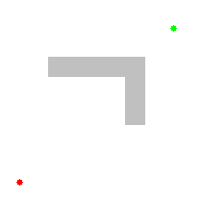
Navigation – Map Planning methods
Algorithms Examples:
A*
D*
Dijkstra
Voronoi Map
Dijkstra
A*
Notes:
In order to overcome the computational complexity with generating a solution for every cell on the grid, different algorithms have been developed for higher efficiency.
<button press to make pictures appear>
I wanted to give a quick overview of two example algorithms to show how they perform their calculations. Specifically we will look at Dijkstra’s and A*.

Slide 20
Navigation – Map Planning methods
Algorithms Examples:
A*
D*
Dijkstra
Voronoi Map
Dijkstra
A*
Notes:
<Had to add the gif’s on another slide because they gifs are loaded into memory and begin to step through once they are loaded into memory with the slide, regardless of whether or not they are visible>
In both cases the filled nodes represent explored sets and the unfilled nodes represent cells that remain to be explored.
Dijkstras algorithm works by uniformly exploring each node (uniform cost assumption) in a relatively circular pattern from the start point which is usually referred to as a propagating wavefront.
A* searches a bit different. It will first search in a straight path from the start node to the goal node. Upon hitting an obstacle, the algorithm then calculates alternative routes around the obstacle.

Slide 21
Navigation – Map Planning Efficiency
It is important to remember computational efficiency/cost
A* Algorithm
Will find the optimal (admissible) solution - if it exists
Finding the optimal solution has a cost
Admissible A*
ε-Admissible A*
Notes:
Admissable = never overestimates the solution
Illustration of weighted A* search with , for faster, but sub-optimal path planning.

Slide 22
Navigation – Map Planning Efficiency
It is important to remember computational efficiency/cost
A* Algorithm
Will find the optimal (admissible) solution - if it exists
Finding the optimal solution has a cost
Admissible A*
ε-Admissible A*
Notes:
Admissable = never overestimates the solution
Illustration of weighted A* search with , for faster, but sub-optimal path planning.

Slide 23
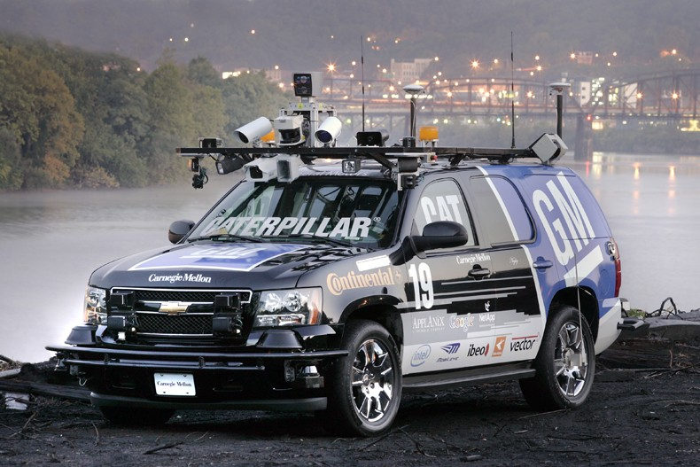
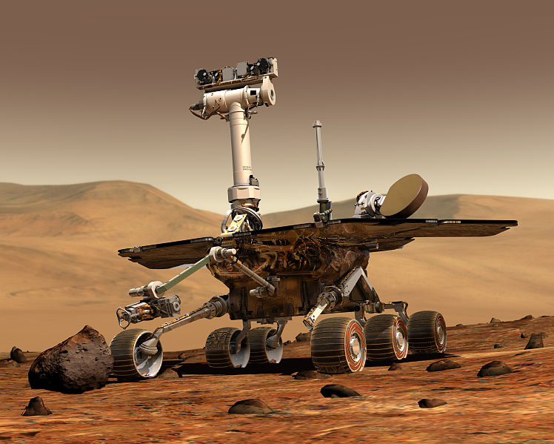
Navigation – Map Planning D*
D* Overview
Maintains list of nodes like A* and Dijkstra
But, has the ability to incrementally replan
Helps when encountering new obstacles
D* Applications
Notes:
The key feature of D* is that it supports incremental replanning. This is important if, while we are moving, we discover that the world is different to our map. If we discover that a route has a higher than expected cost or is completely blocked we can incrementally replan to find a better path. The incremental replanning has a lower computational cost than completely replanning as would be required using the distance transform method just discussed.

Slide 24
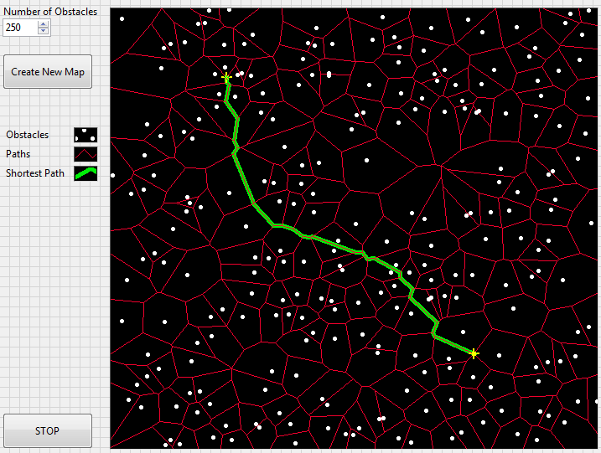
Navigation – Map Planning Voronoi
Voronoi Overview
Create a network of path free obstacles
Reduce the cost of recalculating a path - comparatively

Slide 25
Navigation – Overall Recommendations
How does everything compare?
^{R} – Reactive
^{M} – Map-based
Method | Complexity | Advantage | Disadvantage
Braitenberg^{R} | Low | Simple w/ sensorimotor | No logic
Bug2^{R} | Low | Simple w/ state logic | No planning
Dijkstra^{M} | Medium | Brute force calculation | “slow” calculation
A*^{M} | High | Optimal solution | Planning cost
D*^{M} | High | Incremental replanning | Planning cost
Voronoi^{M} | High | Efficient recalculation | Less optimal path

Slide 26
Navigation – Bug2 LabVIEW Examples
Reactive Method Example
Bug2 in LabVIEW

Slide 27
Navigation – D* LabVIEW Examples
Map-based Method Example
D* in LabVIEW

Slide 28
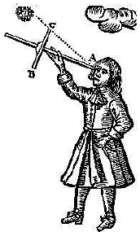
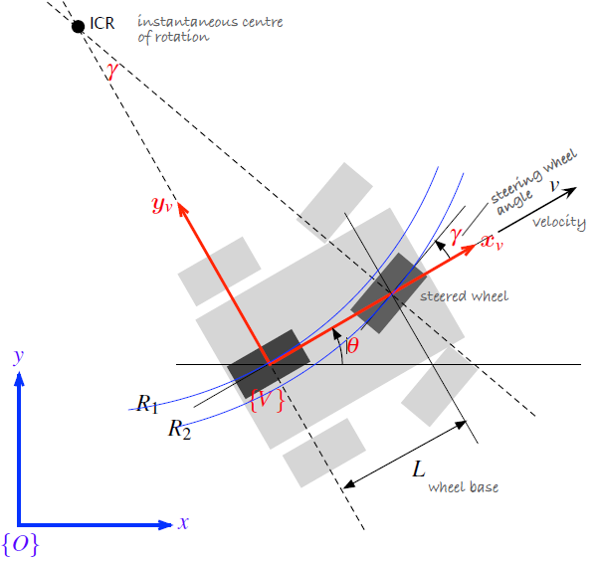
Navigation – What comes next?
Navigation is only one piece of the puzzle
What about,
Sensors?
Localization?
Deployment?
Mobility?
Simulation?

Slide 29
Navigation – What comes next?
Witty End slide…

Slide 30
<Blank>

