Slide 1

Natural Language Processing
Yue Zhang
Westlake University

Slide 2
Chapter 2
Counting Relative Frequencies

Slide 3
Contents
2.1 Probabilistic Modelling
2.1.1 Maximum Likelihood Estimation (MLE)
2.1.2 Modelling the Probability of Words
2.1.3 Probability Distribution
2.2 N-gram Language Models
2.2.1 Unigram Language Models
2.2.2 Bigram Language Models
2.2.3 Trigram Language Models and Beyond
2.2.4 Generative Models
2.3 Naïve Bayes Text Classification
2.3.1 Naïve Bayes Text Classification
2.3.2 Evaluating Text Classifier
2.3.3 Features

Slide 4
Models
What is a “ model”:
An imaginary abstract and simplified version of a subject
Makes mathematical calculation feasible
Probabilistic model:
Calculate the probability of a random event
Take probabilistic language modelling for example:
Assign a probability to words or sentences
e.g. P(I know it) > P(eye no it)

Slide 5
Contents
2.1 Probabilistic Modelling
2.1.1 Maximum Likelihood Estimation (MLE)
2.1.2 Modelling the Probability of Words
2.1.3 Probability Distribution
2.2 N-gram Language Models
2.2.1 Unigram Language Models
2.2.2 Bigram Language Models
2.2.3 Trigram Language Models and Beyond
2.2.4 Generative Models
2.3 Naïve Bayes Text Classification
2.3.1 Naïve Bayes Text Classification
2.3.2 Evaluating Text Classifier
2.3.3 Features

Slide 6
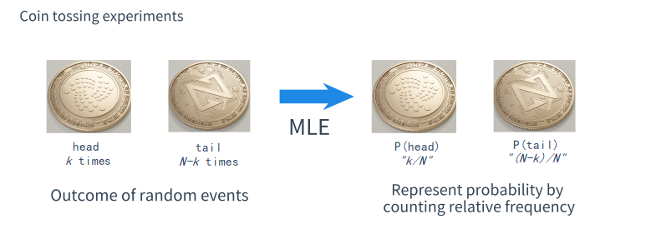
From coin tossing experiments
Intuition

Slide 7
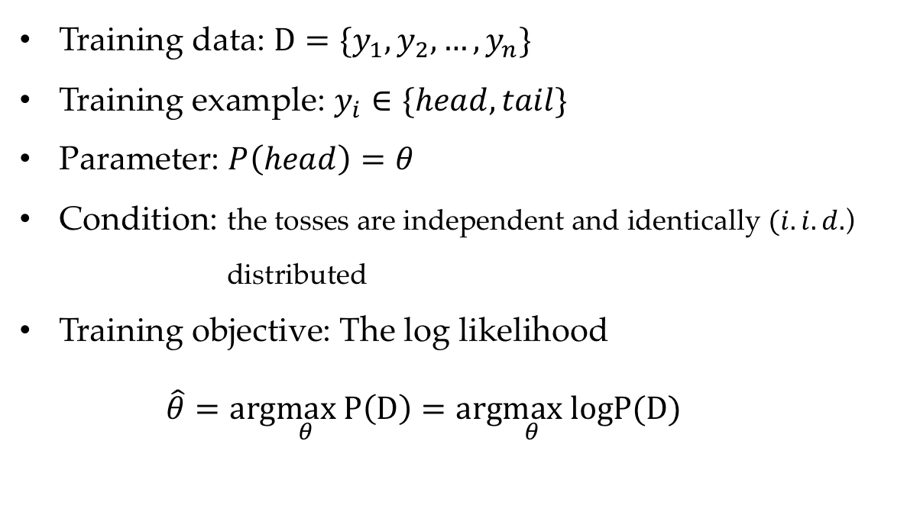
MLE leads to counting relative frequencies
Training data: $D=\{y_{1},y_{2},…,y_{n}\}$
Training example: $y_{i}∈\{head, tail\}$
Parameter: $P\left(head\right)=θ$
Condition: the tosses are independent and identically $(i.i.d.$) distributed
Training objective: The log likelihood
$$\hat{θ}=arg\max_{θ} P\left(D\right)=arg\max_{θ} logP(D)$$

Slide 8
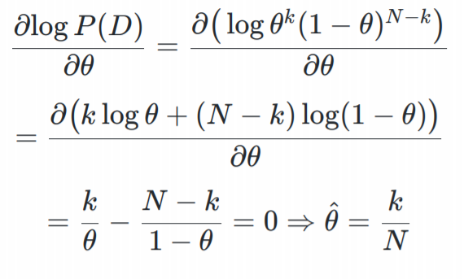
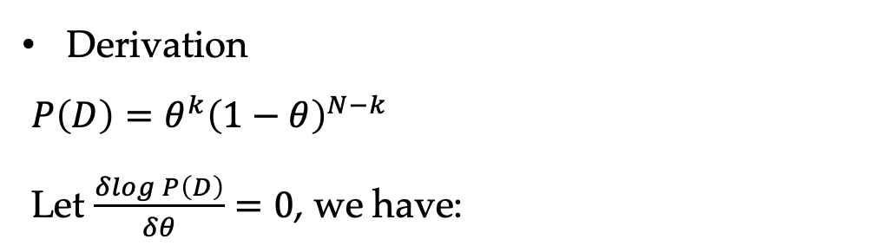
MLE leads to counting relative frequencies
Derivation
$P\left(D\right)=θ^{k}{\left(1−θ\right)}^{N−k}$
Let $\frac{δlogP\left(D\right)}{δθ}=0$, we have:

Slide 9
Contents
2.1 Probabilistic Modelling
2.1.1 Maximum Likelihood Estimation (MLE)
2.1.2 Modelling the Probability of Words
2.1.3 Probability Distribution
2.2 N-gram Language Models
2.2.1 Unigram Language Models
2.2.2 Bigram Language Models
2.2.3 Trigram Language Models and Beyond
2.2.4 Generative Models
2.3 Naïve Bayes Text Classification
2.3.1 Naïve Bayes Text Classification
2.3.2 Evaluating Text Classifier
2.3.3 Features

Slide 10
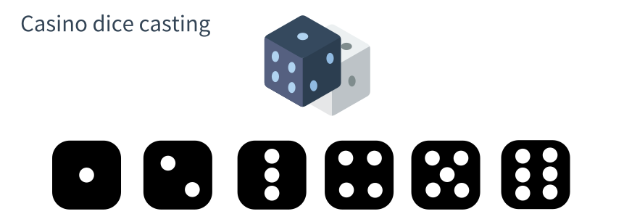
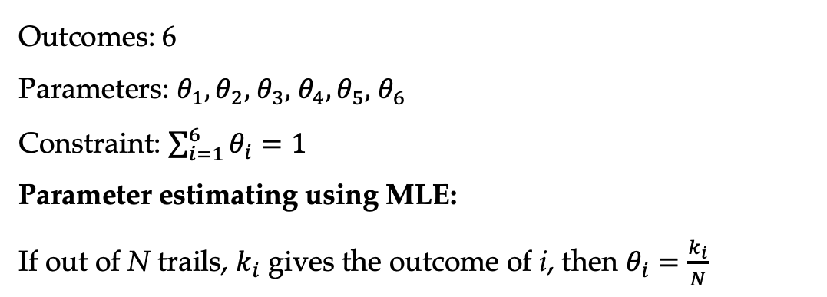
Casino dice casting
Outcomes: 6
Parameters: $θ_{1},θ_{2},$ $θ_{3},$ $θ_{4},θ_{5},$ $θ_{6}$
Constraint: $\sum_{i=1}^{6}{θ_{i}}=1$
Parameter estimating using MLE:
If out of N trails, $k_{i}$ gives the outcome of i, then $θ_{i}=\frac{k_{i}}{N}$

Slide 11
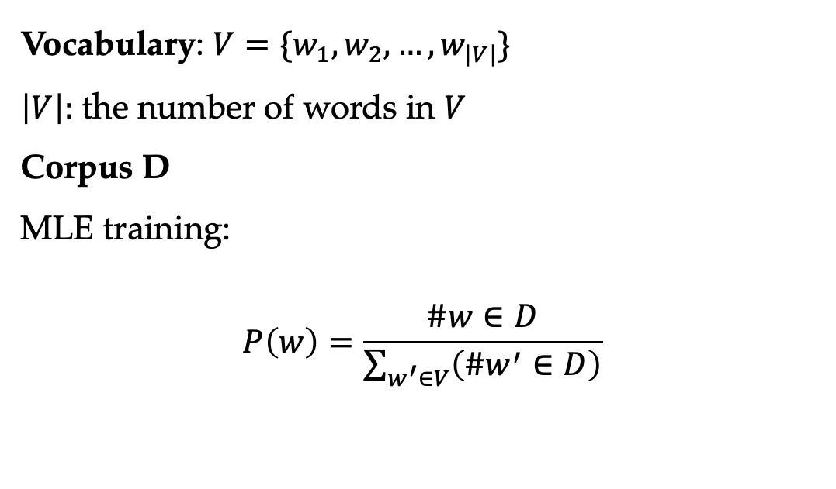
Training a word model
Vocabulary: $V=\{w_{1},w_{2},…,w_{\left|V\right|}\}$
$\left|V\right|:$ the number of words in $V$
Corpus D
MLE training:
$$P\left(w\right)=\frac{\#w∈D}{\sum_{w^{′}∈V}{\left(\#w^{′}∈D\right)}}$$

Slide 12
Contents
2.1 Probabilistic Modelling
2.1.1 Maximum Likelihood Estimation (MLE)
2.1.2 Modelling the Probability of Words
2.1.3 Probability Distribution
2.2 N-gram Language Models
2.2.1 Unigram Language Models
2.2.2 Bigram Language Models
2.2.3 Trigram Language Models and Beyond
2.2.4 Generative Models
2.3 Naïve Bayes Text Classification
2.3.1 Naïve Bayes Text Classification
2.3.2 Evaluating Text Classifier
2.3.3 Features

Slide 13
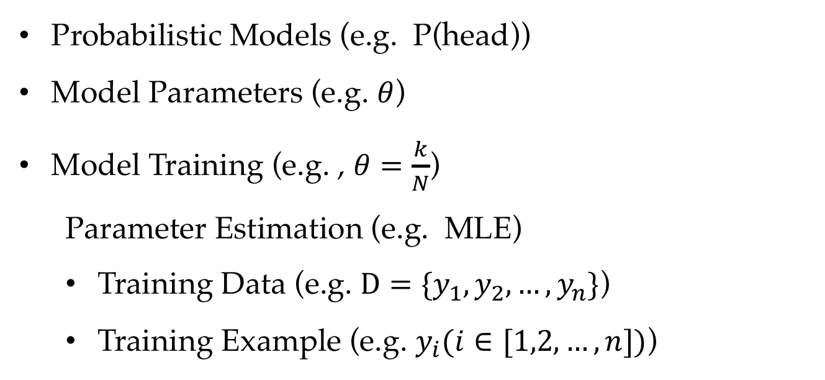
Review
Probabilistic Models (e.g. P(head))
Model Parameters (e.g. $θ$)
Model Training (e.g. , $θ=\frac{k}{N}$)
Parameter Estimation (e.g. MLE)
Training Data (e.g. $D=\{y_{1},y_{2},…,y_{n}\}$)
Training Example (e.g. $y_{i}(i∈[1,2,…,n])$)

Slide 14
Terminology
Random variable:
distinct outcome of a random event using a distinct value e.g., head = 0 tail = 1
Parameterisation:
specifies a calculable equation to compute probabilities involving the definition of model parameters

Slide 15
Probability Distributions
The probabilities of all possible values of a discrete random variable is a probability distribution
A Bernoulli distribution example:
coin tossing
A categorical distribution (multinoulli distribution) example:
dice casting, word drawing
MLE training for i.i.d. Bernoulli random variables and
categorical random variables leads to relative frequencies
0
1
1
2
3
4
5
6

Slide 16
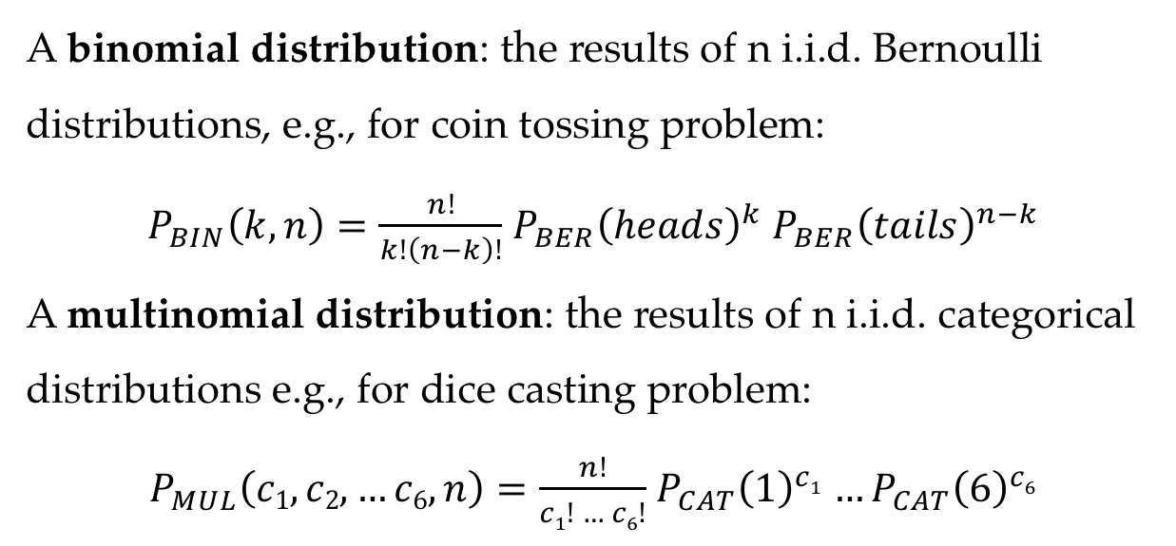
Probability Distributions
A binomial distribution: the results of n i.i.d. Bernoulli distributions, e.g., for coin tossing problem:
$P_{BIN}\left(k,n\right)=\frac{n!}{k!\left(n−k\right)!}$ ${P_{BER}\left(heads\right)}^{k}$ ${P_{BER}\left(tails\right)}^{n−k}$
A multinomial distribution: the results of n i.i.d. categorical distributions e.g., for dice casting problem:
$P_{MUL}\left(c1,\text{c}\text{2}\text{,}…c6,n\right)=\frac{n!}{c1! … c6!}$ ${P_{CAT}\left(1\right)}^{c1}$ $…{P_{CAT}\left(6\right)}^{c6}$

Slide 17
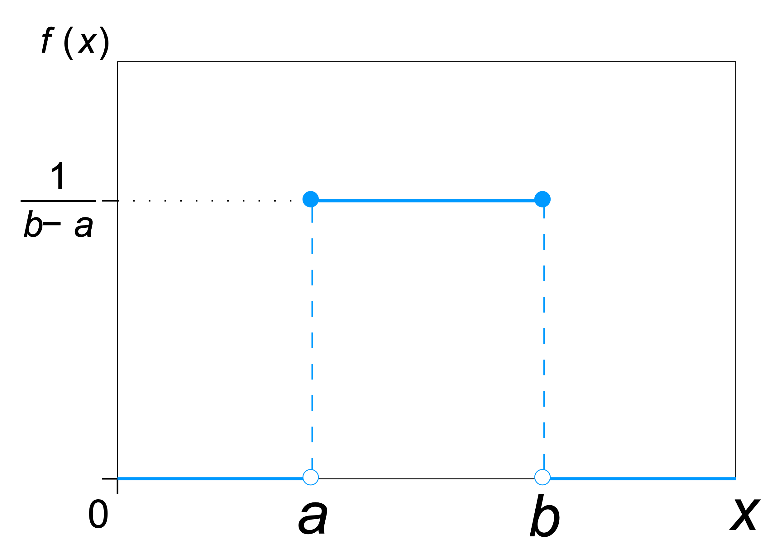
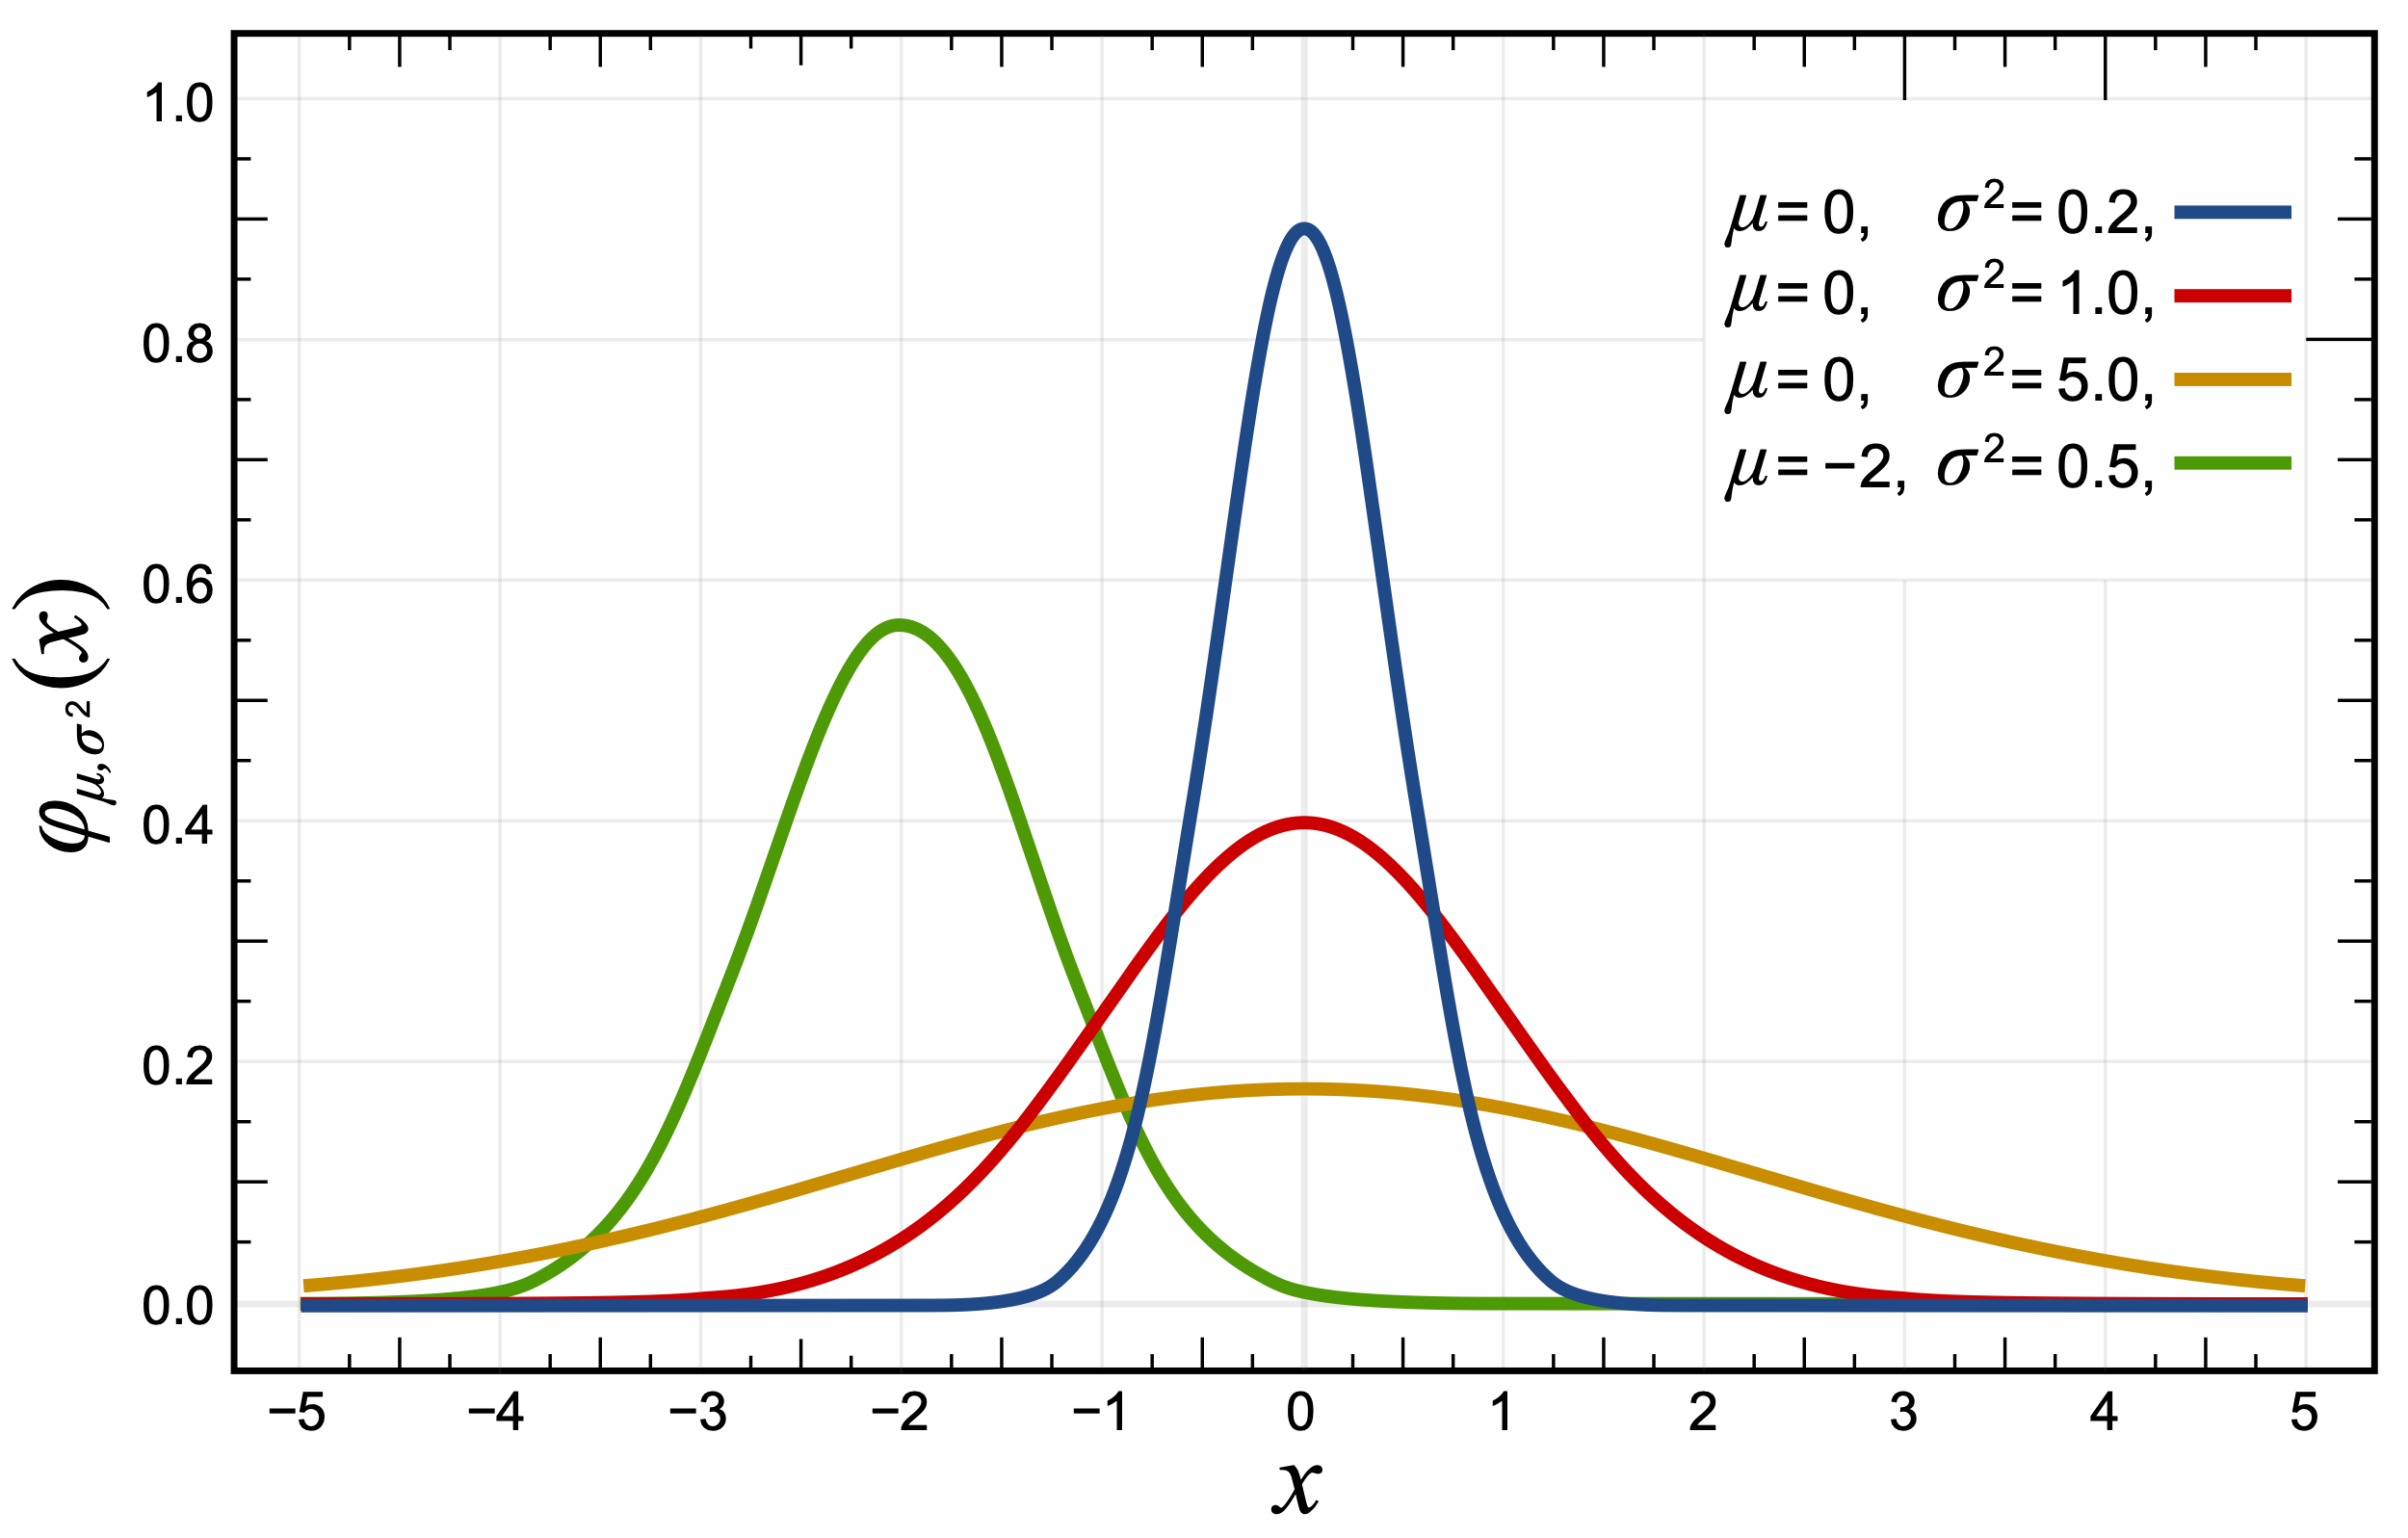
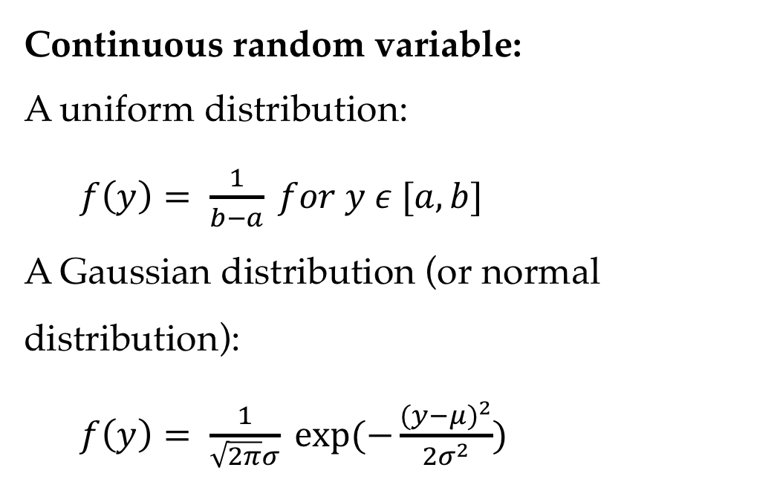
Probability Distributions
Continuous random variable:
A uniform distribution:
$f\left(y\right)= \frac{1}{b−a} for y ε [a,b]$
A Gaussian distribution (or normal distribution):
$f\left(y\right)= \frac{1}{\sqrt{2π}σ} exp⁡(−\frac{{(y−μ)}^{2}}{2σ^{2}})$

Slide 18
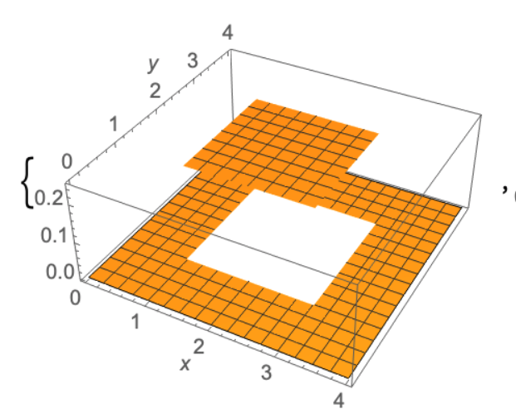
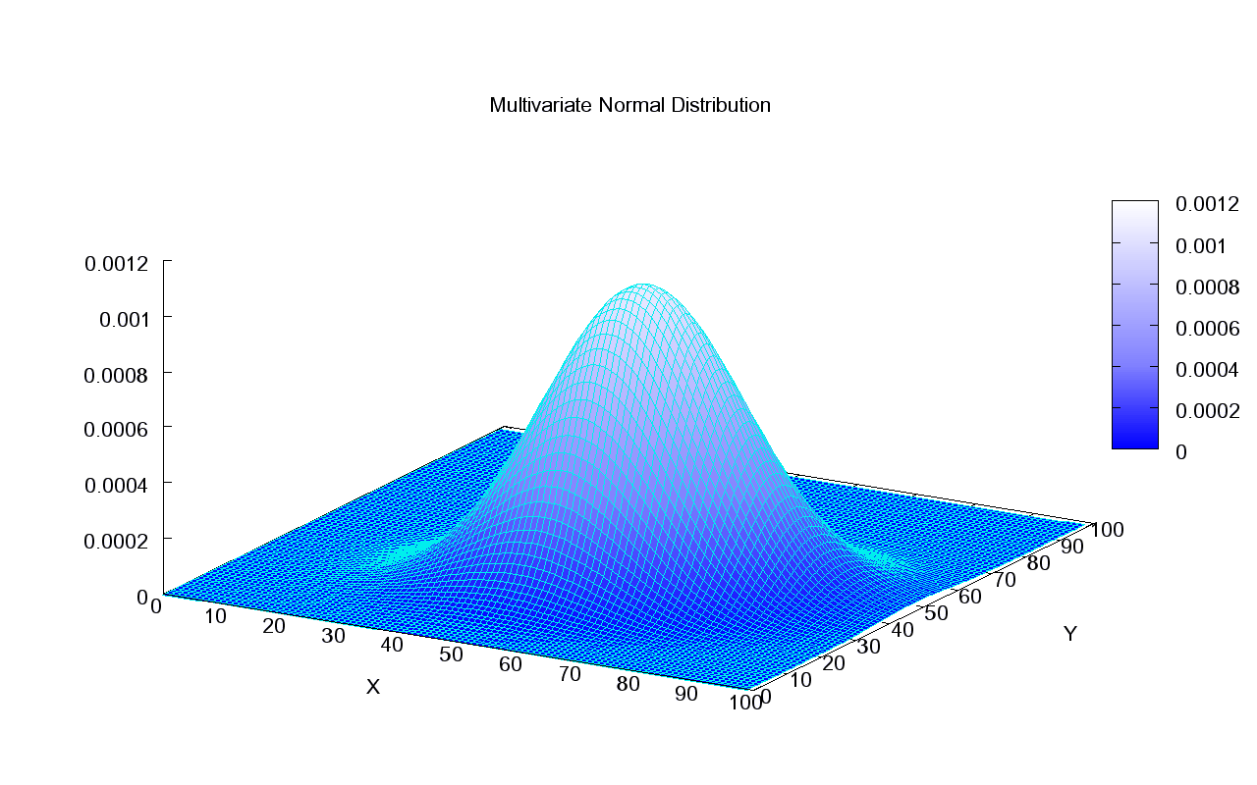
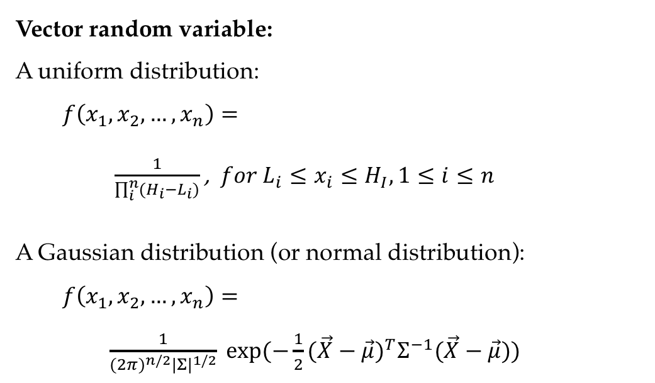
Probability Distributions
Vector random variable:
A uniform distribution:
$f\left(x_{1},x_{2}, …,x_{n}\right)=$
$\frac{1}{\prod_{i}^{n}{(H_{i}−L_{i})}}$ , $for L_{i}≤x_{i}≤H_{I}, 1≤i≤n$
A Gaussian distribution (or normal distribution):
$f\left(x_{1},x_{2}, …,x_{n}\right)=$
$\frac{1}{{(2π)}^{n/2}{|Σ|}^{1/2}} exp⁡(−\frac{1}{2}{(\vec{X}−\vec{μ})}^{T}Σ^{−1}(\vec{X}−\vec{μ}))$

Slide 19
Contents
2.1 Probabilistic Modelling
2.1.1 Maximum Likelihood Estimation (MLE)
2.1.2 Modelling the Probability of Words
2.1.3 Probability Distribution
2.2 N-gram Language Models
2.2.1 Unigram Language Models
2.2.2 Bigram Language Models
2.2.3 Trigram Language Models and Beyond
2.2.4 Generative Models
2.3 Naïve Bayes Text Classification
2.3.1 Naïve Bayes Text Classification
2.3.2 Evaluating Text Classifier
2.3.3 Features

Slide 20
Language Model
A language model (LM) measures the probability of natural language sentences, by means of simpler patterns, such as:
words
“thanks” is more probable than “markov”
phrases
P(“eat pizza”) > P(“drink pizza”)
sentences
P(“he said hi”) > P(“said he hi”)

Slide 21
N-gram
Unigram (bag-of-words)
hello, hyperbole
Bigram
eat pizza, drink pizza
Trigram
cat eat mouse, mouse eat cat

Slide 22
Contents
2.1 Probabilistic Modelling
2.1.1 Maximum Likelihood Estimation (MLE)
2.1.2 Modelling the Probability of Words
2.1.3 Probability Distribution
2.2 N-gram Language Models
2.2.1 Unigram Language Models
2.2.2 Bigram Language Models
2.2.3 Trigram Language Models and Beyond
2.2.4 Generative Models
2.3 Naïve Bayes Text Classification
2.3.1 Naïve Bayes Text Classification
2.3.2 Evaluating Text Classifier
2.3.3 Features

Slide 23
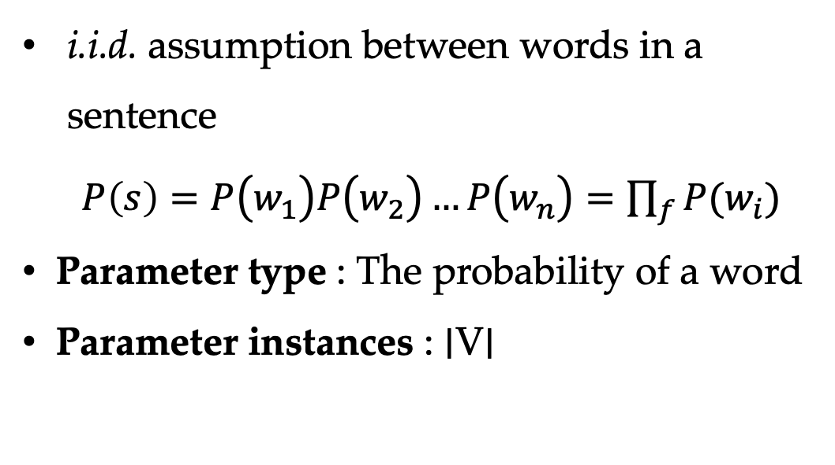
Unigram Language Models
i.i.d. assumption between words in a sentence
$P\left(s\right)=P\left.\left(w_{1}\right.\right)P\left.\left(w_{2}\right.\right)…P\left.\left(w_{n}\right.\right)=\prod_{f}{P(w_{i})}$
Parameter type : The probability of a word
Parameter instances : ∣V∣

Slide 24

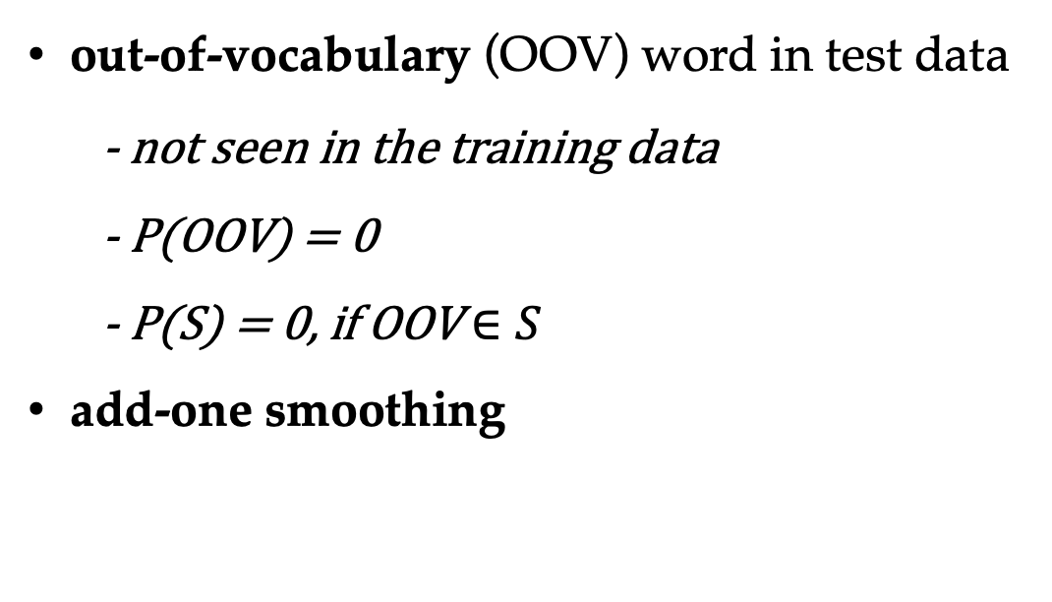
Unigram Language Models
out-of-vocabulary (OOV) word in test data
- not seen in the training data
- P(OOV) = 0
- P(S) = 0, if OOV $∈S$
add-one smoothing

Slide 25
(a) Unigram distributions. (b) Unigram distributions with add-10 smoothing.

Slide 26
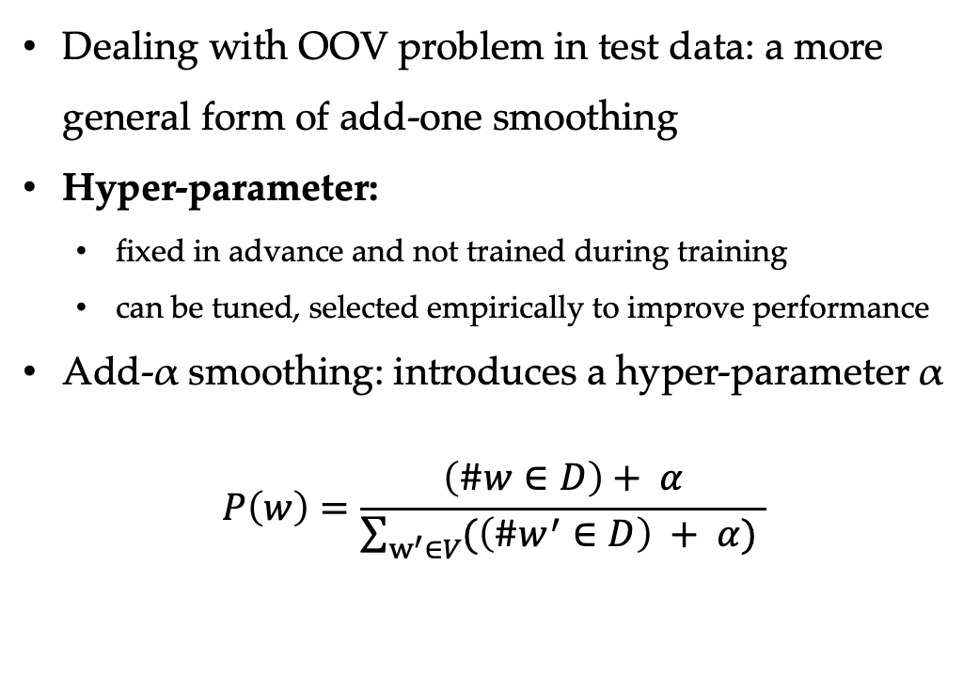
Add-α Smoothing
Dealing with OOV problem in test data: a more general form of add-one smoothing
Hyper-parameter:
fixed in advance and not trained during training
can be tuned, selected empirically to improve performance
Add-α smoothing: introduces a hyper-parameter α
$$P\left(w\right)=\frac{\left(\#w∈D\right)+ α}{\sum_{w^{′}∈V}{(\left(\#w^{′}∈D\right) + α)} }$$

Slide 27
Contents
2.1 Probabilistic Modelling
2.1.1 Maximum Likelihood Estimation (MLE)
2.1.2 Modelling the Probability of Words
2.1.3 Probability Distribution
2.2 N-gram Language Models
2.2.1 Unigram Language Models
2.2.2 Bigram Language Models
2.2.3 Trigram Language Models and Beyond
2.2.4 Generative Models
2.3 Naïve Bayes Text Classification
2.3.1 Naïve Bayes Text Classification
2.3.2 Evaluating Text Classifier
2.3.3 Features

Slide 28
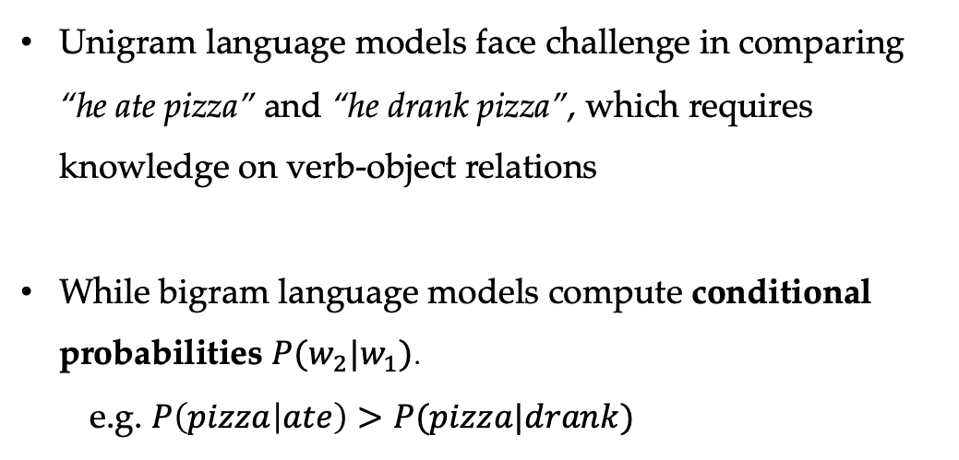
Conditional probability
Unigram language models face challenge in comparing “he ate pizza” and “he drank pizza”, which requires knowledge on verb-object relations
While bigram language models compute conditional probabilities $P(w_{2}|w_{1})$.
e.g. $P\left(pizza | ate\right)>P(pizza|drank)$

Slide 29
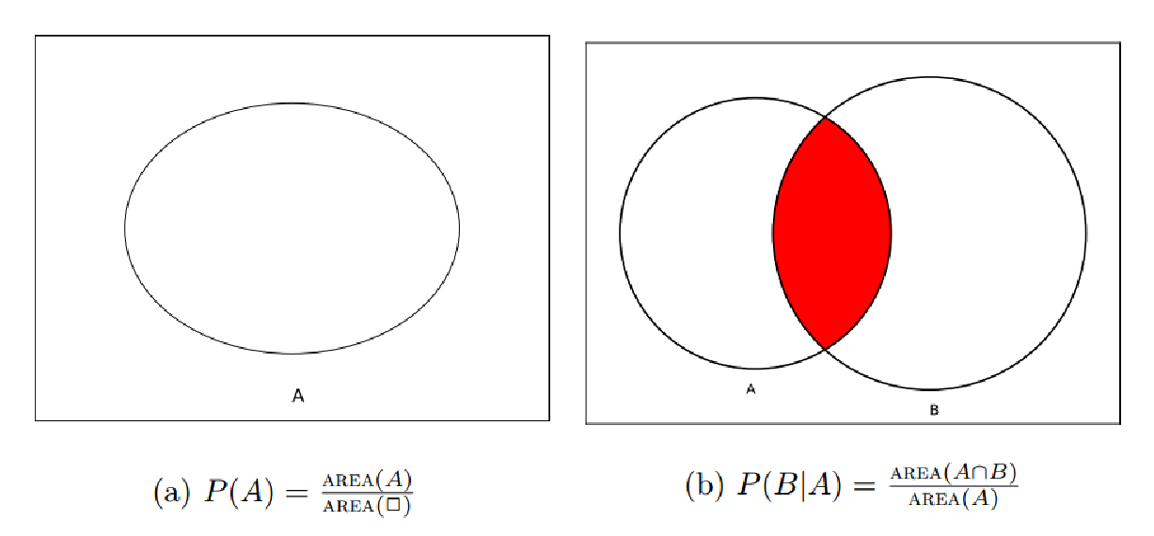
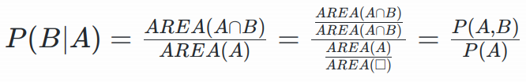
Conditional probability
Unconditional probabilities and conditional probabilities
P(A,B) is the joint probability of A and B

Slide 30

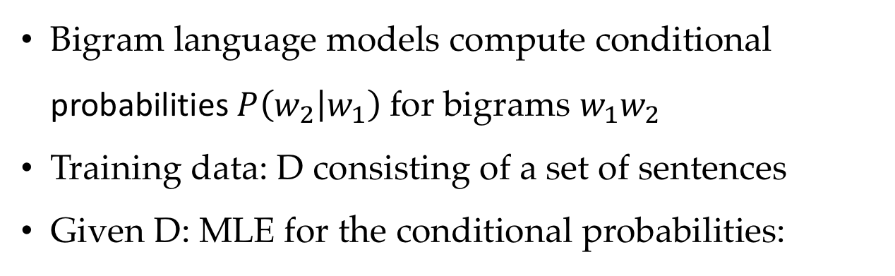
Training bigram language models
Bigram language models compute conditional probabilities $P\left(w_{2} | w_{1}\right)$for bigrams $w_{1}w_{2}$
Training data: D consisting of a set of sentences
Given D: MLE for the conditional probabilities:

Slide 31
Training bigram language models
Reducing sparsity:
Back-off
$λ$ is a hyper-parameter which can be set empirically.

Slide 32
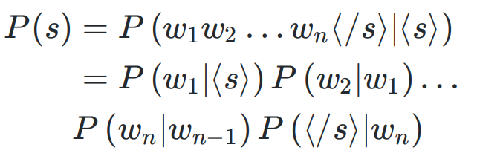
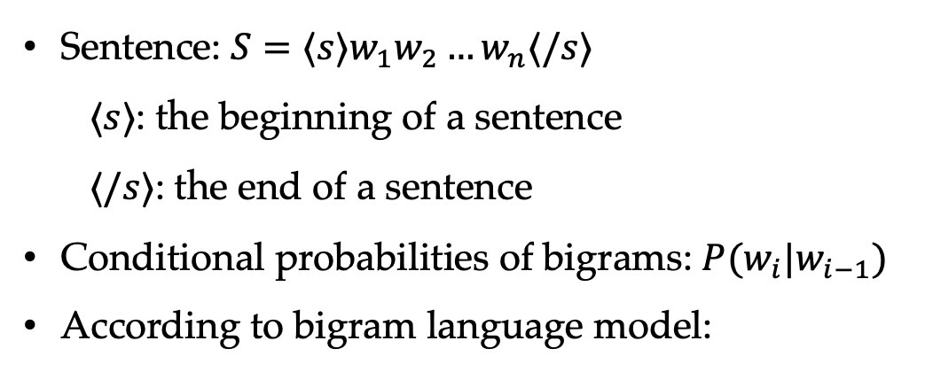
Calculating the probability of a sentence
Sentence: $S=⟨s⟩w_{1}w_{2}…w_{n}⟨/s⟩$
$⟨s⟩$: the beginning of a sentence
$⟨/s⟩$: the end of a sentence
Conditional probabilities of bigrams: $P(w_{i}|w_{i−1})$
According to bigram language model:

Slide 33
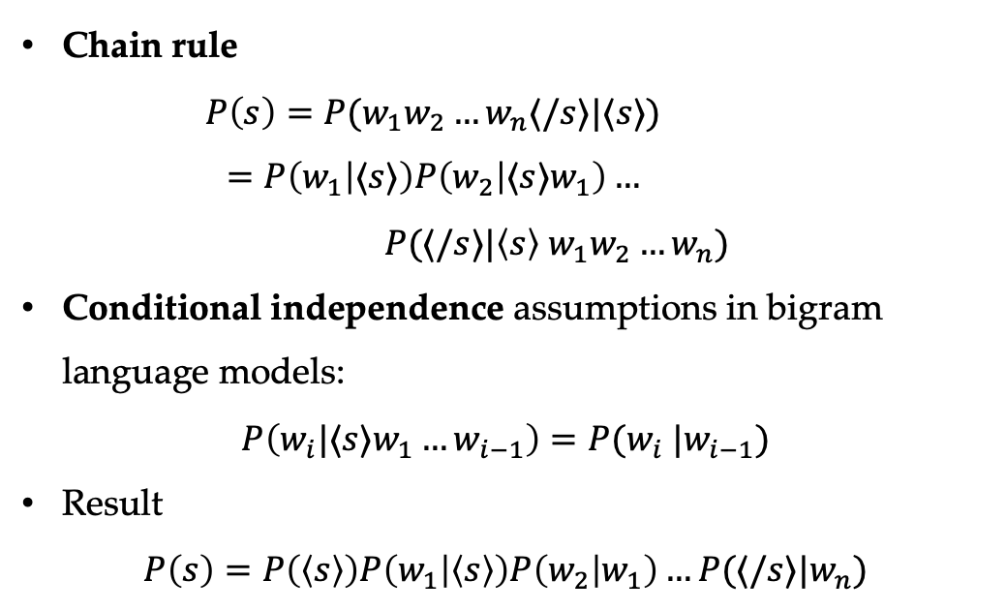
Derivation
Chain rule
$$P\left(s\right)=P(w_{1}w_{2}…w_{n}⟨/s⟩|⟨s⟩)$$
$$=P\left(w_{1} | ⟨s⟩\right)P\left(w_{2} | ⟨s⟩w_{1}\right)…$$
$P(⟨/s⟩|\left\langle s\right\rangle w_{1}w_{2}…w_{n})$
Conditional independence assumptions in bigram language models:
$$P\left(w_{i}|⟨s⟩w_{1}…w_{i−1}\right)=P(w_{i} |w_{i−1})$$
Result
$$P\left(s\right)=P\left(\left\langle s\right\rangle \right)P\left(w_{1} | \left\langle s\right\rangle \right)P\left(w_{2} | w_{1}\right)…P(⟨/s⟩|w_{n})$$

Slide 34
Contents
2.1 Probabilistic Modelling
2.1.1 Maximum Likelihood Estimation (MLE)
2.1.2 Modelling the Probability of Words
2.1.3 Probability Distribution
2.2 N-gram Language Models
2.2.1 Unigram Language Models
2.2.2 Bigram Language Models
2.2.3 Trigram Language Models and Beyond
2.2.4 Generative Models
2.3 Naïve Bayes Text Classification
2.3.1 Naïve Bayes Text Classification
2.3.2 Evaluating Text Classifier
2.3.3 Features

Slide 35
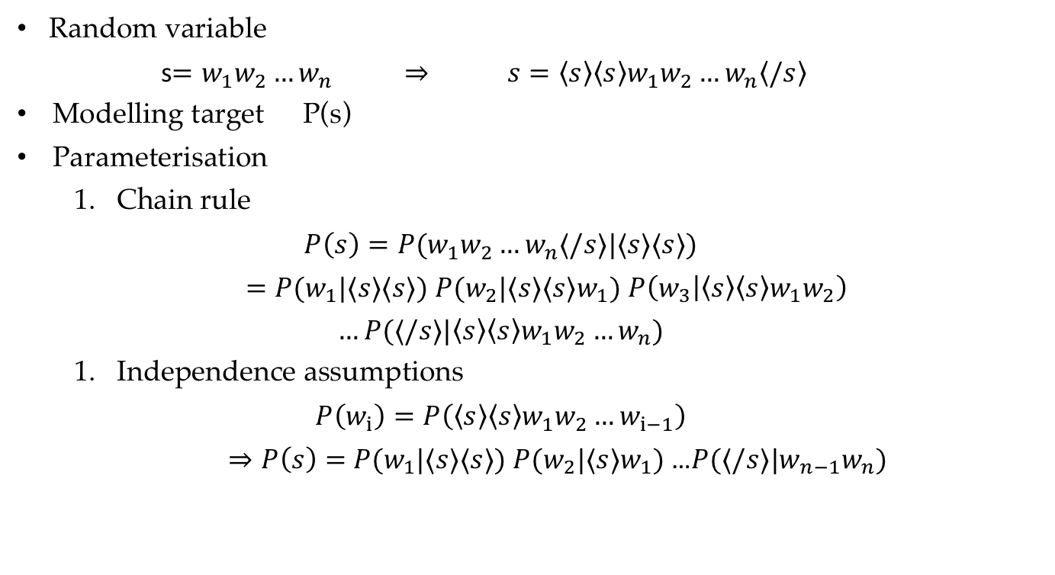
Trigram language modelling
Random variable
s$=w_{1}w_{2}…w_{n} ⇒ s=\left\langle s\right\rangle \left\langle s\right\rangle w_{1}w_{2}…w_{n}\left\langle /s\right\rangle$
Modelling target P(s)
Parameterisation
Chain rule
$$P\left(s\right)=P(w_{1}w_{2}…w_{n}⟨/s⟩|⟨s⟩⟨s⟩)$$
$=P(w_{1}|⟨s⟩⟨s⟩)$ $P(w_{2}|⟨s⟩⟨s⟩w_{1})$ $P\left(w_{3} | \left\langle s\right\rangle \left\langle s\right\rangle w_{1}w_{2}\right)$
$$…P(⟨/s⟩|\left\langle s\right\rangle \left\langle s\right\rangle w_{1}w_{2}…w_{n})$$
Independence assumptions
$$P\left(w_{i}\right)=P\left({\left\langle s\right\rangle \left\langle s\right\rangle w}_{1}w_{2}…w_{i−1}\right)$$
$⇒P\left(s\right)=$ $P(w_{1}|⟨s⟩⟨s⟩)$ $P(w_{2}|⟨s⟩w_{1})$ …$P(⟨/s⟩|{w_{n−1}w}_{n})$

Slide 36
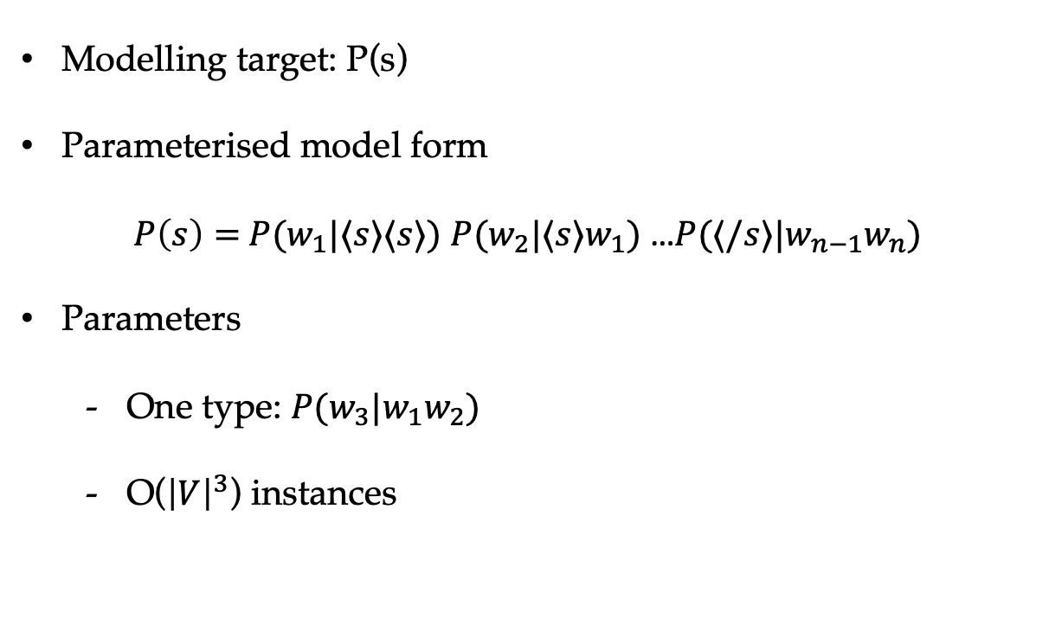
Trigram language modelling
Modelling target: P(s)
Parameterised model form
$P\left(s\right)=$ $P(w_{1}|⟨s⟩⟨s⟩)$ $P(w_{2}|⟨s⟩w_{1})$ …$P(⟨/s⟩|{w_{n−1}w}_{n})$
Parameters
One type: $P(w_{3}|w_{1}w_{2})$
O(${\left|V\right|}^{3}$) instances

Slide 37
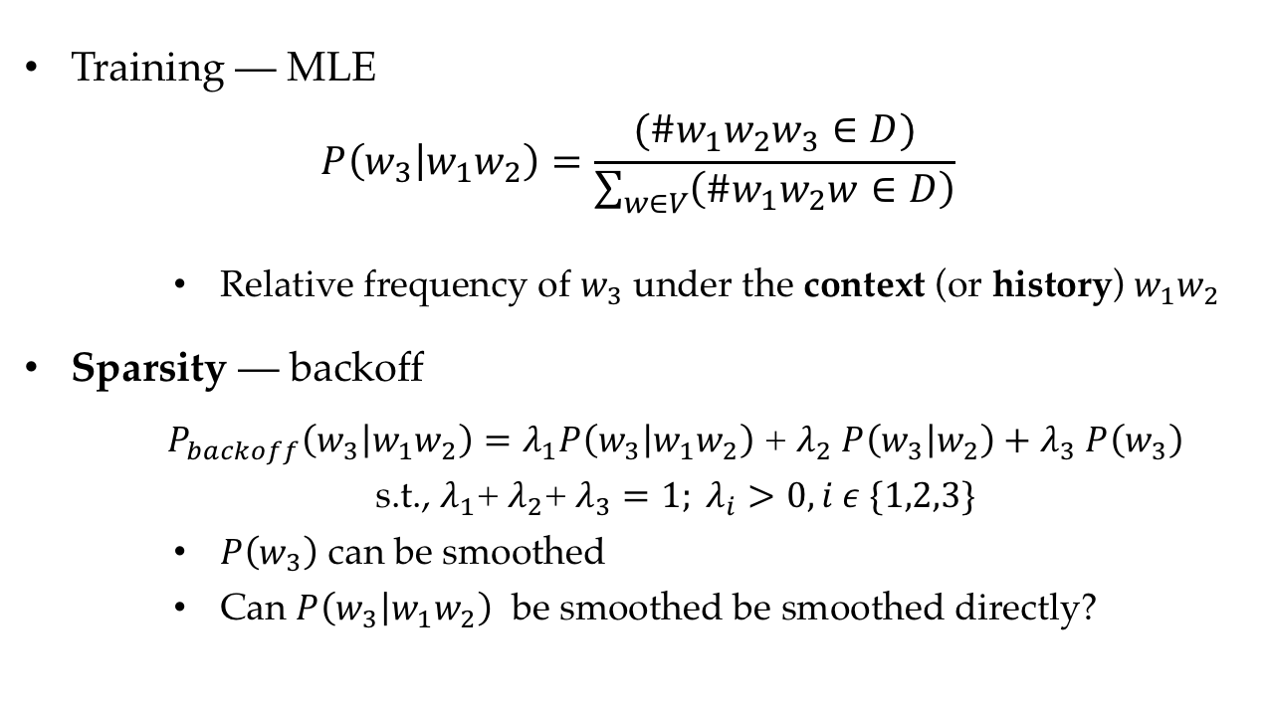
Trigram language modelling
Training — MLE
$$P\left(w_{3} | w_{1}w_{2}\right)=\frac{(\#w_{1}w_{2}w_{3}∈D)}{\sum_{w∈V}{\left(\#w_{1}w_{2}w∈D\right)}}$$
Relative frequency of $w_{3}$ under the context (or history) $w_{1}w_{2}$
Sparsity — backoff
$P_{backoff}\left(w_{3} | w_{1}w_{2}\right)=λ_{1}P\left(w_{3} | w_{1}w_{2}\right)$ + $λ_{2}$ $P\left(w_{3} | w_{2}\right)+λ_{3} P\left(w_{3}\right)$
s.t., $λ_{1}$+ $λ_{2}$+ $λ_{3}=1; λ_{i}>0, i ε \{1,2,3\}$
$P\left(w_{3}\right)$ can be smoothed
Can $P\left(w_{3} | w_{1}w_{2}\right)$ be smoothed be smoothed directly?

Slide 38
Methods to address sparsity
add-one smoothing: add one to the count of all words
add-α smoothing: add α to the count of all words
back-off: use lower order n-gram probabilities to approximate high order n-gram probabilities
Good-Turing smoothing: make a rational guess of the count of OOV words
Knesser-Ney smoothing: work with back-off, consider the history context of lower order n-gram

Slide 39
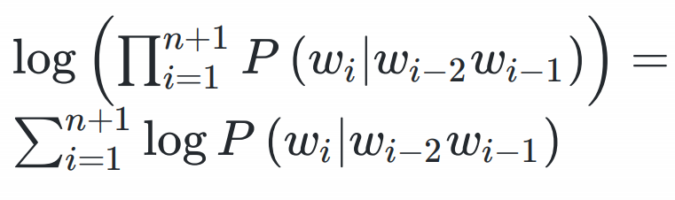
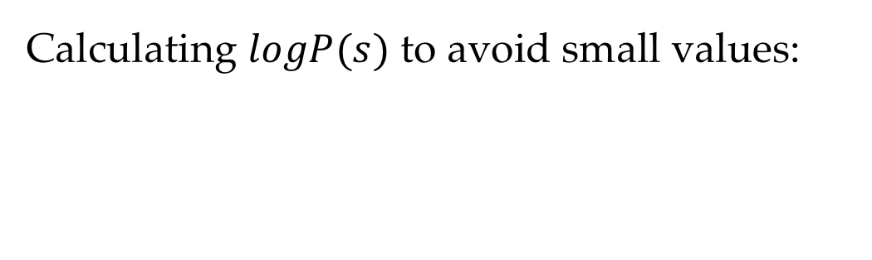
Log-probability models
Calculating $logP(s)$ to avoid small values:

Slide 40
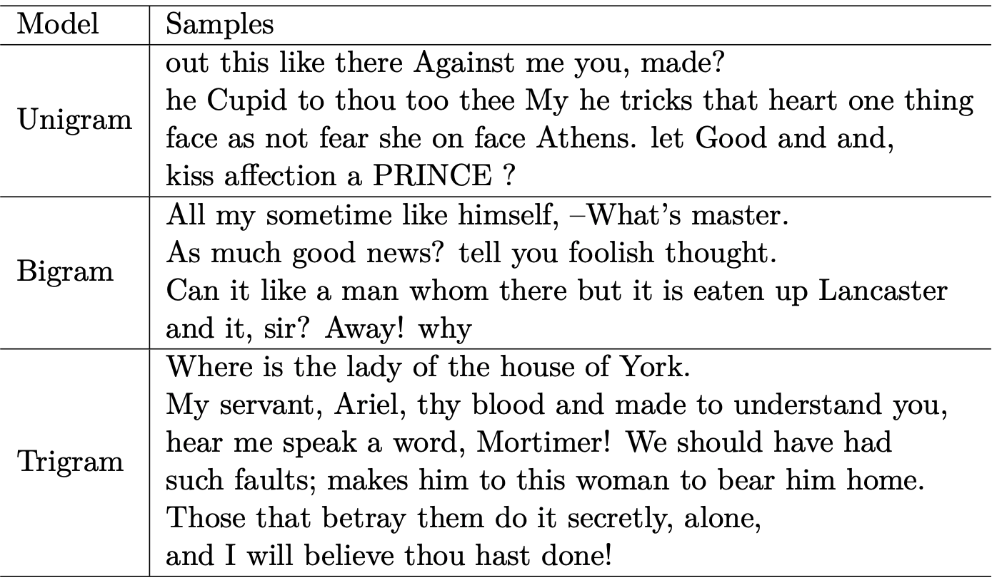
Different n-grams

Slide 41
Contents
2.1 Probabilistic Modelling
2.1.1 Maximum Likelihood Estimation (MLE)
2.1.2 Modelling the Probability of Words
2.1.3 Probability Distribution
2.2 N-gram Language Models
2.2.1 Unigram Language Models
2.2.2 Bigram Language Models
2.2.3 Trigram Language Models and Beyond
2.2.4 Generative Models
2.3 Naïve Bayes Text Classification
2.3.1 Naïve Bayes Text Classification
2.3.2 Evaluating Text Classifier
2.3.3 Features

Slide 42
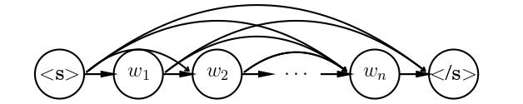

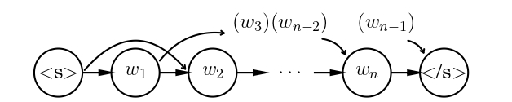
Generative Models
Generative story treats sentence as being generated from left to right
First-order Markov model
Second-order Markov model
Naïve Bayes model

Slide 43
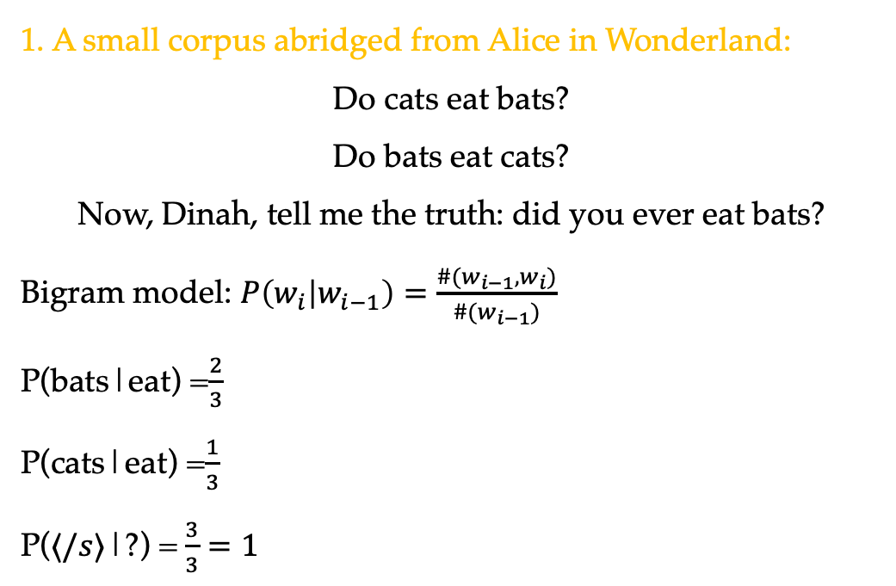
Hands on
1. A small corpus abridged from Alice in Wonderland:
Do cats eat bats?
Do bats eat cats?
Now, Dinah, tell me the truth: did you ever eat bats?
Bigram model: $P\left(w_{i} | w_{i−1}\right)=\frac{{\#(w}_{i−1},w_{i})}{\#(w_{i−1})}$
P(bats|eat) =$\frac{2}{3}$
P(cats|eat) =$\frac{1}{3}$
P($⟨/s⟩$|?) =$\frac{3}{3}=1$

Slide 44
Hands on
2. Berkeley Restaurant Project (BeRP):
http://www.icsi.berkeley.edu/ftp/pub/speech/wooters/berp.tgz
Examples:
can you tell me about any good cantonese restaurants close by
mid priced thai food is what i'm looking for
tell me about chez panisse
can you give me a list of the kinds of food that are available
i'm looking for a good place to eat breakfast
when is caffe venezia open during the day
Unigram counts
i | want | to | eat | Chinese | food | lunch | spend
2533 | 927 | 2417 | 746 | 158 | 1093 | 341 | 278

Slide 45
Hands on
Normalize by unigrams
- | i | want | to | eat | Chinese | food
i | 0.002 | 0.33 | 0 | 0.0036 | 0 | 0
want | 0.0022 | 0 | 0.66 | 0.0011 | 0.0065 | 0.0065
to | 0.00083 | 0 | 0.0017 | 0.28 | 0.00083 | 0
eat | 0 | 0 | 0.0027 | 0 | 0.021 | 0.0027
chinese | 0.0063 | 0 | 0 | 0 | 0 | 0.52
food | 0.014 | 0 | 0.014 | 0 | 0.00092 | 0.0037
lunch | 0.0059 | 0 | 0 | 0 | 0 | 0.0029
spend | 0.0036 | 0 | 0.0036 | 0 | 0 | 0

Slide 46
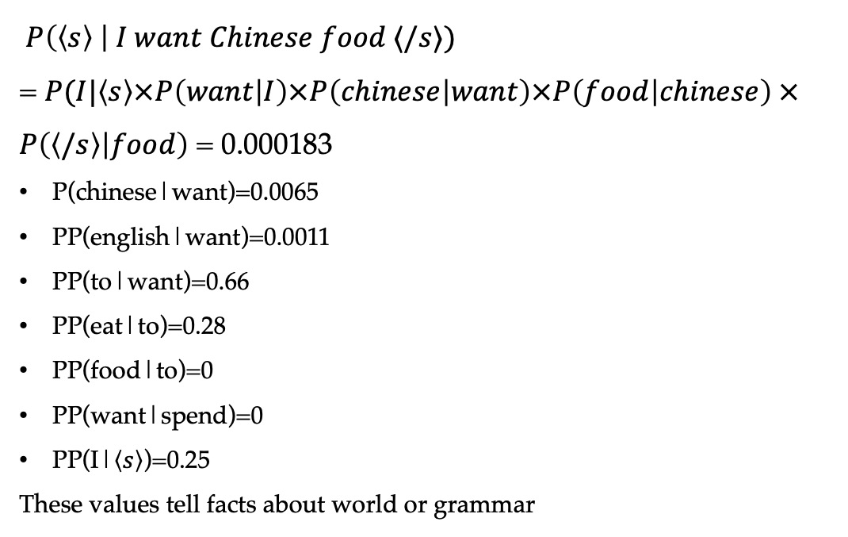
Bigram estimates of sentence probabilities
$P\left(\left\langle s\right\rangle \right| I want Chinese food ⟨/s⟩)$
= $P(I|\left\langle s\right\rangle ×P\left(want | I\right)×P\left(chinese | want\right)×P\left(food | chinese\right) ×P\left(\left\langle /s\right\rangle | food\right)$ = 0.000183
P(chinese|want)=0.0065
PP(english|want)=0.0011
PP(to|want)=0.66
PP(eat|to)=0.28
PP(food|to)=0
PP(want|spend)=0
PP(I|$\left\langle s\right\rangle$)=0.25
These values tell facts about world or grammar

Slide 47
Contents
2.1 Probabilistic Modelling
2.1.1 Maximum Likelihood Estimation (MLE)
2.1.2 Modelling the Probability of Words
2.1.3 Probability Distribution
2.2 N-gram Language Models
2.2.1 Unigram Language Models
2.2.2 Bigram Language Models
2.2.3 Trigram Language Models and Beyond
2.2.4 Generative Models
2.3 Naïve Bayes Text Classification
2.3.1 Naïve Bayes Text Classification
2.3.2 Evaluating Text Classifier
2.3.3 Features

Slide 48
Contents
2.1 Probabilistic Modelling
2.1.1 Maximum Likelihood Estimation (MLE)
2.1.2 Modelling the Probability of Words
2.1.3 Probability Distribution
2.2 N-gram Language Models
2.2.1 Unigram Language Models
2.2.2 Bigram Language Models
2.2.3 Trigram Language Models and Beyond
2.2.4 Generative Models
2.3 Naïve Bayes Text Classification
2.3.1 Naïve Bayes Text Classification
2.3.2 Evaluating Text Classifier
2.3.3 Features

Slide 49
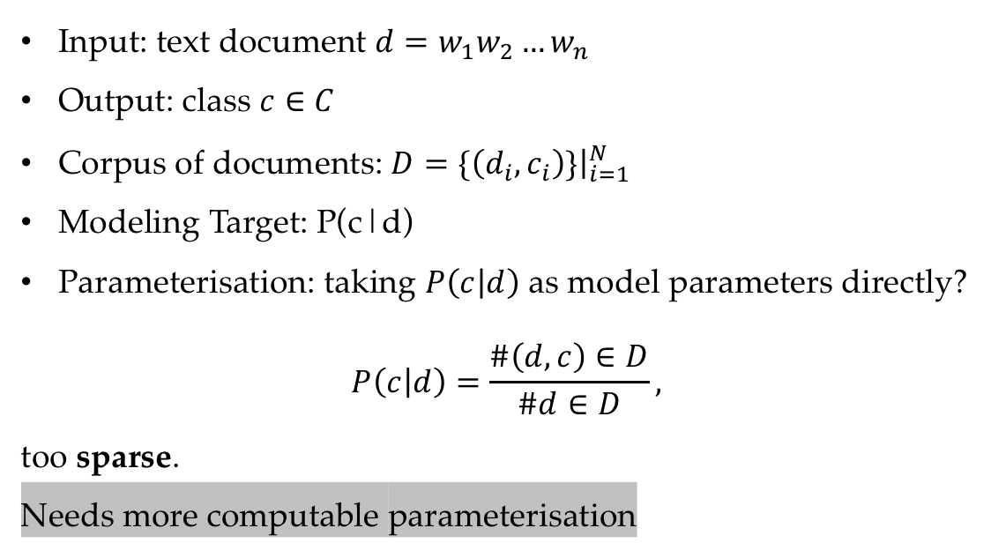
Text classification under MLE
Input: text document $d=w_{1}w_{2}…w_{n}$
Output: class $c∈C$
Corpus of documents: $D=\{\left(d_{i},c_{i}\right)\}{\left.​\right|}_{i=1}^{N}$
Modeling Target: P(c|d)
Parameterisation: taking $P\left(c | d\right)$ as model parameters directly?
$$P\left(c | d\right)=\frac{\#\left(d,c\right)∈D}{\#d∈D},$$
too sparse.
Needs more computable parameterisation

Slide 50
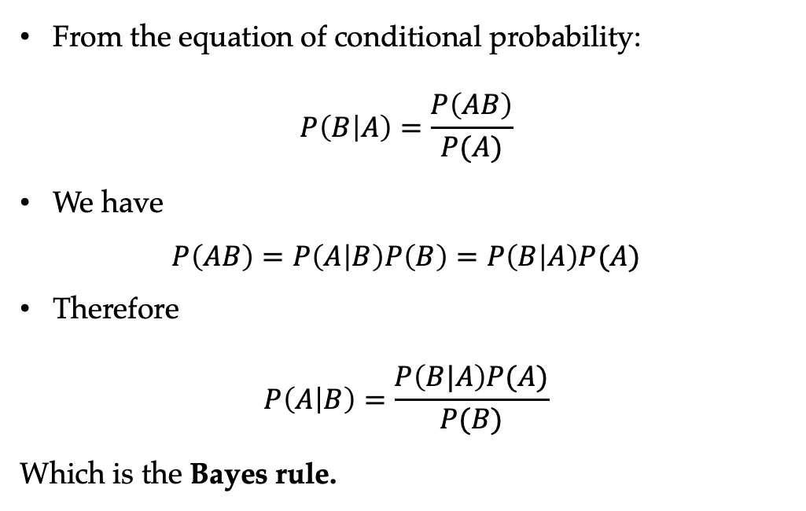
The Bayes rule
From the equation of conditional probability:
$$P\left(B | A\right)=\frac{P\left(AB\right)}{P(A)}$$
We have
$$P\left(AB\right)=P\left(A | B\right)P\left(B\right)=P\left(B | A\right)P(A)$$
Therefore
$$P\left(A | B\right)=\frac{P\left(B|A\right)P(A)}{P(B)}$$
Which is the Bayes rule.

Slide 51
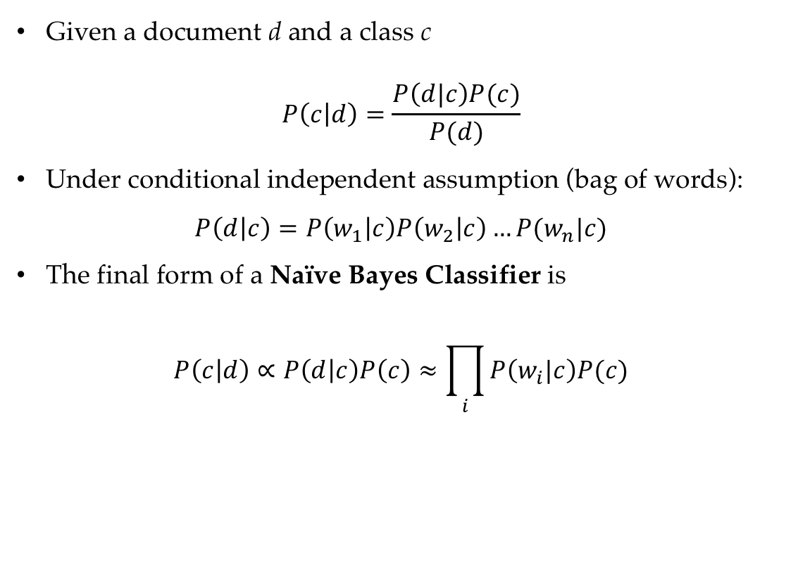
Naïve Bayes model parameterisation process
Given a document d and a class c
$$P\left(c | d\right)=\frac{P\left(d|c\right)P(c)}{P(d)}$$
Under conditional independent assumption (bag of words):
$$P\left(d | c\right)=P\left(w_{1} | c\right)P\left(w_{2} | c\right)…P(w_{n}|c)$$
The final form of a Naïve Bayes Classifier is
$$P\left(c | d\right)∝P\left(d | c\right)P\left(c\right)≈\prod_{i}{P\left(w_{i}|c\right)P(c)}$$

Slide 52
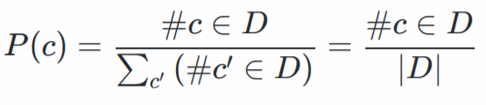
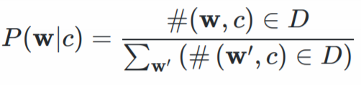
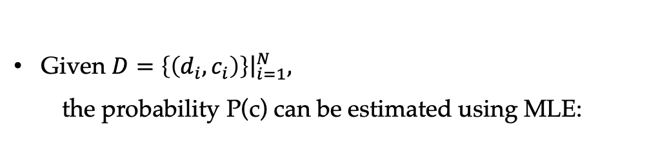
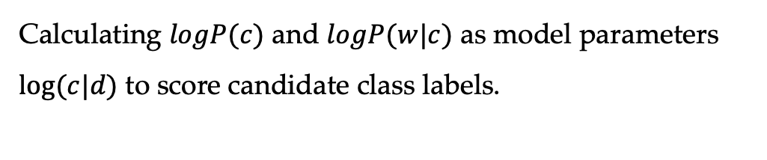
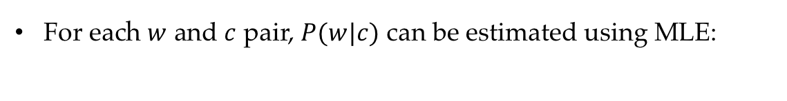
Training a Naïve Bayes classifier
Given $D=\left\{\left(d_{i},c_{i}\right)\right\}{\left.​\right|}_{i=1}^{N},$
the probability P(c) can be estimated using MLE:
For each $w$ and $c$ pair, $P(w|c)$ can be estimated using MLE:
Calculating $logP(c)$ and $logP(w|c)$ as model parameters $log⁡(c|d)$ to score candidate class labels.

Slide 53
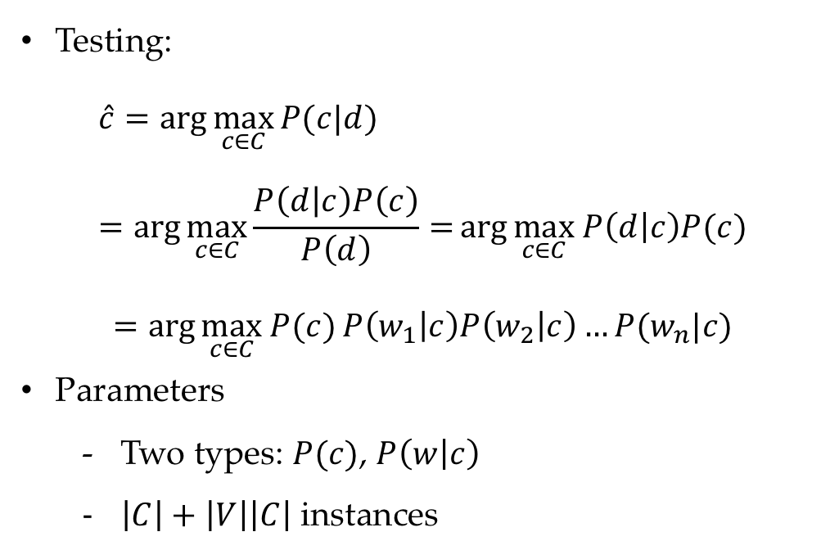
Naïve Bayes text classification
Testing:
$$\hat{c}=\arg{\max_{c∈C}{P(c|d) }} =\arg{\max_{c∈C}{\frac{P\left(d | c\right)P\left(c\right)}{P\left(d\right)}=}\arg{\max_{c∈C} P\left(d | c\right)P(c)}}$$
$$=\arg{\max_{c∈C} P(c)}P\left(w_{1} | c\right)P\left(w_{2} | c\right)…P(w_{n}|c)$$
Parameters
Two types: $P(c)$, $P\left(w | c\right)$
$\left|C\right|+\left|V\right|\left|C\right|$ instances
53

Slide 54
Generative models
(a) Naïve Bayer model
(b) Naïve Bayer model (nested plate notation)
54

Slide 55
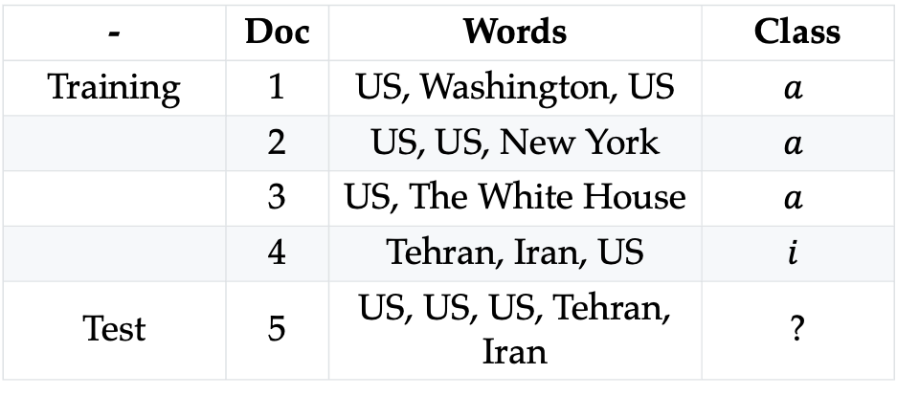
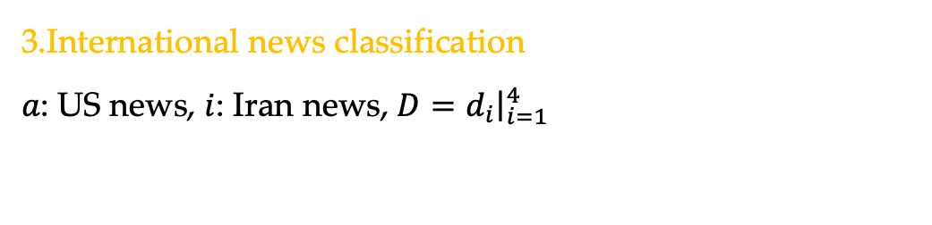
Hands on
3.International news classification
$a$: US news, $i$: Iran news, $D=d_{i}{\left.​\right|}_{i=1}^{4}$
- | Doc | Words | Class
Training | 1 | US, Washington, US | $$a$$
 | 2 | US, US, New York | $$a$$
 | 3 | US, The White House | $$a$$
 | 4 | Tehran, Iran, US | $$i$$
Test | 5 | US, US, US, Tehran, Iran | ?

Slide 56
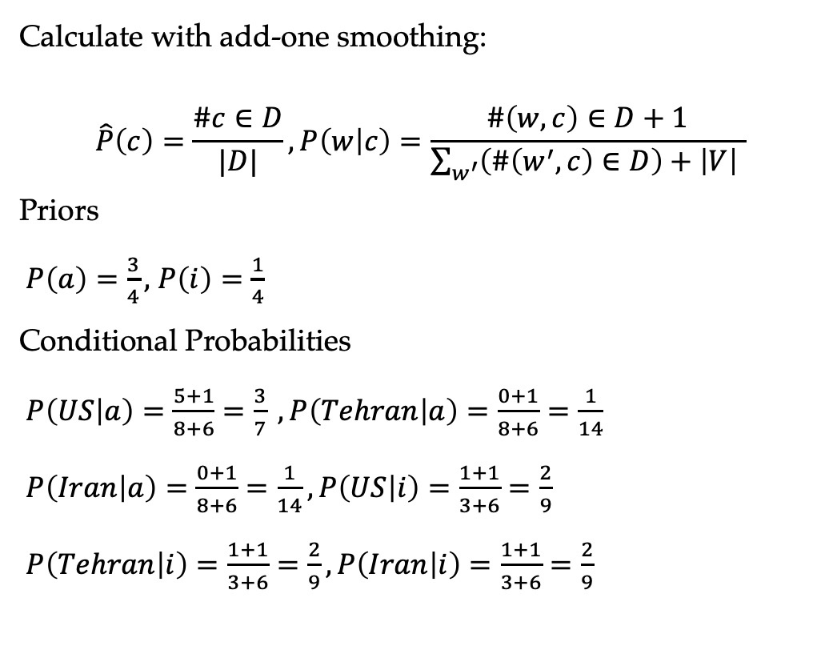
Hands on
Calculate with add-one smoothing:
$$\hat{P}\left(c\right)=\frac{\#c∈D}{|D|}, P\left(w | c\right)=\frac{\#\left(w,c\right)∈D+1}{\sum_{w^{′}}{\left(\#\left(w^{′},c\right)∈D\right)+\left|V\right| }}$$
Priors
$P\left(a\right)=\frac{3}{4},$ $P\left(i\right)=\frac{1}{4}$
Conditional Probabilities
$P\left(US | a\right)=\frac{5+1}{8+6}=\frac{3}{7} ,P\left(Tehran | a\right)=\frac{0+1}{8+6}=\frac{1}{14}$
$P\left(Iran | a\right)=\frac{0+1}{8+6}=\frac{1}{14},P\left(US | i\right)=\frac{1+1}{3+6}=\frac{2}{9}$
$P\left(Tehran | i\right)=\frac{1+1}{3+6}=\frac{2}{9},P\left(Iran | i\right)=\frac{1+1}{3+6}=\frac{2}{9}$

Slide 57
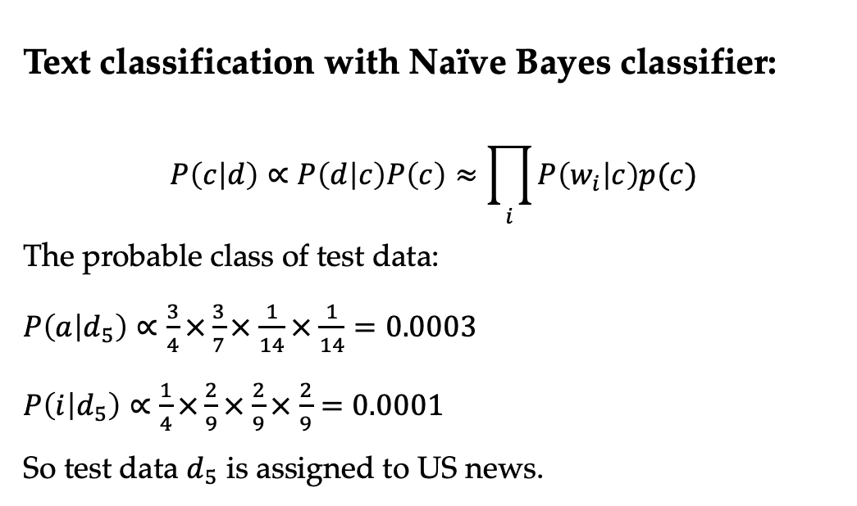
Hands on
Text classification with Naïve Bayes classifier:
$$P\left(c | d\right)∝P\left(d | c\right)P\left(c\right)≈\prod_{i}{P\left(w_{i} | c\right)p(c)}$$
The probable class of test data:
$P\left(a | d_{5}\right)∝\frac{3}{4}×\frac{3}{7}×$ $\frac{1}{14}×$ $\frac{1}{14}=0.0003$
$P\left(i | d_{5}\right)∝\frac{1}{4}×\frac{2}{9}×$ $\frac{2}{9}×$ $\frac{2}{9}=0.0001$
So test data $d_{5}$ is assigned to US news.

Slide 58
Contents
2.1 Probabilistic Modelling
2.1.1 Maximum Likelihood Estimation (MLE)
2.1.2 Modelling the Probability of Words
2.1.3 Probability Distribution
2.2 N-gram Language Models
2.2.1 Unigram Language Models
2.2.2 Bigram Language Models
2.2.3 Trigram Language Models and Beyond
2.2.4 Generative Models
2.3 Naïve Bayes Text Classification
2.3.1 Naïve Bayes Text Classification
2.3.2 Evaluating Text Classifier
2.3.3 Features

Slide 59
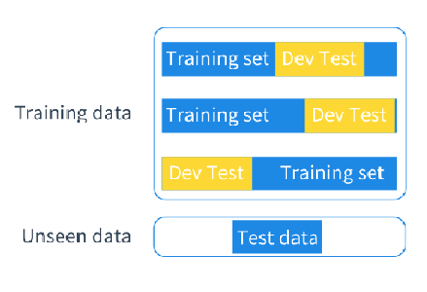
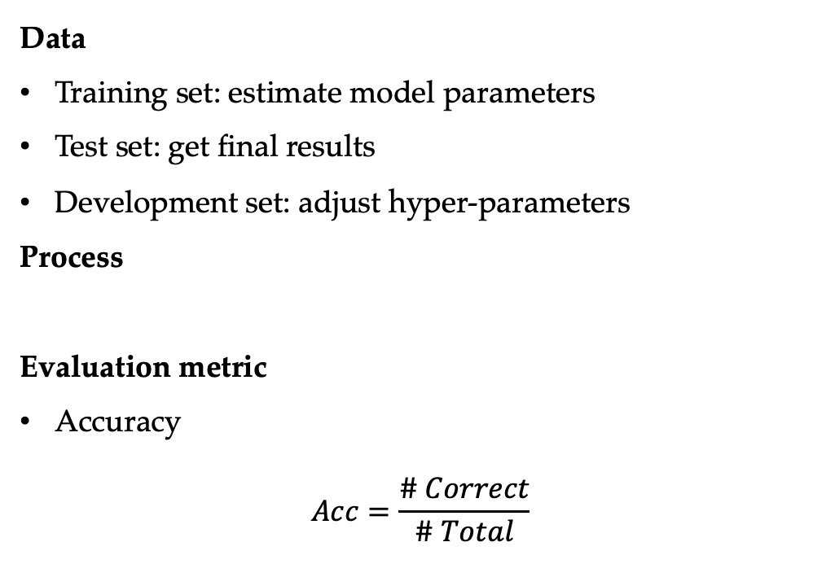
Evaluating a Text Classifier
Data
Training set: estimate model parameters
Test set: get final results
Development set: adjust hyper-parameters
Process
Evaluation metric
Accuracy
$$Acc=\frac{\# Correct}{\# Total}$$
Train -> dev test ->
Train -> dev test -> …
Train -> dev test -> test
strong results
only once

Slide 60
Contents
2.1 Probabilistic Modelling
2.1.1 Maximum Likelihood Estimation (MLE)
2.1.2 Modelling the Probability of Words
2.1.3 Probability Distribution
2.2 N-gram Language Models
2.2.1 Unigram Language Models
2.2.2 Bigram Language Models
2.2.3 Trigram Language Models and Beyond
2.2.4 Generative Models
2.3 Naïve Bayes Text Classification
2.3.1 Naïve Bayes Text Classification
2.3.2 Evaluating Text Classifier
2.3.3 Features

Slide 61
Features in NLP
Features are patterns that are used to parameterise a model
word: P(w)
n-gram: P(w₂|w₁), P(w₃|w₁ w₂)
word-class pair: P(w|c)
With more features, we can obtain more evidences for making a correct prediction
But we need to avoid overlapping features for generative models (e.g., P(w), P(w|c))

Slide 62
Summary
Probabilistic modelling and parametrisation techniques
Maximum likelihood estimation
N-gram language models
Naive Bayes models for text classification

Slide 63
Resources
Language modelling toolkits:
SRILM
http://www.speech.sri.com/projects/srilm/
Google N-gram Release
http://googleresearch.blogspot.com/2006/08/all-our-n-gram-are-belong-to-you.html
Google Book N-grams
http://ngrams.googlelabs.com/

