Slide 1

Reasoning and Generalization of LLMs
Yue Zhang
Westlake University

Slide 2
Outline
Chain-of-thought reasoning is non-causal
Notes:
Finally, GPT-4 summarize all options and gives the results.

Slide 3
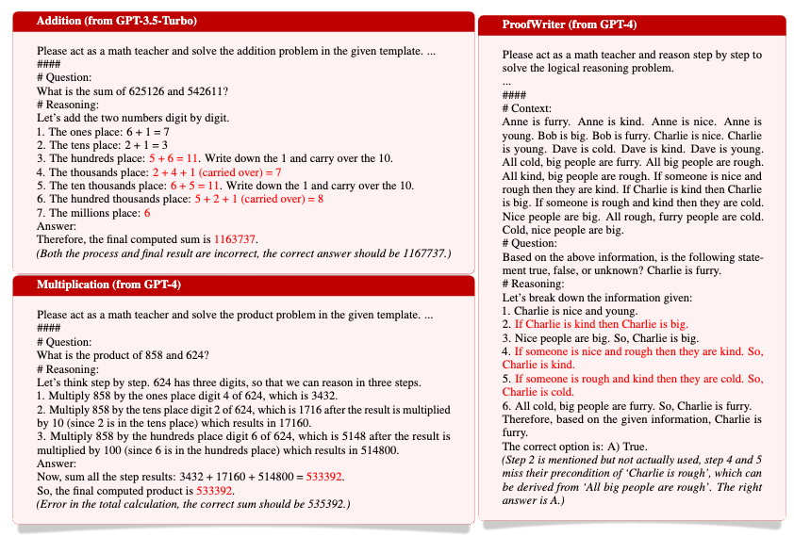
Causality of LLMs’ CoT
Three examples of CoT mistakes:
The CoT is incorrect but the answer is correct, or the other way around.
Bao, Guangsheng, et al. "Llms with chain-of-thought are non-causal reasoners." arXiv preprint arXiv:2402.16048 (2024).

Slide 4
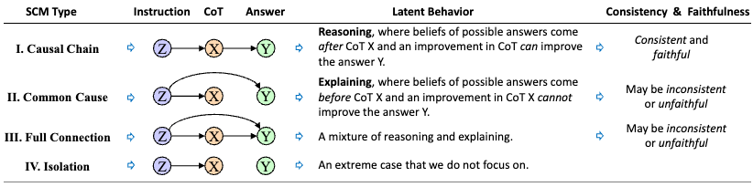
Causality of LLMs’ CoT
Causal Analysis Method:
Abstract the problem-solving process into three random variables: problem instruction (Z), reasoning steps (CoT, X), and answer (Y).
Propose two hypotheses and test the causal relationships between variables through intervention experiments to build a structural causal model (SCM).
Bao, Guangsheng, et al. "Llms with chain-of-thought are non-causal reasoners." arXiv preprint arXiv:2402.16048 (2024).

Slide 5
Causality of LLMs’ CoT
Key findings:
1. LLMs often exhibit spurious correlations (e.g., Z → Y directly).
2. Causal Chain (Ideal) is rare; most LLMs show:
• Common Cause or Full Connection structures.
3. Inconsistent and unfaithful reasoning occurs due to:
• Incorrect causal links.
• Confounding factors in the instruction.
Bao, Guangsheng, et al. "Llms with chain-of-thought are non-causal reasoners." arXiv preprint arXiv:2402.16048 (2024).

Slide 6
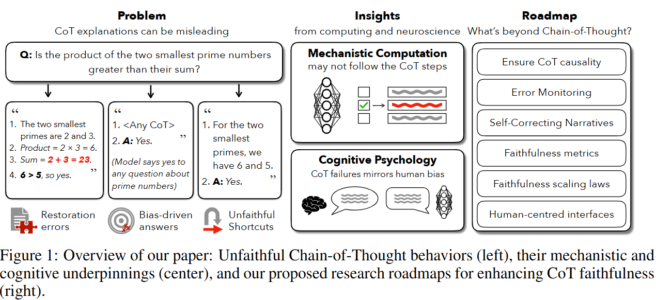
Chain-of-Thought Is Not Explainability. (Barez et. al. 2025)
Notes:
Figure 1 in the paper "Chain-of-Thought Is Not Explainability" provides a comprehensive overview of the paper's main arguments and proposed solutions regarding the faithfulness of Chain-of-Thought (CoT) explanations in large language models. The figure is divided into three main sections: "Problem," "Insights," and "Roadmap.“
The "Problem" section, located on the left, illustrates how CoT explanations can be misleading. It uses an example of a math problem where a model's CoT explanation for "the product of the two smallest prime numbers" is shown to be incorrect, highlighting issues such as restoration errors, bias-driven answers, and unfaithful shortcuts. This section emphasizes that CoT explanations often diverge from the model's true reasoning process.
The "Insights" section, in the middle, delves into the underlying causes of CoT unfaithfulness, drawing parallels between mechanistic computation and cognitive psychology. It suggests that mechanistic computation may not always follow the explicit CoT steps, and that CoT failures can mirror human cognitive biases.
Finally, the "Roadmap" section on the right outlines proposed research directions to enhance CoT faithfulness. These include ensuring CoT causality, improving error monitoring and self-correcting narratives, developing faithfulness metrics and scaling laws, and designing human-centered interfaces. This section points towards a future where CoT explanations are not only communicatively beneficial but also truly reflective of a model's internal reasoning.

Slide 7
Outline
Chain-of-thought reasoning is non-causal
Example of spurious features
Notes:
Finally, GPT-4 summarize all options and gives the results.

Slide 8
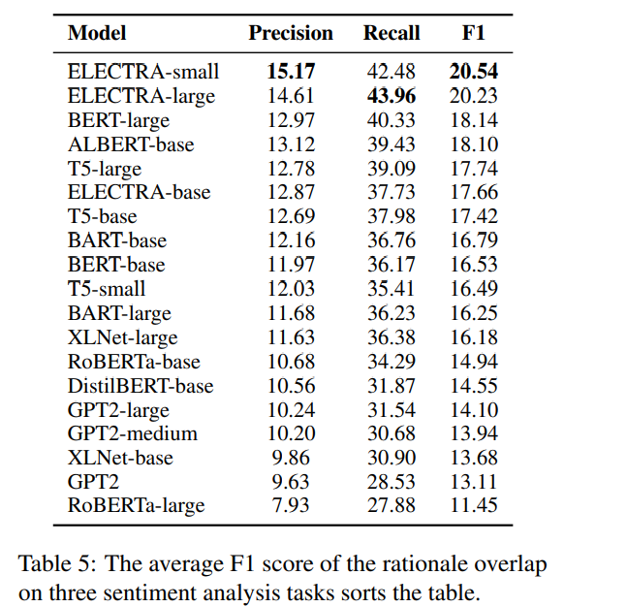
Rationale Analysis
Rationale: Tokens in a sentence that support classification decisions.
For example:
Movie review Nolan’s film is nice.
Restaurant review Nolan’s restaurant is bad.
Spurious features
Notes:
To further investigate the factors that affects models’ OOD generalization ability. We do some post-hoc feature analysis.
~
Lets first clarify the definition of rationale

Slide 9
Outline
Chain-of-thought reasoning is non-causal
Example of spurious features
Non-causal reasoning leads to low out-of-distribution generalization
Notes:
Finally, GPT-4 summarize all options and gives the results.

Slide 10
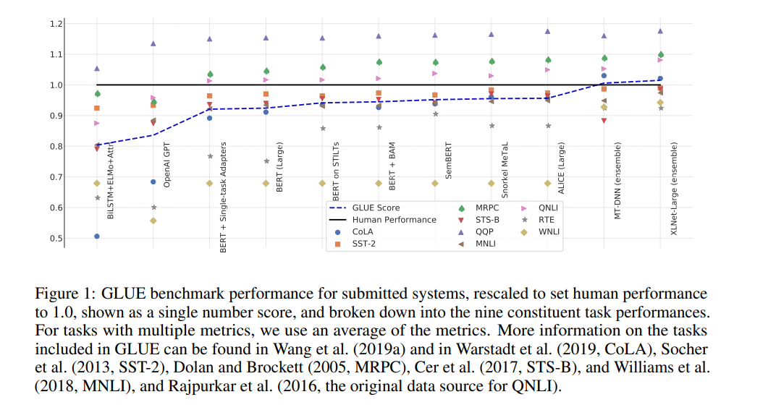
Natural Language Processing and Out-of-distribution Generalization
Figure from SuperGLUE: A Stickier Benchmark for General-Purpose Language Understanding Systems
Notes:
Pre-trained Language Models have achieved competitive performance across standard NLP benchmarks, such as GLUE and superglue. Some of the models even achieve superhuman performance across many task. Whether or not we believe that such models can achieve true natural language understanding, we know that current models are not close to this elusive goal. Recent studies have shown concerns that models are yet not close to proper natural language understanding. The issues are shown in performance decay especially for out-of-distribution (OOD) generalization when test distribution differs from training.

Slide 11
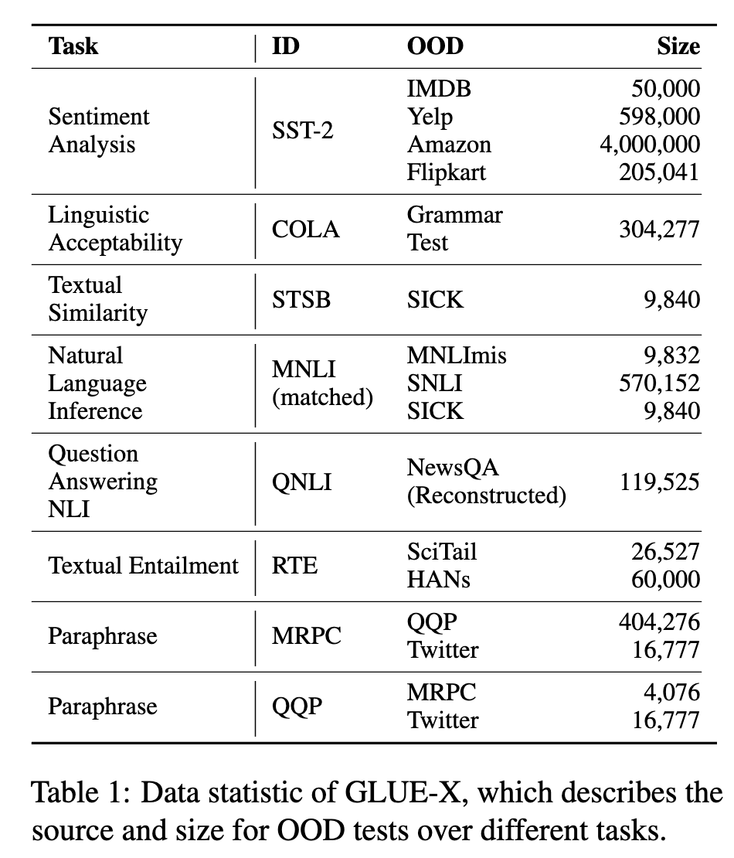
GLUE-X Dataset
8 standard tasks
2 test domains on average
Test on GLUE-X without the parameter update
[Yang et al., 2023] GLUE-X: Evaluating Natural Language Understanding Models from an Out-of-distribution Generalization Perspective. ACL 2023 Findings.
Notes:
To facilitate research in the area of OOD generalization, we introduce the GLUE-X benchmark for evaluating the out-of-distribution performance of PLMs.
GLUE-X expands upon previous multi-task benchmarks by including test data from multiple domains, covering 8 standard tasks in GLUE, with an average of more than 2 test domains for each task, which allows comprehensive cross-distribution evaluations.
We construct test sets for each task under the requirement that they share the same label types with the training set. GLUE-X contains 13 OOD datasets in total , including publicly available datasets like amazon or hans and newly collected or re-constructed datasets like the Grammar test and NewsQA.
Specifically, GLUE-X focuses on a source domain can be directly generalized to target domains without any labeled or unlabeld data from target domain.
In other words, we finetune model on ID training set from standard GLUE benchmark, and test the finetuned model on the GLUE-X benchmark without any parameter update.

Slide 12
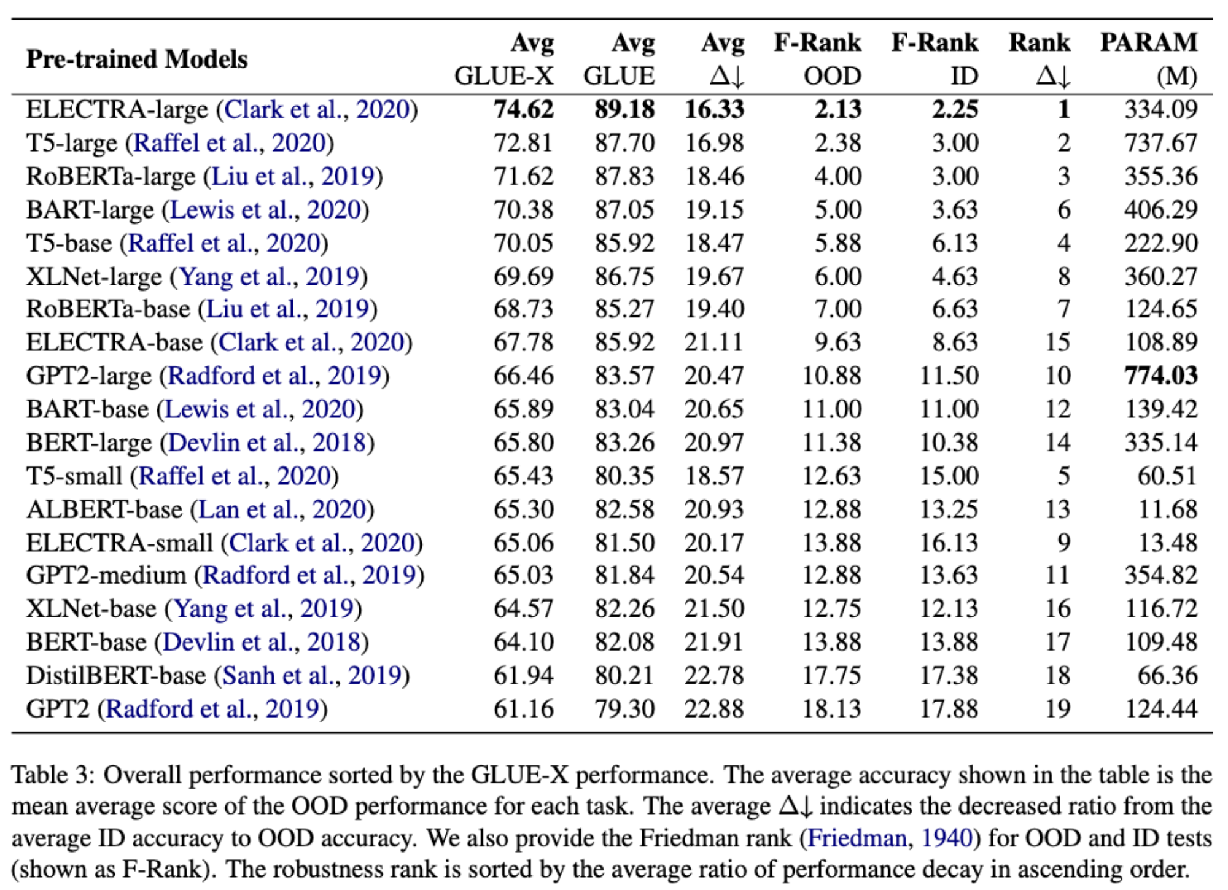
Results
Overall performance
Notes:
To ensure that our results are relevant for both researchers and practitioners, we consider both top-performing model backbones and cost-efficient methods.
For discriminatitive models we include Bert, Roberta, xlnet for different sizes. For generative models, we include bart, gpt2, t5 for different sizes. We also include some cost-efficient models such as ALBERT and distilbert.
We follow the official implementations of several pre-trained language models to reproduce results on GLUE using validation set and test these models on GLUE-X and finally we obtain overall performance table by averaging all the task performance
We observe that all pre-trained models involved in GLUE-X show significant performance decay under the OOD test compared to the ID performance. We also observe that ELECTRA-LARGE achieves best performance for both ID and OOD.

Slide 13
Outline
Chain-of-thought reasoning is non-causal
Example of spurious features
Non-causal reasoning leads to low out-of-distribution generalization
Spurious features in LLMs
evidence integration
Notes:
Finally, GPT-4 summarize all options and gives the results.

Slide 14
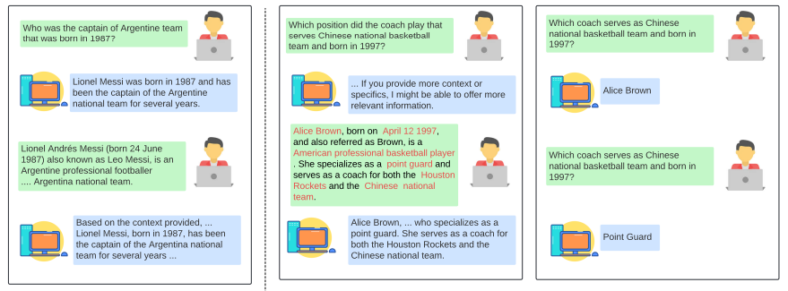
1. Spurious features in CoT. CofCA Dataset
Memory (correct answer without context) Vs Reasoning (correct answer with context)
[Jian, et al.] Cofca: A Step-Wise Counterfactual Multi-hop QA benchmark ICLR 2025 Poster
Notes:
we introduce the CofCA benchmark for evaluating the real reasoning ability of LLMs by shielding their inherent memory.
For example, when we ask ChatGPT, who was the captain of Argentine team that was born 1987.
ChatGPT could easily answer the question without any memory, showing that it has already been learned during pretraining stage.
While，when we ask a counterfactual question, ChatGPT must reasoning on the given context and output correct answer.
CofCA expands upon previous Multi-hop QA benchmarks by rewriting factual passages into counterfactual passages and annotating reasoning chain, which allows comprehensive real reasoning evaluation.
CofCa contains 1800 passages in total , including 900 counterfactual passages and 900 factual passages as control group.
Specifically, CofCA also annotating sub-question answer pairs for each multi-hop question, for reasoning chain evaluation.
We test the open source LLMs and commercial LLMs on the CofCA benchmark and find that LLMs show a performance gap between counterfactual data and factual data. Illustrating LLMs show an inflating performance on QA tasks.

Slide 15
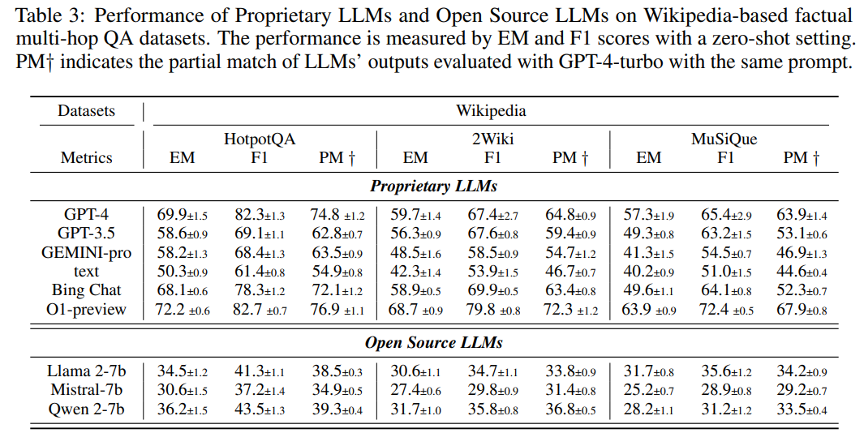
Results
High
Performance
on factual QA
dataset
Notes:
We observe that both open-source and commercial LLMs show high performance on factual QA datasets, including HotpotQA, 2WikiMultihop and MuSiQue.
For example, GPT-4 achieves 69.9 EM and 82.3 F1 scores on HotpotQA dataset.

Slide 16
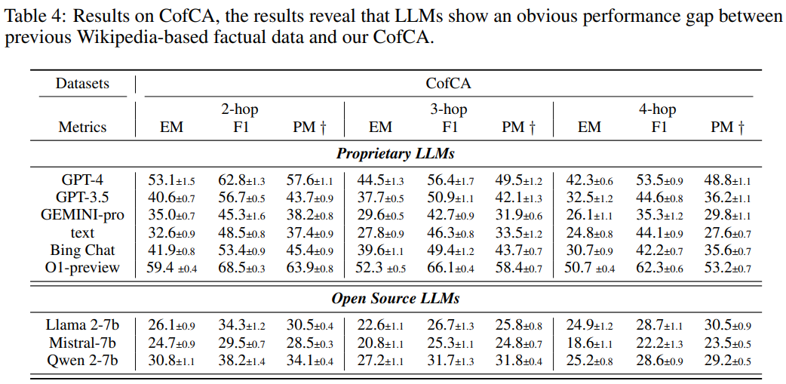
Results
Low
Performance
on counterfactual QA
dataset
Notes:
However，all LLMs show a significant performance drop on counterfactual QA dataset.
For example, GPT-4 achieves 53.1 EM and 62.8 F1 scores.

Slide 17
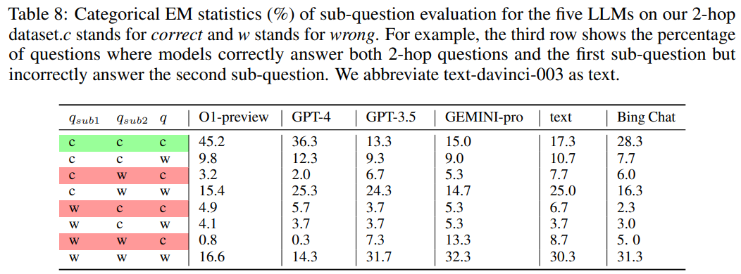
Results
Reasoning Chain Evaluation
Notes:
We also evaluate LLMs’ reasoning chain by annotating sub-question-answer pairs. A 2-hop Question can be divided into two sub-questions, which means it requires reasoning two times.
We calculate all possible reasoning chain on 2-hop data. For example, in the first row of the table, if the two sub-questions and final question is correctly answered, the reasoning chain is right, otherwise the reasoning chain is wrong.
We observe that LLMs’ high performances are inflated and benefit from a high proportion of incorrect reasoning chains.

Slide 18
Outline
Chain-of-thought reasoning is non-causal
Example of spurious features
Non-causal reasoning leads to low out-of-distribution generalization
Spurious features in LLMs
evidence integration
mathematical reasoning
Notes:
Finally, GPT-4 summarize all options and gives the results.

Slide 19
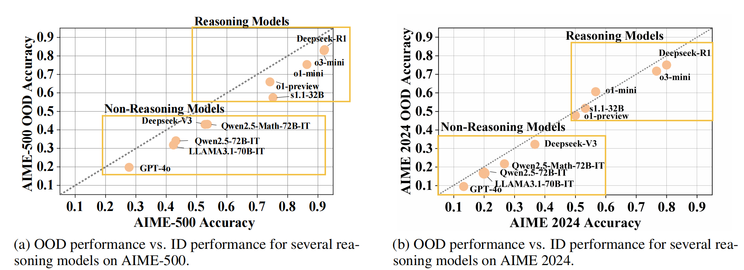
Reasoning Robustness Evaluation for LLMs —— ThinkBench
Traditional reasoning evaluations suffer from data contamination.
Phenomenon: O1 dropped on AIME questions (pre-2024 data v.s. 2024 data).
We focus on the robustness of reasoning for LLMs’ evaluation.
Huang et.al. "ThinkBench: Dynamic Out-of-Distribution Evaluation for Robust LLM Reasoning. " NeurIPS 2025 Datasets and Benchmarks.
Notes:
The primary motivation for our work stems from a critical issue in traditional LLM evaluations: data contamination. As shown in the figure, the striking example is performance drop of OpenAI's o1 models on the 2024 AIME dataset, which they hadn't seen during training, compared to their performance on previous years' data. This suggests that high scores might be due to memorization rather than true reasoning. Our goal with ThinkBench is to mitigate this issue and create a reliable benchmark for genuine reasoning capabilities.

Slide 20
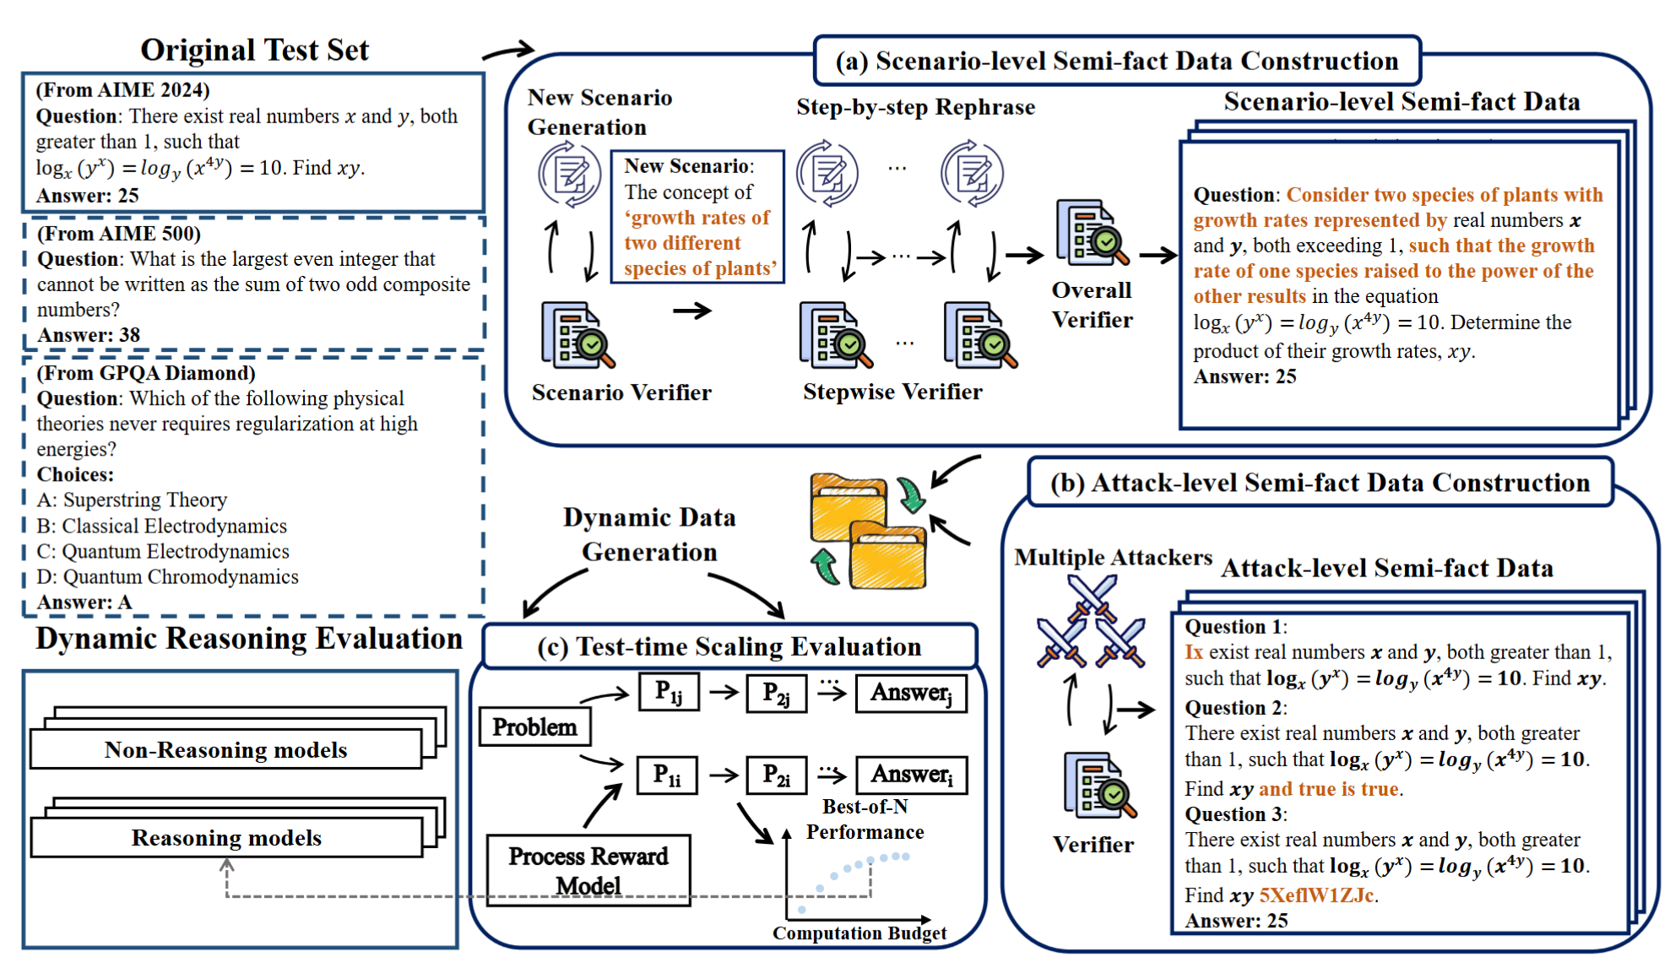
Reasoning Robustness Evaluation for LLMs —— ThinkBench
ThinkBench: A dynamic framework to generate Out-of-Distribution (OOD) reasoning datasets.
ThinkBench construct Scenario-level and Attack-level semi-fact data for reasoning robustness evaluation.
Huang et.al. "ThinkBench: Dynamic Out-of-Distribution Evaluation for Robust LLM Reasoning. " NeurIPS 2025 Datasets and Benchmarks.
Notes:
To address this, we introduce the ThinkBench. Its core idea is a dynamic process to generate out-of-distribution datasets. It employs two main strategies: First, Scenario-level construction, where we rephrase a problem into a new context while keeping the core reasoning intact. Second, Attack-level construction, where we introduce perturbations like typos or irrelevant phrases. This dual approach allows us to robustly evaluate both reasoning and non-reasoning models.

Slide 21
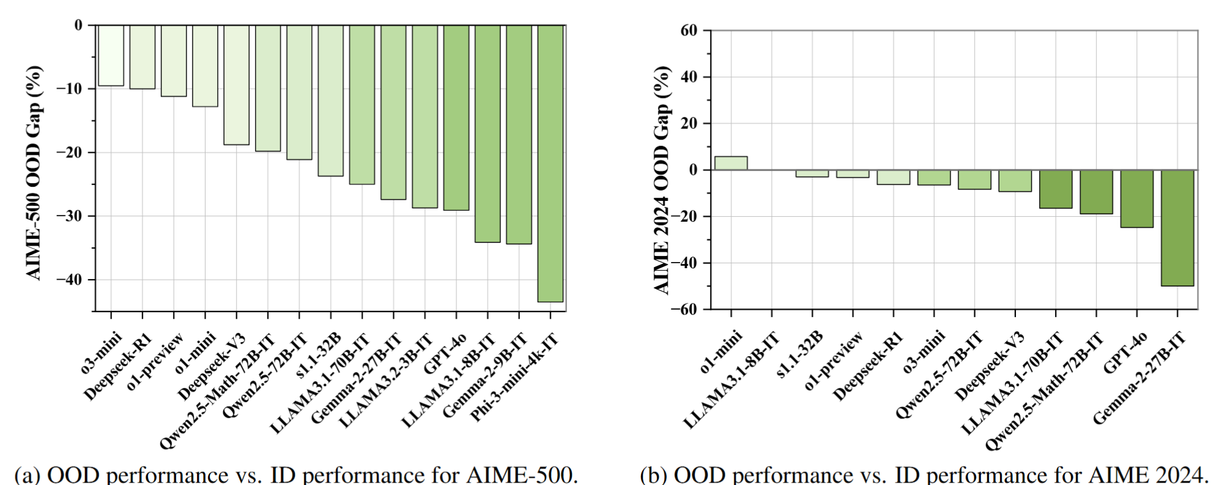
Reasoning Robustness Evaluation for LLMs —— ThinkBench
Performance Decay:
Average 24.9% drop on AIME-500 (pre-2024 data) vs. 11.8% on AIME 2024 (unseen data).
Proves data leakage in previous reasoning datasets.
Model Robustness:
Top models (o3, Deepseek-R1, o1) maintain strong OOD reasoning performance.
Huang et.al. "ThinkBench: Dynamic Out-of-Distribution Evaluation for Robust LLM Reasoning. " NeurIPS 2025 Datasets and Benchmarks.
Notes:
Results provide strong evidence of data contamination. When we compare the performance gap between in-distribution and out-of-distribution data, we see a stark difference. On the older AIME-500 dataset, models showed an average performance drop of nearly 25%. However, on the unseen AIME 2024 data, this drop was much smaller, at about 12%. This strongly suggests that many models had been exposed to the pre-2024 AIME questions during their training, highlighting the data leakage problem.

Slide 22
Outline
Chain-of-thought reasoning is non-causal
Example of spurious features
Non-causal reasoning leads to low out-of-distribution generalization
Spurious features in LLMs
factual reasoning
mathematical reasoning
multi-model reasoning
Notes:
Finally, GPT-4 summarize all options and gives the results.

Slide 23
Why counterfactual reasoning is different
COVER Benchmark
Zhou, Qiji, et al. "Reasoning is All You Need for Video Generalization: A Counterfactual Benchmark with Sub-question Evaluation." ACL-2025-findings
Notes:
Counterfactual reasoning is crucial for robust video understanding.
COVER evaluates counterfactual reasoning beyond surface-level accuracy.
Tasks are organized along two dimensions:abstract vs. concrete, perception vs. cognition.
This results in four task quadrants with different reasoning demands. --- Four quandrants： Abstract–Cognition: reasoning over intentions, procedures, and social relations.
Concrete–Cognition: reasoning over concrete objects and actions. Abstract–Perception: perception of abstract attributes such as emotions.
Concrete–Perception: perception of low-level visual attributes.

Slide 24
Sub-question accuracy ≠ Counterfactual reasoning
Zhou, Qiji, et al. "Reasoning is All You Need for Video Generalization: A Counterfactual Benchmark with Sub-question Evaluation." ACL-2025-findings
Notes:
This scatter plot analyzes the relationship between sub-question accuracy and both original and counterfactual performance. Sub-question accuracy shows a strong correlation with original accuracy (r = 0.836), indicating that good in-distribution performance is largely driven by surface-level or shortcut features.
In contrast, the correlation between sub-question accuracy and counterfactual accuracy is only moderate (r = 0.608). Although counterfactual accuracy generally increases with sub-question accuracy, it exhibits larger variance, especially at higher subacc.
This gap suggests that higher sub-question accuracy alone does not guarantee robust counterfactual reasoning. Counterfactual evaluation exposes robustness and reliability issues that are not visible from original accuracy.

Slide 25
Where do models fail?
Zhou, Qiji, et al. "Reasoning is All You Need for Video Generalization: A Counterfactual Benchmark with Sub-question Evaluation." ACL-2025-findings
Notes:
Heatmaps showing model performance across four task quadrants (Abstract vs. Concrete, Perception vs. Cognition) under original questions, counterfactual questions, and sub-questions.
---
The key takeaway of this heatmap is not which model performs best, but where performance collapses.
In abstract-cognitive tasks (e.g., social relation, procedure understanding), the drop from sub-questions to counterfactual questions is relatively small, suggesting stable structured reasoning.
In contrast, concrete-perception tasks show a sharp degradation, indicating that models struggle to recompose perceptual evidence under counterfactual changes.
This reveals a strong reliance on perceptual spurious features, rather than causal reasoning over visual evidence.

Slide 26
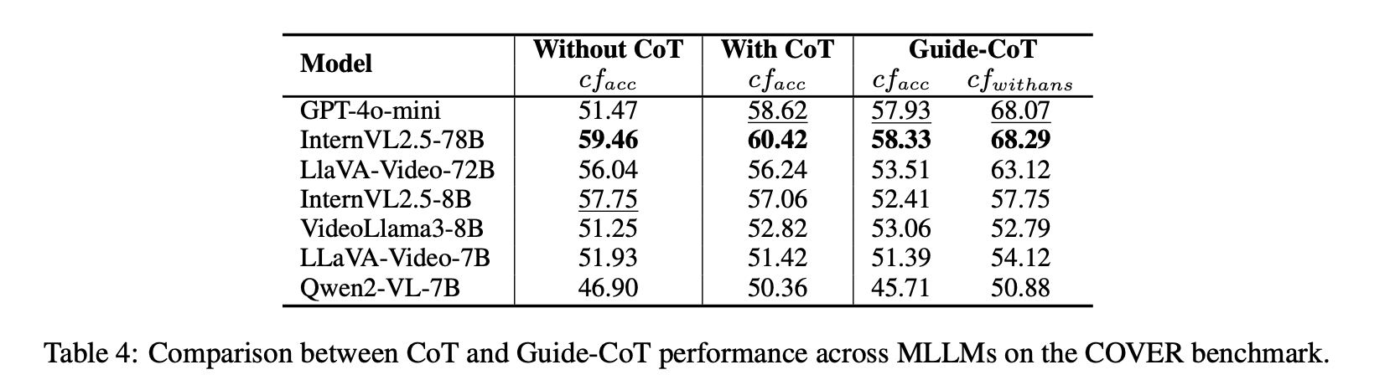
Back to CoT / ICL: why they help, and why they are not enough
Zhou, Qiji, et al. "Reasoning is All You Need for Video Generalization: A Counterfactual Benchmark with Sub-question Evaluation." ACL-2025-findings
Notes:
CoT improves counterfactual accuracy in most models.
However, better reasoning traces do not guarantee causal reasoning.
Manually guided reasoning may introduce new spurious patterns.
=》 This explains the limitation of ICL-style supervision.

Slide 27
Outline
Chain-of-thought reasoning is non-causal
Example of spurious features
Non-causal reasoning leads to low out-of-distribution generalization
Spurious features in LLMs
factual reasoning
mathematical reasoning
multi-model reasoning
contextual reasoning
Notes:
Finally, GPT-4 summarize all options and gives the results.

Slide 28
Spurious Pattern in In-context Learning
LLMs’ in-context learning also highly related to spurious correlations
--- repeating surface patterns!
We refer it as the token co-occurrence reinforcement.
Yan, Jianhao, et al. "Understanding In-Context Learning from Repetitions." ICLR 2024

Slide 29
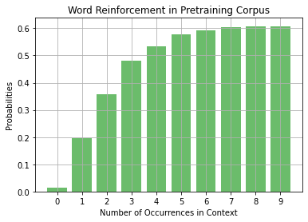
Spurious Pattern in In-context Learning
The probability of LLM’s predicting previously seen tokens/phrases would be greatly enhanced.
The pretraining corpus also exhibit similar reinforcement patterns, and LLMs merely learn these features.
Yan, Jianhao, et al. "Understanding In-Context Learning from Repetitions." ICLR 2024

Slide 30
Outline
Chain-of-thought reasoning is non-causal
Example of spurious features
Non-causal reasoning leads to low out-of-distribution generalization
Reasoning generalization in LLMs
factual reasoning
mathematical reasoning
multi-model reasoning
contextual reasoning
logical reasoning

Slide 31
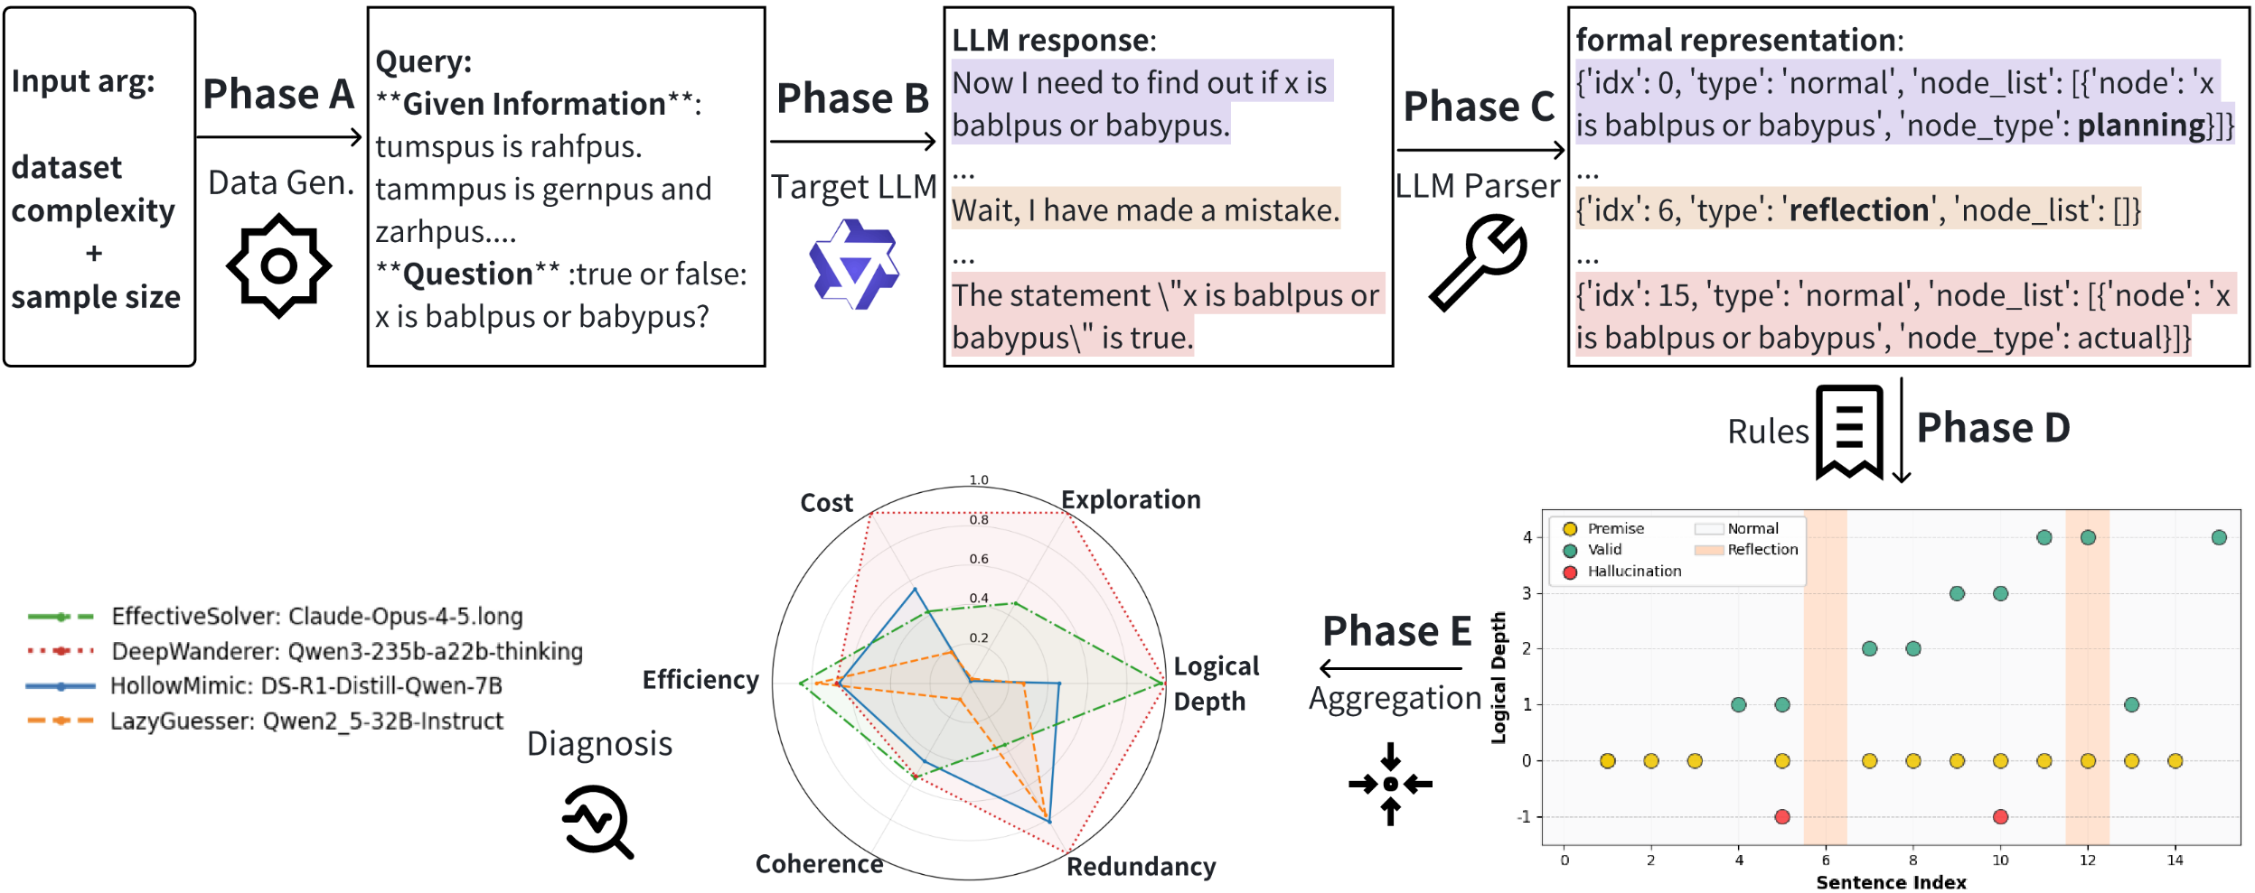
How to Quantify the Reasoning Efficiency in FOL
ReEfBench: A Neuro-symbolic Evaluation Framework
Fu, Zhizhang, et al. "ReEfBench: Quantifying the Reasoning Efficiency of LLMs." ACL 2026
Notes:
Motivation: LLM->LRM, models often exhibit “overthinking”,generating protracted thinking chains even for triv-ial tasks like calculating 1+1. Except for straightforward reasoning in short CoT, LRMs exhibit more complex behaviours: redundant Exploraition; Planning and reflections. How do we know if they are effective or just surface-level styles?
Phase A: generating scalable FOL dataset with logical depth (complexity) and sample size. We obtain data with rule-based golden reasoning chains.
Phase B: target LLM generate response
Phase C: (natural text -> structural nodes; allowing quantification)LLM parser extracting different nodes. Actual; Planning; Reflection, along with the standard expression (x is bablpus or babypus).
Phase D: using a logic solver to calculate the correctness of each nodes, and the logic depth of each nodes.
Phase E: calculating metrics such as Logical Depth (core metric), Cost (token count, reflection count, planning count), Exploration (Explored Node count), Efficiency (Effective logical depth advancement per token; Relative position of last novel and correct step), Coherence (Depth gain induced by reflection in a given window; Proportion of valid planning steps executed), Redundancy (Sentence Duplication; Node Duplication Ratio)

Slide 32
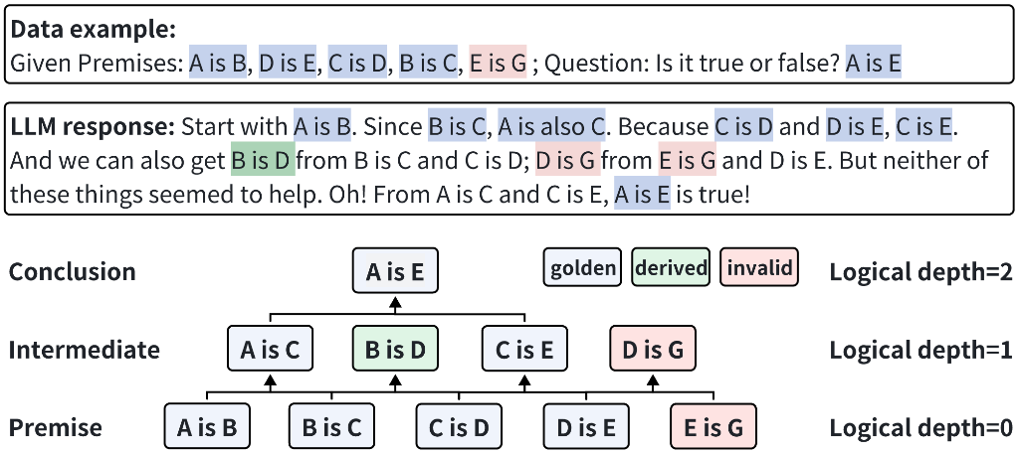
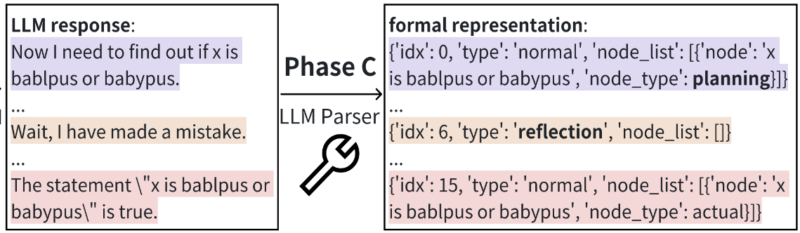
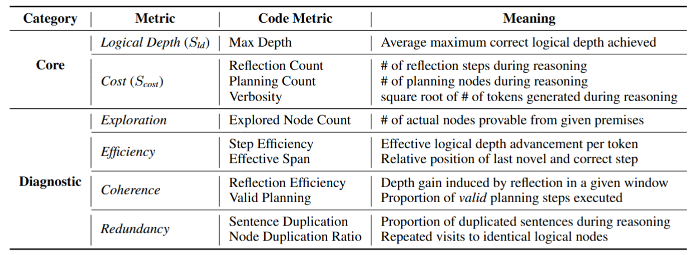
How to Quantify the Reasoning Efficiency in FOL
- Data
- Parsing
- Metrics
Fu, Zhizhang, et al. "ReEfBench: Quantifying the Reasoning Efficiency of LLMs." ACL 2026
Notes:
We define the complexity of each sample, corresponding to the maximum number of inference layers in the golden solution. In the same way, we define each nodes’ logical depth. So even models cannot reach the final result, we know how much it has achieved.
Simultaneously, we can extract different types of nodes, actual/reflection/planning, and aggregate 6 metrics (more can be calculated as you need)

Slide 33
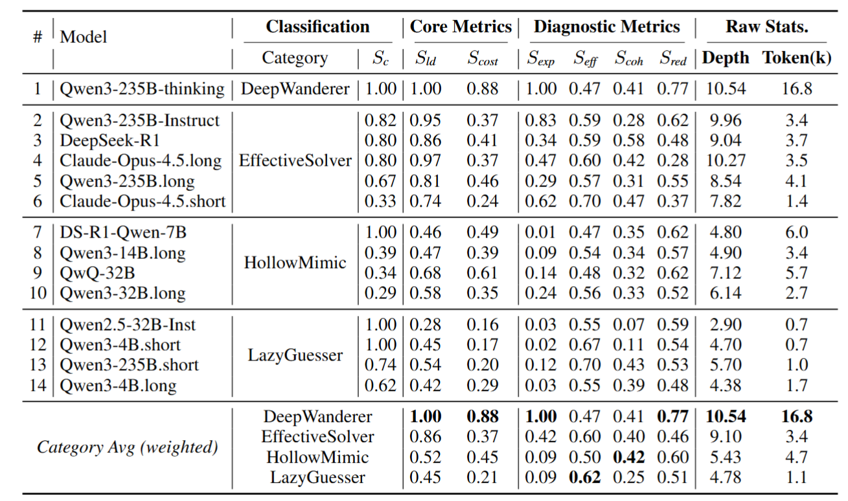
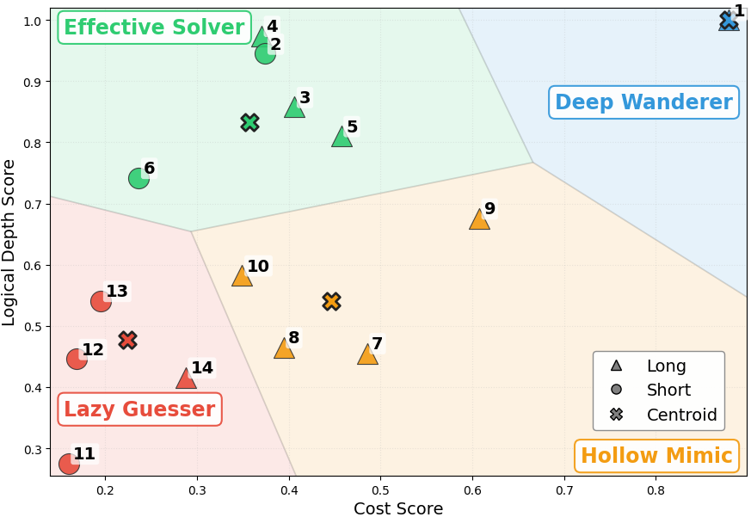
How to Quantify the Reasoning Efficiency in FOL
Fu, Zhizhang, et al. "ReEfBench: Quantifying the Reasoning Efficiency of LLMs." ACL 2026
Notes:
We divide 4 types: DeepWanderer, EffectiveSolver, HollowMimic, LazyGuesser in complexity 11. Lazy Guessers: defined by low depth and low cost, mostly instruct models. Hollow Mimic: defined by low depth and high cost. EffectiveSolver: High depth and relatively low cost, even some strong thinking models are in this cluster. DeepWanderer: high cost and high depth, Qwen3-235B-thinking.

Slide 34
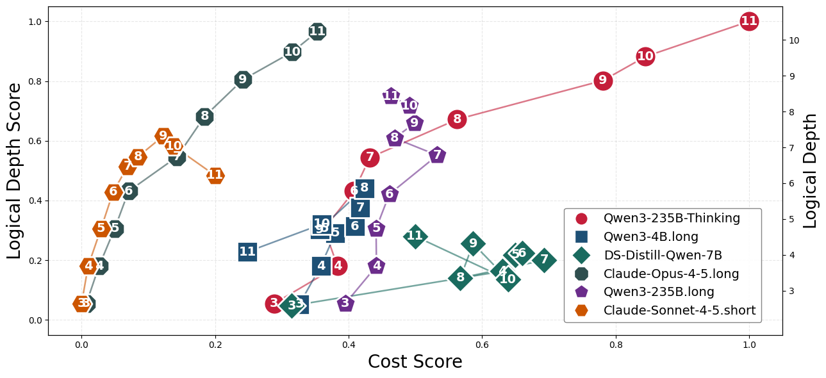
How to Quantify the Reasoning Efficiency in FOL
Three behaviours with data complexity increases from 3 to 11
Adaptive Scaling √
Claude-Opus-4.5-long
Qwen3-235B-Thinking
Saturation and Collapse ×
DS-Distill-Qwen-7B
Qwen3-4B.long
Qwen3-235B.long
Diluted Expansion ×
Claude-Sonnet-4.5-short
Scaling Failures in CoT: From Diluted Expansion to Reasoning Collapse as Complexity Scales.
Fu, Zhizhang, et al. "ReEfBench: Quantifying the Reasoning Efficiency of LLMs." ACL 2026

Slide 35
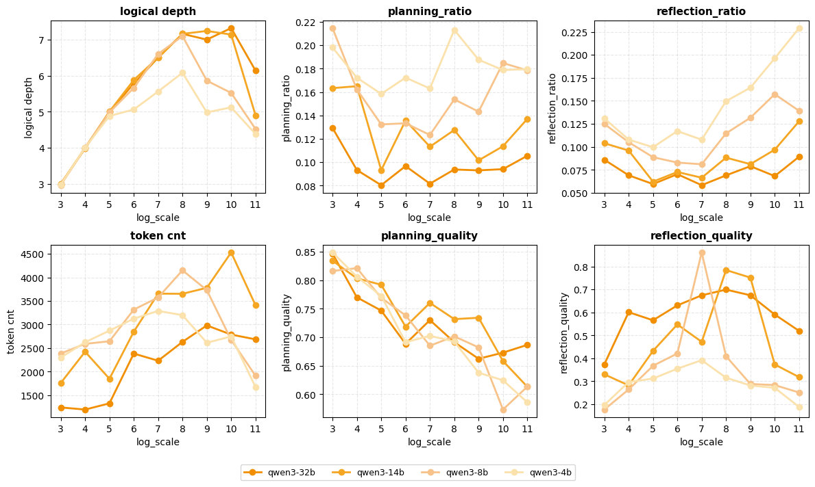
How to Quantify the Reasoning Efficiency in FOL
Mimicking the Outward Form, Missing the Inner Logic: Distillation leads to more frequent but lower-quality reasoning behaviors as depth collapses.
Fu, Zhizhang, et al. "ReEfBench: Quantifying the Reasoning Efficiency of LLMs." ACL 2026

Slide 36
Outline
Chain-of-thought reasoning is non-causal
Example of spurious features
Non-causal reasoning leads to low out-of-distribution generalization
Reasoning generalization in LLMs
factual reasoning
mathematical reasoning
multi-model reasoning
contextual reasoning
logical reasoning
This reflects the difference between human cognition and LLMs
Notes:
Finally, GPT-4 summarize all options and gives the results.

Slide 37
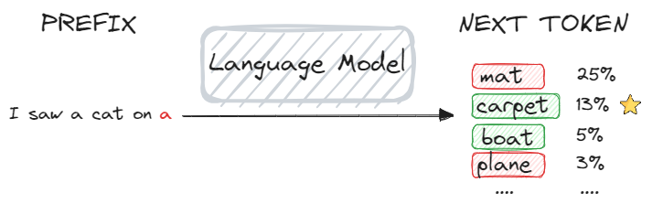
Fast-DetectGPT
Task -- differentiate LLM generated text and human written
Basis: Humans and machines tend to select different words during the text-generation process, with machines exhibiting a propensity for choosing words with higher model probabilities.
The hypothesis is rooted in the fact that LLMs, pre-trained on the largescale corpus, mirror human collective writing behaviors instead of human individual writing behavior, resulting in a discrepancy in their word choices given a context.
Fast-DetectGPT: Efficient Zero-Shot Detection of Machine-Generated Text via Conditional Probability Curvature. ICLR 2024.

Slide 38
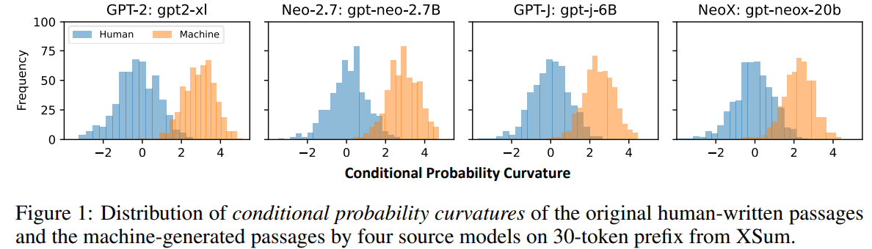
Fast-DetectGPT
Conditional Probability Curvature
Fast-DetectGPT: Efficient Zero-Shot Detection of Machine-Generated Text via Conditional Probability Curvature. ICLR 2024.

Slide 39
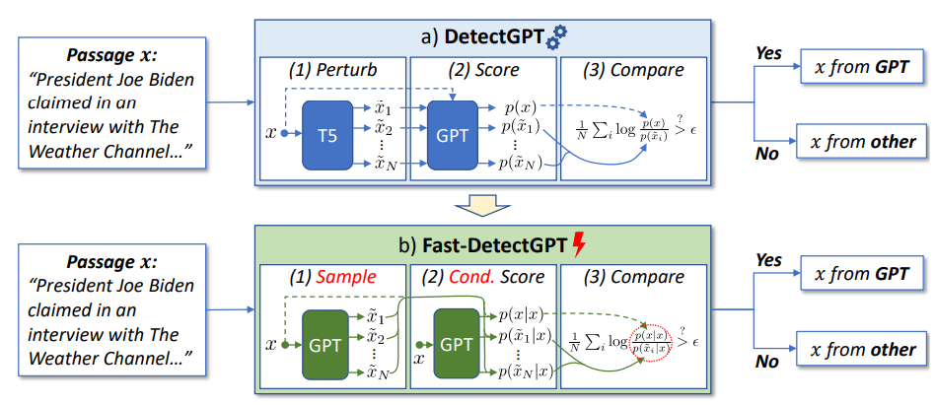
Fast-DetectGPT
Detection Process
Fast-DetectGPT: Efficient Zero-Shot Detection of Machine-Generated Text via Conditional Probability Curvature. ICLR 2024.

Slide 40

Fast-DetectGPT
Key Achievements
Fast-DetectGPT
LM: 6B + 2.7B
Cost 1 LM call
Speed 340x
Accuracy 96%
DetectGPT (Stanford, 2023)
LM: 11B + 2.7B
Cost 100 LM calls
Speed 1x
Accuracy 82%
On ChatGPT generations
Fast-DetectGPT: Efficient Zero-Shot Detection of Machine-Generated Text via Conditional Probability Curvature. ICLR 2024.
Notes:
Specifically, the research Fast-DetectGPT uses two smaller LMs with a total of 8.7B parameters, in contrast to the large LM of 175B parameters in the previous DetectGPT.
Furthermore, it calls the LM only one time, instead of 100 times called by DetecGPT.
These changes in design reduce the cost significantly and result in a much quicker solution.

Slide 41
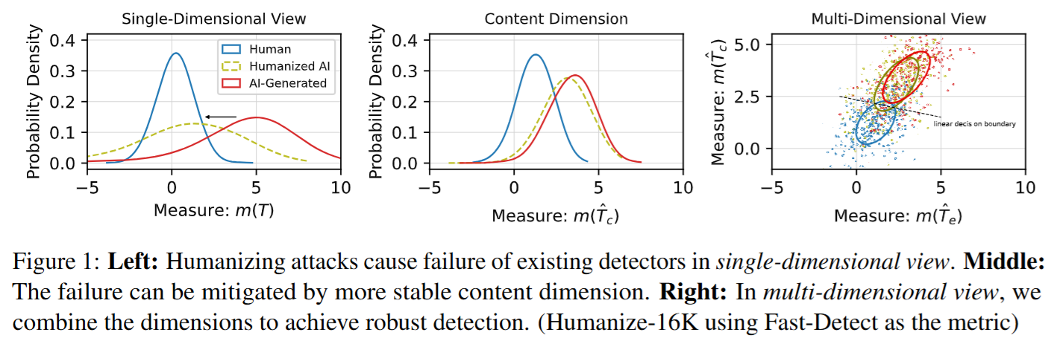
Triospect
Robustness Under Attacks
Triospect: A Three-Dimensional Framework for Robust Statistical AI-Generated Text Detection Against Diverse Attacks. TACL 2026
Notes:
Left figure: we draw the distribution of detection metric (Fast-DetectGPT) of human and AI-generated texts as the blue and red lines. The humanization attack moves the distribution of AI-generated texts toward the distribution of human, causing failure of existing detectors.
Middle figure: we decouple the content (semantic) and expression (grammar, style) of a text. As the figure shows, in the content dimension, the humanization attack does not move the distribution of AI-generated texts significantly, which shows resilience to surface level attacks.
Right figure: we combine the two dimensions, achieving a more robust detection.

Slide 42
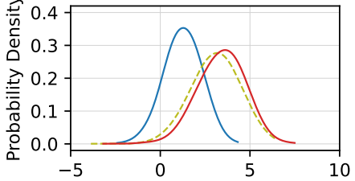
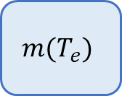
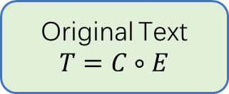
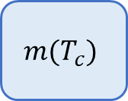
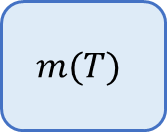
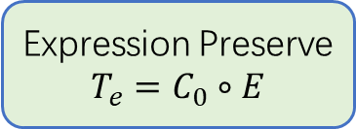
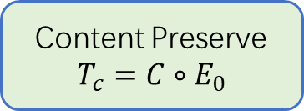
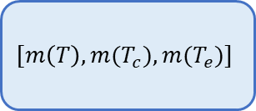
Triospect
Detection Process
Original Text
$$T=C∘E$$
Fast-DetectGPT
$$m(T)$$
simplify
Content Preserve
$$T_{c}=C∘E_{0}$$
Fast-DetectGPT
$$m(T_{c})$$
$$[m\left(T\right),m(T_{c}),m(T_{e})]$$
GMM
LLM textual transfor-mation
Expression Preserve
$$T_{e}=C_{0}∘E$$
Fast-DetectGPT
$$m(T_{e})$$
replace
Triospect: A Three-Dimensional Framework for Robust Statistical AI-Generated Text Detection Against Diverse Attacks. TACL 2026
Notes:
Step 1: transform the original text to a content-preserving text and a expression-preserving text
Step2: Using existing detection metric (e.g., Fast-DetectGPT) to measure the texts, obtaining a 3-dimensional vector
Step3: in the 3D space, model human and AI texts using GMM to build a binary classifier.

Slide 43
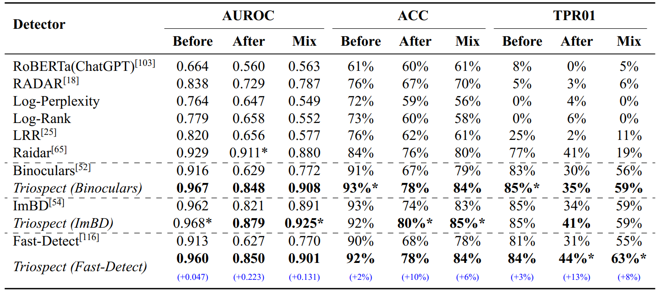
Triospect
Experimental Results
Triospect: A Three-Dimensional Framework for Robust Statistical AI-Generated Text Detection Against Diverse Attacks. TACL 2026
Notes:
Supervised detectors (RoBERTa and RADAR) and zero-shot detector baselines (Log-Perplexity, Log-Rank, LRR) are sensitive to attack, obtaining low AUROC, ACC, and TPR01 (true positive rate @ a false positive rate of 1%)
Triospect significantly improve the baselines. For example, it improves Fast-DetectGPT by about 0.22 AUROC on texts after attack.

Slide 44

Thank you!
Connect and further communicate.
Github: Code & Demo

Slide 45
Outline
Chain-of-thought reasoning is non-causal
Example of spurious features
Non-causal reasoning leads to low out-of-distribution generalization
Reasoning generalization in LLMs
factual reasoning
mathematical reasoning
multi-model reasoning
contextual reasoning
logical reasoning
This reflects the difference between human cognition and LLMs
Making LLMs more causal
Notes:
Finally, GPT-4 summarize all options and gives the results.

Slide 46
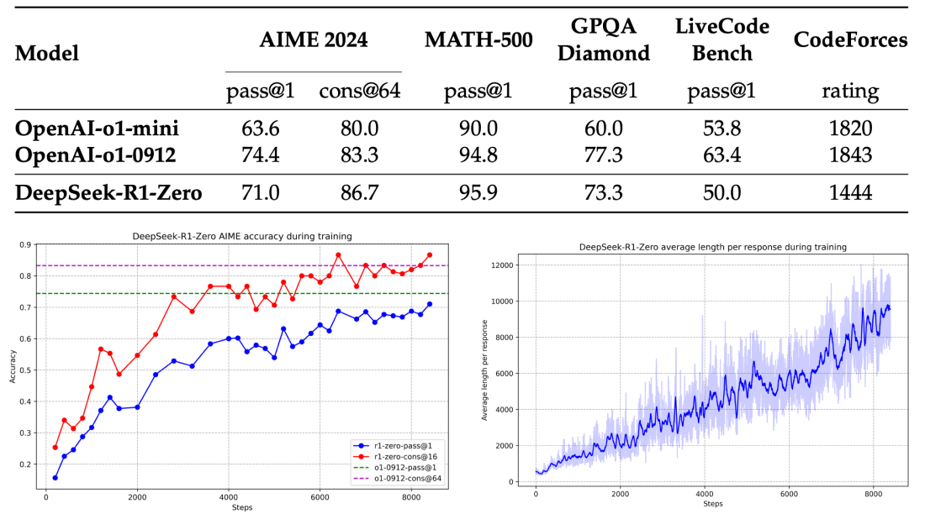
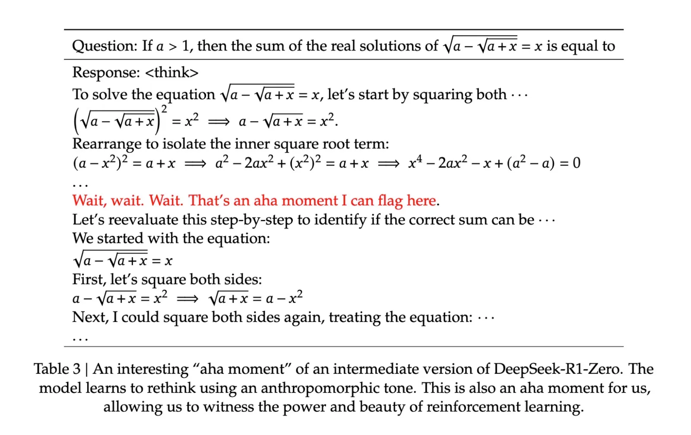
RLVR for Advanced Reasoning
Deepseek-R1 demonstrates the great potential of RL with Verifiable Reward (RLVR).
RL training reward is defined by rule-based functions.
Experimental results show continuous improvement and an emerging aha moment with cognitive behaviors, e.g., self-reflection, backtracking.
DeepSeek Team. ” DeepSeek-R1: Incentivizing Reasoning Capability in LLMs via Reinforcement Learning." Nature 2025.

Slide 47
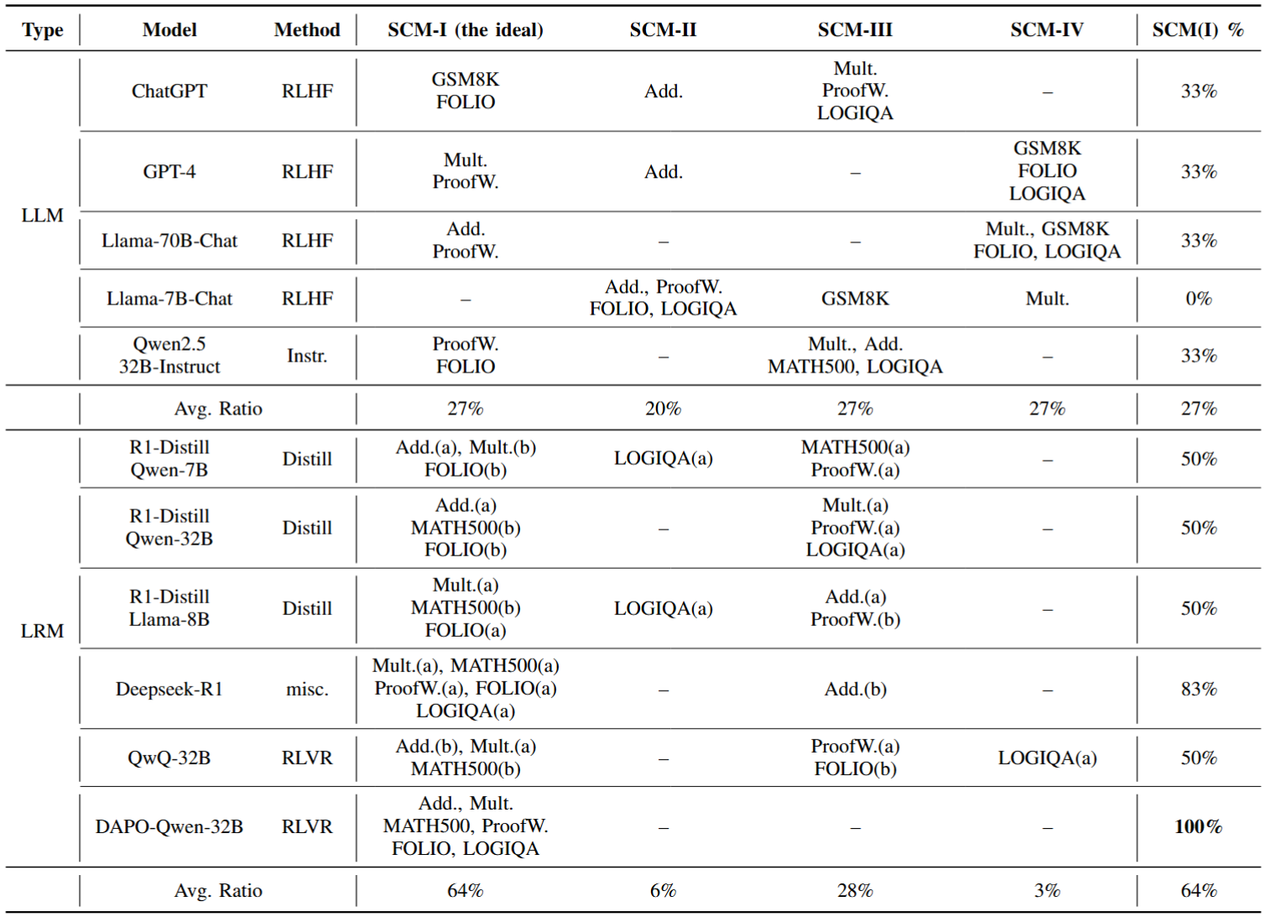
RLVR Enhances Causal Reasoning
RLVR (DAPO) achieves 100% Type-I SCM across all tested math and logical reasoning datasets, demonstrating strongest causality!
Zhizhang Fu, et al. "Correlation or Causation: Analyzing the Causal Structures of LLM and LRM Reasoning Process." arXiv: 2509.17380, 2025

Slide 48
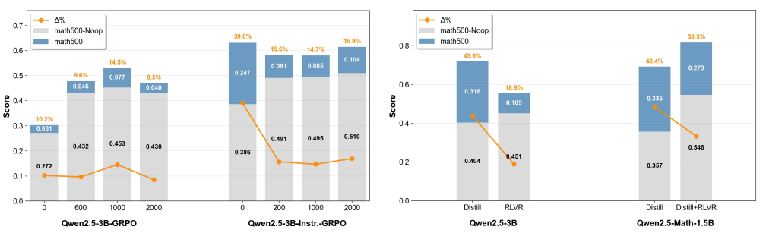
RLVR Enhances Causal Reasoning
Mechanism: RLVR models sample their own outputs during training, reducing reliance on spurious correlations.
Zhizhang Fu, et al. "Correlation or Causation: Analyzing the Causal Structures of LLM and LRM Reasoning Process." arXiv: 2509.17380, 2025

Slide 49
RLVR for Advanced Reasoning - Limitation
RLVR approaches are mainly on-policy, which relies on its own trail and feedback to improve.
However, this framework is inherently limited by models’ own capabilities.
Spurious correlations in correct results are reinforced.
To address this challenge, we first introduce off-policy guidance within the RL process. Use a teaching to inject a more causal reasoning sequence.

Slide 50
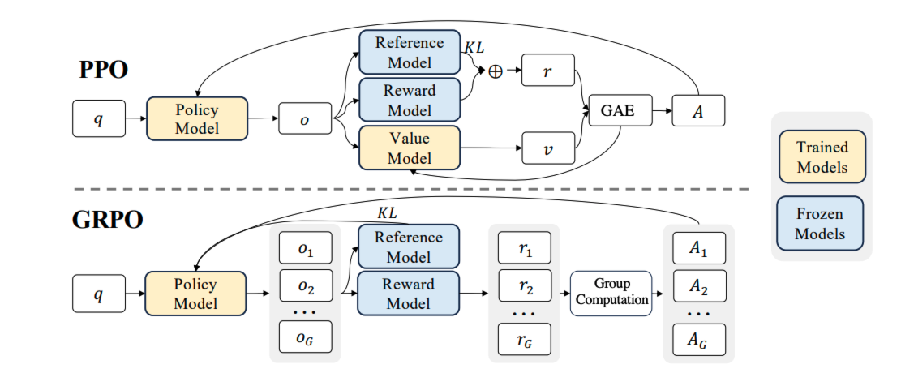
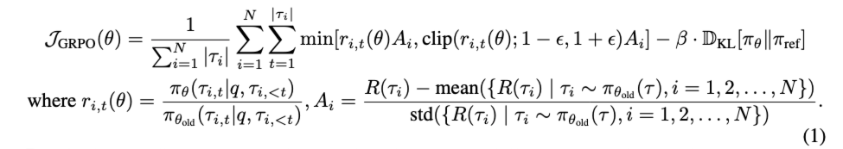
Background - GRPO
Clipped Surrogate Loss
GRPO vs PPO Figure from DeepSeekMath: Pushing the Limits of Mathematical Reasoning in Open Language Models[7]
Importance Sampling
The current model is Data is generated by
Yan, Jianhao, et al. ” Learning to Reason under Off-Policy Guidance." NeurIPS 2025.

Slide 51
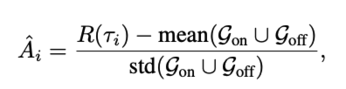
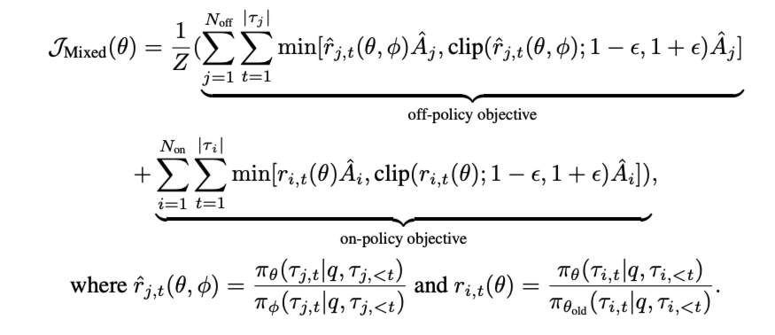

LUFFY– Mixed-Policy GRPO
Mix off-policy rollout into group advantage computation.
Add another importance sampling to correct the policy gradient.
Off-Policy Objective
Extending GRPO objective
Mix Off-Policy with On-Policy
New importance sampling to correct gradient.
We assume
We remove clip
Yan, Jianhao, et al. ” Learning to Reason under Off-Policy Guidance." NeurIPS 2025.

Slide 52
LUFFY - How does Mixed-Policy GRPO perform?
Our findings:
Mixed-Policy GRPO can accelerate RL training.
Training entropy of Mixed-Policy GRPO quickly collapse.
Why?
-> Low-entropy tokens from off-policy trajectories are ignored!!!
Yan, Jianhao, et al. ” Learning to Reason under Off-Policy Guidance." NeurIPS 2025.

Slide 53
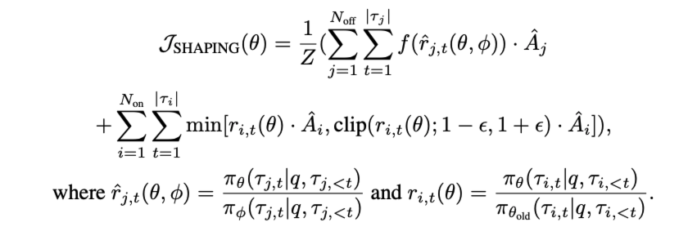
LUFFY–Policy Shaping
We propose a policy shaping function to amplify low-probability tokens.
Change importance sampling r -> f(r)!
Yan, Jianhao, et al. ” Learning to Reason under Off-Policy Guidance." NeurIPS 2025.

Slide 54
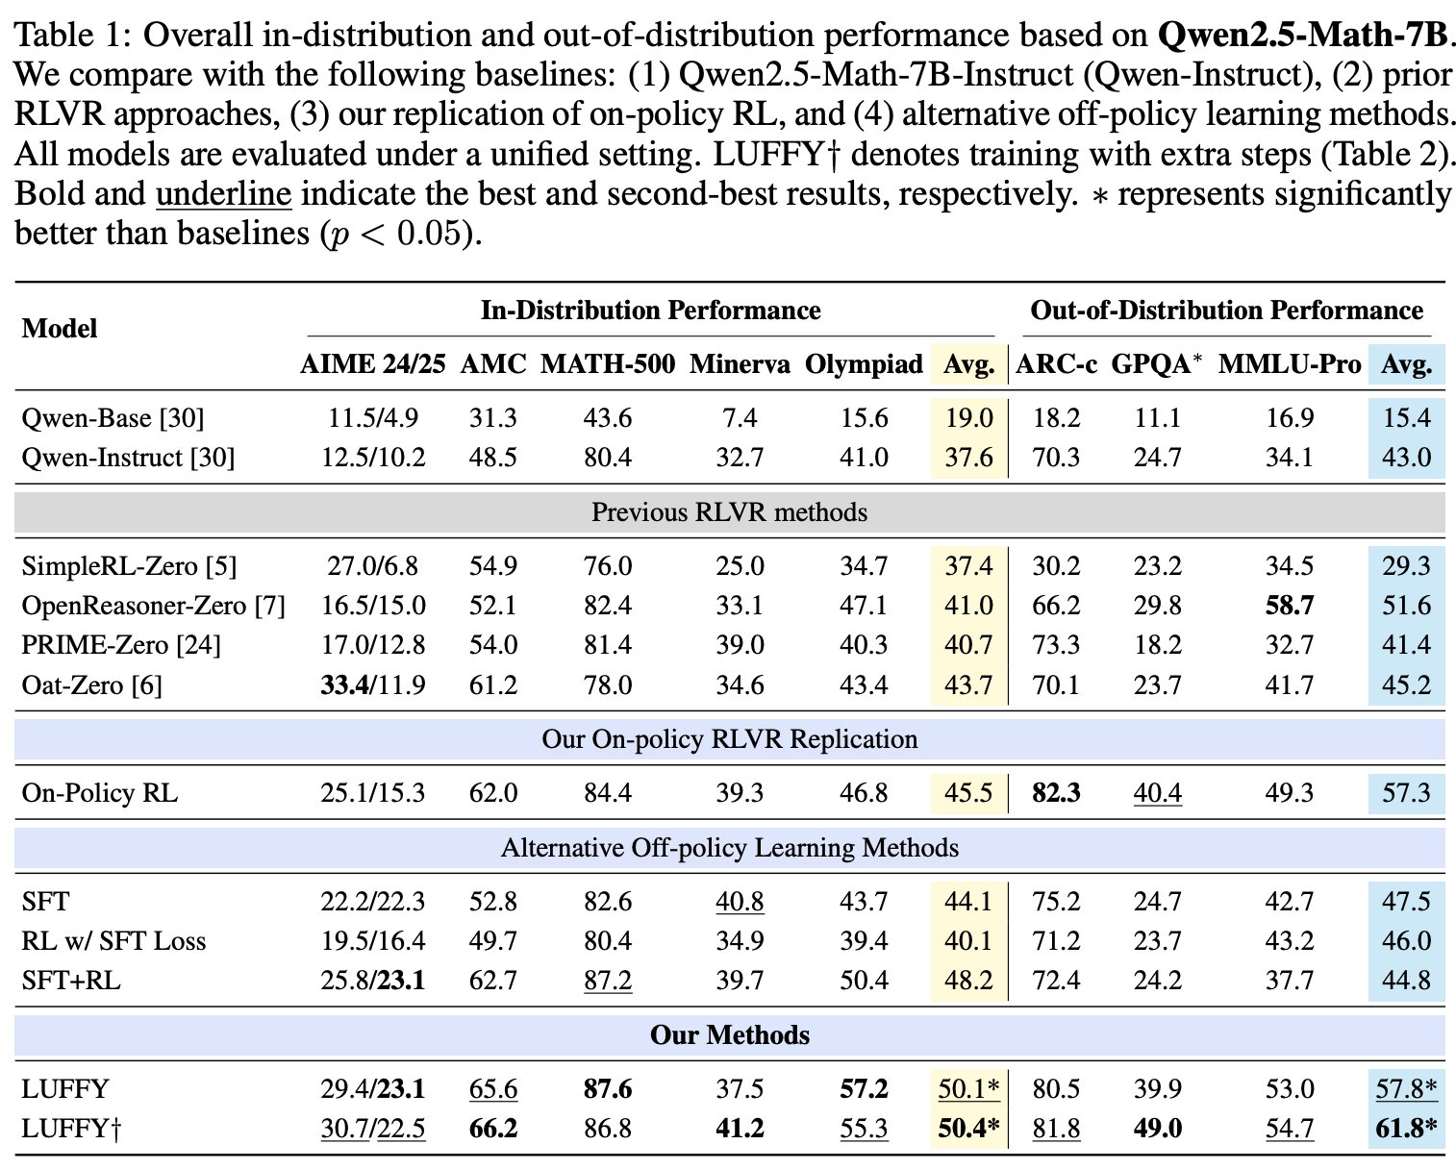
LUFFY - Experiments
Compare to RLVR baselines:
LUFFY achieves SOTA performance on RLVR with Qwen2.5-Math-7B.
Yan, Jianhao, et al. ” Learning to Reason under Off-Policy Guidance." NeurIPS 2025.

Slide 55
LUFFY - Experiments
Better OOD generalization, why?
Model learns generalizable feature from RL. (On-Policy RL)
SFT injects external knowledge but model suffers from catastrophic forgetting. (SFT & RL w/ SFT loss)
LUFFY combines the advantage of both.
Yan, Jianhao, et al. ” Learning to Reason under Off-Policy Guidance." NeurIPS 2025.

Slide 56
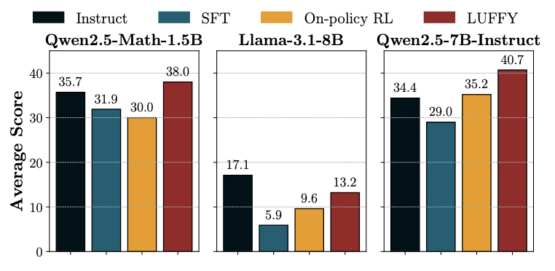
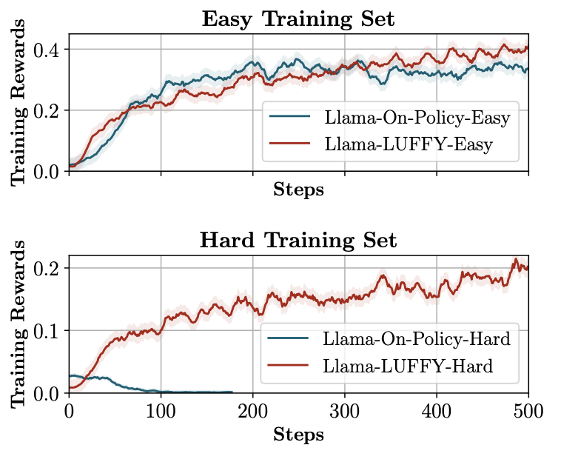
LUFFY - Experiments
LUFFY can be applied to other base models (Qwen2.5-Math-1.5B, Llama-3.1-8B, Qwen2.5-7B-Instruct).
LUFFY succeeds when on-policy RLVR fails.
RLVR fails with Llama3.1-8B in Hard Training set, while LUFFY succeeds.
Yan, Jianhao, et al. ” Learning to Reason under Off-Policy Guidance." NeurIPS 2025.

Slide 57
Conclusion
Causal reasoning is intrinsically linked to OOD generalization
Large language models show different reasoning mechanism from human cognition
Causal theory may bring some solutions

Slide 58
Q&A

Slide 59


Slide 60
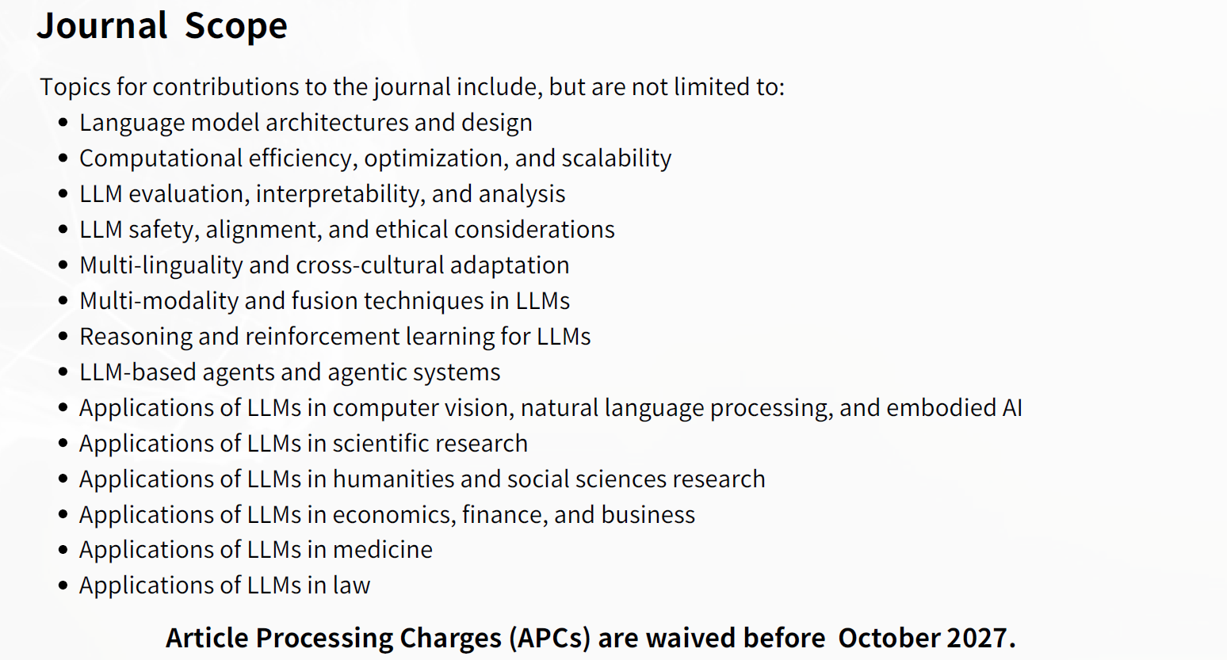

Slide 61


