Slide 1

Natural Language Processing
Yue Zhang
Westlake University

Slide 2
Chapter 10
Predicting Tree Structures

Slide 3
Contents
10.1 Generative Constituent Parsing
10.1.1 Probabilistic Context Free Grammar
10.1.2 CKY Decoding
10.1.3 Evaluating Constituent Parser Outputs
10.1.4 Calculating Marginal Probabilities
10.2 More Features for Constituent Parsing
10.2.1 Lexicalized PCFGs
10.2.2 Discriminative Linear Models for Constituent Parsing
10.2.3 Training Log-linear Models for Constituent Parsing
10.2.4 Training Large Margin Models for Constituent Parsing
10.3 Reranking
10.4 Beyond Sequences and Trees

Slide 4
Contents
10.1 Generative Constituent Parsing
10.1.1 Probabilistic Context Free Grammar
10.1.2 CKY Decoding
10.1.3 Evaluating Constituent Parser Outputs
10.1.4 Calculating Marginal Probabilities
10.2 More Features for Constituent Parsing
10.2.1 Lexicalized PCFGs
10.2.2 Discriminative Linear Models for Constituent Parsing
10.2.3 Training Log-linear Models for Constituent Parsing
10.2.4 Training Large Margin Models for Constituent Parsing
10.3 Reranking
10.4 Beyond Sequences and Trees

Slide 5
Generative Constituent Parsing
Input: Here are the net contributions of the experts.
Output:

Slide 6
Generative Constituent Parsing
Input: Here are the net contributions of the experts.
Output: A constituent tree represented by a bracketed structure.
(S (ADVP (RB “Here”))
(VP (VBP “are”))
(NP
(NP (DT “the”) (JJ “net”) (NNS “contributions”)))
(PP (IN “of”)(NP (DT “the”) (NNS “experts”))))
(. “.”))

Slide 7
Generative Constituent Parsing
Constituent tree binarization
Necessary for some common algorithms (e.g. CKY; shift-reduce)
Modes of binarization
Left-binarization
Right-binarization
Head-binarization

Slide 8
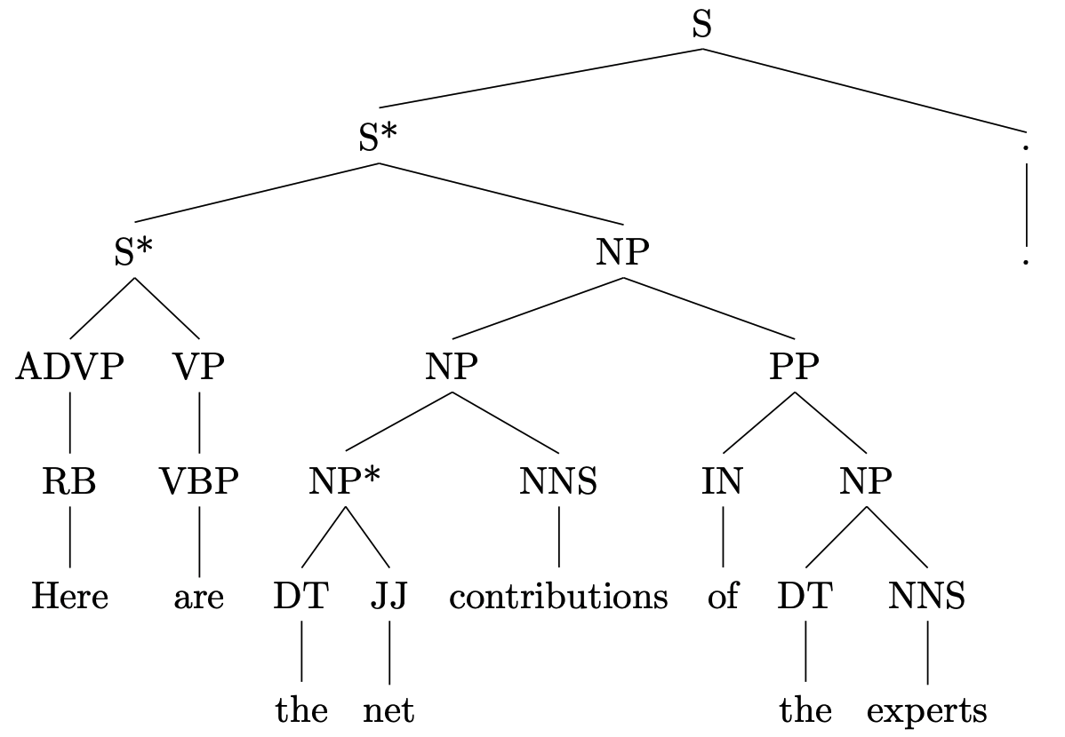
Generative Constituent Parsing
Constituent tree binarization
Left-binarization
Right-binarization
Head-binarization
Original tree
Left-binarization
Notes:
Figure left-bin incorrect

Slide 9
Generative Constituent Parsing
Constituent tree binarization
Left-binarization
Right-binarization
Head-binarization
Original tree
Right-binarization

Slide 10
Generative Constituent Parsing
Constituent tree binarization
Left-binarization
Right-binarization
Head-binarization
Original tree
Head-binarization

Slide 11
Contents
10.1 Generative Constituent Parsing
10.1.1 Probabilistic Context Free Grammar
10.1.2 CKY Decoding
10.1.3 Evaluating Constituent Parser Outputs
10.1.4 Calculating Marginal Probabilities
10.2 More Features for Constituent Parsing
10.2.1 Lexicalized PCFGs
10.2.2 Discriminative Linear Models for Constituent Parsing
10.2.3 Training Log-linear Models for Constituent Parsing
10.2.4 Training Large Margin Models for Constituent Parsing
10.3 Reranking
10.4 Beyond Sequences and Trees

Slide 12
Probabilistic Context Free Grammar
Derivation

Slide 13
Probabilistic Context Free Grammar
Derivation

Slide 14
Probabilistic Context Free Grammar
Derivation

Slide 15
Probabilistic Context Free Grammar
Derivation

Slide 16
Probabilistic Context Free Grammar
Derivation

Slide 17
Probabilistic Context Free Grammar
Derivation

Slide 18
Probabilistic Context Free Grammar
Derivation

Slide 19
Probabilistic Context Free Grammar
Derivation

Slide 20
Probabilistic Context Free Grammar
Derivation

Slide 21
Probabilistic Context Free Grammar
Derivation

Slide 22
Probabilistic Context Free Grammar
Derivation

Slide 23
Probabilistic Context Free Grammar
Derivation

Slide 24
Probabilistic Context Free Grammar
Derivation

Slide 25
Probabilistic Context Free Grammar
Derivation

Slide 26
Probabilistic Context Free Grammar
Derivation

Slide 27
Probabilistic Context Free Grammar
Context Free Grammars (CFG)
Formally, a CFG is a 4-tuple: <N,Σ,R,S>.
N: the set of non-terminals (i.e. A,B,C,…)
Σ: the set of terminals (i.e. α,β,γ,…)
R: the set of production rules (i.e. A->BC, A->γ,…)
S: the start symbol

Slide 28
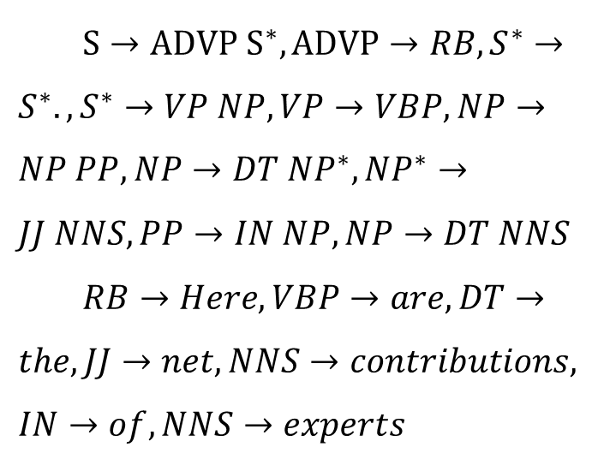
Probabilistic Context Free Grammar
Derivation
A sequence of rule applications that transforms a non-terminal node into a string is called a derivation.
$S→ADVP S^{∗},ADVP→RB,S^{∗}→S^{∗}.,S^{∗}→VP NP,VP→VBP,NP→NP PP,NP→DT NP^{∗},NP^{∗}→JJ NNS, PP→IN NP,NP→DT NNS$
$RB→Here, VBP→are,DT→the, JJ→net, NNS→contributions, IN→of, NNS→experts$

Slide 29
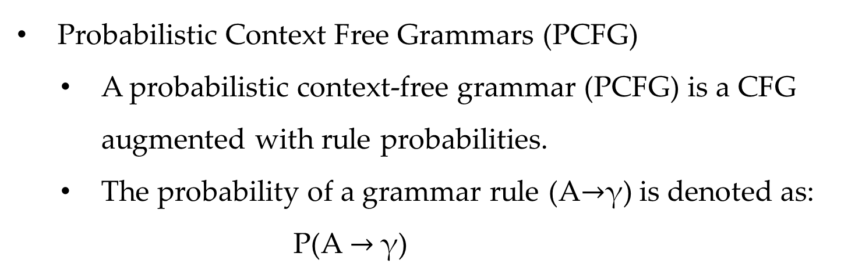
Probabilistic Context Free Grammar
Probabilistic Context Free Grammars (PCFG)
A probabilistic context-free grammar (PCFG) is a CFG augmented with rule probabilities.
The probability of a grammar rule (A$→$γ) is denoted as:
P(A $→$γ)

Slide 30
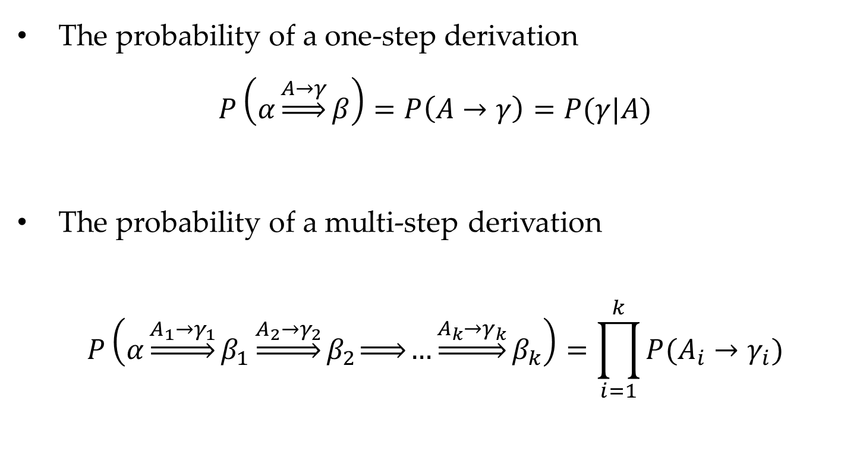
Probabilistic Context Free Grammar
The probability of a one-step derivation
$$P\left(α\underset{⇒}{A→γ}β\right)=P\left(A→γ\right)=P(γ|A)$$
The probability of a multi-step derivation
$$P\left(α\underset{⇒}{A_{1}→γ_{1}}β_{1}\underset{⇒}{A_{2}→γ_{2}}β_{2}\underset{⇒}{ }…\underset{⇒}{A_{k}→γ_{k}}β_{k}\right)=\prod_{i=1}^{k}{P(A_{i}→γ_{i})}$$

Slide 31
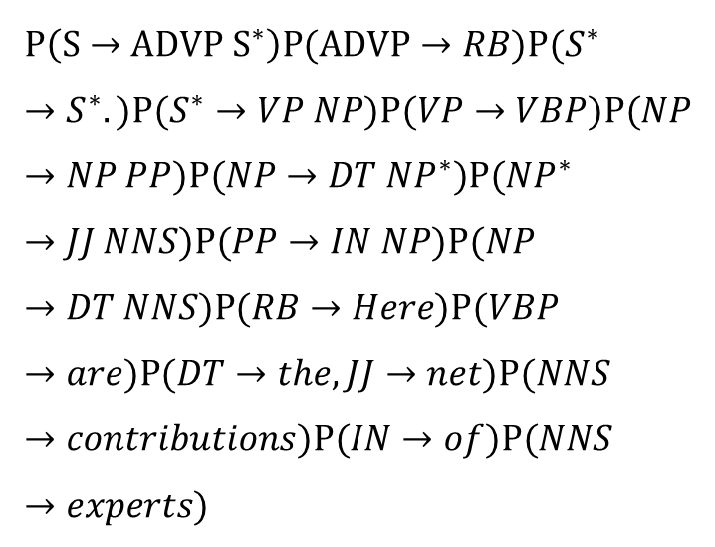
Probabilistic Context Free Grammar
P(S => Here are the net contributions of the experts .) is:
$$P\left(S→ADVP S^{∗}\right)P(ADVP→RB)P(S^{∗}→S^{∗}.)P(S^{∗}→VP NP)P(VP→VBP)P(NP→NP PP)P(NP→DT NP^{∗})P(NP^{∗}→JJ NNS)P(PP→IN NP)P(NP→DT NNS)P(RB→Here)P(VBP→are)P(DT→the, JJ→net)P(NNS→contributions)P(IN→of)P(NNS→experts)$$

Slide 32
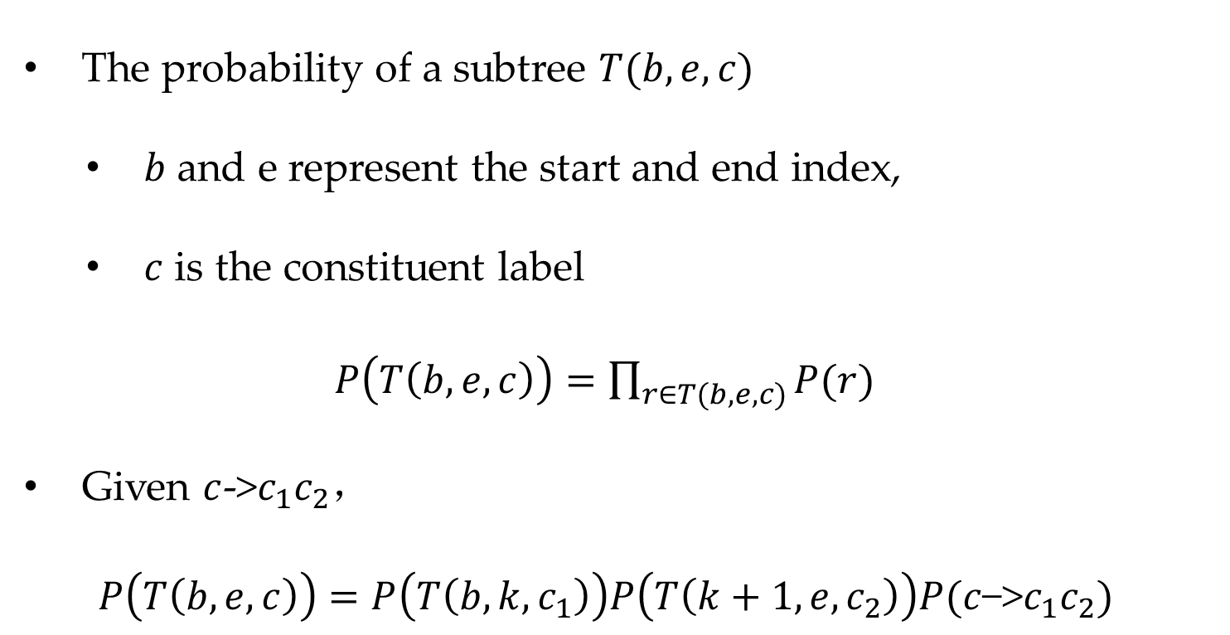

Probabilistic Context Free
Grammar
The probability of a subtree $T(b,e,c)$
$b$ and e represent the start and end index,
$c$ is the constituent label
$P\left(T\left(b,e,c\right)\right)=\prod_{r∈T(b,e,c)}{P(r)}$
Given $c$->$c_{1}c_{2}$，
$P\left(T\left(b,e,c\right)\right)=P\left(T\left(b,k,c_{1}\right)\right)P\left(T\left(k+1,e,c_{2}\right)\right)P(c\text{−>}c_{1}c_{2})$
$$T(3,5,NP)$$

Slide 33
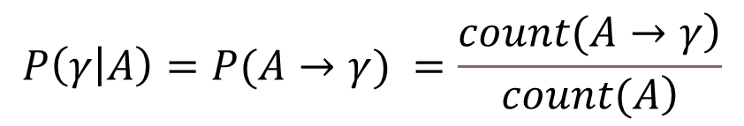
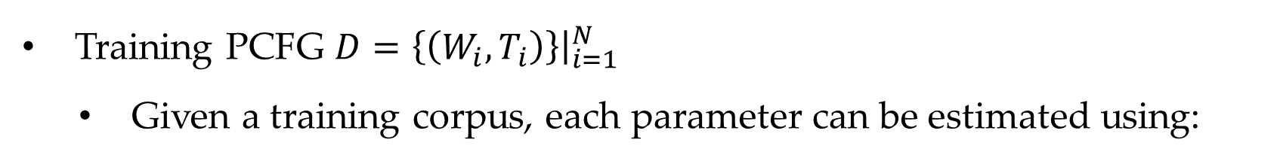
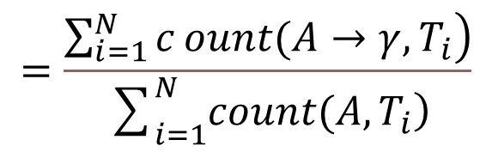
Probabilistic Context Free Grammar
Training PCFG $D=\left\{\left(W_{i},T_{i}\right)\right\}{\left.​\right|}_{i=1}^{N}$
Given a training corpus, each parameter can be estimated using:
$$P\left(γ | A\right)=P(A→γ) =\frac{\left.count(A→γ\right)}{\left.count(A\right)}$$
$$=\frac{\left.\sum_{i=1}^{N}{c}ount(A→γ,T_{i}\right)}{\sum_{i=1}^{N}{\left.count(A,T_{i}\right)}}$$

Slide 34
Contents
10.1 Generative Constituent Parsing
10.1.1 Probabilistic Context Free Grammar
10.1.2 CKY Decoding
10.1.3 Evaluating Constituent Parser Outputs
10.1.4 Calculating Marginal Probabilities
10.2 More Features for Constituent Parsing
10.2.1 Lexicalized PCFGs
10.2.2 Discriminative Linear Models for Constituent Parsing
10.2.3 Training Log-linear Models for Constituent Parsing
10.2.4 Training Large Margin Models for Constituent Parsing
10.3 Reranking
10.4 Beyond Sequences and Trees

Slide 35
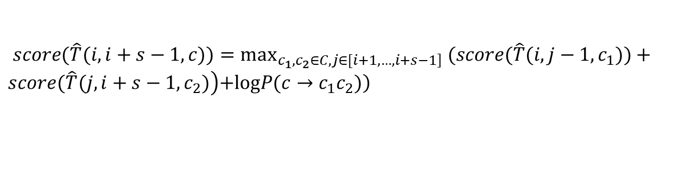
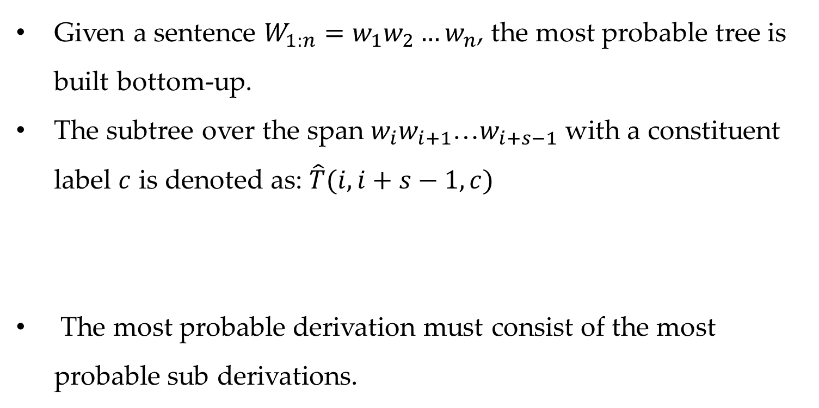
CKY Decoding
Given a sentence $W_{1:n}=w_{1}w_{2}…w_{n}$, the most probable tree is built bottom-up.
The subtree over the span $w_{i}w_{i+1}$…$w_{i+s−1}$ with a constituent label $c$ is denoted as: $\hat{T}(i,i+s−1,c)$
The most probable derivation must consist of the most probable sub derivations.
$\left.score(\hat{T}(i,i+s−1,c))=\max_{\left.c_{1},c_{2}∈C,j∈[i+1,…,i+s−1\right]} (score(\hat{T}(i,j−1,c_{1}))+score(\hat{T}(j,i+s−1, c_{2})\right)\left.+logP(c→c_{1}c_{2})\right)$

Slide 36
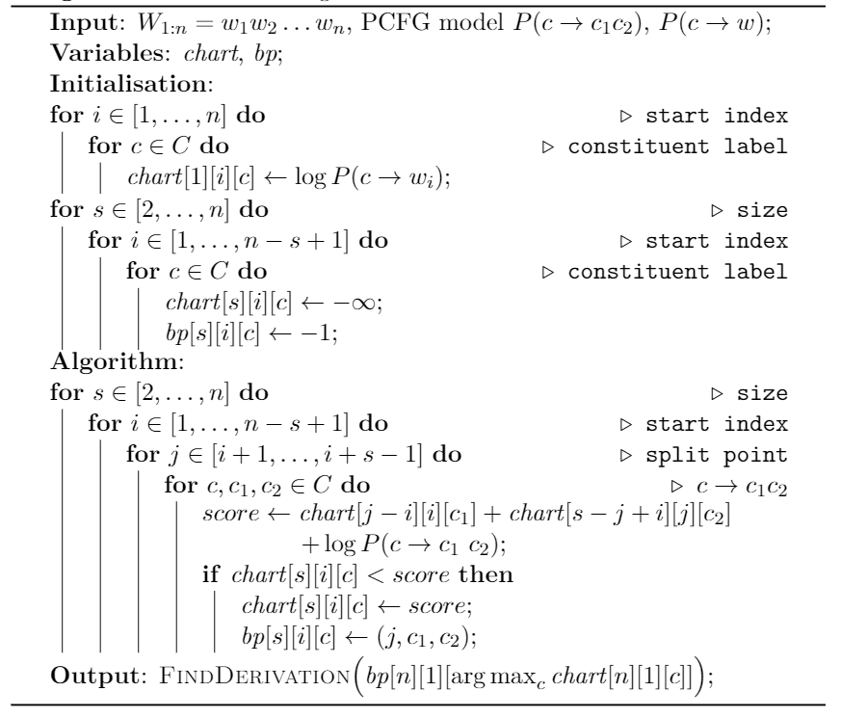
CKY Decoding

Slide 37
Contents
10.1 Generative Constituent Parsing
10.1.1 Probabilistic Context Free Grammar
10.1.2 CKY Decoding
10.1.3 Evaluating Constituent Parser Outputs
10.1.4 Calculating Marginal Probabilities
10.2 More Features for Constituent Parsing
10.2.1 Lexicalized PCFGs
10.2.2 Discriminative Linear Models for Constituent Parsing
10.2.3 Training Log-linear Models for Constituent Parsing
10.2.4 Training Large Margin Models for Constituent Parsing
10.3 Reranking
10.4 Beyond Sequences and Trees

Slide 38



Evaluating Constituent Parser Outputs
Evaluating spans $(b,e,c)$
$$(3, 5, NP)$$
$$\left(1, 1, RB\right)$$
$$(1, 1, ADVP)$$

Slide 39
Evaluating Constituent Parser Outputs
Constituent (b: begin, e: end, c: constituent label)
Precision
the percentage of constituents in the output set that are correct
Recall
the percentage of gold-standard constituents that are identified in the parser output
F-score
2PR/(P+R)
Labeled (b, e, c), unlabeled (b, e).

Slide 40
Contents
10.1 Generative Constituent Parsing
10.1.1 Probabilistic Context Free Grammar
10.1.2 CKY Decoding
10.1.3 Evaluating Constituent Parser Outputs
10.1.4 Calculating Marginal Probabilities
10.2 More Features for Constituent Parsing
10.2.1 Lexicalized PCFGs
10.2.2 Discriminative Linear Models for Constituent Parsing
10.2.3 Training Log-linear Models for Constituent Parsing
10.2.4 Training Large Margin Models for Constituent Parsing
10.3 Reranking
10.4 Beyond Sequences and Trees

Slide 41
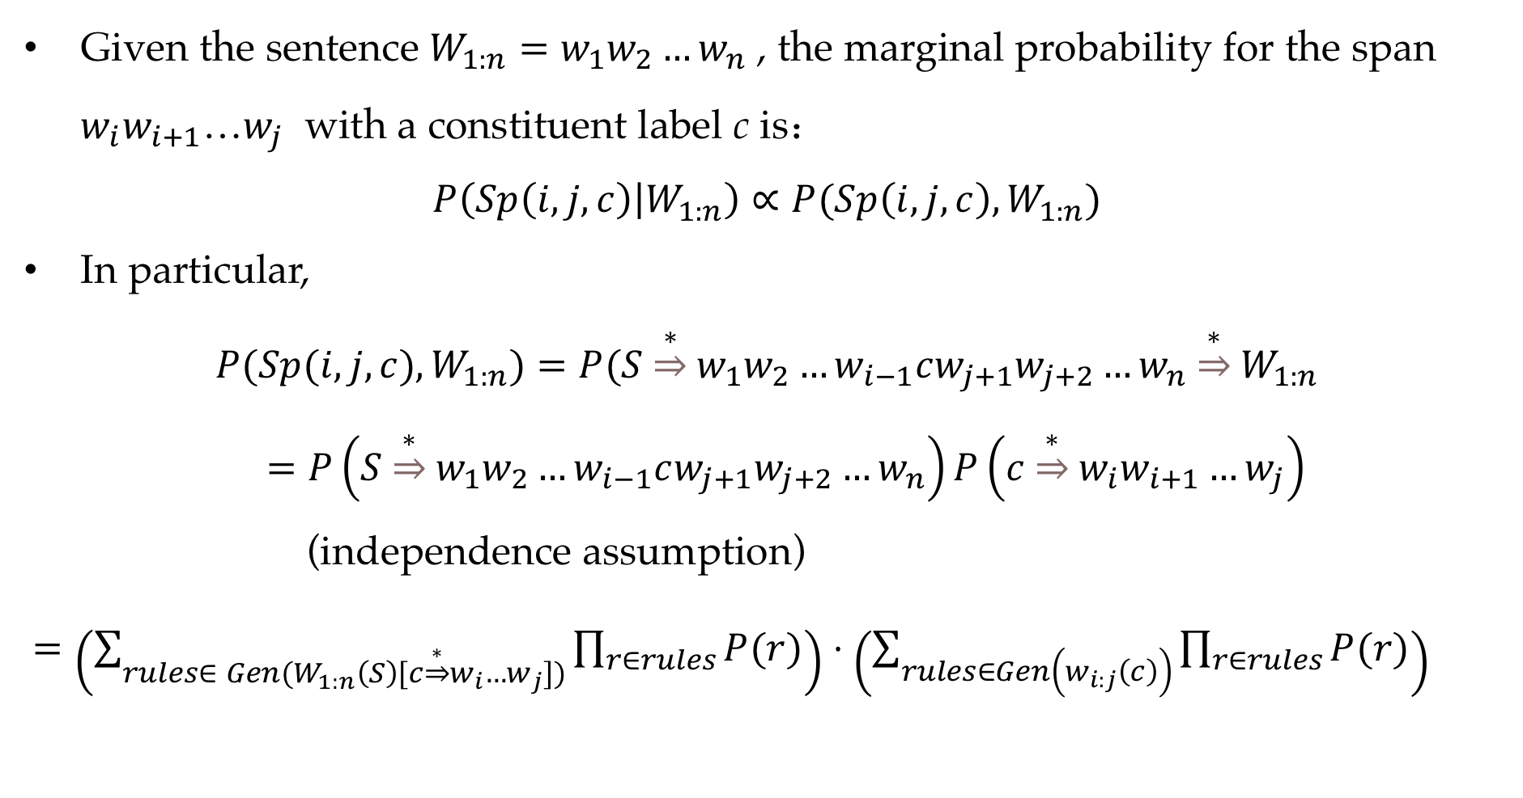
Calculating Marginal Probabilities
Given the sentence $W_{1:n}=w_{1}w_{2}…w_{n}$ , the marginal probability for the span $w_{i}w_{i+1}$…$w_{j}$ with a constituent label c is：
$$P\left(Sp\left(i,j,c\right) | W_{1:n}\right)∝P(Sp\left(i,j,c\right),W_{1:n})$$
In particular,
$$P(Sp(i,j,c),W_{1:n})=P(S\underset{⇒}{∗}w_{1}w_{2}…w_{i−1}cw_{j+1}w_{j+2}…w_{n}\underset{⇒}{∗}W_{1:n}$$
$=P\left(S\underset{⇒}{∗}w_{1}w_{2}…w_{i−1}cw_{j+1}w_{j+2}…w_{n}\right)P\left(c\underset{⇒}{∗}w_{i}w_{i+1}…w_{j}\right)$
(independence assumption)
$=\left(\sum_{rules∈ Gen(W_{1:n}\left(S\right)[c\underset{⇒}{∗}w_{i}…w_{j}])}{\prod_{r∈rules}{P(r)}}\right)⋅\left(\sum_{rules∈Gen\left(w_{i:j}\left(c\right)\right)}{\prod_{r∈rules}{P(r)}}\right)$

Slide 42
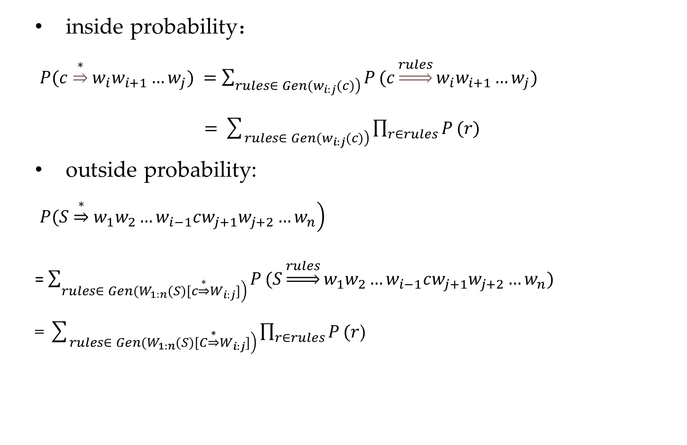
Calculating Marginal Probabilities
inside probability：
$P(c\underset{⇒}{∗}w_{i}w_{i+1}…w_{j}) =\sum_{\left.rules∈ Gen(w_{i:j}(c)\right)}{P}(c\underset{⇒}{rules}w_{i}w_{i+1}…w_{j})$
$=\sum_{\left.rules∈ Gen(w_{i:j}(c)\right)}{\prod_{r∈rules}{P}}(r)$
outside probability:
$\left.P(S\underset{⇒}{∗}w_{1}w_{2}…w_{i−1}cw_{j+1}w_{j+2}…w_{n}\right)$ =$\sum_{\left.rules∈ Gen(W_{1:n}(S)[c\underset{⇒}{∗}W_{i:j}]\right)}{P}(S\underset{⇒}{rules}w_{1}w_{2}…w_{i−1}cw_{j+1}w_{j+2}…w_{n})$
= $\sum_{\left.rules∈ Gen(W_{1:n}(S)[C\underset{⇒}{∗}W_{i:j}]\right)}{\prod_{r∈rules}{P}}(r$)

Slide 43
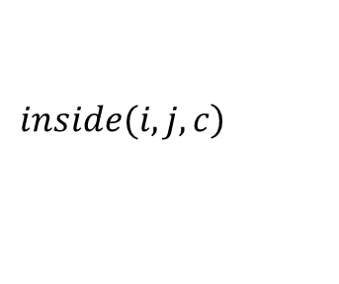
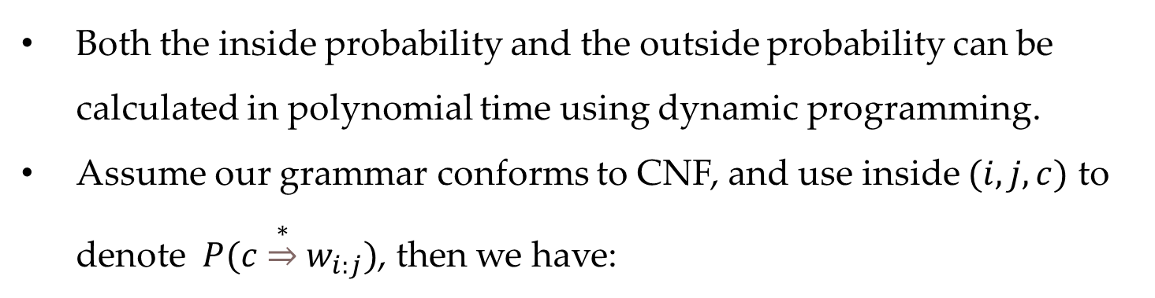
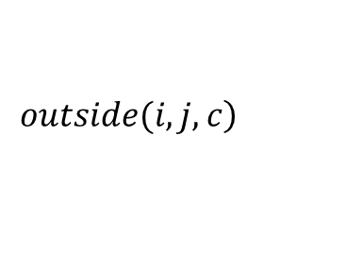
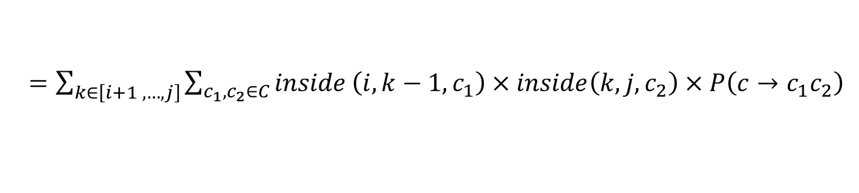
Calculating Marginal Probabilities
Both the inside probability and the outside probability can be calculated in polynomial time using dynamic programming.
Assume our grammar conforms to CNF, and use inside $(i,j,c)$ to denote $P(c\underset{⇒}{∗}w_{i:j})$, then we have:
$$\left.inside(i,j,c\right)$$
$=\sum_{k∈\left[i+1 ,…,j\right]}{\sum_{c_{1},c_{2}∈C}{inside}\left(i,k−1,c_{1}\right)×inside\left(k,j,c_{2}\right)×P\left(c→c_{1}c_{2}\right)}$
$$\left.outside(i,j,c\right)$$
$$=\sum_{k∈\left[j+1,…,n\right]}{\sum_{c^{′},c_{2}∈C}{outside}(i,k,c^{′})×inside(j+1,k,c_{2})×P(c^{′}→cc_{2})}$$
$$+\sum_{k∈\left[1,…,i−1\right]}{\sum_{c^{′},c_{2}∈C}{outside}(k,j,c^{′})×inside(k,i−1,c_{2})×P(c^{′}→c_{2}c)}$$

Slide 44
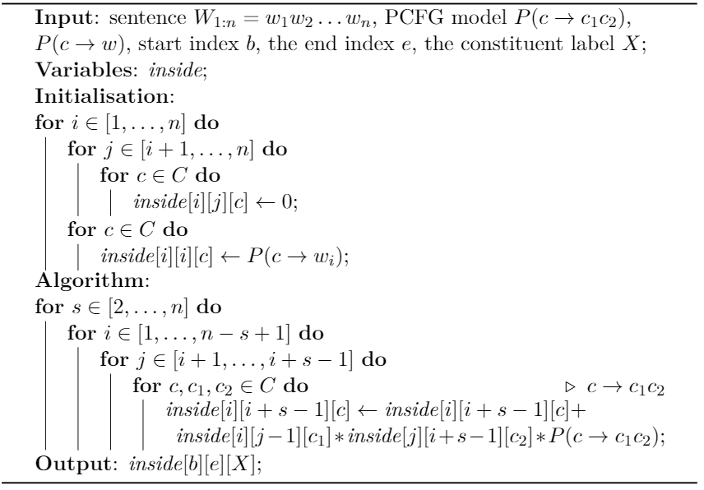
Inside algorithm

Slide 45
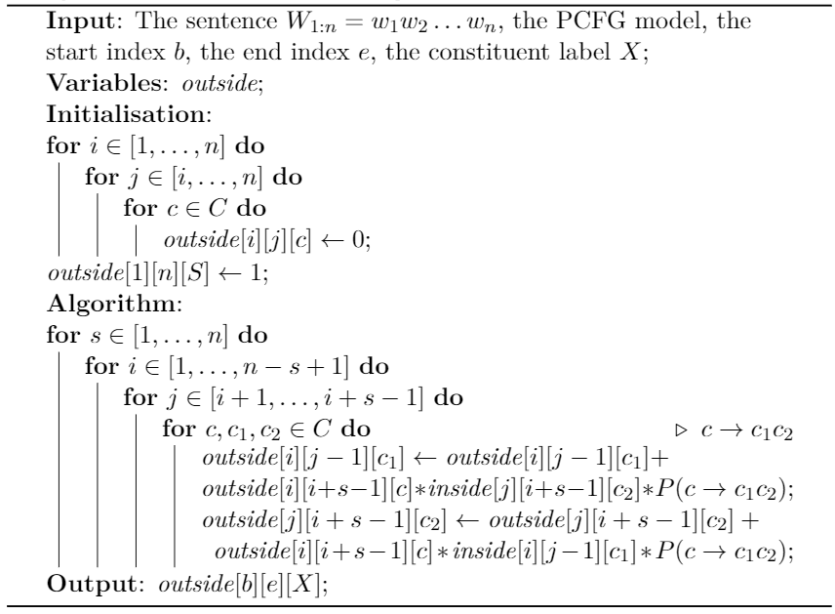
Outside algorithm

Slide 46
Contents
10.1 Generative Constituent Parsing
10.1.1 Probabilistic Context Free Grammar
10.1.2 CKY Decoding
10.1.3 Evaluating Constituent Parser Outputs
10.1.4 Calculating Marginal Probabilities
10.2 More Features for Constituent Parsing
10.2.1 Lexicalized PCFGs
10.2.2 Discriminative Linear Models for Constituent Parsing
10.2.3 Training Log-linear Models for Constituent Parsing
10.2.4 Training Large Margin Models for Constituent Parsing
10.3 Reranking
10.4 Beyond Sequences and Trees

Slide 47
More Features for Constituent Parsing
The feature set of PCFG is rather simple for disambiguation.
Methods to integrate richer features:
(1). Extend the generative story of PCFGs.
(2). Use a discriminative model to accommodate overlapping features.

Slide 48
Contents
10.1 Generative Constituent Parsing
10.1.1 Probabilistic Context Free Grammar
10.1.2 CKY Decoding
10.1.3 Evaluating Constituent Parser Outputs
10.1.4 Calculating Marginal Probabilities
10.2 More Features for Constituent Parsing
10.2.1 Lexicalized PCFGs
10.2.2 Discriminative Linear Models for Constituent Parsing
10.2.3 Training Log-linear Models for Constituent Parsing
10.2.4 Training Large Margin Models for Constituent Parsing
10.3 Reranking
10.4 Beyond Sequences and Trees

Slide 49
Lexicalized PCFGs
Disambiguation
rule1: VP-->VB NP
rule2: VP-->VB
If V is a transitive verb, it is difficult to decide which rule is better.
Solution
Enrich PCFG constituent labels with lexical information.
e.g. VP[eat] --> VB[eat] NP
VP[eat] --> VB[eat] NP[pizza]

Slide 50
Lexicalized PCFGs
A head-lexicalized constituent tree
Head-binarization
Head-lexicalized version

Slide 51
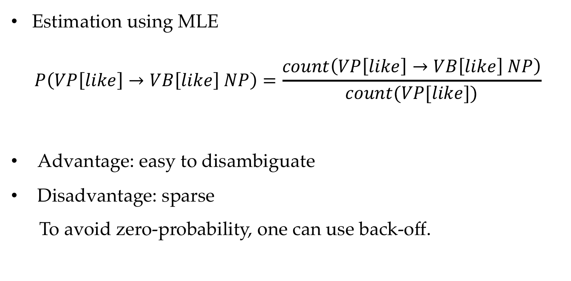
Lexicalized PCFGs
Estimation using MLE
$$P\left(VP\left[like\right]→VB\left[like\right] NP\right)=\frac{count\left(VP\left[like\right]→VB\left[like\right] NP\right)}{count(VP[like])}$$
Advantage: easy to disambiguate
Disadvantage: sparse
To avoid zero-probability, one can use back-off.

Slide 52
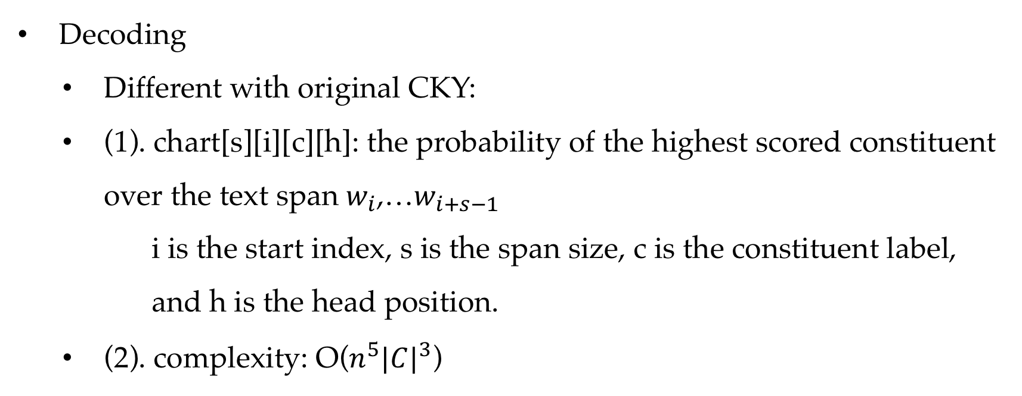
Lexicalized PCFGs
Decoding
Different with original CKY:
(1). chart[s][i][c][h]: the probability of the highest scored constituent over the text span $w_{i}$,…$w_{i+s−1}$
i is the start index, s is the span size, c is the constituent label, and h is the head position.
(2). complexity: O($n^{5}{|C|}^{3}$)

Slide 53
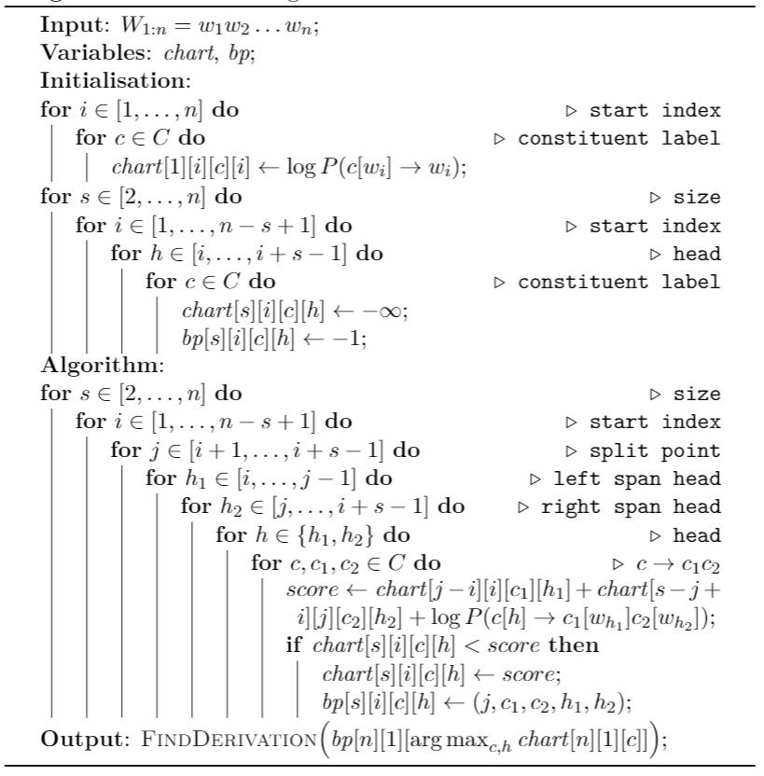
CKY algorithm for head lexicalized PCFG

Slide 54
Contents
10.1 Generative Constituent Parsing
10.1.1 Probabilistic Context Free Grammar
10.1.2 CKY Decoding
10.1.3 Evaluating Constituent Parser Outputs
10.1.4 Calculating Marginal Probabilities
10.2 More Features for Constituent Parsing
10.2.1 Lexicalized PCFGs
10.2.2 Discriminative Linear Models for Constituent Parsing
10.2.3 Training Log-linear Models for Constituent Parsing
10.2.4 Training Large Margin Models for Constituent Parsing
10.3 Reranking
10.4 Beyond Sequences and Trees

Slide 55
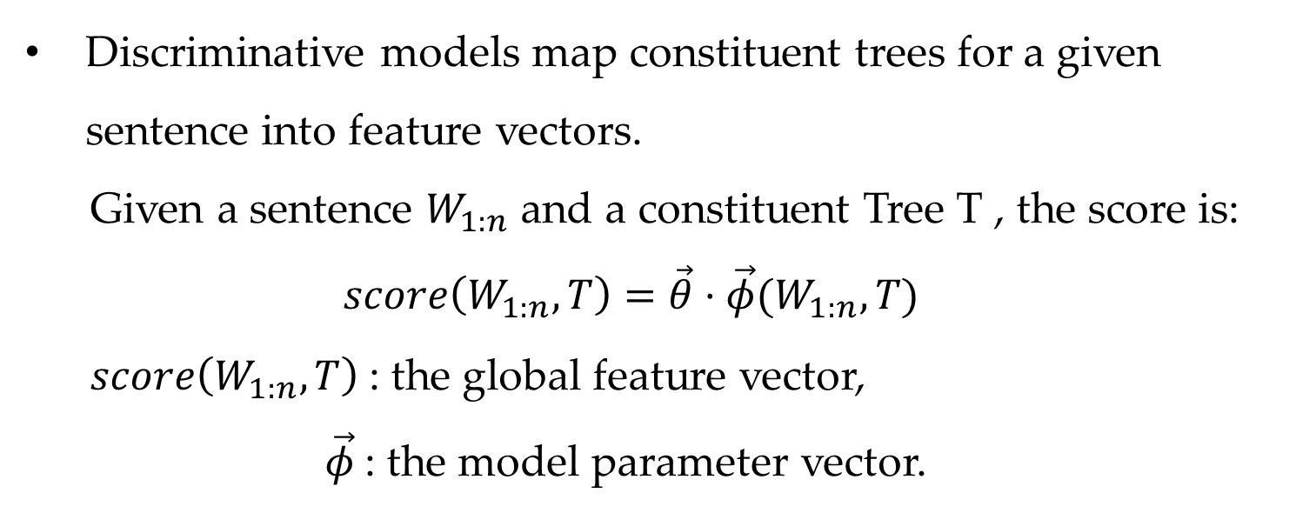
Discriminative Linear Models for Constituent Parsing
Discriminative models map constituent trees for a given sentence into feature vectors.
Given a sentence $W_{1:n}$ and a constituent Tree T , the score is:
$$score\left(W_{1:n},T\right)=\vec{θ}⋅\vec{φ}(W_{1:n},T)$$
$score\left(W_{1:n},T\right)$: the global feature vector,
$\vec{φ}$: the model parameter vector.

Slide 56
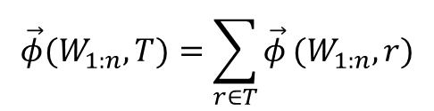
Discriminative Linear Models for Constituent Parsing
Feature Factorization
The global feature vector can be factorized into local feature components,
$$\vec{φ}(W_{1:n},T)=\sum_{r∈T}{\vec{φ}}(W_{1:n},r)$$

Slide 57
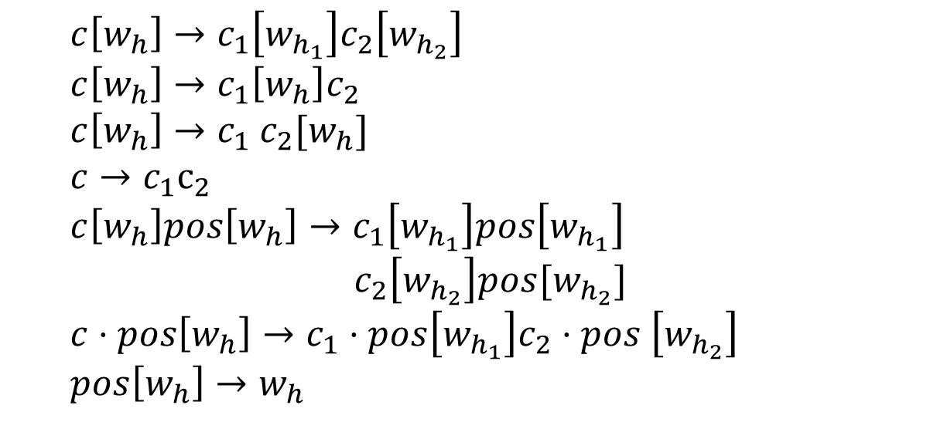
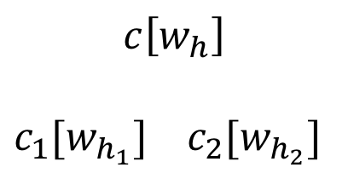
Discriminative Linear Models for Constituent Parsing
Features
$c\left[w_{h}\right]→c_{1}\left[w_{h_{1}}\right]c_{2}\left[w_{h_{2}}\right]$
$c\left[w_{h}\right]→c_{1}\left[w_{h}\right]c_{2}$
$c\left[w_{h}\right]→c_{1} c_{2}[w_{h}]$
$c→c_{1}c_{2}$
$c\left[w_{h}\right]pos\left[w_{h}\right]→c_{1}\left[w_{h_{1}}\right]pos\left[w_{h_{1}}\right]$
$c_{2}\left[w_{h_{2}}\right]pos[w_{h_{2}}]$
$c⋅pos\left[w_{h}\right]→c_{1}⋅pos\left[w_{h_{1}}\right]c_{2}⋅pos \left[w_{h_{2}}\right]$
$pos\left[w_{h}\right]→w_{h}$
$$c\left[w_{h}\right]$$
$c_{1}[w_{h_{1}}]$ $c_{2}[w_{h_{2}}]$

Slide 58
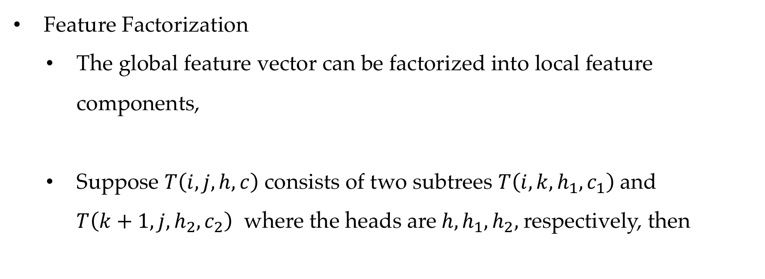
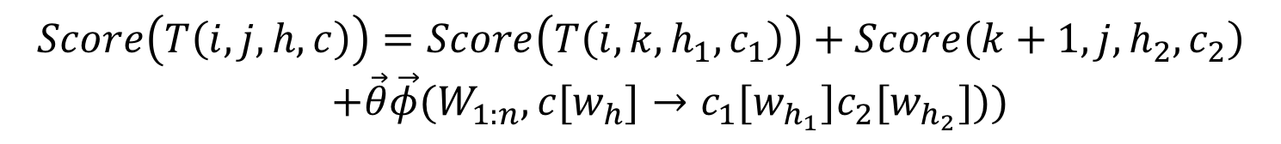
Discriminative Linear Models for Constituent Parsing
Feature Factorization
The global feature vector can be factorized into local feature components,
Suppose $T\left(i,j,h,c\right)$ consists of two subtrees $T\left(i,k,{h_{1},c}_{1}\right)$and $T\left(k+1,j,{h_{2},c}_{2}\right)$ where the heads are$h, h_{1}, h_{2},$respectively, then
$$\vec{φ}(W_{1:n},T)=\sum_{r∈T}{\vec{φ}}(W_{1:n},r)$$
$$Score\left(T\left(i,j,h,c\right)\right)=Score\left(T\left(i,k,{h_{1},c}_{1}\right)\right)+Score\left(k+1,j,{h_{2},c}_{2}\right)$$
$+\vec{θ}\vec{φ}(W_{1:n},c[w_{h}]→c_{1}[w_{h_{1}}]c_{2}[w_{h_{2}}]))$

Slide 59
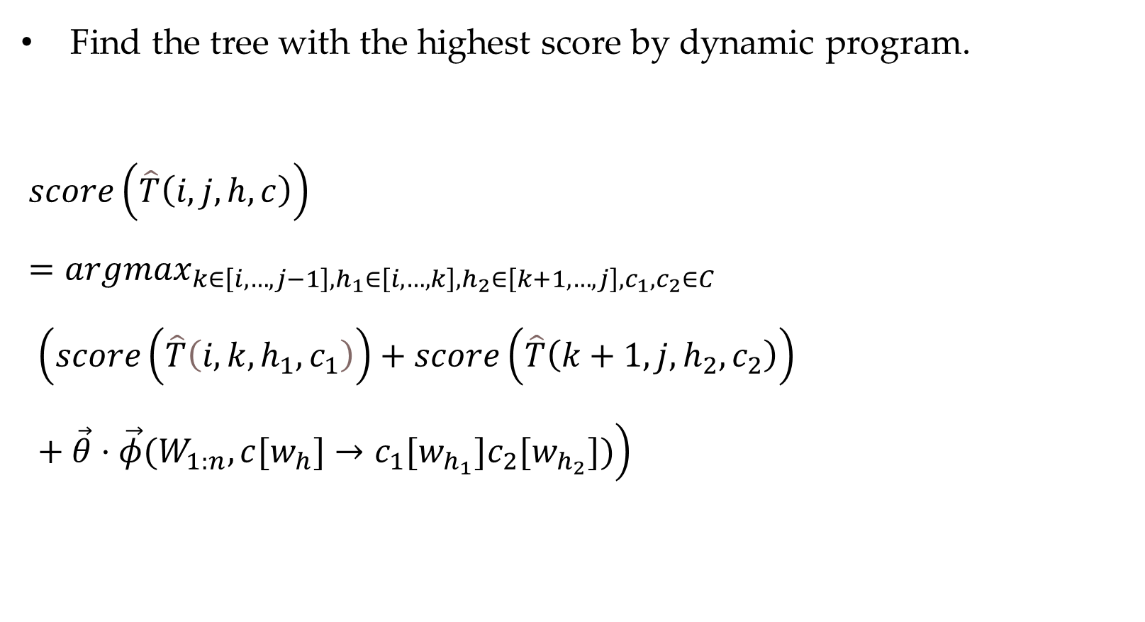
Decoding
Find the tree with the highest score by dynamic program.
$score\left(\hat{T}\left(i,j,h,c\right)\right)$
$=argmax_{k∈\left[i,…,j−1\right],h_{1}∈\left[i,…,k\right],h_{2}∈\left[k+1,…,j\right],c_{1},c_{2}∈C}$
$$\left(score\left(\hat{T}\left(i,k,h_{1},c_{1}\right)\right)+score\left(\hat{T}\left(k+1,j,h_{2},c_{2}\right)\right) +\vec{θ}⋅\vec{φ}(W_{1:n},c[w_{h}]→c_{1}[w_{h_{1}}]c_{2}[w_{h_{2}}])\right)$$

Slide 60
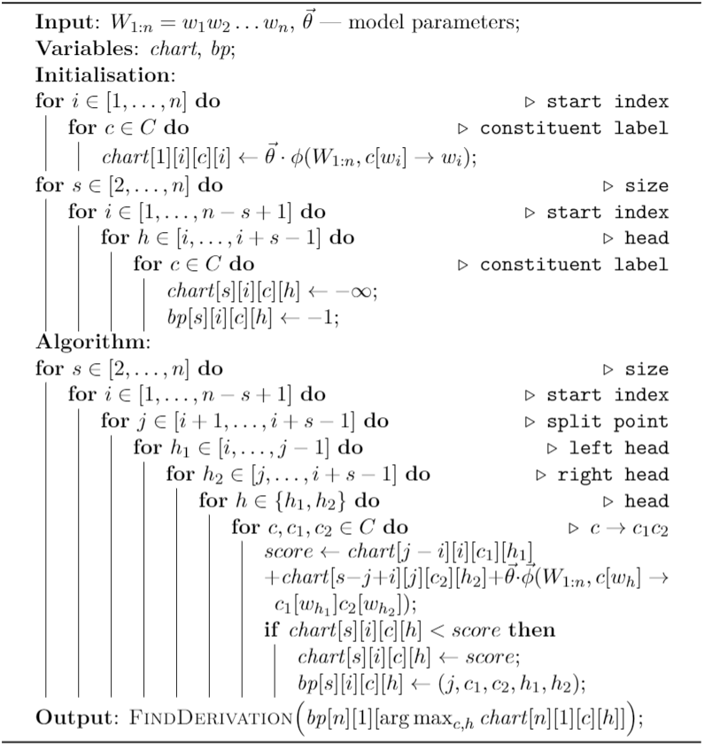
Decoding with CKY

Slide 61
Decoding
Unary rules
Beam search decoding

Slide 62
Contents
10.1 Generative Constituent Parsing
10.1.1 Probabilistic Context Free Grammar
10.1.2 CKY Decoding
10.1.3 Evaluating Constituent Parser Outputs
10.1.4 Calculating Marginal Probabilities
10.2 More Features for Constituent Parsing
10.2.1 Lexicalized PCFGs
10.2.2 Discriminative Linear Models for Constituent Parsing
10.2.3 Training Log-linear Models for Constituent Parsing
10.2.4 Training Large Margin Models for Constituent Parsing
10.3 Reranking
10.4 Beyond Sequences and Trees

Slide 63
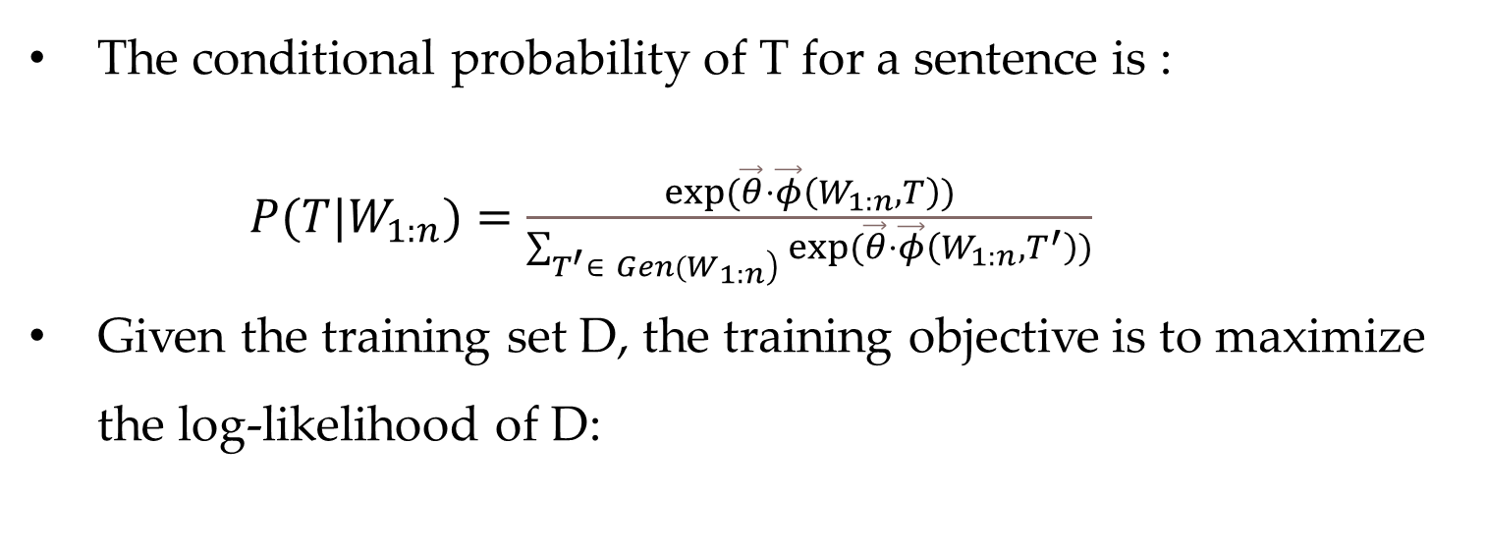
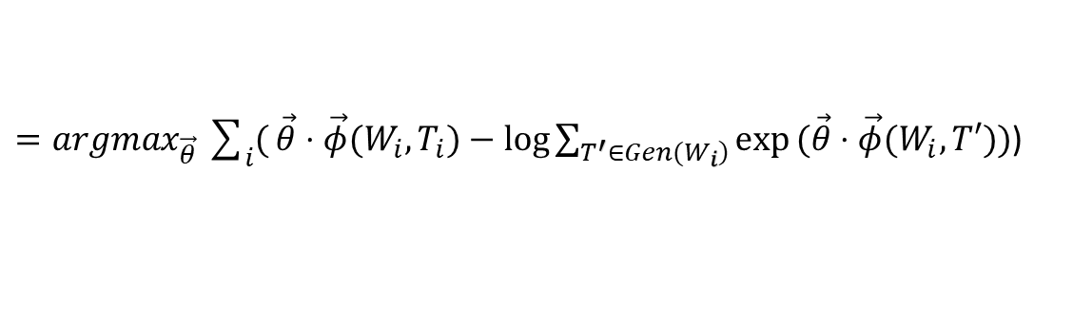
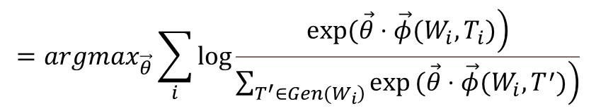
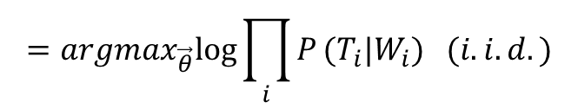

Training Log-linear Models for Constituent Parsing
The conditional probability of T for a sentence is :
$P(T|W_{1:n})=\frac{exp(\vec{θ}⋅\vec{φ}\left(W_{1:n},T\right))}{\sum_{\left.T^{′}∈ Gen(W_{1:n}\right)}{exp}(\vec{θ}⋅\vec{φ}\left(W_{1:n},T^{′}\right))}$
Given the training set D, the training objective is to maximize the log-likelihood of D:
$$\vec{\hat{θ}}=argmax_{\vec{θ}}logP(D)$$
$$=argmax_{\vec{θ}}log\prod_{i}{P}(T_{i}|W_{i}) (i.i.d.)$$
$$=argmax_{\vec{θ}}\sum_{i}{log}\frac{\left.exp(\vec{θ}⋅\vec{φ}(W_{i},T_{i})\right)}{\left.\sum_{\left.T^{′}∈Gen(W_{i}\right)}{exp}(\vec{θ}⋅\vec{φ}(W_{i},T^{′})\right)}$$
$=argmax_{\vec{θ}}\sum_{i}{(}\vec{θ}⋅\vec{φ}(W_{i},T_{i})−log\sum_{\left.T^{′}∈Gen(W_{i}\right)}{exp}(\vec{θ}⋅\vec{φ}(W_{i},T′))$)

Slide 64



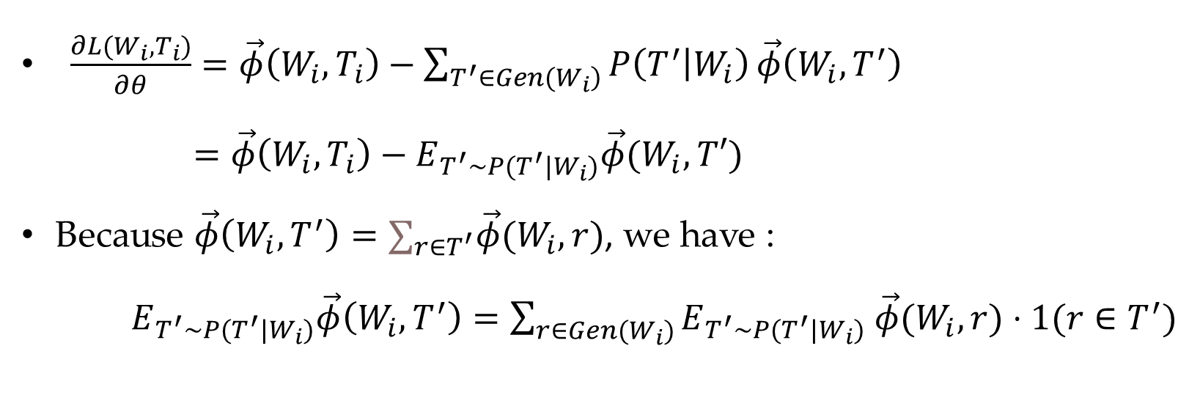



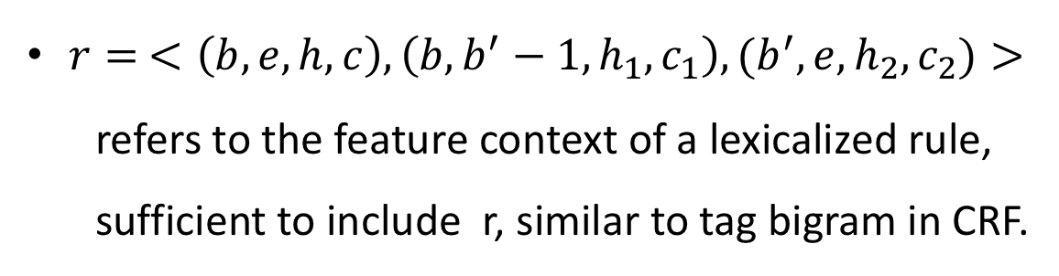
Training Log-linear Models for Constituent Parsing
$\frac{∂L(W_{i},T_{i})}{∂θ}=\vec{φ}\left(W_{i},T_{i}\right)−\sum_{\left.T^{′}∈Gen(W_{i}\right)}{P\left(T^{′} | W_{i}\right)}\vec{φ}\left(W_{i},T^{′}\right)$
$=\vec{φ}\left(W_{i},T_{i}\right)−E_{T^{′}\sim P(T^{′}|W_{i})}\vec{φ}(W_{i},T′)$
Because $\vec{φ}\left(W_{i},T^{′}\right)=∑_{r∈T^{′}}\vec{φ}(W_{i},r)$, we have :
$E_{T^{′}\sim P(T^{′}|W_{i})}\vec{φ}\left(W_{i},T^{′}\right)=\sum_{r∈Gen(W_{i})}{E_{T^{′}\sim P(T^{′}|W_{i})}}$ $\vec{φ}(W_{i},r)⋅1(r∈T^{′})$
$r= <\left(b,e,h,c\right),\left(b,b^{′}−1,h_{1}, c_{1}\right),(b^{′},e,h_{2},c_{2})>$
refers to the feature context of a lexicalized rule, sufficient to include r, similar to tag bigram in CRF.
$$c$$
$$c_{1}$$
$$c_{2}$$
$$b$$
$$b^{′}$$
$$e$$

Slide 65
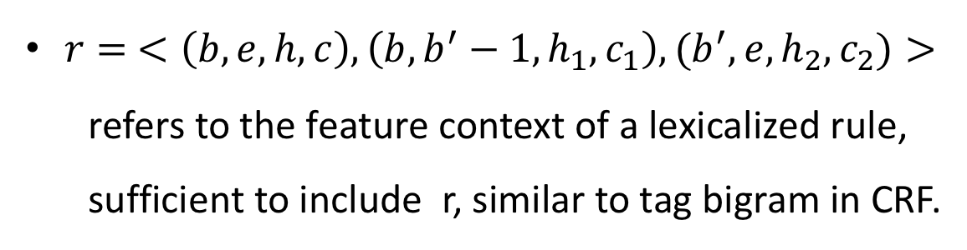
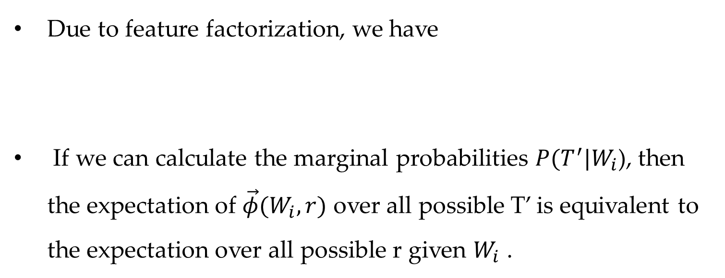
Training Log-linear Models for Constituent Parsing
Due to feature factorization, we have
If we can calculate the marginal probabilities $P(T^{′}|W_{i}$), then the expectation of $\vec{φ}(W_{i},r)$ over all possible T’ is equivalent to the expectation over all possible r given $W_{i}$ .
$\sum_{\left.r∈GenR(W_{i}\right)}{E_{\left.T^{′}\sim P(T^{′}|W_{i}\right)}}(\vec{φ}(W_{i},r)⋅1(r∈T^{′}))=\sum_{\left.r∈GenR(W_{i}\right)}{E_{\left.r\sim P(r|W_{i}\right)}}\vec{φ}(W_{i},r)$
$$c$$
$r= <\left(b,e,h,c\right),\left(b,b^{′}−1,h_{1}, c_{1}\right),(b^{′},e,h_{2},c_{2})>$
refers to the feature context of a lexicalized rule, sufficient to include r, similar to tag bigram in CRF.
$$c_{1}$$
$$c_{2}$$
$$b$$
$$b^{′}$$
$$e$$

Slide 66

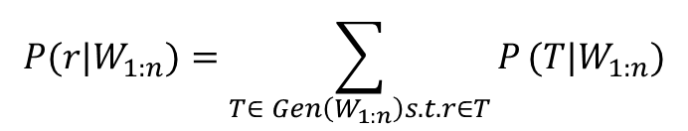

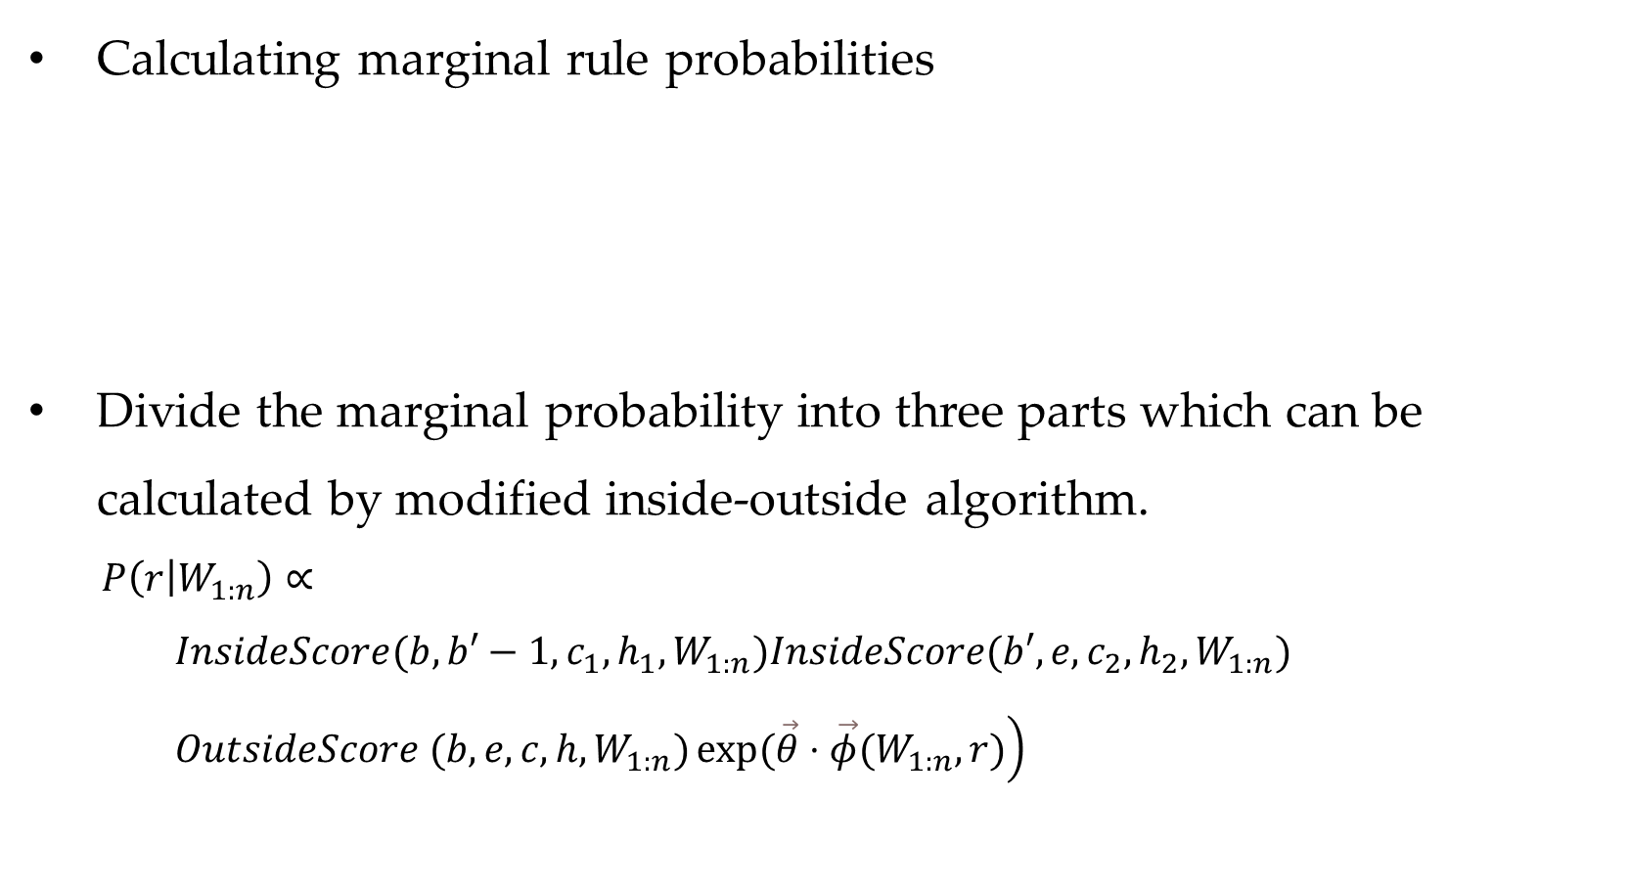



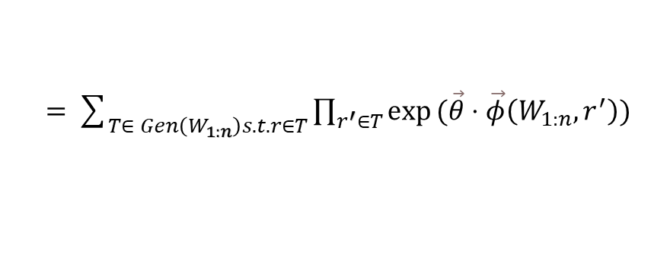

Training Log-linear Models for Constituent Parsing
Calculating marginal rule probabilities
Divide the marginal probability into three parts which can be calculated by modified inside-outside algorithm.
$P\left(r | W_{1:n}\right)∝$
$InsideScore(b, b′−1, c_{1}, h_{1}, W_{1:n})InsideScore(b′, e, c_{2}, h_{2},W_{1:n})$
$OutsideScore (b, e, c, h, W_{1:n})\left.exp(\vec{θ}⋅\vec{φ}(W_{1:n},r)\right)$
$$P(r|W_{1:n})=\sum_{T∈ Gen\left(W_{1:n}\right)s.t.r∈T}{P}(T|W_{1:n})$$
$=\sum_{T∈ Gen\left(W_{1:n}\right)s.t.r∈T}{\prod_{r^{′}∈T}{exp}}(\vec{θ}⋅\vec{φ}\left(W_{1:n},r^{′}\right))$
$$c$$
$$c_{1}$$
$$c_{2}$$
$$b$$
$$b^{′}$$
$$e$$

Slide 67
Contents
10.1 Generative Constituent Parsing
10.1.1 Probabilistic Context Free Grammar
10.1.2 CKY Decoding
10.1.3 Evaluating Constituent Parser Outputs
10.1.4 Calculating Marginal Probabilities
10.2 More Features for Constituent Parsing
10.2.1 Lexicalized PCFGs
10.2.2 Discriminative Linear Models for Constituent Parsing
10.2.3 Training Log-linear Models for Constituent Parsing
10.2.4 Training Large Margin Models for Constituent Parsing
10.3 Reranking
10.4 Beyond Sequences and Trees

Slide 68
Training Log-linear Models for Constituent Parsing
Training goal
For both structured perceptron and SVM models, the training goal is to ensure a outside score margin between gold-standard outputs and incorrect outputs.

Slide 69
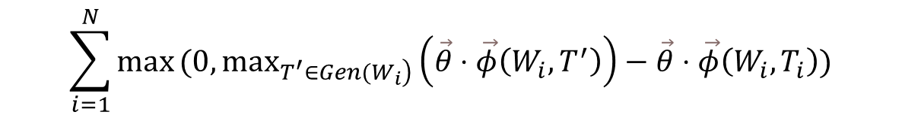
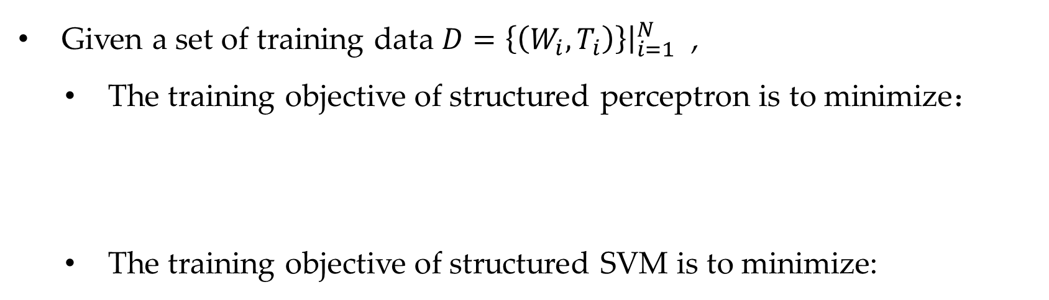

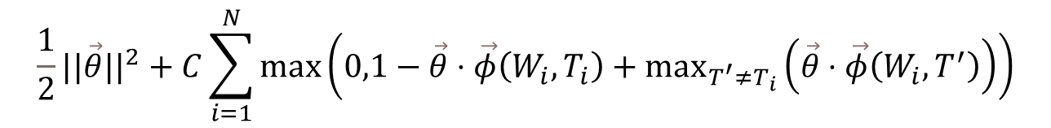
Training Log-linear Models for Constituent Parsing
Given a set of training data $D=\left\{\left(W_{i},T_{i}\right)\right\}{\left.​\right|}_{i=1}^{N}$ ,
The training objective of structured perceptron is to minimize：
The training objective of structured SVM is to minimize:
$$\sum_{i=1}^{N}{max}(0,\max_{\left.T^{′}∈Gen(W_{i}\right)}\left(\vec{θ}⋅\vec{φ}\left(W_{i},T^{′}\right)\right)−\vec{θ}⋅\vec{φ}\left(W_{i},T_{i}\right))$$
$$\frac{1}{2}||\vec{θ}||^{2}+C\sum_{i=1}^{N}{max}\left(0,1−\vec{θ}⋅\vec{φ}\left(W_{i},T_{i}\right)+\max_{T^{′}≠T_{i}}\left(\vec{θ}⋅\vec{φ}\left(W_{i},T^{′}\right)\right)\right)$$
$$where T^{′}∈Gen(w_{i}).$$

Slide 70
Contents
10.1 Generative Constituent Parsing
10.1.1 Probabilistic Context Free Grammar
10.1.2 CKY Decoding
10.1.3 Evaluating Constituent Parser Outputs
10.1.4 Calculating Marginal Probabilities
10.2 More Features for Constituent Parsing
10.2.1 Lexicalized PCFGs
10.2.2 Discriminative Linear Models for Constituent Parsing
10.2.3 Training Log-linear Models for Constituent Parsing
10.2.4 Training Large Margin Models for Constituent Parsing
10.3 Reranking
10.4 Beyond Sequences and Trees

Slide 71
Reranking
Non-local features
useful for disambiguation
but add time complexity of decoding
Reranking
integrate non-local features
without additional asymptotic complexity

Slide 72
Non-local Features
Unbinarized rule

Slide 73
Non-local Features
Unbinarized rule and parent

Slide 74
Non-local Features
Surrounding context

Slide 75
Non-local Features
3
Distance

Slide 76
Reranking
Steps of reranking
(1). obtain output candidates from a base parser with local features.
(1.1). obtain a fixed number of k-best candidates
(1.2). obtain a set of candidates that score higher than a threshold
(2). rescore the set of candidates, considering the score output by base model and non-local features.

Slide 77
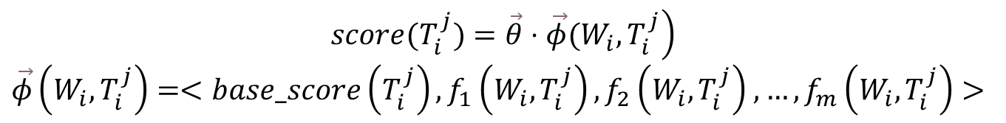
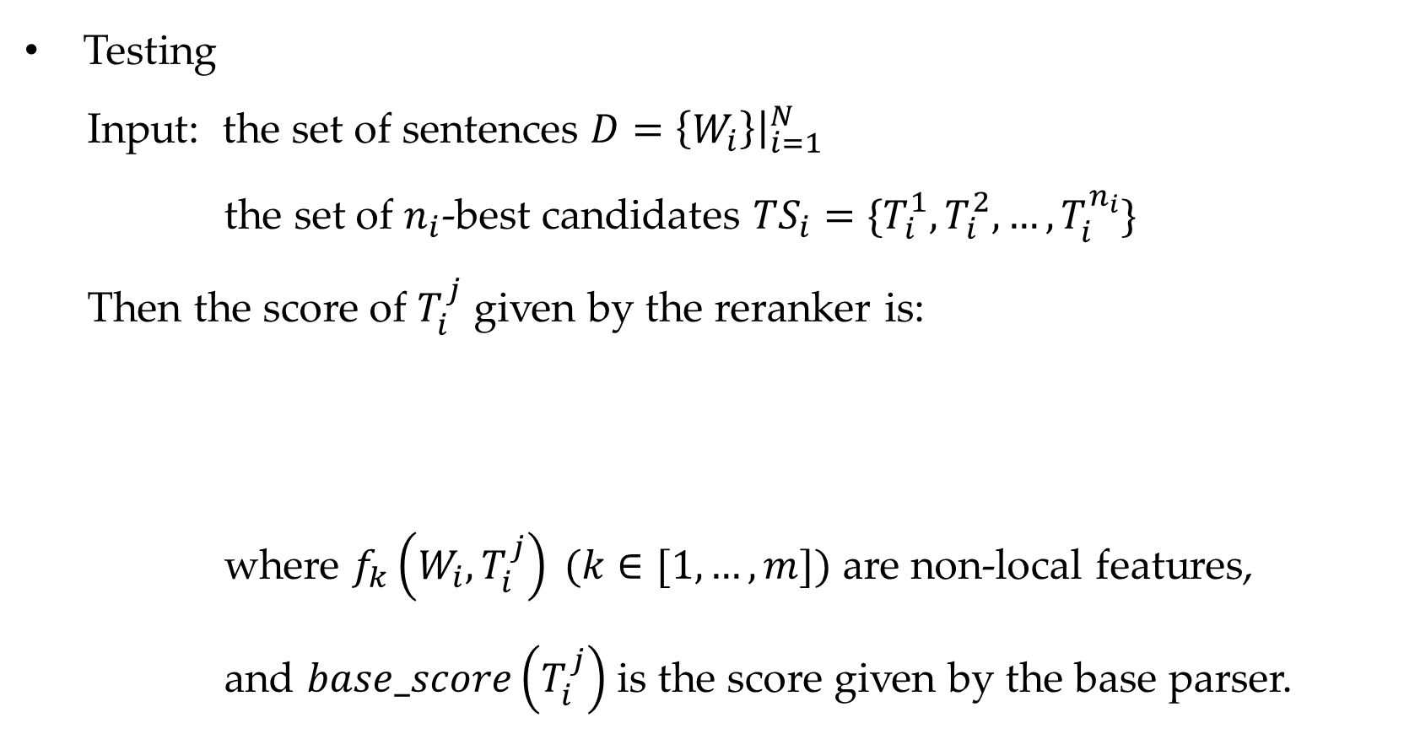
Reranking
Testing
Input: the set of sentences $D=\left\{W_{i}\right\}{\left.​\right|}_{i=1}^{N}$
the set of $n_{i}$-best candidates ${TS}_{i}=\{T_{i}^{1},T_{i}^{2},…,T_{i}^{n_{i}}\}$
Then the score of $T_{i}^{j}$ given by the reranker is:
where $f_{k}\left(W_{i},T_{i}^{j}\right) (k∈[1,…,m])$ are non-local features,
and $base_score\left(T_{i}^{j}\right)$ is the score given by the base parser.
$$\left.score(T_{i}^{j})=\vec{θ}⋅\vec{φ}(W_{i},T_{i}^{j}\right)$$
$\vec{φ}\left(W_{i},T_{i}^{j}\right)=<base_score\left(T_{i}^{j}\right),f_{1}\left(W_{i},T_{i}^{j}\right),f_{2}\left(W_{i},T_{i}^{j}\right)$ $,…,f_{m}\left(W_{i},T_{i}^{j}\right)>$

Slide 78
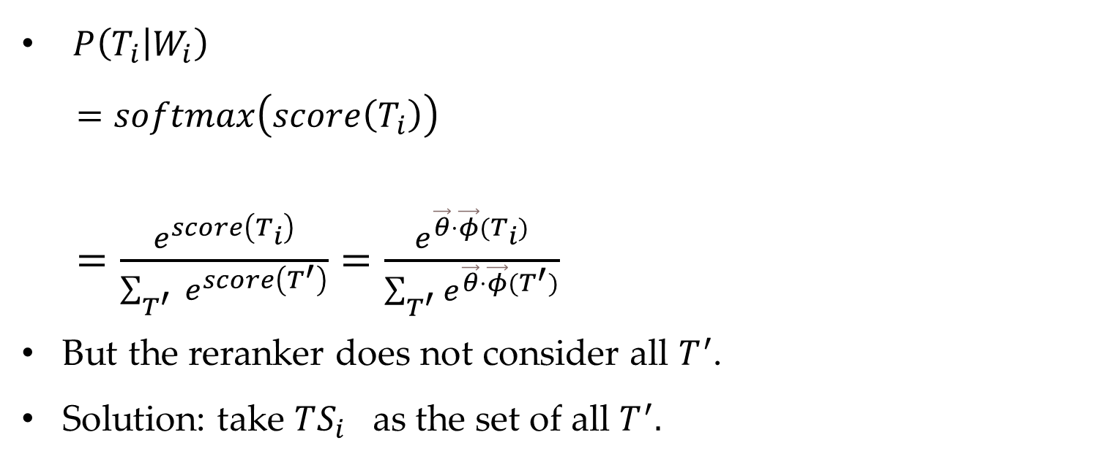
Probability score
$P\left(T_{i} | W_{i}\right)$
$=softmax\left(score\left(T_{i}\right)\right)$
$=\frac{e^{score\left(T_{i}\right)}}{\sum_{T^{′} }{e^{score\left(T^{′}\right)}}}=\frac{e^{\vec{θ}⋅\vec{φ}(T_{i})}}{\sum_{T^{′}}{e^{\vec{θ}⋅\vec{φ}(T^{′})}}}$
But the reranker does not consider all $T^{′}$.
Solution: take $TS_{i}$ as the set of all $T^{′}.$

Slide 79
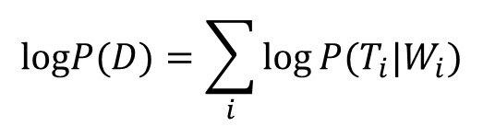
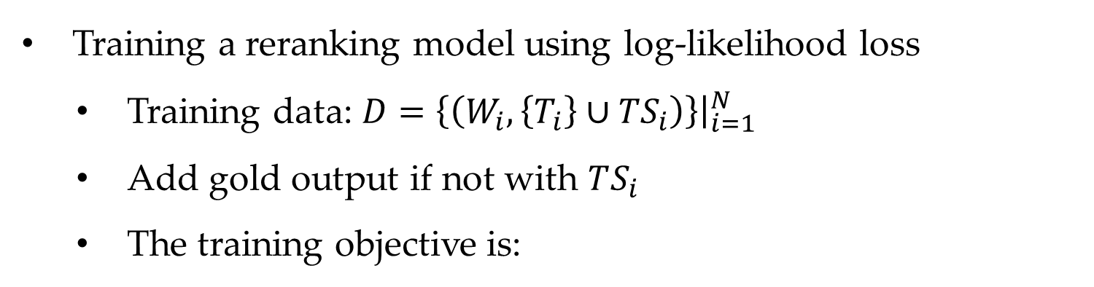

Reranking
Training a reranking model using log-likelihood loss
Training data: $D=\left\{\left(W_{i},{\left\{T_{i}\right\}∪TS}_{i}\right)\right\}{\left.​\right|}_{i=1}^{N}$
Add gold output if not with $TS_{i}$
The training objective is:
$$logP(D)=\sum_{i}{log}P(T_{i}|W_{i})$$
$$=\sum_{i}{(}(score(T_{i}))−log(e^{\left.score(T_{i}\right)}+\sum_{j=1}^{n_{i}}{e^{\left.score(T_{i}^{j}\right)}}))$$

Slide 80


Reranking
Training a reranking model using log-likelihood loss
SGD can be used for optimization, then the local gradient is:
$$\frac{∂}{∂\vec{θ}}logP(T_{i}|W_{i})=\vec{φ}(W_{i},T_{i})−(P\left(T_{i} | W_{i}\right)⋅\vec{φ}\left(W_{i},T_{i}\right)+\sum_{j=1}^{n_{i}}{P}\left(T_{i}^{j} | W_{i}\right)⋅\vec{φ}\left(W_{i},T_{i}^{j})\right)$$
$$=(1−P(T_{i}|W_{i}))⋅\vec{φ}(W_{i},T_{i})+\sum_{j=1}^{n_{i}}{P}(T_{i}^{j}|W_{i})⋅\vec{φ}(W_{i},T_{i}^{j})$$

Slide 81


Reranking
K-fold jacknifing
$D_{1}$ $D_{2}$ … $D_{j}$ … $D_{k}$
Predict $TS_{i}$ on
Train
modeling

Slide 82

Reranking
Training a reranking model using large-margin loss
The objective function is to minimize the score margin:
SGD can be used for optimization, then the local gradient is:
$$\left.max(0,1+\max_{T^{′}∈TS_{i}}(\vec{θ}⋅\vec{φ}(W_{i},T^{′}))−\vec{θ}⋅\vec{φ}(W_{i},T_{i})\right)$$

Slide 83
Contents
10.1 Generative Constituent Parsing
10.1.1 Probabilistic Context Free Grammar
10.1.2 CKY Decoding
10.1.3 Evaluating Constituent Parser Outputs
10.1.4 Calculating Marginal Probabilities
10.2 More Features for Constituent Parsing
10.2.1 Lexicalized PCFGs
10.2.2 Discriminative Linear Models for Constituent Parsing
10.2.3 Training Log-linear Models for Constituent Parsing
10.2.4 Training Large Margin Models for Constituent Parsing
10.3 Reranking
10.4 Beyond Sequences and Trees

Slide 84
Beyond Sequences and Trees
Common underlying modeling techniques
probability chain rule, independency assumption
Bayes rule
dynamic programs
Dynamic programs and feature constraints
Efficiency
Accuracy
More alternatives to discuss

Slide 85
Summary
Generative constituent parsing, binarization, probabilistic context free grammars (PCFGs)
CKY algorithm, inside-outside algorithm, lexicalized PCFGs
Log-linear models for discriminative constituent parsing Large-margin models for discriminative constituent parsing
Reranking

