Slide 1

Natural Language Processing
Yue Zhang
Westlake University

Slide 2
Chapter 12
Bayesian Network

Slide 3
Contents
12.1 A General Probabilistic Model
12.2 Training Bayesian Networks
12.2.1 Maximum Likelihood Estimation
12.2.2 Maximum a Posteriori
12.2.3 Conjugate priors
12.2.4 Bayesian Estimation
12.2.5 Bayesian Unigram Language Model
12.3 Inference
12.3.1 Exaction Inference
12.3.2 Gibbs Sampling
12.4 Latent Dirichlet Allocation
12.4.1 Training with Hidden Variables
12.4.2 Parameter Estimation
12.4.3 Topic Evaluation
12.5 Bayesian IBM Model 1

Slide 4
Contents
12.1 A General Probabilistic Model
12.2 Training Bayesian Networks
12.2.1 Maximum Likelihood Estimation
12.2.2 Maximum a Posteriori
12.2.3 Conjugate priors
12.2.4 Bayesian Estimation
12.2.5 Bayesian Unigram Language Model
12.3 Inference
12.3.1 Exaction Inference
12.3.2 Gibbs Sampling
12.4 Latent Dirichlet Allocation
12.4.1 Training with Hidden Variables
12.4.2 Parameter Estimation
12.4.3 Topic Evaluation
12.5 Bayesian IBM Model 1

Slide 5
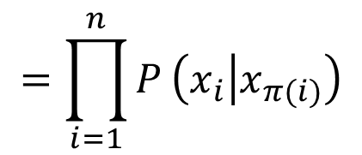
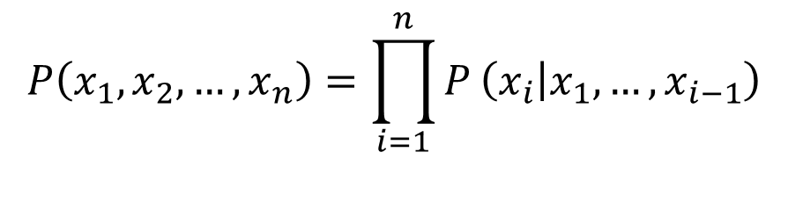
A General Probabilistic Model
Bayesian network
General form of n-gram LM, NB, PLSA, HMM etc.
Formally chain rule + independence assumption
$$P\left(x_{1},x_{2},…,x_{n}\right)=\prod_{i=1}^{n}{P}\left(x_{i} | x_{1},…,x_{i−1}\right)$$
$$=\prod_{i=1}^{n}{P}\left(x_{i} | x_{π(i)}\right)$$

Slide 6
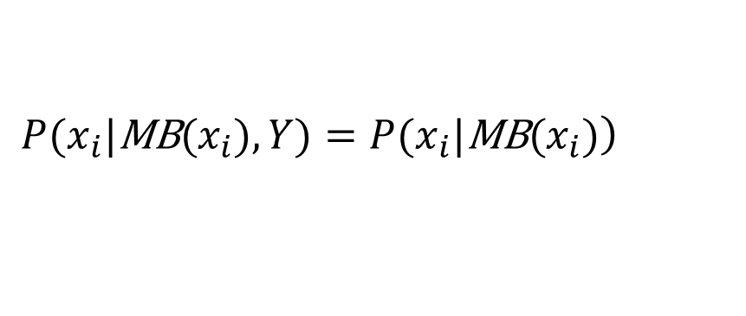
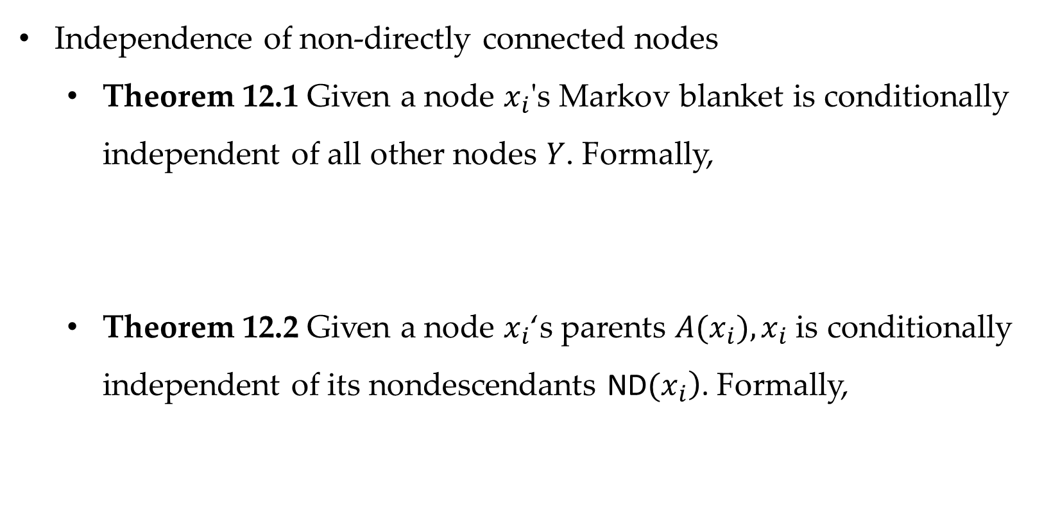
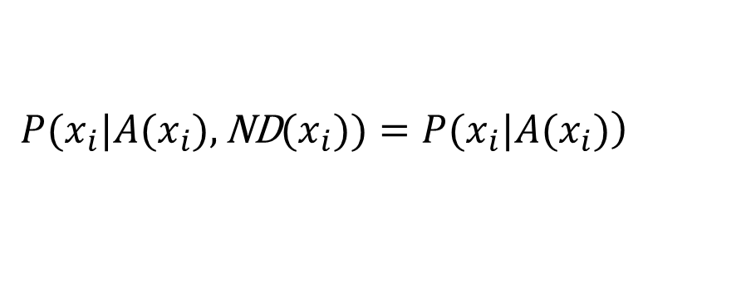
A General Probabilistic Model
Independence of non-directly connected nodes
Theorem 12.1 Given a node $x_{i}$'s Markov blanket is conditionally independent of all other nodes $Y$. Formally,
Theorem 12.2 Given a node $x_{i}$‘s parents $A(x_{i}),x_{i}$ is conditionally independent of its nondescendants $\left.\text{ND}(x_{i}\right)$. Formally,
$$\left.P(x_{i}|\text{MB}(x_{i}),Y)=P(x_{i}|\text{MB}(x_{i})\right)$$
$$\left.P(x_{i}|A(x_{i}),\text{ND}(x_{i}))=P(x_{i}|A(x_{i})\right)$$

Slide 7
Contents
12.1 A General Probabilistic Model
12.2 Training Bayesian Networks
12.2.1 Maximum Likelihood Estimation
12.2.2 Maximum a Posteriori
12.2.3 Conjugate priors
12.2.4 Bayesian Estimation
12.2.5 Bayesian Unigram Language Model
12.3 Inference
12.3.1 Exaction Inference
12.3.2 Gibbs Sampling
12.4 Latent Dirichlet Allocation
12.4.1 Training with Hidden Variables
12.4.2 Parameter Estimation
12.4.3 Topic Evaluation
12.5 Bayesian IBM Model 1

Slide 8
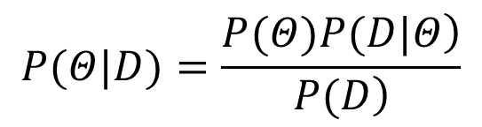
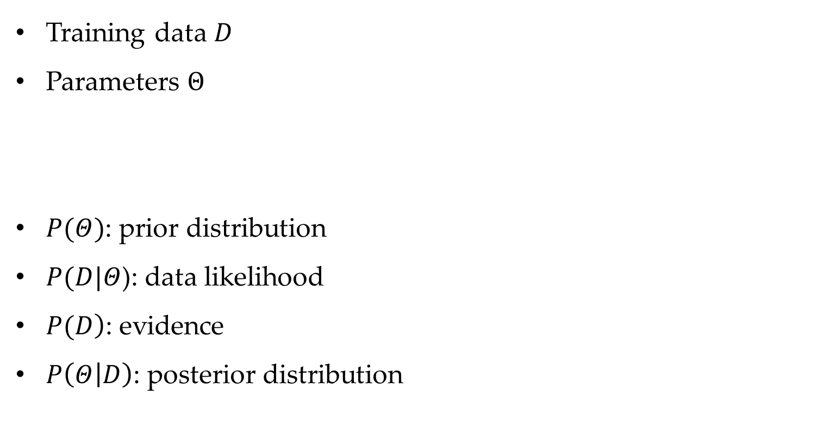
Training Bayesian Networks
Training data $D$
Parameters $Θ$
$P(Θ)$: prior distribution
$P(D|Θ$): data likelihood
$\left.P(D\right)$: evidence
$P\left(Θ | D\right)$: posterior distribution
$$P(Θ|D)=\frac{\left.P(Θ)P(D|Θ\right)}{\left.P(D\right)}$$

Slide 9


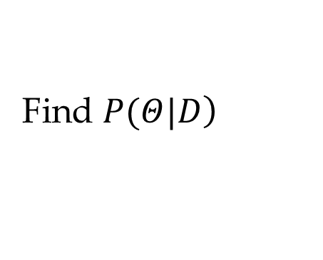
Training Bayesian Networks
Three training strategies
Maximum likelihood estimation (MLE)
Maximum a posteriori (MAP)
Bayesian estimation
$$\left.θ^{MLE}={ \text{argmax}}_{Θ}P(D|Θ\right)$$
$$\left.Θ^{MAP}={ \text{argmax}}_{Θ}P(Θ)P(D|Θ\right)$$
Find $\left.P(Θ|D\right)$

Slide 10
Contents
12.1 A General Probabilistic Model
12.2 Training Bayesian Networks
12.2.1 Maximum Likelihood Estimation
12.2.2 Maximum a Posteriori
12.2.3 Conjugate priors
12.2.4 Bayesian Estimation
12.2.5 Bayesian Unigram Language Model
12.3 Inference
12.3.1 Exaction Inference
12.3.2 Gibbs Sampling
12.4 Latent Dirichlet Allocation
12.4.1 Training with Hidden Variables
12.4.2 Parameter Estimation
12.4.3 Topic Evaluation
12.5 Bayesian IBM Model 1

Slide 11
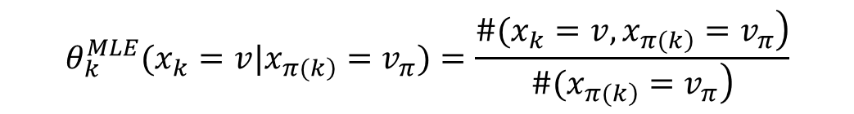

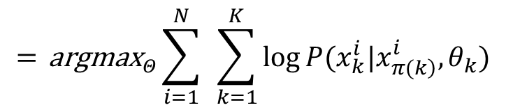

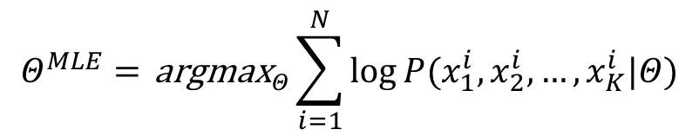
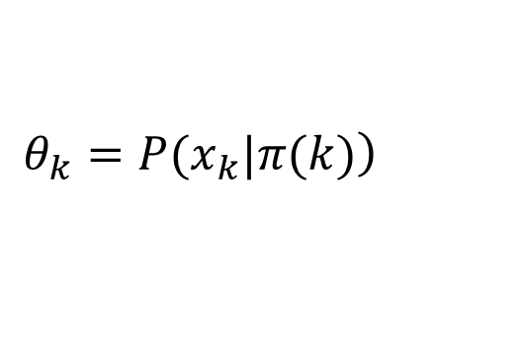

Training Bayesian Networks
Maximum likelihood estimation
Without hidden variables
$$D=\{X_{i}\}|_{i=1}^{N}$$
$$X_{i}=x_{1}^{i},x_{2}^{i},…,x_{K}^{i}$$
$$Θ=\{θ_{k}\}|_{k=1}^{K}$$
$$\left.θ_{k}=P(x_{k}|π(k)\right)$$
$$Θ^{MLE}={ \text{argmax}}_{Θ}\sum_{i=1}^{N}{log}P(x_{1}^{i},x_{2}^{i},…,x_{K}^{i}|Θ)$$
$$={ \text{argmax}}_{Θ}\sum_{i=1}^{N}{ }\sum_{k=1}^{K}{log}P(x_{k}^{i}|x_{\left.π(k\right)}^{i},θ_{k})$$
$$θ_{k}^{MLE}(x_{k}=v|x_{\left.π(k\right)}=v_{π})=\frac{\left.\#(x_{k}=v,x_{\left.π(k\right)}=v_{π}\right)}{\left.\#(x_{\left.π(k\right)}=v_{π}\right)}$$

Slide 12
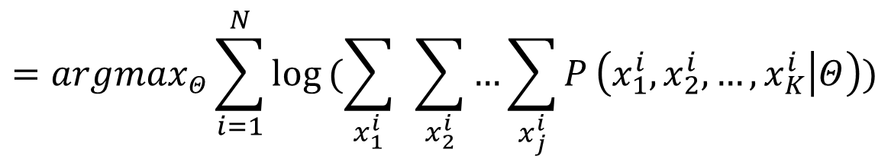
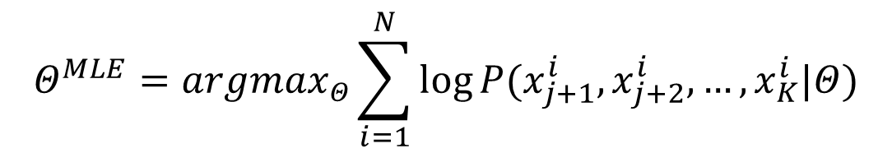
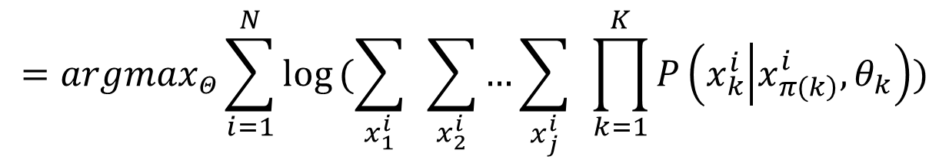
Training Bayesian Networks
Maximum likelihood estimation
With hidden variables
$$Θ^{MLE}=argmax_{Θ}\sum_{i=1}^{N}{log}P(x_{j+1}^{i},x_{j+2}^{i},…,x_{K}^{i}|Θ)$$
$$=argmax_{Θ}\sum_{i=1}^{N}{log}(\sum_{x_{1}^{i}}{ }\sum_{x_{2}^{i}}{…}\sum_{x_{j}^{i}}{P}\left(x_{1}^{i},x_{2}^{i},…,x_{K}^{i} | Θ\right))$$
$$=argmax_{Θ}\sum_{i=1}^{N}{log}(\sum_{x_{1}^{i}}{ }\sum_{x_{2}^{i}}{…}\sum_{x_{j}^{i}}{ }\prod_{k=1}^{K}{P}\left(x_{k}^{i} | x_{\left.π(k\right)}^{i},θ_{k}\right))$$

Slide 13


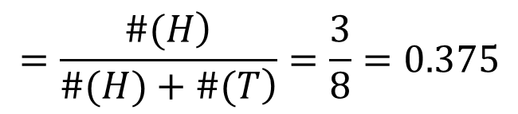

Training Bayesian Networks
Maximum likelihood estimation
Coin tossing example
$$\text{D}\text{=}\text{HTHTHTTT}$$
$$P(D|θ)=θ^{\left.\#(H\right)}{\left(1−θ\right)}^{\left.\#(T\right)}$$
$$θ^{MLE}=argmax_{θ}θ^{\left.\#(H\right)}{\left(1−θ\right)}^{\left.\#(T\right)}$$
$$=\frac{\left.\#(H\right)}{\left.\#(H)+\#(T\right)}=\frac{3}{8}=0.375$$

Slide 14
Contents
12.1 A General Probabilistic Model
12.2 Training Bayesian Networks
12.2.1 Maximum Likelihood Estimation
12.2.2 Maximum a Posteriori
12.2.3 Conjugate priors
12.2.4 Bayesian Estimation
12.2.5 Bayesian Unigram Language Model
12.3 Inference
12.3.1 Exaction Inference
12.3.2 Gibbs Sampling
12.4 Latent Dirichlet Allocation
12.4.1 Training with Hidden Variables
12.4.2 Parameter Estimation
12.4.3 Topic Evaluation
12.5 Bayesian IBM Model 1

Slide 15
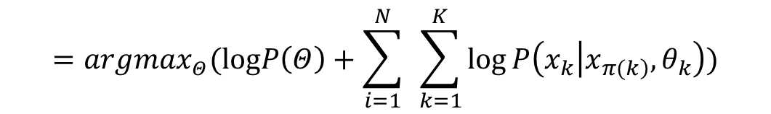
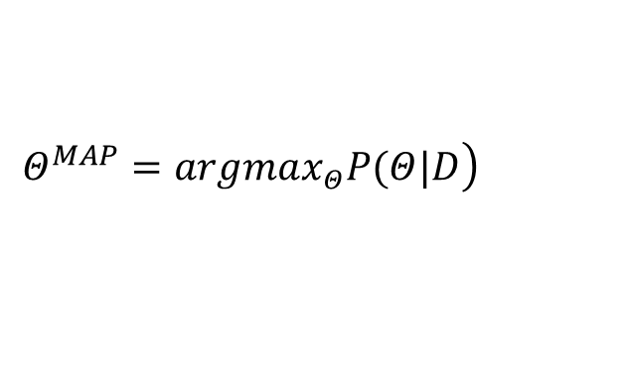
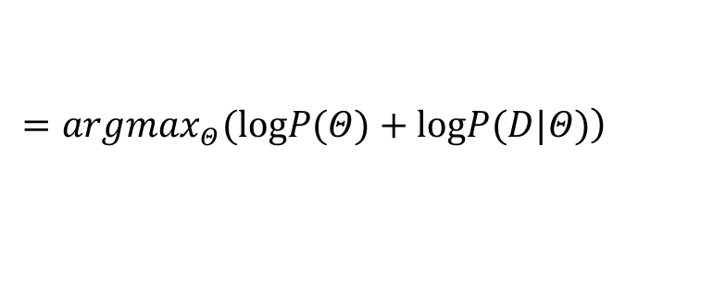

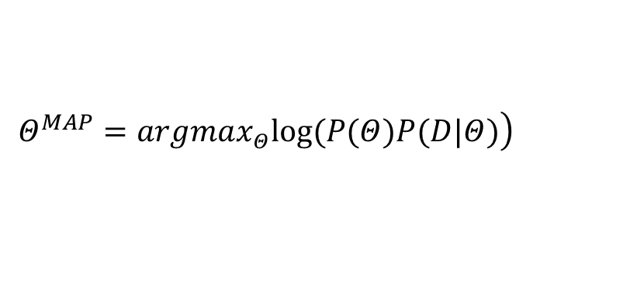
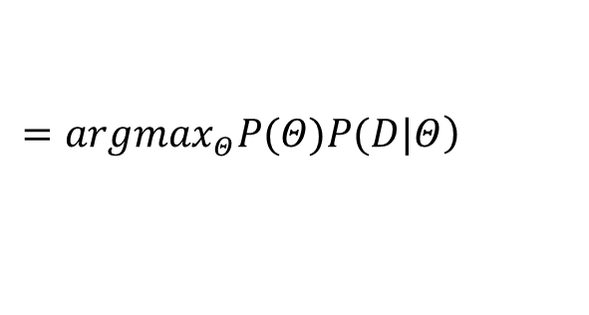
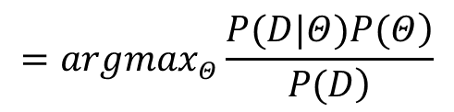
Training Bayesian Networks
Maximum a posterior
Data $D$, parameter $Θ$
Calculation
$$\left.Θ^{MAP}=argmax_{Θ}P(Θ|D\right)$$
$$=argmax_{Θ}\frac{\left.P(D|Θ)P(Θ\right)}{\left.P(D\right)}$$
$$\left.=argmax_{Θ}P(Θ)P(D|Θ\right)$$
$$\left.Θ^{MAP}=argmax_{Θ}log(P(Θ)P(D|Θ)\right)$$
$$\left.=argmax_{Θ}(logP(Θ)+logP(D|Θ)\right)$$
$$=argmax_{Θ}(logP\left(Θ\right)+\sum_{i=1}^{N}{ }\sum_{k=1}^{K}{log}P\left(x_{k} | x_{\left.π(k\right)},θ_{k}\right))$$

Slide 16
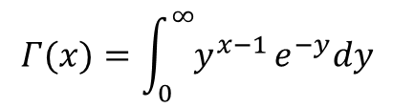
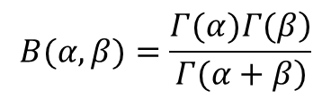
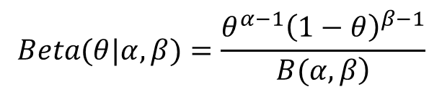
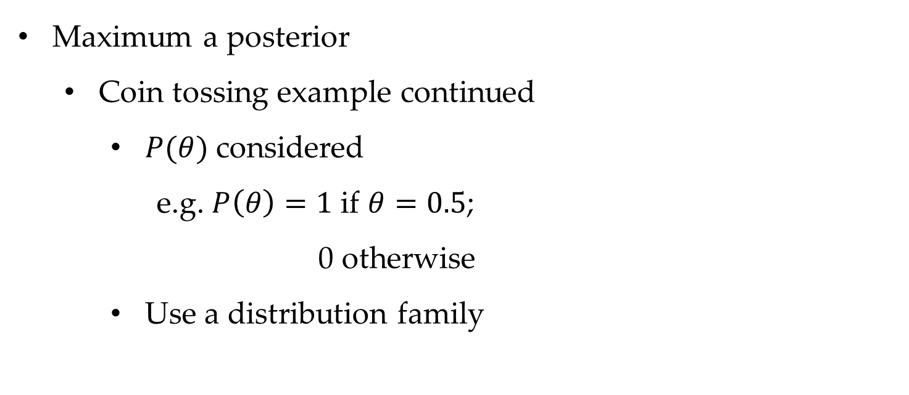
Training Bayesian Networks
Maximum a posterior
Coin tossing example continued
$P(θ)$ considered
e.g. $P\left(θ\right)=1$ if $θ=0.5$;
0 otherwise
Use a distribution family
$$Beta(θ|α,β)=\frac{θ^{α−1}{\left(1−θ\right)}^{β−1}}{\left.B(α,β\right)}$$
$$B(α,β)=\frac{\left.Γ(α)Γ(β\right)}{\left.Γ(α+β\right)}$$
$$Γ(x)=\int_{0}^{∞}{y^{x−1}}e^{−y}dy$$

Slide 17
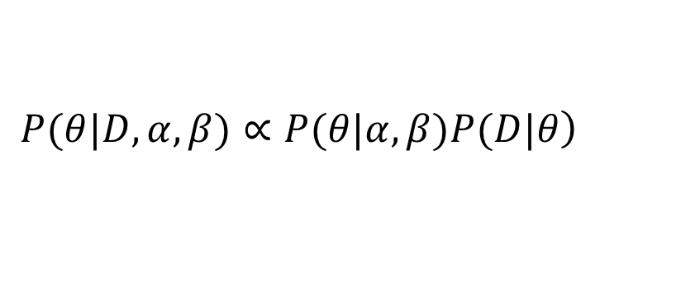
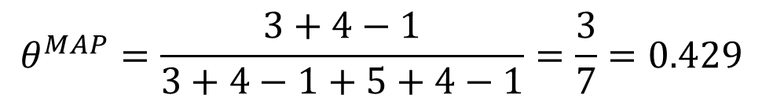
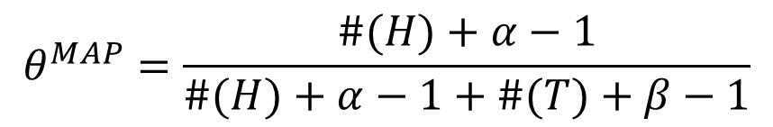

Training Bayesian Networks
Maximum a posterior
Coin tossing example continued
$$\left.P(θ|D,α,β)∝P(θ|α,β)P(D|θ\right)$$
$$∝θ^{α−1}{\left(1−θ\right)}^{β−1}⋅θ^{\left.\#(H\right)}{\left(1−θ\right)}^{\left.\#(T\right)}$$
$$=θ^{\#(H)+α−1}{\left(1−θ\right)}^{\#(T)+β−1}$$
$$θ^{MAP}=\frac{\#(H)+α−1}{\#(H)+α−1+\#(T)+β−1}$$
$$θ^{MAP}=\frac{3+4−1}{3+4−1+5+4−1}=\frac{3}{7}=0.429$$

Slide 18
Contents
12.1 A General Probabilistic Model
12.2 Training Bayesian Networks
12.2.1 Maximum Likelihood Estimation
12.2.2 Maximum a Posteriori
12.2.3 Conjugate priors
12.2.4 Bayesian Estimation
12.2.5 Bayesian Unigram Language Model
12.3 Inference
12.3.1 Exaction Inference
12.3.2 Gibbs Sampling
12.4 Latent Dirichlet Allocation
12.4.1 Training with Hidden Variables
12.4.2 Parameter Estimation
12.4.3 Topic Evaluation
12.5 Bayesian IBM Model 1

Slide 19

Training Bayesian Networks
Conjugate priors
Beta-Binomial conjugate
Facilitates calculation
$$P(D|θ)∝θ^{n_{1}}{\left(1−θ\right)}^{n_{2}}$$

Slide 20
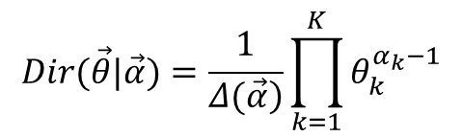

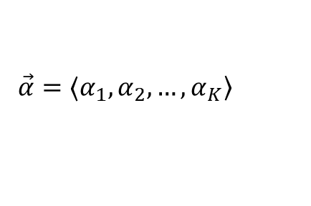




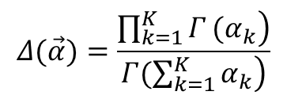
Training Bayesian Networks
Conjugate priors
Dirichlet-Multinomial conjugate
Dirichlet distribution
$$P(D|\vec{θ})∝\prod_{i=1}^{K}{θ_{k}^{n_{k}}}$$
$$\vec{θ}=〈θ_{1},θ_{2},…,θ_{K}〉$$
$$P(e=r_{k})=θ_{k}$$
$$\sum_{k=1}^{K}{θ_{k}}=1$$
$$D=〈n_{1},n_{2},…,n_{k}〉$$
$$\vec{α}=〈α_{1},α_{2},…,α_{K}〉$$
$$Dir(\vec{θ}|\vec{α})=\frac{1}{\left.Δ(\vec{α}\right)}\prod_{k=1}^{K}{θ_{k}^{α_{k}−1}}$$
$$Δ(\vec{α})=\frac{\left.\prod_{k=1}^{K}{Γ}(α_{k}\right)}{\left.Γ(\sum_{k=1}^{K}{α_{k}}\right)}$$

Slide 21
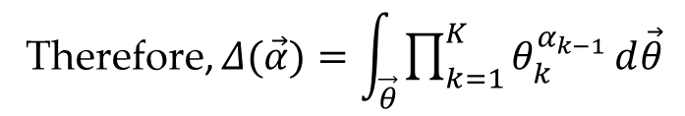

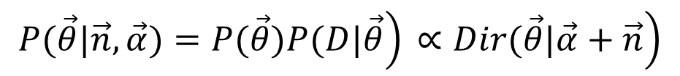
Training Bayesian Networks
Conjugate priors
Dirichlet-Multinomial conjugate
Normalizing constant
Posterior
$$\int_{θ_{1}}{\int_{θ_{2}}{…}}\int_{θ_{K}}{P}(\vec{θ}|\vec{α})dθ_{1}dθ_{1}…dθ_{K}=\int_{\vec{θ}}{P}(\vec{θ}|\vec{α})d\vec{θ}=\int_{\vec{θ}}{\frac{1}{\left.Δ(\vec{α}\right)}}\prod_{k=1}^{K}{θ_{k}^{α_{k}−1}}d\vec{θ}=1$$
Therefore, $Δ(\vec{α})=\int_{\vec{θ}}{\prod_{k=1}^{K}{θ_{k}^{α_{k−1}}}}d\vec{θ}$
$$\left.P(\vec{θ}|\vec{n},\vec{α})=P(\vec{θ})P(D|\vec{θ}\right)\left. ∝Dir(\vec{θ}|\vec{α}+\vec{n}\right)$$

Slide 22
Contents
12.1 A General Probabilistic Model
12.2 Training Bayesian Networks
12.2.1 Maximum Likelihood Estimation
12.2.2 Maximum a Posteriori
12.2.3 Conjugate priors
12.2.4 Bayesian Estimation
12.2.5 Bayesian Unigram Language Model
12.3 Inference
12.3.1 Exaction Inference
12.3.2 Gibbs Sampling
12.4 Latent Dirichlet Allocation
12.4.1 Training with Hidden Variables
12.4.2 Parameter Estimation
12.4.3 Topic Evaluation
12.5 Bayesian IBM Model 1

Slide 23
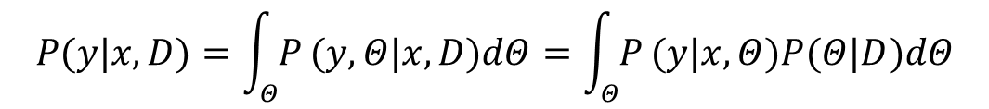
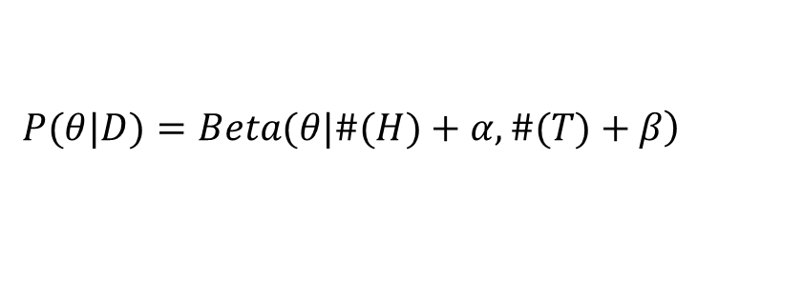
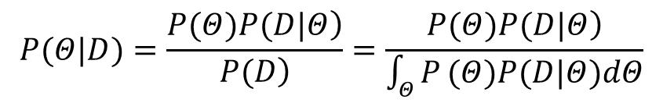


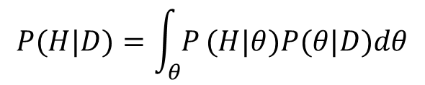
Training Bayesian Networks
Bayesian Estimation
Finding output
Coin tossing example
$$P(Θ|D)=\frac{\left.P(Θ)P(D|Θ\right)}{\left.P(D\right)}=\frac{\left.P(Θ)P(D|Θ\right)}{\int_{Θ}{P}(Θ)P(D|Θ)dΘ}$$
$$P(y|x,D)=\int_{Θ}{P}(y,Θ|x,D)dΘ=\int_{Θ}{P}(y|x,Θ)P(Θ|D)dΘ$$
$$P(H|D)=\int_{θ}{P}(H|θ)P(θ|D)dθ$$
$$=\int_{θ}{θ}⋅Beta(θ|\#(H)+α,\#(T)+β)dθ$$
$$P(H|θ)=θ$$
$$\left.P(θ|D)=Beta(θ|\#(H)+α,\#(T)+β\right)$$

Slide 24
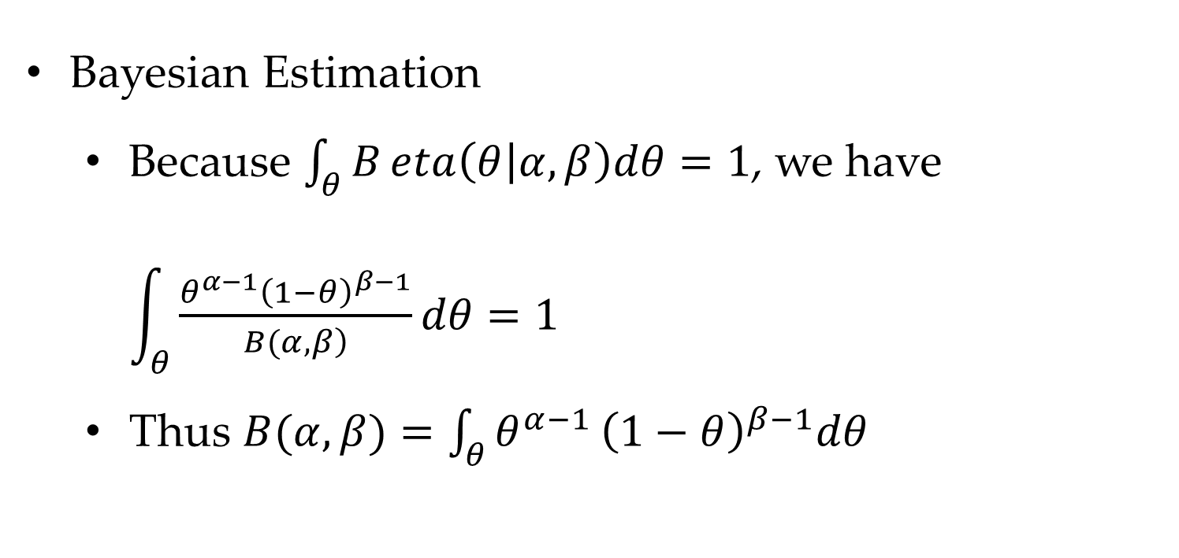
Training Bayesian Networks
Bayesian Estimation
Because $\int_{θ}{B}eta\left(θ | α,β\right)dθ=1$, we have $\int_{θ}{\frac{θ^{α−1}{\left(1−θ\right)}^{β−1}}{\left.B(α,β\right)}}dθ=1$
Thus $B(α,β)=\int_{θ}{θ^{α−1}}{\left(1−θ\right)}^{β−1}dθ$

Slide 25
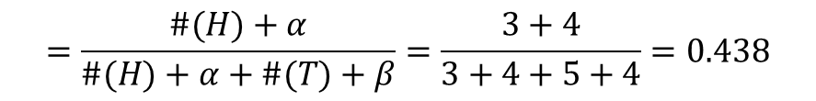
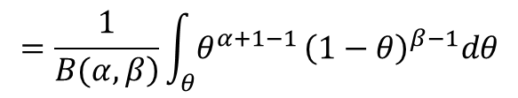
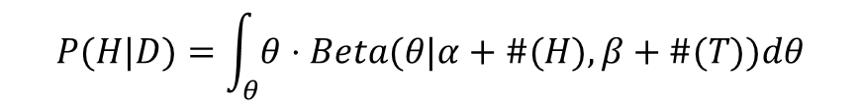

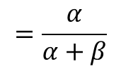
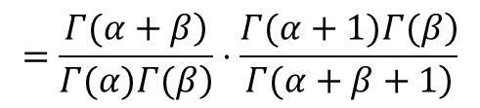

Training Bayesian Networks
Bayesian Estimation
Thus
$$\int_{θ}{θ}⋅Beta(θ|α,β)dθ=\int_{θ}{θ}⋅\frac{θ^{α−1}{\left(1−θ\right)}^{β−1}}{\left.B(α,β\right)}dθ$$
$$=\frac{1}{\left.B(α,β\right)}\int_{θ}{θ^{α+1−1}}{\left(1−θ\right)}^{β−1}dθ$$
$$=\frac{1}{\left.B(α,β\right)}⋅B(α+1,β)$$
$$=\frac{\left.Γ(α+β\right)}{\left.Γ(α)Γ(β\right)}⋅\frac{\left.Γ(α+1)Γ(β\right)}{\left.Γ(α+β+1\right)}$$
$$=\frac{α}{α+β}$$
$$P(H|D)=\int_{θ}{θ}⋅Beta(θ|α+\#(H),β+\#(T))dθ$$
$$=\frac{\#(H)+α}{\#(H)+α+\#(T)+β}=\frac{3+4}{3+4+5+4}=0.438$$

Slide 26
Contents
12.1 A General Probabilistic Model
12.2 Training Bayesian Networks
12.2.1 Maximum Likelihood Estimation
12.2.2 Maximum a Posteriori
12.2.3 Conjugate priors
12.2.4 Bayesian Estimation
12.2.5 Bayesian Unigram Language Model
12.3 Inference
12.3.1 Exaction Inference
12.3.2 Gibbs Sampling
12.4 Latent Dirichlet Allocation
12.4.1 Training with Hidden Variables
12.4.2 Parameter Estimation
12.4.3 Topic Evaluation
12.5 Bayesian IBM Model 1

Slide 27




Training Bayesian Networks
Bayesian Unigram Language Model
Dirichlet prior
$s=w_{1}w_{2}…w_{n}$
$$P(s)=\prod_{j=1}^{n}{P}(w_{j})$$
$$P\left(D | \vec{θ}\right)=\prod_{i=1}^{\left|V\right|}{P}{\left(w_{i}\right)}^{n_{i}}=\prod_{i=1}^{|V|}{θ_{i}^{n_{i}}}$$
$$\left.P(\vec{θ})=Dir(\vec{θ}|\vec{α}\right)$$

Slide 28



Training Bayesian Networks
Bayesian Unigram Language Model
Posterior
Expectation values
add-$α$ smoothing
$$P(\vec{θ}|D)∝Dir(\vec{θ}|\vec{n}+\vec{α})=\frac{1}{\left.Δ(\vec{n}+\vec{α}\right)}\prod_{i=1}^{|V|}{P}{\left(w_{i}\right)}^{n_{i}+α_{i}−1}$$
$$E(\vec{θ})=〈\frac{n_{1}+α_{1}}{\sum_{i=1}^{|V|}{\left(n_{i}+α_{i}\right)}},\frac{n_{2}+α_{2}}{\sum_{i=1}^{|V|}{\left(n_{i}+α_{i}\right)}},…,\frac{n_{|V|}+α_{|V|}}{\sum_{i=1}^{|V|}{\left(n_{i}+α_{i}\right)}}〉$$

Slide 29
Contents
12.1 A General Probabilistic Model
12.2 Training Bayesian Networks
12.2.1 Maximum Likelihood Estimation
12.2.2 Maximum a Posteriori
12.2.3 Conjugate priors
12.2.4 Bayesian Estimation
12.2.5 Bayesian Unigram Language Model
12.3 Inference
12.3.1 Exaction Inference
12.3.2 Gibbs Sampling
12.4 Latent Dirichlet Allocation
12.4.1 Training with Hidden Variables
12.4.2 Parameter Estimation
12.4.3 Topic Evaluation
12.5 Bayesian IBM Model 1

Slide 30

Inference
Given observed variables $E$ and query $X$, find $P(X|E = e)$
$P(X|E=e)=\frac{\left.P(X,E=e\right)}{\left.P(E=e\right)}$
Exact and approximate methods

Slide 31
Contents
12.1 A General Probabilistic Model
12.2 Training Bayesian Networks
12.2.1 Maximum Likelihood Estimation
12.2.2 Maximum a Posteriori
12.2.3 Conjugate priors
12.2.4 Bayesian Estimation
12.2.5 Bayesian Unigram Language Model
12.3 Inference
12.3.1 Exaction Inference
12.3.2 Gibbs Sampling
12.4 Latent Dirichlet Allocation
12.4.1 Training with Hidden Variables
12.4.2 Parameter Estimation
12.4.3 Topic Evaluation
12.5 Bayesian IBM Model 1

Slide 32




Inference
Exact inference
Enumeration
$\left.P(X,E=e\right)=\sum_{Z}{P}(X,E=e,Z)$
$z$ denotes $¬(X,E)$
Example
$$P(x_{2}|x_{4}=T)∝P(x_{2},x_{4}=T)$$
$$=\sum_{x_{1},x_{3},x_{5}}{P}(x_{1},x_{2},x_{3},x_{4}=T,x_{5})$$
$$=\sum_{x_{1},x_{3},x_{5}}{P}(x_{1})P(x_{2})P(x_{3}|x_{1},x_{2})P(x_{4}=T|x_{3})P(x_{5}|x_{3})$$

Slide 33





Inference
Exact inference
Variable elimination
$$P(x_{2},x_{4}=T)=\sum_{x_{1},x_{3},x_{5}}{P}(x_{1})P(x_{2})P(x_{3}|x_{1},x_{2})P(x_{4}=T|x_{3})P(x_{5}|x_{3})$$
$$=P(x_{2})\sum_{x_{1}}{P}(x_{1})\sum_{x_{3}}{P}(x_{3}|x_{1},x_{2})P(x_{4}=T|x_{3})\sum_{x_{5}}{P}(x_{5}|x_{3})$$
$$=P(x_{2})\sum_{x_{1}}{P}(x_{1})\sum_{x_{3}}{P}(x_{3}|x_{1},x_{2})P(x_{4}=T|x_{3})s_{x_{5}}[x_{3}]$$
$$=P(x_{2})\sum_{x_{1}}{P}(x_{1})s_{x_{3}}[x_{1},x_{2}]$$
$$=P\left(x_{2}\right)s_{x_{1}}[x_{2}]$$

Slide 34
Contents
12.1 A General Probabilistic Model
12.2 Training Bayesian Networks
12.2.1 Maximum Likelihood Estimation
12.2.2 Maximum a Posteriori
12.2.3 Conjugate priors
12.2.4 Bayesian Estimation
12.2.5 Bayesian Unigram Language Model
12.3 Inference
12.3.1 Exaction Inference
12.3.2 Gibbs Sampling
12.4 Latent Dirichlet Allocation
12.4.1 Training with Hidden Variables
12.4.2 Parameter Estimation
12.4.3 Topic Evaluation
12.5 Bayesian IBM Model 1

Slide 35



Inference
Gibbs sampling
Generate 60 samples where 28 with $E=e$ and $X=x$, $P\left(X=x,E=e\right)≈\frac{28}{60}$
Sample variables in turn
Hidden variables
$P(x_{i}|x_{\left.π(i\right)})\prod_{j:x_{i}∈x_{\left.π(j\right)}}{P}(x_{j}|x_{\left.π(j\right)})$

Slide 36
Contents
12.1 A General Probabilistic Model
12.2 Training Bayesian Networks
12.2.1 Maximum Likelihood Estimation
12.2.2 Maximum a Posteriori
12.2.3 Conjugate priors
12.2.4 Bayesian Estimation
12.2.5 Bayesian Unigram Language Model
12.3 Inference
12.3.1 Exaction Inference
12.3.2 Gibbs Sampling
12.4 Latent Dirichlet Allocation
12.4.1 Training with Hidden Variables
12.4.2 Parameter Estimation
12.4.3 Topic Evaluation
12.5 Bayesian IBM Model 1

Slide 37




Latent Dirichlet Allocation
Bayesian version of PLSA
Topics ${\vec{z}}_{d}=〈z_{1},z_{2},…,z_{N_{d}}〉$ ,words ${\vec{w}}_{d}=〈w_{1},w_{2},…,w_{N_{d}}〉$
If
$n_{d,k}$ and $c_{k,i}$ are unknown
PLSA uses EM
LDA uses Bayesian Estimation
$$P(w_{j}|d)=\sum_{k=1}^{K}{P}(w_{j}|z_{j}=k)P(z_{j}=k|d)$$
$$P(D)=\prod_{d=1}^{|D|}{P}({\vec{z}}_{d},{\vec{w}}_{d})$$
$$=\prod_{d=1}^{|D|}{ }\prod_{k=1}^{K}{P}{\left(z=k|d\right)}^{n_{d,k}}⋅\prod_{k=1}^{K}{ }\prod_{i=1}^{|V|}{P}{\left(w_{i}|z=k\right)}^{c_{k,i}}$$

Slide 38





Latent Dirichlet Allocation
Need to specify priors
Notation
$P\left(w | z\right):$
$P\left(z | d\right):$
$$\vec{Φ}={\vec{φ}}_{1},{\vec{φ}}_{2},…,{\vec{φ}}_{K}$$
Where $\left.{\vec{φ}}_{k}=〈P(w_{1}|z=k),P(w_{2}|z=k),…,P(w_{|V|}|z=k)〉,k∈\{1,…,K\right\}$
$$\vec{Θ}={\vec{θ}}_{1},{\vec{θ}}_{2},…,{\vec{θ}}_{|D|}$$
Where ${\vec{θ}}_{d}=〈P(z=1|d),P(z=2|d),…,P(z=K|d)〉$

Slide 39
Contents
12.1 A General Probabilistic Model
12.2 Training Bayesian Networks
12.2.1 Maximum Likelihood Estimation
12.2.2 Maximum a Posteriori
12.2.3 Conjugate priors
12.2.4 Bayesian Estimation
12.2.5 Bayesian Unigram Language Model
12.3 Inference
12.3.1 Exaction Inference
12.3.2 Gibbs Sampling
12.4 Latent Dirichlet Allocation
12.4.1 Training with Hidden Variables
12.4.2 Parameter Estimation
12.4.3 Topic Evaluation
12.5 Bayesian IBM Model 1

Slide 40









Latent Dirichlet Allocation
Joint Distribution
Bayesian estimation (Find the posteriors)
Training
Randomly initialize topic assignments
Train Eq(2) by counting ${\vec{n}}_{d}$and ${\vec{c}}_{k}$
Use Eq(1) resample topics
$$\left.P(\vec{Θ},\vec{Φ},\vec{Z},\vec{W}|\vec{α},\vec{β}\right)$$
$$(1)$$
$$=\prod_{d=1}^{|D|}{D}ir({\vec{θ}}_{d}|\vec{α})\prod_{i=1}^{N_{d}}{P}(z_{d,i}|{\vec{θ}}_{d})\prod_{k=1}^{K}{D}ir({\vec{φ}}_{k}|\vec{β})P(w_{d,i}|{\vec{φ}}_{z_{d,i}})$$
$$\left.P({\vec{θ}}_{d}|D,\vec{α})=Dir({\vec{θ}}_{d}|{\vec{n}}_{d}+\vec{α}\right)$$
$$\left.P({\vec{φ}}_{k}|D,\vec{β})=Dir({\vec{φ}}_{k}|{\vec{c}}_{k}+\vec{β}\right)$$
Where ${\vec{n}}_{d}=〈n_{d,1},n_{d,2},…,n_{d,K}〉$
$$(2)$$
$${\vec{c}}_{k}=〈c_{k,1},c_{k,2},…,c_{k,|V|}〉$$
iterate

Slide 41


Latent Dirichlet Allocation
Training simplified
Marginalize out $\vec{θ}$ and $Φ$ !
Revised algorithm
Randomly initialize topic assignments to ${\vec{n}}_{d}$and ${\vec{c}}_{k}$
Calculate $\left.P(\vec{Z},\vec{W}|\vec{α},\vec{β}\right)$
Use Gibbs sampling to update topic assignments
$\left.P(\vec{Z},\vec{W}|\vec{α},\vec{β}\right)$ closed form.
iterate

Slide 42





Latent Dirichlet Allocation
Find the joint distribution
For Gibbs sampling, we further need
$$\left.P(\vec{Z},\vec{W}|\vec{α},\vec{β})=P(\vec{Z}|\vec{α})P(\vec{W}|\vec{Z},\vec{β}\right)$$
$P(\vec{Z}|\vec{α})=\prod_{d=1}^{|D|}{\frac{\left.Δ({\vec{n}}_{d}+\vec{α}\right)}{\left.Δ(\vec{α}\right)}}$
Where $P({\vec{z}}_{d}|\vec{α})=\int_{{\vec{θ}}_{d}}{P}({\vec{z}}_{d}|{\vec{θ}}_{d})P({\vec{θ}}_{d}|D,\vec{α})d{\vec{θ}}_{d}=\frac{\left.Δ({\vec{n}}_{d}+\vec{α}\right)}{\left.Δ(\vec{α}\right)}$
$P(\vec{W}|\vec{Z},\vec{β})=\prod_{k=1}^{K}{\frac{Δ\left({\vec{c}}_{k}+\vec{β}\right)}{Δ(\vec{β})} }$
Thus $P(\vec{Z},\vec{W}|\vec{α},\vec{β})=\prod_{d=1}^{|D|}{\frac{\left.Δ({\vec{n}}_{d}+\vec{α}\right)}{\left.Δ(\vec{α}\right)}}\prod_{k=1}^{K}{\frac{\left.Δ({\vec{c}}_{k}+\vec{β}\right)}{\left.Δ(\vec{β}\right)}}$
$$\left.P(z_{d,j}|{\vec{Z}}^{¬d,j},\vec{W},\vec{α},\vec{β}\right)$$

Slide 43







Latent Dirichlet Allocation
Calculate marginal
$$P(z_{I}=k|{\vec{Z}}^{¬I},\vec{W},\vec{α},\vec{β})=\frac{\left.P(\vec{Z},\vec{W}|\vec{α},\vec{β}\right)}{\left.P({\vec{Z}}^{¬I},\vec{W}|\vec{α},\vec{β}\right)}$$
$$=\frac{\left.P(\vec{Z},\vec{W}|\vec{α},\vec{β}\right)}{\left.P({\vec{Z}}^{¬I},{\vec{W}}^{¬I},w_{I}|\vec{α},\vec{β}\right)}=\frac{\left.P(\vec{Z},\vec{W}|\vec{α},\vec{β}\right)}{\left.P({\vec{Z}}^{¬I},{\vec{W}}^{¬I}|\vec{α},\vec{β})P(w_{I}|{\vec{Z}}^{¬I},{\vec{W}}^{¬I},\vec{α},\vec{β}\right)}$$
$$∝\frac{\left.P(\vec{Z},\vec{W}|\vec{α},\vec{β}\right)}{\left.P({\vec{Z}}^{¬I},{\vec{W}}^{¬I}|\vec{α},\vec{β}\right)}$$
$=\frac{\prod_{d^{′}=1}^{|D|}{\frac{\left.Δ({\vec{n}}_{d^{′}}+\vec{α}\right)}{\left.Δ(\vec{α}\right)}}\prod_{k^{′}=1}^{K}{\frac{\left.Δ({\vec{c}}_{k^{′}}+\vec{β}\right)}{\left.Δ(\vec{β}\right)}}}{\prod_{d^{′}=1}^{|D|}{\frac{\left.Δ({\vec{n}}_{d^{′}}^{¬I}+\vec{α}\right)}{\left.Δ(\vec{α}\right)}}\prod_{k^{′}=1}^{K}{\frac{\left.Δ({\vec{c}}_{k^{′}}^{¬I}+\vec{β}\right)}{\left.Δ(\vec{β}\right)}}}$
$$=\frac{\left.Δ({\vec{n}}_{d}+\vec{α}\right)}{\left.Δ({\vec{n}}_{d}^{¬I}+\vec{α}\right)}\frac{\left.Δ({\vec{c}}_{k}+\vec{β}\right)}{\left.Δ({\vec{c}}_{k}^{¬I}+\vec{β}\right)}$$
$$=\frac{\left.\prod_{k^{′}=1}^{K}{Γ}(n_{d,k^{′}}+α_{k^{′}}\right)}{\left.Γ(\sum_{k^{′}=1}^{K}{(}n_{d,k^{′}}+α_{k^{′}})\right)}\frac{\left.Γ(\sum_{k^{′}=1}^{K}{(}n_{d,k^{′}}^{¬I}+α_{k^{′}})\right)}{\left.\prod_{k^{′}=1}^{K}{Γ}(n_{d,k^{′}}^{¬I}+α_{k^{′}}\right)}$$
$$\frac{\left.\prod_{i^{′}=1}^{|V|}{Γ}(c_{k,i^{′}}+β_{i^{′}}\right)}{\left.Γ(\sum_{i^{′}=1}^{|V|}{(}c_{k,i^{′}}+β_{i^{′}})\right)}\frac{\left.Γ(\sum_{i^{′}=1}^{|V|}{(}c_{k,i^{′}}^{¬I}+β_{i^{′}})\right)}{\left.\prod_{i^{′}=1}^{V}{Γ}(c_{k,i^{′}}^{¬I}+β_{i^{′}}\right)}$$

Slide 44





Latent Dirichlet Allocation
Calculate marginal
$$=\frac{\left.Γ(n_{d,k}+α_{k}\right)}{\left.Γ(n_{d,k}^{¬I}+α_{k}\right)}\frac{\left.Γ(\sum_{k^{′}=1}^{K}{(}n_{d,k^{′}}^{¬I}+α_{k^{′}})\right)}{\left.Γ(\sum_{k^{′}=1}^{K}{(}n_{d,k^{′}}+α_{k^{′}})\right)}$$
$$\frac{\left.Γ(c_{k,i}+β_{i}\right)}{\left.Γ(c_{k,i}^{¬I}+β_{i}\right)}\frac{\left.Γ(\sum_{i^{′}=1}^{|V|}{(}c_{k,i^{′}}^{¬I}+β_{i^{′}})\right)}{\left.Γ(\sum_{i^{′}=1}^{|V|}{(}c_{k,i^{′}}+β_{i^{′}})\right)}$$
$$=\frac{\left.Γ(n_{d,k}^{¬I}+α_{k}+1\right)}{\left.Γ(n_{d,k}^{¬I}+α_{k}\right)}\frac{\left.Γ(\sum_{k^{′}=1}^{K}{(}n_{d,k^{′}}^{¬I}+α_{k^{′}})\right)}{\left.Γ(\sum_{k^{′}=1}^{K}{(}n_{d,k^{′}}^{¬I}+α_{k^{′}})+1\right)}$$
$$\frac{\left.Γ(c_{k,i}^{¬I}+β_{i}+1\right)}{\left.Γ(c_{k,i}^{¬I}+β_{i}\right)}\frac{\left.Γ(\sum_{i^{′}=1}^{|V|}{(}c_{k,i^{′}}^{¬I}+β_{i^{′}})\right)}{\left.Γ(\sum_{i^{′}=1}^{|V|}{(}c_{k,i^{′}}^{¬I}+β_{i^{′}})+1\right)}$$
$$=\frac{n_{d,k}^{¬I}+α_{k}}{\left.\sum_{k^{′}=1}^{K}{(}n_{d,k^{′}}^{¬I}+α_{k^{′}}\right)}⋅\frac{c_{k,i}^{¬I}+β_{i}}{\left.\sum_{i^{′}=1}^{|V|}{(}c_{k,i^{′}}^{¬I}+β_{i^{′}}\right)}$$

Slide 45

Latent Dirichlet Allocation

Slide 46
Contents
12.1 A General Probabilistic Model
12.2 Training Bayesian Networks
12.2.1 Maximum Likelihood Estimation
12.2.2 Maximum a Posteriori
12.2.3 Conjugate priors
12.2.4 Bayesian Estimation
12.2.5 Bayesian Unigram Language Model
12.3 Inference
12.3.1 Exaction Inference
12.3.2 Gibbs Sampling
12.4 Latent Dirichlet Allocation
12.4.1 Training with Hidden Variables
12.4.2 Parameter Estimation
12.4.3 Topic Evaluation
12.5 Bayesian IBM Model 1

Slide 47







Bayesian IBM Model 1
Data
Model
Joint distribution
Add prior
$Dir(α)$ on each ${\vec{θ}}_{y}$
$$D=\{(X_{i},Y_{i})\}|_{i=1}^{N}$$
$$\left.{\vec{θ}}_{y}=\{P(x|y)\right\}$$
$$\vec{Θ}=〈{\vec{θ}}_{1},{\vec{θ}}_{2},…,{\vec{θ}}_{|V_{y}|}〉$$
$${\vec{θ}}_{y}=〈P(x_{1}|y),P(x_{2}|y),…,P(x_{|V_{x}|}|y)〉$$
$$P(X,Y,A|\vec{Θ}) =\frac{\left.\prod_{i=1}^{N}{P}(x_{i}|y_{a_{i}}\right)}{{\left(|Y|+1|\right)}^{N_{x}}}∝\prod_{i=1}^{N}{P}(x_{i}|y_{a_{i}})=\prod_{j=1}^{|V_{y}|}{ }\prod_{i=1}^{|V_{x}|}{P}{\left(x_{i}|y_{j}\right)}^{c_{y_{j},x_{i}}}$$
$$P(α_{j}=i|X,Y,A^{¬j},\vec{α})∝\frac{c_{y_{j},x_{i}}^{¬j}+α}{\sum_{v=1}^{|V_{x}|}{\left(c_{y_{j},x_{v}}^{¬j}+α\right)}}$$

Slide 48

Bayesian IBM Model 1
Algorithm
Randomly initialize $A$
Calculate $P(α_{j}=i|X,Y,A^{¬j},\vec{α})$
Resample each $α_{j}=i$
iterate

