Slide 1

Natural Language Processing
Yue Zhang
Westlake University

Slide 2
Chapter 13
Neural Networks

Slide 3
Contents
13.1 From One Layer to Multiple Layers
13.1.1 Multi-Layer Perceptron for Text Classification
13.1.2 Training a Multi-Layer Perceptron
13.2 Building a Text Classifier without Manual Features
13.2.1 Word Embeddings
13.2.2 Sequence Encoding Layers
13.2.3 Output layer
13.2.4 Training
13.3 Improve Neural Network Training
13.3.1 Avoiding Gradient Issues
13.3.2 Better Generalization
13.3.3 Improving SGD Training for Neural Networks
13.3.4 Hyper-Parameter Search

Slide 4
Contents
13.1 From One Layer to Multiple Layers
13.1.1 Multi-Layer Perceptron for Text Classification
13.1.2 Training a Multi-Layer Perceptron
13.2 Building a Text Classifier without Manual Features
13.2.1 Word Embeddings
13.2.2 Sequence Encoding Layers
13.2.3 Output layer
13.2.4 Training
13.3 Improve Neural Network Training
13.3.1 Avoiding Gradient Issues
13.3.2 Better Generalization
13.3.3 Improving SGD Training for Neural Networks
13.3.4 Hyper-Parameter Search

Slide 5
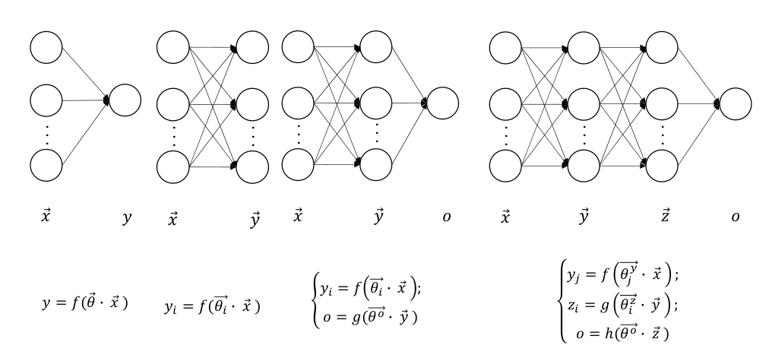
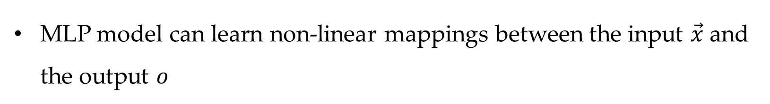
Multi-layer perceptron
From a single layer to multiple layers
MLP model can learn non-linear mappings between the input $\vec{x}$ and the output $o$

Slide 6
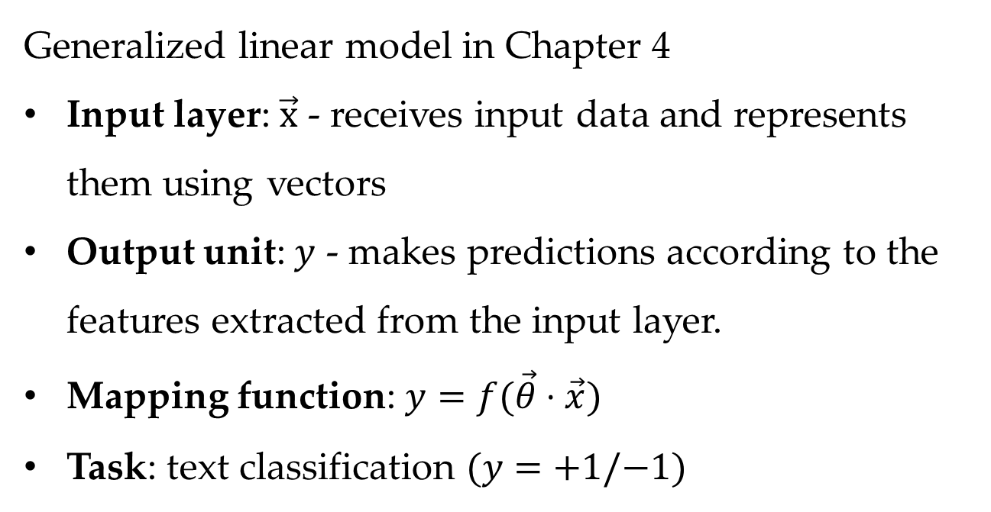
Single-layer perceptron
Generalized linear model in Chapter 4
Input layer: $\vec{x}$ - receives input data and represents them using vectors
Output unit: $y$ - makes predictions according to the features extracted from the input layer.
Mapping function: $y=f(\vec{θ}⋅\vec{x})$
Task: text classification $(y=+1/−1)$

Slide 7

Multi-outputs
Tasks:
$y_{1}=f(\vec{θ_{1}}⋅\vec{x})$ sentiment positive/negative
$y_{2}=f(\vec{θ_{2}}⋅\vec{x})$ document class sports/politics/$…$
$…$
$y_{i}=f(\vec{θ_{i}}⋅\vec{x})$ $…$

Slide 8
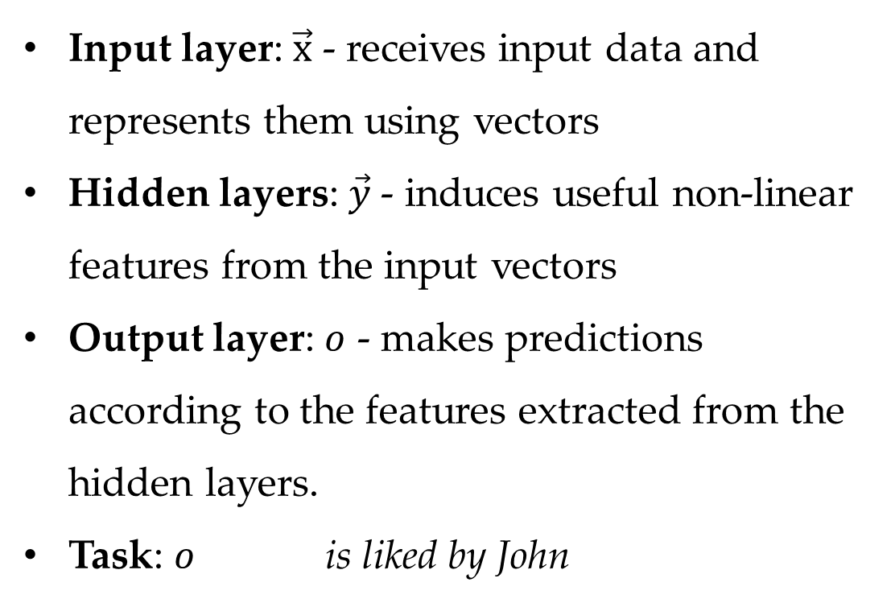
Two-layers
Input layer: $\vec{x}$ - receives input data and represents them using vectors
Hidden layers: $\vec{y}$- induces useful non-linear features from the input vectors
Output layer: $o$ - makes predictions according to the features extracted from the hidden layers.
Task: $o$ is liked by John

Slide 9
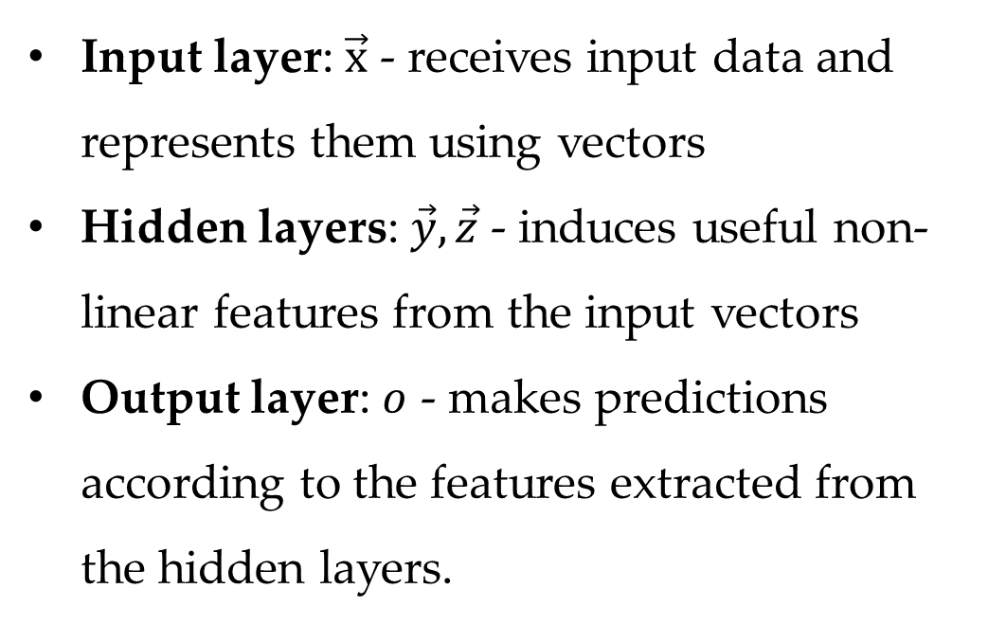
Three-layers
Input layer: $\vec{x}$ - receives input data and represents them using vectors
Hidden layers: $\vec{y},\vec{z}$ - induces useful non-linear features from the input vectors
Output layer: $o$ - makes predictions according to the features extracted from the hidden layers.

Slide 10
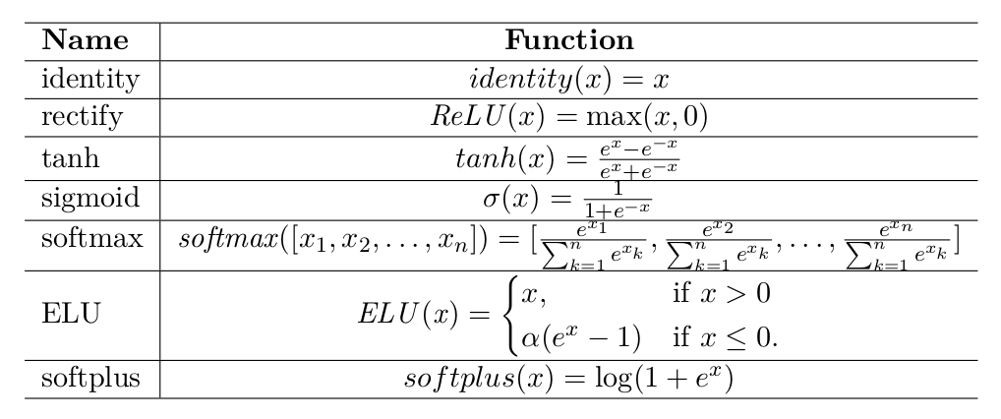
Activation function
Non-linear activation functions

Slide 11
Contents
13.1 From One Layer to Multiple Layers
13.1.1 Multi-Layer Perceptron for Text Classification
13.1.2 Training a Multi-Layer Perceptron
13.2 Building a Text Classifier without Manual Features
13.2.1 Word Embeddings
13.2.2 Sequence Encoding Layers
13.2.3 Output layer
13.2.4 Training
13.3 Improve Neural Network Training
13.3.1 Avoiding Gradient Issues
13.3.2 Better Generalization
13.3.3 Improving SGD Training for Neural Networks
13.3.4 Hyper-Parameter Search

Slide 12
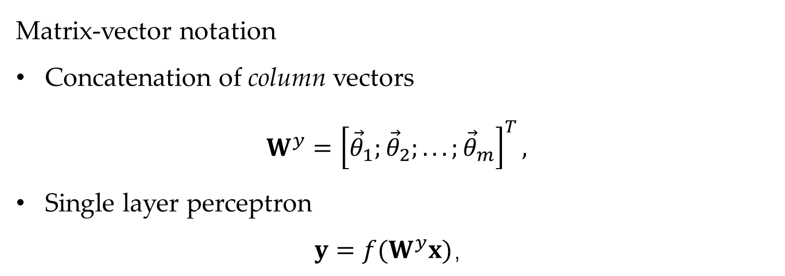
Neural network notation
Matrix-vector notation
Concatenation of column vectors
$$W^{y}={\left[{\vec{θ}}_{1};{\vec{θ}}_{2};...;{\vec{θ}}_{m}\right]}^{T},$$
Single layer perceptron
$$y=f(W^{y}x)，$$

Slide 13
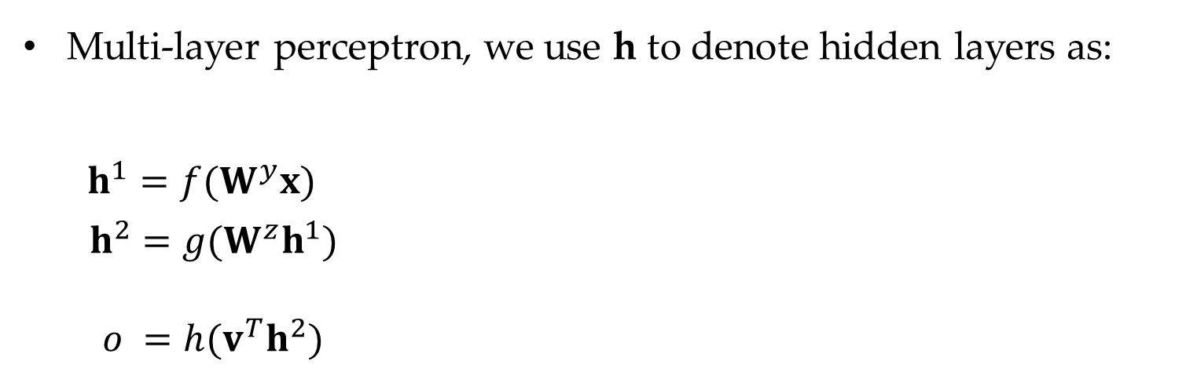
Matrix Vector Notation
Multi-layer perceptron, we use h to denote hidden layers as:
$$\begin{aligned}h^{1}=f(W^{y}x) \\ h^{2}=g(W^{z}h^{1}) \\ \end{aligned}$$
$o =h(v^{T}h^{2})$

Slide 14

Matrix Vector Notation
Multi-class classifier:
$$o=〈o_{1},o_{2},⋯,o_{m}〉$$
$$W^{o}={\left[v_{1};v_{2};⋯;v_{m}\right]}^{T}$$
As a result,
$$o=W^{o}h$$
Applying softmax function:
$$\left.p=softmax(o\right)$$

Slide 15
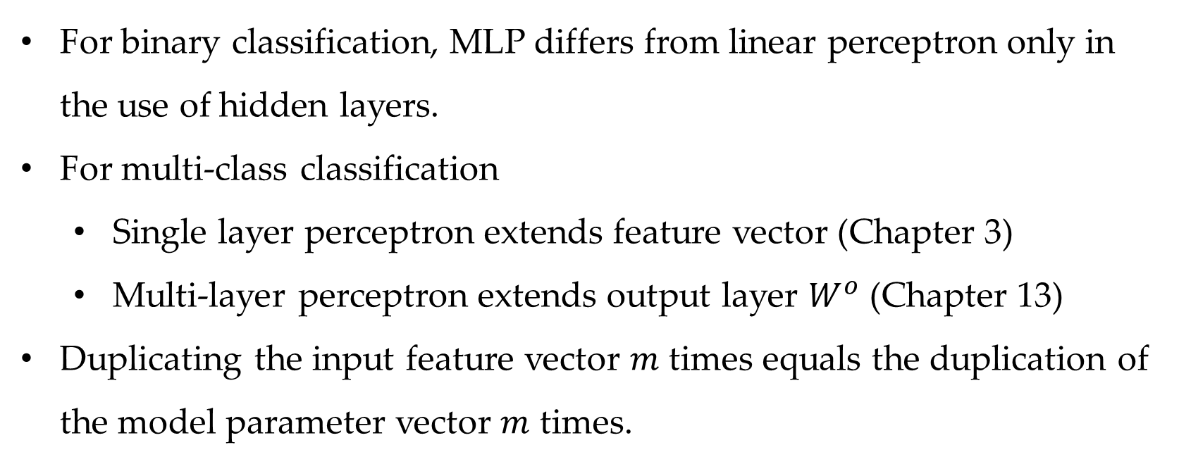
Correlation with linear classifier
For binary classification, MLP differs from linear perceptron only in the use of hidden layers.
For multi-class classification
Single layer perceptron extends feature vector (Chapter 3)
Multi-layer perceptron extends output layer $W^{o}$ (Chapter 13)
Duplicating the input feature vector $m$ times equals the duplication of the model parameter vector $m$ times.

Slide 16
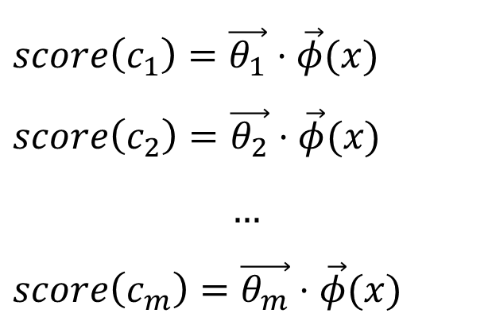
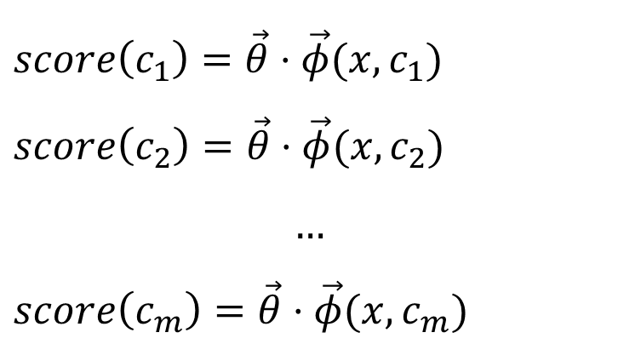
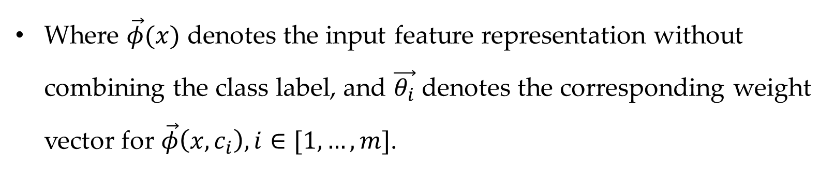
Correlation with linear classifier
$score\left(c_{1}\right)=\vec{θ}⋅\vec{φ}(x,c_{1})$
$score\left(c_{2}\right)=\vec{θ}⋅\vec{φ}(x,c_{2})$
$$…$$
$score\left(c_{m}\right)=\vec{θ}⋅\vec{φ}(x,c_{m})$
$score\left(c_{1}\right)=\vec{θ_{1}}⋅\vec{φ}(x)$
$score\left(c_{2}\right)=\vec{θ_{2}}⋅\vec{φ}(x)$
$$…$$
$score\left(c_{m}\right)=\vec{θ_{m}}⋅\vec{φ}(x)$
Where $\vec{φ}(x)$ denotes the input feature representation without combining the class label, and $\vec{θ_{i}}$ denotes the corresponding weight vector for $\vec{φ}\left(x,c_{i}\right), i∈[1,…,m]$.

Slide 17











Correlation with linear classifier
As a result, no matter for binary or multi-class classification, MLP differs from linear perceptron only in the use of hidden layers.
$$h$$
$$c_{1}$$
$$c_{1}$$
$$x$$
$$c_{2}$$
$$o$$
$$x$$
$$c_{2}$$
$$o$$
…
…
…
$$c_{m}$$
…
…
$$c_{m}$$
Single-layer perceptron for multiclass classification
Multi-layer perceptron for multiclass classification

Slide 18
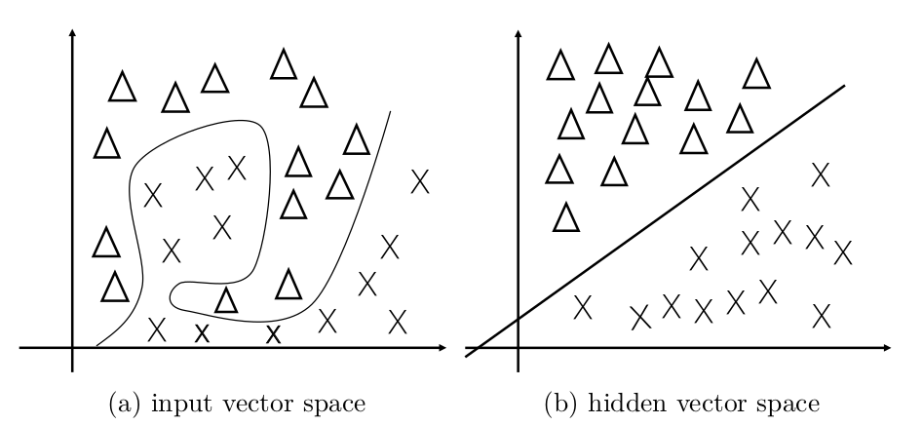
Characteristics of neural hidden layers and their representation power
Low dimensional
Dense, with nodes in real numbers
Dynamically calculated
The effect of hidden layer representation
Notes:
Add equation and figure
Extend feature vector ⬄ extend parameter vector

Slide 19
Contents
13.1 From One Layer to Multiple Layers
13.1.1 Multi-Layer Perceptron for Text Classification
13.1.2 Training a Multi-Layer Perceptron
13.2 Building a Text Classifier without Manual Features
13.2.1 Word Embeddings
13.2.2 Sequence Encoding Layers
13.2.3 Output layer
13.2.4 Training
13.3 Improve Neural Network Training
13.3.1 Avoiding Gradient Issues
13.3.2 Better Generalization
13.3.3 Improving SGD Training for Neural Networks
13.3.4 Hyper-Parameter Search

Slide 20
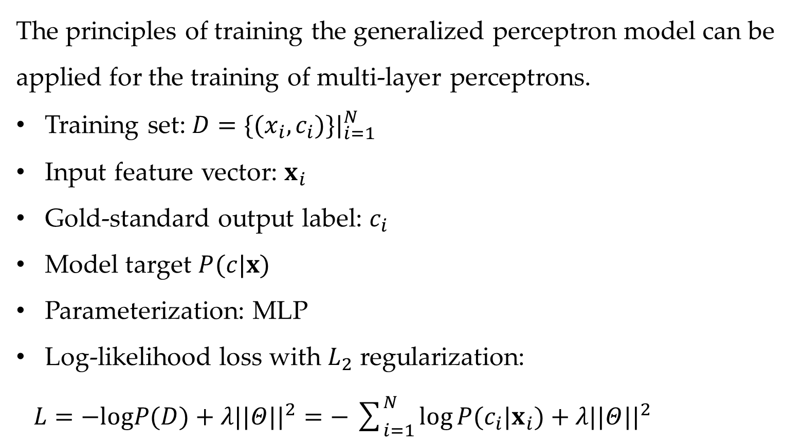
Training multi-layer perceptrons
The principles of training the generalized perceptron model can be applied for the training of multi-layer perceptrons.
Training set: $D=\{(x_{i},c_{i})\}|_{i=1}^{N}$
Input feature vector: $x_{i}$
Gold-standard output label: $c_{i}$
Model target $P(c|x)$
Parameterization: MLP
Log-likelihood loss with $L_{2}$ regularization:
$L=−logP(D)+λ||Θ||^{2}=−\sum_{i=1}^{N}{log}P(c_{i}|x_{i})+λ||Θ||^{2}$

Slide 21
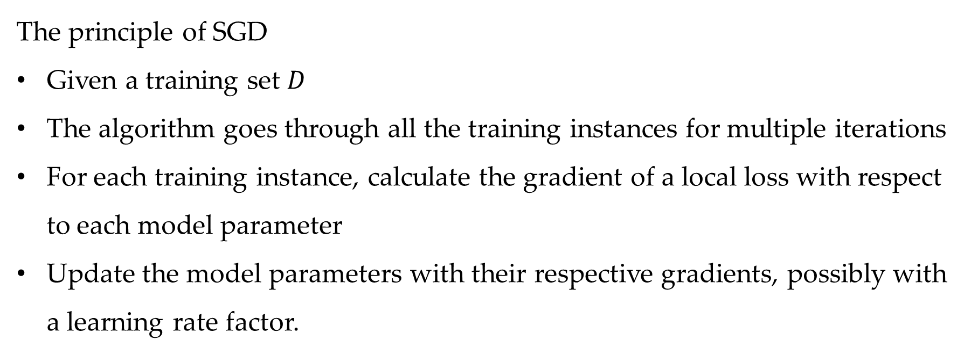
Training multi-layer perceptrons using SGD
The principle of SGD
Given a training set $D$
The algorithm goes through all the training instances for multiple iterations
For each training instance, calculate the gradient of a local loss with respect to each model parameter
Update the model parameters with their respective gradients, possibly with a learning rate factor.

Slide 22
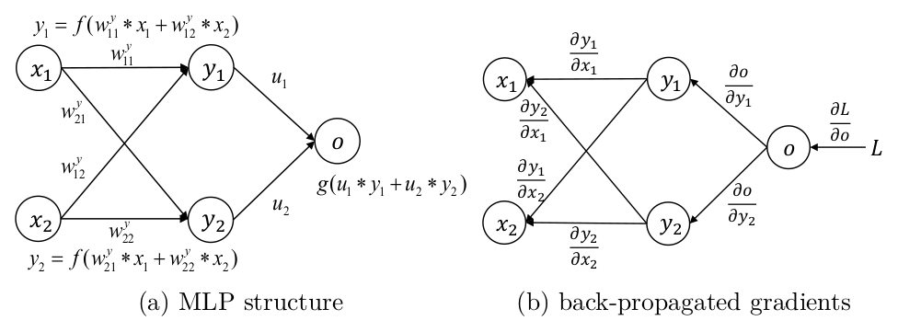
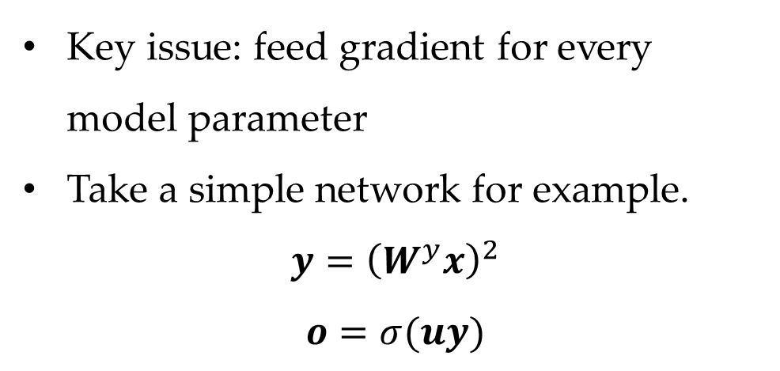
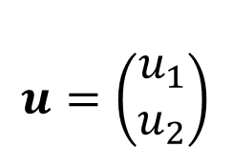
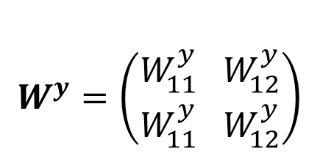
Training a neural network
Key issue: feed gradient for every model parameter
Take a simple network for example.
$$y={\left(W^{y}x\right)}^{2}$$
$$o=σ(uy)$$
$$W^{y}=\left(\begin{aligned}W_{11}^{y} W_{12}^{y} \\ W_{11}^{y} W_{12}^{y}\end{aligned}\right)$$
$$u=\left(\begin{aligned}u_{1} \\ u_{2}\end{aligned}\right)$$

Slide 23
Computation graph for a neural network
Now calculate gradients

Slide 25
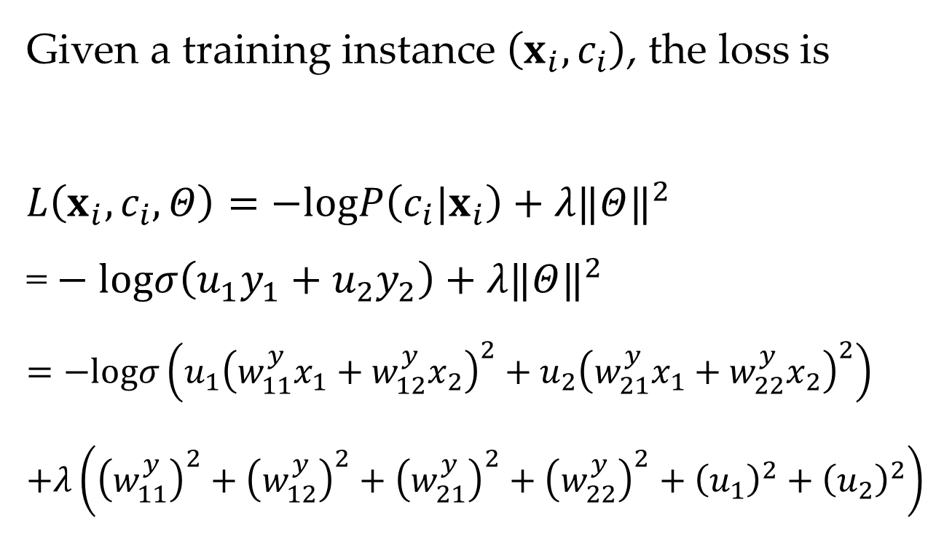
Loss function
Given a training instance $\left(x_{i},c_{i}\right)$, the loss is
$L\left(x_{i},c_{i},Θ\right)=−logP\left(c_{i}|x_{i}\right)+λ‖Θ‖^{2}$
$\text{=}−logσ\left(u_{1}y_{1}+u_{2}y_{2}\right)+λ‖Θ‖^{2}$
$=−logσ\left(u_{1}{\left(w_{11}^{y}x_{1}+w_{12}^{y}x_{2}\right)}^{2}+u_{2}{\left(w_{21}^{y}x_{1}+w_{22}^{y}x_{2}\right)}^{2}\right)$
$+λ\left({\left(w_{11}^{y}\right)}^{2}+{\left(w_{12}^{y}\right)}^{2}+{\left(w_{21}^{y}\right)}^{2}+{\left(w_{22}^{y}\right)}^{2}+{\left(u_{1}\right)}^{2}+{\left(u_{2}\right)}^{2}\right)$

Slide 26
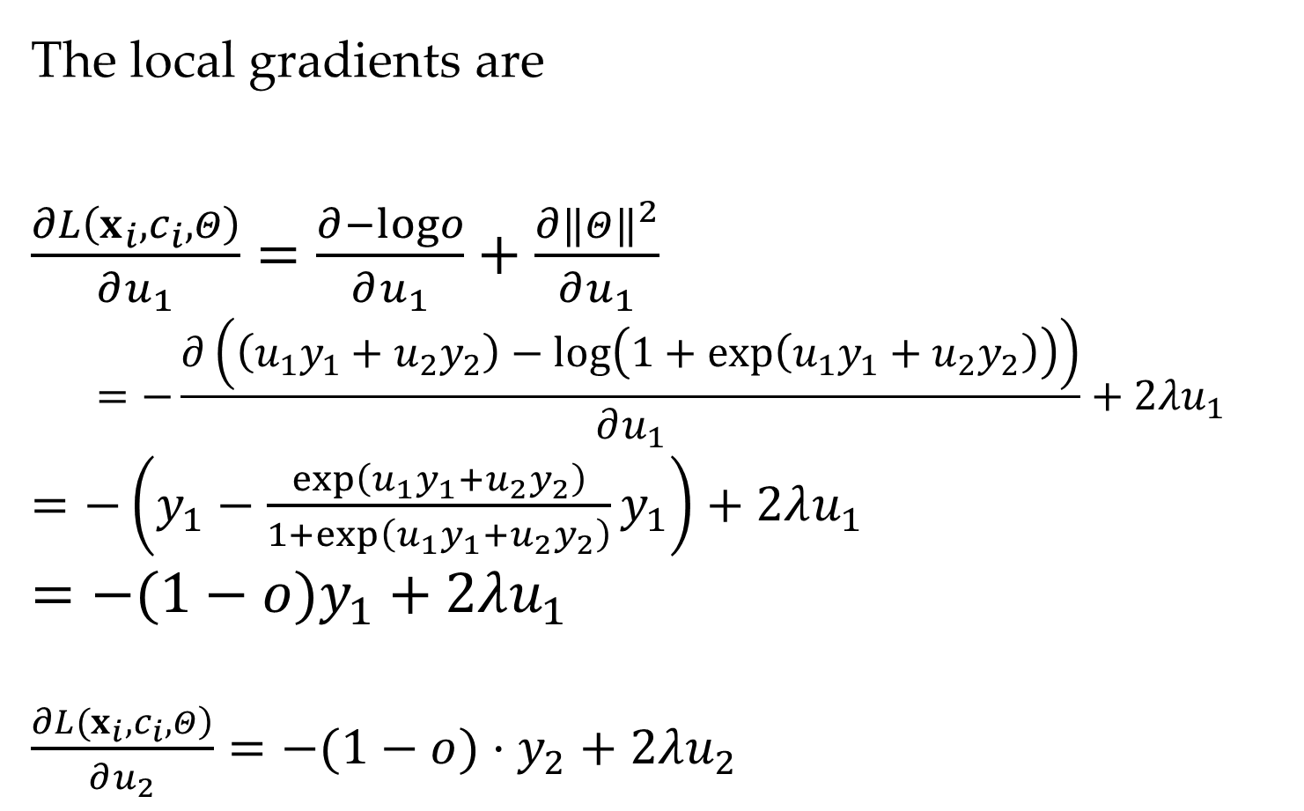
Gradients
The local gradients are
$\frac{∂L\left(x_{i},c_{i},Θ\right)}{∂u_{1}}=\frac{∂−logo}{∂u_{1}}+\frac{∂‖Θ‖^{2}}{∂u_{1}}$
$$=−\frac{∂\left(\left(u_{1}y_{1}+u_{2}y_{2}\right)−log\left(1+exp\left(u_{1}y_{1}+u_{2}y_{2}\right)\right)\right)}{∂u_{1}}+2λu_{1}$$
$=−\left(y_{1}−\frac{exp\left(u_{1}y_{1}+u_{2}y_{2}\right)}{1+exp\left(u_{1}y_{1}+u_{2}y_{2}\right)}y_{1}\right)+2λu_{1}$
$=−(1−o)y_{1}+2λu_{1}$
$\frac{\left.∂L(x_{i},c_{i},Θ\right)}{∂u_{2}}=−(1−o)⋅y_{2}+2λu_{2}$

Slide 27
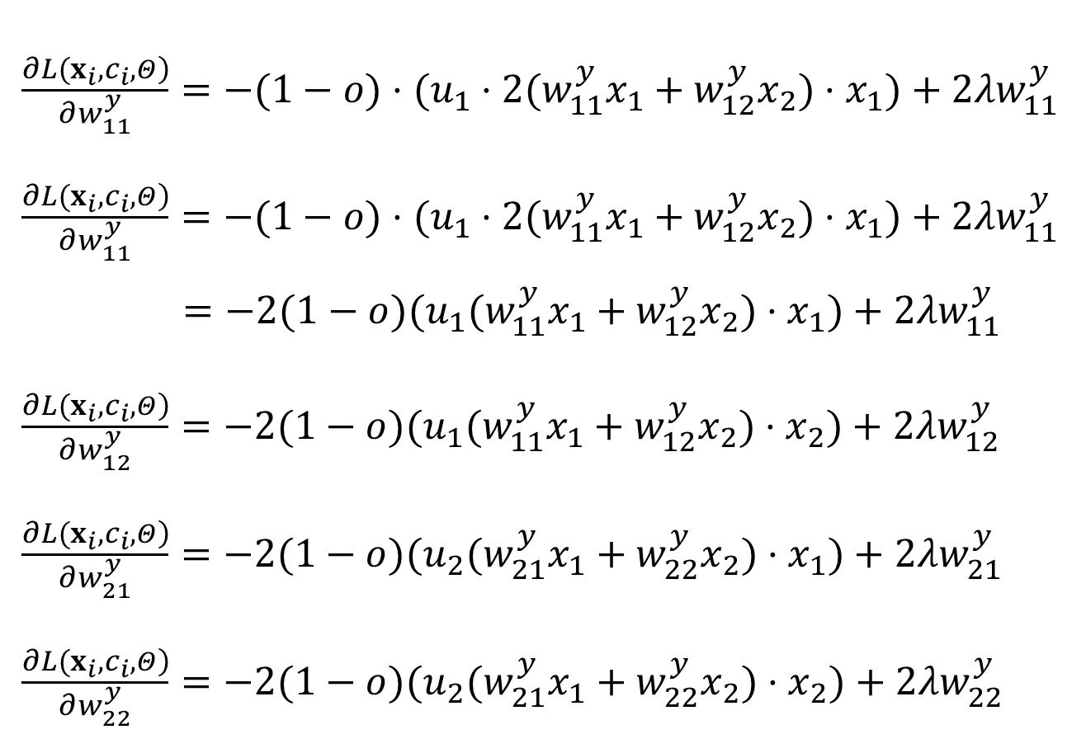
Gradients
$\frac{\left.∂L(x_{i},c_{i},Θ\right)}{∂w_{11}^{y}}=−(1−o)⋅(u_{1}⋅2(w_{11}^{y}x_{1}+w_{12}^{y}x_{2})⋅x_{1})+2λw_{11}^{y}$
$\frac{\left.∂L(x_{i},c_{i},Θ\right)}{∂w_{11}^{y}}=−(1−o)⋅(u_{1}⋅2(w_{11}^{y}x_{1}+w_{12}^{y}x_{2})⋅x_{1})+2λw_{11}^{y}$
$=−2(1−o)(u_{1}(w_{11}^{y}x_{1}+w_{12}^{y}x_{2})⋅x_{1})+2λw_{11}^{y}$
$\frac{\left.∂L(x_{i},c_{i},Θ\right)}{∂w_{12}^{y}}=−2(1−o)(u_{1}(w_{11}^{y}x_{1}+w_{12}^{y}x_{2})⋅x_{2})+2λw_{12}^{y}$
$\frac{\left.∂L(x_{i},c_{i},Θ\right)}{∂w_{21}^{y}}=−2(1−o)(u_{2}(w_{21}^{y}x_{1}+w_{22}^{y}x_{2})⋅x_{1})+2λw_{21}^{y}$
$\frac{\left.∂L(x_{i},c_{i},Θ\right)}{∂w_{22}^{y}}=−2(1−o)(u_{2}(w_{21}^{y}x_{1}+w_{22}^{y}x_{2})⋅x_{2})+2λw_{22}^{y}$

Slide 28

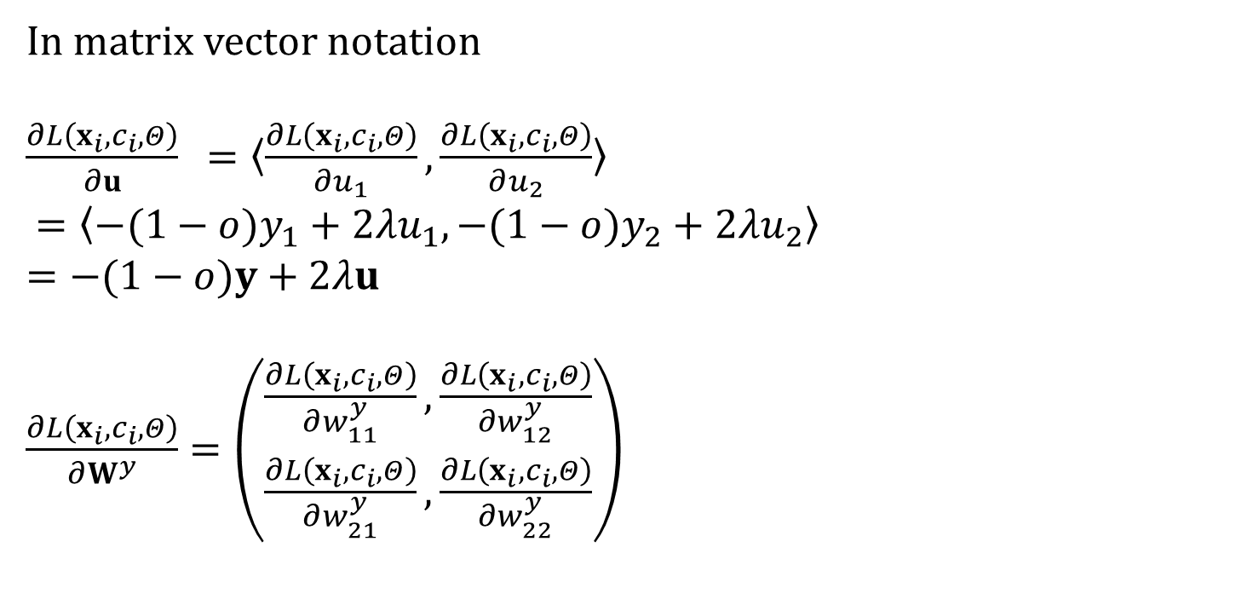
Matrix-vector notation of gradients
In matrix vector notation
$\frac{∂L\left(x_{i},c_{i},Θ\right)}{∂u} =〈\frac{∂L\left(x_{i},c_{i},Θ\right)}{∂u_{1}},\frac{∂L\left(x_{i},c_{i},Θ\right)}{∂u_{2}}〉$
$=〈−(1−o)y_{1}+2λu_{1},−(1−o)y_{2}+2λu_{2}〉$
$=−(1−o)y+2λu$
$\frac{∂L\left(x_{i},c_{i},Θ\right)}{∂W^{y}}=\left(\begin{matrix}\frac{∂L\left(x_{i},c_{i},Θ\right)}{∂w_{11}^{y}},\frac{∂L\left(x_{i},c_{i},Θ\right)}{∂w_{12}^{y}} \\ \frac{∂L\left(x_{i},c_{i},Θ\right)}{∂w_{21}^{y}},\frac{∂L\left(x_{i},c_{i},Θ\right)}{∂w_{22}^{y}}\end{matrix}\right)$
$$=−2\left(1−o\right)u⊗\left(W^{y}x\right)x^{T}$$

Slide 29
Contents
13.1 From One Layer to Multiple Layers
13.1.1 Multi-Layer Perceptron for Text Classification
13.1.2 Training a Multi-Layer Perceptron
13.2 Building a Text Classifier without Manual Features
13.2.1 Word Embeddings
13.2.2 Sequence Encoding Layers
13.2.3 Output layer
13.2.4 Training
13.3 Improve Neural Network Training
13.3.1 Avoiding Gradient Issues
13.3.2 Better Generalization
13.3.3 Improving SGD Training for Neural Networks
13.3.4 Hyper-Parameter Search

Slide 30
Computation graph for a neural network
Now calculate gradients

Slide 31
Back-propagation
The above process is tedious for large neural nets
Solution: perform modularized and incremental gradient calculation
Back-propagation allows modularization of neural network components in deep networks
the forward computation
the back-propagation rule
the partial derivative of the loss with respect to the model parameters
the partial derivative of the loss with respect to the input layer

Slide 32
Back-propagation
For each layer
the structure – input to output
the input -- gradient on output nodes
the computation
the partial derivative with respect to the model parameters
the partial derivative with respect to the input nodes

Slide 34
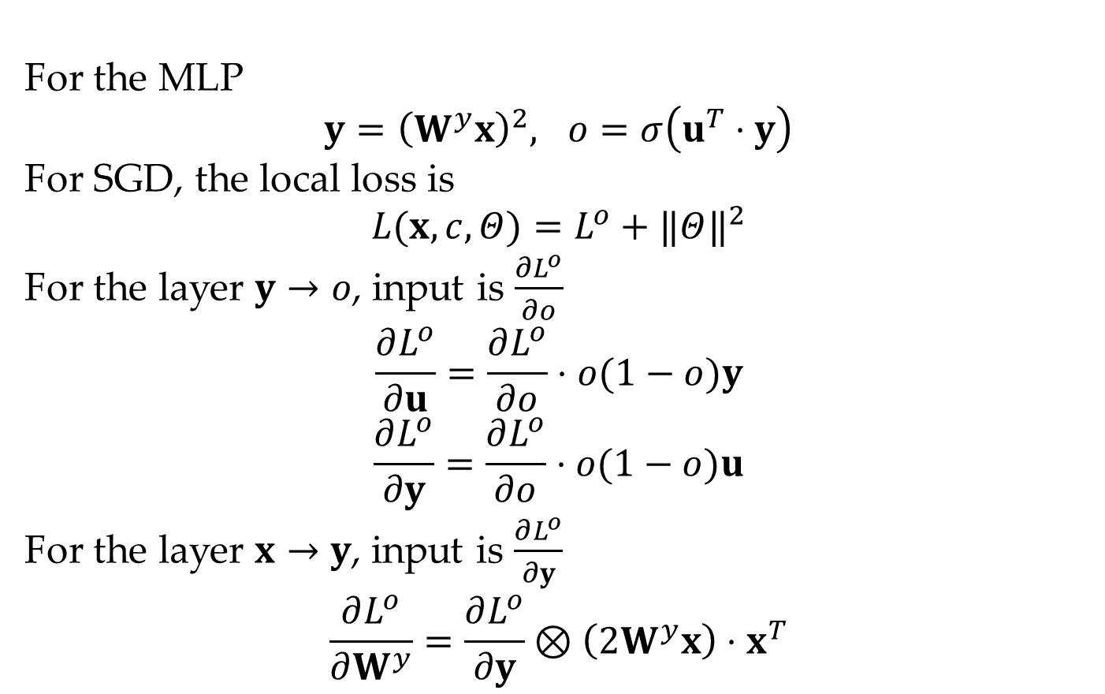
Back-propagation
For the MLP
$$y={\left(W^{y}x\right)}^{2}, o=σ\left(u^{T}⋅y\right)$$
For SGD, the local loss is
$$L(x,c,Θ)=L^{o}+‖Θ‖^{2}$$
For the layer $y→o$, input is $\frac{∂L^{o}}{∂o}$
$$\frac{∂L^{o}}{∂u}=\frac{∂L^{o}}{∂o}⋅o(1−o)y$$
$$\frac{∂L^{o}}{∂y}=\frac{∂L^{o}}{∂o}⋅o(1−o)u$$
For the layer $x→y$, input is $\frac{∂L^{o}}{∂y}$
$$\frac{∂L^{o}}{∂W^{y}}=\frac{∂L^{o}}{∂y}⊗\left(2W^{y}x\right)⋅x^{T}$$

Slide 35
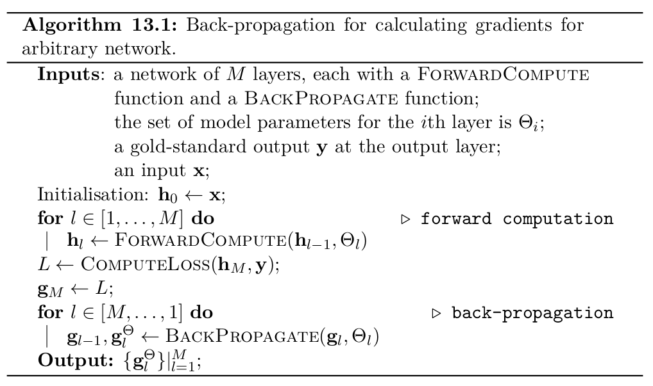
Back-propagation for calculating gradients for arbitrary network

Slide 36
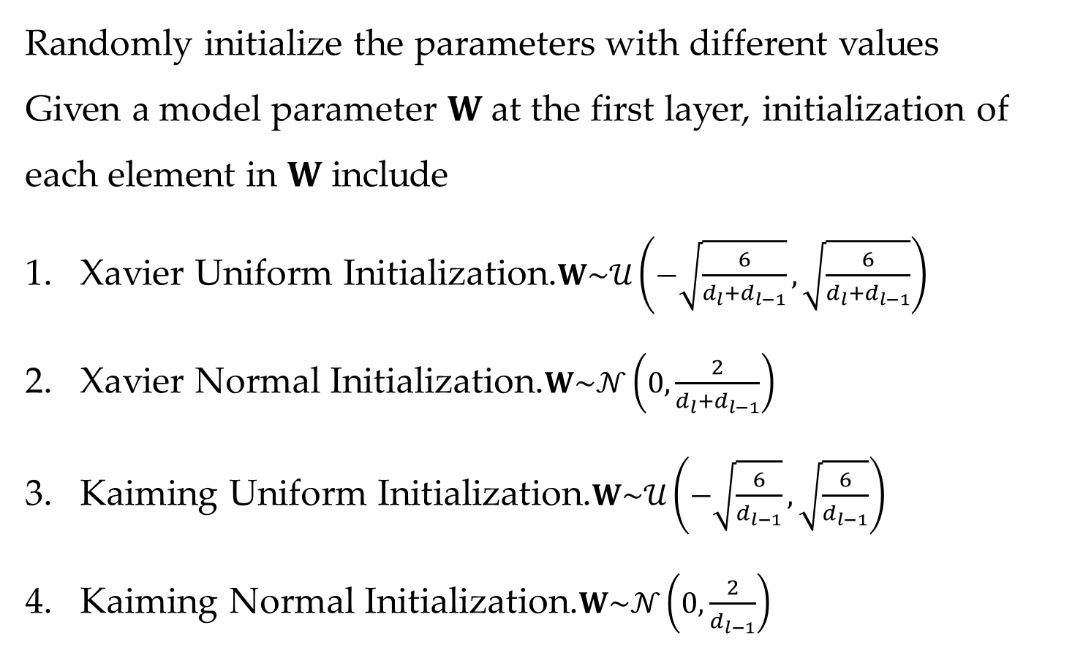
Parameter Initialization
Randomly initialize the parameters with different values
Given a model parameter $W$ at the first layer, initialization of each element in $W$ include
Xavier Uniform Initialization.$W\sim 𝒰\left(−\sqrt{\frac{6}{d_{l}+d_{l−1}}},\sqrt{\frac{6}{d_{l}+d_{l−1}}}\right)$
Xavier Normal Initialization.$W\sim 𝒩\left(0,\frac{2}{d_{l}+d_{l−1}}\right)$
Kaiming Uniform Initialization.$W\sim 𝒰\left(−\sqrt{\frac{6}{d_{l−1}}},\sqrt{\frac{6}{d_{l−1}}}\right)$
Kaiming Normal Initialization.$W\sim 𝒩\left(0,\frac{2}{d_{l−1}}\right)$
Notes:
Randomly init hidden values?

Slide 37
Contents
13.1 From One Layer to Multiple Layers
13.1.1 Multi-Layer Perceptron for Text Classification
13.1.2 Training a Multi-Layer Perceptron
13.2 Building a Text Classifier without Manual Features
13.2.1 Word Embeddings
13.2.2 Sequence Encoding Layers
13.2.3 Output layer
13.2.4 Training
13.3 Improve Neural Network Training
13.3.1 Avoiding Gradient Issues
13.3.2 Better Generalization
13.3.3 Improving SGD Training for Neural Networks
13.3.4 Hyper-Parameter Search

Slide 38
Neural Text Classification Structure
Neural hidden layers are dense low-dimensional vectors
Input still discrete sparse high-dimensional
…
…
…
…
…
…
…

Slide 39
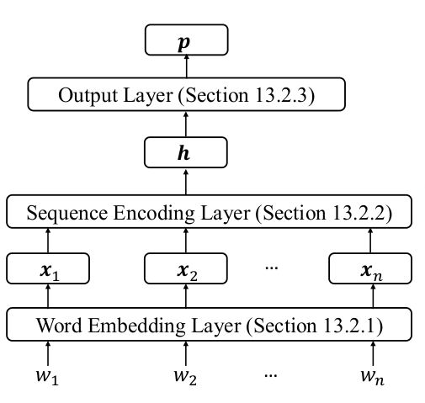
Neural Text Classification Structure
Represent each word in the sentence also using a dense low-dimensional vector, called word embedding.
Use a sequence encoding network to extract hidden features automatically.

Slide 40
Contents
13.1 From One Layer to Multiple Layers
13.1.1 Multi-Layer Perceptron for Text Classification
13.1.2 Training a Multi-Layer Perceptron
13.2 Building a Text Classifier without Manual Features
13.2.1 Word Embeddings
13.2.2 Sequence Encoding Layers
13.2.3 Output layer
13.2.4 Training
13.3 Improve Neural Network Training
13.3.1 Avoiding Gradient Issues
13.3.2 Better Generalization
13.3.3 Improving SGD Training for Neural Networks
13.3.4 Hyper-Parameter Search

Slide 41
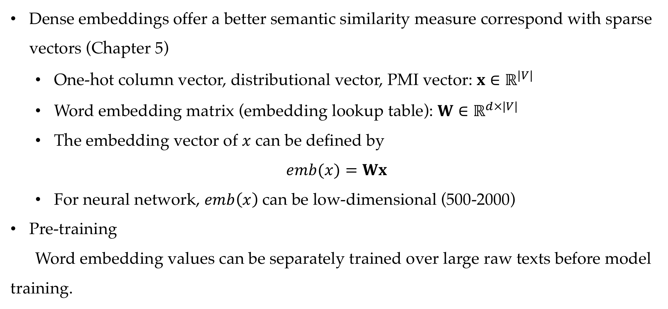
Embedding layer
Dense embeddings offer a better semantic similarity measure correspond with sparse vectors (Chapter 5)
One-hot column vector, distributional vector, PMI vector: $x∈ℝ^{|V|}$
Word embedding matrix (embedding lookup table): $W∈ℝ^{d×|V|}$
The embedding vector of $x$ can be defined by
$$emb(x)=Wx$$
For neural network, $emb\left(x\right)$can be low-dimensional (500-2000)
Pre-training
Word embedding values can be separately trained over large raw texts before model training.

Slide 42
Contents
13.1 From One Layer to Multiple Layers
13.1.1 Multi-Layer Perceptron for Text Classification
13.1.2 Training a Multi-Layer Perceptron
13.2 Building a Text Classifier without Manual Features
13.2.1 Word Embeddings
13.2.2 Sequence Encoding Layers
13.2.3 Output layer
13.2.4 Training
13.3 Improve Neural Network Training
13.3.1 Avoiding Gradient Issues
13.3.2 Better Generalization
13.3.3 Improving SGD Training for Neural Networks
13.3.4 Hyper-Parameter Search

Slide 43
Sequence encoder
A subnetwork that transforms a sequence of dense vectors into a single dense vector that represents features over the whole sequence.
Pooling
Convolutional network
Recurrent neural network
Attentional neural network

Slide 44
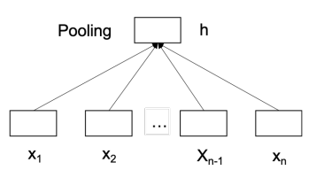
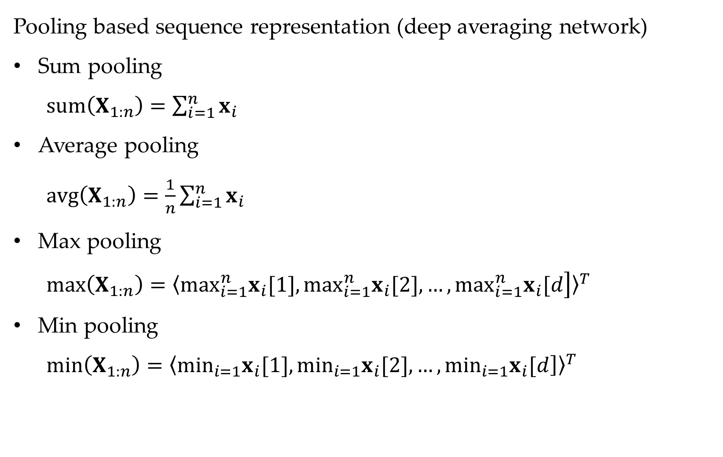
Pooling
Pooling based sequence representation (deep averaging network)
Sum pooling
$sum\left(X_{1:n}\right)=\sum_{i=1}^{n}{x_{i}}$
Average pooling
$avg\left(X_{1:n}\right)=\frac{1}{n}\sum_{i=1}^{n}{x_{i}}$
Max pooling
$max\left(X_{1:n}\right)={〈\left.\max_{i=1}^{n}x_{i}[1],\max_{i=1}^{n}x_{i}[2],…,\max_{i=1}^{n}x_{i}[d\right]〉}^{T}$
Min pooling
$min\left(X_{1:n}\right)={〈\left.\min_{i=1}x_{i}[1],\min_{i=1}x_{i}[2],…,\min_{i=1}x_{i}[d\right]〉}^{T}$

Slide 45
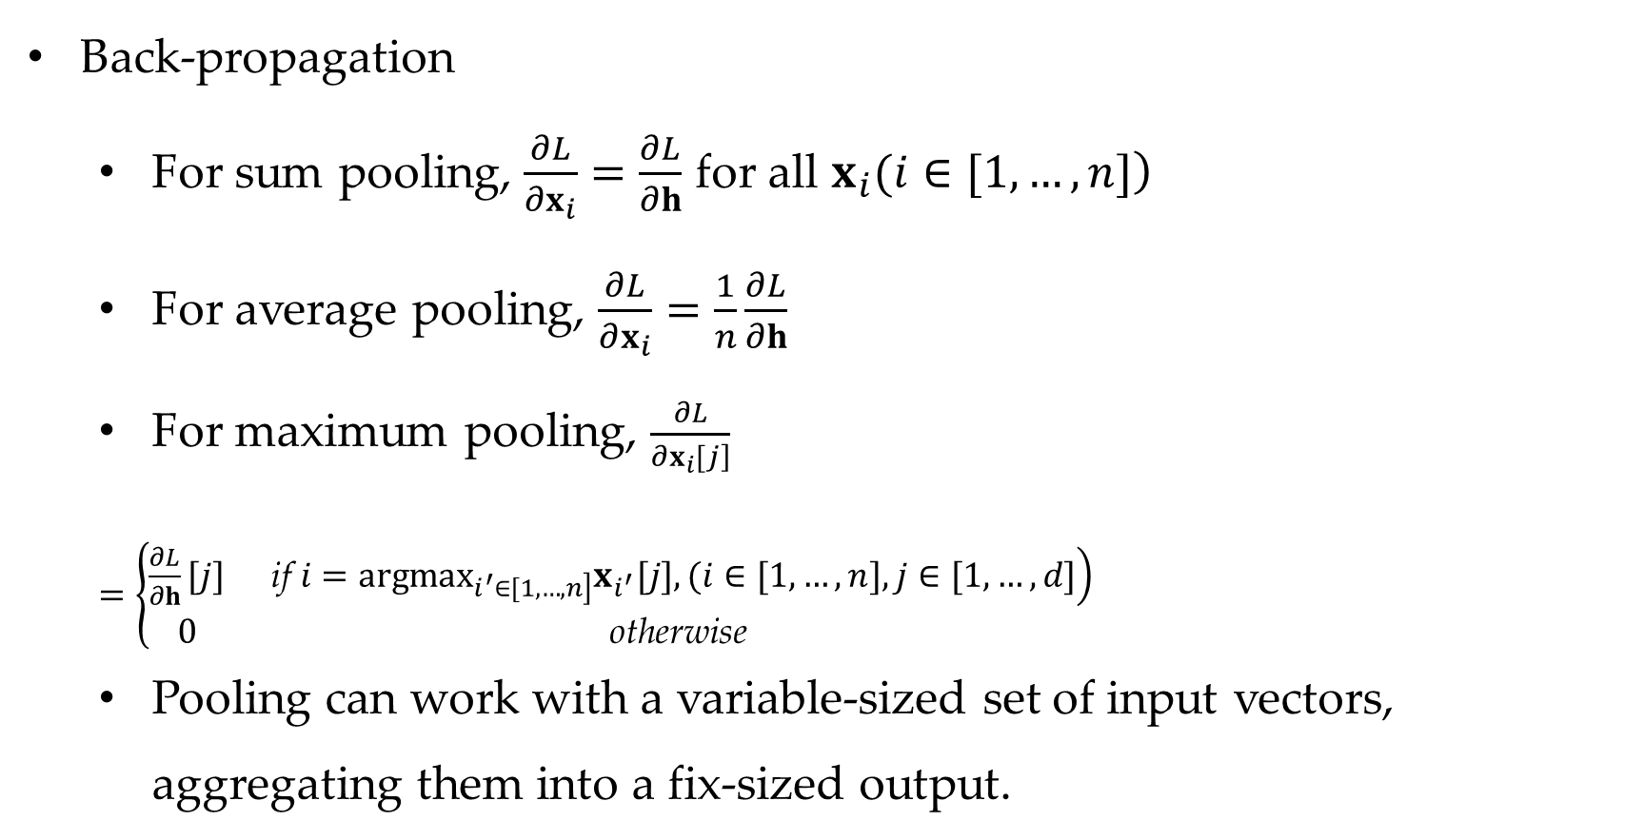
Pooling
Back-propagation
For sum pooling, $\frac{∂L}{∂x_{i}}=\frac{∂L}{∂h}$ for all $\left.x_{i}(i∈[1,…,n]\right)$
For average pooling, $\frac{∂L}{∂x_{i}}=\frac{1}{n}\frac{∂L}{∂h}$
For maximum pooling, $\frac{∂L}{\left.∂x_{i}[j\right]}$
$=\left\{\begin{matrix}\frac{∂L}{∂h}[j] & \left. \text{if} i=arg\max_{\left.i^{′}∈[1,…,n\right]}x_{i^{′}}[j],(i∈[1,…,n],j∈[1,…,d]\right) \\ 0 & \text{otherwise} \end{matrix}\right.$
Pooling can work with a variable-sized set of input vectors, aggregating them into a fix-sized output.

Slide 46
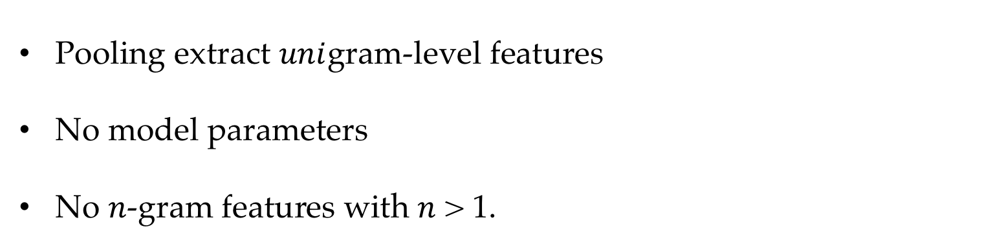
Convolutional neural network (CNN)
Pooling extract $uni$gram-level features
No model parameters
No $n$-gram features with $n$ > 1.

Slide 47
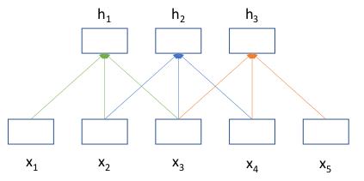
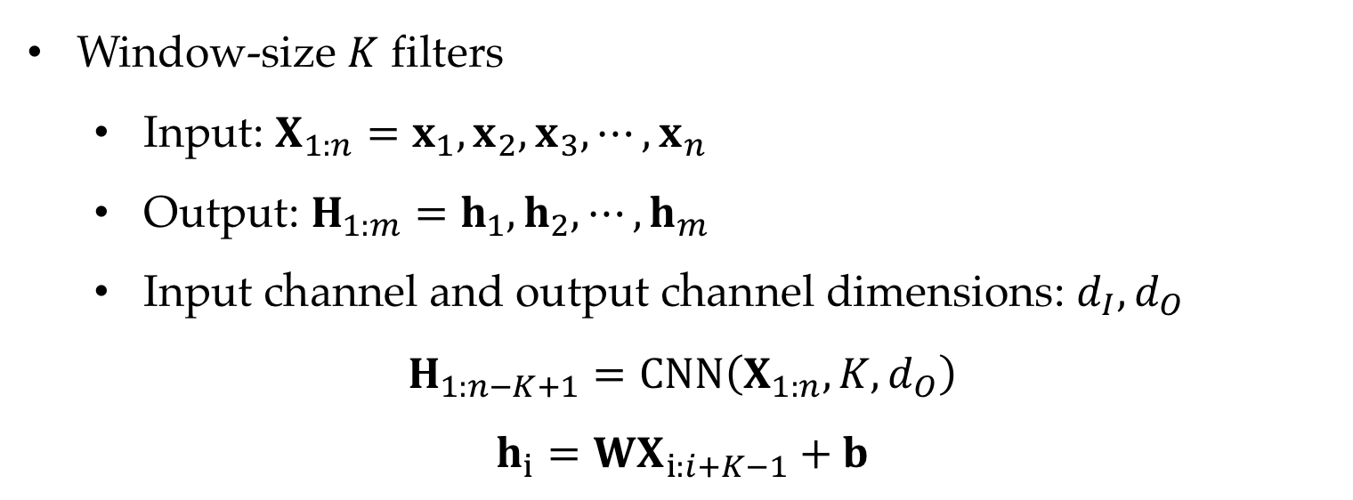
Convolutional neural network (CNN)
Use convolutional filters to extract n-gram features
Window-size $K$ filters
Input: $X_{1:n}=x_{1},x_{2},x_{3},⋯,x_{n}$
Output: $H_{1:m}=h_{1},h_{2},⋯,h_{m}$
Input channel and output channel dimensions: $d_{I},d_{O}$
$$H_{1:n−K+1}=CNN\left(X_{1:n},K,d_{O}\right)$$
$$h_{i}=WX_{i:i+K−1}+b$$

Slide 48
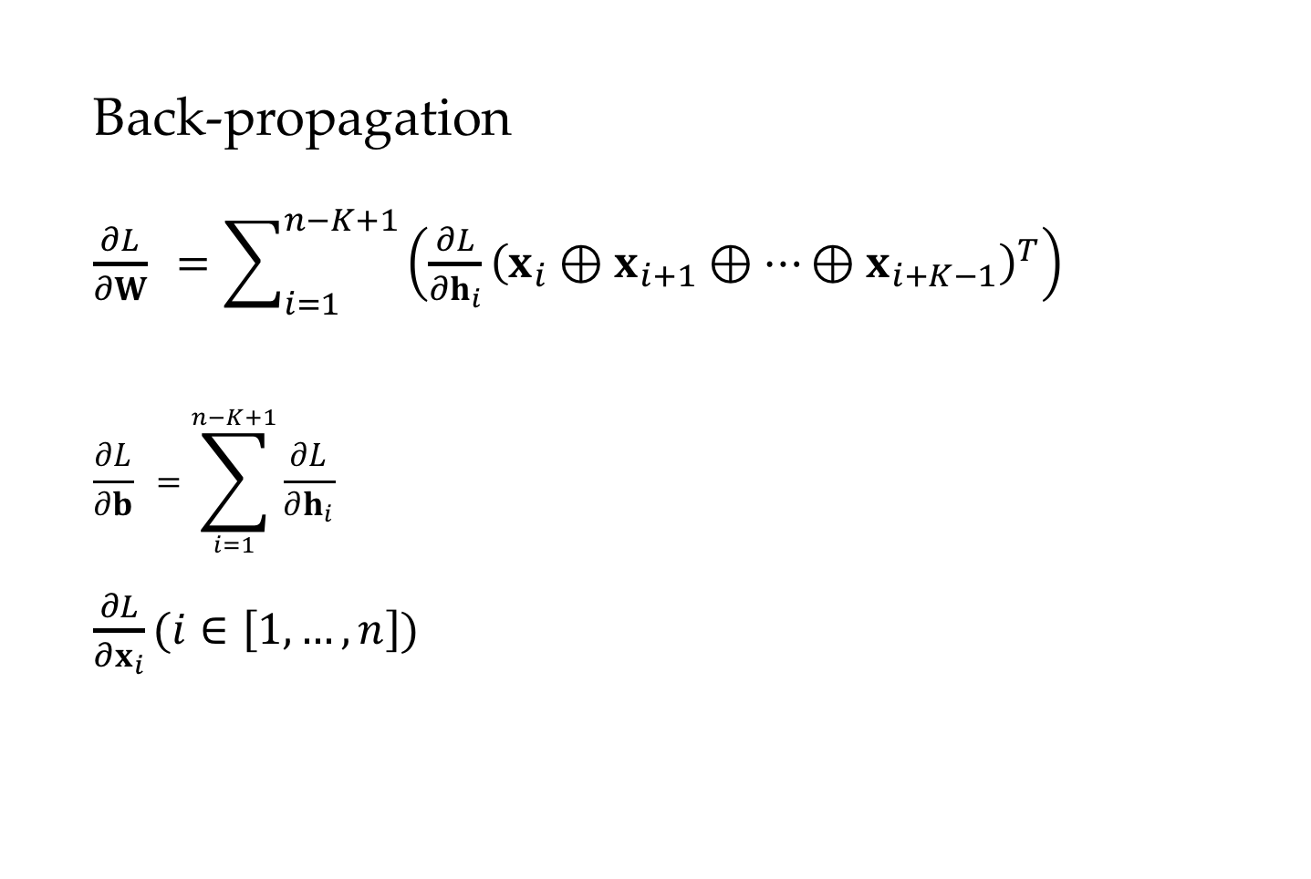
Convolutional neural network (CNN)
Back-propagation
$\frac{∂L}{∂W} =\sum_{i=1}^{n−K+1}{\left(\frac{∂L}{∂h_{i}}{\left(x_{i}⊕x_{i+1}⊕…⊕x_{i+K−1}\right)}^{T}\right)}$
$$\frac{∂L}{∂b} =\sum_{i=1}^{n−K+1}{\frac{∂L}{∂h_{i}}}$$
$\frac{∂L}{∂x_{i}}(i∈\left[1,…,n\right])$

Slide 49
Comparison with discrete n-gram features
CNN features are different from Chapter3 feature vectors
Dense and low-dimensional
Dynamically computed
Adjustable during training

Slide 50
Contents
13.1 From One Layer to Multiple Layers
13.1.1 Multi-Layer Perceptron for Text Classification
13.1.2 Training a Multi-Layer Perceptron
13.2 Building a Text Classifier without Manual Features
13.2.1 Word Embeddings
13.2.2 Sequence Encoding Layers
13.2.3 Output layer
13.2.4 Training
13.3 Improve Neural Network Training
13.3.1 Avoiding Gradient Issues
13.3.2 Better Generalization
13.3.3 Improving SGD Training for Neural Networks
13.3.4 Hyper-Parameter Search

Slide 51
Neural Text Classififcation Structure
Represent each word in the sentence also using a dense low-dimensional vector, called word embedding.
Find a single hidden vector for the sequence.

Slide 52
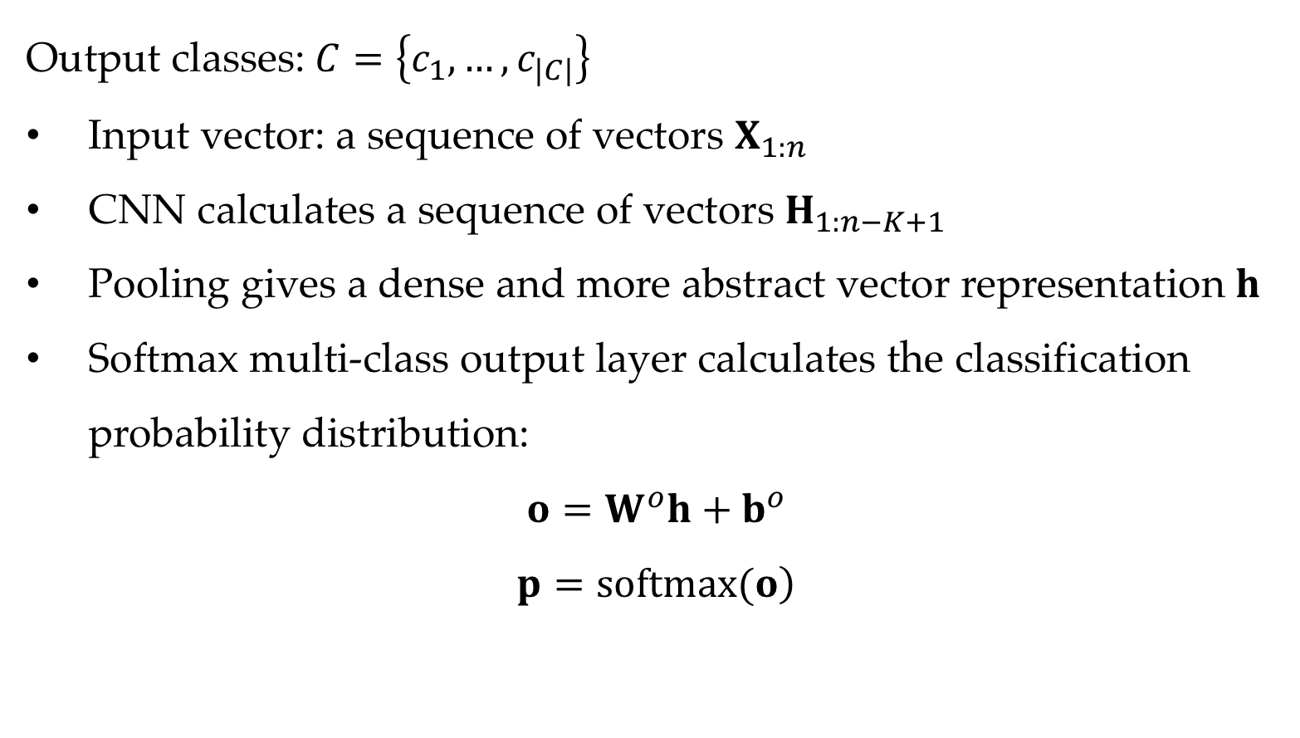
Output layer
Output classes:$C=\left\{c_{1},…,c_{|C|}\right\}$
Input vector: a sequence of vectors $X_{1:n}$
CNN calculates a sequence of vectors $H_{1:n−K+1}$
Pooling gives a dense and more abstract vector representation $h$
Softmax multi-class output layer calculates the classification probability distribution:
$$o=W^{o}h+b^{o}$$
$$\left.p=softmax(o\right)$$

Slide 53
Contents
13.1 From One Layer to Multiple Layers
13.1.1 Multi-Layer Perceptron for Text Classification
13.1.2 Training a Multi-Layer Perceptron
13.2 Building a Text Classifier without Manual Features
13.2.1 Word Embeddings
13.2.2 Sequence Encoding Layers
13.2.3 Output layer
13.2.4 Training
13.3 Improve Neural Network Training
13.3.1 Avoiding Gradient Issues
13.3.2 Better Generalization
13.3.3 Improving SGD Training for Neural Networks
13.3.4 Hyper-Parameter Search

Slide 54
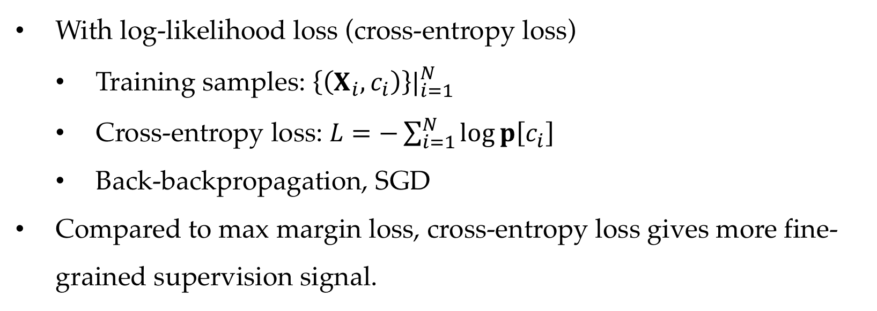
Training under the SGD framework
With log-likelihood loss (cross-entropy loss)
Training samples: ${\left\{\left(X_{i},c_{i}\right)\right\}|}_{i=1}^{N}$
Cross-entropy loss: $L=−\sum_{i=1}^{N}{log}p\left[c_{i}\right]$
Back-backpropagation, SGD
Compared to max margin loss, cross-entropy loss gives more fine-grained supervision signal.

Slide 55
Contents
13.1 From One Layer to Multiple Layers
13.1.1 Multi-Layer Perceptron for Text Classification
13.1.2 Training a Multi-Layer Perceptron
13.2 Building a Text Classifier without Manual Features
13.2.1 Word Embeddings
13.2.2 Sequence Encoding Layers
13.2.3 Output layer
13.2.4 Training
13.3 Improve Neural Network Training
13.3.1 Avoiding Gradient Issues
13.3.2 Better Generalization
13.3.3 Improving SGD Training for Neural Networks
13.3.4 Hyper-Parameter Search

Slide 56
Neural network models are difficult to train
Train arbitrary hyper-surface shapes in a high-dimensional vector space
Gradient diminishing -- Back-propagated gradients can become negligibly small through layers
Gradient explosion – Back-propagated gradients become infinitely large causing numerical overflow
Tendency of overfitting

Slide 57
Contents
13.1 From One Layer to Multiple Layers
13.1.1 Multi-Layer Perceptron for Text Classification
13.1.2 Training a Multi-Layer Perceptron
13.2 Building a Text Classifier without Manual Features
13.2.1 Word Embeddings
13.2.2 Sequence Encoding Layers
13.2.3 Output layer
13.2.4 Training
13.3 Improve Neural Network Training
13.3.1 Avoiding Gradient Issues
13.3.2 Better Generalization
13.3.3 Improving SGD Training for Neural Networks
13.3.4 Hyper-Parameter Search

Slide 58
Avoid Gradient Explosion
Gradient clipping
Prevent gradient being too large by consulting hard threshold values

Slide 59
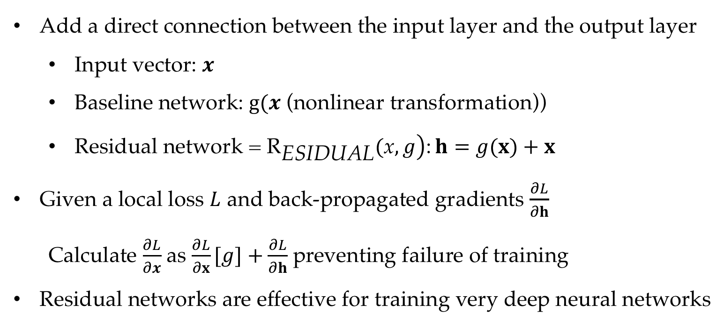
Residual network
Add a direct connection between the input layer and the output layer
Input vector: $x$
Baseline network: $g(x$ (nonlinear transformation))
Residual network = $\left.{\text{R}}_{\text{ESIDUAL}}(\text{x},g\right)$: $h=g(x)+x$
Given a local loss $L$ and back-propagated gradients $\frac{∂L}{∂h}$
Calculate $\frac{∂L}{∂x}$ as $\frac{∂L}{∂x}[g]+\frac{∂L}{∂h}$ preventing failure of training
Residual networks are effective for training very deep neural networks

Slide 60
Contents
13.1 From One Layer to Multiple Layers
13.1.1 Multi-Layer Perceptron for Text Classification
13.1.2 Training a Multi-Layer Perceptron
13.2 Building a Text Classifier without Manual Features
13.2.1 Word Embeddings
13.2.2 Sequence Encoding Layers
13.2.3 Output layer
13.2.4 Training
13.3 Improve Neural Network Training
13.3.1 Avoiding Gradient Issues
13.3.2 Better Generalization
13.3.3 Improving SGD Training for Neural Networks
13.3.4 Hyper-Parameter Search

Slide 61
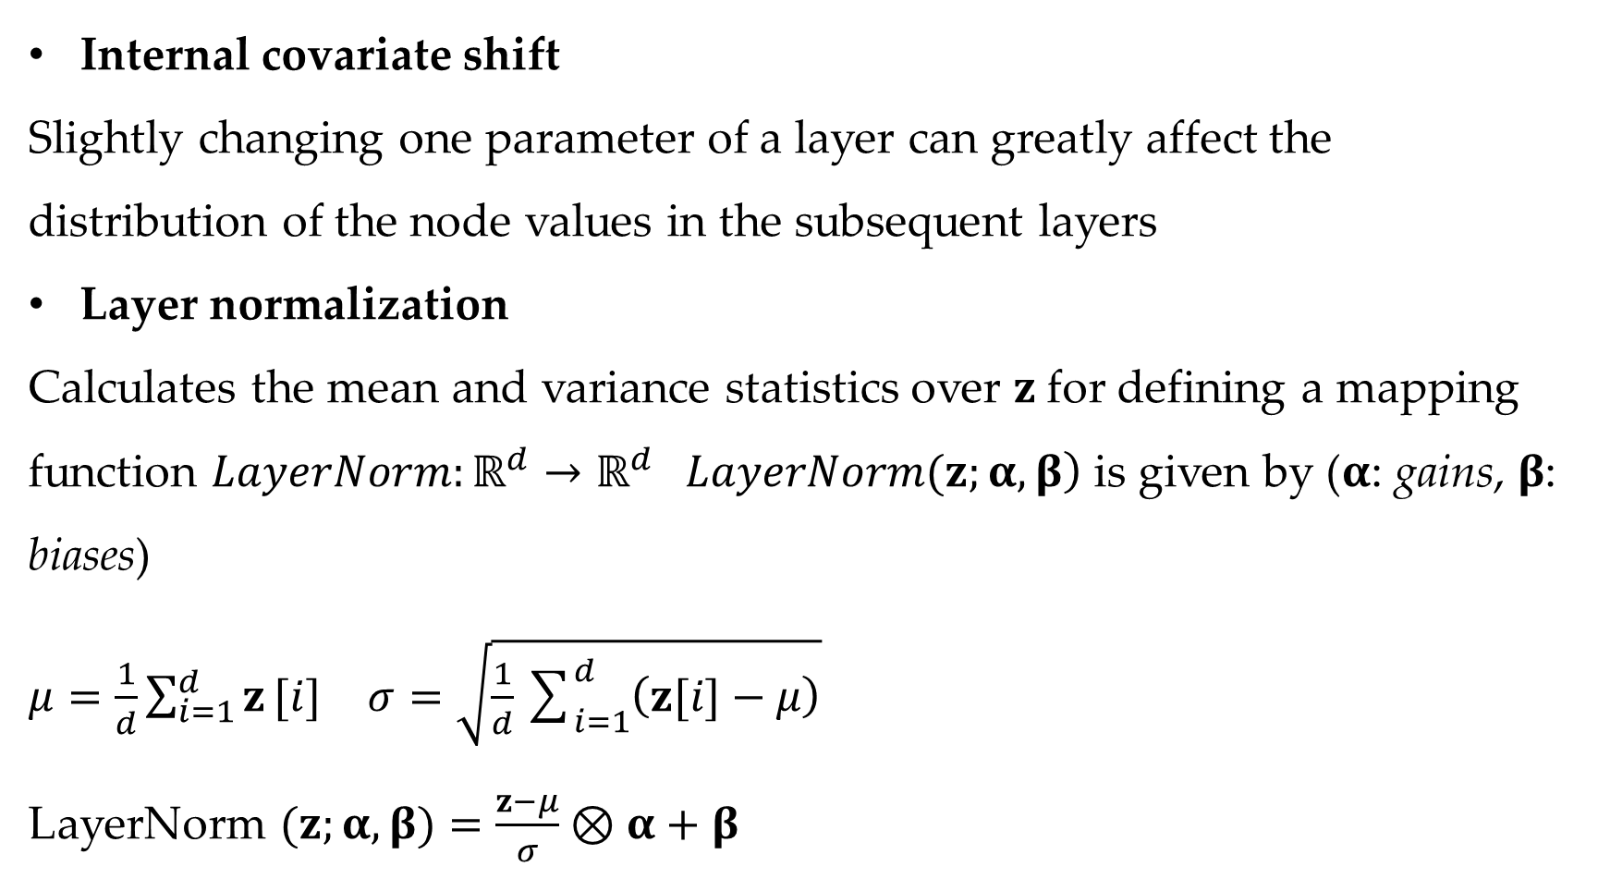
Layer Normalization
Internal covariate shift
Slightly changing one parameter of a layer can greatly affect the distribution of the node values in the subsequent layers
Layer normalization
Calculates the mean and variance statistics over $z$for defining a mapping function $LayerNorm:ℝ^{d}→ℝ^{d} \left.LayerNorm(z;α,β\right)$ is given by ($α$: gains, $β$: biases)
$μ=\frac{1}{d}\sum_{i=1}^{d}{z}[i]$ $σ=\sqrt{\frac{1}{d}\sum_{i=1}^{d}{\left(z[i]−μ\right)}}$
LayerNorm $(z;α,β)=\frac{z−μ}{σ}⊗α+β$

Slide 62
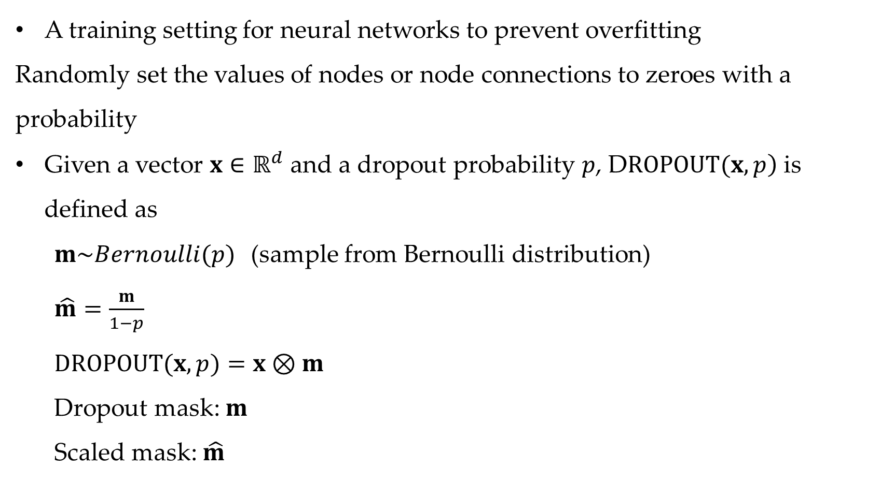
Dropout
A training setting for neural networks to prevent overfitting
Randomly set the values of nodes or node connections to zeroes with a probability
Given a vector $x∈ℝ^{d}$ and a dropout probability $p$, $\left.\text{D}ROPOUT(x,p\right)$ is defined as
$m\sim Bernoulli(p)$(sample from Bernoulli distribution)
$\hat{m}=\frac{m}{1−p}$
$DROPOUT(x,p)=x⊗m$
Dropout mask: $m$
Scaled mask: $\hat{m}$

Slide 63
Contents
13.1 From One Layer to Multiple Layers
13.1.1 Multi-Layer Perceptron for Text Classification
13.1.2 Training a Multi-Layer Perceptron
13.2 Building a Text Classifier without Manual Features
13.2.1 Word Embeddings
13.2.2 Sequence Encoding Layers
13.2.3 Output layer
13.2.4 Training
13.3 Improve Neural Network Training
13.3.1 Avoiding Gradient Issues
13.3.2 Better Generalization
13.3.3 Improving SGD Training for Neural Networks
13.3.4 Hyper-Parameter Search

Slide 64
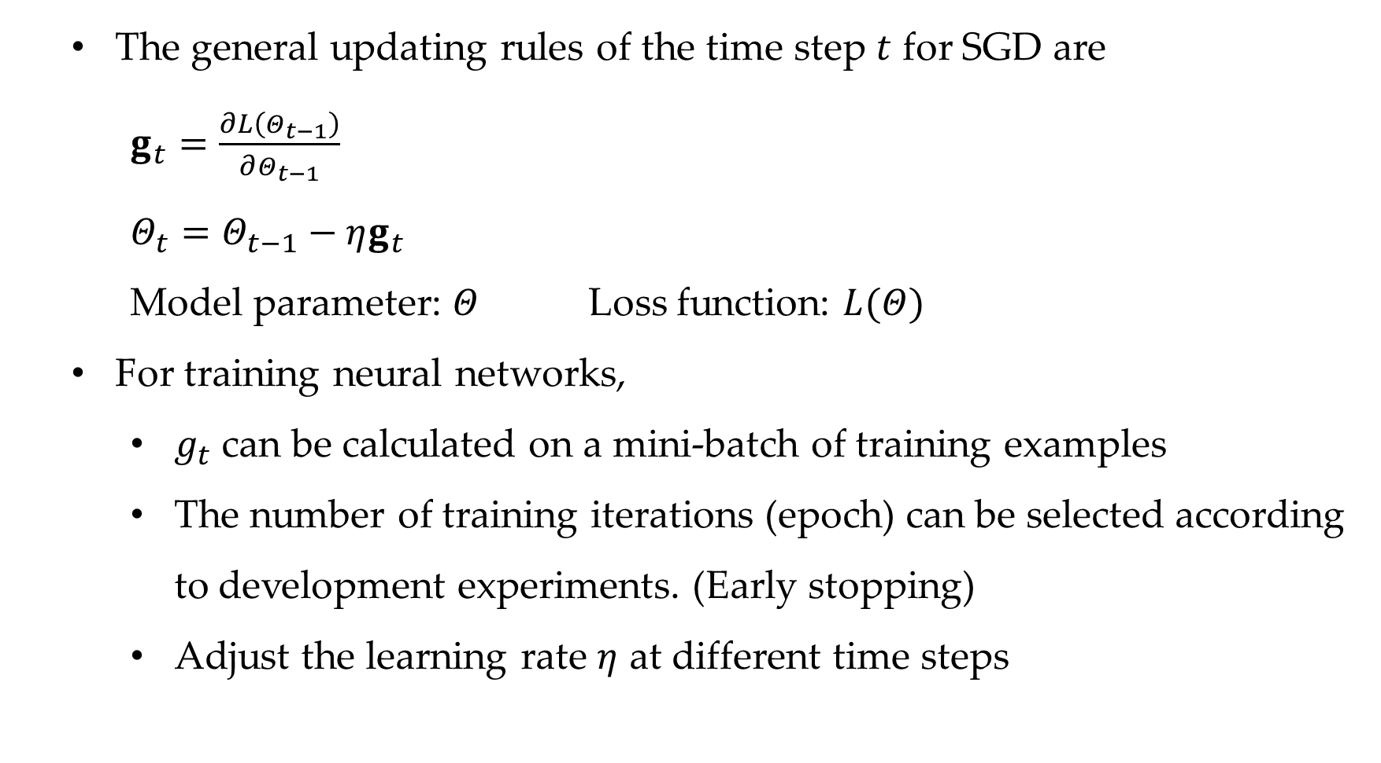
SGD training
The general updating rules of the time step $t$ for SGD are
$g_{t}=\frac{∂L\left(Θ_{t−1}\right)}{∂Θ_{t−1}}$
$Θ_{t}=Θ_{t−1}−ηg_{t}$
Model parameter: $Θ$ Loss function: $L(Θ)$
For training neural networks,
$g_{t}$ can be calculated on a mini-batch of training examples
The number of training iterations (epoch) can be selected according to development experiments. (Early stopping)
Adjust the learning rate $η$ at different time steps

Slide 65
Several techniques for improving SGD training
Learning rate decay
step decay
exponential decay
gradient clipping
Prevent gradient being too large by consulting hard threshold values
SGD with Momentum
A way to soften oscillations, accelerating the converging process

Slide 66
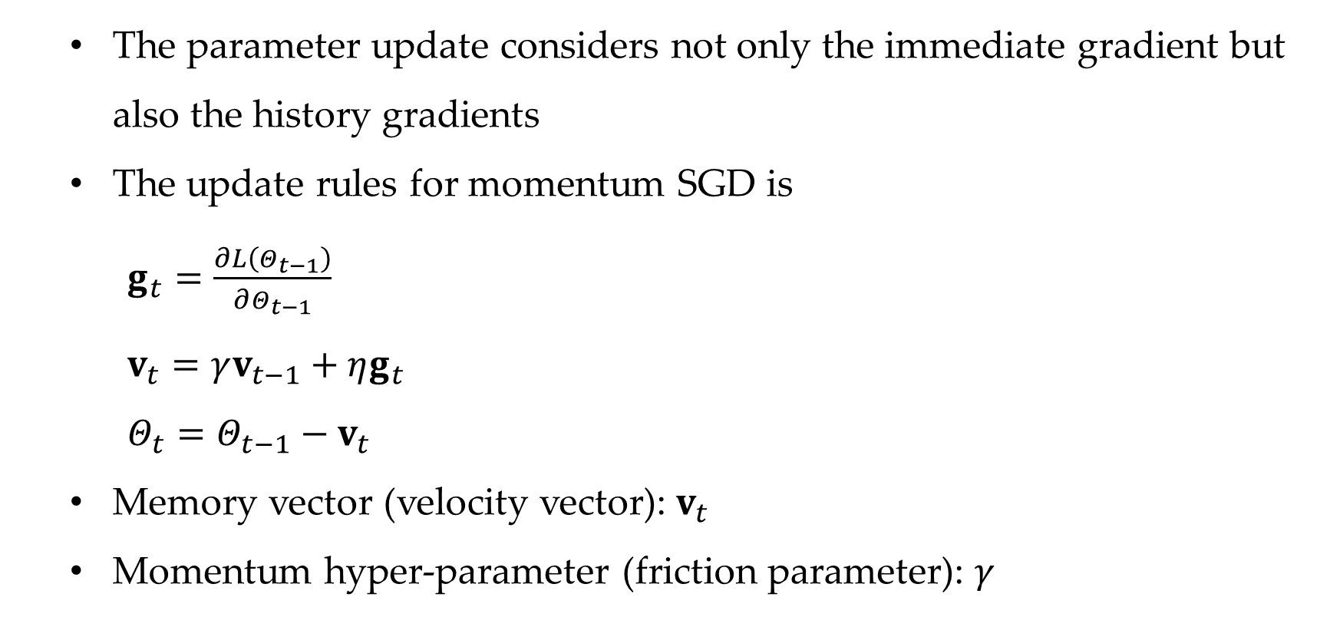
SGD with momentum
The parameter update considers not only the immediate gradient but also the history gradients
The update rules for momentum SGD is
$g_{t}=\frac{∂L\left(Θ_{t−1}\right)}{∂Θ_{t−1}}$
$v_{t}=γv_{t−1}+ηg_{t}$
$Θ_{t}=Θ_{t−1}−v_{t}$
Memory vector (velocity vector): $v_{t}$
Momentum hyper-parameter (friction parameter): $γ$

Slide 67
Contents
13.1 From One Layer to Multiple Layers
13.1.1 Multi-Layer Perceptron for Text Classification
13.1.2 Training a Multi-Layer Perceptron
13.2 Building a Text Classifier without Manual Features
13.2.1 Word Embeddings
13.2.2 Sequence Encoding Layers
13.2.3 Output layer
13.2.4 Training
13.3 Improve Neural Network Training
13.3.1 Avoiding Gradient Issues
13.3.2 Better Generalization
13.3.3 Improving SGD Training for Neural Networks
13.3.4 Hyper-Parameter Search

Slide 68
Hyper-Parameter Search
Grid search
Specify a set of candidate values for each hyperparameter
Build a model for every combination of the specified hyperparameters and evaluate the performance of each model
Random search
Random combinations of hyperparameters

Slide 69
Summary
Multi-layer perceptrons and deep neural networks
Convolutional neural networks for text classification
Dropout, layer normalizations and residual network
SGD with momentum

