Slide 1

Natural Language Processing
Yue Zhang
Westlake University

Slide 2
Chapter 15
Neural Structured Prediction

Slide 3
Contents
15.1 Local Graph-Based Models
15.1.1 Sequence labelling
15.1.2 Dependency Parsing
15.1.3 Constituent Parsing
15.1.4 Comparison with Linear Models
15.2 Local Transition-Based Models
15.2.1 Model 1
15.2.2 Model 2
15.2.3 Model 3
15.3 Global Structured Models
15.3.1 Neural CRF
15.3.2 Neural Transition-Based Models with Global Normalization

Slide 4
Contents
15.1 Local Graph-Based Models
15.1.1 Sequence labelling
15.1.2 Dependency Parsing
15.1.3 Constituent Parsing
15.1.4 Comparison with Linear Models
15.2 Local Transition-Based Models
15.2.1 Model 1
15.2.2 Model 2
15.2.3 Model 3
15.3 Global Structured Models
15.3.1 Neural CRF
15.3.2 Neural Transition-Based Models with Global Normalization

Slide 6
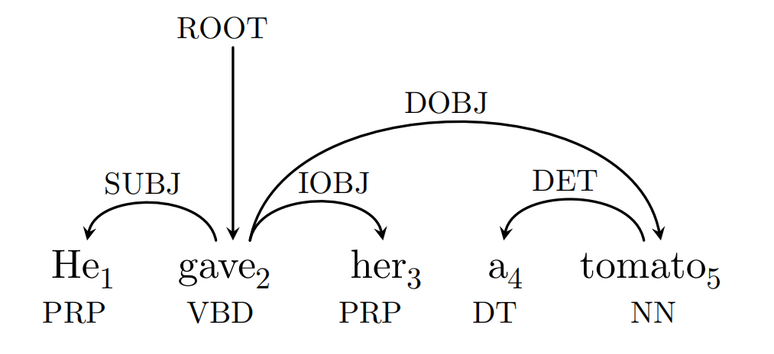
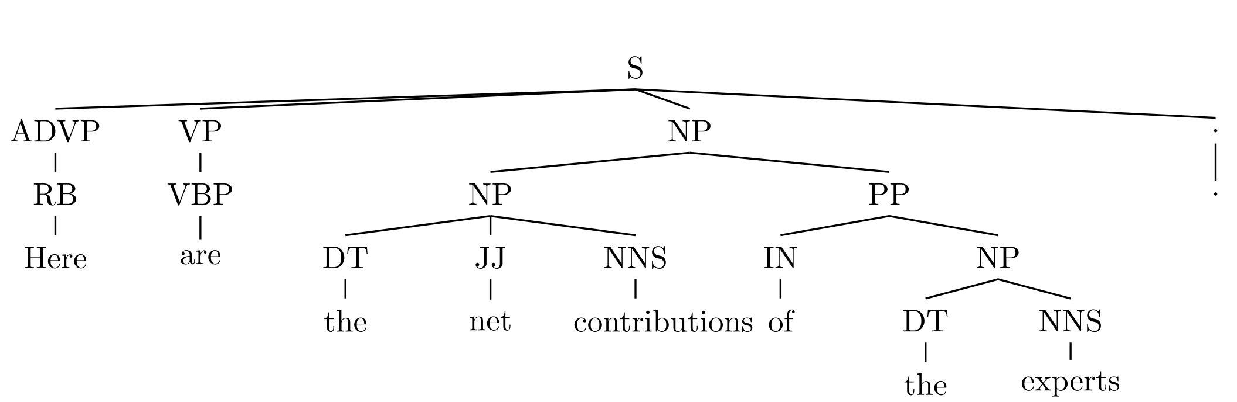
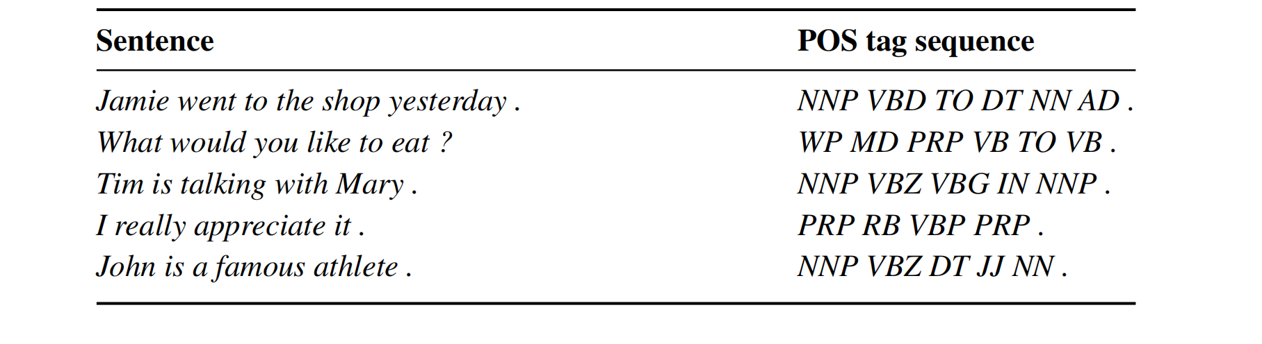
Structure Prediction

Slide 7
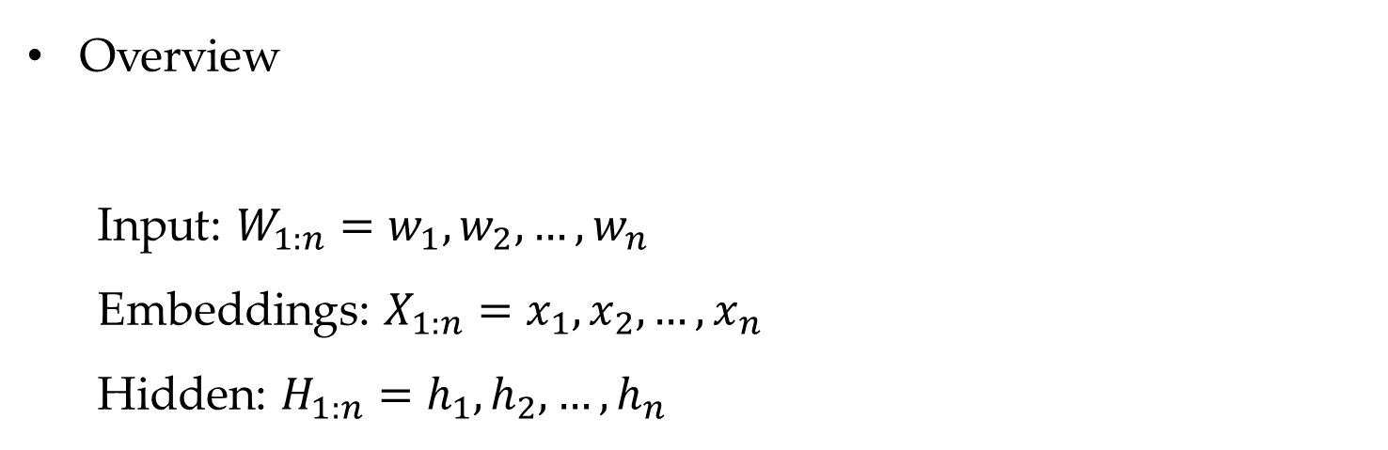
Local Graph-Based Models
Overview
Input: $W_{1:n}=w_{1},w_{2},…,w_{n}$
Embeddings: $X_{1:n}=x_{1},x_{2},…,x_{n}$
Hidden: $H_{1:n}=h_{1},h_{2},…,h_{n}$

Slide 8
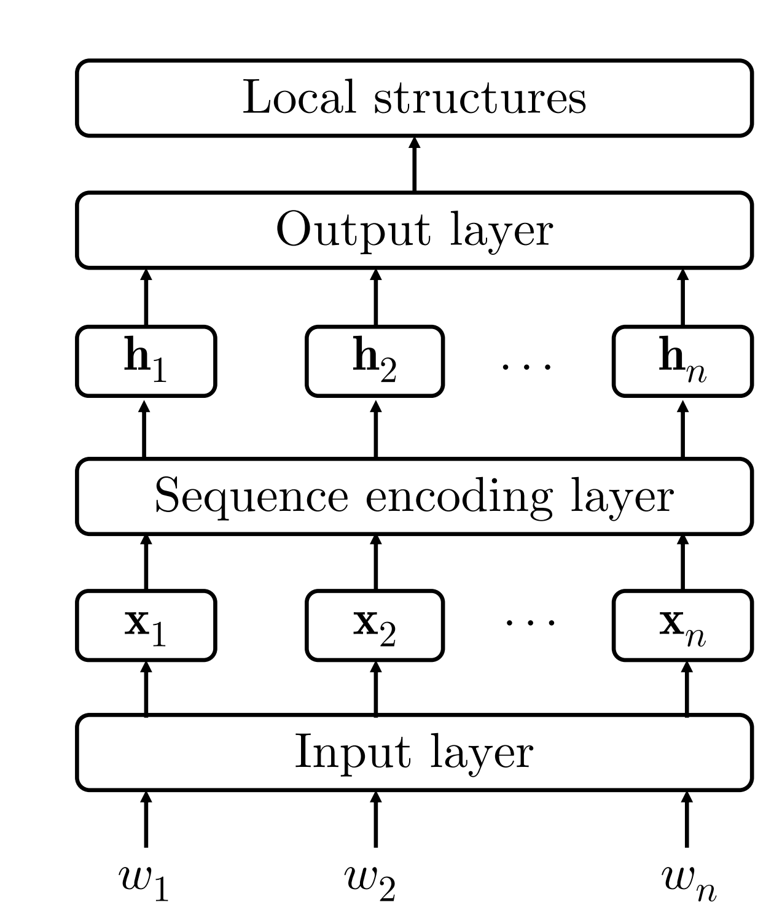
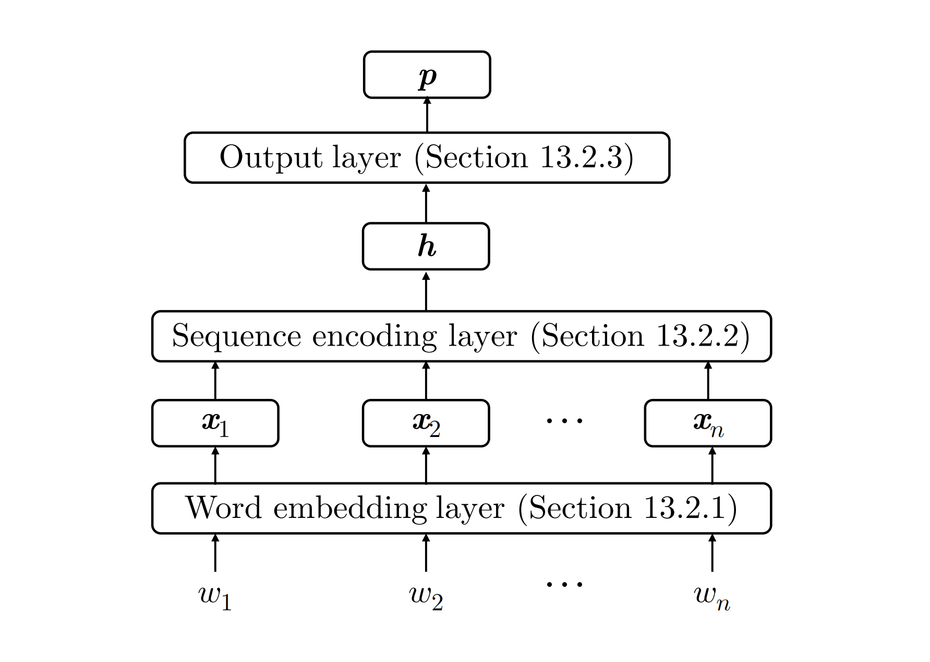
Local Graph-Based Models

Slide 9
Contents
15.1 Local Graph-Based Models
15.1.1 Sequence labelling
15.1.2 Dependency Parsing
15.1.3 Constituent Parsing
15.1.4 Comparison with Linear Models
15.2 Local Transition-Based Models
15.2.1 Model 1
15.2.2 Model 2
15.2.3 Model 3
15.3 Global Structured Models
15.3.1 Neural CRF
15.3.2 Neural Transition-Based Models with Global Normalization

Slide 10
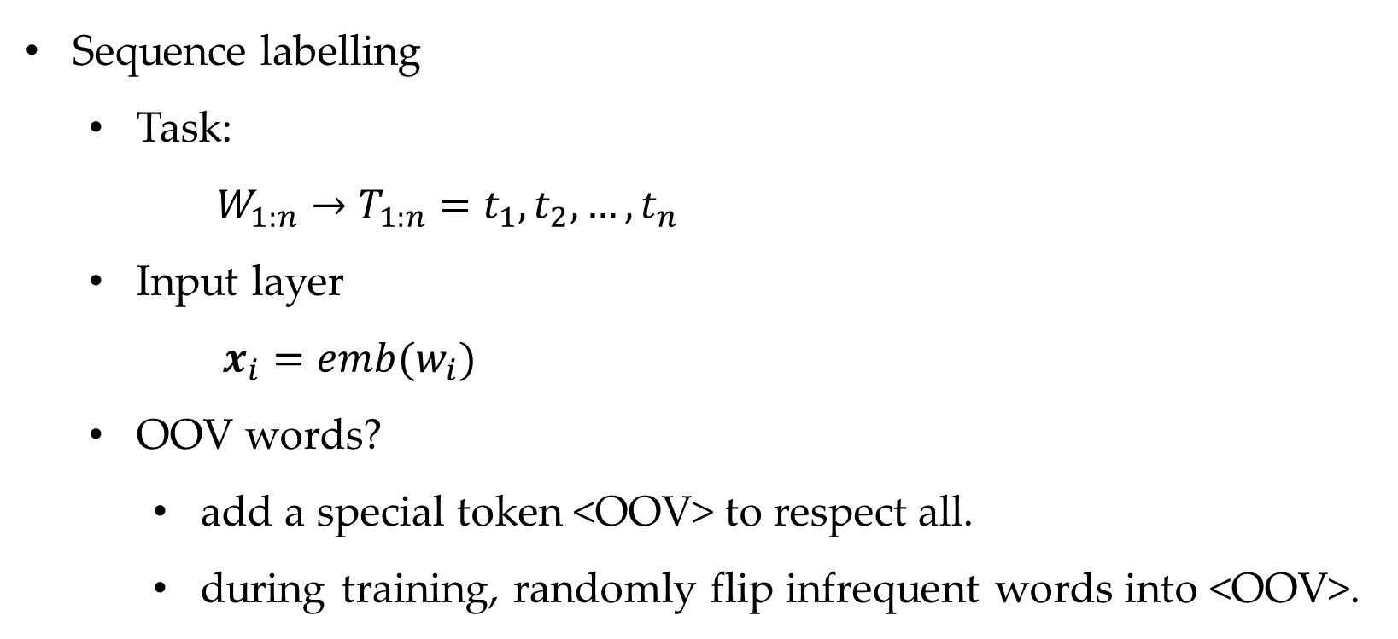
Local Graph-Based Models
Sequence labelling
Task:
$W_{1:n}→T_{1:n}=t_{1},t_{2},…,t_{n}$
Input layer
$x_{i}=emb(w_{i})$
OOV words?
add a special token <OOV> to respect all.
during training, randomly flip infrequent words into <OOV>.

Slide 11



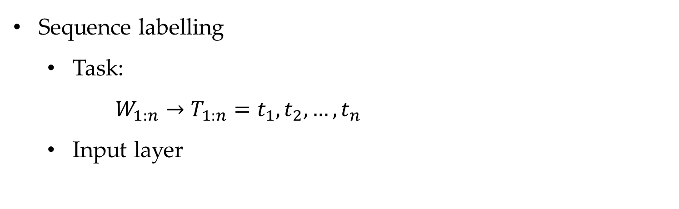




Local Graph-Based Models
Sequence labelling
Task:
$W_{1:n}→T_{1:n}=t_{1},t_{2},…,t_{n}$
Input layer
$$w_{i}=C_{1:\left|w_{i}\right|}=c_{1}^{i},c_{2}^{i},…,c_{\left|w_{i}\right|}^{i}$$
$$x_{w_{i}}^{c}=[emb(c_{1}^{i})…emb^{c}(c_{\left|w_{i}\right|}^{i})]$$
…
…
…
…
$$×$$
$$c_{i}$$
$$chr\left(w_{i}\right)=Encoder\left(x_{w_{i}}^{c}\right)$$
$$x_{i}=chr\left(w_{i}\right)⊕emb\left(w_{i}\right)$$
$emb^{c}(c_{1})$ $emb^{c}(c_{1})$ $emb^{c}(c_{|C|})$ one-hot

Slide 12
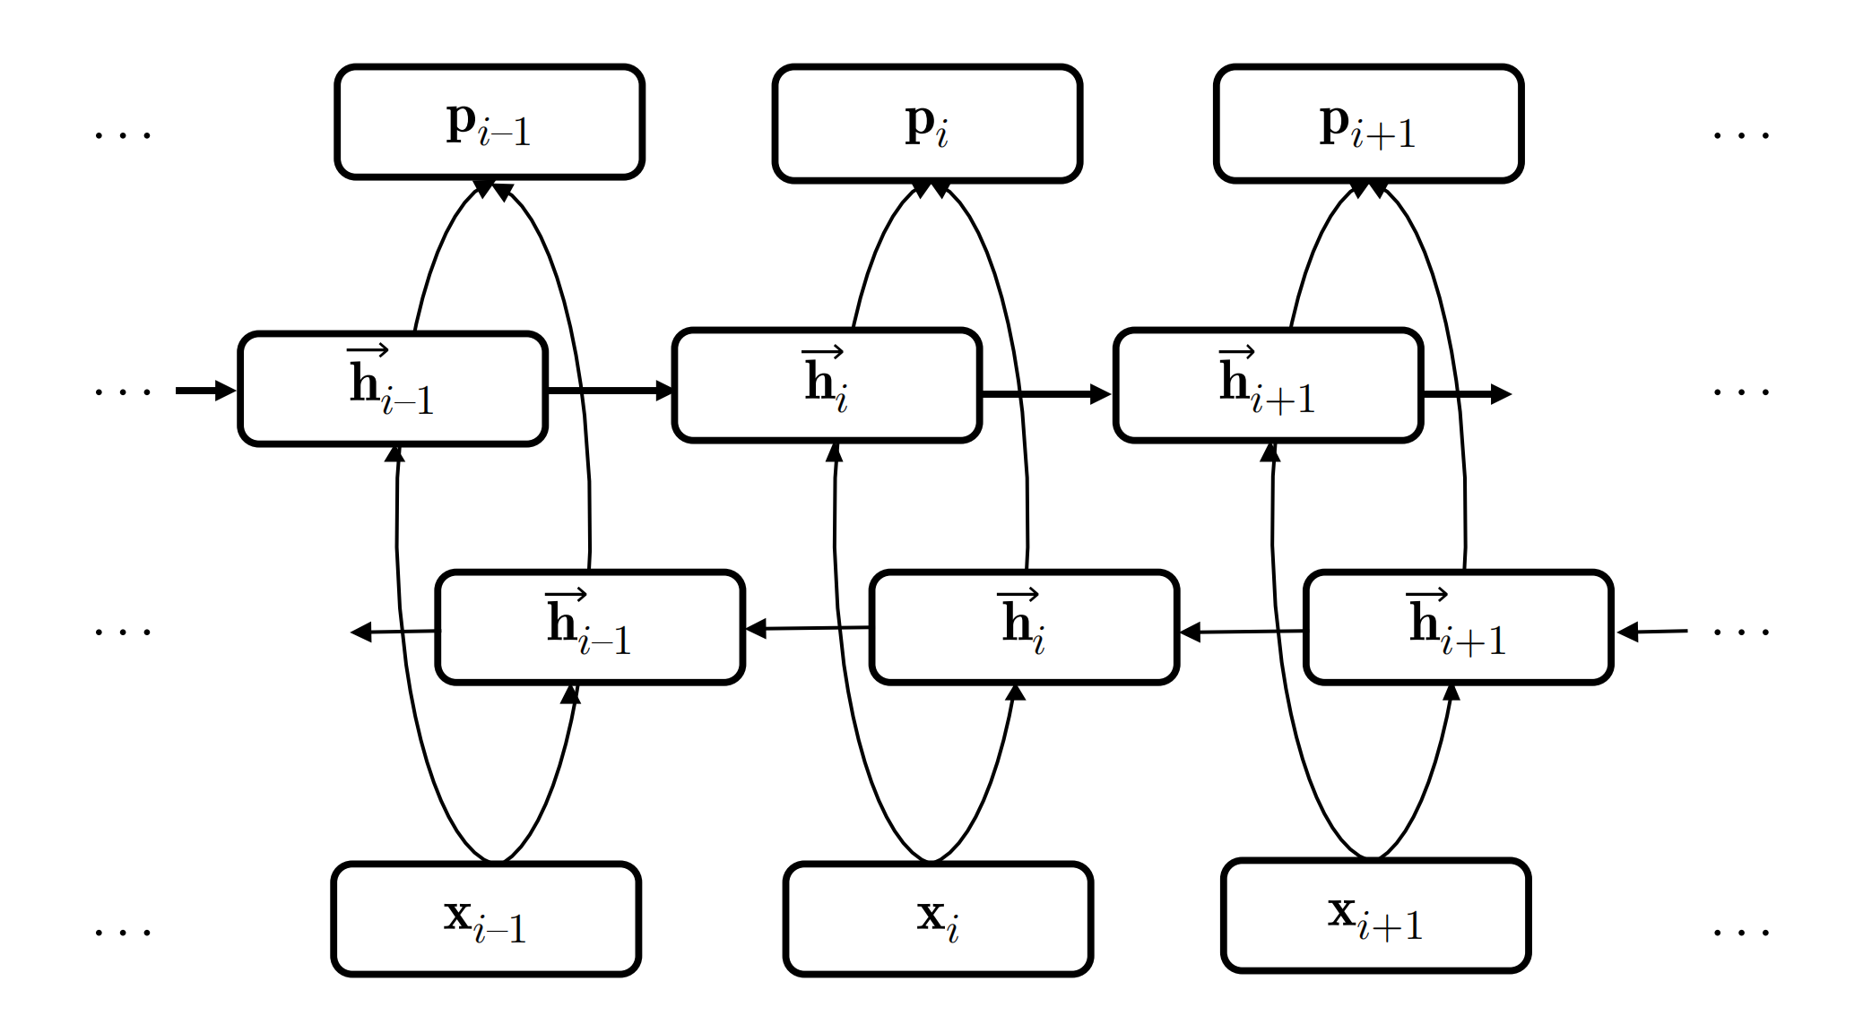

Local Graph-Based Models
Sequence labelling
Sequence representation layer
Can stack multi layers.
$$H_{1:n }=BiLSTM\left(X_{1:n}\right)$$

Slide 13

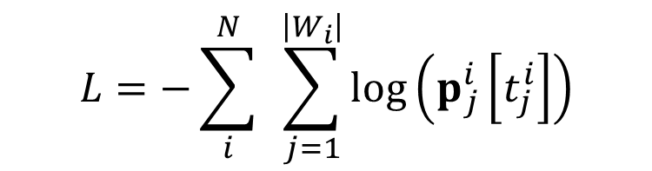

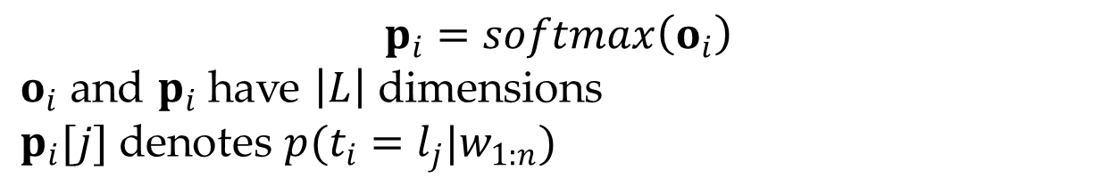

Local Graph-Based Models
Sequence labelling
Each $x_{i}$is classified using $h_{i}$
There are $|L|$ labels.
Output layer
Training
$$o_{i}=Wh_{i}+b$$
$$p_{i}=softmax\left(o_{i}\right)$$
$o_{i}$ and $p_{i}$ have $\left|L\right|$ dimensions
$p_{i}[j]$ denotes $p(t_{i}=l_{j}|w_{1:n})$
$$D=\left\{\left(W_{i} , T_{i}\right)\right\}{\left.|\right.}_{i=1}^{N}$$
$$L=−\sum_{i}^{N}{ }\sum_{j=1}^{\left|W_{i}\right|}{log}\left(p_{j}^{i}\left[t_{j}^{i}\right]\right)$$
Notes:
Why large margin model not work for neural networks
A graph to illustrating gradients propogation

Slide 14








Local Graph-Based Models
There is a loss at every $t_{i}(i∈[1,…,n])$.
Gradient Propagation for RNN-based models
Gradients from each label are accumulated.
$$t_{1} t_{2 }… { t}_{i} … t_{n}$$
$${L(t}_{1}) L\left(t_{2}\right) L\left(t_{i}\right) L(t_{n})$$
BiLSTM
$$t_{i}$$
…
$$h_{0} h_{1} h_{i−1 } h_{i}$$
$$x_{1}$$
$$x_{i−1}$$
$$x_{i}$$

Slide 15
Contents
15.1 Local Graph-Based Models
15.1.1 Sequence labelling
15.1.2 Dependency Parsing
15.1.3 Constituent Parsing
15.1.4 Comparison with Linear Models
15.2 Local Transition-Based Models
15.2.1 Model 1
15.2.2 Model 2
15.2.3 Model 3
15.3 Global Structured Models
15.3.1 Neural CRF
15.3.2 Neural Transition-Based Models with Global Normalization

Slide 16
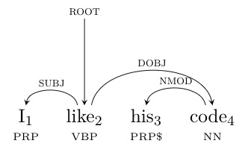
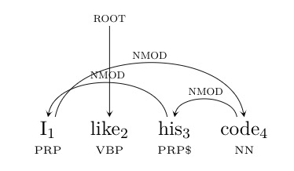



Local Graph-Based Models
Dependency parsing
Input
Output
$w_{0}=ROOT$ pseudo root
$$S=\left(w_{1} , t_{1}\right),\left(w_{2} , t_{2}\right),…,\left(w_{n} , t_{n}\right)$$
$$o=\left\{\left(i , h_{i} , l_{i}\right)\right\}{\left.|\right.}_{i=1}^{n}$$

Slide 17



Local Graph-Based Models
Dependency parsing
Input layer
POS embedding
$$x_{i}=emb\left(w_{i}\right)⊕chr\left(w_{i}\right)⊕emb^{p}\left(t_{i}\right)$$
…
…
…
…
$$×$$
$$p$$
$emb^{p}(l_{1})$ $emb^{p}(l_{2})$ $emb^{p}(l_{|L|})$ one-hot

Slide 18






Local Graph-Based Models
Dependency parsing
Sequence encoding layer
Output layer
Structure assignment (each word $i$looks for a head $j$ ,including <ROOT>=0)
$o,p$ has $n+1$ dimensions, and $p_{i}^{arc}\left[j\right]=P(w_{j} is head of w_{i})$
$$H_{1:n }=BiLSTM\left(X_{1:n}\right)$$
$$s_{i,j}=h_{i}^{T}Uh_{j}+v^{T}\left(\left[h_{i} ; h_{j}\right]\right)$$
$$o_{i}^{arc}=〈s_{i,1} , s_{i,2} , … , s_{i,n}〉$$
$$p_{i}^{arc}=softmax\left(o_{i}^{arc}\right)$$
$$h_{i}=\underset{h}{argmax}p_{i}^{arc}\left[h\right]$$

Slide 19



Local Graph-Based Models
Dependency parsing
Output layer
Label assignment
$p_{i}^{label}$[j] $=p(arc i ←h_{i} has label l_{j} )$
Results in invalid tree?
Use a dynamic program.
$$o_{i}^{label}=h_{i}^{T}U^{′}h_{h_{i}}+V^{′}\left(\left[h_{i} ; h_{h_{i}}\right]\right)+b^{′}$$
$$p_{i}^{label}=softmax\left(o_{i}^{label}\right)$$

Slide 20


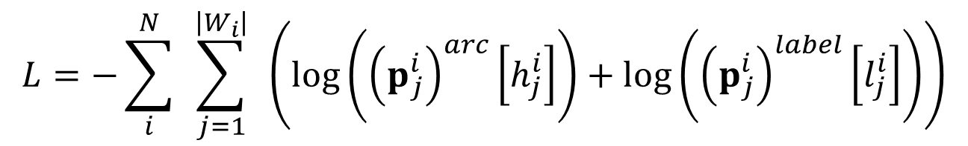

Local Graph-Based Models
Dependency parsing
Training
Loss from every arc accumulates via $h_{i}, h_{j}$
Loss from every arc label accumulates via $h_{i},h_{j}$
$$D=\left\{\left(S_{i} , T_{i}\right)\right\}{\left.|\right.}_{i=1}^{N}$$
$$T_{i}=\left\{\left(j , h_{j}^{i} , l_{j}^{i}\right)\right\}{\left.|\right.}_{j=1}^{\left|S_{i}\right|}$$
$$L=−\sum_{i}^{N}{ }\sum_{j=1}^{\left|W_{i}\right|}{ }\left(log\left({\left(p_{j}^{i}\right)}^{arc}\left[h_{j}^{i}\right]\right)+log\left({\left(p_{j}^{i}\right)}^{label}\left[l_{j}^{i}\right]\right)\right)$$

Slide 21
Contents
15.1 Local Graph-Based Models
15.1.1 Sequence labelling
15.1.2 Dependency Parsing
15.1.3 Constituent Parsing
15.1.4 Comparison with Linear Models
15.2 Local Transition-Based Models
15.2.1 Model 1
15.2.2 Model 2
15.2.3 Model 3
15.3 Global Structured Models
15.3.1 Neural CRF
15.3.2 Neural Transition-Based Models with Global Normalization

Slide 22
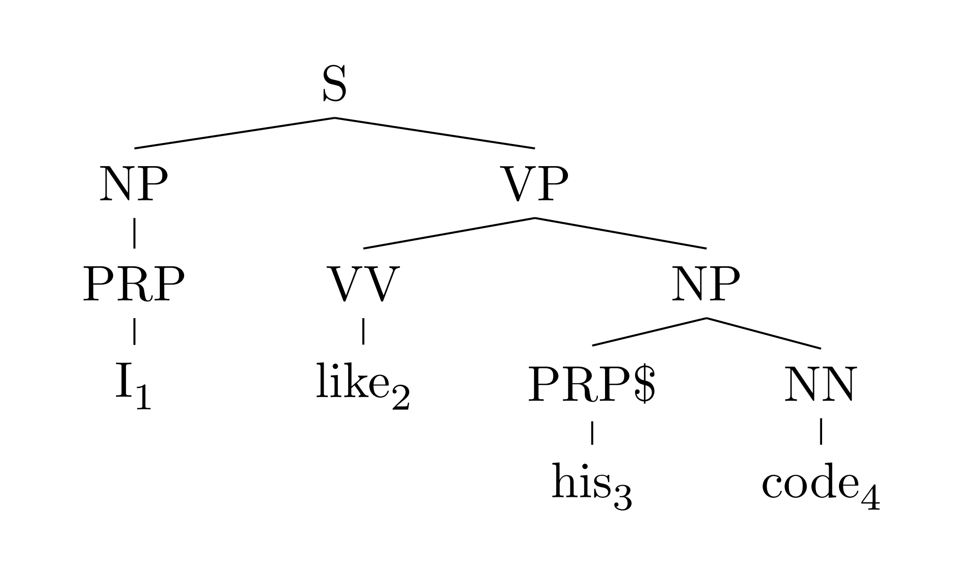


Local Graph-Based Models
Constituent parsing
Task
Input
Output
Local model classify each span.
$$S=\left(w_{1} , t_{1}\right),\left(w_{2} , t_{2}\right),…,\left(w_{n} , t_{n}\right)$$
$$T=\left\{(b,e,c)\right\},1≤b≤e≤n, c=[b,e]$$

Slide 23

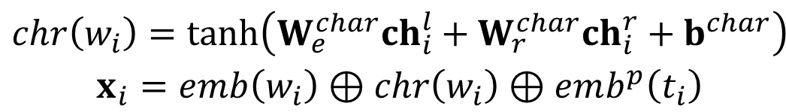
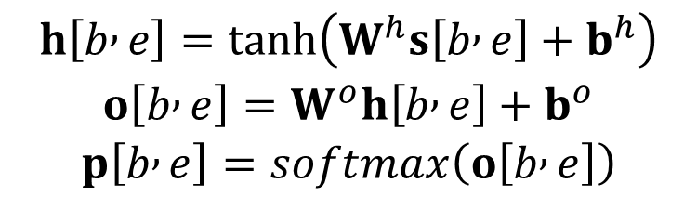
Local Graph-Based Models
Constituent parsing
Input layer
Sequence encoding layer (stacked bi-LSTM)
Output layer
$$\begin{matrix}chr\left(w_{i}\right)=tanh\left(W_{e}^{char}ch_{i}^{l}+W_{r}^{char}ch_{i}^{r}+b^{char}\right) \\ x_{i}=emb\left(w_{i}\right)⊕chr\left(w_{i}\right)⊕emb^{p}\left(t_{i}\right)\end{matrix}$$
$$\left.\left.s\left.[\right.b,e]\right.=\left.[\right.h_{b}⊕h_{e}]\right.$$
$$\begin{matrix}h\left[b , e\right]=tanh\left(W^{h}s\left[b , e\right]+b^{h}\right) \\ o\left[b , e\right]=W^{o}h\left[b , e\right]+b^{o} \\ p\left[b , e\right]=softmax\left(o\left[b , e\right]\right)\end{matrix}$$

Slide 24
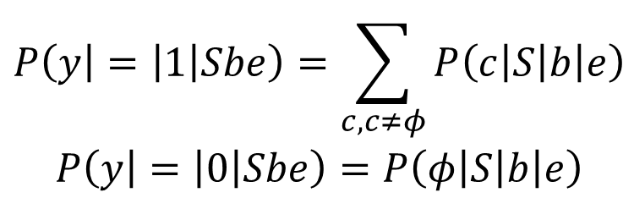

Local Graph-Based Models
Constituent parsing
Decoding (find structure first)
Rule (disregarding consistent labels)
$$W_{b:e}→W_{b:b^{′}−1}W_{b^{′}:e}$$
$$P(r | S,b,e) = P( y = 1 |S,b, b′−1)P( y = 1 |S,b’,e)$$
CKY
$$\begin{matrix}P\left(y | = | 1 | Sbe\right)=\sum_{c,c≠φ}{P\left(c | S | b | e\right)} \\ P\left(y | = | 0 | Sbe\right)=P\left(φ | S | b | e\right)\end{matrix}$$

Slide 25
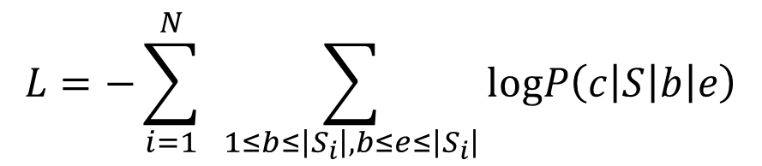
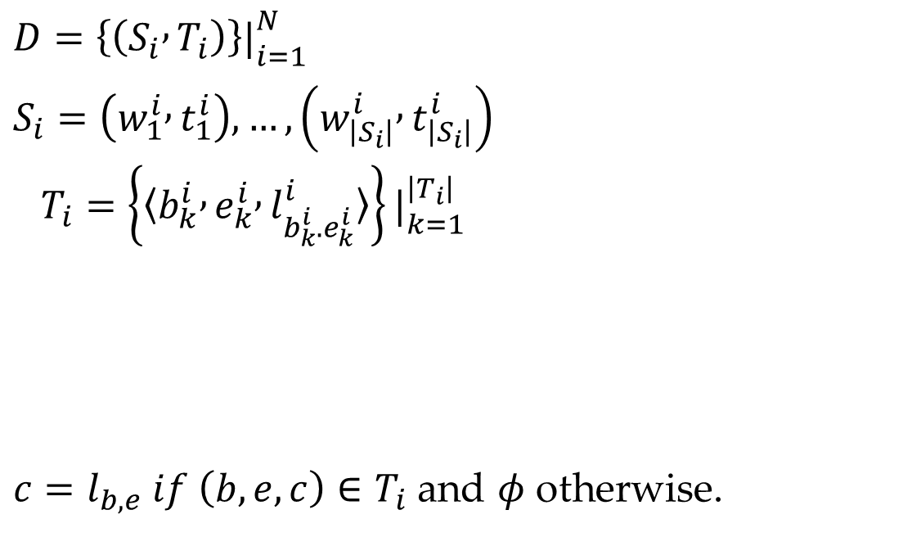
Local Graph-Based Models
Constituent parsing
Training
$$D=\left\{\left(S_{i} , T_{i}\right)\right\}{\left.|\right.}_{i=1}^{N}$$
$$\begin{matrix} \\ S_{i}=\left(w_{1}^{i} , t_{1}^{i}\right),…,\left(w_{\left|S_{i}\right|}^{i} , t_{\left|S_{i}\right|}^{i}\right) \\ T_{i}=\left\{〈b_{k}^{i} , e_{k}^{i} , l_{b_{k}^{i}.e_{k}^{i}}^{i}〉\right\}{\left.|\right.}_{k=1}^{\left|T_{i}\right|} \\ \end{matrix}$$
$c=l_{b,e} if \left(b,e,c\right)∈T_{i}$ and $φ$ otherwise.
$$L=−\sum_{i=1}^{N}{ }\sum_{1≤b≤\left|S_{i}\right|,b≤e≤\left|S_{i}\right|}{logP\left(c | S | b | e\right)}$$

Slide 26
Contents
15.1 Local Graph-Based Models
15.1.1 Sequence labelling
15.1.2 Dependency Parsing
15.1.3 Constituent Parsing
15.1.4 Comparison with Linear Models
15.2 Local Transition-Based Models
15.2.1 Model 1
15.2.2 Model 2
15.2.3 Model 3
15.3 Global Structured Models
15.3.1 Neural CRF
15.3.2 Neural Transition-Based Models with Global Normalization

Slide 27

Local Transition-Based Models
State transitions
State represents a partially constructed output
Transition actions represent incremental steps for building structures
Example
$$\begin{matrix}s=\left(σ , β , A\right) \\ σ=\left[… , s_{1} , s_{0}\right] \\ β=\left[b_{0} , b_{1} , …\right]\end{matrix}$$
Notes:
Add an animation of shift-reduce for “he gave her a pen”
Arch-standard

Slide 28
Local Transition-Based Models
Arc-standard Projective Dependency
Example
Next action: SHIFT
He gave her a pen
Notes:
Add example for “he gave me a tomato”

Slide 29
Local Transition-Based Models
Arc-standard Projective Dependency
Example
Next action: SHIFT
He
gave her a pen
Notes:
Add example for “he gave me a tomato”

Slide 30
Local Transition-Based Models
Arc-standard Projective Dependency
Example
Next action: LEFT-ARC-SUBJ
He
gave
her a pen
Notes:
Add example for “he gave me a tomato”

Slide 31
Local Transition-Based Models
Arc-standard Projective Dependency
Example
Next action: SHIFT
gave
her a pen
SUBJ
He
Notes:
Add example for “he gave me a tomato”

Slide 32
Local Transition-Based Models
Arc-standard Projective Dependency
Example
Next action: RIGHT-ARC-IOBJ
gave her
a pen
SUBJ
He
Notes:
Add example for “he gave me a tomato”

Slide 33
Local Transition-Based Models
Arc-standard Projective Dependency
Example
Next action: SHIFT
gave
a pen
SUBJ
IOBJ
He
her
Notes:
Add example for “he gave me a tomato”

Slide 34
Local Transition-Based Models
Arc-standard Projective Dependency
Example
Next action: SHIFT
gave
a
pen
SUBJ
IOBJ
He
her
Notes:
Add example for “he gave me a tomato”

Slide 35
Local Transition-Based Models
Arc-standard Projective Dependency
Example
Next action: LEFT-ARC-DET
gave
a
pen
SUBJ
IOBJ
He
her
Notes:
Add example for “he gave me a tomato”

Slide 36
Local Transition-Based Models
Arc-standard Projective Dependency
Example
Next action: RIGHT-ARC-DOBJ
gave
pen
SUBJ
IOBJ
DET
He
her
a
Notes:
Add example for “he gave me a tomato”

Slide 37
Local Transition-Based Models
Arc-standard Projective Dependency
Example
Next action: END
gave
DOBJ
SUBJ
IOBJ
DET
He
her
a
pen
Notes:
Add example for “he gave me a tomato”

Slide 38
Contents
15.1 Local Graph-Based Models
15.1.1 Sequence labelling
15.1.2 Dependency Parsing
15.1.3 Constituent Parsing
15.1.4 Comparison with Linear Models
15.2 Local Transition-Based Models
15.2.1 Model 1
15.2.2 Model 2
15.2.3 Model 3
15.3 Global Structured Models
15.3.1 Neural CRF
15.3.2 Neural Transition-Based Models with Global Normalization

Slide 39
Local Transition-Based Models
Model 1 -- directly takes embedding features.

Slide 40
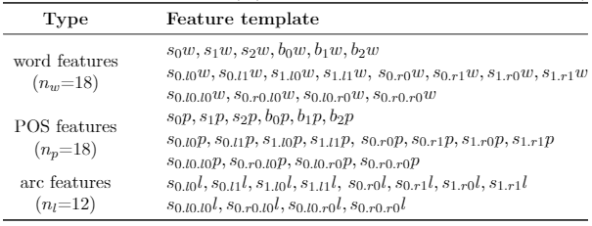
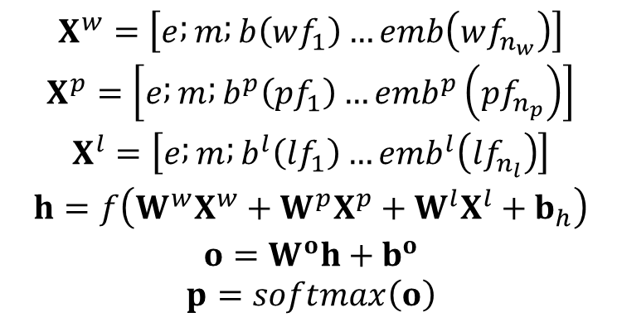
Local Transition-Based Models
Model 1 -- MLP classifier
$$\begin{matrix}X^{w}=\left[e ; m ; b\left(wf_{1}\right)…emb\left(wf_{n_{w}}\right)\right] \\ X^{p}=\left[e ; m ; b^{p}\left(pf_{1}\right)…emb^{p}\left(pf_{n_{p}}\right)\right] \\ X^{l}=\left[e ; m ; b^{l}\left(lf_{1}\right)…emb^{l}\left(lf_{n_{l}}\right)\right] \\ h=f\left(W^{w}X^{w}+W^{p}X^{p}+W^{l}X^{l}+b_{h}\right) \\ o=W^{o}h+b^{o} \\ p=softmax\left(o\right)\end{matrix}$$

Slide 41
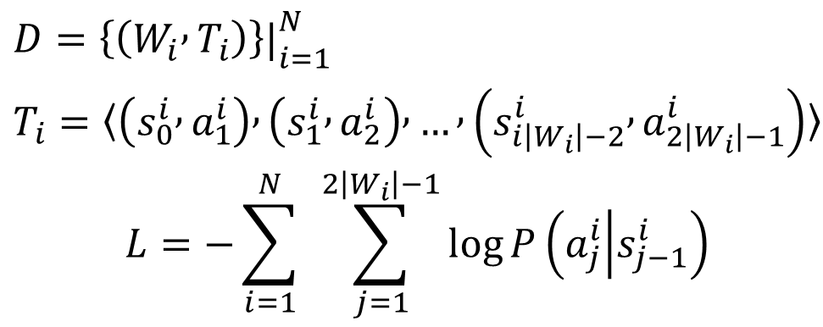
Local Transition-Based Models
Model 1
Training
$$D=\left\{\left(W_{i} , T_{i}\right)\right\}{\left.|\right.}_{i=1}^{N}$$
$$\begin{matrix} \\ T_{i}=〈\left(s_{0}^{i} , a_{1}^{i}\right) , \left(s_{1}^{i} , a_{2}^{i}\right) , … , \left(s_{i\left|W_{i}\right|−2}^{i} , a_{2\left|W_{i}\right|−1}^{i}\right)〉 \\ L=−\sum_{i=1}^{N}{ }\sum_{j=1}^{2\left|W_{i}\right|−1}{log}P\left(a_{j}^{i} | s_{j−1}^{i}\right)\end{matrix}$$

Slide 42
Contents
15.1 Local Graph-Based Models
15.1.1 Sequence labelling
15.1.2 Dependency Parsing
15.1.3 Constituent Parsing
15.1.4 Comparison with Linear Models
15.2 Local Transition-Based Models
15.2.1 Model 1
15.2.2 Model 2
15.2.3 Model 3
15.3 Global Structured Models
15.3.1 Neural CRF
15.3.2 Neural Transition-Based Models with Global Normalization

Slide 43
Local Transition-Based Models
Model 2 – enrich input sequence features
Sequence encoding

Slide 44





Local Transition-Based Models
Model 2 – reduce stack feature sources.
$$x_{i}=emb\left(w_{i}\right)⊕emb^{p}\left(t_{i}\right)$$
$$H_{1:n }=BiLSTM\left(X_{1:n}\right)$$
$$h=h_{s_{0}}⊕h_{s_{1}}⊕h_{s_{2}}⊕h_{0}$$
$$o=W^{o}tanh\left(W^{h}h+b^{h}\right)+b^{o}$$
$$p=softmax\left(o\right)$$

Slide 45
Contents
15.1 Local Graph-Based Models
15.1.1 Sequence labelling
15.1.2 Dependency Parsing
15.1.3 Constituent Parsing
15.1.4 Comparison with Linear Models
15.2 Local Transition-Based Models
15.2.1 Model 1
15.2.2 Model 2
15.2.3 Model 3
15.3 Global Structured Models
15.3.1 Neural CRF
15.3.2 Neural Transition-Based Models with Global Normalization

Slide 46
Local Transition-Based Models
Model 3 –better represents the state

Slide 47
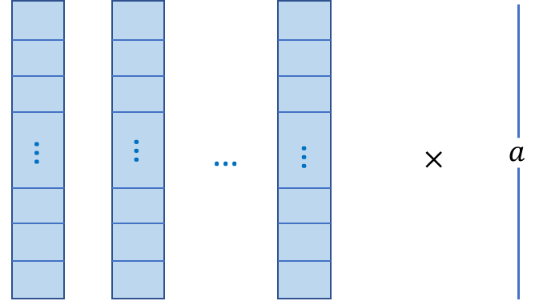









Local Transition-Based Models
Model 3
Buffer LSTM
Action LSTM
action embedding
$emb\left(a\right)=W$
$$h_{b}$$
…
$$x_{n}$$
$$x_{n−1}$$
$$x_{1}$$
$$h_{a}$$
…
$$a_{0}$$
$$a_{1}$$
$$a_{i−1}$$
(one hot)

Slide 48
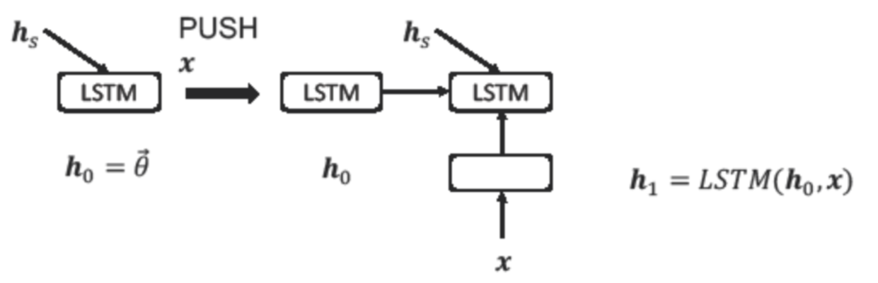
Local Transition-Based Models
Model 3
Stack LSTM

Slide 49



Local Transition-Based Models
Model 3
Further reduces stack features
$$h=h_{s}⊕h_{b}⊕h_{a}$$
$$o=MLP (h)$$
$$p=softmax\left(o\right)$$

Slide 50
Contents
15.1 Local Graph-Based Models
15.1.1 Sequence labelling
15.1.2 Dependency Parsing
15.1.3 Constituent Parsing
15.1.4 Comparison with Linear Models
15.2 Local Transition-Based Models
15.2.1 Model 1
15.2.2 Model 2
15.2.3 Model 3
15.3 Global Structured Models
15.3.1 Neural CRF
15.3.2 Neural Transition-Based Models with Global Normalization

Slide 51


Global Structured Models
Neural CRF
CRF
Neural CRF – replace $\vec{θ}⋅\vec{φ}$ with a neural score.
$$\begin{matrix}P\left(T_{1:n} | W_{1:n}\right)=\frac{exp\left(\vec{θ}⋅\vec{φ}\left(T_{1:n} , W_{1:n}\right)\right)}{\sum_{T_{1:n}^{′}}{exp}\left(\vec{θ}⋅\vec{φ}\left(T_{1:n}^{′} , W_{1:n}\right)\right)} \\ \vec{θ}⋅\vec{φ}\left(T_{1:n} , W_{1:n}\right)=\sum_{i=1}^{n}{\vec{θ}}⋅\vec{φ}\left(t_{i} , t_{i−1} , W_{1:n}\right) \\ P\left(T_{1:n} | W_{1:n}\right)=\frac{exp\left(\sum_{i=1}^{n}{\vec{θ}⋅\vec{φ}}\left(t_{i} , t_{i−1} , W_{1:n}\right)\right)}{\sum_{T_{1:n}^{′}}{exp}\left(\sum_{i=1}^{n}{\vec{θ}}⋅\vec{φ}\left(t_{i^{′}} , t_{i−1^{′}} , W_{1:n}\right)\right)}\end{matrix}$$

Slide 52
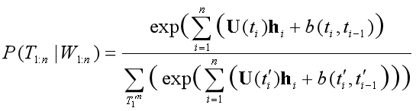

Global Structured Models
Neural CRF
A simple version
$$\begin{matrix}X_{i−2:i+2}=emb\left(w_{i−2}\right)⊕emb\left(w_{i−1}\right)⊕emb\left(w_{i}\right)⊕emb\left(w_{i+1}\right)⊕emb\left(w_{i+2}\right) \\ \end{matrix}$$
$$h_{i}=f\left(W_{1:n} , i\right)=tanh\left(W^{x}X_{i−2:i+2}+b^{x}\right)$$

Slide 53
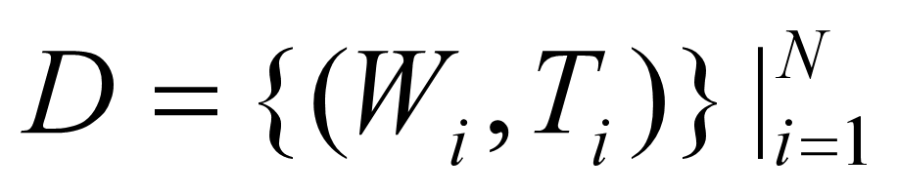
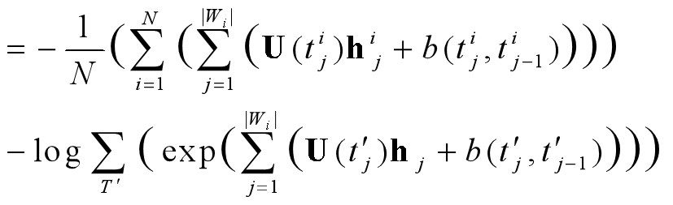
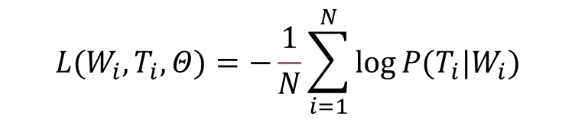
Global Structured Models
Neural CRF
Training
Use SGD
$$\left.\left.L\left.(\right.W_{i},T_{i},Θ)\right.=−\frac{1}{N}\sum_{i=1}^{N}{log}P\left.(\right.T_{i}\left.|\right.W_{i})\right.$$

Slide 54
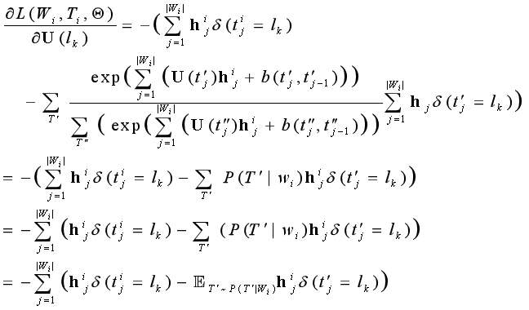
Global Structured Models
Neural CRF
A simple version
Training
$$𝔼_{T^{′}\sim P\left(T^{′} | W_{i}\right)}h_{j}^{i}δ\left({t^{′}}_{j}=l_{k}\right)=𝔼_{{t^{′}}_{j}\sim P\left({t^{′}}_{j} | W_{i}\right)}h_{j}^{i}δ\left({t^{′}}_{j}=l_{k}\right)$$

Slide 55
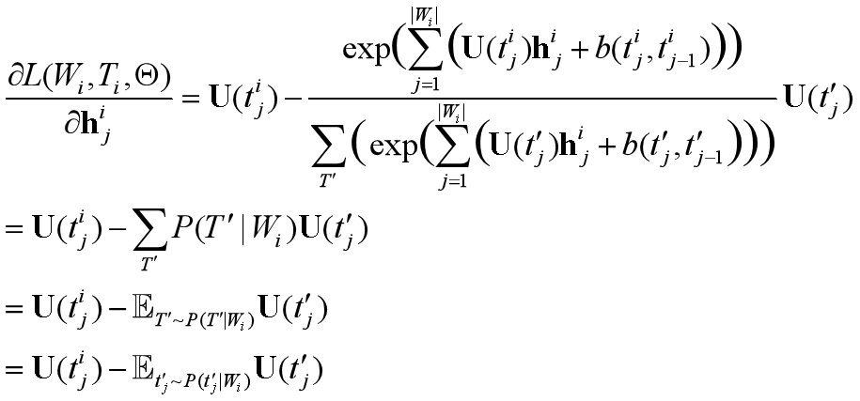
Global Structured Models
Neural CRF
A simple version
Training

Slide 56
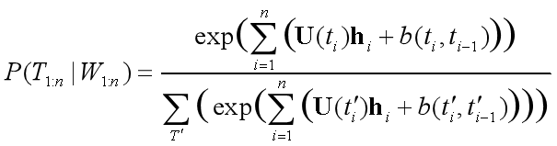

Global Structured Models
Neural CRF
A more complex version BiLSTM CRF.
(add a sequence encoder)
Gradient calculation remains similar.
$$\left.H_{1:n}=BiLSTM\left.(\right.X_{1:n })\right.$$

Slide 57
Global Structured Models
Neural CRF
More variants?
Consider label embedding

Slide 58
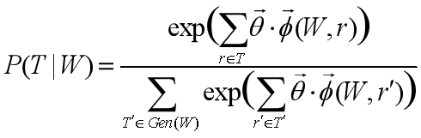
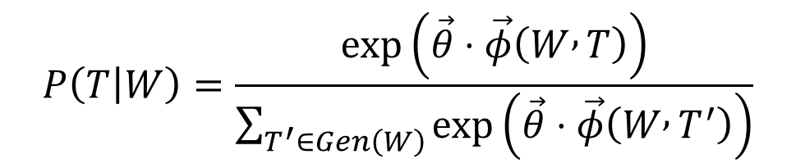

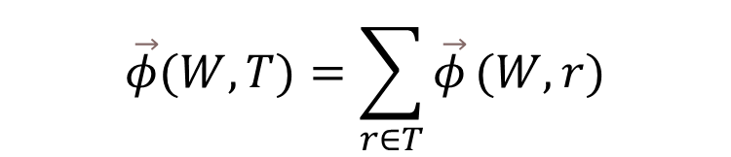
Global Structured Models
Neural CRF
Tree CRF
Neural version – replace $\vec{θ}⋅\vec{φ}$ with a neural score.
$$P\left(T | W\right)=\frac{exp\left(\vec{θ}⋅\vec{φ}\left(W , T\right)\right)}{\sum_{T^{′}∈Gen\left(W\right)}{exp}\left(\vec{θ}⋅\vec{φ}\left(W , T^{′}\right)\right)}$$
$$\left.\left.\vec{φ}\left.(\right.W,T)\right.=\sum_{r∈T}{\vec{φ}}\left.(\right.W,r)\right.$$

Slide 59
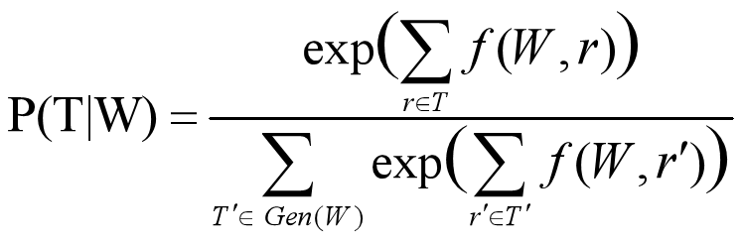
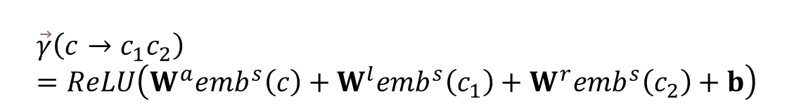
Global Structured Models
Neural CRF
Neural version using label embedding parameterization
$$f\left(W , r\right)=f\left(W , c , → , c_{1} , c_{2} , bb^{′}e\vec{θ}\right)=\vec{τ}{\left(W , b , b^{′} , e\right)}^{T}W^{f}\vec{γ}\left(c→c_{1}c_{2}\right)$$
$$\vec{τ}\left(W , b , b^{′} , e\right)=ReLU\left(W^{w}\left(h_{b}⊕h_{b^{′}−1}⊕h_{e}\right)\right)$$
$$\vec{γ}\left(c→c_{1}c_{2}\right)=ReLU\left(W^{a}emb^{s}\left(c\right)+W^{l}emb^{s}\left(c_{1}\right)+W^{r}emb^{s}\left(c_{2}\right)+b\right)$$

Slide 60
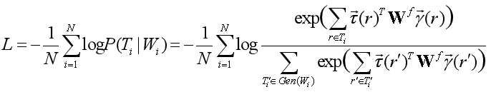
Global Structured Models
Neural CRF
Training
Use SGD

Slide 61
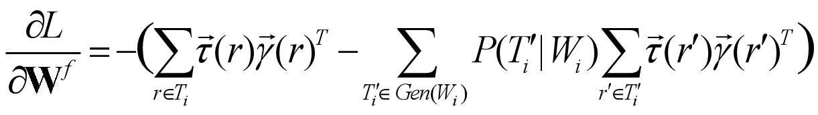



Global Structured Models
Neural CRF
Tree CRF
Training
$$=−\left(\sum_{r∈T_{i}}{\vec{τ}}\left(r\right)\vec{γ}{\left(r\right)}^{T}−𝔼_{{T^{′}}_{i}\sim P\left({T^{′}}_{i} | W_{i}\right)}\sum_{r^{′}∈{T^{′}}_{i}}{\vec{τ}}\left(r^{′}\right)\vec{γ}{\left(r^{′}\right)}^{T}\right)$$
$$\frac{∂L}{∂\vec{τ}\left(r\right)}=−\left(\sum_{r∈T_{i}}{W^{f}}\vec{γ}\left(r\right)−\sum_{{T^{′}}_{i}∈Gen\left(W_{i}\right)}{P}\left({T^{′}}_{i} | W_{i}\right)\sum_{r^{′}∈{T^{′}}_{i}}{W^{f}}\vec{γ}\left(r^{′}\right)\right)$$
$$=−\left(\sum_{r∈T_{i}}{W^{f}}\vec{γ}\left(r\right)−𝔼_{{T^{′}}_{i}\sim P\left({T^{′}}_{i} | W_{i}\right)}\sum_{r^{′}∈{T^{′}}_{i}}{W^{f}}\vec{γ}\left(r^{′}\right)\right)$$

Slide 62
Contents
15.1 Local Graph-Based Models
15.1.1 Sequence labelling
15.1.2 Dependency Parsing
15.1.3 Constituent Parsing
15.1.4 Comparison with Linear Models
15.2 Local Transition-Based Models
15.2.1 Model 1
15.2.2 Model 2
15.2.3 Model 3
15.3 Global Structured Models
15.3.1 Neural CRF
15.3.2 Neural Transition-Based Models with Global Normalization

Slide 63
Global Structured Models
Neural Transition-Based Models with Global Normalization

Slide 64



Global Structured Models
Neural Transition-Based Models with Global Normalization
Linear version
$score\left(A_{1:i }\right)=\sum_{j=1}^{i}{score\left(a_{j}\right)=\sum_{j=1}^{i}{\vec{θ}⋅\vec{φ}(s_{j−1}⋅a_{j})}}$
Neural version
$$score\left(A_{1:i}\right)=\sum_{j=1}^{i}{s}core\left(a_{j}\right)=\sum_{j=1}^{i}{o_{j}}\left[a_{j}\right]$$
$$A_{1:i}=a_{1},a_{2},…,a_{i}$$

Slide 65



Global Structured Models
Neural Transition-Based Models with Global Normalization
Training
$$P\left(A_{1:i} | W_{1:n}\right)=softmax\left(A_{1:i} , {A^{′}}_{1:i}∈gen\left(W_{1:n} , i\right)\right)=\frac{exp\left(\sum_{j=1}^{i}{o_{j}}\left[a_{j}\right]\right)}{\sum_{{A^{′}}_{1:i}}{exp}\left(\sum_{j=1}^{i}{{o^{′}}_{j}}\left[a_{j}\right]\right)}$$
$$\begin{matrix}L=−logP\left(A_{1:i} | W_{1:n}\right) \\ =−log\frac{exp\left(\sum_{j=1}^{i}{o_{j}}\left[a_{j}\right]\right)}{\sum_{{A^{′}}_{1:i}}{exp}\left(\sum_{j=1}^{i}{o_{j^{′}}}\left[a_{j}\right]\right)} \\ =−log\frac{exp\left(\sum_{j=1}^{i}{o_{j}}\left[a_{j}\right]\right)}{Z} \\ =logZ−\sum_{j=1}^{i}{o_{j}}\left[a_{j}\right]\end{matrix}$$
where $\left.\left.Z=\sum_{{A^{′}}_{1:i}}{exp}\left.(\right.\sum_{j=1}^{i}{o_{j}}\left.[\right.{a^{′}}_{j}]\right.)\right.$

Slide 66


Global Structured Models
Neural Transition-Based Models with Global Normalization
$A_{1:i}^{′}$ is exponential to $i$
Contrastive estimation
$$\left.\left. \left.Z^{′}\left.(\right.x_{i},θ)\right.=\sum_{{A^{′}}_{1:i}∈\left[s_{i,1} , … , s_{i,n_{i}}\right]}{exp}\left.(\right.\sum_{j=1}^{i}{o_{j}}\left.[\right.{a^{′}}_{j}]\right.)\right.$$

Slide 67
Summary
Local graph-based neural models
Local transition-based neural models
Global graph-based neural models
Global transition-based neural models

