Slide 1

Natural Language Processing
Yue Zhang
Westlake University

Slide 2
Chapter 17
Pre-training and Transfer Learning

Slide 3
Contents
17.1 Neural language models and word embedding
17.1.1 Neural n-gram language modelling
17.1.2 Noise contrastive estimation
17.1.3 Word Embeddings
17.2 Contextualized word representations
17.2.1 Recurrent neural language models
17.2.2 ELMo, GPT and BERT
17.2.3 Using contextualized embeddings
17.3 Transfer learning
17.3.1 Multi-task learning
17.3.2 Shared-private network structure

Slide 4
Contents
17.1 Neural language models and word embedding
17.1.1 Neural n-gram language modelling
17.1.2 Noise contrastive estimation
17.1.3 Word Embeddings
17.2 Contextualized word representations
17.2.1 Recurrent neural language models
17.2.2 ELMo, GPT and BERT
17.2.3 Using contextualized embeddings
17.3 Transfer learning
17.3.1 Multi-task learning
17.3.2 Shared-private network structure

Slide 5

Neural n-gram language modelling
n-gram language models
In Chapter 2, n-gram LM are parameterized by conditional probability.
Neural n-gram language models
parameterized by neural network

Slide 6
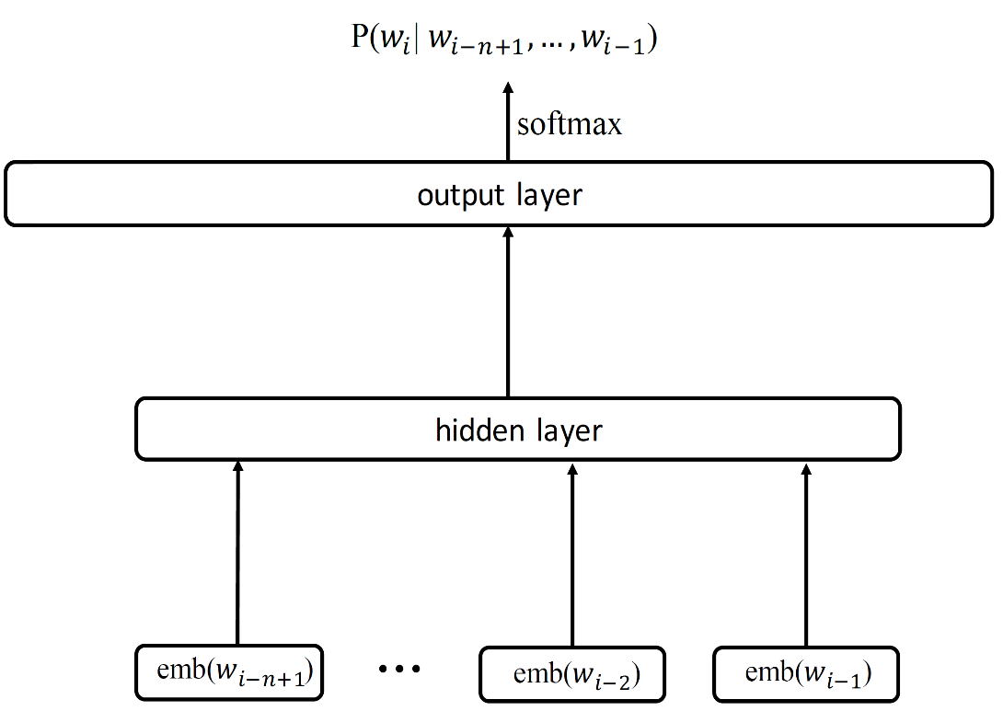
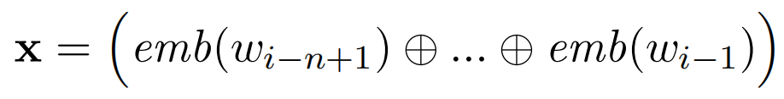
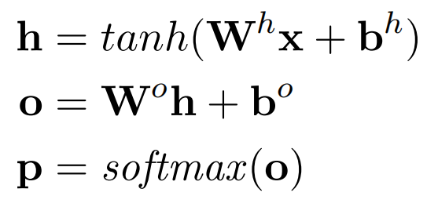
Neural n-gram language modelling
Base model
Here emb denotes word embeddings.
W^{h},Wº,b^{h},bº are model parameters.
p stands for the probability of word w_{i}.

Slide 7
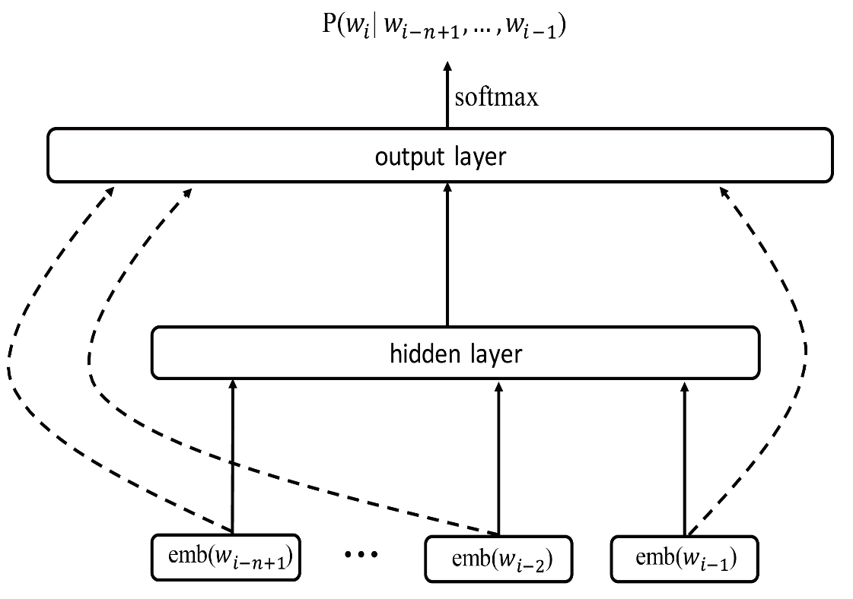
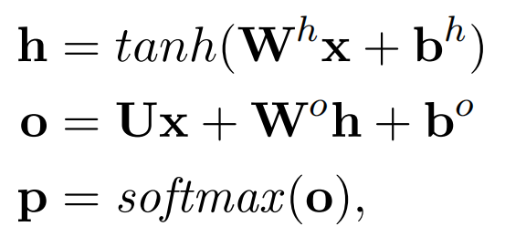
Neural n-gram language modelling
Adding shortcut connection

Slide 8
Neural n-gram language modelling
Adding shortcut connection
Short connection can empirically give better results.

Slide 9
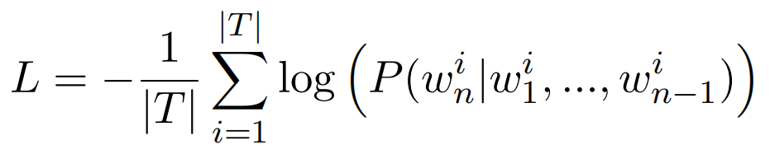
Neural n-gram language modelling
Adding shortcut connection
Training:
Given training corpus
We minimise the loss function:

Slide 10
Contents
17.1 Neural language models and word embedding
17.1.1 Neural n-gram language modelling
17.1.2 Noise contrastive estimation
17.1.3 Word Embeddings
17.2 Contextualized word representations
17.2.1 Recurrent neural language models
17.2.2 ELMo, GPT and BERT
17.2.3 Using contextualized embeddings
17.3 Transfer learning
17.3.1 Multi-task learning
17.3.2 Shared-private network structure

Slide 11
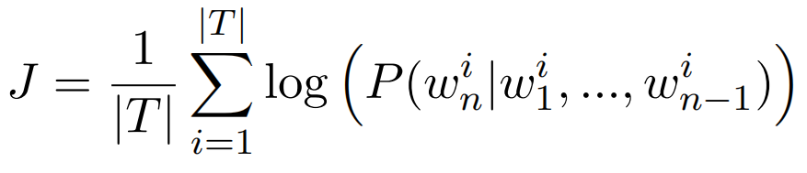
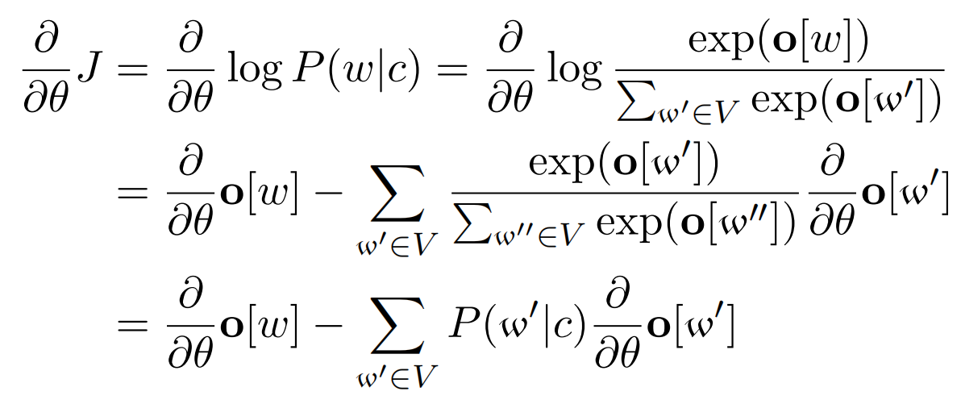
Noise contrastive estimation
The training objective in the last section can also ve viewed as maxmising:
Given the training instance (w, c), the local derivative with respect to a model parameter θ is :

Slide 12
Noise contrastive estimation
However, to compute the probability cen be expensive due to enumeration of all words in the vocabulary where

Slide 13
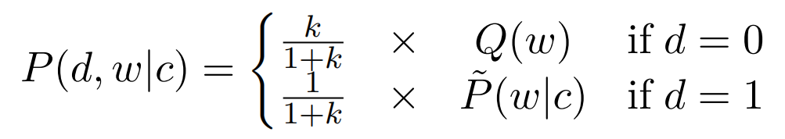
Noise contrastive estimation
Noise contrastive estimation (NCE)
NCE approximates MLE by drawing positive (real) samples and negative (out of data) sample.
In particular, we sample positive and negative samples from different distributions:
d=1: positive samples; d=0:denotes negative samples
(w|c): empirical (data) distribution
Q: uniform or empirical unigram distribution

Slide 14
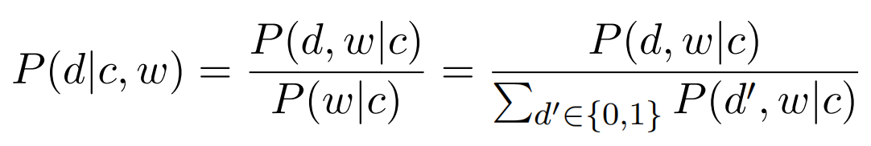
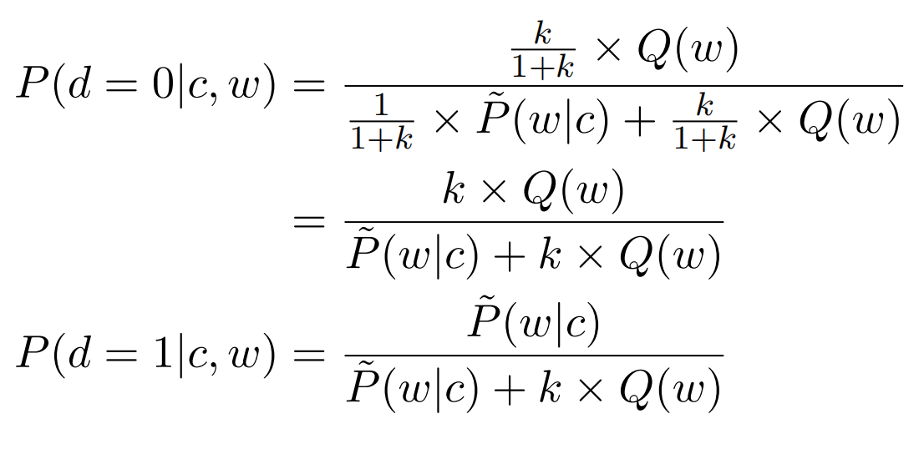
Noise contrastive estimation
According to :

Slide 15
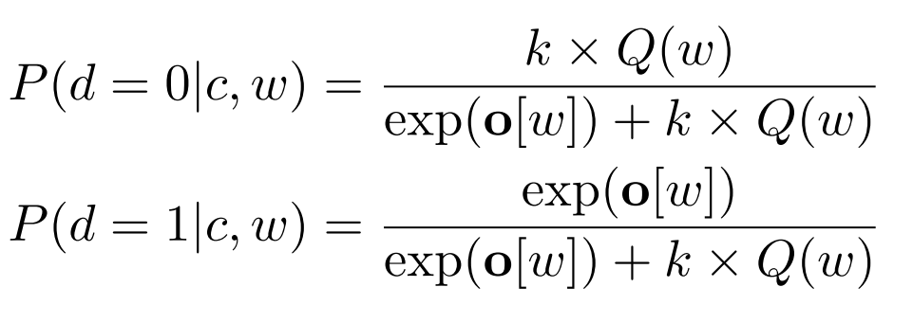
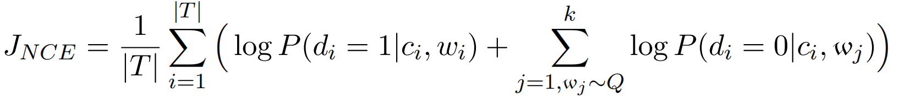
Noise contrastive estimation
To assume Z=1 in , We further have:
And we get the final training objective using NCE:
Notes:
Z=?;
Self-normalization

Slide 16
Optimizing neural language models
Speed the model:
A big computational bottleneck is the softmax function (output layer) over the whole vocabulary. NCE does not change the model itself.
Methods:
Two techniques can be introduced to make the model smaller:
Hierarchical softmax and log-bilinear model.

Slide 17
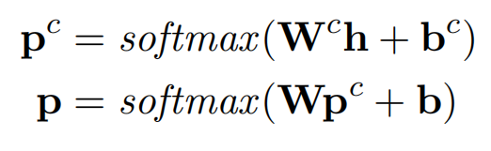


Optimizing neural language models
Hierarchical softmax
We can arrange the vocabulary into a hierarchy of two layers, with the first layer containing M categories, and the second layer containing |V|/M words in each category.
Size of the output layer:

Slide 18
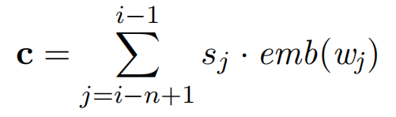
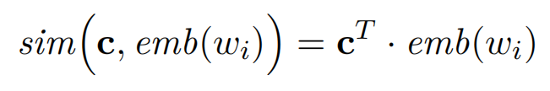
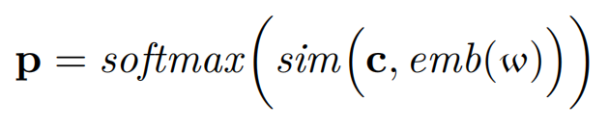
Optimizing neural language models
Log-bilinear model
emb(w_{i}) is used directly for computing the probability through a bi-linear similarity function, which reduce the model size effectively.

Slide 19
Contents
17.1 Neural language models and word embedding
17.1.1 Neural n-gram language modelling
17.1.2 Noise contrastive estimation
17.1.3 Word Embeddings
17.2 Contextualized word representations
17.2.1 Recurrent neural language models
17.2.2 ELMo, GPT and BERT
17.2.3 Using contextualized embeddings
17.3 Transfer learning
17.3.1 Multi-task learning
17.3.2 Shared-private network structure

Slide 20
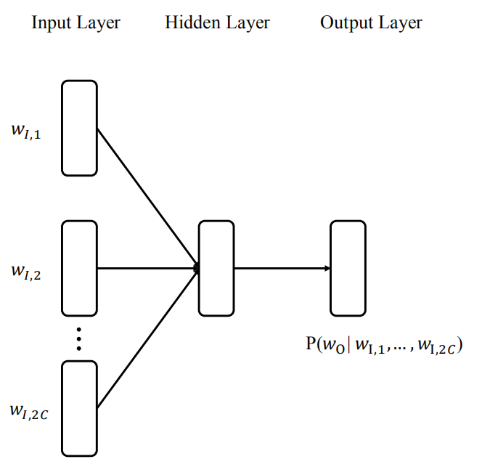
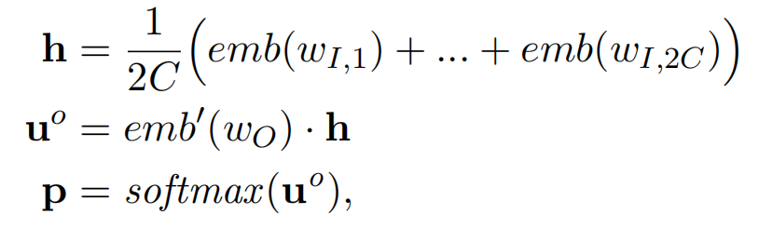
Distributed word representations
Continuous bag of words (CBOW)
where C is the window size for target word w_{o} ,
w_{I,1}, w_{I,2}, ..., w_{I,2C} can be a surrounding window
of w_{o} , emb and emb’ represents context and target embeddings, respectively.

Slide 21
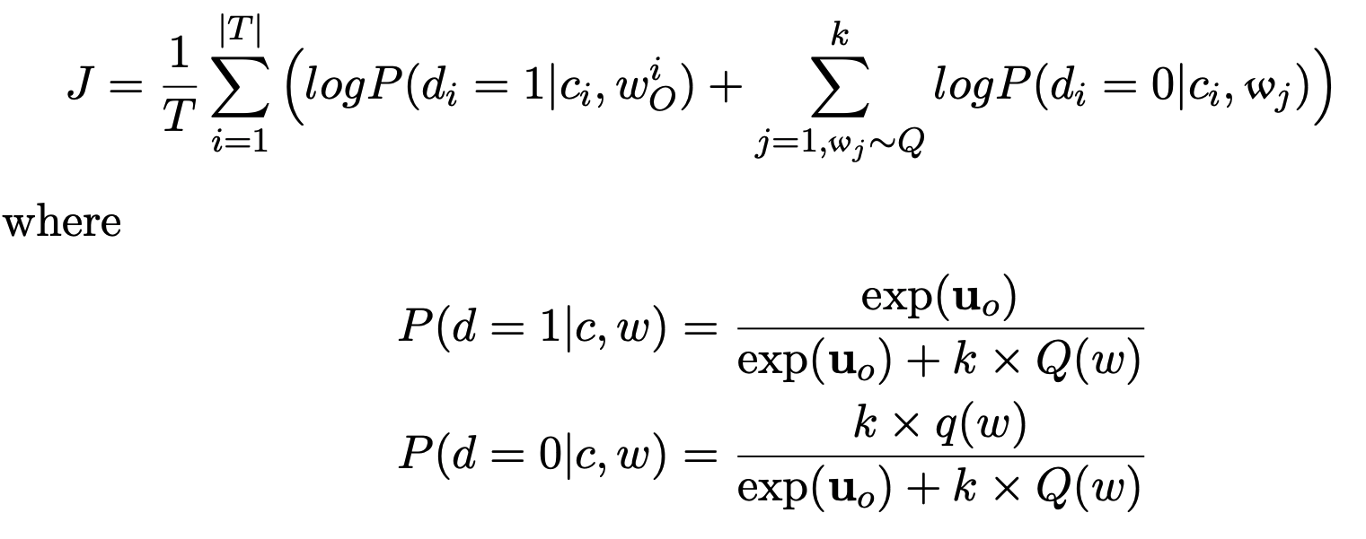
Distributed word representations
Continuous bag of words (CBOW)
Training:
Here k is the number of negative samples, d = 1 represents a positive sample and d = 0 represents a negative sample.

Slide 22
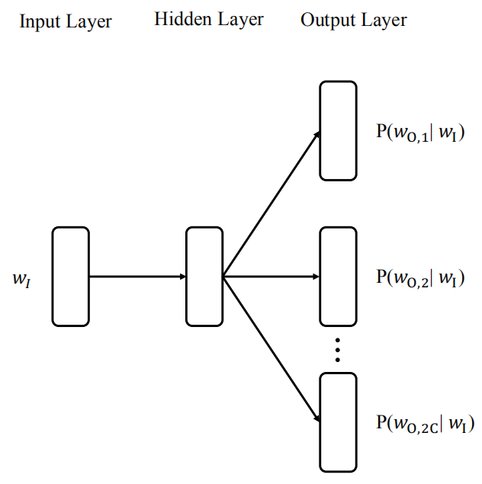
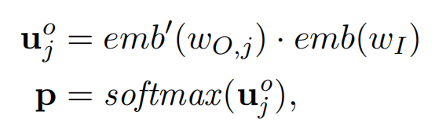
Distributed word representations
Skip-gram
where C is the window size for inout word w_{I} ,
w_{O,1}, w_{O,2}, ..., w_{O,2C} denote the context words, emb and emb’ represents target and context word embeddings, respectively.
Notes:
Add loss function

Slide 23
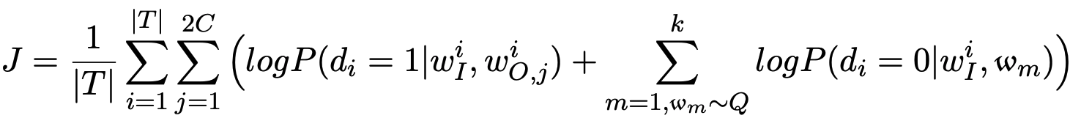
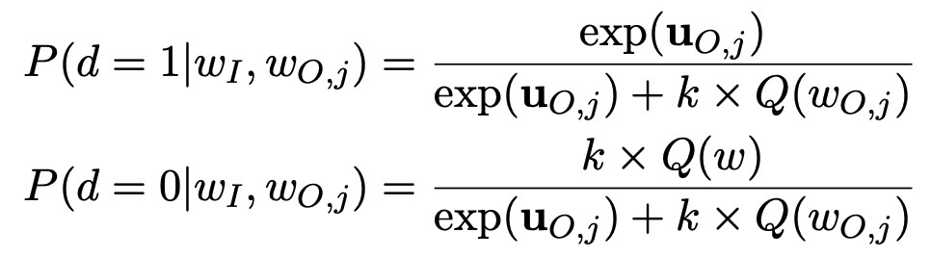
Distributed word representations
Skip-gram
Training:
where
Here k is the number of negative samples, d = 1 represents a positive sample and d = 0 represents a negative sample.
Notes:
Add loss function

Slide 24
Distributed word representation
Conparison between CBOW and Skip-gram
In CBOW, each target word is predicted once conditioned on the context window. The time complexity is O(|V|).
In skip-gram, in contrast, each target word is used to predict 2C context words, respectively, and therefore the time complexity is O(2C|V|).
During training, CBOW is faster than skip-gram. Skip-gram has been shown comparable or sightly more accurate empirically compared to CBOW.

Slide 25
Word embeddings using Global Statistics (GloVe)
CBOW and skip-gram make weak use global corpus-level information since they train word vectors based on local context windows.
GloVe is a different approach to train embeddings on global word-word co-occurrence counts in a corpus.

Slide 26

Word embeddings using Global Statistics (GloVe)
Use a matrix X denote word-word co-occurrence counts; X_{ij} represents the number of times word j occurs in the context of word i; emb and emb' to denote the target embedding and the context embedding.
The word vectors are learned with so that the dot-product scales with the probabilities:

Slide 27
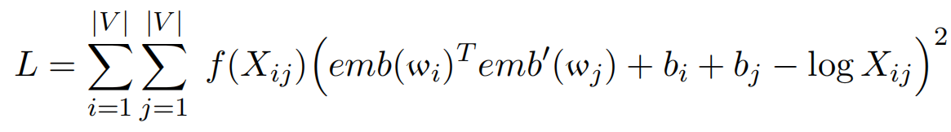
Word embeddings using Global Statistics (GloVe)
The training objective is to minimise:
where V denotes the vocabulary, f(X_{ij}) is a weighting function.

Slide 28
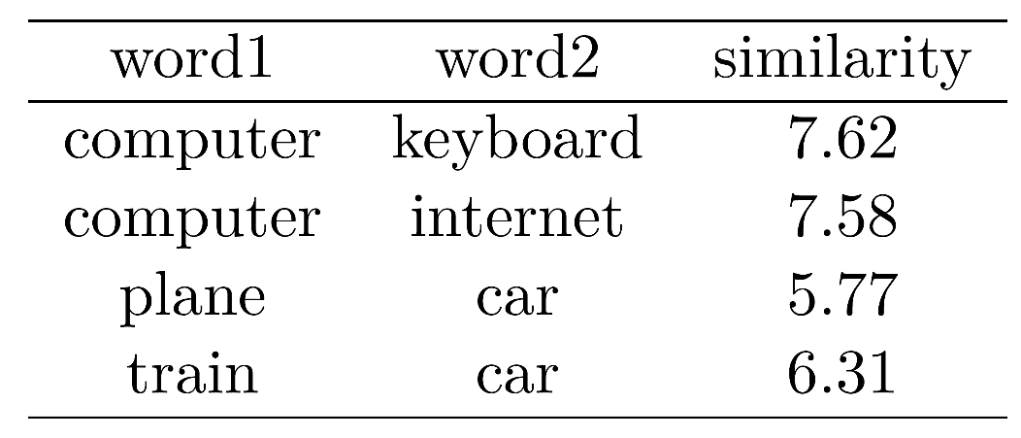
Word embedding evaluation
Word similarities
There is a corpora that contain words and their related words, each with a similarity score given by human expert.

Slide 29
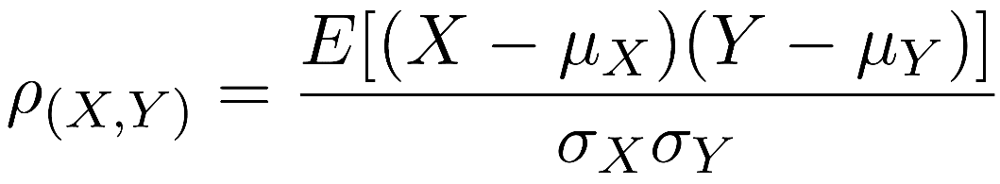
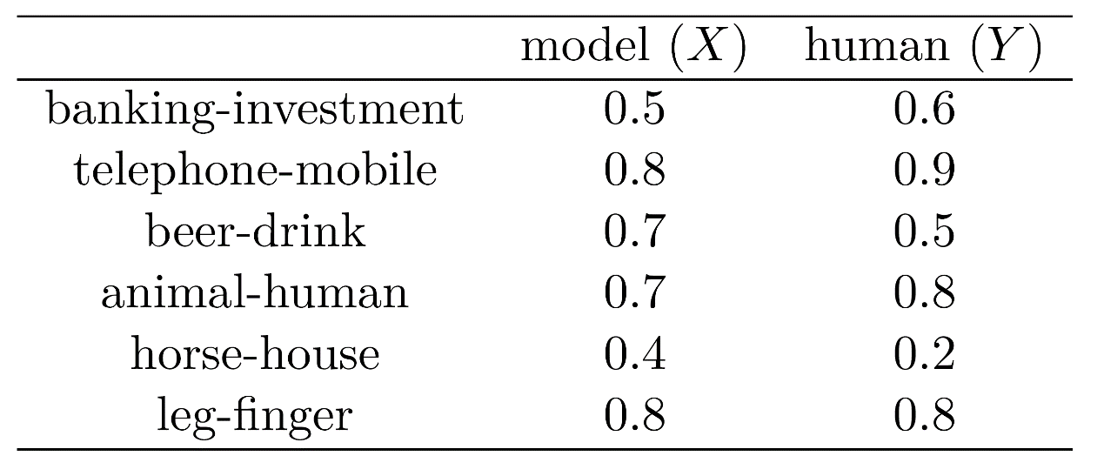
Word embedding evaluation
Word similarities
Finding the correlation between embedding based similarity scores and human-given scores using Pearson correlation co-efficient:

Slide 30
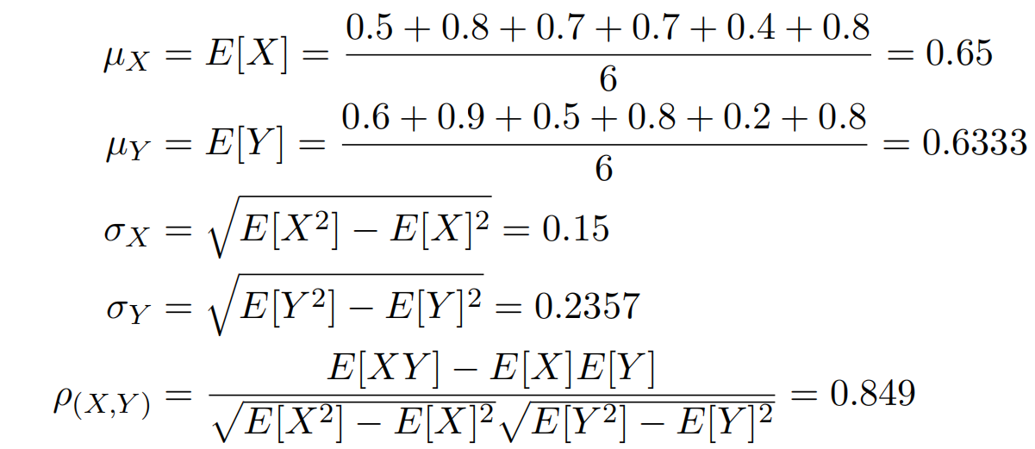
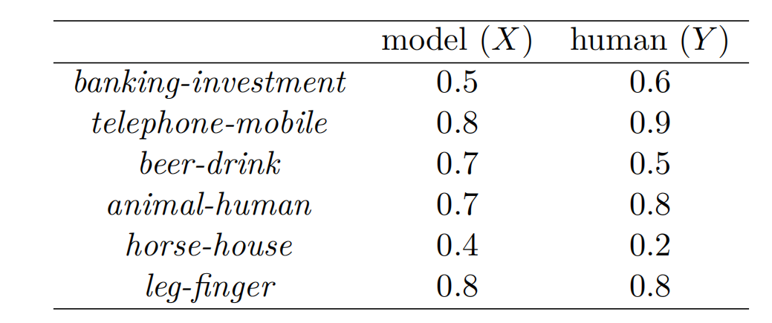
Word embedding evaluation
For the scores in the right table:
The Pearson correlation value of 0.849 shows that word embeddings well capture word relations.

Slide 31
Word embedding evaluation
Word analogy
Given a word pair “king - queen” and a third word “man”, and a fourth word is asked for making an analogy:
(king - queen) v.s. (man - ?)
The correct answer is “woman”.
Evaluate word embeddings, which allows the word vectors to follow:

Slide 32
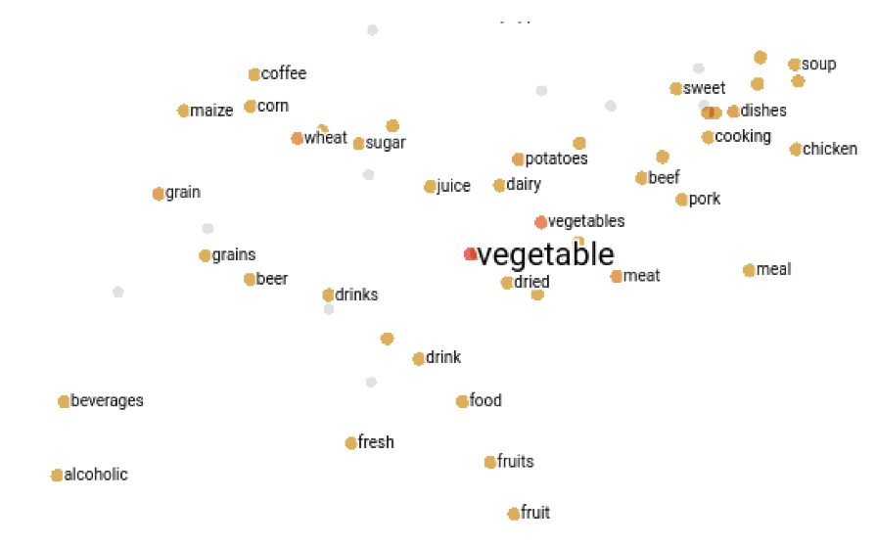
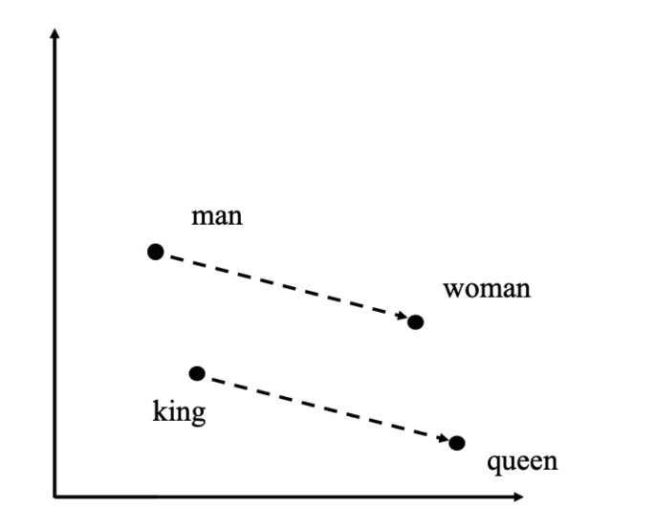
Word embedding evaluation
Visualization
A non-linear dimensionality reduction technique t-SNE(t-Distributed Stochastic Neighbor Embedding) is used to preserve the distance correlation between points in the high-dimensional space and the projected two-dimensional space.
Similarity Analogy

Slide 33
Embeddings and unknown words
The vocabulary V_{p} for pre-trained embeddings and the vocabulary V_{t} for a dataset of the end task can be different.
1.|V_{p}| is much larger.
2. There can also be words in V_{t} that do not exist in V_{p}.

Slide 34
Embeddings and unknown words
V_{p} -V_{t} : words in V_{p} but not V_{t}
1) if pre-trained embeddings are not fine-tuned:
consistent on the word embedding level for both in-domain and cross-domain test sets.
2) if pre-trained embeddings are fine-tuned:
increase in-domain performance;
decrease the generalisation power of the model across domains.

Slide 35
Embeddings and unknown words
V_{t} -V_{p} : words in V_{t} but not V_{p}
How to represent them?
1) assigned as <UNK> and set to 0 vector or a random vector.
2) learn the embedding during training.
3) derived from their characters and sub-words.

Slide 36
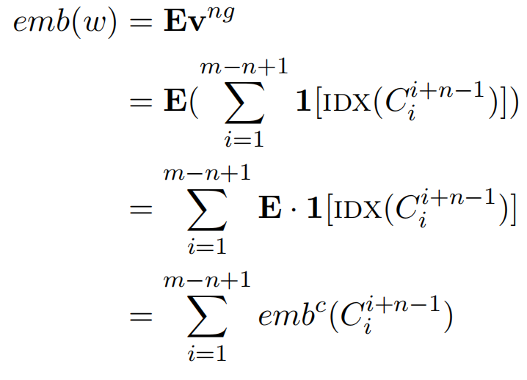
Character n-gram based word embedding
Suppose w=c₁,...,c_{m}, C_{ij} = c_{i}, ..., c_{j} denotes the subsequence of characters from position i to position j. The embedding of w can be written as:
Tri-grams for word “embedding” :
emb('embedding')
= emb('emb')+emb('mbe')+
emb('bed')+emb('edd')+
emb('ddi')+emb('din')+
emb('ing')

Slide 37
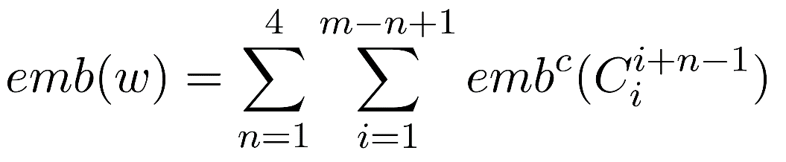
Character n-gram based word embedding
Summing up n-gram embeddings of different length:

Slide 38
Contents
17.1 Neural language models and word embedding
17.1.1 Neural n-gram language modelling
17.1.2 Noise contrastive estimation
17.1.3 Word Embeddings
17.2 Contextualized word representations
17.2.1 Recurrent neural language models
17.2.2 ELMo, GPT and BERT
17.2.3 Using contextualized embeddings
17.3 Transfer learning
17.3.1 Multi-task learning
17.3.2 Shared-private network structure

Slide 39
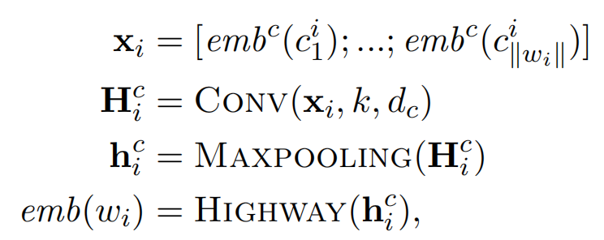
Recurrent neural language models
RNN LM use a history from beginning of the sentence until the previous word to predict the target word.
First, CNN is used to represent each word.

Slide 40
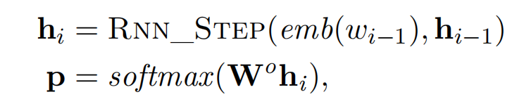
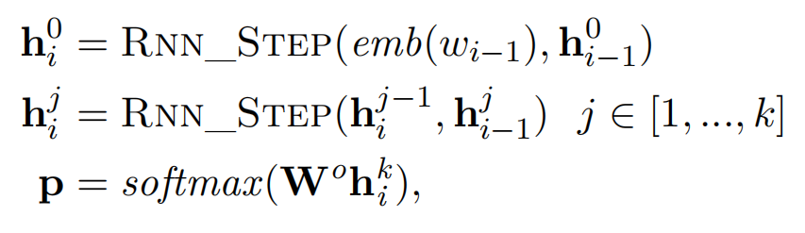
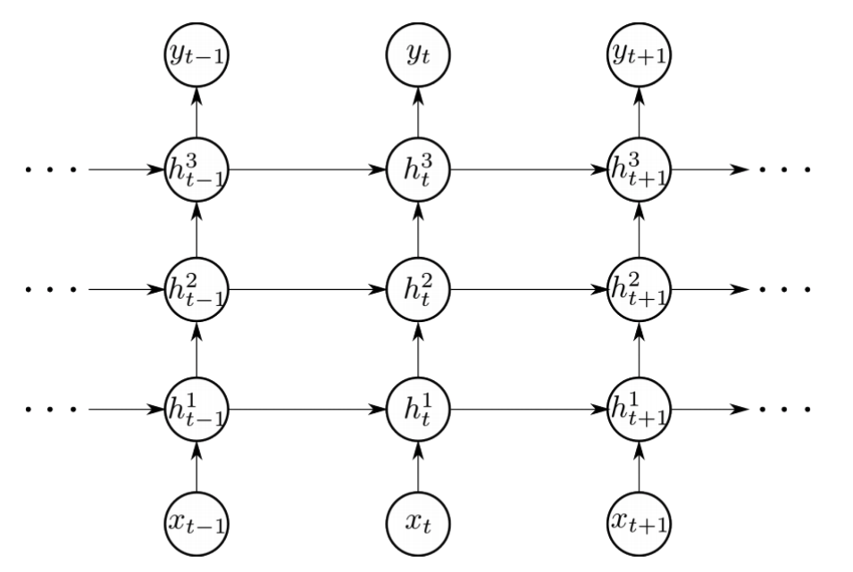
Recurrent neural language models
On the sequence level, P(w_{i}|w₁, w₂, ..., w_{i-1}) is calculated by:
Stacking multiple layers:
Conventional Stacked RNN
Figure Credit: https://cs224d.stanford.edu/reports/Lambert.pdf
Notes:
Add a figure (copied from chp14)

Slide 41
Contents
17.1 Neural language models and word embedding
17.1.1 Neural n-gram language modelling
17.1.2 Noise contrastive estimation
17.1.3 Word Embeddings
17.2 Contextualized word representations
17.2.1 Recurrent neural language models
17.2.2 ELMo, GPT and BERT
17.2.3 Using contextualized embeddings
17.3 Transfer learning
17.3.1 Multi-task learning
17.3.2 Shared-private network structure

Slide 42
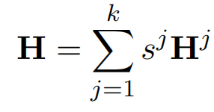
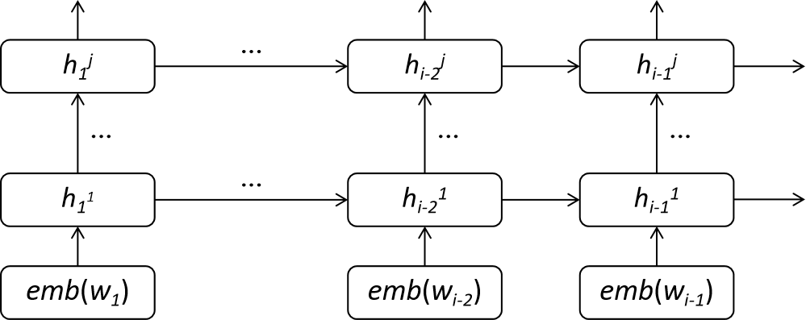
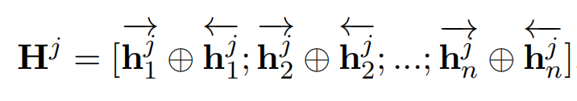
ELMo
The contextualized word embeddings can be computed by integrating multiple hidden layers:
Considering bi-directional information:
The embeddings above is also referred to as
Embeddings from Language Models (ELMo).

Slide 43
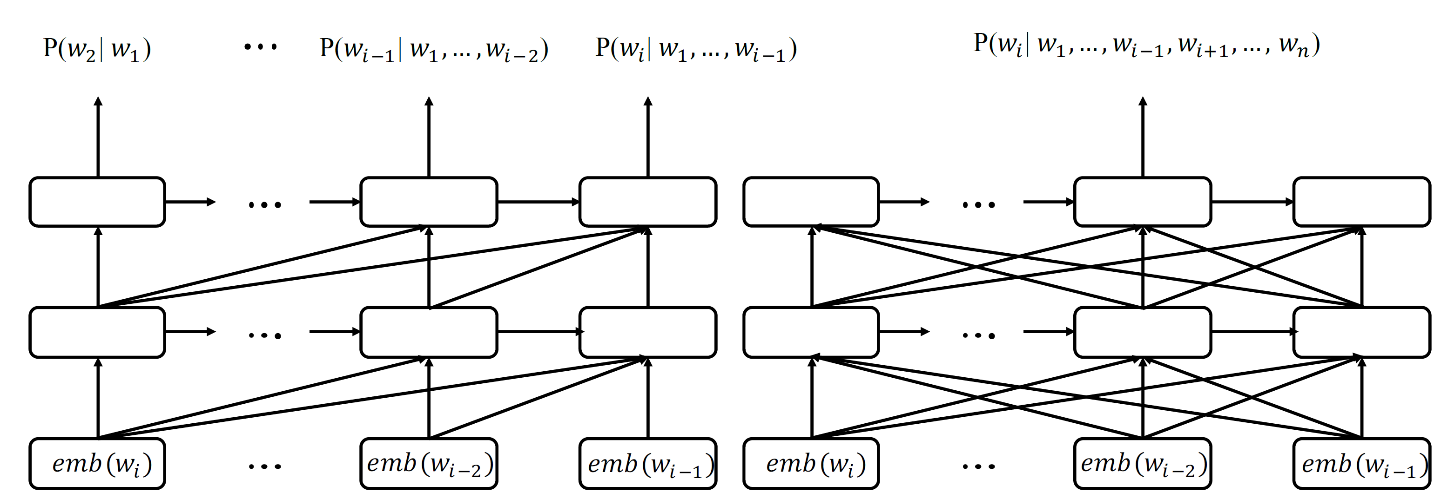
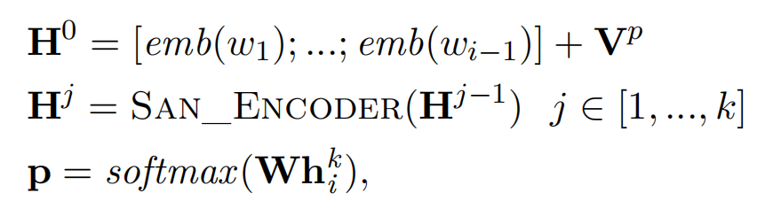
GPT
SANs being an alternative sequence encoder choice to RNNsThis method has been used as a principle behind the Generative Pre-Training (GPT) model.
Given a sequence of words W₁^{i-1} = w₁, ..., w_{i-1}, a k-layers SAN LM predicts the next word w_{i} by:

Slide 44
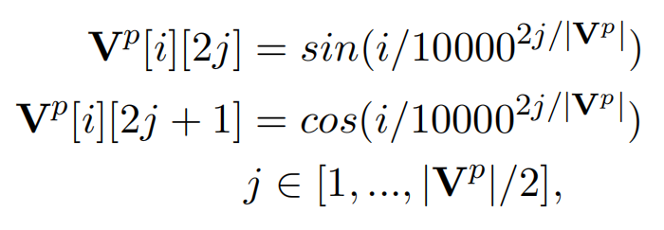
GPT
In the last equation, V^{p} is a position embedding matrix.
where 2j and 2j + 1 denotes an element in V^{p}[i].

Slide 45
BERT
Masked langauge modeling (MLM).
predicting the mask word using left and right context.
e.g. I went to the <mask> to get some food.
“restaurant”, “pizzeria”,“store”, “cafe” or “pub”...

Slide 46
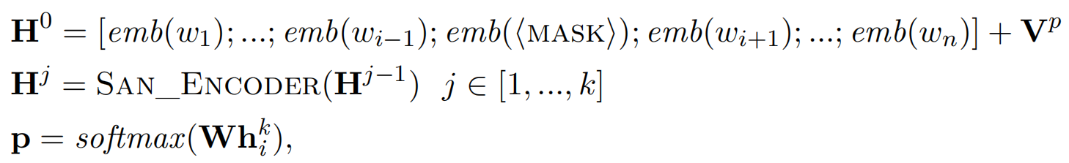
BERT
Instead of using the history information, we predict w_{i} using MLM by:
The above contextualised embedding method has been used as a principle behind the Bidirectional Encoder Representations from Transformers
(BERT) model.

Slide 47
Contents
17.1 Neural language models and word embedding
17.1.1 Neural n-gram language modelling
17.1.2 Noise contrastive estimation
17.1.3 Word Embeddings
17.2 Contextualized word representations
17.2.1 Recurrent neural language models
17.2.2 ELMo, GPT and BERT
17.2.3 Using contextualized embeddings
17.3 Transfer learning
17.3.1 Multi-task learning
17.3.2 Shared-private network structure

Slide 48
Using contextualized embeddings
Text Classification/Sequence Labeling/Parsing ...
Your own models (or MLP simply)
ELMo,GPT,BERT...
Input Text

Slide 49
Using contextualized embeddings
Text Classification/Sequence Labeling/Parsing ...
Your own models (or MLP simply)
Syntactic info
Semantic info
Factual knowledge
Common Sense
...
ELMo,GPT,BERT...
Input Text

Slide 50
Contents
17.1 Neural language models and word embedding
17.1.1 Neural n-gram language modelling
17.1.2 Noise contrastive estimation
17.1.3 Word Embeddings
17.2 Contextualized word representations
17.2.1 Recurrent neural language models
17.2.2 ELMo, GPT and BERT
17.2.3 Using contextualized embeddings
17.3 Transfer learning
17.3.1 Multi-task learning
17.3.2 Shared-private network structure

Slide 51
Transfer learning
Pretraining from LM
Skip Gram, CBOW, ELMo, GPT, BERT
Pretraining beyond LM
Transferring knowledge from resource-rich tasks, domains, languages and annotation standards to low-resource ones.
e.g
syntactic resources pretraining for semantic role labeling.
corpora in news domain pretraining for low-resources social media.
English-French machine translation pretraining for English-Uzbek.

Slide 52
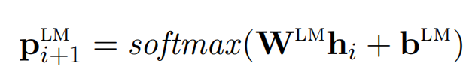

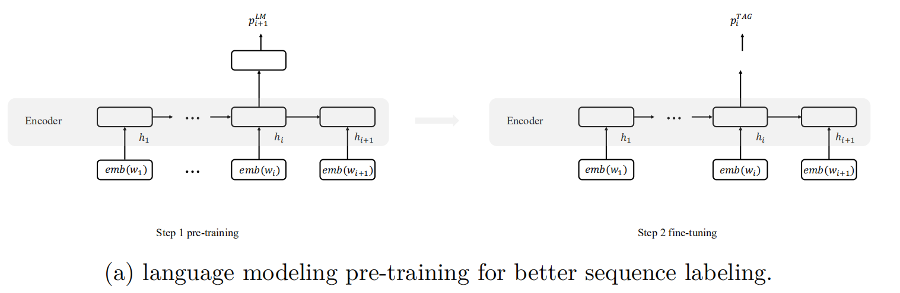
Multi-task learning
Multi-task learning (MTL) exploits parameter sharing for seeking mutual benefits between tasks.
e.g
knowledge from language modeling is transferred to sequence labeling.
1)We do the LM pre-training.
2)Sequence labeling can benefit from LM with more informed starting parameters.

Slide 53
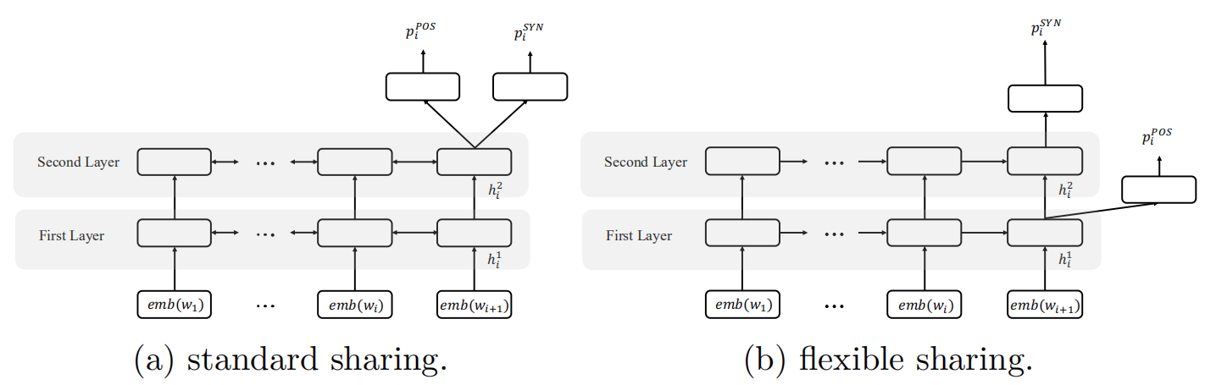
Selecting parameters for sharing
Selecting shared layers.
Different infomation can be encoded in different layers.
Sequence labeling benefits from more shallow contextual information, which is better captured in lower LSTM layers.

Slide 54
Shared-private network structure
Sharing model parameters across tasks can potentially suffer from information conflict.
We want to minimise such conflict while maximising the mutual benefit between tasks via common information.
Solution:
learn a set of shared parameters across tasks,
while keeping a separate copy of parameters for each task.

Slide 55
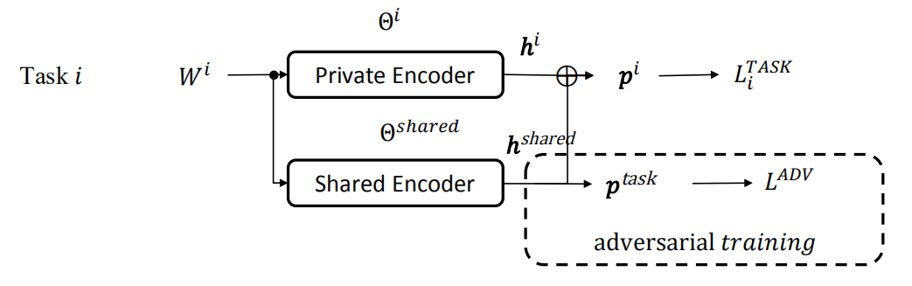



Shared-private network structure
Shared/Separated representation for each tasks

Slide 56
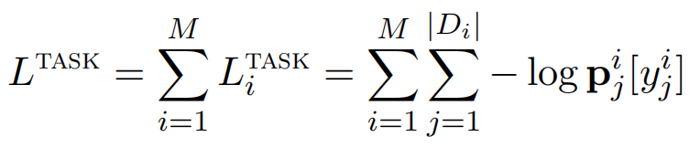
Shared-private network structure
Loss for each tasks

Slide 57

Shared-private network structure
Adversarial Training
To ensure that h^{shared} contains no task-specific information through p^{task}

Slide 58

Shared-private network structure
Total Loss

Slide 59
Summary
Neural n-gram language models and recurrent neural language models;
Noise contrastive estimation;
Word embeddings as distributed word representations;
Contextualized word embeddings;
Pre-training and transfer learning.

