Slide 1

Natural Language Processing
Yue Zhang
Westlake University

Slide 2
Chapter 18
Deep Latent Variable Models

Slide 3
Contents
18.1 Introducing latent variables into a neural network model
18.2 Working with categorical latent variables
18.3 Working with structured latent variables
18.4 Variational Inference
18.5 Neural Topic Models
18.6 VAEs for Language Modeling

Slide 4
Contents
18.1 Introducing latent variables into a neural network model
18.2 Working with categorical latent variables
18.3 Working with structured latent variables
18.4 Variational Inference
18.5 Neural Topic Models
18.6 VAEs for Language Modeling

Slide 5
Deep Latent Variable Models
Why deep latent variable models?
Deep neural networks can be used as strong function approximators to infer latent variables from data
Latent variables can help deep neural networks to explicitly model compositional factors to generate data

Slide 6
Deep Latent Variable Models
Challenging but useful:
Extra challenges to SGD and back-propagation
Useful applications include variational autoencoders for text generation and neural topic models for document modeling

Slide 7
A probabilistic generative model
: A model that describes the generative probability of some observed variables ,
: the set of model parameters

Slide 8
A probabilistic generative model
: A model that describes the generative probability of some observed variables ,
: the set of model parameters
How to introduce latent variables in such a generative model?

Slide 9
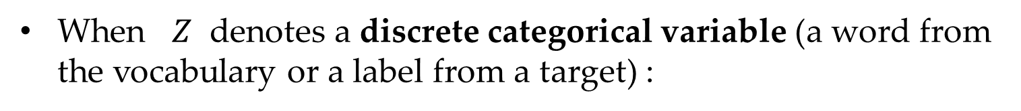
A generative model with discrete latent variables
When $Z$ denotes a discrete categorical variable (a word from the vocabulary or a label from a target) :
: joint likelihood of and
: prior distribution of the latent variable
: conditional generative probability distribution of given

Slide 10
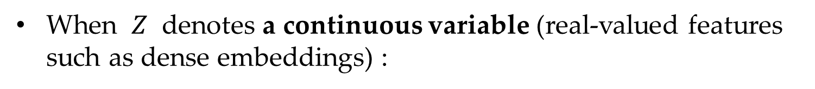
A generative model with continuous latent variables
When $Z$ denotes a continuous variable (real-valued features such as dense embeddings) :
: joint likelihood of and
: prior distribution of the latent variable
: conditional generative probability distribution of given

Slide 11
Why introducing a latent variable ?
What is the problem?
A model can be highly complex when learning a representation that fits the distribution of observed data
When introducing a latent variable ?
A structured model consisting of simpler distributions for both and , even a Gaussian distribution for can represent powerful distribution.

Slide 12
Contents
18.1 Introducing latent variables into a neural network model
18.2 Working with categorical latent variables
18.3 Working with structured latent variables
18.4 Variational Inference
18.5 Neural Topic Models
18.6 VAEs for Language Modeling

Slide 13
Model with SGD Training
Given a dataset , the gradient of the log marginal likelihood of with respect to is given by
For each training example , the local update is:

Slide 14
Model with SGD Training
When $Z$ represents a discrete latent variable,
can be explicitly calculated by
Both and are parameterized model probabilities .
can be calculated by enumerating all values of the categorical random variable .

Slide 15
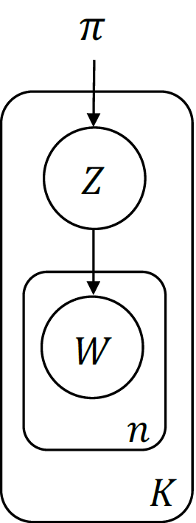
A Bag-of-Words Model
Considering a neural bag-of-words model with a latent topic serves as a latent topic, according to which a document can be generated:
is a latent categorical random variable
, distributed by

Slide 16
A Bag-of-Words Model
Considering a neural bag-of-words model with a latent topic ( serves as a latent topic, according to which a document can be generated):
Given a specific topic
The distribution of a word :
The distribution of a document
:

Slide 17
A Bag-of-Words Model
Given a set of documents , we train the model by maximising
Where denotes the number of words in

Slide 18
Text clustering
For clustering, the posterior can be used, which can be calculated as

Slide 19
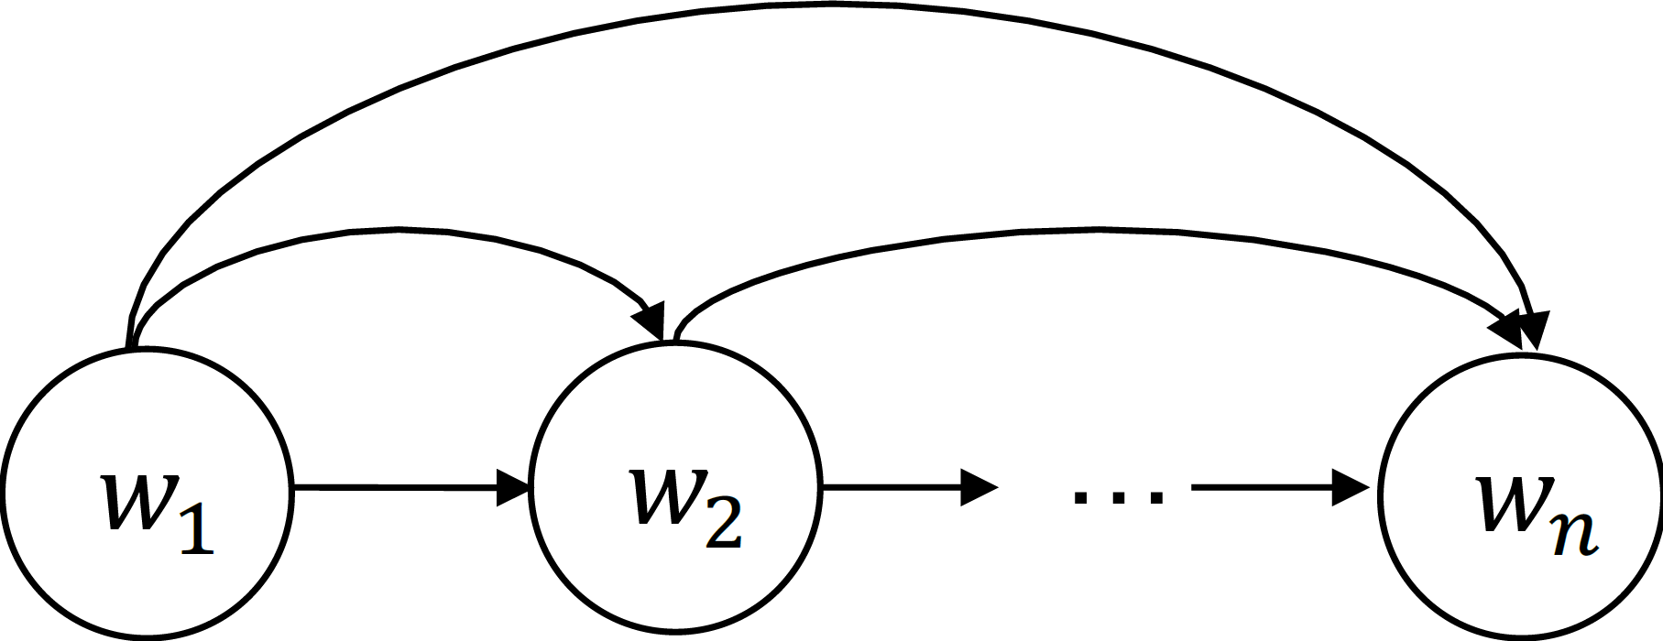
RNN Language Model
Considering an RNN language model, which generates each word according to all the preceding words:
Firstly, A LSTM encoder is used to find a sequence of hidden vectors for a sequence of words:
Where denotes the LSTM parameters

Slide 20
RNN Language Model
Considering an RNN language model, which generates each word according to all the preceding words:
Then, is given by
Where and are model parameters

Slide 21
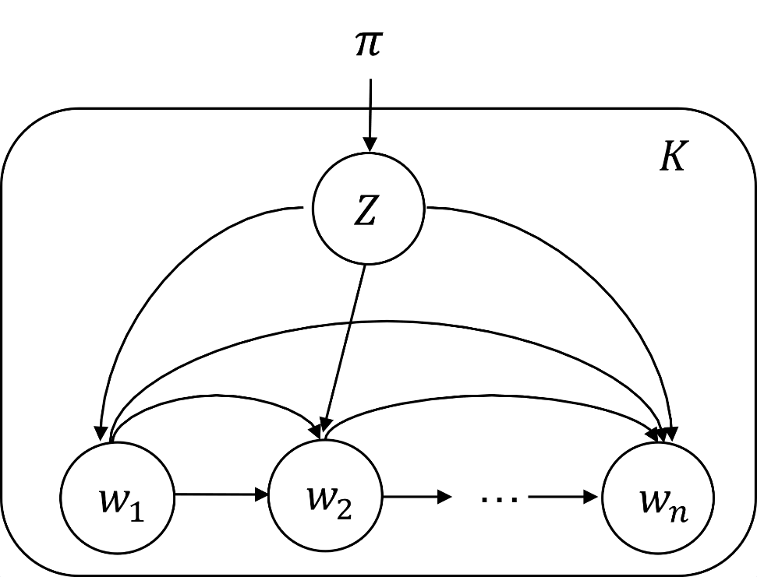
RNN Language Model with a categorical variable
Now considering an RNN language model with a categorical random variable
Given a specific topic
The distribution of a word :
The distribution of a set of sentences:
:

Slide 22
RNN Language Model with a categorical variable
Given a set of sentences , we train the model by maximising
For each sentence , we have
Where

Slide 23
Text clustering
For clustering, the posterior can be used, which can be calculated as

Slide 24
Contents
18.1 Introducing latent variables into a neural network model
18.2 Working with categorical latent variables
18.3 Working with structured latent variables
18.4 Variational Inference
18.5 Neural Topic Models
18.6 VAEs for Language Modeling

Slide 25
Structured Latent Variables
Let the latent variable denotes a certain structure:
Given input sentence representation ,
the distribution of :
are the model parameters for the neural network models.

Slide 26
Structured Latent Variables
Given original input and latent variable ,
we can obtain a context vector :
is a neural network function (annotation function)
is the Q function for , when is a scalar
is a feature containing prior knowledge such as sentiment, when is a dense vector

Slide 27
Dynamic Programming
To calculate the expectation over , dynamic programming algorithms can be used to enumerate all
represents an individual clique, is the sub structure, and is the log potential function and is the partition function.

Slide 28
Dynamic Programming
When ,
is the marginal posterior distribution of the clique

Slide 29
Sequence Labelling
Assume that is a latent tag sequence, where denotes the tag for
For a first-order Markov model, each is defined as two consecutive tags, the log potential function is the sum of two components:
corresponds to the emission
corresponds to the transition

Slide 30
Sequence Labelling
Given the log clique potential functions, the conditional probability
Given , we have
The annotation function for is the concatenation of and

Slide 31
Sequence Segmentation
Considering a latent variable , indicating whether the ith word begins a new contiguous subsequence or not.
When and , tests whether is equal to 1.
is a weighted sum of the input vectors

Slide 32
Sequence Segmentation
Further considering a 0th-order Markov assumption between consecutive segments
Let denote the potential score for a segment that begins with :
We get

Slide 33
Sequence Segmentation
Local models can work well for structured prediction thanks to the representation power of neural network encoders.
Higher-order semi-CRF models can be defined to capture dependencies of consecutive segments also.

Slide 34
Constituent Parsing
Similar to modeling the sequential label dependencies as latent variables, the probability of syntactic spans of latent variables can also be learned by a constituent parser.
Considering for all , each latent variable indicates whether the span belongs to constituent tree.
A constituent attention layer is defined by
is a representation vector of the span

Slide 35
Constituent Parsing
Given a latent variable , which represents a valid binarized constituent tree, the posterior probability of is given by
is the log potential of the span :
and are model parameters.

Slide 36
Constituent Parsing
Thus, we have
is the partial function.
Higher-order tree CRF models can be defined by considering the dependencies of . For example a first-order model can model the dependencies as a CFG rule.

Slide 37
Contents
18.1 Introducing latent variables into a neural network model
18.2 Working with categorical latent variables
18.3 Working with structured latent variables
18.4 Variational Inference
18.5 Neural Topic Models
18.6 VAEs for Language Modeling

Slide 38
Variational Inference
The expectation over the posterior can be intractable, for instance when involves continuous variables:
To approximate the intractable posterior inference with a tractable proxy:
Variational inference (VI) is such a method by optimising a lower bound of with a surrogate of the exact posterior

Slide 39
Evidence Lower Bound (ELBO)
Assuming as a discrete latent variable, using Jensen inequality:
This lower bound is named the evidence lower bound (ELBO).

Slide 40
Evidence Lower Bound (ELBO)
Using the variational posterior (a simpler distribution family, denotes a set of variational parameters) to approximate , the lower bound can be:
This is the expectation of over the distribution

Slide 41
Evidence Lower Bound (ELBO)
The difference between the evidence and the evidence lower bound:
KL divergence of the approximate posterior and the true posterior.
Maximising this lower bound is intuitively equivalent to choosing a probability distribution which is the closest to according to the distance measured by .

Slide 42
Evidence Lower Bound (ELBO)
Given a dataset , for the ith input , let its variational parameter be , the log marginal likelihood of the whole dataset is
Where . The lower bound of the dataset is the aggregate ELBO of each data point.

Slide 43
Coordinate Ascent Variational Inference
Coordinate ascent VI (CAVI) resembles EM and it is also called variational EM.
Variational E-step: finding the optimal variational posterior distribution for each input by assuming that are constants.
Formally, is given by

Slide 44
Coordinate Ascent Variational Inference
Coordinate ascent VI (CAVI) resembles EM and it is also called variational EM.
Variational M-step: optimizing to maximise the ELBO of the whole dataset by fixing each to its corresponding value obtained in the variational E-step

Slide 45
Stochastic Variational Inference
Stochastic variational inference (SVI) considers a batch of M examples to illustrate the updating procedure of SVI.
Gradient-based E-step: updating the variational parameter for the ith training instance by the gradient
is the learning rate. The initial parameter can be randomly initialised. Each training instance is performed for K steps to make a good approximation.

Slide 46
Stochastic Variational Inference
Stochastic variational inference (SVI) considers a batch of M examples to illustrate the updating procedure of SVI.
Gradient-based M-step: with the learned variational parameters , updating by the gradient

Slide 47
Amortised Variational Inference
Potential issues of CAVI and SVI (learning one set of variational parameters for each training instance):
Not scale for large datasets.
Optimisation process is necessary for a new test sample.
Optimisation for a single example can be expensive.
Amortised variational inference (AVI) restricts the variational distribution family to a certain distribution parameterized by deep neural network, which are called recognition network, inference network or encoders.
Learning a globally shared set of neural network parameters to predict the variational parameter of each instance.

Slide 48
Amortised Variational Inference
Denoting the inference network as , where are the model parameters of the inference network. The variational parameter of is dynamically decided by
Given the training set , the shared parameter set can be optimized by maximizing the aggregate ELBO of the whole dataset where the loss is
For simplicity, denoting as

Slide 49
Amortised Variational Inference
Using the above learning objective, mini-batch stochastic gradient ascent can be used to alternatively optimize and :
and are learned jointly.

Slide 50
Amortised Variational Inference
On the one hand:
Compared with CAVI and SVI, amortised VI is less expressive since the variation posterior distribution is a parameterised mapping from the observation data.
Amortisation gap: gap between free-form VI (e.g., CAVI and SVI) and amortised VI.
On the other hand:
Amotised VI can be much faster than CAVI and SVI.
Variational parameters learned by the encoder can represent good variational posterior distributions.
Amortised bridges deep neural networks and efficient VI for massive datasets.

Slide 51
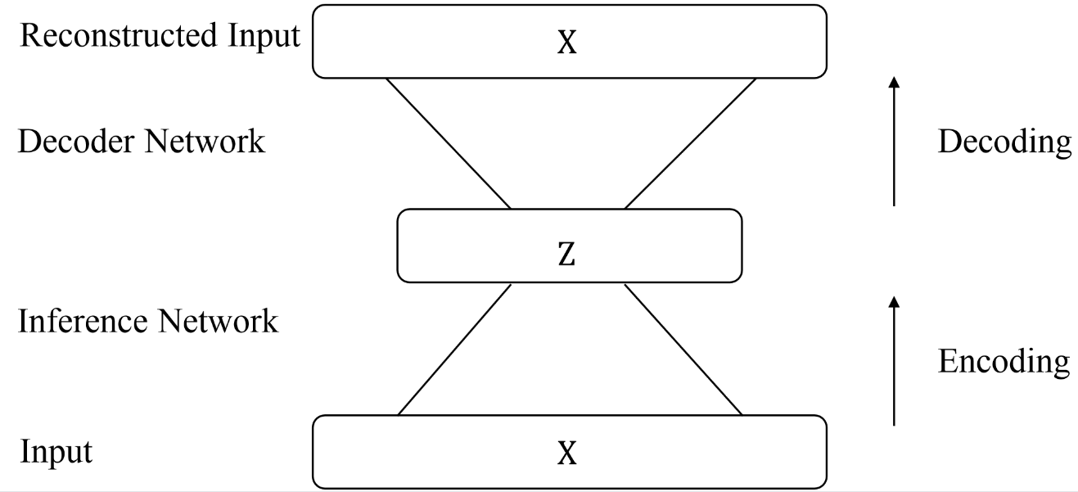
Variational Autoencoders
What is an autoencoder?
autoencoder
Training a model that can encode an input x into a representation z and then reconstruct (i.e, decode) z from x.
The representation z is typically a more compact representation of x that contains all information about x.

Slide 52
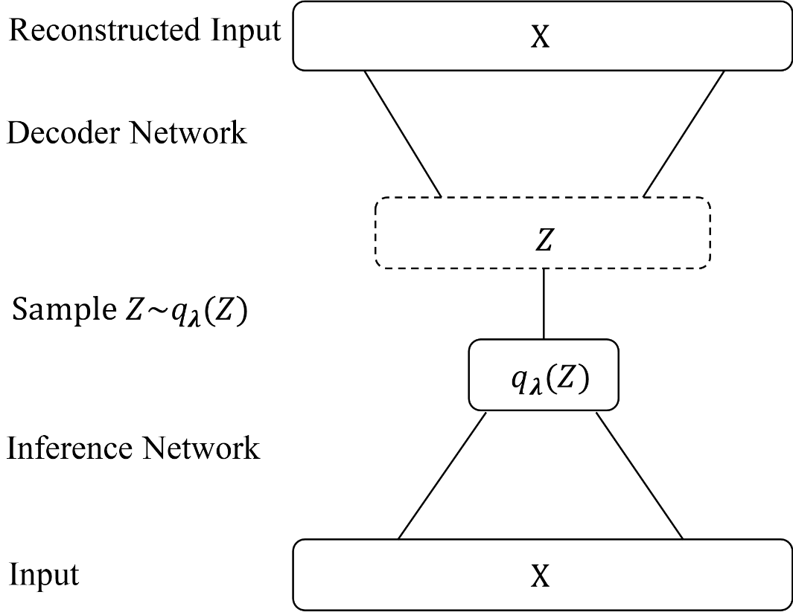
Variational Autoencoders
What is a variational autoencoder?
Variational autoencoder
Applications of amortised VI for unsupervised representation learning using latent variables based on an autoencoder framework.
z is a stochastic variable instead.

Slide 53
Variational Autoencoders
Generative process:
Sample a random vector from the prior distribution
Construct x from , using a decoder network
When inference:
Find a variational posterior distribution , which is conditioned on x, are parameters.
To ensure the random vector from prior can encode meaningful representations of the input, enforce the posterior to match when training.

Slide 54
Variational Autoencoders
and are jointly trained to maximise the ELBO of x:
The first term can be regraded as a reconstruction loss. The latent random vector is trained to best construct x by maximizing the log-likelihood .
The second term is a regulariser, which forces the posterior distribution to be similar to the prior.

Slide 55
Variational Autoencoders
and are jointly trained to maximise the ELBO of x:
The first term can be regraded as a reconstruction loss. The latent random vector is trained to best construct x by maximizing the log-likelihood .
The second term is a regulariser, which forces the posterior distribution to be similar to the prior.

Slide 56
Variational Autoencoders
Assuming that posterior distribution and prior distribution are multivariate Gaussian distributions with diagonal covariance matrices:
Where and are predicted by in inference network over x, and :
Where and are two separate networks parameterized by and .

Slide 57
Variational Autoencoders
Training of the decoder, update using the gradient:
This is the expectation of the gradients of the complete data log-likelihood with respect to according to the variational posterior .
To estimate the intractable expectation term, approximating the gradient by generating samples of from , namely :
can typically be set to 1 for both efficiency and accuracy.

Slide 58
Variational Autoencoders
Training of the inference network, update using the gradient:
The calculation of and
are similar.

Slide 59
Variational Autoencoders

Slide 60
Variational Autoencoders
Similarly:

Slide 61
Variational Autoencoders
Finally:
Again, using random samples to do approximation:

Slide 62
Reparameterization
The sampling process is a discrete-valued function that is non-differentiable, how to ensure that all the parameters are updated during SGD training?
Reparameterisation of the posterior distribution:
is typically the inverse function of a standardisation function , which maps a parameterized distribution into a standardized distribution such as the standard normal distribution and the uniform distribution.

Slide 63
Reparameterisation for Gaussian
Supposing that is a diagonal Gaussian:
The standardization function is , which is distributed as
Reparameterisation for a Gaussian random sample :
and are produced by the encoder network.

Slide 64
Reparameterization
Considering the gradient of :
For the first term, using reparameterization, the expectation can be written as
Now the expectation is independent on

Slide 65
Reparameterization
The gradient for the KL divergence term:
Reparameterisation trick similar to the first term for approximate gradients.
Analytical solution for accurate gradients. Fox example:
Given and :
is the feature dimension of
The gradients can be directly back-propagated through the decoder to the inference network through and , without considering the or samples.

Slide 66
Gumbel-max Trick
Supposing that is a random sample of the categorical probability distribution , where and
.
When represents the one-hot vector of , can be represented by a Gumbel distribution ,
where is a sample from the uniform distribution:
is also called the gumbel noise. returns a one-hot vector with the kth element being one and the other elements being zeros.

Slide 67
Gumbel-max Trick
The arg max operation in gumbel-max is non-differentiable, which makes back-propagation difficult.
Instead, using a softmax function not approximate the max function, gumbel softmax can be used to reparameterise categorical distribution:
is a temperature hyper-parameter to sharpen the softmax fuction, making only one element in close to 1, and the other close to 0. In practice, when , moves towards the one-hot vector of the class. In contrast, when , tends to a uniform random vector, which we do not prefer.

Slide 68
Contents
18.1 Introducing latent variables into a neural network model
18.2 Working with categorical latent variables
18.3 Working with structured latent variables
18.4 Variational Inference
18.5 Neural Topic Models
18.6 VAEs for Language Modeling

Slide 69
Neural Topic Models
Supposing that the document is and the latent vector is , ELBO is used as learning objective:
Where represents topic-related features, is the variational posterior distribution and is the prior distribution.

Slide 70
Neural Variational Document Model
For neural variational document model (NVDM), the document representation is based on bag-of-words assumptions.
Let the set of words in be , the prior be , the posterior be , which allows the gradients for the KL term to be computed in a convenient way.
Given , and are predicted by:
Where is a non-linear activation function. and denote two linear mapping functions.

Slide 71
Neural Variational Document Model
For calculating gradients for the expectation term, reparameterization trick for generating samples:
Given a sample , the reconstruction log-likelihood for the decoder can be written as
Where is calculated using a softmax output layer

Slide 72
Neural Variational Document Model
The ELBO is thus
Here gives a one-hot representation vector of the word , and gives the embedding
. The matrix is an embedding lookup table and
is a bias vector, which are model parameters shared across documents.

Slide 73
Neural Topic Models
: a set of trainable model parameters and is the number of topics,
, where is the word embedding lookup table and is the topic embedding of .
: vector stores the probability of each vocabulary word conditioned on the topic .
Given a sample , the latent variable can be marginalized out to obtain as:

Slide 74
VAEs for Language Modelling
Considering variational inference for language modelling:
TextVAE: generating a single sentence from a random continuous vector.
Seq2seq VAE: extending the seq2seq models with a continuous latent hidden vector.

Slide 75
TextVAE
Given an input sentence representation , TextVAE:
Encode into a latent variable ,
Reconstruct input sentence from .
Considering the latent variable as a continuous latent variable and put a Gaussian prior over to regularize the vector space of .
The training objective is to maximise the generative likelihood of :

Slide 76
TextVAE
Turing the training objective to the ELBO of the log-likelihood function, using amortised variational inference for optimization:

Slide 77
TextVAE
is parameterized by an inference network based on an LSTM encoder over the input sequence .
is the probability to decode the ith word depending on the previously generated words and latent random vector .
is the representation vector of the sentence starting symbol .
Both and are assumed to be a multivariate diagonal Gaussian distribution. Particularly,
and .

Slide 78
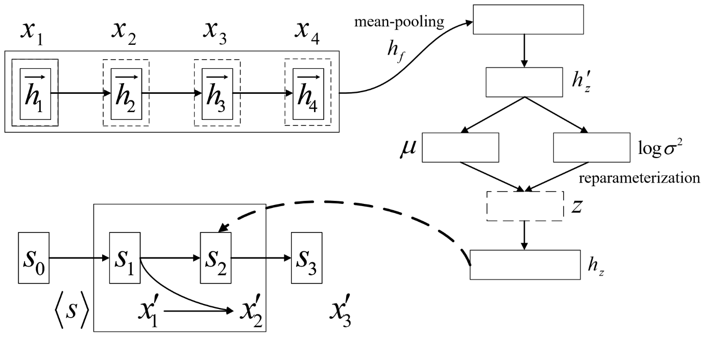
Parameterisation
A typical TextVAE model:
For the encoder, an LSTM is used to generate a sequence of hidden vectors based on the input word representation sequence :
Where denotes the parameters of the encoding LSTM.

Slide 79
Parameterisation
A typical TextVAE model:
Using a mean pooling function to generate the representation vector

Slide 80
Parameterisation
A typical TextVAE model:
is fed to an MLP layer to derive the distribution parameters of :
Where is a non-linear activation function. , , , ,
and are the model parameters.

Slide 81
Parameterisation
A typical TextVAE model:
Using the reparameterization trick for Gaussian distributions to sample with a random noise vector from uniform distribution:

Slide 82
Parameterisation
A typical TextVAE model:
Given , the LSTM decoder reproduces the input sentence.
Supposing given the first two reconstructed tokens:
Where , and are model parameters of the decoder

Slide 83
Parameterisation
A typical TextVAE model:
During training, sampling from the posterior .
At testing time, directly sampling from the prior distribution to generate the sentence without consulting the posterior distribution.

Slide 84
Posterior collapse
What is posterior collapse?
The decoder completely ignores the latent variable and degrades to a naïve RNN language model, which means .
Maximising ELBO leads to , which means the posterior collapses to the prior distribution .
and become conditionally independent.
Take TextVAE for example, if the generation of a sentence is independent of the latent vector under posterior collapse situations, the model becomes a vanilla language model, which generates the same sentences regardless of the input latent vector.

Slide 85
Posterior collapse
How to alleviate the posterior collapse issue?
Forcing the decoder to depend on the latent variable by wakening the conditional dependence within the decoder. (For TextVAE, applying dropout to the decoder steps or applying conditional independence assumptions such as Markov assumptions to decoder).
Injecting the semantic content into by using additional regularisers so that can capture global properties of the input sentence (Including an additional bag-of-words loss into ELBO to enforce that can directly predict the output contents:
Where is a hyper-parameter for controlling the
contributions of the bag-of-words loss).

Slide 86
Posterior collapse
How to alleviate the posterior collapse issue?
KL annealing, where KL divergence term is not used during the initial training iterations but is gradually enlarged after a few iterations. The model can therefore be forced to optimize the reconstruction loss by depending on in the early stage, avoiding the posterior distribution moving close to the prior distribution too soon. In particular, the training objective becomes
Where is an annealing hyper-parameter gradually
increasing from 0 to 1.

Slide 87
Variational Seq2seq Model
What is a variational seq2seq model?
A variational seq2seq model can introduce a latent hidden vector into the source representation to capture its latent semantic features.
The latent vector services to guide target generation together with the other source representation vectors.
By introducing such latent vectors, more diverse target text generation is allowed by varying its sample value after the source is encoded.

Slide 88
Variational Seq2seq Model
Formally, a seq2seq model calculates a conditional probability distribution for mapping a source sequence to a target sequence . Using a latent hidden vector , rewriting the generative probability distribution as:
Generating a random vector from the prior distribution , which modeled by a prior encoding network.
Generating the target sequence based on the sampled vector and the source sequence ,
is modelled by a seq2seq decoder network.

Slide 89
Variational Seq2seq Model
To optimise this model, the amortised variational inference method by introducing a variational posterior distribution to approximate the true posterior distribution , where and are parameters of the inference network and the decoder model, respectively.
The ELBO of the likelihood is:
Different from , is a conditional probability distribution. Thus should be included into the conditions of all the probability distributions.

Slide 90
Variational Seq2seq Model
Similar to VAE, assuming both the variational posterior distribution and the prior distribution are multivariate diagonal Gaussian distributions:
Different from VAE, the prior distribution is also parameterized according to the source sentence instead of being a standard multivariate Gaussian distribution . In this way, the prior contains global semantic information of .

Slide 91
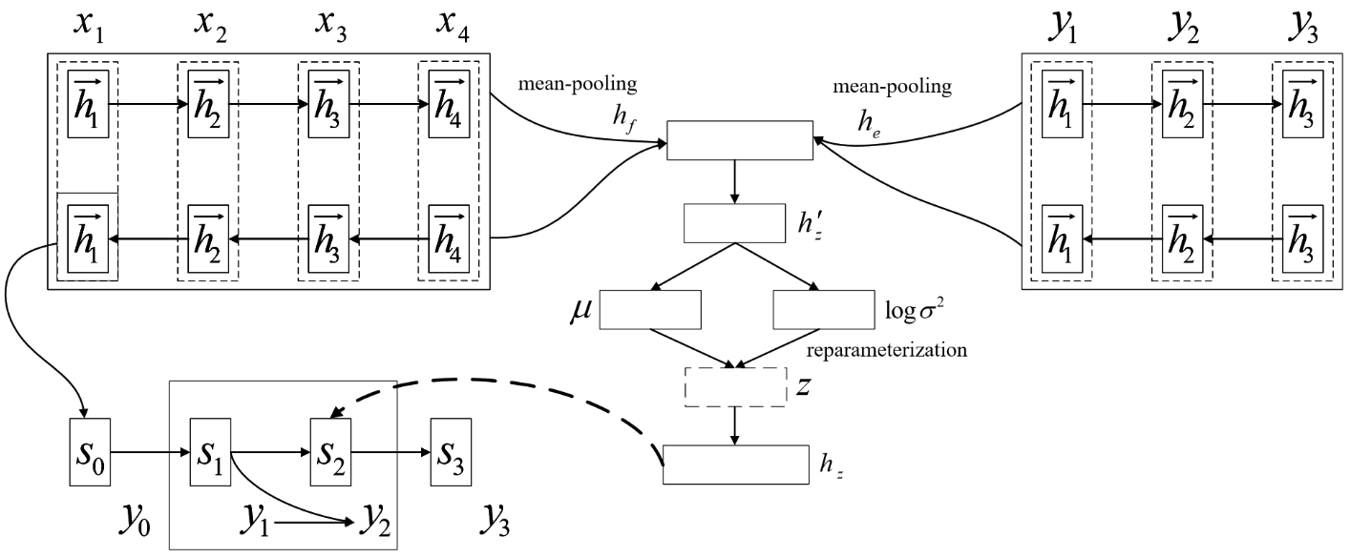
Parameterisation
Suppose using a bi-directional LSTM encoder network for the source sequence to compute hidden representations , and another bi-directional LSTM encoder for the target sequence to obtain .

Slide 92
Parameterisation
Mean pooling can be used to create global and of the source sentence and the target sequence, respectively:

Slide 93
Parameterisation
For the prior distribution , using to calculate
and :
Where is a nonlinear activation function, , , ,
and are model parameters.

Slide 94
Parameterisation
Similarly, the parameters of the posterior distribution
conditioned on both and can be obtained by
Where , , , , and are model parameters.

Slide 95
Parameterisation
has a closed-form solution:
Where is the feature dimension of the latent vector.

Slide 96
Parameterisation
Using the reparameterisation trick for Gaussian distributions to sample :
Where is a random uniform noise.

Slide 97
Parameterisation
can be further passed through an NLP layer :

Slide 98
Parameterisation
The log-likelihood can be written as :
is used at each decoding step. It can be regarded as an extended representation of the input token .

Slide 99
Parameterisation
During training, is sampled from the posterior distribution .
For testing, in order to generate a flexible given ,
is sampled from the prior distribution ,
which is used to guide the generation of the targe output.

