Slide 1
Python for neuroimaging Session I – basic intro
Darya Frank

Slide 2
Guidelines and expectations
Tutorial session every other week (~1 hr), feel free to interrupt me to ask questions.
Homework will test understanding of concepts (solutions will also be given).
Like most things – practice makes perfect – dedicate some time to write code, read other people’s code.

Slide 3
What will we cover?
Basic intro to python (today)
IDEs, anaconda, packages
Image I/O and manipulation (nibabel, nilearn)
Neuroimaging analysis packages & pipelines

Slide 4
Today’s agenda
What is python?
Basic syntax
Storing data
Classes
Loops
Functions

Slide 5
What is python
A programming language duh
Very verstaile and flexible
Runs in many ways (shell/terminal, IDEs, jupyter)
Python files are saved as .py
Open-source
Large and active community developing packages
→ Extremely popular

Slide 6
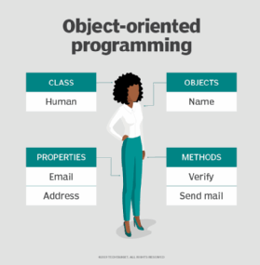
What is python
Object-oriented programming (OOP) focuses on the objects that developers want to manipulate rather than the logic required to manipulate them.
"objects” can contain data and code:
data in the form of fields (properties)
code in the form of procedures (methods).
This may sound very abstract now, but will make more sense as we start coding
https://www.techtarget.com/searchapparchitecture/definition/object-oriented-programming-OOP

Slide 7
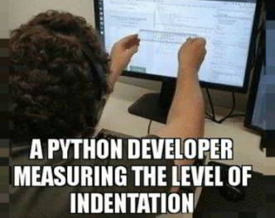
Basic syntax
Requires indentation (4 spaces/tab).
if 1 > 0:
Print(true)
You will get a syntax error if you use anything else (and remember the semi-colon too)
Comments with # sign
Booleans with 1/0 or True/False
Basic operators same as Matlab, except:
Modulus %%
Exponentiation **
Not equal !=

Slide 8
Basic syntax
If in Matlab we’ve used x = x+1 as a counter in a loop, we have an elegant python solution:
x += 1 This can be done for any operation (+ - * / etc)
Logical operators – and, or, not (x > 5 and not y)
Membership operators – in, not in (x in y)
Identity operators – is, is not (for objects identity, not values!)
Notes:
Identity if objects are the same true (x = 101, x = y), but if they are equal (x = 101, y = 101 --> False)

Slide 9
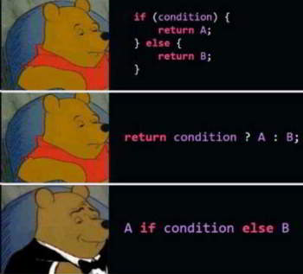
Basic syntax – If statement
x = 1
y = [2,3,4]
z = [1,5,7]
if x in y:
print(‘x is in y’)
elif x in z:
print(‘x is in z’)
else:
print(‘where is x?’)
But can also use it in one line:
print("A") if a > b else print("=") if a == b else print("B")

Slide 10
Storing data
We use = to assign variables with value e.g.
Age = 30
Sex = ‘F’
You can also define multiple variables in one line:
A, B = 1, 2 → A=1 B=2
We have 4 built-in object types to store variables:
List
Tuple
Dictionary
Set
Plus options from numpy, pandas and other packages, later on…

Slide 11
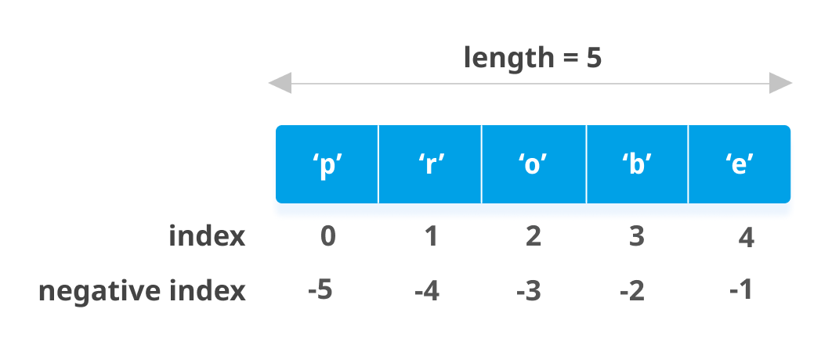
Storing data - Lists
defined using [], can include strings, numeric values, and other lists
e.g. subjects = [1, 2, 3] or subejctsID = [’1’, ‘2’, ‘3’], or mixed = [‘1’, 2]
Lists are mutable (changeable), allow duplicates, ordered, and can be indexed.
subjects[0] → Python used 0-based indexing! → 1
subjects[0] = 10 → subjects [10,2,3]
Subjects.append([4,5,6]) → subjects [10,2,3,4,5,6] (add values to end of list)
Subjects.insert(1, 9) → subjects [10,9,2,3,4,5,6]
Subjects.pop(0) → subjects [9,2,3,4,5,6] (remove by index)
subjectsID.remove(‘1’) → subjectsID [‘2’, ‘3’] (remove by value)

Slide 12
Storing data - Tuples
defined using (), like lists allows multiple data types and are ordered. Unlike lists, tuples are immutable (unchangeable)
Age = (20, 24, 18)
Age[-1] → 18
Age(1) = 30 → error
Age.append(25) → error
If we want to change tuples we can convert them to list:
List(Age)

Slide 13
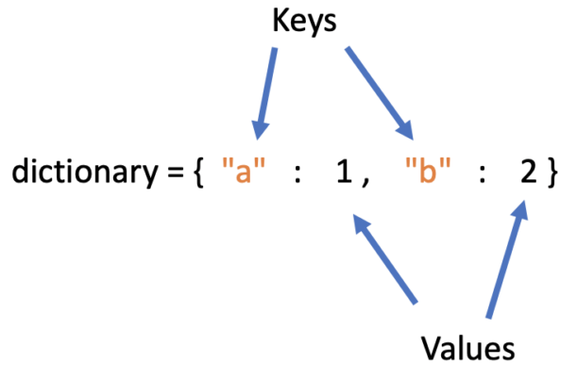
Storing data - Dictionaries
Defined using {key:value}, is changeable but does not
allow duplicates
e.g. Dict = {‘hemisphere’: ’left’, ‘taskID’: 1, ‘taskName’: ’recog’}
Dict[‘taskName’] → ‘recog’
Adding/changing items:
Dict[‘hemisphere’] = ‘right’ or Dict.update({‘subject’: ‘1’})
Removing items:
Dict.pop(‘taskID’)

Slide 14
Storing data - Sets
Defined using {}, unorderd, unindexed and can add/remove items but not change existing ones.
Images = {‘1.jpg’, ‘2.jpg’}
Images.add(‘3.jpg’)
Images.remove(‘3.jpg’)
You cannot access items in a set by referring to an index or a key!
If need to access items need to use for loop

Slide 15
Indexing & slicing data
a[start:stop] # items start through stop-1
a[start:] # items start through the rest of the array
a[:stop] # items from the beginning through stop-1
a[:] # a copy of the whole array
a[start:stop:step] # start through not past stop, by step
Same thing goes for the range() function --> inclusive, exclusive [ )

Slide 16
OOP – methods
When we use x.append()/add()/remove() we’re using a method procedure on an object (list, dictionary, etc).
A bit like a function but associated with a specific object, don’t need to ‘re-define’ the object as a variable i.e. we don’t use a = a.sort()
To find out which methods are associated with a given object you can use dir(a)

Slide 17
Classes
A class is a ‘blue print’ for creating objects.
All classes have an __init__ function to assign values to object properties, or other operations that are necessary to do when the object is being created:
class Person: def __init__(self, name, age): self.name = name self.age = age p1 = Person("John", 36) print(p1.name) print(p1.age)
We can also create a method for our class
def myfunc(self): print("Hello my name is " + self.name) p1 = Person("John", 36) p1.myfunc()
The self parameter is a reference to the current instance of the class, and is used to access variables that belongs to the class.

Slide 18
Loops
fruits = ["apple", "banana", "cherry"] for x in fruits: print(x)
for x in range(6): print(x)
→ 0,1,2,3,4,5

Slide 19
Loops
For loops can also be written in one line – list* comprehension:
nums = [0, 1, 2, 3, 4]
squares = [x ** 2 for x in nums] →
[0, 1, 4, 9, 16]
These can also incorporate if conditions:
string_nums = ['one', 'two', 'three’]
starts_with_t = ['yes' if s[0] == 't' else 'no' for s in string_nums] →
['no', 'yes', 'yes’]
*Similarly used with dictionaries, sets

Slide 20
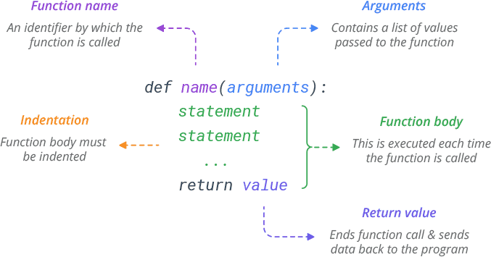
Functions

Slide 21
Functions
From a function's perspective:
A parameter is the variable listed inside the parentheses in the function definition.
An argument is the value that is sent to the function when it is called.
Functions are an integral part of your script, and don’t need to be specified in a different file.

Slide 22
Functions – default parameter val
If we call the function without argument, we need to set the default parameter value:
def my_function(country = "Norway"): print("I am from " + country) my_function(”Spain") my_function()

Slide 23
Functions – arbitrary args
If you do not know how many arguments will be passed into your function, add a * before the parameter name in the function definition (this is referred to as *args)
This way the function will receive a tuple of arguments, and can access the items accordingly
def test_var_args(f_arg, *argv):
print("first normal arg:", f_arg)
for arg in argv:
print("another arg through *argv:", arg)
test_var_args('yasoob', 'python', 'eggs', 'test’)
first normal arg: yasoob
another arg through *argv: python
another arg through *argv: eggs
another arg through *argv: test

Slide 24
Functions – arbitrary keyword args
You can also send arguments with the key = value syntax. This way the order of the arguments does not matter
**kwargs allows you to pass keyworded variable length of arguments to a function. You should use **kwargs if you want to handle named arguments in a function.
def greet_me(**kwargs):
for key, value in kwargs.items():
print("{0} = {1}".format(key, value))
>>> greet_me(name="yasoob")
name = yasoob

Slide 25
That’s it!
Now, to code…
You should be able to:
Define variables, lists, dictionaries, tuples, sets, classes
Apply methods to these objects and perform some operations on them.
Use if and for loops, including list comprhension
Define and use functions with set and variable arguments.

