Slide 2
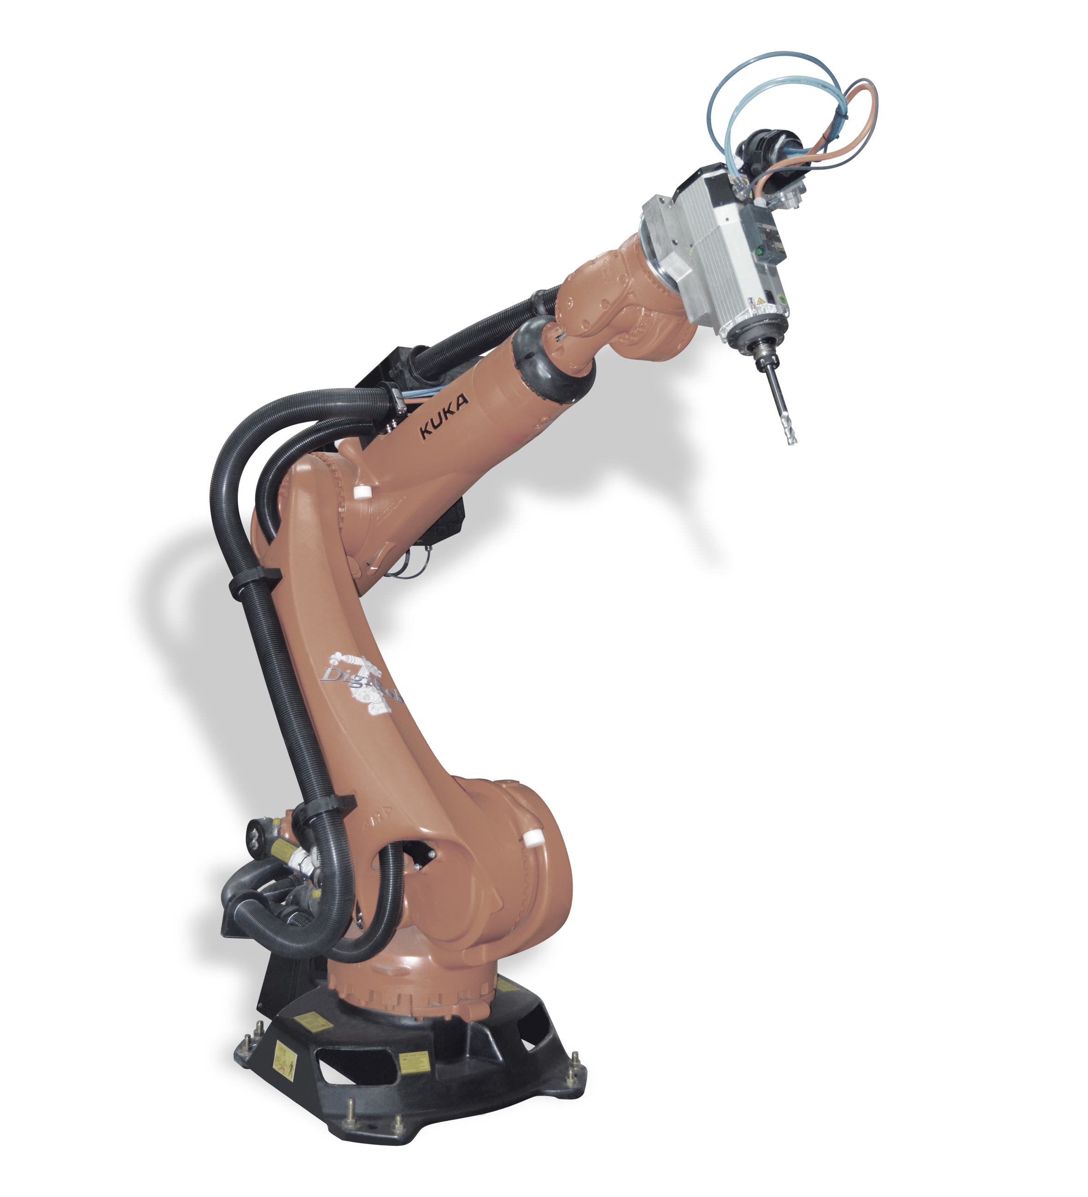
flange
Link 5
Joint 5
End effector/tool
Joint 4
Joint 6
TCP frame
Link 4
Joint 3
Link 3
Link 2
Joint 2
Base frame
Link 1
base
Joint 1

