Slide 1
9
Drop down list selected.
Possible dests are shown.
Start page
Shows our logo briefly
[Background]
RGB (85 182 215)
[textbox]
Fill (255 255 255)
Stroke (89 89 89)
Text (217 217 217)
16
dSTOP
Choose your destination
Business Admi..
Position
H: Center/ V:center
...
...
...

Slide 2
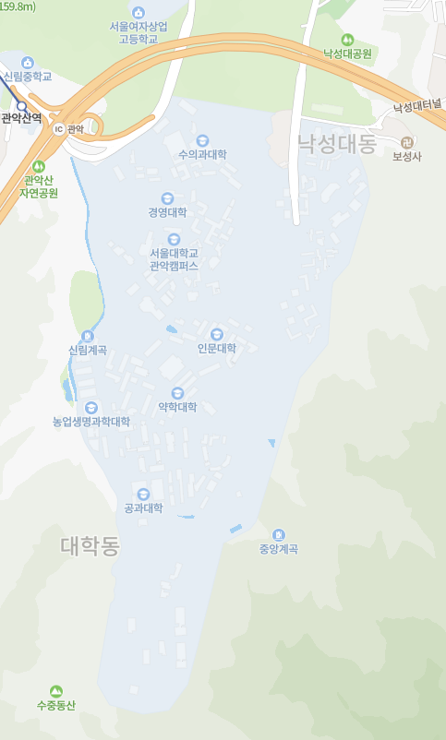


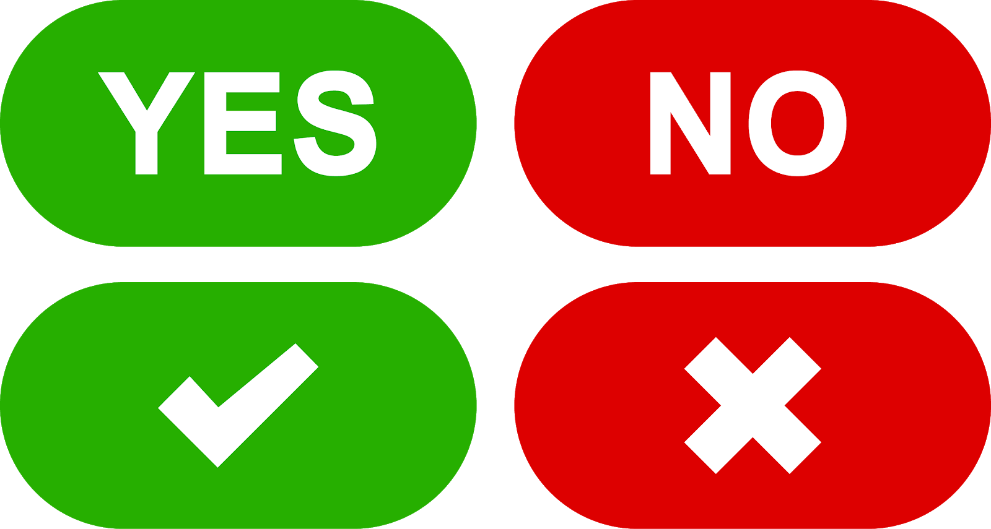
9
When destination is
Selected,
In text box
BOLD and BLACK (0 0 0)
Then page turn to next ->
Text box selected..
Cursor
16
302 Building
When destination is
Selected,
In text box
BOLD and BLACK (0 0 0)
Then page turn to next ->
Distance : 3.0km to go !
When “V” is pressed,
Current geolocation information will be received.

Slide 3

Text box selected..
Cursor
Arrive notification!!!!
Distance : 0.1km to go !
Now I am listening to!

Slide 4
Information of Travel
Time
Path
...

Slide 5
