Slide 2
Antra SEP Program
HyperText Transfer Protocol (HTTP)
Day 1

Slide 3
Website layers
Behavior (JS)
Presentation (CSS)
Content (HTML)

Slide 4
HyperText Markup Language (HTML)

Slide 5
What is HTML
Hyper Text Markup Languages
Link
Link
Link

Slide 6
What is HTML
To publish information for global distribution, one needs a universally understood language, a kind of publishing language that all computers may potentially understand. The publishing language used by the World Wide Web is HTML (from Hyper Text Markup Language).

Slide 7
Uses of HTML
Publish online documents with headings, texts, tables, lists, photos, etc.
Retrieve online information via hypertexts links.
Design forms for conducting transactions with remote services, for use in searching for information, making reservations, ordering products, etc.
Include spread-sheets, video clips, sound clips, and other applications directly in their documents.

Slide 8
History of HTML
1991
HTML first published
1995
HTML 2.0
After HTML 4.01 was released, focus shifted to XHTML and its stricter standards.
1997
HTML 3.2
1999
HTML 4.01
XHTML 2.0 had even stricter standards than 1.0, rejecting web pages that did not comply. It fell out of favor gradually and was abandoned completely in 2009.
2000
XHTML 1.0
2002 -2009
HTML5 is much more tolerant and can handle markup from all the prior versions.
XHTML 2.0
HTML5
Though HTML5 was published officially in 2012, it has been in development since 2004.
2012

Slide 9
Tag
A tag is a reference in an HTML document which describes the style and structure of the document.
All tag start with < (less than symbol) and end with > (greater than symbol)
Tags which mark a beginning have no / (front slash).
Tags which mark an ending have a / immediately after <, as in </.
Tags are not case sensitive.

Slide 10
Tags

Slide 11
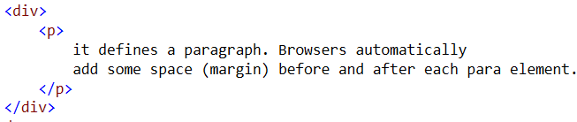
Nested Tags

Slide 12
Basic Structure
<! DOCTYPE HTML>
<html>
<head>
<title> ….. </title>
</head>
<body>
<form> </form>
</body>
</html>

Slide 13
Head

Slide 14
Head tag elements
Tag | Usage
Title | Defines the title for HTML document. This tag is mandatory to use
Style | Use to style an element in an HTML Document (for embedded style)
Base | Sets a default URL and a default target for all links on a page
Link | To link an external style sheet
Meta | Use to define metadata within an HTML document. E.g. Description, keywords, author, viewport
Script | Use to define client-side script
Noscript | The <noscript> tag defines an alternate content for users that have disabled scripts in their browser or have a browser that doesn't support script. The <noscript> element can be used in both <head> and <body>.
Notes:
Metadata is data (information) about data.
The <meta> tag provides metadata about the HTML document. Metadata will not be displayed on the page, but will be machine parsable.
Meta elements are typically used to specify page description, keywords, author of the document, last modified, and other metadata.
The metadata can be used by browsers (how to display content or reload page), search engines (keywords), or other web services.
HTML5 introduced a method to let web designers take control over the viewport (the user's visible area of a web page), through the <meta> tag

Slide 15
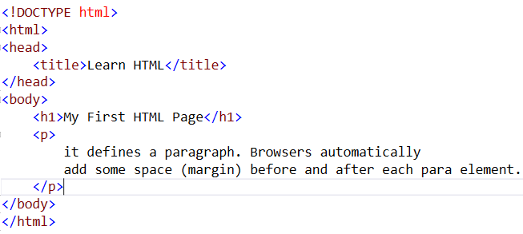
Body

Slide 16
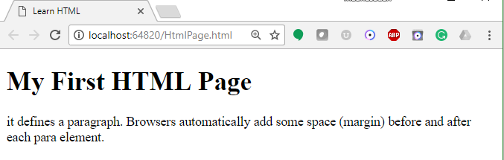
Preview

Slide 17
Headers

Slide 18
Preview

Slide 19
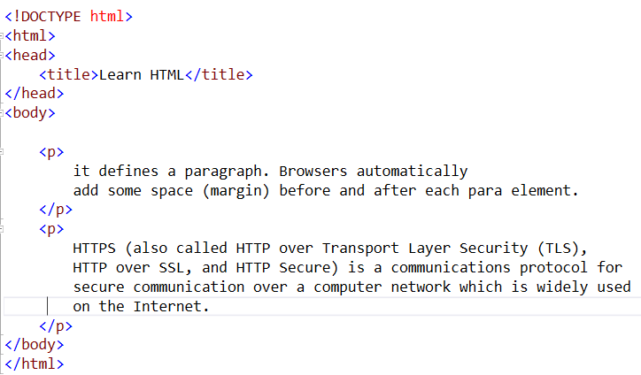
Paragraph

Slide 20
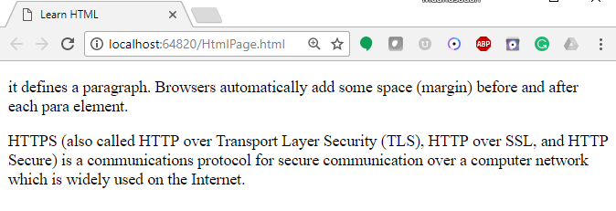
Preview

Slide 21
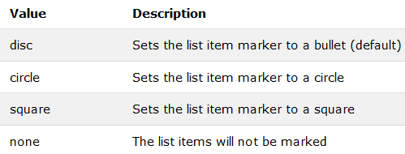
Lists (Unordered list)
An unordered list starts with the <ul> tag. Each list item starts with the <li> tag.
The list items will be marked with bullets (small black circles) by default.
The CSS list-style-type property is used to define the style of the list item marker

Slide 22
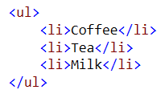
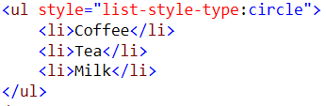


Lists (Unordered list)

Slide 23
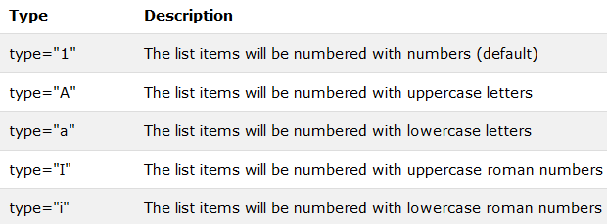
Lists (Ordered list)
The type attribute of the <ol> tag, defines the type of the list item marker

Slide 24
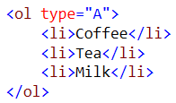
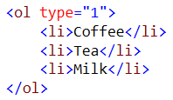


Lists (Ordered list)

Slide 25
Break, <br/>
Line breaks allow you to decide where the text will break on a line or continue to the end of the window.
A <br/> is an empty Element, meaning that it may contain attributes but it does not contain content.
The <br/> element does not have a closing tag.

Slide 26
Break, <br/>
<html>
<head>
<title> Example Page</title>
</head>
<body>
<h1> Heading 1 </h1>
<p>Paragraph 1, <br/>
Line 2 <br/> Line 3 <br/>….
</p>
</body>
</html>
Heading 1
Paragraph 1,
Line 2
Line 3

Slide 27
Horizontal Rule, <hr>
The <hr> element causes the browser to display a horizontal line (rule) in your document.
<hr> is an empty element and does not use a closing tag.

Slide 28
Horizontal Rule, <HR>
Attribute | Description | Default Value
SIZE | Height of the rule in pixels | 2 pixels
WIDTH | Width of the rule in pixels or percentage of screen width | 100%
NOSHADE | Draw the rule with a flat look instead of a 3D look | Not set (3D look)
ALIGN | Aligns the line (Left, Center, Right) | Center
COLOR | Sets a color for the rule (IE 3.0 or later) | Not set

Slide 29
Div
1. <div> tag is a container for other tags.
2. div elements are block elements and work behind the scenes grouping other tags together.
Some of the attributes of <div> tag are:
id, width, height, title, style
Notes:
The div element provides an alternative of table to design the layout, since a div can contain any/every other type of html element within its beginning and ending tag.
The div tag defines a division or section within an HTML .
span and div are the only elements that carry no innate semantic meaning, besides the logical grouping of the enclosed elements.
div and span differ from each other in one regard. In standard HTML, a div is a block-level element (and so visually isolates a section of a document on the page, in the same way as a paragraph, whereas a span is an inline element (for containing a piece of information inline with the surrounding text).

Slide 30
Div

Slide 31
Preview

Slide 32
SPAN
SPAN is a inline tag.
It is used to format small chunks of data within another element.
Combining <span> tag with CSS allows us to create custom tags.
Notes:
SPAN has no defined display, you're free to write your own rules and apply them as you wish.
SPAN is an inline tag, which means that it's used to format small chunks of text inside another element. In contrast, a paragraph tag is a block-level element that can contain a number of inline elements like bold, italics, strong, and SPAN tags.

Slide 33
Block Elements

Slide 34
Inline Element

Slide 35
Preview

Slide 36
More Inline Element

Slide 37
Preview

Slide 38
Attribute

Slide 39
Horizontal Rule, <HR>
<HTML>
<HEAD>
<TITLE> Example Page</TITLE>
</HEAD>
<BODY>
<H1> Heading 1 </H1>
<P>Paragraph 1, <BR>
Line 2 <BR>
<HR>Line 3 <BR>
</P>
</BODY>
</HTML>
Heading 1
Paragraph 1,….
Line 2
_________________________
Line 3

Slide 40
Character Formatting
In this chapter you will learn how to enhance your page with Bold, Italics, and other character formatting options.
Objectives
Upon completing this section, you should be able to
Change the color and size of your text.
Use Common Character Formatting Elements.
Align your text.
Add special characters.
Use other character formatting elements.

Slide 41
Bold, Italic and other Character Formatting Elements
<FONT SIZE=“+2”> Two sizes bigger</FONT>
The size attribute can be set as an absolute value from 1 to 7 or as a relative value using the “+” or “-” sign. Normal text size is 3 (from -2 to +4).
<B> Bold </B>
<I> Italic </I>
<U> Underline </U>
Color = “#RRGGBB” The COLOR attribute of the FONT element. E.g., <FONT COLOR=“#RRGGBB”>this text has color</FONT>
<PRE> Preformatted </PRE> Text enclosed by PRE tags is displayed in a mono-spaced font. Spaces and line breaks are supported without additional elements or special characters.

Slide 42
Bold, Italic and other Character Formatting Elements
<EM> Emphasis </EM> Browsers usually display this as italics.
<STRONG> STRONG </STRONG> Browsers display this as bold.
<TT> TELETYPE </TT> Text is displayed in a mono-spaced font. A typewriter text, e.g. fixed-width font.
<CITE> Citation </CITE> represents a document citation (italics). For titles of books, films, etc. Typically displayed in italics. (A Beginner's Guide to HTML)

Slide 43
Bold, Italic and other Character Formatting Elements
<P> <FONT SIZE=“+1”> One Size Larger </FONT> - Normal –
<FONT SIZE=“-1”> One Size Smaller </FONT> <BR>
<B> Bold</B> - <I> italics</I> - <U> Underlined </U> -
<FONT COLOR=“#FF0000”> Colored </FONT> <BR>
<EM> Emphasized</EM> - <STRONG> Strong </STRONG> - <TT> Tele Type </TT> <BR>
One Size Larger - Normal – One Size Smaller Bold - italics - Underlined - Colored Emphasized - Strong - Tele Type

Slide 44
Alignment
Some elements have attributes for alignment (ALIGN) e.g. Headings, Paragraphs and Horizontal Rules.
The Three alignment values are : LEFT, RIGHT, CENTER.
<CENTER></CENTER> Will center elements.

Slide 45
Alignment
<DIV ALIGN=“value”></DIV> Represents a division in the document and can contain most other element type. The alignment attribute of the DIV element is well supported.
<TABLE></TABLE> Inside a TABLE, alignment can be set for each individual cell.

Slide 46
Special Characters and Symbols
These Characters are recognized in HTML as they begin with an ampersand and end with a semi-colon e.g. &value; The value will either be an entity name or a standard ASCII character number. They are called escape sequences.
The next table represents some of the more commonly used special characters. For a comprehensive listing, visit the W3C’s section on special characters at: http://www.w3.org/MarkUp/HTMLPlus/htmlplus_13.html

Slide 47
Special Characters and Symbols
Special Character | Entity Name | Special Character | Entity Name
Ampersand | &amp; & | Greater-than sign | &gt; >
Asterisk | &lowast; ∗∗ | Less-than sign | &lt; <
Cent sign | &cent; ¢ | Non-breaking space | &nbsp;
Copyright | &copy; © | Quotation mark | &quot; "
Fraction one qtr | &frac14; ¼ | Registration mark | &reg; ®
Fraction one half | &frac12; ½ | Trademark sign | &trade; ™

Slide 48
Special Characters and Symbols
Additional escape sequences support accented characters, such as:
&ouml;
a lowercase o with an umlaut: ö
&ntilde;
a lowercase n with a tilde: ñ
&Egrave;
an uppercase E with a grave accent: È
NOTE: Unlike the rest of HTML, the escape sequences are case sensitive. You cannot, for instance, use &LT; instead of &lt;.

Slide 49
Additional Character Formatting Elements
<STRIKE> strike-through text</STRIKE>
DEL is used for STRIKE at the latest browsers
<BIG> places text in a big font</BIG>
<SMALL> places text in a small font</SMALL>
<SUB> places text in subscript position </SUB>
<SUP> places text in superscript style position </SUP>

Slide 50
Using Links
The Anchor Tag
HTML uses the <a> (anchor) tag to create a link to another document.
Attributes of <a>(anchor) tag
href : is used to address the document to link to, and the words between the open and close of the anchor tag will be displayed as a hyperlink.
Syntax:
<a href=”url”>Text to be displayed</a>
Notes:
The <a> tag is used to create an anchor to link from, the href attribute is used to address the document to link to, and the words between the open and close of the anchor tag will be displayed as a hyperlink.

Slide 51
Using Links (Contd.)
Attributes of <a>(anchor) tag
target : The target attribute defines where the linked document will be opened.
Syntax:
<a href=“http://w3.ibm.com” target=“where to place the document”>Text to be displayed</a>
name :The name attribute is used to create a named anchor. When using named anchors we can create links that can jump directly into a specific section on a page.
Syntax
<a name=“label”>Text to be displayed</a>

Slide 52
Target
There are 4 special target names that cannot be assigned by the NAME attribute of the FRAME tag.
1. TARGET=“_top” : This loads the linked document into the full browser window with the URL specified by the HREF attribute. All frames disappear, leaving the new linked page to occupy the entire window. The back is turned on.
2. TARGET=“_blank” : Opens an unnamed new browser window and loads the document specified in the URL attribute into the new window (and your old window stays open). The back is turned off. Other windows remains on.
3. TARGET=“_self” : Loads the document in the same window where the anchor was {Clicked}. This is the default setting for linking elements.
4. TARGET=“_parent” : the _parent frame is a prior frameset that the current frameset was “spawned” from. If there isn’t one it is the browser window. The document is loaded into the area occupied by the columns or rows frameset containing the frame that contains the link. The back is turned on. All windows disappear.

Slide 53
Email using Anchor
E.g. mailto:xxxx@yahoo.com
The type of service is identified as the mail client program. This type of link will launch the users mail client.
The recipient of the message is xxxx@yahoo.com
<A HREF=“mailto:xxxx@yahoo.com”>Send me
More Information </A>

Slide 54
Tables
The <TABLE></TABLE> element has four sub-elements:
Table Row<TR></TR>.
Table Header <TH></TH>.
Table Data <TD></TD>.
Caption <CAPTION></CAPTION>.
The table row elements usually contain table header elements or table data elements.

Slide 55
Tables
The <TABLE></TABLE> element has four sub-elements:
Table Row<TR></TR>.
Table Header <TH></TH>.
Table Data <TD></TD>.
Caption <CAPTION></CAPTION>.
The table row elements usually contain table header elements or table data elements.

Slide 56
Tables
<table border=“1”>
<tr> <th> Column 1 header </th>
<th> Column 2 header </th> </tr>
<tr> <td> Row1, Col1 </td>
<td> Row1, Col2 </td> </tr>
<tr> <td> Row2, Col1 </td>
<td> Row2, Col2 </td> </tr>
</table>

Slide 57
Tables
Column 1 Header | Column 2 Header
Row1, Col1 | Row1, Col2
Row2, Col1 | Row2, Col2

Slide 58
Tables Attribute
BGColor: Some browsers support background colors in a table.
Width: you can specify the table width as an absolute number of pixels or a percentage of the document width. You can set the width for the table cells as well.
Border: You can choose a numerical value for the border width, which specifies the border in pixels.
CellSpacing: Cell Spacing represents the space between cells and is specified in pixels.

Slide 59
Table Attribute
CellPadding: Cell Padding is the space between the cell border and the cell contents and is specified in pixels.
Align: tables can have left, right, or center alignment.
Background: Background Image, will be titled in IE3.0 and above.
BorderColor, BorderColorDark.

Slide 60
Table Caption
A table caption allows you to specify a line of text that will appear centered above or bellow the table.
<TABLE BORDER=1 CELLPADDING=2>
<CAPTION ALIGN=“BOTTOM”> Label For My Table </CAPTION>
The Caption element has one attribute ALIGN that can be either TOP (Above the table) or BOTTOM (below the table).

Slide 61
Table Header
Table Data cells are represented by the TD element. Cells can also be TH (Table Header) elements which results in the contents of the table header cells appearing centered and in bold text.

Slide 62
Table Data and Table Header Attributes
Colspan: Specifies how many cell columns of the table this cell should span.
Rowspan: Specifies how many cell rows of the table this cell should span.
Align: cell data can have left, right, or center alignment.
Valign: cell data can have top, middle, or bottom alignment.
Width: you can specify the width as an absolute number of pixels or a percentage of the document width.
Height: You can specify the height as an absolute number of pixels or a percentage of the document height.

Slide 63
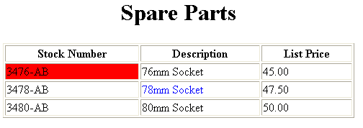
Basic Table Code
<TABLE BORDER=1 width=50%>
<CAPTION> <h1>Spare Parts <h1> </Caption>
<TR><TH>Stock Number</TH><TH>Description</TH><TH>List Price</TH></TR>
<TR><TD bgcolor=red>3476-AB</TD><TD>76mm Socket</TD><TD>45.00</TD></TR>
<TR><TD >3478-AB</TD><TD><font color=blue>78mm Socket</font> </TD><TD>47.50</TD></TR>
<TR><TD>3480-AB</TD><TD>80mm Socket</TD><TD>50.00</TD></TR>
</TABLE>

Slide 64
Table Data and Table Header Attributes
<Table border=1 cellpadding =2>
<tr> <th> Column 1 Header</th> <th> Column 2 Header</th> </tr>
<tr> <td colspan=2> Row 1 Col 1</td> </tr>
<tr> <td rowspan=2>Row 2 Col 1</td>
<td> Row 2 Col2</td> </tr>
<tr> <td> Row 3 Col2</td> </tr>
</table>

Slide 65
Table Data and Table Header Attributes
Column 1 Header | Column 2 Header
Row 1 Col 1
Row 2 Col 1 | Row 2 Col 2
 | Row 3 Col 2

Slide 66
Points to remember..
TH, TD and TR should always have end tags. Although the end tags are formally optional, many browsers will mess up the formatting of the table if you omit the end tags. In particular, you should always use end tags if you have a TABLE within a TABLE -- in this situation, the table parser gets hopelessly confused if you don't close your TH, TD and TR elements.
A default TABLE has no borders By default, tables are drawn without border lines. You need the BORDER attribute to draw the lines.
By default, a table is flush with the left margin TABLEs are plopped over on the left margin. If you want centered tables, You can either: place the table inside a DIV element with attribute ALIGN="center". Most current browsers also supports table alignment, using the ALIGN attribute. Allowed values are "left", "right", or "center", for example: <TABLE ALIGN="left">. The values "left" and "right" float the table to the left or right of the page, with text flow allowed around the table. This is entirely equivalent to IMG alignment

Slide 67
Form
An HTML form is a section of a document containing normal content, markup, special elements called controls (checkboxes, radio buttons, menus, etc.), and labels on those controls.
Users generally "complete" a form by modifying its controls (entering text, selecting menu items, etc.), before submitting the form for processing (e.g., to a Web server, to a mail server, etc.)

Slide 68
Forms
To insert a form we use the <FORM></FORM> tags. The rest of the form elements must be inserted in between the form tags.
<HTML> <HEAD>
<TITLE> Sample Form</TITLE>
</HEAD>
<BODY BGCOLOR=“FFFFFF”>
<FORM ACTION = “” method=“Get”>
<P> First Name: <INPUT TYPE=“TEXT” NAME=“fname” MAXLENGTH=“50”> </P>
<P> <INPUT TYPE=“SUBMIT” NAME=“fsubmit1” VALUE=“Send Info”> </P>
</FORM>
</BODY> </HTML>

Slide 69
Form Element’s attributes
ACTION: is the URL of the web application that is going to accept the data from the form, process it, and send a response back to the browser.
METHOD: GET (default) or POST specifies which HTTP method will be used to send the form’s contents to the web server. The web application should be written to accept the data from either method.
NAME: is a form name used by VBScript or JavaScripts.
TARGET: is the target frame where the response page will show up.

Slide 70
Form Elements
Form elements have properties: Text boxes, Password boxes, Checkboxes, Option(Radio) buttons, Submit, Reset, File, Hidden and Image.
The properties are specified in the TYPE Attribute of the HTML element <INPUT></INPUT>.

Slide 71
Form Elements
<INPUT> Element’s Properties
TYPE= Type of INPUT entry field.
NAME = Variable name passed to web application
VALUE= The data associated with the variable name to be passed to the web application
CHECKED= Button/box checked
SIZE= Number of visible characters in text field
MAXLENGHT= Maximum number of characters accepted.

Slide 72

Text Box
Text boxes: Used to provide input fields for text, phone numbers, dates, etc.
<INPUT TYPE= " TEXT " >
Textboxes use the following attributes:
TYPE: text.
SIZE: determines the size of the textbox in characters. Default=20 characters.
MAXLENGHT : determines the maximum number of characters that the field will accept.
NAME: is the name of the variable to be sent to the web application.
VALUE: will display its contents as the default value.

Slide 73
Text Box Example
<TITLE>Form_Text_Type</TITLE>
</HEAD> <BODY>
<h1> <font color=blue>Please enter the following bioData</font></h1>
<FORM name="fome1" Method= " get " Action= " URL " >
First Name: <INPUT TYPE="TEXT" NAME="FName“ SIZE="15" MAXLENGTH="25"><BR>
Last Name: <INPUT TYPE="TEXT" NAME="LName“ SIZE="15" MAXLENGTH="25"><BR>
Nationality: <INPUT TYPE="TEXT" NAME="Country“ SIZE="25" MAXLENGTH="25"><BR>
The Phone Number: <INPUT TYPE="TEXT" NAME="Phone“ SIZE="15" MAXLENGTH="12"><BR>
</FORM> </BODY> </HTML>

Slide 74
Password
Password: Used to allow entry of passwords.
<INPUT TYPE= " PASSWORD " >
Text typed in a password box is starred out in the browser display.
Password boxes use the following attributes:
TYPE: password.
SIZE: determines the size of the textbox in characters.
MAXLENGHT: determines the maximum size of the password in characters.
NAME: is the name of the variable to be sent to the web application.
VALUE: is usually blank.

Slide 75
Password Example
<HTML><HEAD>
<TITLE>Form_Password_Type</TITLE></HEAD>
<BODY>
<h1> <font color=red>To Access, Please enter:</font></h1>
<FORM name="fome2" Action="url" method="get">
User Name: <INPUT TYPE="TEXT" Name="FName“ SIZE="15" MAXLENGTH="25"><BR>
Password: <INPUT TYPE="PASSWORD" NAME="PWord" value="" SIZE="15” MAXLENGTH="25"><BR>
</FORM></BODY> </HTML>

Slide 76
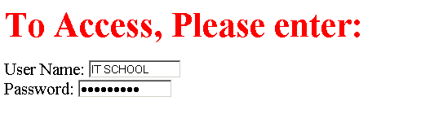
Output

Slide 77
Hidden
Hidden: Used to send data to the web application that you don’t want the web surfer to see, change or have to enter but is necessary for the application to process the form correctly.
<INPUT TYPE=“HIDDEN”>
Nothing is displayed in the browser.
Hidden inputs have the following attributes:
TYPE: hidden.
NAME: is the name of the variable to be sent to the web application.
VALUE: is usually set a value expected by the web application.

Slide 78
Checkbox
Check Box: Check boxes allow the users to select more than one option.
<INPUT TYPE=“CHECKBOX”>
Checkboxes have the following attributes:
TYPE: checkbox.
CHECKED: is blank or CHECKED as the initial status.
NAME: is the name of the variable to be sent to the web application.
VALUE: is usually set to a value.

Slide 79
Radio Button
Radio Button: Radio buttons allow the users to select only one option.
<INPUT TYPE=“RADIO”>
Radio buttons have the following attributes:
TYPE: radio.
CHECKED: is blank or CHECKED as the initial status. Only one radio button can be checked
NAME: is the name of the variable to be sent to the web application.
VALUE: usually has a set value.

Slide 80
Button
Push Button: This element would be used with JavaScript to cause an action to take place.
<INPUT TYPE=“BUTTON”>
Push Button has the following attributes:
TYPE: button.
NAME: is the name of the button to be used in scripting.
VALUE: determines the text label on the button.

Slide 81
Submit Button
Submit: Every set of Form tags requires a Submit button. This is the element causes the browser to send the names and values of the other elements to the web Application specified by the ACTION attribute of the FORM element.
<INPUT TYPE=“SUBMIT”>
Submit has the following attributes:
TYPE: submit.
NAME: value used by the script for processing.
VALUE: determines the text label on the button, usually Submit Query.

Slide 82
Difference between Submit and Button
Submit button is added for a form. When submit is clicked it triggers to the address written in the "action" attribute of form element. Button can be used anywhere as a general purpose. It can be used to redirect to any link and not restricted to a form action.

Slide 83
Reset Button
Reset: It is a good idea to include one of these for each form where users are entering data. It allows the surfer to clear all the input in the form.
<INPUT TYPE=“RESET”>
Reset buttons have the following attributes:
TYPE: reset.
VALUE: determines the text label on the button, usually Reset.

Slide 84

File
File Upload: You can use a file upload to allow surfers to upload files to your web server.
<INPUT TYPE=“FILE”>
File Upload has the following attributes:
TYPE: file.
SIZE: is the size of the text box in characters.
NAME: is the name of the variable to be sent to the web application.
MAXLENGHT: is the maximum size of the input in the textbox in characters.

Slide 85
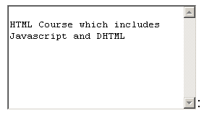
Textarea
<TEXTAREA></TEXTAREA>: is an element that allows for free form text entry.
Textarea has the following attributes:
NAME: is the name of the variable to be sent to the web application.
ROWS: the number of rows to the textbox.
COLS: the number of columns to the textbox.

