Slide 2
Antra SEP Program
Bootstrap

Slide 3
Glyphicons
Glyphicons are icon fonts which you can use in your web projects.
Glyphicons can be found within the fonts folder. This contains the following files.
lyphicons-halflings-regular.eot
glyphicons-halflings-regular.svg
glyphicons-halflings-regular.ttf
glyphicons-halflings-regular.woff
Associated CSS rules are present within bootstrap.css and bootstrap-min.css files within css folder of dist folder.

Slide 4
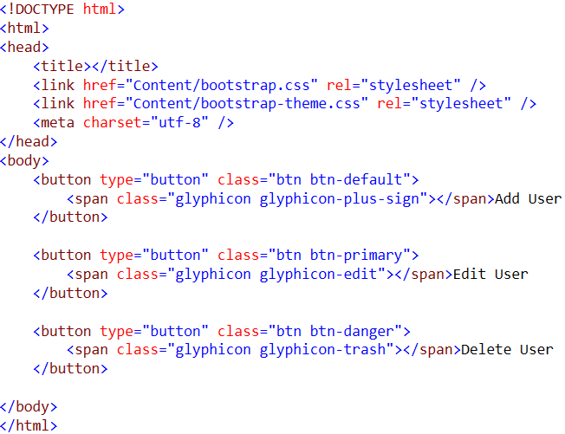

Glyphicon

Slide 5
Dropdown
To use dropdown, just wrap the dropdown menu within the class .dropdown.
Dropdown menus can be changed to expand upwards (instead of downwards) by adding .dropup to the parent.
By default, a dropdown menu is automatically positioned 100% from the top and along the left side of its parent. Add .dropdown-menu-right to a .dropdown-menu to right align the dropdown menu
Add a header to label sections of actions in any dropdown menu by using .dropdown-header class.
Add a divider to separate series of links in a dropdown menu by using .divider class.
Add .disabled to a <li> in the dropdown to disable the link

Slide 6
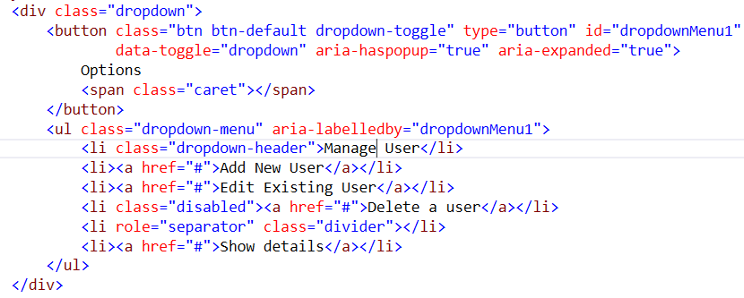
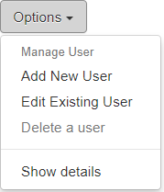
Dropdown

Slide 7
Button Group
Button groups allow multiple buttons to be stacked together on a single line. This is useful when you want to place items like alignment buttons together. You can add on optional JavaScript radio and checkbox style behavior with Bootstrap Button Plugin
Wrap a series of buttons with .btn in .btn-group.

Slide 8
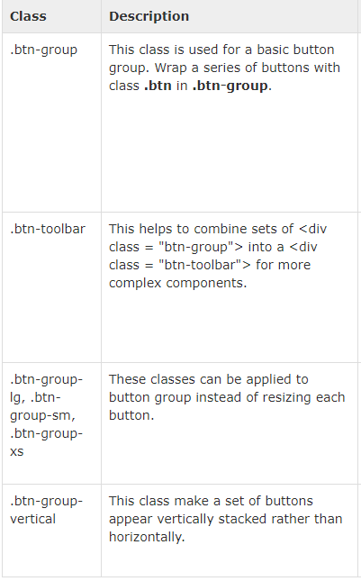
Button group

Slide 9
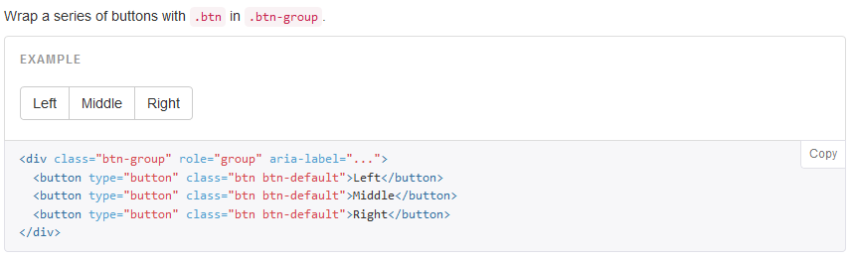
Button Group

Slide 10
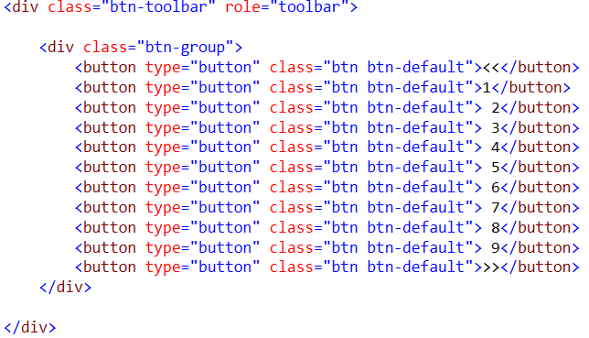

Button Toolbar
Combine sets of <div class="btn-group"> into a <div class="btn-toolbar"> for more complex components

Slide 11
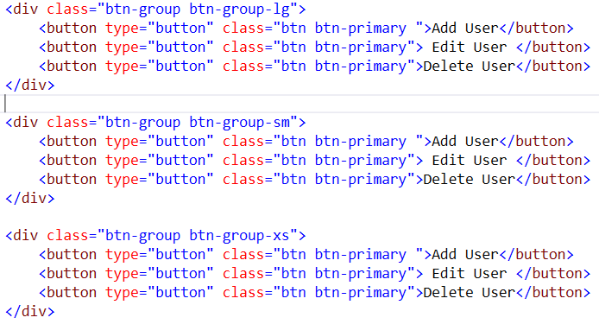
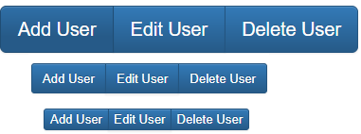
Button Size

Slide 12
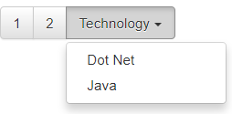
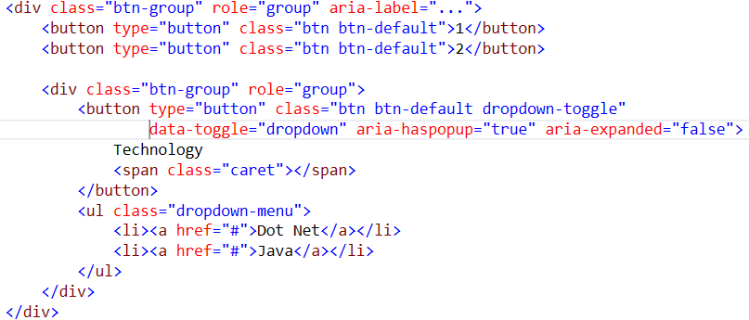
Nesting Button
You can nest button groups within another button group i.e, place a .btn-group within another .btn-group . This is done when you want dropdown menus mixed with a series of buttons

Slide 13
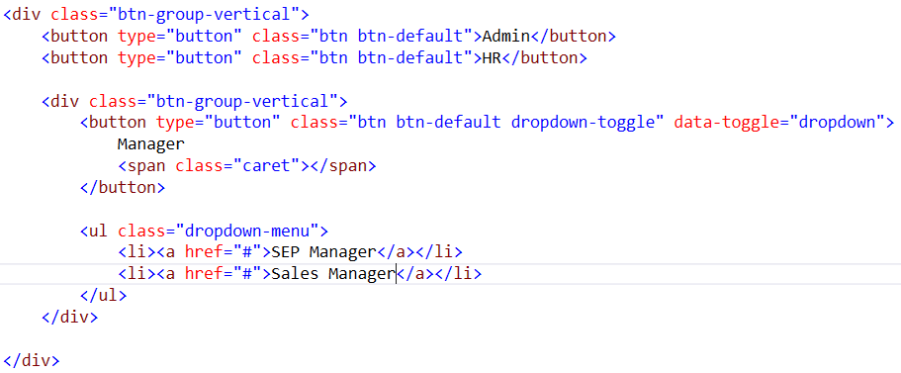
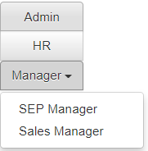
Vertical Variation
Make a set of buttons appear vertically stacked rather than horizontally. Split button dropdowns are not supported here

Slide 14
Button Dropdown
Use any button to trigger a dropdown menu by placing it within a .btn-group and providing the proper menu markup

Slide 15
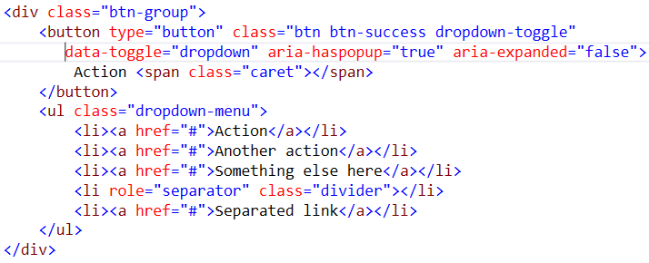
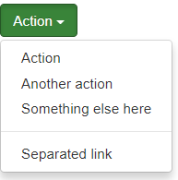
Single Button dropdown

Slide 16
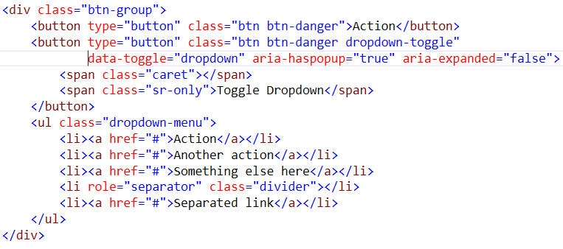
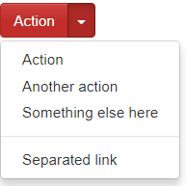
Split button dropdown

Slide 17
Input Groups
Input groups are extended Form Controls. Using input groups you can easily prepend and append text or buttons to the text-based inputs.
By adding prepended and appended content to an input field, you can add common elements to the user’s input. For example, you can add the dollar symbol, the @ for a Twitter username, or anything else that might be common for your application interface.
To prepend or append elements to a .form-control−
Wrap it in a <div> with class .input-group
As a next step, within that same <div> , place your extra content inside a <span> with class .input-group-addon.
Now place this <span> either before or after the <input> element

Slide 18
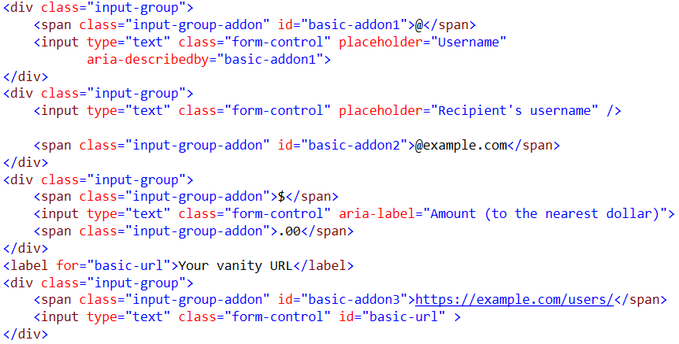
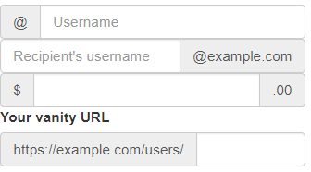
Input group

Slide 19
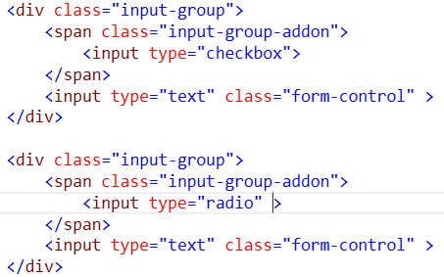

Checkbox and radio addons

Slide 20
Button AddOns
Buttons in input groups are a bit different and require one extra level of nesting. Instead of .input-group-addon, you'll need to use .input-group-btn to wrap the buttons. This is required due to default browser styles that cannot be overridden

Slide 21
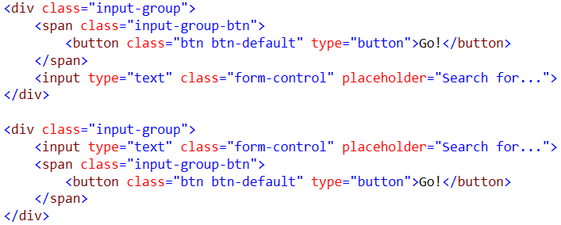

Button Addons

Slide 22
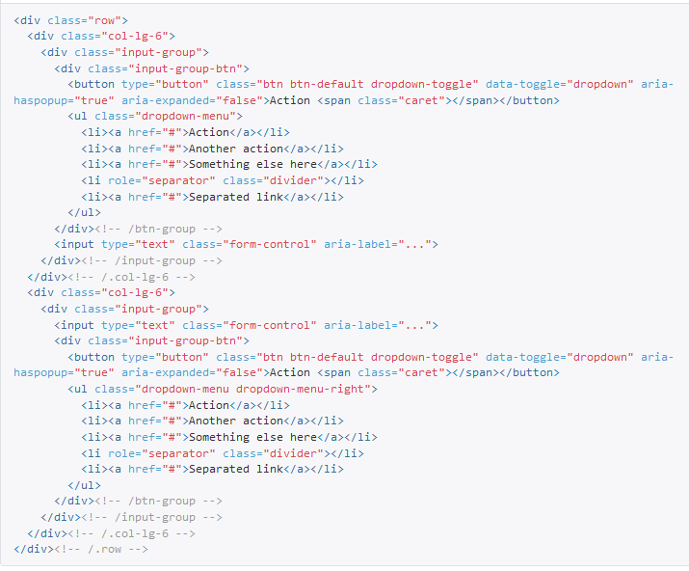
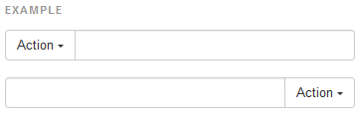
Button with dropdowns

Slide 23
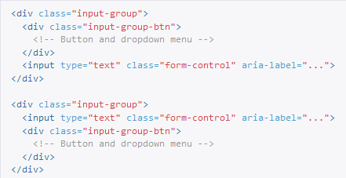

Segmented Buttons

Slide 24


Navs
To create a tabbed navigation menu −
Start with a basic unordered list with the base class of .nav
Add class .nav-tabs

Slide 25


Pills
To turn the tabs into pills, use the class .nav-pills instead of .nav-tabs

Slide 26
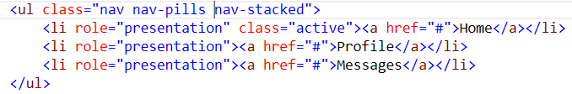
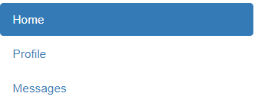
Pills
Pills can be vertically stacked. Just add .nav-stacked

Slide 27
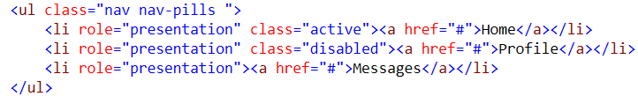

Disabled pills
For any nav component (tabs or pills), add .disabled for gray links and no hover effects

Slide 28
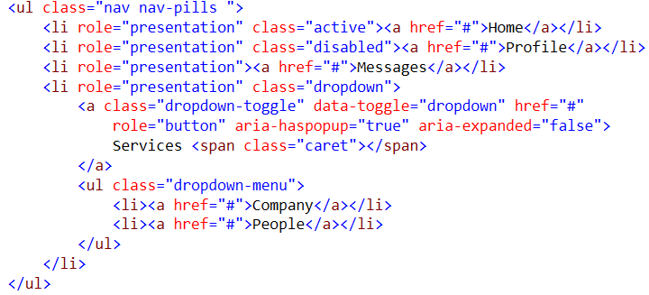
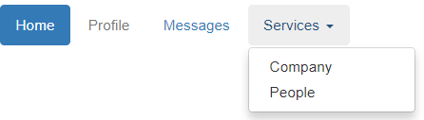
Tabs with dropdown

Slide 29
Navbar
Navbars are responsive meta components that serve as navigation headers for your application or site. They begin collapsed (and are toggleable) in mobile views and become horizontal as the available viewport width increases
To create a default navbar −
Add the classes .navbar, .navbar-default to the <nav> tag.
Add role = "navigation" to the above element, to help with accessibility.
Add a header class .navbar-header to the <div> element. Include an <a> element with class navbar-brand. This will give the text a slightly larger size.
To add links to the navbar, simply add an unordered list with the classes of .nav, .navbar-nav

Slide 30
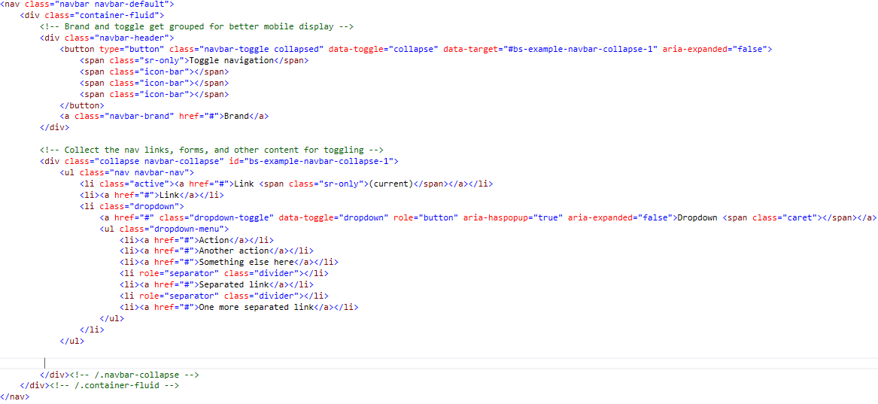

Slide 31
Output

Slide 32
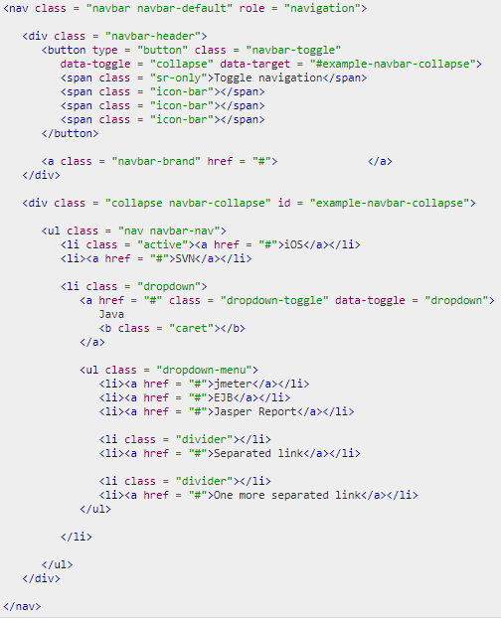

Navbar brand image

Slide 33

Navbar classes
Apart from this you can use following classes with navbar

Slide 34
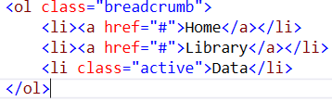

Breadcrumb
Indicate the current page's location within a navigational hierarchy.
Separators are automatically added in CSS

Slide 35
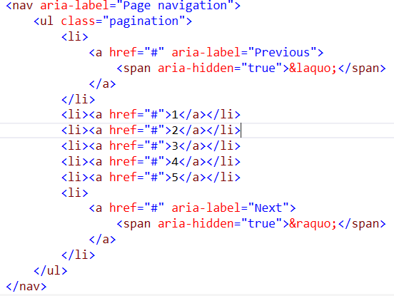

Pagination

Slide 36
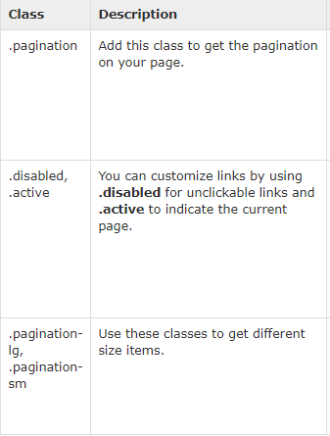
Pagination

Slide 37
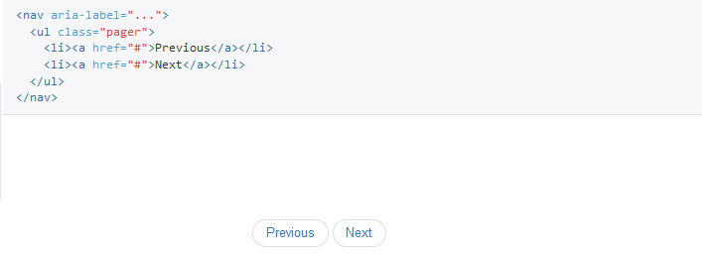
Pager

Slide 38
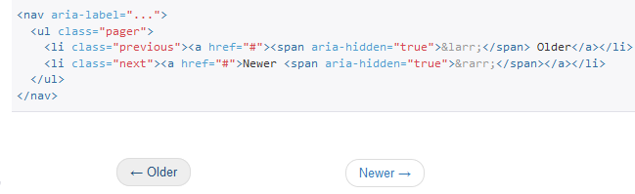
Pager (aligned links)

Slide 39

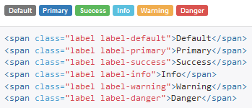
Labels

Slide 40
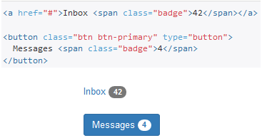
Badges

Slide 41
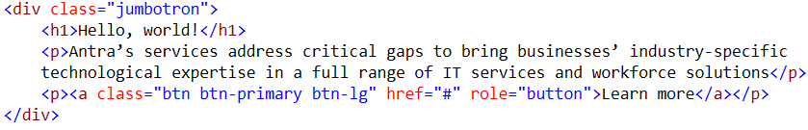

Jumbotron
A lightweight, flexible component that can optionally extend the entire viewport to showcase key content on your site

Slide 42


Headers

Slide 43
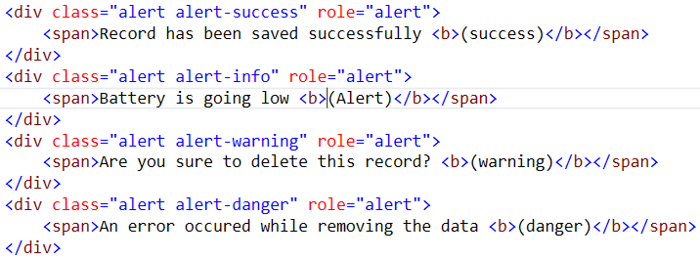
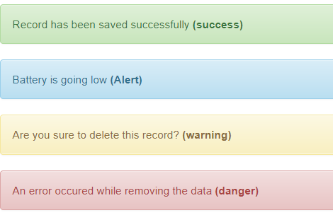
Alerts

Slide 44
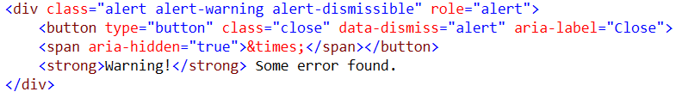

Dismissible Alert

Slide 45
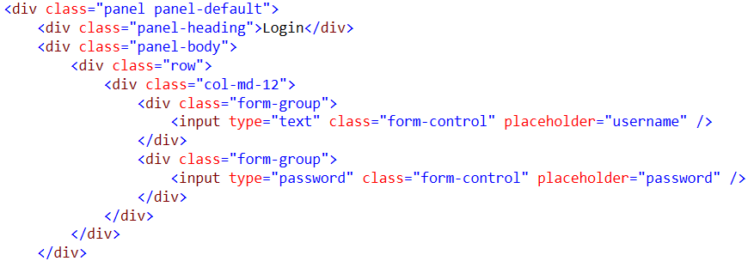
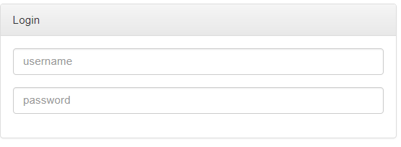
Panel

Slide 46
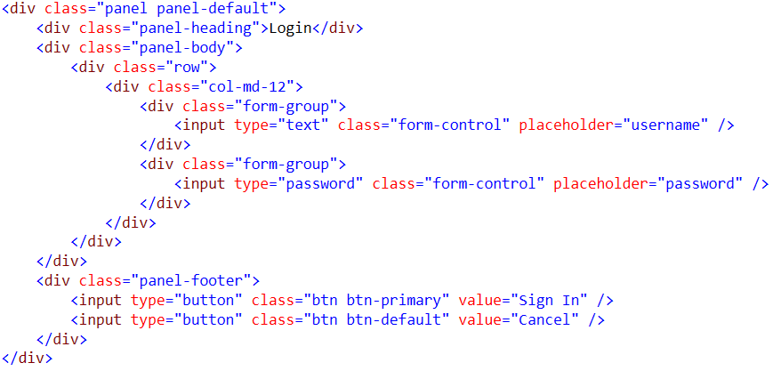
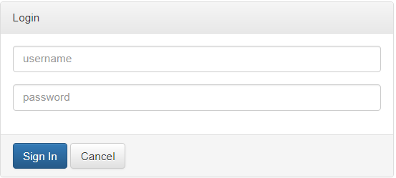
Panel with footer

