Slide 2
Antra SEP Program
Cascading Style Sheet (CSS)
Day 1

Slide 3
What is CSS?
/* Styles for sitename.com*/
body { font-family:Arial; background: #000; }
#container { text-align:left; width:1020px;
}
#header { height:232px; }
#footer { width: 100%; padding: 0 10px; margin-bottom: 10px;
}
And so on….
CSS stands for Cascading Style Sheets
Styles define how to display HTML elements
Styles are normally stored in Style Sheets
Styles were added to HTML 4.0 to solve a problem
External style sheets can save a lot of work
External style sheets are stored in CSS files
Multiple style definitions will cascade into one
* To create a style sheet, create a file using Notepad (PC) or Text Edit (Mac), save it as a .css document and start
writing the CSS code (see right).

Slide 4
CSS Benefits
Separates structure from presentation
Provides advanced control of presentation
Easy maintenance of multiple pages
Faster page loading
Better accessibility for disabled users
Easy to learn

Slide 5
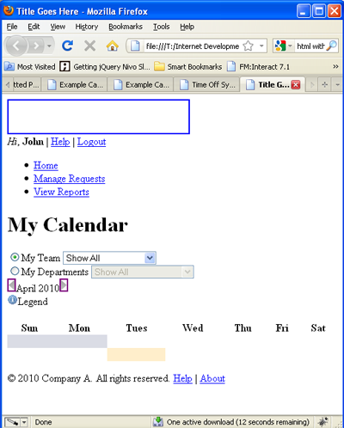
HTML Without CSS
“HTML without CSS is like a piece of candy without a pretty wrapper.”
Without CSS, HTML elements typically flow from top to bottom of the page and position themselves to the left by default.
With CSS help, we can create containers or DIVs to better organize content and make a Web page visually appealing.

Slide 6
HTML & CSS
HTML and CSS work together to produce beautiful and functional Web sites
HTML = structure
CSS = style

Slide 7
HTML CSS
div id=“header”
#content {
background-color: #ccc;
margin-bottom: 10px;
border: 1px dashed blue;
color: #fff;
width: auto;
}
div id=“content”
div id=“footer”

Slide 8
Attaching a Style Sheet
Attach a style sheet to a page by adding the code to the <head> section of the HTML page. There are 3 ways to attach CSS to a page:
1. External Style Sheet: Best used to control styling on multiple pages.
<link rel="stylesheet" type="text/css" media="all" href="css/styles.css" />
2. Internal Style Sheet: Best used to control styling on one page.
<style type=“text/css”> h1 {color: red) </style>
3. Inline Style Sheet*: CSS is not attached in the <header> but is used directly within HTML tags.
<p style=“color: red”>Some Text</p>

Slide 9
CSS Style Rule
p {
font-size: x-large ;
background-color: yellow
}
property names
declarations
selector string
declaration block

Slide 10
CSS Syntax
A CSS comprises of style rules that are interpreted by the browser and then applied to the corresponding elements in document. A style rule is made of three parts
Selector − A selector is an HTML tag at which a style will be applied. This could be any tag like <h1> or <table> etc.
Property - A property is a type of attribute of HTML tag. Put simply, all the HTML attributes are converted into CSS properties. They could be color, border etc.
Value - Values are assigned to properties. For example, color property can have value either red or #F1F1F1 etc.
Syntax:
selector { property: value }
Example:
table{ border :1px solid #C00; }
Notes:
Here table is a selector and border is a property and given value 1px solid #C00 is the value of that property

Slide 11
CSS Selectors
Selectors can be defined in various ways as following:
Type Selectors
Universal Selectors
Descendant Selectors
Class Selectors
ID Selectors
Child Selectors
Attribute Selectors
Grouping Selectors

Slide 12
Type Selectors
CSS type selectors match elements by tag name. Used alone, therefore, a type selector for a particular tag name selects all elements of that type — that is, with that tag name — in the document. For example
h1 {
color: #36CFFF;
}

Slide 13
Universal Selectors
An asterisk (*) is the universal selector for CSS. It matches a single element of any type. Rather than selecting elements of a specific type, the universal selector quite simply matches the name of any element type.
* {
color: #000000;
}
This rule renders the content of every element in our document in black

Slide 14
Descendent Selectors
Descendant selectors typically are represented by a single space character — It combines two selectors such that elements matched by the second selector are selected if they have an ancestor element matching the first selector. Selectors that utilize a descendant combinator are called descendant selectors.The descendant selector matches all elements that are descendants of a specified element.
The following example selects all <p> elements inside <div> elements:
div p {
background-color: yellow;
}

Slide 15
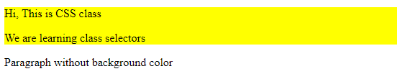
Class Selectors
You can define style rules based on the class attribute of the elements. All the elements having that class will be formatted according to the defined rule.
.intro { background-color: yellow; }
you can use this class in html elements as shown below:-
<div class="intro">
<p>Hi, This is CSS class</p>
<p>We are learning class selectors</p>
</div>
<p> Paragraph without intro class</p>

Slide 16

Id Selectors
CSS ID selectors match an element based on the contents of that element's id attribute, which must match exactly the value given in the selector.
#identified {
background-color: DodgerBlue;
}
<span id="identified">Here's a span with some text.</span>
<span>Here's another.</span>
Output:-

Slide 17
Child Selectors
The child Selector (>) separates two selectors and matches only those elements matched by the second selector that are children of elements matched by the first.
The element>element selector is used to select elements with a specific parent.
Note: Elements that are not directly a child of the specified parent, are not selected.

Slide 18

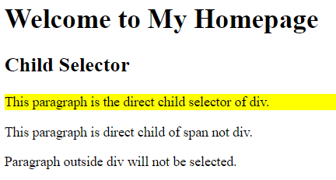
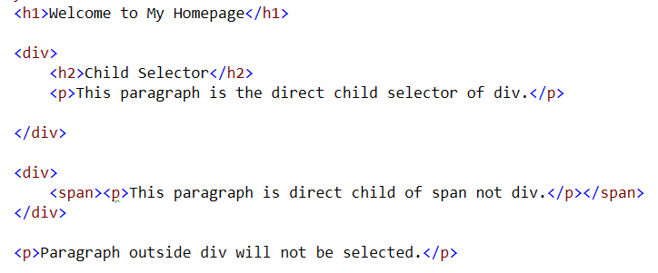
Child Selectors
Code
Output

Slide 19
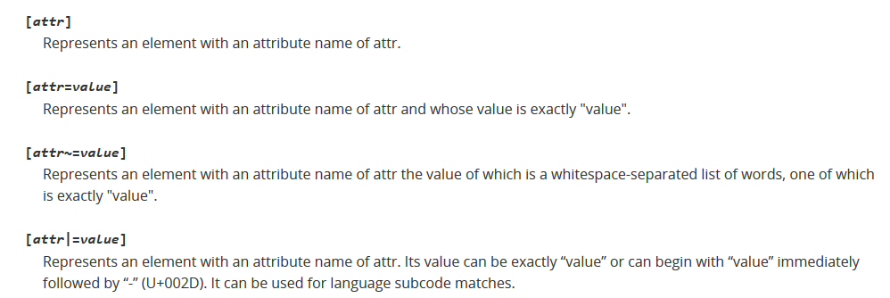
Attribute Selectors
Attribute selectors select an element using the presence of a given attribute or attribute value.

Slide 20
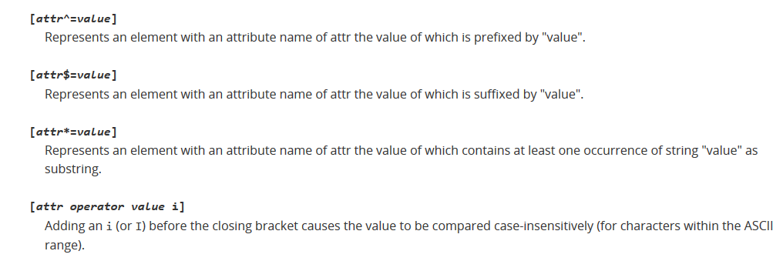
Attribute Selectors

Slide 21
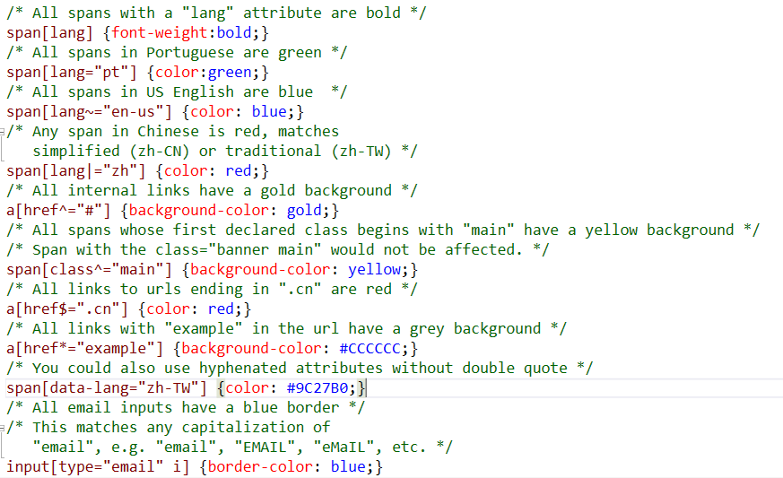
Attribute Selector (code)

Slide 22
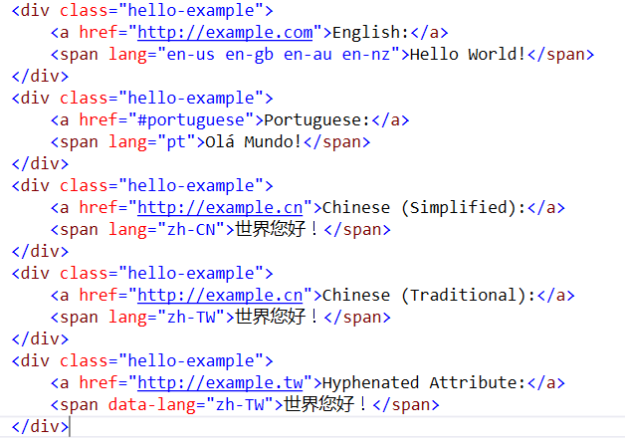
Attribute Selector (Code)

Slide 23
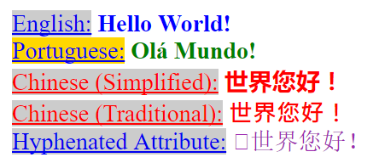
Attribute Selectors (Output)

Slide 24
Grouping Selectors
Group the same selector with different declarations together on one line.
h1 {color: black;}
h1 {font-weight: bold;}
h1 {background: white;}
h1 {
color: black;
font-weight: bold;
background: white;
}
Example of grouping selectors (both are correct):

Slide 25
Grouping Selectors
Group different selectors with the same declaration on one line.
h1 {color: yellow;}
h2 {color: yellow;}
h3 {color: yellow;}
Example of grouping selectors (both are correct):
h1, h2, h3 {color: yellow;}

Slide 26
CSS Inclusion
There are four ways to associate styles with your HTML document. Most commonly used methods are inline CSS and External CSS.
Embedded CSS - The <style> Element
Inline CSS - The style Attribute
External CSS - The <link> Element
Imported CSS - @import Rule

Slide 27
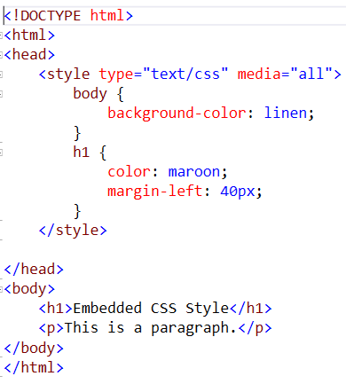
Embedded CSS - The <style> Element
You can put your CSS rules into an HTML document using the <style> element. This tag is placed inside <head>...</head> tags. Rules defined using this syntax will be applied to all the elements available in the document. Here is the generic syntax

Slide 28
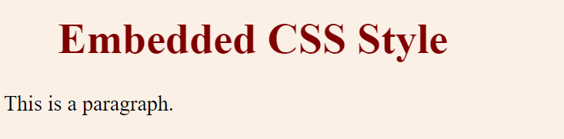
Embedded Style (output)

Slide 29
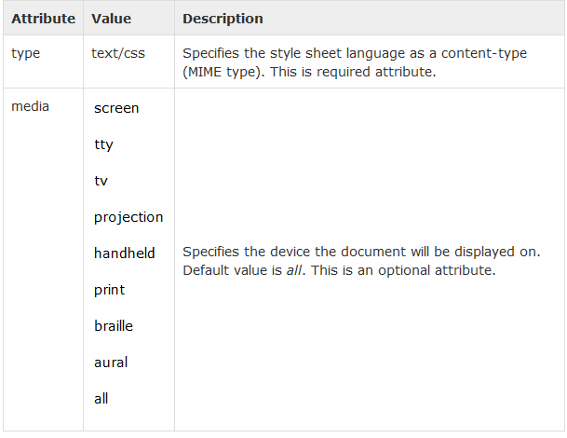
Attributes associated with <style> elements are

Slide 30
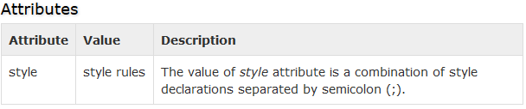
Inline CSS - The style Attribute
You can use style attribute of any HTML element to define style rules. These rules will be applied to that element only. Here is the generic syntax
<element style = "...style rules....">

Slide 31
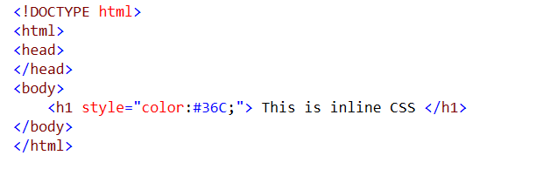

Inline CSS - The style Attribute
Output

Slide 32
External CSS - The <link> Element
The <link> element can be used to include an external stylesheet file in HTML document.
An external style sheet is a separate file with .css extension. One can define all the Style rules within this file and then can include this file in any HTML document using <link> element
Syntax is
<head>
<link type = "text/css" href = "..." />
</head>

Slide 33
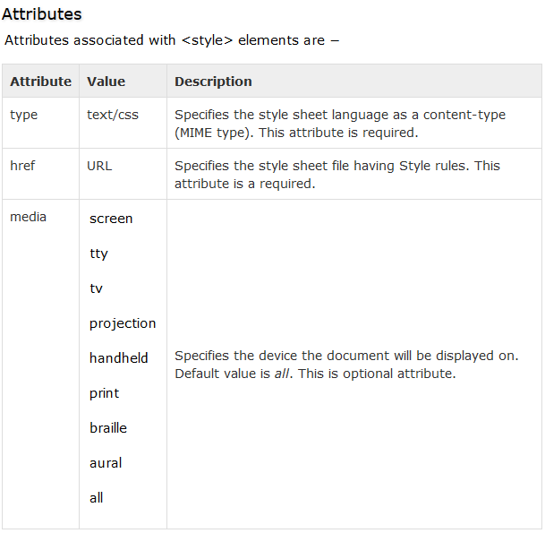
External CSS - The <link> Element (Attribute)

Slide 34
Imported CSS - @import Rule
@import is used to import an external stylesheet in a manner similar to the <link> element. Here is the generic syntax of @import rule.
<head>
<@import "URL";
</head>
Here URL is the URL of the style sheet file having style rules. You can use another syntax as well
<head>
<@import url("URL");
</head>

Slide 35
CSS Overriding Rules
Any inline style sheet takes highest priority. So, it will override any rule defined in <style>...</style> tags or rules defined in any external style sheet file.
Any rule defined in <style>...</style> tags will override rules defined in any external style sheet file.
Any rule defined in external style sheet file takes lowest priority, and rules defined in this file will be applied only when above two rules are not applicable

Slide 36
Comments in CSS
Explain the purpose of the coding
Help others read and understand the code
Serve as a reminder to you for what it all means
Starts with /*and ends with*/
p {color: #ff0000;} /*Company Branding*/

Slide 37
Measurement Units

Slide 38
Measurement Units
CSS supports a number of measurements including absolute units such as inches, centimeters, points, and so on, as well as relative measures such as percentages and em units. You need these values while specifying various measurements in your Style rules e.g border = "1px solid red"

Slide 39
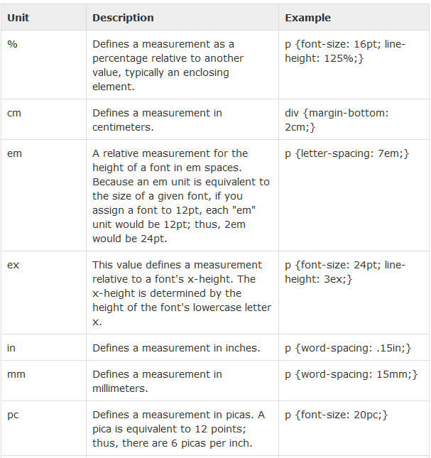
Measurement Units

Slide 40
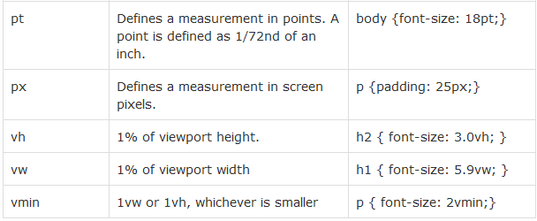
Measurement Units

Slide 41
CSS Colors

Slide 42
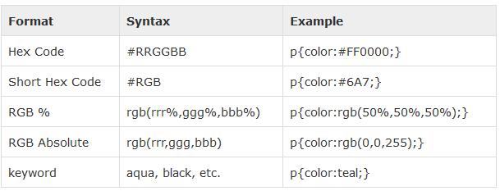
CSS Colors
CSS uses color values to specify a color. Typically, these are used to set a color either for the foreground of an element (i.e., its text) or else for the background of the element. They can also be used to affect the color of borders and other decorative effects.
One can specify your color values in various formats. Following table lists all the possible formats

Slide 43
CSS Background

Slide 44
CSS Background
The background-color property is used to set the background color of an element.
The background-image property is used to set the background image of an element.
The background-repeat property is used to control the repetition of an image in the background.
The background-position property is used to control the position of an image in the background.
The background-attachment property is used to control the scrolling of an image in the background.
The background property is used as a shorthand to specify a number of other background properties.

Slide 45
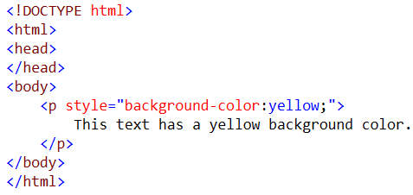

Setting background-color
Output

Slide 46
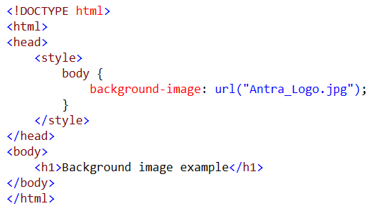
Setting Background Image

Slide 47

Background Image

Slide 48
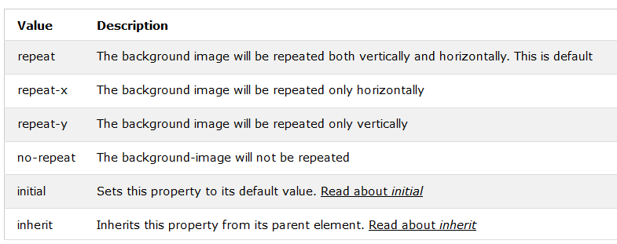
Background-repeat

Slide 49

Image Positioning
left
top
center
top
The background-position property positions the image using either combined keywords (top, bottom, left, right, and center); length values; or percentage values.
left
bottom
center
bottom
right
bottom
background-position: right top; /*can also use number values*/
The background-attachment property fixes or scrolls an image in the browser window. Values include fixed and scroll.
background-attachment: fixed; /*can also use ‘scroll’*/

Slide 50
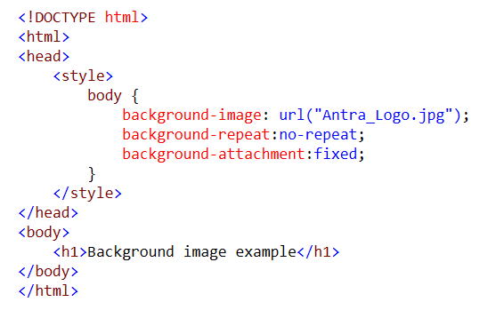
Background attachment

Slide 51
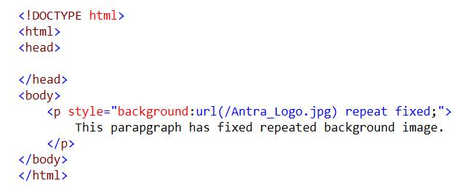
Background (shorthand property)

Slide 52
Font
The font-family property is used to change the face of a font.
The font-style property is used to make a font italic or oblique.
The font-variant property is used to create a small-caps effect.
The font-weight property is used to increase or decrease how bold or light a font appears.
The font-size property is used to increase or decrease the size of a font.
The font property is used as shorthand to specify a number of other font properties

Slide 53
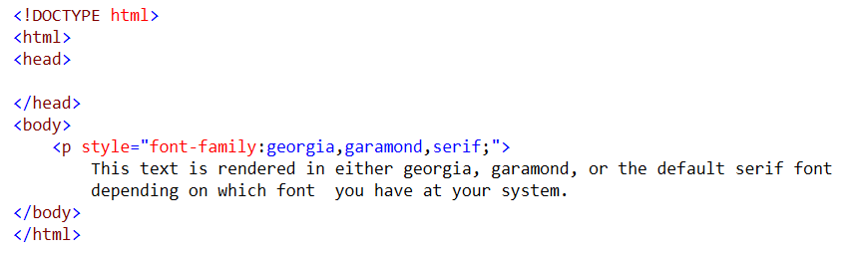
Setting Font Family
OUTPUT

Slide 54
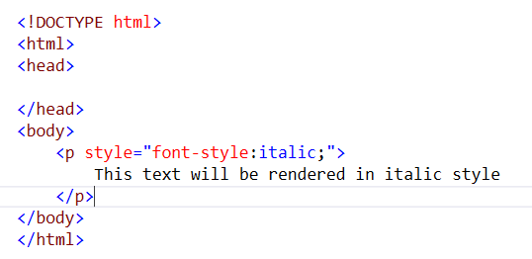

Font Style
Output

Slide 55
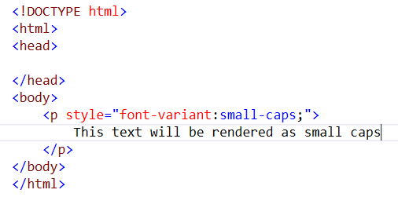

Font variant

Slide 56
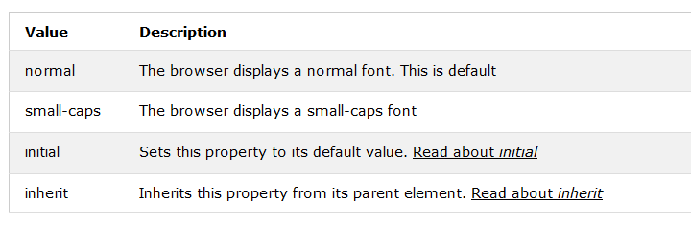
Font Variant

Slide 57
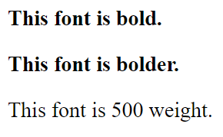
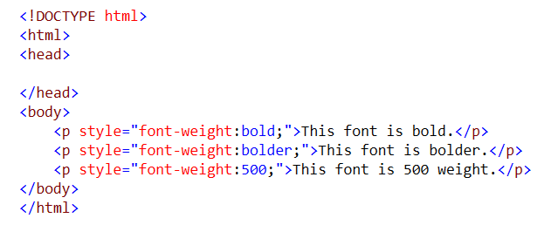
Font Weight
The font-weight property provides the functionality to specify how bold a font is. Possible values could be normal, bold, bolder, lighter, 100, 200, 300, 400, 500, 600, 700, 800, 900

Slide 58
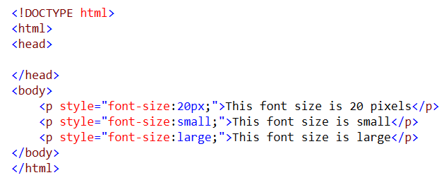
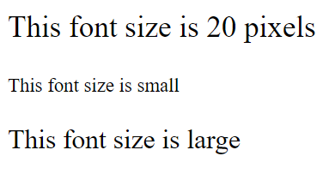
Font Size
The font-size property is used to control the size of fonts. Possible values could be xx-small, x-small, small, medium, large, x-large, xx-large, smaller, larger, size in pixels or in %

Slide 59
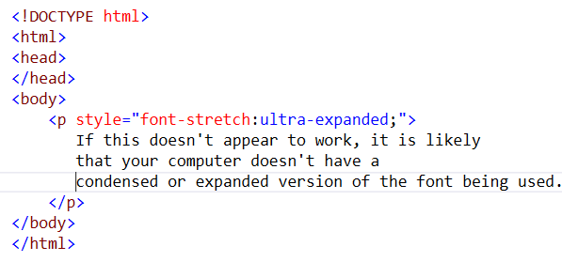
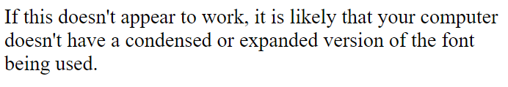
Font Stretch
This property relies on the user's computer to have an expanded or condensed version of the font being used.
Possible values could be normal, wider, narrower, ultra-condensed, extra-condensed, condensed, semi-condensed, semi-expanded, expanded, extra-expanded, ultra-expanded

Slide 60
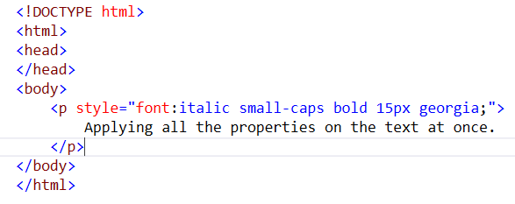
Font (shorthand property)
Output

Slide 61
CSS - TEXT

Slide 62
CSS - Text
The color property is used to set the color of a text.
The direction property is used to set the text direction.
The letter-spacing property is used to add or subtract space between the letters that make up a word.
The word-spacing property is used to add or subtract space between the words of a sentence.
The text-indent property is used to indent the text of a paragraph.
The text-align property is used to align the text of a document.
The text-decoration property is used to underline, overline, and strikethrough text.
The text-transform property is used to capitalize text or convert text to uppercase or lowercase letters.
The white-space property is used to control the flow and formatting of text.
The text-shadow property is used to set the text shadow around a text

Slide 63
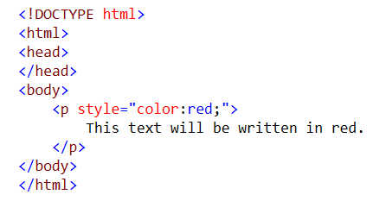

Setting Text Color
Output

Slide 64
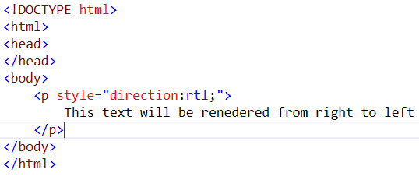
Set Text Direction
Possible values are ltr or rtl
Output

Slide 65
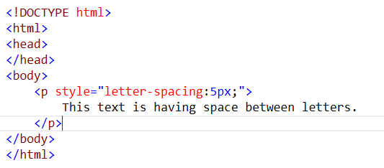
Space between Characters
Possible values are normal or a number specifying space.

Slide 66
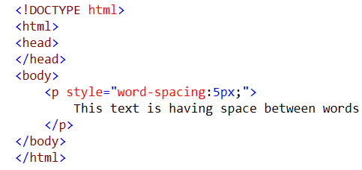

Set space between words
OUTPUT

Slide 67
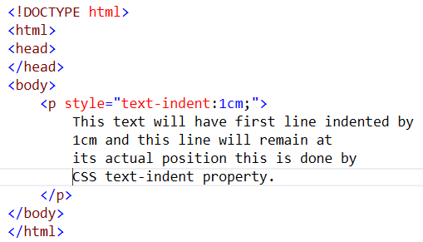
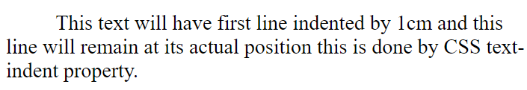
Set Text Indent
Indent the first line of a paragraph. Possible values are % or a number specifying indent space

Slide 68
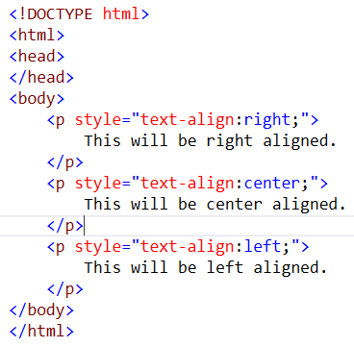
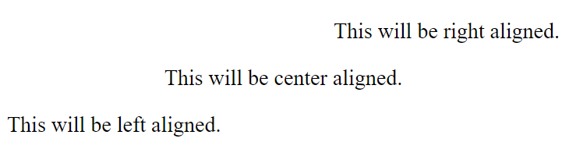
Set Text Alignment
It is used to align a text. Possible values are left, right, center, justify.
Output

Slide 69
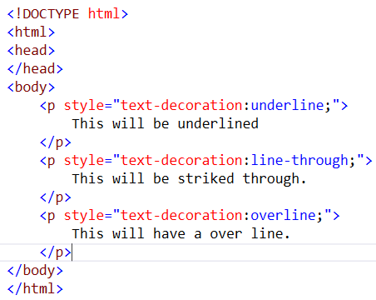
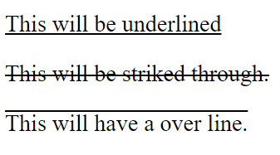
Decorating the Text

Slide 70
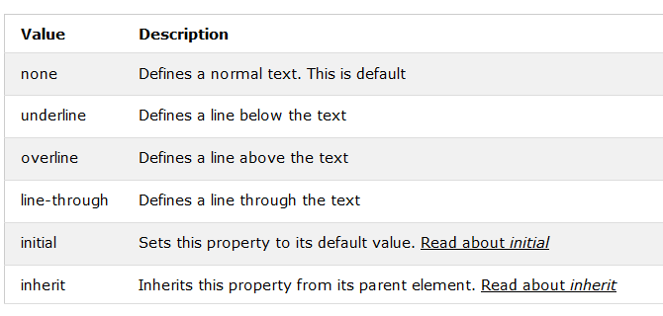
Text Decoration

Slide 71
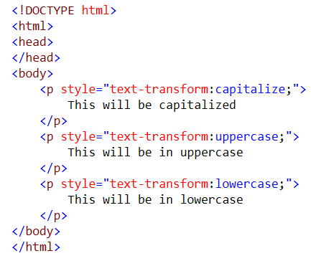
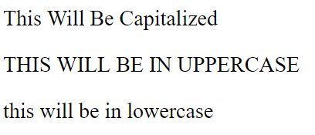
Set Text Cases
Output

Slide 72
CSS - Links

Slide 73
CSS - Links
The :link signifies unvisited hyperlinks.
The :visited signifies visited hyperlinks.
The :hover signifies an element that currently has the user's mouse pointer hovering over it.
The :active signifies an element on which the user is currently clicking
Remember a:hover MUST come after a:link and a:visited in the CSS definition in order to be effective. Also, a:active MUST come after a:hover in the CSS

Slide 74
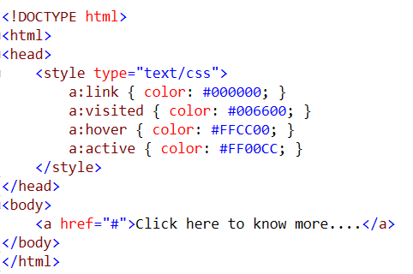
Links

Slide 75
CSS – Tables

Slide 76
CSS Tables
The border-collapse specifies whether the browser should control the appearance of the adjacent borders that touch each other or whether each cell should maintain its style.
The border-spacing specifies the width that should appear between table cells.
The caption-side captions are presented in the <caption> element. By default, these are rendered above the table in the document. You use the caption-side property to control the placement of the table caption.
The empty-cells specifies whether the border should be shown if a cell is empty.
The table-layout allows browsers to speed up layout of a table by using the first width properties it comes across for the rest of a column rather than having to load the whole table before rendering it

Slide 77
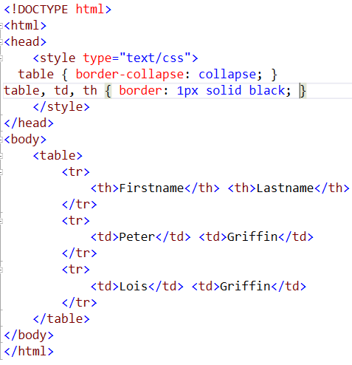
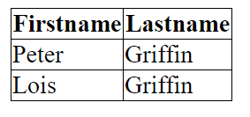
Border-collapse
The border-collapse property sets whether the table borders are collapsed into a single border or detached as in standard HTML

Slide 78

Border-collapse

Slide 79
Borders

Slide 80
Border
The border properties allow you to specify how the border of the box representing an element should look. There are three properties of a border you can change
The border-color specifies the color of a border.
The border-style specifies whether a border should be solid, dashed line, double line, or one of the other possible values.
The border-width specifies the width of a border

Slide 81
Border Color Property
border-bottom-color changes the color of bottom border.
border-top-color changes the color of top border.
border-left-color changes the color of left border.
border-right-color changes the color of right border

Slide 82
Border Style property
none: No border. (Equivalent of border-width:0;)
solid: Border is a single solid line.
dotted: Border is a series of dots.
dashed: Border is a series of short lines.
double: Border is two solid lines.
groove: Border looks as though it is carved into the page.
ridge: Border looks the opposite of groove.
inset: Border makes the box look like it is embedded in the page.
outset: Border makes the box look like it is coming out of the canvas.
hidden: Same as none, except in terms of border-conflict resolution for table elements

Slide 83
Border-width property
The border-width property allows you to set the width of an element borders. The value of this property could be either a length in px, pt or cm or it should be set to thin, medium or thick.
You can individually change the width of the bottom, top, left, and right borders of an element using the following properties −
border-bottom-width changes the width of bottom border.
border-top-width changes the width of top border.
border-left-width changes the width of left border.
border-right-width changes the width of right border.

Slide 84

Box Model

Slide 85
CSS Margins

Slide 86
Margin
The margin property defines the space around an HTML element. It is possible to use negative values to overlap content.
The values of the margin property are not inherited by the child elements. Remember that the adjacent vertical margins (top and bottom margins) will collapse into each other so that the distance between the blocks is not the sum of the margins, but only the greater of the two margins or the same size as one margin if both are equal

Slide 87
Margin
The margin specifies a shorthand property for setting the margin properties in one declaration.
The margin-bottom specifies the bottom margin of an element.
The margin-top specifies the top margin of an element.
The margin-left specifies the left margin of an element.
The margin-right specifies the right margin of an element.

Slide 88


Margin
Output

Slide 89
Padding
The padding property allows you to specify how much space should appear between the content of an element and its border −
The value of this attribute should be either a length, a percentage, or the word inherit. If the value is inherit, it will have the same padding as its parent element. If a percentage is used, the percentage is of the containing box
The following CSS properties can be used to control lists. You can also set different values for the padding on each side of the box using the following properties −
The padding-bottom specifies the bottom padding of an element.
The padding-top specifies the top padding of an element.
The padding-left specifies the left padding of an element.
The padding-right specifies the right padding of an element.
The padding serves as shorthand for the preceding properties

Slide 90
Padding
The padding property may be specified using one, two, three, or four values. Each value is a <length> or a <percentage>.
When one value is specified, it applies the same padding to all four sides.
When two values are specified, the first padding applies to the top and bottom, the second to the left and right.
When three values are specified, the first padding applies to the top, the second to the left and right, the third to the bottom.
When four values are specified, the paddings apply to the top, right, bottom, and left in that order (clockwise)

Slide 91


Padding
Output

Slide 92

CSS - Overflow
CSS provides a property called overflow which tells the browser what to do if the box's contents is larger than the box itself. This property can take one of the following values.

Slide 93


Overflow

Slide 94
CSS - Visibility

Slide 95

Visibility
Visibility allows to hide an element from view. You can use this property along with JavaScript to create very complex menu and very complex webpage layouts.
Remember that the source code will still contain whatever is in the invisible paragraph, so you should not use this to hide sensitive information such as credit card details or passwords

Slide 96

Visibility property

Slide 97
CSS Positioning
CSS helps you to position your HTML element. You can put any HTML element at whatever location you like. You can specify whether you want the element positioned relative to its natural position in the page or absolute based on its parent element
There are three different types of positioning, Relative, Absolute and Fixed

Slide 98
Relative Positioning
Relative positioning changes the position of the HTML element relative to where it normally appears. So "left:20" adds 20 pixels to the element's LEFT position.
You can use two values top and left along with the position property to move an HTML element anywhere in the HTML document.
Move Left - Use a negative value for left.
Move Right - Use a positive value for left.
Move Up - Use a negative value for top.
Move Down - Use a positive value for top
You can use bottom or right values as well in the same way as top and left.

Slide 99

Relative Positioning

Slide 100
Absolute Positioning
An element with position: absolute is positioned at the specified coordinates relative to your screen top-left corner.
You can use two values top and left along with the position property to move an HTML element anywhere in the HTML document.
Move Left - Use a negative value for left.
Move Right - Use a positive value for left.
Move Up - Use a negative value for top.
Move Down - Use a positive value for top.
NOTE − You can use bottom or right values as well in the same way as top and left.

Slide 101

Absolute Positioning

Slide 102
Fixed Positioning
Fixed positioning allows you to fix the position of an element to a particular spot on the page, regardless of scrolling. Specified coordinates will be relative to the browser window.
You can use two values top and left along with the position property to move an HTML element anywhere in the HTML document.
Move Left - Use a negative value for left.
Move Right - Use a positive value for left.
Move Up - Use a negative value for top.
Move Down - Use a positive value for top.
NOTE − You can use bottom or right values as well in the same way as top and left.

Slide 103


Fixed Position

Slide 104
CSS - Layers
CSS gives you opportunity to create layers of various divisions. The CSS layers refer to applying the z-index property to elements that overlap with each other.
The z-index property is used along with the position property to create an effect of layers. You can specify which element should come on top and which element should come at bottom

Slide 105


CSS - Layers

Slide 106
Pseudo Classes
CSS pseudo-classes are used to add special effects to some selectors. You do not need to use JavaScript or any other script to use those effects. A simple syntax of pseudo-classes is as follows
selector:pseudo-class {property: value}
CSS classes can also be used with pseudo-classes
selector.class:pseudo-class {property: value}

Slide 107

Pseudo Classes
Pseudo-class names are not case-sensitive.
Pseudo-class are different from CSS classes but they can be combined.

Slide 108
The :first-child pseudo-class
The :first-child pseudo-class matches a specified element that is the first child of another element and adds special style to that element that is the first child of some other element.
To make :first-child work in IE <!DOCTYPE> must be declared at the top of document.

Slide 109


The :first-child pseudo-class
Output

Slide 110

CSS - Pseudo Elements
CSS pseudo-elements are used to add special effects to some selectors.
selector:pseudo-element {property: value}
CSS classes can also be used with pseudo-elements −
selector.class:pseudo-element {property: value}

Slide 111


The :first-line pseudo-element

Slide 112


The :first-letter pseudo-element

Slide 113


The :before pseudo-element

Slide 114


The :after pseudo-element

Slide 115
CSS @rules

Slide 116
CSS @rules
The @import: rule imports another style sheet into the current style sheet.
The @charset rule indicates the character set the style sheet uses.
The !important rule indicates that a user-defined rule should take precedence over the author's style sheets

Slide 117
@import rule
The @import rule allows you to import styles from another style sheet. It should appear right at the start of the style sheet before any of the rules, and its value is a URL
Syntax
@import url;
@import url list-of-media-queries;
Notes:
url
Is a <string> or a <uri> representing the location of the resource to import. The URL may be absolute or relative. Note that the URL need not actually specify a file; it can just specify the package name and part, and the appropriate file is chosen automatically (e.g. chrome://communicator/skin/). See here for more information.
list-of-media-queries
Is a comma-separated list of media queries conditioning the application of the CSS rules defined in the linked URL. If the browser does not support any these queries, it does not load the linked resource.

Slide 118
Examples
@import url("fineprint.css") print;
@import url("bluish.css") projection, tv;
@import 'custom.css';
@import url("chrome://communicator/skin/");
@import "common.css" screen, projection;
@import url('landscape.css') screen and (orientation:landscape);

Slide 119
@charset rule
If you are writing your document using a character set other than ASCII or ISO-8859-1 you might want to set the @charset rule at the top of your style sheet to indicate what character set the style sheet is written in.
The @charset rule must be written right at the beginning of the style sheet without even a space before it.
Syntax
@charset "UTF-8";
@charset "iso-8859-15";
Notes:
The @charset CSS at-rule specifies the character encoding used in the style sheet. It must be the first element in the style sheet and not be preceded by any character; as it is not a nested statement, it cannot be used inside conditional group at-rules. If several @charset at-rules are defined, only the first one is used, and it cannot be used inside a style attribute on an HTML element or inside the <style> element where the character set of the HTML page is relevant.
This at-rule is useful when using non-ASCII characters in some CSS properties, like content.
As there are several ways to define the character encoding of a style sheet, the browser will try the following methods in the following order (and stop as soon as one yields a result) :
The value of the Unicode byte-order character placed at the beginning of the file.
The value given by the charset attribute of the Content-Type: HTTP header or the equivalent in the protocol used to serve the style sheet.
The @charset CSS at-rule.
Use the character encoding defined by the referring document: the charset attribute of the <link> element. This method is obsoleted in HTML5 and must not be used.
Assume that the document is UTF-8

Slide 120

!important
The !important rule provides a way to make your CSS cascade. It also includes the rules that are to be applied always. A rule having a !important property will always be applied, no matter where that rule appears in the CSS document

Slide 121
Media Type
One of the most important features of style sheets is that they specify how a document is to be presented on different media: on the screen, on paper, with a speech synthesizer, with a braille device, etc.
We can specify media dependencies for style sheets −
Specify the target medium from a style sheet with the @media or @import at-rules.
Specify the target medium within the document language

Slide 122

@media rule
An @media rule specifies the target media types (separated by commas) of a set of rules.

Slide 123

Media rule
Media type names are case sensitive

Slide 124
Rounded Coners
CSS3 Rounded corners are used to add special colored corner to body or text by using the border-radius property. A simple syntax of rounded corners is as follows −
#rconers7{
border-radius: 60px/15px;
background: #FF0000;
padding: 20px;
width: 200px;
height: 150px;
}

Slide 125
Rounded Coners
Values | Description
border-radius | Use this element for setting four boarder radius property
border-top-left-radius | Use this element for setting the boarder of top left corner
border-top-right-radius | Use this element for setting the boarder of top right corner
border-bottom-right-radius | Use this element for setting the boarder of bottom right corner
border-bottom-left-radius | Use this element for setting the boarder of bottom left corner

Slide 126

Rounded Coners
<html>
<head>
<style>
#rcorners1 {
border-radius: 15px 50px 30px 5px;
background: #a44170;
padding: 20px;
width: 100px;
height: 100px; }
#rcorners2 {
border-radius: 15px 50px 30px;
background: #a44170;
padding: 20px;
width: 100px;
height: 100px; }
#rcorners3 {
border-radius: 15px 50px;
background: #a44170;
padding: 20px;
width: 100px;
height: 100px; }
</style>
</head>
<body>
<p id="rcorners1"></p>
<p id="rcorners2"></p>
<p id="rcorners3"></p>
</body>
<body>
Output:

Slide 127
Border Image
CSS Border image property is used to add image boarder to some elements. You don't need to use any HTML code to call boarder image. A sample syntax of boarder image is as follows −
#borderimg {
border: 10px solid transparent;
padding: 15px;
}

Slide 128
Border Image
Values | Description
border-image-source | Used to set the image path
border-image-slice | Used to slice the boarder image
border-image-width | Used to set the boarder image width
border-image-repeat | Used to set the boarder image as rounded, repeated and stretched

Slide 129

Border Image
border-image-repeat: round;
border-image-slice: 30;
border-image-width: 30px; }
</style>
</head>
<body>
<p id="borderimg1">This is image boarder example.</p>
<p id="borderimg2">This is image boarder example.</p>
<p id="borderimg3">This is image boarder example.</p>
</body>
</html>
<html>
<head>
<style>
#borderimg1 {
border: 10px solid transparent;
padding: 15px;
border-image-source: url(/css/images/border.png);
border-image-repeat: round;
border-image-slice: 30;
border-image-width: 10px; }
#borderimg2 {
border: 10px solid transparent;
padding: 15px;
border-image-source: url(/css/images/border.png);
border-image-repeat: round;
border-image-slice: 30;
border-image-width: 20px; }
#borderimg3 {
border: 10px solid transparent;
padding: 15px;
border-image-source: url(/css/images/border.png);
Output:

Slide 130
Multi Background
CSS Multi background property is used to add one or more images at a time without HTML code, We can add images as per our requirement. A sample syntax of multi background images is as follows −
#multibackground {
background-image: url (), url();
background-position: left top, left top;
background-repeat: no-repeat, repeat;
padding: 75px;
}

Slide 131
Multi Background
Values | Description
background | Used to setting all the background image properties in one section
background-clip | Used to declare the painting area of the background
background-image | Used to specify the background image
background-origin | Used to specify position of the background images
background-size | Used to specify size of the background images

Slide 132
Size of Multi background
Multi background property is accepted to add different sizes for different images. A sample syntax is as shown below −
As shown below an example, each image is having specific sizes as 50px, 130px and auto size.
#multibackground {
background: url() left top no-repeat, url() right bottom no-repeat, url() left top repeat;
background-size: 50px, 130px, auto;
}

Slide 133
Color
CSS3 has Supported additional color properties as follows −
RGBA colors
HSL colors
HSLA colors
Opacity

Slide 134
Color
RGBA stands for Red Green Blue Alpha. It is an extension of CSS2,Alpha specifies the opacity of a color and parameter number is a numerical between 0.0 to 1.0. A Sample syntax of RGBA as shown below −
#d1 {background-color: rgba(255, 0, 0, 0.5);}
#d2 {background-color: rgba(0, 255, 0, 0.5);}
#d3 {background-color: rgba(0, 0, 255, 0.5);}

Slide 135

Color
Example for RGBA
<html>
<head>
<style>
#p1 {background-color:rgba(255,0,0,0.3);}
#p2 {background-color:rgba(0,255,0,0.3);}
#p3 {background-color:rgba(0,0,255,0.3);}
</style>
</head>
<body>
<p>RGBA colors:</p>
<p id="p1">Red</p>
<p id="p2">Green</p>
<p id="p3">Blue</p>
</body>
</html>
Output:

Slide 136
Color
HSL stands for huge, saturation, lightness. Here Huge is a degree on the color wheel, saturation and lightness are percentage values between 0 to 100%. A Sample syntax of HSL as shown below −
#g1 {background-color: hsl(120, 100%, 50%);}
#g2 {background-color: hsl(120, 100%, 75%);}
#g3 {background-color: hsl(120, 100%, 25%);}

Slide 137

Color
Example for HSL
<html>
<head>
<style>
#p1 {background-color:rgba(255,0,0,0.3);}
#p2 {background-color:rgba(0,255,0,0.3);}
#p3 {background-color:rgba(0,0,255,0.3);}
</style>
</head>
<body>
<p>RGBA colors:</p>
<p id="p1">Red</p>
<p id="p2">Green</p>
<p id="p3">Blue</p>
</body>
</html>
Output:

Slide 138
Color
HSLA stands for huge, saturation, lightness and alpha. Alpha value specifies the opacity as shown RGBA. A Sample syntax of HSLA as shown below −
#g1 {background-color: hsla(120, 100%, 50%, 0.3);}
#g2 {background-color: hsla(120, 100%, 75%, 0.3);}
#g3 {background-color: hsla(120, 100%, 25%, 0.3);}

Slide 139

Color
Example for HSLA
<html>
<head>
<style>
#d1 {background-color:hsla(120,100%,50%,0.3);}
#d2 {background-color:hsla(120,100%,75%,0.3);}
#d3 {background-color:hsla(120,100%,25%,0.3);}
</style>
</head>
<body>
<p>HSLA colors:</p>
<p id="d1">Less opacity green</p>
<p id="d2">Green</p>
<p id="d3">Green</p>
</body>
</html>
Output:

Slide 140
Color
Opacity is a thinner paints need black added to increase opacity. A sample syntax of opacity is as shown below −
#g1 {background-color:rgb(255,0,0);opacity:0.6;}
#g2 {background-color:rgb(0,255,0);opacity:0.6;}
#g3 {background-color:rgb(0,0,255);opacity:0.6;}

Slide 141

Color
Example for Opacity
<html>
<head>
<style>
#m1 {background-color:rgb(255,0,0);opacity:0.6;}
#m2 {background-color:rgb(0,255,0);opacity:0.6;}
#m3 {background-color:rgb(0,0,255);opacity:0.6;}
</style>
</head>
<body>
<p>HSLA colors:</p>
<p id="m1">Red</p>
<p id="m2">Green</p>
<p id="m3">Blue</p>
</body>
</html>
Output:

Slide 142

Gradients
Gradients displays the combination of two or more colors as shown below −
Types of Gradients
Linear Gradients(down/up/left/right/diagonally)
Radial Gradients

Slide 143
Linear Gradients
Linear gradients are used to arrange two or more colors in linear formats like
Top to bottom
Left to right
Diagonal
Multicolor

Slide 144
Linear Gradients (Top to Bottom)
<html>
<head>
<style>
#grad1 {
height: 100px;
background: -webkit-linear-gradient(orange,yellow);
background: -o-linear-gradient(orange,yellow);
background: -moz-linear-gradient( orange,yellow);
background: linear-gradient(orange,yellow); }
</style>
</head>
<body>
<div id="grad1"></div>
</body>
</html>
Output:

Slide 145
Linear Gradients (Left to Right)
<html>
<head>
<style>
#grad1 {
height: 100px;
background: -webkit-linear-gradient(left, red , blue);
background: -o-linear-gradient(right, red, blue);
background: -moz-linear-gradient(right, red, blue);
background: linear-gradient(to right, red , blue); }
</style>
</head>
<body> <div id="grad1"></div> </body>
</html>
Output:

Slide 146
Linear Gradients (Diagonal)
<html>
<head>
<style>
#grad1 {
height: 100px;
background: -webkit-linear-gradient(left top, red , blue);
background: -o-linear-gradient(bottom right, red, blue);
background: -moz-linear-gradient(bottom right, red, blue);
background: linear-gradient(to bottom right, red , blue); }
</style>
</head>
</html>
Output:
Notes:
Diagonal starts at top left and right button

Slide 147
Linear Gradients (Multi color)
<html>
<head>
<style>
#grad2 {
height: 100px;
background: -webkit-linear-gradient(red, orange, yellow, white);
background: -o-linear-gradient(red, orange, yellow, white);
background: -moz-linear-gradient(red, orange, yellow, white);
background: linear-gradient(red, orange, yellow, white); }
</style>
</head>
<body> <div id="grad2"></div> </body>
</html>
Output:

Slide 148
Radial Gradients
<html>
<head>
<style>
#grad1 {
height: 100px;
width: 550px;
background: -webkit-radial-gradient(red 5%, yellow 15%,
orange 60%);
background: -o-radial-gradient(red 5%, yellow 15%,
orange 60%);
background: -moz-radial-gradient(red 5%, yellow 15%,
orange 60%);
background: radial-gradient(red 5%, yellow 15%, orange 60%); }
</style>
</head>
<body>
<div id="grad1"></div>
</body>
</html>
Output:
Notes:
Radial gradients appears at center.

Slide 149

Repeat Radial Gradients
<html>
<head>
<style>
#grad1 {
height: 100px;
width: 550px;
background: -webkit-repeating-radial-gradient(red, yellow 10%,
orange 15%);
background: -o-repeating-radial-gradient(red, yellow 10%,
orange 15%);
background: -moz-repeating-radial-gradient(red, yellow 10%,
orange 15%);
background: repeating-radial-gradient(red, yellow 10%, orange 15%);
}
</style>
</head>
<body>
<div id="grad1"></div>
</body>
</html>
Output:

Slide 150
Shadow
With CSS3 you can add shadow to text and to elements. Shadow property has divided as follows
Text shadow
Box Shadow

Slide 151
Text Shadow
<html>
<head>
<style>
h1 { text-shadow: 2px 2px; }
h2 { text-shadow: 2px 2px red; }
h3 { text-shadow: 2px 2px 5px red; }
h4 { color: white;
text-shadow: 2px 2px 4px #000000; }
h5 { text-shadow: 0 0 3px #FF0000; }
h6 { text-shadow: 0 0 3px #FF0000, 0 0 5px #0000FF; }
p { color: white;
text-shadow: 1px 1px 2px black, 0 0 25px blue, 0 0 5px darkblue; }
</style>
</head>
Output:
<body>
<h1>Antra.net</h1>
<h2>Antra.net</h2>
<h3>Antra.net</h3>
<h4>Antra.net</h4>
<h5>Antra.net</h5>
<h6>Antra.net</h6>
<p>Antra.net</p>
</body>
</html>
Notes:
The text-shadow property adds shadow to text.

Slide 152

Box Shadow
<html>
<head>
<style>
div {
width: 300px;
height: 100px;
padding: 15px;
background-color: red;
box-shadow: 10px 10px; }
</style>
</head>
<body> <div>This is a div element with a box-shadow</div> </body>
</html>
Output:
Notes:
The box-shadow property attaches one or more shadows to an element.

Slide 153
Text
CSS3 contains several new text features.
text-overflow
word-wrap
word-break

Slide 154
Text
Values | Description
text-align-last | Used to align the last line of the text
text-emphasis | Used to emphasis text and color
text-overflow | used to determines how overflowed content that is not displayed is signaled to users
word-break | Used to break the line based on word
word-wrap | Used to break the line and wrap onto next line

Slide 155
Text-Overflow
The text-overflow property determines how overflowed content that is not displayed is signaled to users.
Value | Description
clip | Default value. Clips the text
ellipsis | Render an ellipsis ("...") to represent clipped text
string | Render the given string to represent clipped text
initial | Sets this property to its default value.
inherit | Inherits this property from its parent element.

Slide 156

Text-Overflow
<p class="text1">
Antra’s services address critical gaps to bring
businesses’ industry-specific technological expertise
in a full range of IT services and workforce solutions.</p>
<b>Text overflow:ellipsis</b>
<p class="text2">
Antra’s services address critical gaps to bring
businesses’ industry-specific technological expertise
in a full range of IT services and workforce solutions. </p>
</body>
</html>
<html>
<head>
<style>
p.text1 {
white-space: nowrap;
width: 200px;
border: 1px solid #000000;
overflow: hidden;
text-overflow: clip; }
p.text2 {
white-space: nowrap;
width: 200px;
border: 1px solid #000000;
overflow: hidden;
text-overflow: ellipsis; }
</style>
</head>
<body>
<b>Original Text:</b>
<p>
Antra’s services address critical gaps to bring
businesses’ industry-specific technological expertise
in a full range of IT services and workforce solutions. </p>
<b>Text overflow:clip:</b>
Output:

Slide 157
Word-Breaking
Used to break the line.
Value | Description
normal | Default value. Break words according to their usual rules
break-all | Lines may break between any two letters
keep-all | Breaks are prohibited between pairs of letters
initial | Sets this property to its default value.
inherit | Inherits this property from its parent element.

Slide 158

Word Breaking
<html>
<head>
<style>
p.text1 {
width: 140px;
border: 1px solid #000000;
word-break: keep-all; }
p.text2 {
width: 140px;
border: 1px solid #000000;
word-break: break-all; }
</style>
</head>
<body>
<b>line break at hyphens:</b>
<p class="text1"> Antra’s services address critical gaps to bring
businesses’ industry-specific technological expertise in a full range
of IT services and workforce solutions. </p>
<b>line break at any character</b>
<p class="text2">
Antra’s services address critical gaps to bring businesses’ industry-specific
technological expertise in a full range of IT services and workforce solutions. </p>
</body>
</html>
Output:

Slide 159
Word Wrapping
Word wrapping is used to break the line and wrap onto next line.
Syntax:
p { word-wrap: break-word; }
Value | Description
normal | Break words only at allowed break points
break-word | Allows unbreakable words to be broken
initial | Sets this property to its default value.
inherit | Inherits this property from its parent element.

Slide 160
Web Fonts
Web fonts are used to allows the fonts in CSS, which are not installed on local system.
Different web fonts formats
Fonts | Description
TrueType Fonts (TTF) | TrueType is an outline font standard developed by Apple and Microsoft in the late 1980s, It became most common fonts for both windows and MAC operating systems
OpenType Fonts (OTF) | OpenType is a format for scalable computer fonts and developed by Microsoft
The Web Open Font Format (WOFF) | WOFF is used for develop web page and developed in the year of 2009. Now it is using by W3C recommendation.
SVG Fonts/Shapes | SVG allow SVG fonts within SVG documentation. We can also apply CSS to SVG with font face property
Embedded OpenType Fonts (EOT) | EOT is used to develop the web pages and it has embedded in webpages so no need to allow 3rd party fonts

Slide 161
Web Fonts
<html>
<head>
<style>
@font-face {
font-family: myFirstFont;
src: url(/css/font/SansationLight.woff);
}
div {
font-family: myFirstFont;
}
</Style>
</head>
<body>
<div>This is the example of font face with CSS3.</div>
<p><b>Original Text :</b>This is the example of font face
with CSS3.</p>
</body>
</html>
Output:

Slide 162
Web Fonts
Fonts description
Values | Description
font-family | Used to defines the name of font
src | Used to defines the URL
font-stretch | Used to find, how font should be stretched
font-style | Used to defines the fonts style
font-weight | Used to defines the font weight(boldness)

Slide 163
2D-Transforms
2D transforms are used to re-change the element structure as translate, rotate, scale, and skew. The following table has contained common values which are used in 2D transforms
Values | Description
matrix(n,n,n,n,n,n) | Used to defines matrix transforms with six values
translate(x,y) | Used to transforms the element along with x-axis and y-axis
translateX(n) | Used to transforms the element along with x-axis
translateY(n) | Used to transforms the element along with y-axis
scale(x,y) | Used to change the width and height of element
scaleX(n) | Used to change the width of element
scaleY(n) | Used to change the height of element
rotate(angle) | Used to rotate the element based on an angle
skewX(angle) | Used to defines skew transforms along with x axis
skewY(angle) | Used to defines skew transforms along with y axis

Slide 164
2D-Transforms
<html>
<head>
<style>
div {
width: 300px;
height: 100px;
background-color: pink;
border: 1px solid black; }
div#myDiv {
/* IE 9 */
-ms-transform: rotate(20deg);
/* Safari */
-webkit-transform: rotate(20deg);
/* Standard syntax */
transform: rotate(20deg); }
</style>
</head>
<body>
<div> Antra.net. </div><div id="myDiv"> Antra.net </div>
</body>
</html>
Output:

Slide 165
2D-Transforms (Rotate -20 degrees)
<html>
<head>
<style>
div {
width: 300px;
height: 100px;
background-color: pink;
border: 1px solid black; }
div#myDiv {
/* IE 9 */
-ms-transform: rotate(-20deg);
/* Safari */
-webkit-transform: rotate(-20deg);
/* Standard syntax */
transform: rotate(-20deg); }
</style>
</head>
<body>
<div> Antra.net </div> <div id="myDiv"> Antra.net</div>
</body>
</html>
Output
Notes:
Box rotation with -20 degrees angle

Slide 166

2D-Transformers (Skew X axis)
<html>
<head>
<style>
div {
width: 300px;
height: 100px;
background-color: pink;
border: 1px solid black; }
div#skewDiv {
/* IE 9 */
-ms-transform: skewX(20deg);
/* Safari */
-webkit-transform: skewX(20deg);
/* Standard syntax */
transform: skewX(20deg); }
</style>
</head>
<body>
<div>
Antra.net </div> <div id="skewDiv"> Antra.net </div>
</body>
</html>
Output:
Notes:
Box rotation with skew x-axis

Slide 167
2D-Transforms (Skew Y axis)
<html>
<head>
<style>
div {
width: 300px;
height: 100px;
background-color: pink;
border: 1px solid black; }
div#skewDiv {
/* IE 9 */
-ms-transform: skewY(20deg);
/* Safari */
-webkit-transform: skewY(20deg);
/* Standard syntax */
transform: skewY(20deg); }
</style>
</head>
<body>
<div>Antra.net</div><div id="skewDiv">Antra.net</div>
</body>
</html>
Output:
Notes:
Box rotation with skew y-axis.

Slide 168

2D-Transformers (Matrix Transforms)
<html>
<head>
<style>
div {
width: 300px;
height: 100px;
background-color: pink;
border: 1px solid black; }
div#myDiv1 {
/* IE 9 */
-ms-transform: matrix(1, -0.3, 0, 1, 0, 0);
/* Safari */
-webkit-transform: matrix(1, -0.3, 0, 1, 0, 0);
/* Standard syntax */
transform: matrix(1, -0.3, 0, 1, 0, 0); }
</style>
</head>
<body>
<div>Antra.net</div> <div id="myDiv1">Antra.net</div>
</body>
</html>
Output:

Slide 169

2D-Transforms (Matrix transforms with another direction)
<html>
<head>
<style>
div {
width: 300px;
height: 100px;
background-color: pink;
border: 1px solid black; }
div#myDiv2 {
/* IE 9 */
-ms-transform: matrix(1, 0, 0.5, 1, 150, 0);
/* Safari */
-webkit-transform: matrix(1, 0, 0.5, 1, 150, 0);
/* Standard syntax */
transform: matrix(1, 0, 0.5, 1, 150, 0); }
</style>
</head>
<body>
<div>Antra.net</div><div id="myDiv2">Antra.net</div>
</body>
</html>
Output:

Slide 170
3D-Transforms
CSS 3D Transforms extends CSS Transforms to allow elements rendered by CSS to be transformed in three-dimensional space.
In this chapter we will learn about the following 3D transformation methods:
rotateX()
rotateY()
rotateZ()

Slide 171

3D-Transforms(X-axis)
<html>
<head>
<style>
div {
width: 200px;
height: 100px;
background-color: pink;
border: 1px solid black; }
div#myDiv {
-webkit-transform: rotateX(150deg);
/* Safari */
transform: rotateX(150deg);
/* Standard syntax */ }
</style>
</head>
<body>
<div> Antra.net </div>
<p>Rotate X-axis</p>
<div id="myDiv"> Antra.net </div>
</body>
</html>
Output:

Slide 172

3D-Transforms(Y-axis)
<html>
<head>
<style>
div {
width: 200px;
height: 100px;
background-color: pink;
border: 1px solid black; }
div#yDiv {
-webkit-transform: rotateY(150deg);
/* Safari */
transform: rotateY(150deg);
/* Standard syntax */ }
</style>
</head>
<body>
<div> Antra.net </div>
<p>Rotate Y axis</p>
<div id="yDiv"> Antra.net </div>
</body>
</html>
Output:

Slide 173


3D-Transforms(Z-axis)
<html>
<head>
<style>
div {
width: 200px;
height: 100px;
background-color: pink;
border: 1px solid black; }
div#zDiv {
-webkit-transform: rotateZ(90deg);
/* Safari */
transform: rotateZ(90deg);
/* Standard syntax */ }
</style>
</head>
<body>
<p>rotate Z axis</p>
<div id="zDiv"> Antra.net </div>
</body>
</html>
Output:

Slide 174
Animation
An animation lets an element gradually change from one style to another.
You can change as many CSS properties you want, as many times you want.
To use CSS3 animation, you must first specify some keyframes for the animation.
Keyframes hold what styles the element will have at certain times.

Slide 175
The @keyframe Rule
When you specify CSS styles inside the @keyframes rule, the animation will gradually change from the current style to the new style at certain times.
To get an animation to work, you must bind the animation to an element.
Syntax:
@keyframes animation {
from {background-color: pink;}
to {background-color: green;} }
div {
width: 100px;
height: 100px;
background-color: red;
animation-name: animation;
animation-duration: 5s;
}

Slide 176

Multi Columns
Multi-column layout allows easy definition of multiple columns of text - just like in newspapers:

Slide 177
Multi Columns
Values | Description
column-count | Used to count the number of columns that element should be divided
column-fill | Used to decide, how to fill the columns
column-gap | Used to decide the gap between the columns
column-rule | Used to specifies the number of rules
rule-color | Used to specifies the column rule color
rule-style | Used to specifies the style rule for column
rule-width | Used to specifies the width
column-span | Used to specifies the span between columns

Slide 178
Multi Columns
<body>
<div class="multi">
Antra’s services address critical gaps to bring businesses’ industry-specific
technological expertise in a full range of IT services and workforce solutions.
Our one of the biggest domain expertise includes Information technology,
which efficiently enhances the speed of productivity in this present-day work
environment. We combine this modern technology, knowledge & business
savviness to enhance our clients.
</div>
</body>
</html>
<!DOCTYPE html>
<html>
<head>
<style>
.multi {
/* Column count property */
-webkit-column-count: 4;
-moz-column-count: 4;
column-count: 4;
/* Column gap property */
-webkit-column-gap: 40px;
-moz-column-gap: 40px;
column-gap: 40px;
/* Column style property */
-webkit-column-rule-style: solid;
-moz-column-rule-style: solid;
column-rule-style: solid; }
</style>
</head>
Output:

Slide 179
User Interface
The user interface property allows to change any element into one of several standard user interface elements.
Properties of User Interface
Values | Description
appearance | Used to allow the user to make elements as user interface elements
box-sizing | Allows to users to fix elements on area in clear way
icon | Used to provide the icon on area
resize | Used to resize elements which are on area
outline-offset | Used to draw the behind the outline
nav-down | Used to move down when you have pressed on down arrow button in keypad
nav-left | Used to move left when you have pressed on left arrow button in keypad
nav-right | Used to move right when you have pressed on right arrow button in keypad
nav-up | Used to move up when you have pressed on up arrow button in keypad

Slide 180
User Interface
Resize Property
The resize property specifies whether or not an element is resizable by the user.
Resize property is having three common values as shown below
horizontal
vertical
both
Using of both value in resize property in css3 user interface

Slide 181
User Interface
Resize Property values
Value | Description
none | Default value. The user cannot resize the element
both | The user can adjust both the height and the width of the element
horizontal | The user can adjust the width of the element
vertical | The user can adjust the height of the element
initial | Sets this property to its default value.
inherit | Inherits this property from its parent element.

Slide 182

User Interface
Example of resize property
<html>
<head>
<style>
div {
border: 2px solid;
padding: 20px;
width: 300px;
resize: both;
overflow: auto;
}
</style>
</head>
<body>
<div>Antra.net</div>
</body>
</html>
Output:

Slide 183
User Interface
Outline Offset
The outline-offset property adds space between an outline and the edge or border of an element.
Outlines differ from borders in three ways:
An outline is a line drawn around elements, outside the border edge
An outline does not take up space
An outline may be non-rectangular

Slide 184
User Interface
Outline Offset Property values
Value | Description
length | The distance the outline is outset from the border edge. Default value is 0
initial | Sets this property to its default value.
inherit | Inherits this property from its parent element.

Slide 185

User Interface
Outline Offset Example
<html>
<head>
<style>
div {
border: 2px solid;
padding: 20px;
width: 300px;
resize: both;
overflow: auto;
}
</style>
</head>
<body>
<div>TutorialsPoint.com</div>
</body>
</html>
Output

Slide 186
Box-Sizing
The box-sizing property is used to tell the browser what the sizing properties (width and height) should include.
Box-Sizing Properties values
Value | Description
content-box | Default. The width and height properties (and min/max properties) includes only the content. Border, padding, or margin are not included
border-box | The width and height properties (and min/max properties) includes content, padding and border, but not the margin
initial | Sets this property to its default value.
inherit | Inherits this property from its parent element.

Slide 187

Box-Sizing
CSS2 sizing property
<html>
<head>
<style>
.div1 {
width: 200px;
height: 100px;
border: 1px solid green; }
.div2 {
width: 200px;
height: 100px;
padding: 50px;
border: 1px solid pink; }
</style>
</head>
<body>
<div class="div1">Antra.net</div></br>
<div class="div2">Antra.net</div>
</body>
</html>
Output:

Slide 188

User Interface
CSS3 box sizing property
<html>
<head>
<style>
.div1 {
width: 300px;
height: 100px;
border: 1px solid blue;
box-sizing: border-box; }
.div2 {
width: 300px;
height: 100px;
padding: 50px;
border: 1px solid red;
box-sizing: border-box; }
</style>
</head><body>
<div class="div1">Antra.net</div></br>
<div class="div2">Antra.net</div>
</body>
</html>
Output:

