Slide 2
Antra SEP Program
HyperText Transfer Protocol
Day 1

Slide 3
What is World Wide Web?
The World Wide Web (Web) is a network of information resources. The Web relies on three mechanisms to make these resources readily available to the widest possible audience:
A uniform naming scheme for locating resources on the Web (e.g., URIs).
Protocols, for access to named resources over the Web (e.g., HTTP).
Hypertext, for easy navigation among resources (e.g., HTML).

Slide 4
HyperText Transfer Protocol (HTTP)

Slide 5
What is a protocol and http?
Protocol: A Protocol is a standard procedure for defining and regulating communication. For example TCP, UDP, HTTP etc.
HTTP is the foundation of data communication for the World Wide Web.
The HTTP is the Web’s application-layer protocol for transferring various forms of data between server and client like plaintext, hypertext, image, videos and sounds.
Application
Presentation
Session
Transport
Network
Datalink
Physical

Slide 6
Terminology
IP Address: An Internet Protocol address (IP address) is a numerical label assigned to each device (e.g., computer, printer) participating in a computer network that uses the Internet Protocol for communication.
HTTP : HTTP is a stateless protocol, because an HTTP server maintains no information about the clients. If a particular client asks for the same object twice in a period of a few seconds, the server does not respond by saying that it just served the object to the client; instead, the server resends the object, as it has completely forgotten what it did earlier.
HTTPS : HTTPS consists of communication over Hypertext Transfer Protocol (HTTP) within a connection encrypted by Transport Layer Security, or its predecessor, Secure Sockets Layer.
Port Number : A port number is a 16 bit number which when associated with IP address , completes the destination address for a communications session. Default port number for HTTP is 80 and for HTTPS is 443.
Socket : A socket is nothing but a combination of IP address and port number. It is simply an end while communication.

Slide 7
HTTP: A Stateless Protocol
HTTP is a stateless protocol, because an HTTP server maintains no information about the clients.
If a particular client asks for the same object twice in a period of a few seconds, the server does not respond by saying that it just served the object to the client; instead, the server resends the object, as it has completely forgotten what it did earlier.

Slide 8
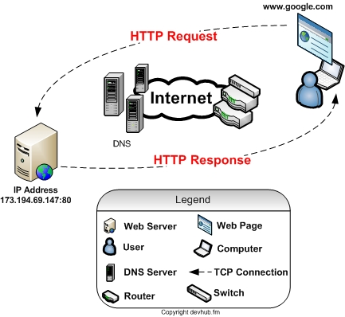
How http works?
HTTP is implemented in two programs: a client program and a server program, executing on different end systems, talk to each other by exchanging HTTP messages.
The HTTP client first initiates a TCP connection with the server. Once the connection is established, the browser and the server processes access TCP through their socket interfaces.

Slide 9
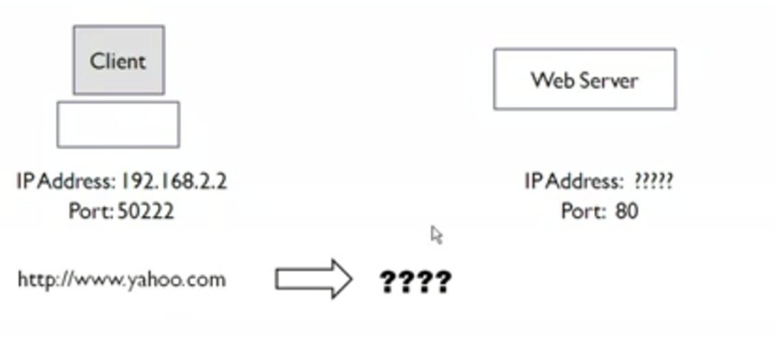
How http works?
Suppose client wants to visit www.yahoo.com

Slide 10
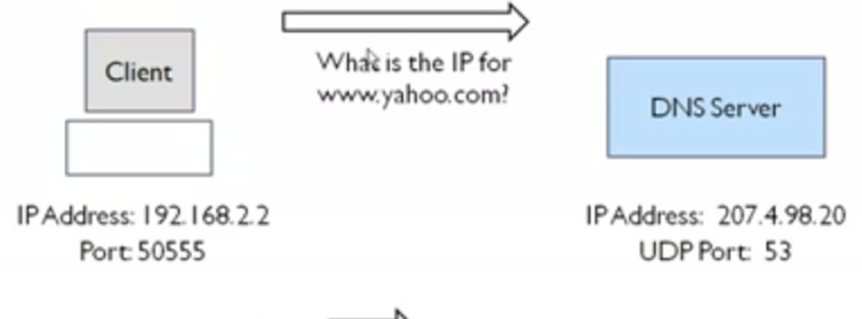
How http works? (cont.)

Slide 11
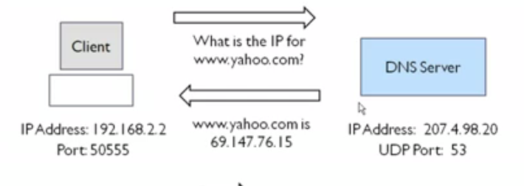
How http works? (cont.)

Slide 12
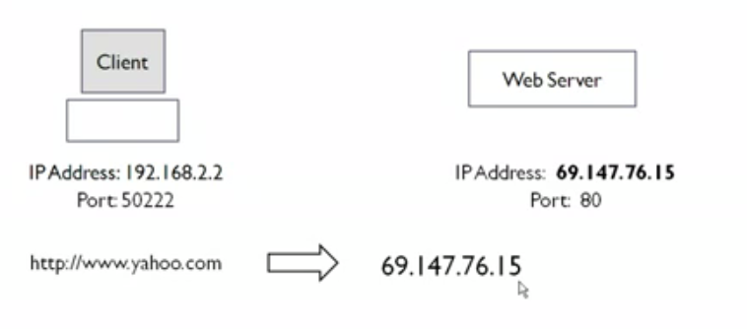
How http works? (cont.)

Slide 13
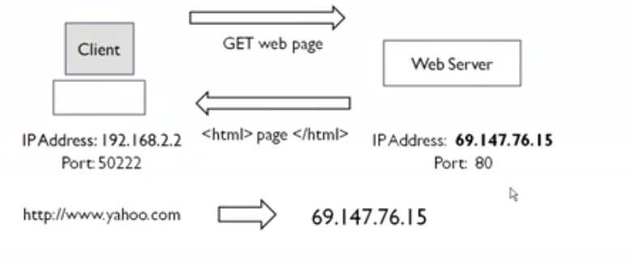
How http works? (cont.)

Slide 14
Persistent and Non-persistent Connections
In non-persistent connection each request/response pair are sent over a separate TCP connection.
In persistent connections all of the requests and their corresponding responses are sent over the same TCP connection.

Slide 15
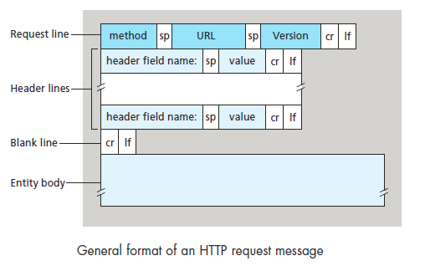
HTTP Request Message
The first line of an HTTP request message is called the request line; the subsequent lines are called the header lines. The request line has three fields: the method field, the URL field, and the HTTP version field. The method field can take on several different values, including GET, POST, HEAD, PUT, and DELETE etc. The great majority of HTTP request messages use the GET method. The GET method is used when the browser requests an object, with the requested object identified in the URL field.

Slide 16
Request methods
GET: Retrieve Document identified in URL
HEAD: Retrieve meta information about document identified in URL
DELETE: Delete specified URL
OPTIONS: Request information about available options
PUT: Store document under specified URL
POST: Give information to server
TRACE: Loopback request message
CONNECT: For use by Proxies

Slide 17
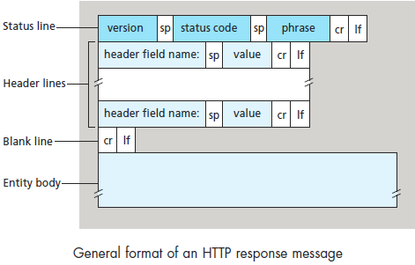
HTTP Response messages
It has three sections: an initial status line, header lines, and then the entity body. The entity body contains the requested object itself. The status line has three fields: the protocol version field, a status code, and a corresponding status message.

Slide 18
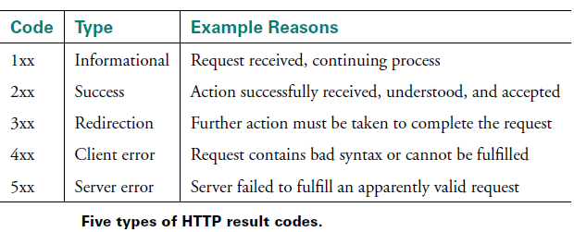
Some common status codes and associated phrases
Some common status codes and associated phrases include:
200 OK: Request succeeded and the information is returned in the response.
301 Moved Permanently: Requested object has been permanently moved; the new URL is specified in Location: header of the response message. The client software will automatically retrieve the new URL.
400 Bad Request: This is a generic error code indicating that the request could not be understood by the server.
404 Not Found: The requested document does not exist on this server.
505 HTTP Version Not Supported: The requested HTTP protocol version is not supported by the server.

