Slide 2

JavaScript

Slide 3
History
JavaScript was first known as LiveScript, but Netscape changed its name to JavaScript, possibly because of the excitement being generated by Java. JavaScript made its first appearance in Netscape 2.0 in 1995 with the name LiveScript. The general-purpose core of the language has been embedded in Netscape, Internet Explorer, and other web browsers.

Slide 4
What is JavaScript?
JavaScript is a dynamic computer programming language. It is lightweight and most commonly used as a part of web pages, whose implementations allow client-side script to interact with the user and make dynamic pages. It is an interpreted programming language with object-oriented capabilities.

Slide 5
Client-side JavaScript
Client-side JavaScript is the most common form of the language. The script should be included in or referenced by an HTML document for the code to be interpreted by the browser.
It means that a web page need not be a static HTML, but can include programs that interact with the user, control the browser, and dynamically create HTML content.
The JavaScript client-side mechanism provides many advantages over traditional CGI server-side scripts. For example, you might use JavaScript to check if the user has entered a valid e-mail address in a form field.
The JavaScript code is executed when the user submits the form, and only if all the entries are valid, they would be submitted to the Web Server.

Slide 6
Client-side JavaScript
JavaScript can be used to trap user-initiated events such as button clicks, link navigation, and other actions that the user initiates explicitly or implicitly.

Slide 7
Advantages of JavaScript
The merits of using JavaScript are −
Less server interaction − We can validate user input before sending the page off to the server. This saves server traffic, which means less load on your server.
Immediate feedback to the visitors − They don't have to wait for a page reload to see if they have forgotten to enter something.
Increased interactivity − We can create interfaces that react when the user hovers over them with a mouse or activates them via the keyboard.
Richer interfaces − We can use JavaScript to include such items as drag-and-drop components and sliders to give a Rich Interface to your site visitors.

Slide 8
Limitations of JavaScript
We cannot treat JavaScript as a full-fledged programming language. It lacks the following important features −
Client-side JavaScript does not allow the reading or writing of files. This has been kept for security reason.
JavaScript cannot be used for networking applications because there is no such support available.
JavaScript doesn't have any multithreading or multiprocessor capabilities.

Slide 9
Where is JavaScript Today?
The ECMAScript Edition 5 standard will be the first update to be released in over four years. JavaScript 2.0 conforms to Edition 5 of the ECMAScript standard, and the difference between the two is extremely minor.
The specification for JavaScript 2.0 can be found on the following site: http://www.ecmascript.org/
Today, Netscape's JavaScript and Microsoft's JScript conform to the ECMAScript standard, although both the languages still support the features that are not a part of the standard.

Slide 10

JavaScript - Syntax
JavaScript can be implemented using JavaScript statements that are placed within the <script>... </script> HTML tags in a web page.
You can place the <script> tags, containing your JavaScript, anywhere within your web page, but it is normally recommended that you should keep it within the <head> tags.
The <script> tag alerts the browser program to start interpreting all the text between these tags as a script. A simple syntax of your JavaScript will appear as follows.

Slide 11

JavaScript - Syntax
The script tag takes two important attributes −
Language − This attribute specifies what scripting language you are using. Typically, its value will be javaScript. Although recent versions of HTML (and XHTML, its successor) have phased out the use of this attribute.
Type − This attribute is what is now recommended to indicate the scripting language in use and its value should be set to "text/javascript".
So your JavaScript segment will look like −

Slide 12
Your First JavaScript Script
Let us take a sample example to print out "Hello World". We added an optional HTML comment that surrounds our JavaScript code. This is to save our code from a browser that does not support JavaScript. The comment ends with a "//-->". Here "//" signifies a comment in JavaScript, so we add that to prevent a browser from reading the end of the HTML comment as a piece of JavaScript code. Next, we call a function document.write which writes a string into our HTML document.
This function can be used to write text, HTML, or both. Take a look at the following code.

Slide 13
Whitespace and Line Breaks
JavaScript ignores spaces, tabs, and newlines that appear in JavaScript programs. You can use spaces, tabs, and newlines freely in your program and you are free to format and indent your programs in a neat and consistent way that makes the code easy to read and understand.

Slide 14


Semicolons are Optional
Simple statements in JavaScript are generally followed by a semicolon character, just as they are in C, C++, and Java. JavaScript, however, allows you to omit this semicolon if each of your statements are placed on a separate line. For example, the following code could be written without semicolons.
But when formatted in a single line as follows, you must use semicolons −
Notes:
Note − It is a good programming practice to use semicolons.

Slide 15
Case Sensitivity
JavaScript is a case-sensitive language. This means that the language keywords, variables, function names, and any other identifiers must always be typed with a consistent capitalization of letters.
So the identifiers Time and TIME will convey different meanings in JavaScript.
Notes:
NOTE − Care should be taken while writing variable and function names in JavaScript.

Slide 16
Comments in JavaScript
JavaScript supports both C-style and C++-style comments, Thus −
Any text between a // and the end of a line is treated as a comment and is ignored by JavaScript.
Any text between the characters /* and */ is treated as a comment. This may span multiple lines.
JavaScript also recognizes the HTML comment opening sequence <!--. JavaScript treats this as a single-line comment, just as it does the // comment.
The HTML comment closing sequence --> is not recognized by JavaScript so it should be written as //-->.

Slide 17
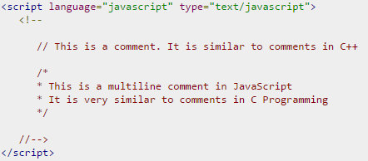
Example
The following example shows how to use comments in JavaScript.

Slide 18
Enabling JavaScript in Browser
All the modern browsers come with built-in support for JavaScript. Frequently, you may need to enable or disable this support manually. This chapter explains the procedure of enabling and disabling JavaScript support in your browsers: Internet Explorer, Firefox, chrome, and Opera.

Slide 19
JavaScript in Internet Explorer
Here are simple steps to turn on or turn off JavaScript in your Internet Explorer −
Follow Tools → Internet Options from the menu.
Select Security tab from the dialog box.
Click the Custom Level button.
Scroll down till you find Scripting option.
Select Enable radio button under Active scripting.
Finally click OK and come out
To disable JavaScript support in your Internet Explorer, you need to select Disable radio button under Active scripting.

Slide 20
JavaScript in Chrome
Here are the steps to turn on or turn off JavaScript in Chrome −
Click the Chrome menu at the top right hand corner of your browser.
Select Settings.
Click Show advanced settings at the end of the page.
Under the Privacy section, click the Content settings button.
In the "Javascript" section, select "Do not allow any site to run JavaScript" or "Allow all sites to run JavaScript (recommended)".

Slide 21
JavaScript in Opera
Here are the steps to turn on or turn off JavaScript in Opera −
Follow Tools → Preferences from the menu.
Select Advanced option from the dialog box.
Select Content from the listed items.
Select Enable JavaScript checkbox.
Finally click OK and come out.
To disable JavaScript support in your Opera, you should not select the Enable JavaScript checkbox.

Slide 22
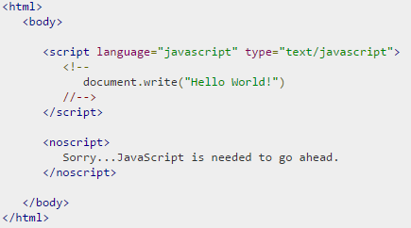
Warning for Non-JavaScript Browsers
If we have to do something important using JavaScript, then you can display a warning message to the user using <noscript> tags.
We can add a noscript block immediately after the script block as follows −
Now, if the user's browser does not support JavaScript or JavaScript is not enabled, then the message from </noscript> will be displayed on the screen.

Slide 23
JavaScript – Placement in HTML File
There is a flexibility given to include JavaScript code anywhere in an HTML document. However the most preferred ways to include JavaScript in an HTML file are as follows −
Script in <head>...</head> section.
Script in <body>...</body> section.
Script in <body>...</body> and <head>...</head> sections.
Script in an external file and then include in <head>...</head> section.
In the following section, we will see how we can place JavaScript in an HTML file in different ways.

Slide 24
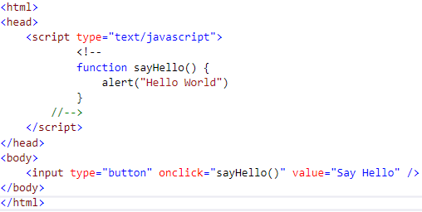
JavaScript in <head>...</head> section
If you want to have a script run on some event, such as when a user clicks somewhere, then you will place that script in the head as follows −
This code will produce the following results −

Slide 25
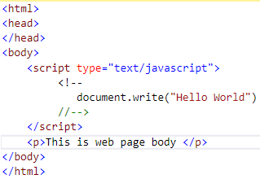

JavaScript in <body>...</body> section
If We need a script to run as the page loads so that the script generates content in the page, then the script goes in the <body> portion of the document. In this case, you would not have any function defined using JavaScript. Take a look at the following code.
This code will produce the following results −

Slide 26
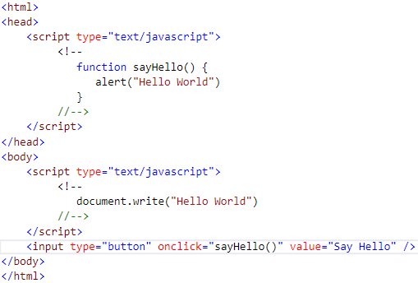
JavaScript in <body> and <head> Sections
We can put your JavaScript code in <head> and <body> section altogether as follows −
This code will produce the following result −

Slide 27
JavaScript in External File
As we begin to work more extensively with JavaScript, we will be likely to find that there are cases where you are reusing identical JavaScript code on multiple pages of a site.
You are not restricted to be maintaining identical code in multiple HTML files. The script tag provides a mechanism to allow you to store JavaScript in an external file and then include it into your HTML files.
Here is an example to show how you can include an external JavaScript file in your HTML code using script tag and its src attribute.

Slide 28
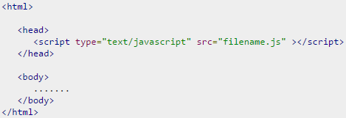

JavaScript in External File
To use JavaScript from an external file source, you need to write all your JavaScript source code in a simple text file with the extension ".js" and then include that file as shown above.
For example, you can keep the following content in filename.js file and then you can use sayHello function in your HTML file after including the filename.js file.

Slide 29
JavaScript Datatypes
One of the most fundamental characteristics of a programming language is the set of data types it supports. These are the type of values that can be represented and manipulated in a programming language.
JavaScript allows you to work with three primitive data types −
Numbers, eg. 123, 120.50 etc.
Strings of text e.g. "This text string" etc.
Boolean e.g. true or false.
JavaScript also defines two trivial data types, null and undefined, each of which defines only a single value. In addition to these primitive data types, JavaScript supports a composite data type known as object. We will cover objects in detail in a separate chapter.
Notes:
JavaScript does not make a distinction between integer values and floating-point values. All numbers in JavaScript are represented as floating-point values. JavaScript represents numbers using the 64-bit floating-point format defined by the IEEE 754 standard.

Slide 30
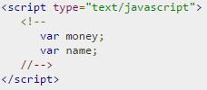

JavaScript Variables
Like many other programming languages, JavaScript has variables. Variables can be thought of as named containers. You can place data into these containers and then refer to the data simply by naming the container.
Before you use a variable in a JavaScript program, you must declare it. Variables are declared with the var keyword as follows.
We can also declare multiple variables with the same var keyword as follows −

Slide 31
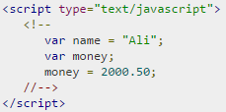
JavaScript Variables
Storing a value in a variable is called variable initialization. You can do variable initialization at the time of variable creation or at a later point in time when you need that variable.
For instance, you might create a variable named money and assign the value 2000.50 to it later. For another variable, you can assign a value at the time of initialization as follows.
JavaScript is untyped language. This means that a JavaScript variable can hold a value of any data type. Unlike many other languages, you don't have to tell JavaScript during variable declaration what type of value the variable will hold. The value type of a variable can change during the execution of a program and JavaScript takes care of it automatically.
Notes:
Use the var keyword only for declaration or initialization, once for the life of any variable name in a document. You should not re-declare same variable twice.

Slide 32
JavaScript Variable Scope
The scope of a variable is the region of your program in which it is defined. JavaScript variables have only two scopes.
Global Variables − A global variable has global scope which means it can be defined anywhere in your JavaScript code.
Local Variables − A local variable will be visible only within a function where it is defined. Function parameters are always local to that function.
Within the body of a function, a local variable takes precedence over a global variable with the same name. If you declare a local variable or function parameter with the same name as a global variable, you effectively hide the global variable. Take a look into the following example.

Slide 33
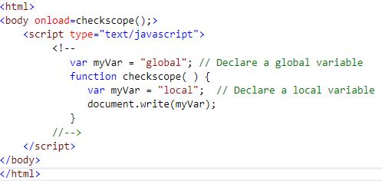

Example
This produces the following result −

Slide 34
JavaScript Variable Names
While naming your variables in JavaScript, keep the following rules in mind.
You should not use any of the JavaScript reserved keywords as a variable name. These keywords are mentioned in the next section. For example, break or boolean variable names are not valid.
JavaScript variable names should not start with a numeral (0-9). They must begin with a letter or an underscore character. For example, 123test is an invalid variable name but _123test is a valid one.
JavaScript variable names are case-sensitive. For example, Name and name are two different variables.

Slide 35
JavaScript Reserved Words
A list of all the reserved words in JavaScript are given in the following table. They cannot be used as JavaScript variables, functions, methods, loop labels, or any object names.
abstract boolean break byte case catch char class const continue debugger default delete do double | else enum export extends false final finally float for function goto if implements import in | instanceof int interface long native new null package private protected public return short static super | switch synchronized this throw throws transient true try typeof var void volatile while with

Slide 36
What is an operator?
Let us take a simple expression 4 + 5 is equal to 9. Here 4 and 5 are called operands and ‘+’ is called the operator. JavaScript supports the following types of operators.
Arithmetic Operators
Comparision Operators
Logical (or Relational) Operators
Assignment Operators
Conditional (or ternary) Operators
Lets have a look on all operators one by one.

Slide 37
Arithmetic Operators
Sr.No | Operator and Description
1 | + (Addition) Adds two operands Ex: A + B will give 30
2 | - (Subtraction) Subtracts the second operand from the first Ex: A - B will give -10
3 | * (Multiplication) Multiply both operands Ex: A * B will give 200
4 | / (Division) Divide the numerator by the denominator Ex: B / A will give 2
5 | % (Modulus) Outputs the remainder of an integer division Ex: B % A will give 0
6 | ++ (Increment) Increases an integer value by one Ex: A++ will give 11
7 | -- (Decrement) Decreases an integer value by one Ex: A-- will give 9
JavaScript supports the following arithmetic operators −
Assume variable A holds 10 and variable B holds 20, then −

Slide 38
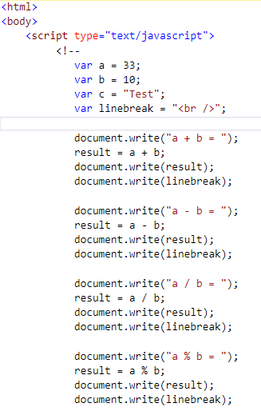
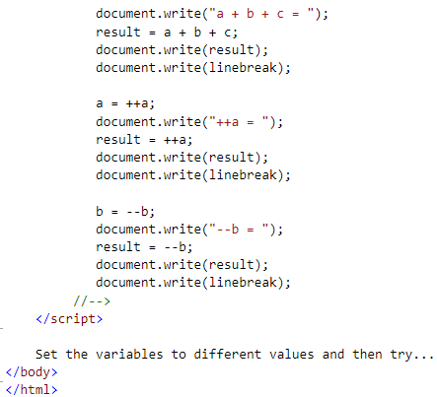
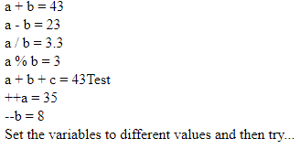
Example
Output
Notes:
Addition operator (+) works for Numeric as well as Strings. e.g. "a" + 10 will give "a10".

Slide 39
Comparison Operators
JavaScript supports the following comparison operators −
Assume variable A holds 10 and variable B holds 20, then −

Slide 40
Comparison Operators
Sr.No | Operator and Description
1 | = = (Equal) Checks if the value of two operands are equal or not, if yes, then the condition becomes true. Ex: (A == B) is not true.
2 | != (Not Equal) Checks if the value of two operands are equal or not, if the values are not equal, then the condition becomes true. Ex: (A != B) is true.
3 | > (Greater than) Checks if the value of the left operand is greater than the value of the right operand, if yes, then the condition becomes true. Ex: (A > B) is not true.
4 | < (Less than) Checks if the value of the left operand is less than the value of the right operand, if yes, then the condition becomes true. Ex: (A < B) is true.
5 | >= (Greater than or Equal to) Checks if the value of the left operand is greater than or equal to the value of the right operand, if yes, then the condition becomes true. Ex: (A >= B) is not true.
6 | <= (Less than or Equal to) Checks if the value of the left operand is less than or equal to the value of the right operand, if yes, then the condition becomes true. Ex: (A <= B) is true.

Slide 41
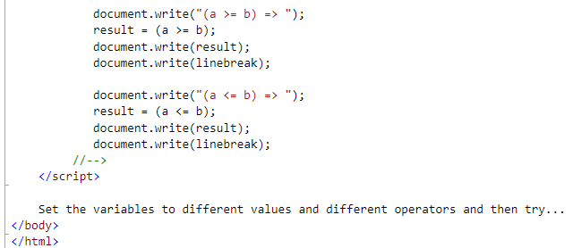
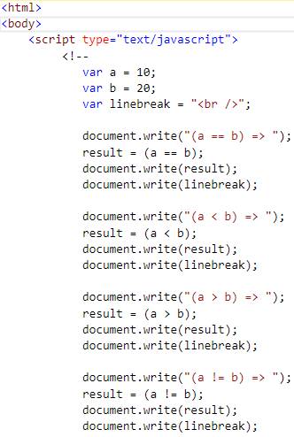
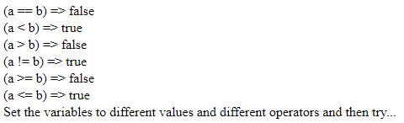
Example
Output

Slide 42
Logical Operators
JavaScript supports the following logical operators −
Assume variable A holds 10 and variable B holds 20, then −
Sr.No | Operator and Description
1 | && (Logical AND) If both the operands are non-zero, then the condition becomes true. Ex: (A && B) is true.
2 | || (Logical OR) If any of the two operands are non-zero, then the condition becomes true. Ex: (A || B) is true.
3 | ! (Logical NOT) Reverses the logical state of its operand. If a condition is true, then the Logical NOT operator will make it false. Ex: ! (A && B) is false.

Slide 43
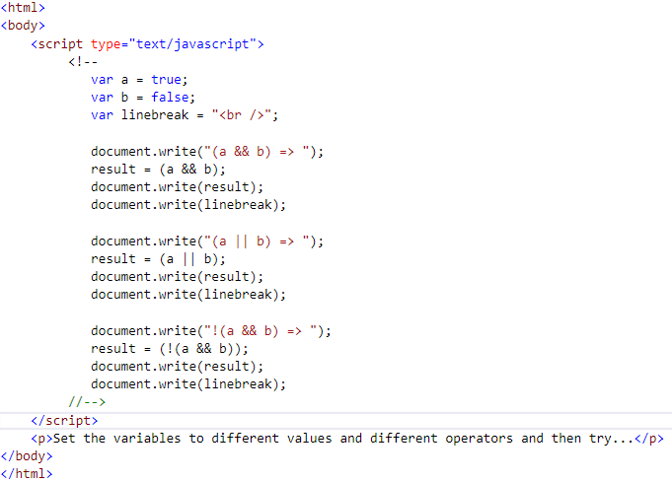
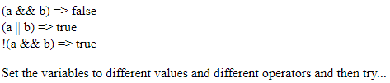
Example
Try the following code to learn how to implement Logical Operators in JavaScript.
Output

Slide 44
Bitwise Operators
JavaScript supports the following bitwise operators −
Assume variable A holds 2 and variable B holds 3, then −
Sr.No | Operator and Description
1 | & (Bitwise AND) It performs a Boolean AND operation on each bit of its integer arguments. Ex: (A & B) is 2.
2 | | (BitWise OR) It performs a Boolean OR operation on each bit of its integer arguments. Ex: (A | B) is 3.
3 | ^ (Bitwise XOR) It performs a Boolean exclusive OR operation on each bit of its integer arguments. Exclusive OR means that either operand one is true or operand two is true, but not both. Ex: (A ^ B) is 1.
4 | ~ (Bitwise Not) It is a unary operator and operates by reversing all the bits in the operand. Ex: (~B) is -4.

Slide 45
Bitwise Operators
5 | << (Left Shift) It moves all the bits in its first operand to the left by the number of places specified in the second operand. New bits are filled with zeros. Shifting a value left by one position is equivalent to multiplying it by 2, shifting two positions is equivalent to multiplying by 4, and so on. Ex: (A << 1) is 4.
6 | >> (Right Shift) Binary Right Shift Operator. The left operand’s value is moved right by the number of bits specified by the right operand. Ex: (A >> 1) is 1.
7 | >>> (Right shift with Zero) This operator is just like the >> operator, except that the bits shifted in on the left are always zero. Ex: (A >>> 1) is 1.

Slide 46
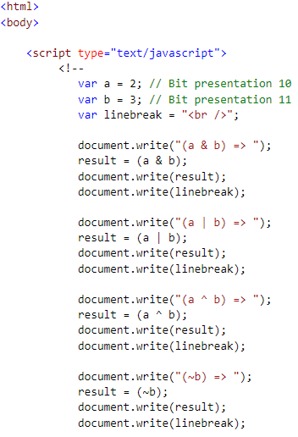
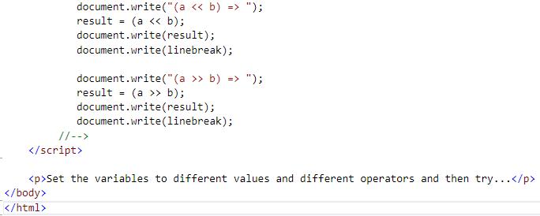
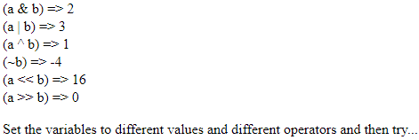
Example
Try the following code to implement Bitwise operator in JavaScript.
Output

Slide 47
Assignment Operators
JavaScript supports the following assignment operators −
Sr.No | Operator and Description
1 | = (Simple Assignment ) Assigns values from the right side operand to the left side operand Ex: C = A + B will assign the value of A + B into C
2 | += (Add and Assignment) It adds the right operand to the left operand and assigns the result to the left operand. Ex: C += A is equivalent to C = C + A
3 | −= (Subtract and Assignment) It subtracts the right operand from the left operand and assigns the result to the left operand. Ex: C -= A is equivalent to C = C - A
4 | *= (Multiply and Assignment) It multiplies the right operand with the left operand and assigns the result to the left operand. Ex: C *= A is equivalent to C = C * A
5 | /= (Divide and Assignment) It divides the left operand with the right operand and assigns the result to the left operand. Ex: C /= A is equivalent to C = C / A
6 | %= (Modules and Assignment) It takes modulus using two operands and assigns the result to the left operand. Ex: C %= A is equivalent to C = C % A
Notes:
Same logic applies to Bitwise operators so they will become like <<=, >>=, >>=, &=, |= and ^=.

Slide 48
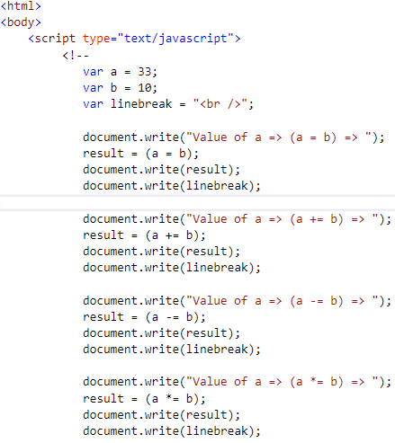
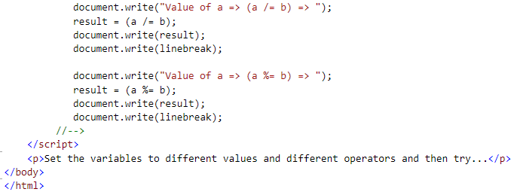
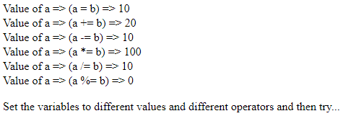
Example
Try the following code to implement assignment operator in JavaScript.
Output

Slide 49
Miscellaneous Operator
We will discuss two operators here that are quite useful in JavaScript: the conditional operator (? :) and the typeof operator.
Conditional Operator (? :)
The conditional operator first evaluates an expression for a true or false value and then executes one of the two given statements depending upon the result of the evaluation.
Sr.No | Operator and Description
1 | ? : (Conditional ) If Condition is true? Then value X : Otherwise value Y

Slide 50
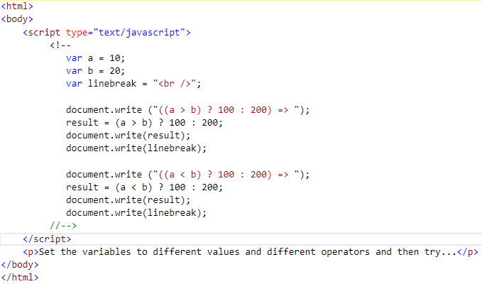

Example
Try the following code to understand how the Conditional Operator works in JavaScript.
Output

Slide 51
typeof Operator
The typeof operator is a unary operator that is placed before its single operand, which can be of any type. Its value is a string indicating the data type of the operand.
The typeof operator evaluates to "number", "string", or "boolean" if its operand is a number, string, or boolean value and returns true or false based on the evaluation.
Here is a list of the return values for the typeof Operator.
Type | String Returned by typeof
Number | "number"
String | "string"
Boolean | "boolean"
Object | "object"
Function | "function"
Undefined | "undefined"
Null | "object"

Slide 52
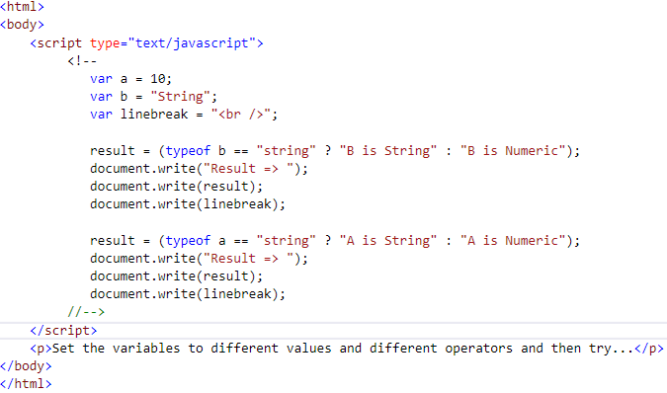

Example
The following code shows how to implement typeof operator.
Output

Slide 53
JavaScript - if...else Statement
While writing a program, there may be a situation when you need to adopt one out of a given set of paths. In such cases, you need to use conditional statements that allow your program to make correct decisions and perform right actions.
JavaScript supports conditional statements which are used to perform different actions based on different conditions. Here we will explain the if..else statement.

Slide 54
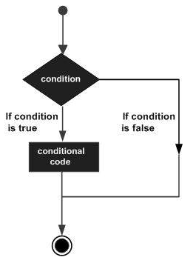
Flow Chart of if-else
The following flow chart shows how the if-else statement works.
JavaScript supports the following forms of if..else statement −
if statement
if...else statement
if...else if... statement.

Slide 55

if statement
The if statement is the fundamental control statement that allows JavaScript to make decisions and execute statements conditionally.
Syntax
The syntax for a basic if statement is as follows −
Here a JavaScript expression is evaluated. If the resulting value is true, the given statement(s) are executed. If the expression is false, then no statement would be not executed. Most of the times, you will use comparison operators while making decisions.

Slide 56
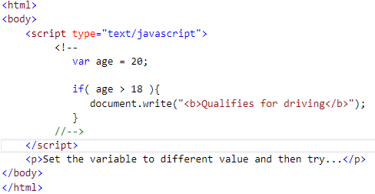

Example
Try the following example to understand how the if statement works.
Output

Slide 57
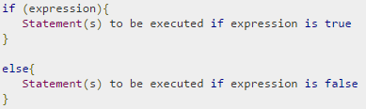
if...else statement:
The 'if...else' statement is the next form of control statement that allows JavaScript to execute statements in a more controlled way.
Syntax
Here JavaScript expression is evaluated. If the resulting value is true, the given statement(s) in the ‘if’ block, are executed. If the expression is false, then the given statement(s) in the else block are executed.

Slide 58
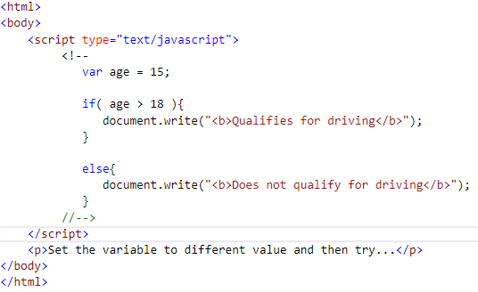

Example
Try the following code to learn how to implement an if-else statement in JavaScript.
Output

Slide 59
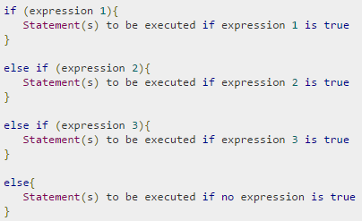
if...else if... statement
The if...else if... statement is an advanced form of if…else that allows JavaScript to make a correct decision out of several conditions.
Syntax
The syntax of an if-else-if statement is as follows −
There is nothing special about this code. It is just a series of if statements, where each if is a part of the else clause of the previous statement. Statement(s) are executed based on the true condition, if none of the conditions is true, then the else block is executed.

Slide 60
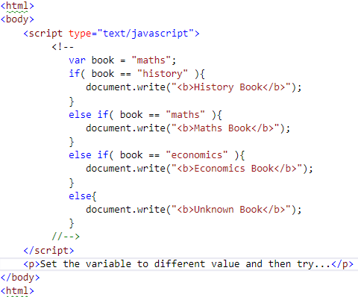

Example
Try the following code to learn how to implement an if-else-if statement in JavaScript.
Output

Slide 61
Switch Case
We can use multiple if...else…if statements, as in the previous chapter, to perform a multiway branch. However, this is not always the best solution, especially when all of the branches depend on the value of a single variable.
Starting with JavaScript 1.2, we can use a switch statement which handles exactly this situation, and it does so more efficiently than repeated if...else if statements.

Slide 62
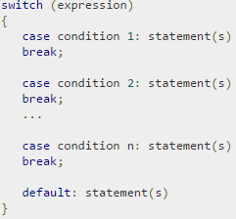
Syntax – Switch Case
The objective of a switch statement is to give an expression to evaluate and several different statements to execute based on the value of the expression. The interpreter checks each case against the value of the expression until a match is found. If nothing matches, a default condition will be used.
The break statements indicate the end of a particular case. If they were omitted, the interpreter would continue executing each statement in each of the following cases.
We will explain break statement in Loop Control chapter.

Slide 63
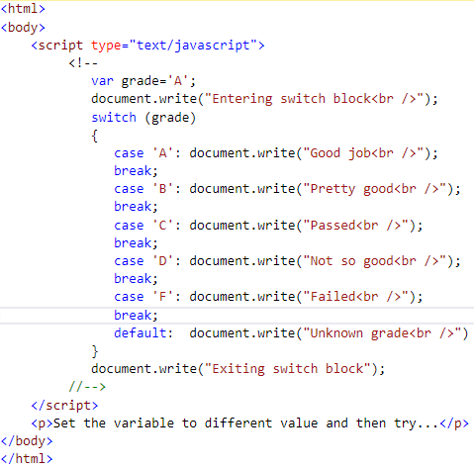

Example
Output

Slide 64
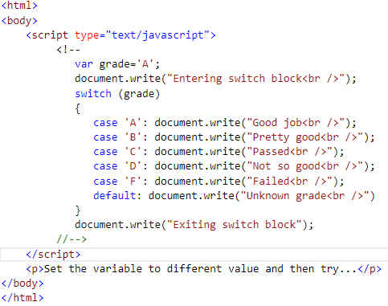
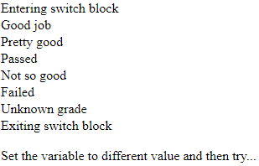
Example Contd
Break statements play a major role in switch-case statements. Try the following code that uses switch-case statement without any break statement.
Output

Slide 65
While Loops
While writing a program, you may encounter a situation where you need to perform an action over and over again. In such situations, you would need to write loop statements to reduce the number of lines.
JavaScript supports all the necessary loops to ease down the pressure of programming.
The while Loop
The most basic loop in JavaScript is the while loop which would be discussed in this chapter. The purpose of a while loop is to execute a statement or code block repeatedly as long as an expression is true. Once the expression becomes false, the loop terminates.

Slide 66
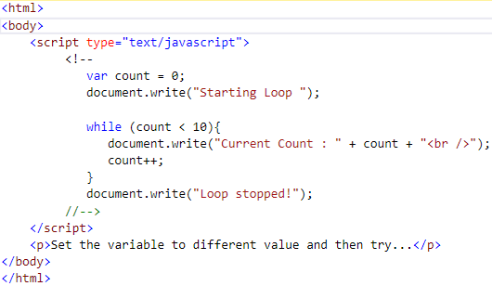
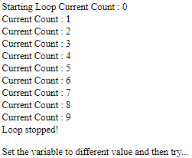
Syntax – While Loop
Try the following example to implement while loop.
Output

Slide 67

The do...while Loop
The do...while loop is similar to the while loop except that the condition check happens at the end of the loop. This means that the loop will always be executed at least once, even if the condition is false.
Flow Chart
The flow chart of a do-while loop would be as follows −
Syntax
The syntax for do-while loop in JavaScript is as follows −
Notes:
Don’t miss the semicolon used at the end of the do...while loop.

Slide 68
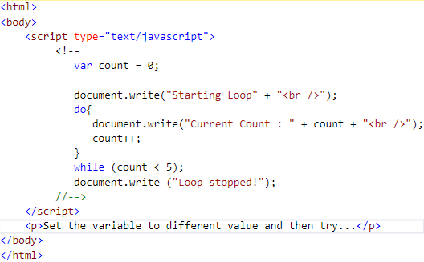
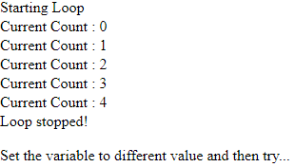
Example
Try the following example to learn how to implement a do-while loop in JavaScript.
Output

Slide 69
For Loop
The 'for' loop is the most compact form of looping. It includes the following three important parts −
The loop initialization where we initialize our counter to a starting value. The initialization statement is executed before the loop begins.
The test statement which will test if a given condition is true or not. If the condition is true, then the code given inside the loop will be executed, otherwise the control will come out of the loop.
The iteration statement where you can increase or decrease your counter.
You can put all the three parts in a single line separated by semicolons.

Slide 70
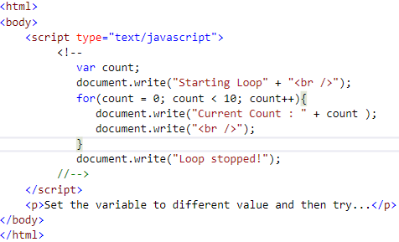
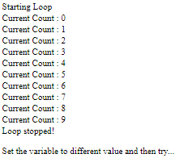
Example
Try the following example to learn how a for loop works in JavaScript.
Output

Slide 71

for...in loop
The for...in loop is used to loop through an object's properties. As we have not discussed Objects yet, you may not feel comfortable with this loop. But once you understand how objects behave in JavaScript, you will find this loop very useful.
Syntax
In each iteration, one property from object is assigned to variablename and this loop continues till all the properties of the object are exhausted.

Slide 72
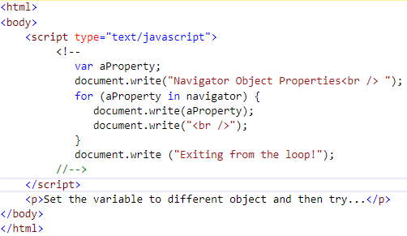
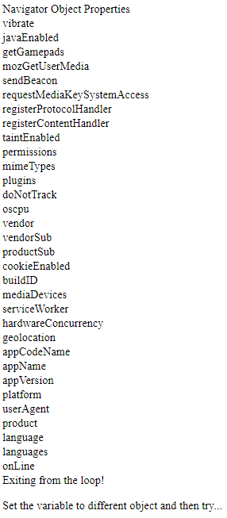
Example
Try the following example to implement ‘for-in’ loop. It prints the web browser’s Navigator object.
Output

Slide 73
Loop Control
JavaScript provides full control to handle loops and switch statements. There may be a situation when you need to come out of a loop without reaching its bottom. There may also be a situation when you want to skip a part of your code block and start the next iteration of the loop.
To handle all such situations, JavaScript provides break and continue statements. These statements are used to immediately come out of any loop or to start the next iteration of any loop respectively.

Slide 74
The break Statement
The break statement, which was briefly introduced with the switch statement, is used to exit a loop early, breaking out of the enclosing curly braces.

Slide 75
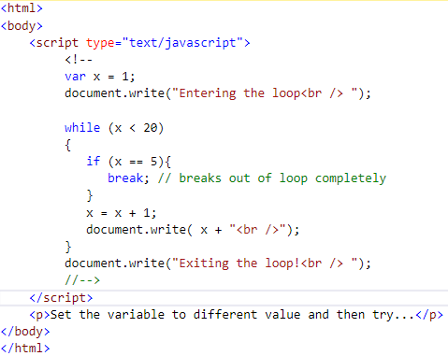
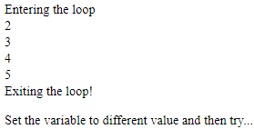
Example
The following example illustrates the use of a break statement with a while loop. Notice how the loop breaks out early once x reaches 5 and reaches to document.write (..) statement just below to the closing curly brace −
Output
Notes:
We already have seen the usage of break statement inside a switch statement.

Slide 76
The continue Statement
The continue statement tells the interpreter to immediately start the next iteration of the loop and skip the remaining code block. When a continue statement is encountered, the program flow moves to the loop check expression immediately and if the condition remains true, then it starts the next iteration, otherwise the control comes out of the loop.

Slide 77
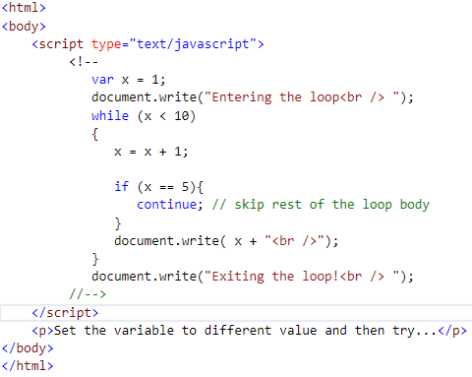
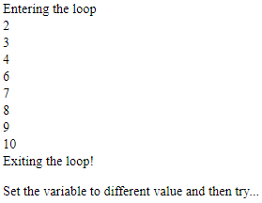
Example
This example illustrates the use of a continue statement with a while loop. Notice how the continue statement is used to skip printing when the index held in variable x reaches 5 −
Output

Slide 78
Using Labels to Control the Flow
Starting from JavaScript 1.2, a label can be used with break and continue to control the flow more precisely. A label is simply an identifier followed by a colon (:) that is applied to a statement or a block of code. We will see two different examples to understand how to use labels with break and continue.
Try the following two examples for a better understanding of Labels.
Notes:
Line breaks are not allowed between the ‘continue’ or ‘break’ statement and its label name. Also, there should not be any other statement in between a label name and associated loop.

Slide 79
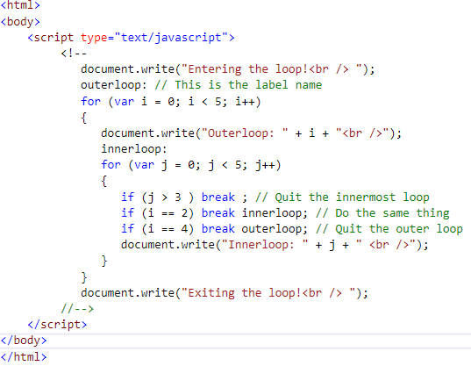
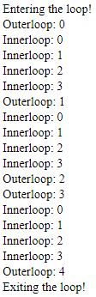
Example
The following example shows how to implement Label with a break statement.
Output

Slide 80
Functions
A function is a group of reusable code which can be called anywhere in your program. This eliminates the need of writing the same code again and again. It helps programmers in writing modular codes. Functions allow a programmer to divide a big program into a number of small and manageable functions.
Like any other advanced programming language, JavaScript also supports all the features necessary to write modular code using functions. You must have seen functions like alert() and write() in the earlier chapters. We were using these functions again and again, but they had been written in core JavaScript only once.
JavaScript allows us to write our own functions as well. This section explains how to write your own functions in JavaScript.

Slide 81
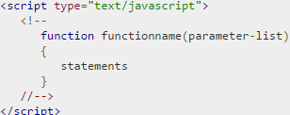
Function Definition
Before we use a function, we need to define it. The most common way to define a function in JavaScript is by using the function keyword, followed by a unique function name, a list of parameters (that might be empty), and a statement block surrounded by curly braces.
Syntax
The basic syntax is shown here.

Slide 82

Example
Try the following example. It defines a function called sayHello that takes no parameters −

Slide 83


Calling a Function
To invoke a function somewhere later in the script, you would simply need to write the name of that function as shown in the following code.
Output

Slide 84
Function Parameters
Till now, we have seen functions without parameters. But there is a facility to pass different parameters while calling a function. These passed parameters can be captured inside the function and any manipulation can be done over those parameters. A function can take multiple parameters separated by comma.

Slide 85


Example
Try the following example. We have modified our sayHello function here. Now it takes two parameters.
Output

Slide 86
The return Statement
A JavaScript function can have an optional return statement. This is required if you want to return a value from a function. This statement should be the last statement in a function.
For example, you can pass two numbers in a function and then you can expect the function to return their multiplication in your calling program.

Slide 87


Example
Try the following example. It defines a function that takes two parameters and concatenates them before returning the resultant in the calling program.
Output

Slide 88
There is a lot to learn about JavaScript functions, however we have covered the most important concepts.
JavaScript Nested Functions
JavaScript Function( ) Constructor
JavaScript Function Literals

Slide 89
Nested Functions
Prior to JavaScript 1.2, function definition was allowed only in top level global code, but JavaScript 1.2 allows function definitions to be nested within other functions as well. Still there is a restriction that function definitions may not appear within loops or conditionals. These restrictions on function definitions apply only to function declarations with the function statement.
As we'll discuss later in the next chapter, function literals (another feature introduced in JavaScript 1.2) may appear within any JavaScript expression, which means that they can appear within if and other statements.

Slide 90


Example
Try the following example to learn how to implement nested functions.
Output

Slide 91

The Function() Constructor
The function statement is not the only way to define a new function; you can define your function dynamically using Function() constructor along with the new operator.
Syntax
Following is the syntax to create a function using Function( ) constructor along with the new operator.
The Function() constructor expects any number of string arguments. The last argument is the body of the function – it can contain arbitrary JavaScript statements, separated from each other by semicolons.
Notes:
Constructor is a terminology from Object Oriented Programming. You may not feel comfortable for the first time, which is OK.

Slide 92


The Function() Constructor Contd…
Notice that the Function() constructor is not passed any argument that specifies a name for the function it creates. The unnamed functions created with the Function() constructor are called anonymous functions.
Example
Output

Slide 93


Function Literals
JavaScript 1.2 introduces the concept of function literals which is another new way of defining functions. A function literal is an expression that defines an unnamed function.
SyntaxThe syntax for a function literal is much like a function statement, except that it is used as an expression rather than a statement and no function name is required.
Syntactically, you can specify a function name while creating a literal function as follows.
Notes:
But this name does not have any significance, so it is not worthwhile.

Slide 94


Example
Output

Slide 95
What is Events
JavaScript's interaction with HTML is handled through events that occur when the user or the browser manipulates a page.
When the page loads, it is called an event. When the user clicks a button, that click too is an event. Other examples include events like pressing any key, closing a window, resizing a window, etc.
Developers can use these events to execute JavaScript coded responses, which cause buttons to close windows, messages to be displayed to users, data to be validated, and virtually any other type of response imaginable.
Events are a part of the Document Object Model (DOM) Level 3 and every HTML element contains a set of events which can trigger JavaScript Code.

Slide 96


onclick Event Type
This is the most frequently used event type which occurs when a user clicks the left button of his mouse. You can put your validation, warning etc., against this event type.
Output

Slide 97

onsubmit Event type
onsubmit is an event that occurs when you try to submit a form. You can put your form validation against this event type.
Example
The following example shows how to use onsubmit. Here we are calling a validate() function before submitting a form data to the webserver. If validate() function returns true, the form will be submitted, otherwise it will not submit the data.
Output

Slide 98


onmouseover and onmouseout
These two event types will help you create nice effects with images or even with text as well. The onmouseover event triggers when you bring your mouse over any element and the onmouseout triggers when you move your mouse out from that element. Try the following example.
Output

Slide 99
HTML5 Standard Events
The standard HTML 5 events are listed here for your reference. Here script indicates a Javascript function to be executed against that event.
Attribute | Value | Description
Offline | script | Triggers when the document goes offline
Onabort | script | Triggers on an abort event
onafterprint | script | Triggers after the document is printed
onbeforeonload | script | Triggers before the document loads
onbeforeprint | script | Triggers before the document is printed
onblur | script | Triggers when the window loses focus
oncanplay | script | Triggers when media can start play, but might has to stop for buffering
oncanplaythrough | script | Triggers when media can be played to the end, without stopping for buffering

Slide 100
HTML5 Standard Events
onchange | script | Triggers when an element changes
onclick | script | Triggers on a mouse click
oncontextmenu | script | Triggers when a context menu is triggered
ondblclick | script | Triggers on a mouse double-click
ondrag | script | Triggers when an element is dragged
ondragend | script | Triggers at the end of a drag operation
ondragenter | script | Triggers when an element has been dragged to a valid drop target
ondragleave | script | Triggers when an element is being dragged over a valid drop target
ondragover | script | Triggers at the start of a drag operation
ondragstart | script | Triggers at the start of a drag operation

Slide 101
HTML5 Standard Events
ondrop | script | Triggers when dragged element is being dropped
ondurationchange | script | Triggers when the length of the media is changed
onemptied | script | Triggers when a media resource element suddenly becomes empty.
onended | script | Triggers when media has reach the end
onerror | script | Triggers when an error occur
onfocus | script | Triggers when the window gets focus
onformchange | script | Triggers when a form changes
onforminput | script | Triggers when a form gets user input
onhaschange | script | Triggers when the document has change

Slide 102
HTML5 Standard Events
oninput | script | Triggers when an element gets user input
oninvalid | script | Triggers when an element is invalid
onkeydown | script | Triggers when a key is pressed
onkeypress | script | Triggers when a key is pressed and released
onkeyup | script | Triggers when a key is released
onload | script | Triggers when the document loads
onloadeddata | script | Triggers when media data is loaded
onloadedmetadata | script | Triggers when the duration and other media data of a media element is loaded
onloadstart | script | Triggers when the browser starts to load the media data
onmessage | script | Triggers when the message is triggered

Slide 103
HTML5 Standard Events
onmousedown | script | Triggers when a mouse button is pressed
onmousemove | script | Triggers when the mouse pointer moves
onmouseout | script | Triggers when the mouse pointer moves out of an element
onmouseover | script | Triggers when the mouse pointer moves over an element
onmouseup | script | Triggers when a mouse button is released
onmousewheel | script | Triggers when the mouse wheel is being rotated
onoffline | script | Triggers when the document goes offline
onoine | script | Triggers when the document comes online
ononline | script | Triggers when the document comes online
onpagehide | script | Triggers when the window is hidden

Slide 104
HTML5 Standard Events
onpageshow | script | Triggers when the window becomes visible
onpause | script | Triggers when media data is paused
onplay | script | Triggers when media data is going to start playing
onplaying | script | Triggers when media data has start playing
onpopstate | script | Triggers when the window's history changes
onprogress | script | Triggers when the browser is fetching the media data
onratechange | script | Triggers when the media data's playing rate has changed
onreadystatechange | script | Triggers when the ready-state changes

Slide 105
HTML5 Standard Events
onredo | script | Triggers when the document performs a redo
onresize | script | Triggers when the window is resized
onscroll | script | Triggers when an element's scrollbar is being scrolled
onseeked | script | Triggers when a media element's seeking attribute is no longer true, and the seeking has ended
onseeking | script | Triggers when a media element's seeking attribute is true, and the seeking has begun
onselect | script | Triggers when an element is selected
onstalled | script | Triggers when there is an error in fetching media data
onstorage | script | Triggers when a document loads
onsubmit | script | Triggers when a form is submitted
onsuspend | script | Triggers when the browser has been fetching media data, but stopped before the entire media file was fetched

Slide 106
HTML5 Standard Events
ontimeupdate | script | Triggers when media changes its playing position
onundo | script | Triggers when a document performs an undo
onunload | script | Triggers when the user leaves the document
onvolumechange | script | Triggers when media changes the volume, also when volume is set to "mute"
onwaiting | script | Triggers when media has stopped playing, but is expected to resume

Slide 107
What are Cookies ?
Web Browsers and Servers use HTTP protocol to communicate and HTTP is a stateless protocol. But for a commercial website, it is required to maintain session information among different pages. For example, one user registration ends after completing many pages. But how to maintain users' session information across all the web pages.
In many situations, using cookies is the most efficient method of remembering and tracking preferences, purchases, commissions, and other information required for better visitor experience or site statistics.

Slide 108
How It Works ?
Your server sends some data to the visitor's browser in the form of a cookie. The browser may accept the cookie. If it does, it is stored as a plain text record on the visitor's hard drive. Now, when the visitor arrives at another page on your site, the browser sends the same cookie to the server for retrieval. Once retrieved, your server knows/remembers what was stored earlier.
Cookies are a plain text data record of 5 variable-length fields −
Expires − The date the cookie will expire. If this is blank, the cookie will expire when the visitor quits the browser.
Domain − The domain name of your site.
Path − The path to the directory or web page that set the cookie. This may be blank if you want to retrieve the cookie from any directory or page.

Slide 109
How It Works ?
Secure − If this field contains the word "secure", then the cookie may only be retrieved with a secure server. If this field is blank, no such restriction exists.
Name=Value − Cookies are set and retrieved in the form of key-value pairs
Cookies were originally designed for CGI programming. The data contained in a cookie is automatically transmitted between the web browser and the web server, so CGI scripts on the server can read and write cookie values that are stored on the client.
JavaScript can also manipulate cookies using the cookie property of the Document object. JavaScript can read, create, modify, and delete the cookies that apply to the current web page.

Slide 110
Storing Cookies
The simplest way to create a cookie is to assign a string value to the document.cookie object, which looks like this.
Here the expires attribute is optional. If you provide this attribute with a valid date or time, then the cookie will expire on a given date or time and thereafter, the cookies' value will not be accessible.
Note − Cookie values may not include semicolons, commas, or whitespace. For this reason, you may want to use the JavaScript escape() function to encode the value before storing it in the cookie. If you do this, you will also have to use the corresponding unescape() function when you read the cookie value.

Slide 111


Example
Output
Notes:
Now your machine has a cookie called name. You can set multiple cookies using multiple key=value pairs separated by comma.

Slide 112
Reading Cookies
Reading a cookie is just as simple as writing one, because the value of the document.cookie object is the cookie. So you can use this string whenever you want to access the cookie. The document.cookie string will keep a list of name=value pairs separated by semicolons, where name is the name of a cookie and value is its string value.
We can use strings' split() function to break a string into key and values as follows −

Slide 113


Example
Output
Notes:
Note :Here length is a method of Array class which returns the length of an array. We will discuss Arrays in a separate chapter. By that time, please try to digest it.
Note: There may be some other cookies already set on your machine. The above code will display all the cookies set on your machine.

Slide 114

Setting Cookies Expiry Date
We can extend the life of a cookie beyond the current browser session by setting an expiration date and saving the expiry date within the cookie. This can be done by setting the ‘expires’ attribute to a date and time.
Output

Slide 115

Deleting a Cookie
Sometimes you will want to delete a cookie so that subsequent attempts to read the cookie return nothing. To do this, you just need to set the expiry date to a time in the past.
Example
Output

Slide 116
What is Page Redirection
You might have encountered a situation where you clicked a URL to reach a page X but internally you were directed to another page Y. It happens due to page redirection. This concept is different from JavaScript Page Refresh.
There could be various reasons why you would like to redirect a user from the original page. We are listing down a few of the reasons −
You did not like the name of your domain and you are moving to a new one. In such a scenario, you may want to direct all your visitors to the new site. Here you can maintain your old domain but put a single page with a page redirection such that all your old domain visitors can come to your new domain.
You have built-up various pages based on browser versions or their names or may be based on different countries, then instead of using your server-side page redirection, you can use client-side page redirection to land your users on the appropriate page.
.

Slide 117
What is Page Redirection
The Search Engines may have already indexed your pages. But while moving to another domain, you would not like to lose your visitors coming through search engines. So you can use client-side page redirection. But keep in mind this should not be done to fool the search engine, it could lead your site to get banned

Slide 118


How Page Re-direction Works ?
The implementations of Page-Redirection are as follows.
Example 1
It is quite simple to do a page redirect using JavaScript at client side. To redirect your site visitors to a new page, you just need to add a line in your head section as follows.
Output

Slide 119

How Page Re-direction Works ?
Example 2
You can show an appropriate message to your site visitors before redirecting them to a new page. This would need a bit time delay to load a new page. The following example shows how to implement the same. Here setTimeout() is a built-in JavaScript function which can be used to execute another function after a given time interval.
Output

Slide 120

How Page Re-direction Works ?
Example 3
The following example shows how to redirect your site visitors onto a different page based on their browsers.

Slide 121
Dialog Boxes
JavaScript supports three important types of dialog boxes. These dialog boxes can be used to raise and alert, or to get confirmation on any input or to have a kind of input from the users. Here we will discuss each dialog box one by one.

Slide 122
Alert Dialog Box
An alert dialog box is mostly used to give a warning message to the users. For example, if one input field requires to enter some text but the user does not provide any input, then as a part of validation, you can use an alert box to give a warning message.
Nonetheless, an alert box can still be used for friendlier messages. Alert box gives only one button "OK" to select and proceed.

Slide 123


Example
Output

Slide 124
Confirmation Dialog Box
A confirmation dialog box is mostly used to take user's consent on any option. It displays a dialog box with two buttons: Cancel.
If the user clicks on the OK button, the window method confirm() will return true. If the user clicks on the Cancel button, then confirm() returns false. You can use a confirmation dialog box as follows.

Slide 125



Example

Slide 126
Prompt Dialog Box
he prompt dialog box is very useful when you want to pop-up a text box to get user input. Thus, it enables you to interact with the user. The user needs to fill in the field and then click OK.
This dialog box is displayed using a method called prompt() which takes two parameters: (i) a label which you want to display in the text box and (ii) a default string to display in the text box.
This dialog box has two buttons: OK and Cancel. If the user clicks the OK button, the window method prompt() will return the entered value from the text box. If the user clicks the Cancel button, the window method prompt() returns null.

Slide 127



Example
Output

Slide 128

Void Keyword
void is an important keyword in JavaScript which can be used as a unary operator that appears before its single operand, which may be of any type. This operator specifies an expression to be evaluated without returning a value.
Syntax
The syntax of void can be either of the following two −

Slide 129



Example 1
The most common use of this operator is in a client-side javascript: URL, where it allows you to evaluate an expression for its side-effects without the browser displaying the value of the evaluated expression.
Here the expression alert ('Warning!!!') is evaluated but it is not loaded back into the current document −
Output

Slide 130


Example 2
Take a look at the following example. The following link does nothing because the expression "0" has no effect in JavaScript. Here the expression "0" is evaluated, but it is not loaded back into the current document.
Output

Slide 131


Example 3
Another use of void is to purposely generate the undefined value as follows.
Output

Slide 132
Page Printing
Many times you would like to place a button on your webpage to print the content of that web page via an actual printer. JavaScript helps you to implement this functionality using the print function of window object.
The JavaScript print function window.print() prints the current web page when executed. You can call this function directly using the onclick event as shown in the following example.

Slide 133

Example
Output
Although it serves the purpose of getting a printout, it is not a recommended way. A printer
friendly page is really just a page with text, no images, graphics, or advertising.

Slide 134
Page Printing Contd
You can make a page printer friendly in the following ways −
Make a copy of the page and leave out unwanted text and graphics, then link to that printer friendly page from the original.
If you do not want to keep an extra copy of a page, then you can mark your printable text using proper comments like <!-- PRINT STARTS HERE -->..... <!-- PRINT ENDS HERE --> and then you can use PERL or any other script in the background to purge printable text and display for final printing.

Slide 135
How to Print a Page
If you don’t find the above facilities on a web page, then you can use the browser's standard toolbar to get print the web page. Follow the link as follows.

Slide 136
JavaScript - Objects
JavaScript is an Object Oriented Programming (OOP) language. A programming language can be called object-oriented if it provides four basic capabilities to developers −
Encapsulation − the capability to store related information, whether data or methods, together in an object.
Aggregation − the capability to store one object inside another object.
Inheritance − the capability of a class to rely upon another class (or number of classes) for some of its properties and methods.
Polymorphism − the capability to write one function or method that works in a variety of different ways.
Objects are composed of attributes. If an attribute contains a function, it is considered to be a method of the object, otherwise the attribute is considered a property.

Slide 137
Object Properties
Object properties can be any of the three primitive data types, or any of the abstract data types, such as another object. Object properties are usually variables that are used internally in the object's methods, but can also be globally visible variables that are used throughout the page.
The syntax for adding a property to an object is −
For example − The following code gets the document title using the "title" property of the document object.

Slide 138
Object Methods
Methods are the functions that let the object do something or let something be done to it. There is a small difference between a function and a method – at a function is a standalone unit of statements and a method is attached to an object and can be referenced by the this keyword.
Methods are useful for everything from displaying the contents of the object to the screen to performing complex mathematical operations on a group of local properties and parameters.
For example − Following is a simple example to show how to use the write() method of document object to write any content on the document.

Slide 139

User-Defined Objects
All user-defined objects and built-in objects are descendants of an object called Object.
The new Operator
The new operator is used to create an instance of an object. To create an object, the new operator is followed by the constructor method.
In the following example, the constructor methods are Object(), Array(), and Date(). These constructors are built-in JavaScript functions.

Slide 140
The Object() Constructor
A constructor is a function that creates and initializes an object. JavaScript provides a special constructor function called Object() to build the object. The return value of the Object() constructor is assigned to a variable.
The variable contains a reference to the new object. The properties assigned to the object are not variables and are not defined with the var keyword.

Slide 141


Example 1
Let demonstrates how to create an Object.
Output

Slide 142


Example 2
This example demonstrates how to create an object with a User-Defined Function. Here this keyword is used to refer to the object that has been passed to a function.
Output

Slide 143
Defining Methods for an Object
The previous examples demonstrate how the constructor creates the object and assigns properties. But we need to complete the definition of an object by assigning methods to it.

Slide 144


Example
it shows how to add a function along with an object.
Output

Slide 145

The 'with' Keyword
The ‘with’ keyword is used as a kind of shorthand for referencing an object's properties or methods.
The object specified as an argument to with becomes the default object for the duration of the block that follows. The properties and methods for the object can be used without naming the object.
Syntax
The syntax for with object is as follows −

Slide 146


Example
Output

Slide 147
JavaScript Native Objects
JavaScript has several built-in or native objects. These objects are accessible anywhere in your program and will work the same way in any browser running in any operating system.
Here is the list of all important JavaScript Native Objects −
JavaScript Number Object JavaScript Boolean Object JavaScript String Object
JavaScript Array Object JavaScript Date Object JavaScript Math Object
JavaScript RegExp Object

Slide 148
JavaScript - The Number Object
The Number object represents numerical date, either integers or floating-point numbers. In general, you do not need to worry about Number objects because the browser automatically converts number literals to instances of the number class.
Syntax
The syntax for creating a number object is as follows −
In the place of number, if you provide any non-number argument, then the argument cannot be converted into a number, it returns NaN (Not-a-Number).

Slide 149
Number Properties
Here is a list of each property and their description.
Property | Description
MAX_VALUE | The largest possible value a number in JavaScript can have 1.7976931348623157E+308
MIN_VALUE | The smallest possible value a number in JavaScript can have 5E-324
NaN | Equal to a value that is not a number.
NEGATIVE_INFINITY | A value that is less than MIN_VALUE.
POSITIVE_INFINITY | A value that is greater than MAX_VALUE
prototype | A static property of the Number object. Use the prototype property to assign new properties and methods to the Number object in the current document
constructor | Returns the function that created this object's instance. By default this is the Number object.

Slide 150
Number Methods
The Number object contains only the default methods that are a part of every object's definition.
Method | Description
toExponential() | Forces a number to display in exponential notation, even if the number is in the range in which JavaScript normally uses standard notation.
toFixed() | Formats a number with a specific number of digits to the right of the decimal.
toLocaleString() | Returns a string value version of the current number in a format that may vary according to a browser's local settings.
toPrecision() | Defines how many total digits (including digits to the left and right of the decimal) to display of a number.
toString() | Returns the string representation of the number's value.
valueOf() | Returns the number's value.

Slide 151
JavaScript - The Boolean Object
The Boolean object represents two values, either "true" or "false". If value parameter is omitted or is 0, -0, null, false, NaN, undefined, or the empty string (""), the object has an initial value of false.
Syntax
Use the following syntax to create a boolean object.

Slide 152
Boolean Properties
Here is a list of the properties of Boolean object −
Property | Description
constructor | Returns a reference to the Boolean function that created the object.
prototype | The prototype property allows you to add properties and methods to an object.

Slide 153
Boolean Method
Here is a list of the methods of Boolean object and their description.
Method | Description
toSource() | Returns a string containing the source of the Boolean object; you can use this string to create an equivalent object.
toString() | Returns a string of either "true" or "false" depending upon the value of the object.
valueOf() | Returns the primitive value of the Boolean object.

Slide 154
JavaScript - The Strings Object
The String object lets you work with a series of characters; it wraps Javascript's string primitive data type with a number of helper methods.
As JavaScript automatically converts between string primitives and String objects, you can call any of the helper methods of the String object on a string primitive.
Syntax
Use the following syntax to create a String object −
The String parameter is a series of characters that has been properly encoded.

Slide 155
String Properties
Property | Description
constructor | Returns a reference to the String function that created the object.
length | Returns the length of the string.
prototype | The prototype property allows you to add properties and methods to an object.

Slide 156
String Methods
Here is a list of the methods available in String object along with their description.
Method | Description
charAt() | Returns the character at the specified index.
charCodeAt() | Returns a number indicating the Unicode value of the character at the given index.
concat() | Combines the text of two strings and returns a new string.
indexOf() | Returns the index within the calling String object of the first occurrence of the specified value, or -1 if not found.
lastIndexOf() | Returns the index within the calling String object of the last occurrence of the specified value, or -1 if not found.
localeCompare() | Returns a number indicating whether a reference string comes before or after or is the same as the given string in sort order.
match() | Used to match a regular expression against a string.

Slide 157
String Methods
replace() | Used to find a match between a regular expression and a string, and to replace the matched substring with a new substring.
search() | Executes the search for a match between a regular expression and a specified string.
slice() | Extracts a section of a string and returns a new string.
split() | Splits a String object into an array of strings by separating the string into substrings.
substr() | Returns the characters in a string beginning at the specified location through the specified number of characters.
substring() | Returns the characters in a string between two indexes into the string.
toLocaleLowerCase() | The characters within a string are converted to lower case while respecting the current locale.

Slide 158
String Methods
toLocaleUpperCase() | The characters within a string are converted to upper case while respecting the current locale.
toLowerCase() | Returns the calling string value converted to lower case.
toString() | Returns a string representing the specified object.
toUpperCase() | Returns the calling string value converted to uppercase.
valueOf() | Returns the primitive value of the specified object.

Slide 159
String HTML Wrappers
Here is a list of the methods that return a copy of the string wrapped inside an appropriate HTML tag.
Method | Description
anchor() | Creates an HTML anchor that is used as a hypertext target.
big() | Creates a string to be displayed in a big font as if it were in a <big> tag.
blink() | Creates a string to blink as if it were in a <blink> tag.
bold() | Creates a string to be displayed as bold as if it were in a <b> tag.
fixed() | Causes a string to be displayed in fixed-pitch font as if it were in a <tt> tag
fontcolor() | Causes a string to be displayed in the specified color as if it were in a <font color="color"> tag.
fontsize() | Causes a string to be displayed in the specified font size as if it were in a <font size="size"> tag.

Slide 160
String HTML Wrappers
italics() | Causes a string to be italic, as if it were in an <i> tag.
link() | Creates an HTML hypertext link that requests another URL.
small() | Causes a string to be displayed in a small font, as if it were in a <small> tag.
strike() | Causes a string to be displayed as struck-out text, as if it were in a <strike> tag.
sub() | Causes a string to be displayed as a subscript, as if it were in a <sub> tag
sup() | Causes a string to be displayed as a superscript, as if it were in a <sup> tag

Slide 161
JavaScript - The Arrays Object
The Array object lets you store multiple values in a single variable. It stores a fixed-size sequential collection of elements of the same type. An array is used to store a collection of data, but it is often more useful to think of an array as a collection of variables of the same type.
Syntax
Use the following syntax to create an Array object −
The Array parameter is a list of strings or integers. When you specify a single numeric parameter with the Array constructor, you specify the initial length of the array. The maximum length allowed for an array is 4,294,967,295.

Slide 162

JavaScript - The Arrays Object
We can create array by simply assigning values as follows −
You will use ordinal numbers to access and to set values inside an array as follows.

Slide 163
Array Properties
Here is a list of the properties of the Array object along with their description.
Property | Description
Constructor | Returns a reference to the array function that created the object.
Index | The property represents the zero-based index of the match in the string
Input | This property is only present in arrays created by regular expression matches.
Length | Reflects the number of elements in an array.
prototype | The prototype property allows you to add properties and methods to an object.

Slide 164
Array Methods
Method | Description
concat() | Returns a new array comprised of this array joined with other array(s) and/or value(s).
every() | Returns true if every element in this array satisfies the provided testing function.
filter() | Creates a new array with all of the elements of this array for which the provided filtering function returns true.
forEach() | Calls a function for each element in the array.
indexOf() | Returns the first (least) index of an element within the array equal to the specified value, or -1 if none is found.
join() | Joins all elements of an array into a string.
lastIndexOf() | Returns the last (greatest) index of an element within the array equal to the specified value, or -1 if none is found.

Slide 165
Array Methods
map() | Creates a new array with the results of calling a provided function on every element in this array.
pop() | Removes the last element from an array and returns that element.
push() | Adds one or more elements to the end of an array and returns the new length of the array.
reduce() | Apply a function simultaneously against two values of the array (from left-to-right) as to reduce it to a single value.
reduceRight() | Apply a function simultaneously against two values of the array (from right-to-left) as to reduce it to a single value.
reverse() | Reverses the order of the elements of an array -- the first becomes the last, and the last becomes the first.
shift() | Removes the first element from an array and returns that element.
slice() | Extracts a section of an array and returns a new array.

Slide 166
Array Methods
some() | Returns true if at least one element in this array satisfies the provided testing function.
toSource() | Represents the source code of an object
sort() | Sorts the elements of an array
splice() | Adds and/or removes elements from an array.
toString() | Returns a string representing the array and its elements.
unshift() | Adds one or more elements to the front of an array and returns the new length of the array.

Slide 167
JavaScript - The Date Object
The Date object is a datatype built into the JavaScript language. Date objects are created with the new Date( ) as shown below.
Once a Date object is created, a number of methods allow you to operate on it. Most methods simply allow you to get and set the year, month, day, hour, minute, second, and millisecond fields of the object, using either local time or UTC (universal, or GMT) time.
The ECMAScript standard requires the Date object to be able to represent any date and time, to millisecond precision, within 100 million days before or after 1/1/1970. This is a range of plus or minus 273,785 years, so JavaScript can represent date and time till the year 275755.

Slide 168

Syntax
Syntax
You can use any of the following syntaxes to create a Date object using Date() constructor.
Notes:
Parameters in the brackets are always optional.

Slide 169
Description of the Parameters
No Argument − With no arguments, the Date() constructor creates a Date object set to the current date and time.
milliseconds − When one numeric argument is passed, it is taken as the internal numeric representation of the date in milliseconds, as returned by the getTime() method. For example, passing the argument 5000 creates a date that represents five seconds past midnight on 1/1/70.
datestring − When one string argument is passed, it is a string representation of a date, in the format accepted by the Date.parse() method.
7 agruments − To use the last form of the constructor shown above. Here is a description of each argument:

Slide 170
Description of the Parameters
year − Integer value representing the year. For compatibility (in order to avoid the Y2K problem), you should always specify the year in full; use 1998, rather than 98.
month − Integer value representing the month, beginning with 0 for January to 11 for December.
date − Integer value representing the day of the month.
hour − Integer value representing the hour of the day (24-hour scale).
minute − Integer value representing the minute segment of a time reading.
second − Integer value representing the second segment of a time reading.
millisecond − Integer value representing the millisecond segment of a time reading.

Slide 171
Date Properties
Property | Description
constructor | Specifies the function that creates an object's prototype.
prototype | The prototype property allows you to add properties and methods to an object

Slide 172
Data Methods
Method | Description
Date() | Returns today's date and time
getDate() | Returns the day of the month for the specified date according to local time.
getDay() | Returns the day of the week for the specified date according to local time.
getFullYear() | Returns the year of the specified date according to local time.
getHours() | Returns the hour in the specified date according to local time.
getMilliseconds() | Returns the milliseconds in the specified date according to local time.
getMinutes() | Returns the minutes in the specified date according to local time.

Slide 173
Data Methods
getMinutes() | Returns the minutes in the specified date according to local time.
getMonth() | Returns the month in the specified date according to local time.
getSeconds() | Returns the seconds in the specified date according to local time.
getTime() | Returns the numeric value of the specified date as the number of milliseconds since January 1, 1970, 00:00:00 UTC.
getTimezoneOffset() | Returns the time-zone offset in minutes for the current locale.
getUTCDate() | Returns the day (date) of the month in the specified date according to universal time.
getUTCDay() | Returns the day of the week in the specified date according to universal time.
getUTCFullYear() | Returns the year in the specified date according to universal time.

Slide 174
Data Methods
getUTCHours() | Returns the hours in the specified date according to universal time.
getUTCMilliseconds() | Returns the milliseconds in the specified date according to universal time.
getUTCMinutes() | Returns the minutes in the specified date according to universal time.
getUTCMonth() | Returns the month in the specified date according to universal time.
getUTCSeconds() | Returns the seconds in the specified date according to universal time.
getYear() | Deprecated - Returns the year in the specified date according to local time. Use getFullYear instead.
setDate() | Sets the day of the month for a specified date according to local time.
setFullYear() | Sets the full year for a specified date according to local time.

Slide 175
Data Methods
setHours() | Sets the hours for a specified date according to local time.
setMilliseconds() | Sets the milliseconds for a specified date according to local time.
setMinutes() | Sets the minutes for a specified date according to local time.
setMonth() | Sets the month for a specified date according to local time.
setSeconds() | Sets the seconds for a specified date according to local time.
setTime() | Sets the Date object to the time represented by a number of milliseconds since January 1, 1970, 00:00:00 UTC.
setUTCDate() | Sets the day of the month for a specified date according to universal time.
setUTCFullYear() | Sets the full year for a specified date according to universal time.

Slide 176
Data Methods
setUTCHours() | Sets the hour for a specified date according to universal time.
setUTCMilliseconds() | Sets the milliseconds for a specified date according to universal time.
setUTCMinutes() | Sets the minutes for a specified date according to universal time.
setUTCMonth() | Sets the month for a specified date according to universal time.
setUTCSeconds() | Sets the seconds for a specified date according to universal time.
setYear() | Deprecated - Sets the year for a specified date according to local time. Use setFullYear instead.
toDateString() | Returns the "date" portion of the Date as a human-readable string.
toGMTString() | Deprecated - Converts a date to a string, using the Internet GMT conventions. Use toUTCString instead.

Slide 177
Data Methods
toLocaleDateString() | Returns the "date" portion of the Date as a string, using the current locale's conventions.
toLocaleFormat() | Converts a date to a string, using a format string.
toLocaleString() | Converts a date to a string, using the current locale's conventions.
toLocaleTimeString() | Returns the "time" portion of the Date as a string, using the current locale's conventions.
toSource() | Returns a string representing the source for an equivalent Date object; you can use this value to create a new object.
toString() | Returns a string representing the specified Date object.
toTimeString() | Returns the "time" portion of the Date as a human-readable string.
toUTCString() | Converts a date to a string, using the universal time convention.
valueOf() | Returns the primitive value of a Date object.

Slide 178
Data Static Methods
In addition to the many instance methods listed previously, the Date object also defines two static methods. These methods are invoked through the Date() constructor itself.
Method | Description
Date.parse( ) | Parses a string representation of a date and time and returns the internal millisecond representation of that date.
Date.UTC( ) | Returns the millisecond representation of the specified UTC date and time.

Slide 179

JavaScript - The Math Object
The math object provides you properties and methods for mathematical constants and functions. Unlike other global objects, Math is not a constructor. All the properties and methods of Math are static and can be called by using Math as an object without creating it.
Thus, you refer to the constant pi as Math.PI and you call the sine function as Math.sin(x), where x is the method's argument.
Syntax
The syntax to call the properties and methods of Math are as follows

Slide 180
Math Properties
Property | Description
E \ | Euler's constant and the base of natural logarithms, approximately 2.718.
LN2 | Natural logarithm of 2, approximately 0.693.
LN10 | Natural logarithm of 10, approximately 2.302.
LOG2E | Base 2 logarithm of E, approximately 1.442.
LOG10E | Base 10 logarithm of E, approximately 0.434.
PI | Ratio of the circumference of a circle to its diameter, approximately 3.14159.
SQRT1_2 | Square root of 1/2; equivalently, 1 over the square root of 2, approximately 0.707.
SQRT2 | Square root of 2, approximately 1.414.

Slide 181
Math Methods
Method | Description
abs() | Returns the absolute value of a number.
acos() | Returns the arccosine (in radians) of a number.
asin() | Returns the arcsine (in radians) of a number.
atan() | Returns the arctangent (in radians) of a number.
atan2() | Returns the arctangent of the quotient of its arguments.
ceil() | Returns the smallest integer greater than or equal to a number.
cos() | Returns the cosine of a number.
exp() | Returns E^{N}, where N is the argument, and E is Euler's constant, the base of the natural logarithm.
floor() | Returns the largest integer less than or equal to a number.
log() | Returns the natural logarithm (base E) of a number.
max() | Returns the largest of zero or more numbers.

Slide 182
Math Methods
min() | Returns the smallest of zero or more numbers.
pow() | Returns base to the exponent power, that is, base exponent.
random() | Returns a pseudo-random number between 0 and 1.
round() | Returns the value of a number rounded to the nearest integer.
sin() | Returns the sine of a number.
sqrt() | Returns the square root of a number.
tan() | Returns the tangent of a number.
toSource() | Returns the string "Math".

Slide 183

Regular Expressions and RegExp Object
The JavaScript RegExp class represents regular expressions, and both String and RegExp define methods that use regular expressions to perform powerful pattern-matching and search-and-replace functions on text.
Syntax
A regular expression could be defined with the RegExp () constructor, as follows −

Slide 184
Regular Expressions and RegExp Object
Here is the description of the parameters −
pattern − A string that specifies the pattern of the regular expression or another regular expression.
attributes − An optional string containing any of the "g", "i", and "m" attributes that specify global, case-insensitive, and multiline matches, respectively.

Slide 185
Brackets
Brackets ([]) have a special meaning when used in the context of regular expressions. They are used to find a range of characters.
The ranges shown above are general; you could also use the range [0-3] to match any decimal digit ranging from 0 through 3, or the range [b-v] to match any lowercase character ranging from b through v.
Expression | Description
[...] | Any one character between the brackets.
[^...] | Any one character not between the brackets.
[0-9] | It matches any decimal digit from 0 through 9.
[a-z] | It matches any character from lowercase a through lowercase z.
[A-Z] | It matches any character from uppercase A through uppercase Z.
[a-Z] | It matches any character from lowercase a through uppercase Z.

Slide 186
Quantifiers
The frequency or position of bracketed character sequences and single characters can be denoted by a special character. Each special character has a specific connotation. The +, *, ?, and $ flags all follow a character sequence.
Expression | Description
p+ | It matches any string containing one or more p's.
p* | It matches any string containing zero or more p's.
p? | It matches any string containing at most one p.
p{N} | It matches any string containing a sequence of N p's
p{2,3} | It matches any string containing a sequence of two or three p's.
p{2, } | It matches any string containing a sequence of at least two p's.
p$ | It matches any string with p at the end of it.
^p | It matches any string with p at the beginning of it.

Slide 187
Examples
Following examples explain more about matching characters.
Expression | Description
[^a-zA-Z] | It matches any string not containing any of the characters ranging from a through z and A through Z.
p.p | It matches any string containing p, followed by any character, in turn followed by another p.
^.{2}$ | It matches any string containing exactly two characters.
<b>(.*)</b> | It matches any string enclosed within <b> and </b>.
p(hp)* | It matches any string containing a p followed by zero or more instances of the sequence hp.

Slide 188
Literal characters
Character | Description
Alphanumeric | Itself
\0 | The NUL character (\u0000)
\t | Tab (\u0009)
\n | Newline (\u000A)
\v | Vertical tab (\u000B)
\f | Form feed (\u000C)
\r | Carriage return (\u000D)
\xnn | The Latin character specified by the hexadecimal number nn; for example, \x0A is the same as \n
\uxxxx | The Unicode character specified by the hexadecimal number xxxx; for example, \u0009 is the same as \t
\cX | The control character ^X; for example, \cJ is equivalent to the newline character \n

Slide 189
Metacharacters
A metacharacter is simply an alphabetical character preceded by a backslash that acts to give the combination a special meaning.
For instance, you can search for a large sum of money using the '\d' metacharacter: /([\d]+)000/, Here \d will search for any string of numerical character.
The following table lists a set of metacharacters which can be used in PERL Style Regular Expressions.

Slide 190
Metacharacters
Character | Description
. | a single character
\s | a whitespace character (space, tab, newline)
\S | non-whitespace character
\d | a digit (0-9)
\D | a non-digit
\w | a word character (a-z, A-Z, 0-9, _)
\W | a non-word character
[\b] | a literal backspace (special case).
[aeiou] | matches a single character in the given set
[^aeiou] | matches a single character outside the given set
(foo|bar|baz) | matches any of the alternatives specified

Slide 191
Modifiers
Several modifiers are available that can simplify the way you work with regexps, like case sensitivity, searching in multiple lines, etc.
Modifier | Description
i | Perform case-insensitive matching.
m | Specifies that if the string has newline or carriage return characters, the ^ and $ operators will now match against a newline boundary, instead of a string boundary
g | Performs a global matchthat is, find all matches rather than stopping after the first match.

Slide 192
RegExp Properties
Property | Description
Constructor | Specifies the function that creates an object's prototype.
Global | Specifies if the "g" modifier is set.
ignoreCase | Specifies if the "i" modifier is set.
lastIndex | The index at which to start the next match.
Multiline | Specifies if the "m" modifier is set.
source | The text of the pattern.

Slide 193
RegExp Methods
Method | Description
exec() | Executes a search for a match in its string parameter.
test() | Tests for a match in its string parameter.
toSource() | Returns an object literal representing the specified object; you can use this value to create a new object.
toString() | Returns a string representing the specified object.

Slide 194
JavaScript - Document Object Model or DOM
Every web page resides inside a browser window which can be considered as an object.
A Document object represents the HTML document that is displayed in that window. The Document object has various properties that refer to other objects which allow access to and modification of document content.
The way a document content is accessed and modified is called the Document Object Model, or DOM. The Objects are organized in a hierarchy. This hierarchical structure applies to the organization of objects in a Web document.
Window object − Top of the hierarchy. It is the outmost element of the object hierarchy.
Document object − Each HTML document that gets loaded into a window becomes a document object. The document contains the contents of the page.
Form object − Everything enclosed in the <form>...</form> tags sets the form object.
Form control elements − The form object contains all the elements defined for that object such as text fields, buttons, radio buttons, and checkboxes.

Slide 195

DOM Hierarchy
Here is a simple hierarchy of a few important objects −
There are several DOMs in existence. The following sections explain each of these DOMs in detail and describe how you can use them to access and modify document content.

Slide 196
DOM Hierarchy
The Legacy DOM − This is the model which was introduced in early versions of JavaScript language. It is well supported by all browsers, but allows access only to certain key portions of documents, such as forms, form elements, and images.
The W3C DOM − This document object model allows access and modification of all document content and is standardized by the World Wide Web Consortium (W3C). This model is supported by almost all the modern browsers.
The IE4 DOM − This document object model was introduced in Version 4 of Microsoft's Internet Explorer browser. IE 5 and later versions include support for most basic W3C DOM features.

Slide 197

DOM compatibility
If you want to write a script with the flexibility to use either W3C DOM or IE 4 DOM depending on their availability, then you can use a capability-testing approach that first checks for the existence of a method or property to determine whether the browser has the capability you desire. For example −

Slide 198

JavaScript - Errors & Exceptions Handling
There are three types of errors in programming: (a) Syntax Errors, (b) Runtime Errors, and (c) Logical Errors.
Syntax Errors
Syntax errors, also called parsing errors, occur at compile time in traditional programming languages and at interpret time in JavaScript.
For example, the following line causes a syntax error because it is missing a closing parenthesis.

Slide 199
JavaScript - Errors & Exceptions Handling
When a syntax error occurs in JavaScript, only the code contained within the same thread as the syntax error is affected and the rest of the code in other threads gets executed assuming nothing in them depends on the code containing the error.

Slide 200

Runtime Errors
Runtime errors, also called exceptions, occur during execution (after compilation/interpretation).
For example, the following line causes a runtime error because here the syntax is correct, but at runtime, it is trying to call a method that does not exist.
Exceptions also affect the thread in which they occur, allowing other JavaScript threads to continue normal execution.

Slide 201
Logical Errors
Logic errors can be the most difficult type of errors to track down. These errors are not the result of a syntax or runtime error. Instead, they occur when you make a mistake in the logic that drives your script and you do not get the result you expected.
You cannot catch those errors, because it depends on your business requirement what type of logic you want to put in your program.

Slide 202

The try...catch...finally Statement
The latest versions of JavaScript added exception handling capabilities. JavaScript implements the try...catch...finally construct as well as the throw operator to handle exceptions.
You can catch programmer-generated and runtime exceptions, but you cannot catch JavaScript syntax errors.
Here is the try...catch...finally block syntax −

Slide 203
The try...catch...finally Statement
The try block must be followed by either exactly one catch block or one finally block (or one of both). When an exception occurs in the try block, the exception is placed in e and the catch block is executed. The optional finally block executes unconditionally after try/catch.

Slide 204



Examples
Here is an example where we are trying to call a non-existing function which in turn is raising an exception. Let us see how it behaves without try...catch−
Output

Slide 205

Example
Now let us try to catch this exception using try...catch and display a user-friendly message. You can also suppress this message, if you want to hide this error from a user.
Output

Slide 206



Example
You can use finally block which will always execute unconditionally after the try/catch. Here is an example.
Output

Slide 207
The throw Statement
You can use throw statement to raise your built-in exceptions or your customized exceptions. Later these exceptions can be captured and you can take an appropriate action.

Slide 208


Example
Output

Slide 209


The onerror() Method
The onerror event handler was the first feature to facilitate error handling in JavaScript. The error event is fired on the window object whenever an exception occurs on the page.
Output

Slide 210
The onerror() Method
The onerror event handler provides three pieces of information to identify the exact nature of the error −
Error message − The same message that the browser would display for the given error
URL − The file in which the error occurred
Line number− The line number in the given URL that caused the error

Slide 211




Example
Output

Slide 212
The onerror() Method
You can display extracted information in whatever way you think it is better.
You can use an onerror method, as shown below, to display an error message in case there is any problem in loading an image.
You can use onerror with many HTML tags to display appropriate messages in case of errors.

Slide 213
JavaScript - Form Validation
Form validation normally used to occur at the server, after the client had entered all the necessary data and then pressed the Submit button. If the data entered by a client was incorrect or was simply missing, the server would have to send all the data back to the client and request that the form be resubmitted with correct information. This was really a lengthy process which used to put a lot of burden on the server.
JavaScript provides a way to validate form's data on the client's computer before sending it to the web server. Form validation generally performs two functions.
Basic Validation − First of all, the form must be checked to make sure all the mandatory fields are filled in. It would require just a loop through each field in the form and check for data.
Data Format Validation − Secondly, the data that is entered must be checked for correct form and value. Your code must include appropriate logic to test correctness of data.

Slide 214


Example
Output

Slide 215
Basic Form Validation
First let us see how to do a basic form validation. In the above form, we are calling validate() to validate data when onsubmit event is occurring. The following code shows the implementation of this validate() function.

Slide 216
Data Format Validation
Now we will see how we can validate our entered form data before submitting it to the web server.
The following example shows how to validate an entered email address. An email address must contain at least a ‘@’ sign and a dot (.). Also, the ‘@’ must not be the first character of the email address, and the last dot must at least be one character after the ‘@’ sign.

Slide 217
JavaScript - Animation
You can use JavaScript to create a complex animation having, but not limited to, the following elements −
Fireworks Fade Effect Roll-in or Roll-out Page-in or Page-out Object movements
You might be interested in existing JavaScript based animation library: Script.Aculo.us.
This tutorial provides a basic understanding of how to use JavaScript to create an animation.
JavaScript can be used to move a number of DOM elements (<img />, <div> or any other HTML element) around the page according to some sort of pattern determined by a logical equation or function.

Slide 218
JavaScript - Animation
JavaScript provides the following two functions to be frequently used in animation programs.
setTimeout( function, duration) − This function calls function after duration milliseconds from now.
setInterval(function, duration) − This function calls function after every duration milliseconds.
clearTimeout(setTimeout_variable) − This function calls clears any timer set by the setTimeout() functions.
JavaScript can also set a number of attributes of a DOM object including its position on the screen. You can set top and left attribute of an object to position it anywhere on the screen. Here is its syntax.

Slide 219
Manual Animation
So let's implement one simple animation using DOM object properties and JavaScript functions as follows. The following list contains different DOM methods.
We are using the JavaScript function getElementById() to get a DOM object and then assigning it to a global variable imgObj.
We have defined an initialization function init() to initialize imgObj where we have set its position and left attributes.
We are calling initialization function at the time of window load.
Finally, we are calling moveRight() function to increase the left distance by 10 pixels. You could also set it to a negative value to move it to the left side.

Slide 220


Example
Output

Slide 221
Automated Animation
In the above example, we saw how an image moves to right with every click. We can automate this process by using the JavaScript function setTimeout() as follows −
Here we have added more methods. So let's see what is new here −
The moveRight() function is calling setTimeout() function to set the position of imgObj.
We have added a new function stop() to clear the timer set by setTimeout() function and to set the object at its initial position.

Slide 222


Example
Output

Slide 223
Rollover with a Mouse Event
Here is a simple example showing image rollover with a mouse event.
Let's see what we are using in the following example −
At the time of loading this page, the ‘if’ statement checks for the existence of the image object. If the image object is unavailable, this block will not be executed.
The Image() constructor creates and preloads a new image object called image1.
The src property is assigned the name of the external image file called /images/html.gif.
Similarly, we have created image2 object and assigned /images/http.gif in this object.

Slide 224
Rollover with a Mouse Event
The # (hash mark) disables the link so that the browser does not try to go to a URL when clicked. This link is an image.
The onMouseOver event handler is triggered when the user's mouse moves onto the link, and the onMouseOut event handler is triggered when the user's mouse moves away from the link (image).
When the mouse moves over the image, the HTTP image changes from the first image to the second one. When the mouse is moved away from the image, the original image is displayed.
When the mouse is moved away from the link, the initial image html.gif will reappear on the screen.

Slide 225



Example
Output

Slide 226


JavaScript - Multimedia
The JavaScript navigator object includes a child object called plugins. This object is an array, with one entry for each plug-in installed on the browser. The navigator.plugins object is supported only by Netscape, Firefox, and Mozilla only.

Slide 227
Checking for Plug-Ins
Each plug-in has an entry in the array. Each entry has the following properties −
name − is the name of the plug-in.
filename − is the executable file that was loaded to install the plug-in.
description − is a description of the plug-in, supplied by the developer.
mimeTypes − is an array with one entry for each MIME type supported by the plug-in.

Slide 228


Example
Notes:
Here we are using HTML <embed> tag to embed a multimedia file.

Slide 229


Controlling Multimedia

Slide 230
JavaScript - Debugging
Every now and then, developers commit mistakes while coding. A mistake in a program or a script is referred to as a bug.
The process of finding and fixing bugs is called debugging and is a normal part of the development process. This section covers tools and techniques that can help you with debugging tasks..

Slide 231

Error Messages in IE
The most basic way to track down errors is by turning on error information in your browser. By default, Internet Explorer shows an error icon in the status bar when an error occurs on the page.
Double-clicking this icon takes you to a dialog box showing information about the specific error that occurred.
Since this icon is easy to overlook, Internet Explorer gives you the option to automatically show the Error dialog box whenever an error occurs.

Slide 232

Error Messages in IE
To enable this option, select Tools → Internet Options → Advanced tab. and then finally check the "Display a Notification About Every Script Error" box option as shown below −

Slide 233

Error Messages in Firefox or Mozilla
Other browsers like Firefox, Netscape, and Mozilla send error messages to a special window called the JavaScript Console or Error Consol. To view the console, select Tools → Error Consol or Web Development.
Unfortunately, since these browsers give no visual indication when an error occurs, you must keep the Console open and watch for errors as your script executes.

Slide 234
Error Notifications
Error notifications that show up on Console or through Internet Explorer dialog boxes are the result of both syntax and runtime errors. These error notification include the line number at which the error occurred.
If you are using Firefox, then you can click on the error available in the error console to go to the exact line in the script having error.

Slide 235
How to debug a Script
There are various ways to debug your JavaScript −
Use a JavaScript Validator
One way to check your JavaScript code for strange bugs is to run it through a program that checks it to make sure it is valid and that it follows the official syntax rules of the language. These programs are called validating parsers or just validators for short, and often come with commercial HTML and JavaScript editors.
The most convenient validator for JavaScript is Douglas Crockford's JavaScript Lint, which is available for free at Douglas Crockford's JavaScript Lint.
Simply visit that web page, paste your JavaScript (Only JavaScript) code into the text area provided, and click the jslint button. This program will parse through your JavaScript code, ensuring that all the variable and function definitions follow the correct syntax. It will also check JavaScript statements, such as if and while, to ensure they too follow the correct format

Slide 236

Add Debugging Code to Your Programs
You can use the alert() or document.write() methods in your program to debug your code. For example, you might write something as follows −
By examining the content and order of the alert() as they appear, you can examine the health of your program very easily.

Slide 237
Use a JavaScript Debugger
A debugger is an application that places all aspects of script execution under the control of the programmer. Debuggers provide fine-grained control over the state of the script through an interface that allows you to examine and set values as well as control the flow of execution.
Once a script has been loaded into a debugger, it can be run one line at a time or instructed to halt at certain breakpoints. Once execution is halted, the programmer can examine the state of the script and its variables in order to determine if something is amiss. You can also watch variables for changes in their values.
The latest version of the Mozilla JavaScript Debugger (code-named Venkman) for both Mozilla and Netscape browsers can be downloaded at http://www.hacksrus.com/~ginda/venkman

Slide 238
Useful tips for developers
You can keep the following tips in mind to reduce the number of errors in your scripts and simplify the debugging process −
Use plenty of comments. Comments enable you to explain why you wrote the script the way you did and to explain particularly difficult sections of code.
Always use indentation to make your code easy to read. Indenting statements also makes it easier for you to match up beginning and ending tags, curly braces, and other HTML and script elements.
Write modular code. Whenever possible, group your statements into functions. Functions let you group related statements, and test and reuse portions of code with minimal effort.
Declare variables explicitly using the var keyword.

Slide 239
Useful tips for developers
Be consistent in the way you name your variables and functions. Try using names that are long enough to be meaningful and that describe the contents of the variable or the purpose of the function.
Use consistent syntax when naming variables and functions. In other words, keep them all lowercase or all uppercase; if you prefer Camel-Back notation, use it consistently.
Test long scripts in a modular fashion. In other words, do not try to write the entire script before testing any portion of it. Write a piece and get it to work before adding the next portion of code.
Use descriptive variable and function names and avoid using single-character names.
Watch your quotation marks. Remember that quotation marks are used in pairs around strings and that both quotation marks must be of the same style (either single or double).
Watch your equal signs. You should not used a single = for comparison purpose.

Slide 240
JavaScript - Image Map
You can use JavaScript to create client-side image map. Client-side image maps are enabled by the usemap attribute for the <img /> tag and defined by special <map> and <area> extension tags.
The image that is going to form the map is inserted into the page using the <img /> element as normal, except that it carries an extra attribute called usemap. The value of the usemap attribute is the value of the name attribute on the <map> element, which you are about to meet, preceded by a pound or hash sign.
The <map> element actually creates the map for the image and usually follows directly after the <img /> element. It acts as a container for the <area /> elements that actually define the clickable hotspots. The <map> element carries only one attribute, the name attribute, which is the name that

Slide 241
JavaScript - Image Map
identifies the map. This is how the <img /> element knows which <map> element to use.
The <area> element specifies the shape and the coordinates that define the boundaries of each clickable hotspot.
The following code combines imagemaps and JavaScript to produce a message in a text box when the mouse is moved over different parts of an image.

Slide 242


JavaScript - Image Map

Slide 243
JavaScript - Browsers Compatibility
It is important to understand the differences between different browsers in order to handle each in the way it is expected. So it is important to know which browser your web page is running in.
To get information about the browser your webpage is currently running in, use the built-in navigator object.

Slide 244
Navigator Properties
There are several Navigator related properties that you can use in your Web page. The following is a list of the names and descriptions of each.
Sr.No | Property & Description
1 | appCodeName This property is a string that contains the code name of the browser, Netscape for Netscape and Microsoft Internet Explorer for Internet Explorer.
2 | appVersion This property is a string that contains the version of the browser as well as other useful information such as its language and compatibility.
3 | language This property contains the two-letter abbreviation for the language that is used by the browser. Netscape only.

Slide 245
Navigator Properties
4 | mimTypes[] This property is an array that contains all MIME types supported by the client. Netscape only.
5 | platform[] This property is a string that contains the platform for which the browser was compiled."Win32" for 32-bit Windows operating systems
6 | plugins[] This property is an array containing all the plug-ins that have been installed on the client. Netscape only.
7 | userAgent[] This property is a string that contains the code name and version of the browser. This value is sent to the originating server to identify the client.

Slide 246
Navigator Methods
Sr.No | Description
1 | javaEnabled() This method determines if JavaScript is enabled in the client. If JavaScript is enabled, this method returns true; otherwise, it returns false.
2 | plugings.refresh This method makes newly installed plug-ins available and populates the plugins array with all new plug-in names. Netscape only.
3 | preference(name,value) This method allows a signed script to get and set some Netscape preferences. If the second parameter is omitted, this method will return the value of the specified preference; otherwise, it sets the value. Netscape only.
4 | taintEnabled() This method returns true if data tainting is enabled; false otherwise.

Slide 247


Browser Detection
There is a simple JavaScript which can be used to find out the name of a browser and then accordingly an HTML page can be served to the user.

