Slide 1

SECURE THE RANGE
Vulnerability Assessment Report — Nimbus Retail Co.

Slide 2
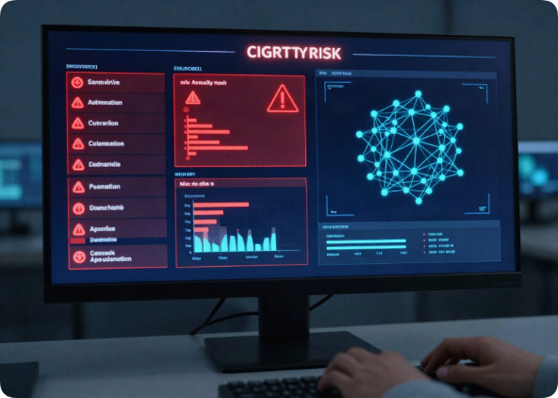
Executive Summary
Posture: High-to-Critical risk exposure identified
Critical: vsFTPd 2.3.4 backdoor, Samba RCE flaw
High: Outdated Unreal IRC, distccd services
Risk 1: Unauthorized access to customer/payment data
Risk 2: Service disruption and revenue impact
Risk 3: Reputational damage and regulatory exposure

Slide 3
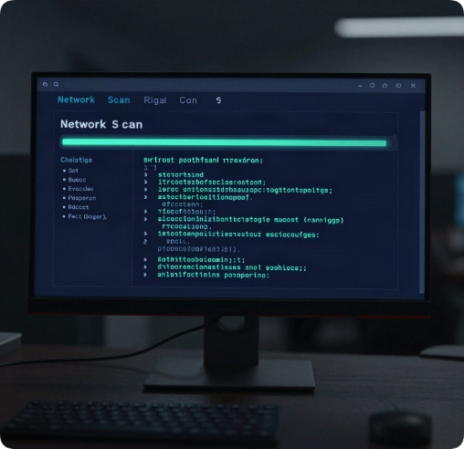
Scope & Method
Targets: hackthissite.org (OSINT) & Metasploitable 2 (Lab).
5-Phase approach: 1) Foundations (CIA, Architecture) 2) Recon (OSINT, Subdomains) 3) Enumeration & Scanning (Nmap) 4) Vulnerability Assessment (CVE/CVSS) 5) Reporting.

Slide 4
Phase 1: Network Design
DMZ (192.168.10.0/24): Internet-facing systems
Internal (192.168.20.0/24): DB and workstations
Firewall: Default-deny inbound policy
Access Control: Role-based, MFA, separation of duties
Principle of Least Privilege applied throughout

Slide 5
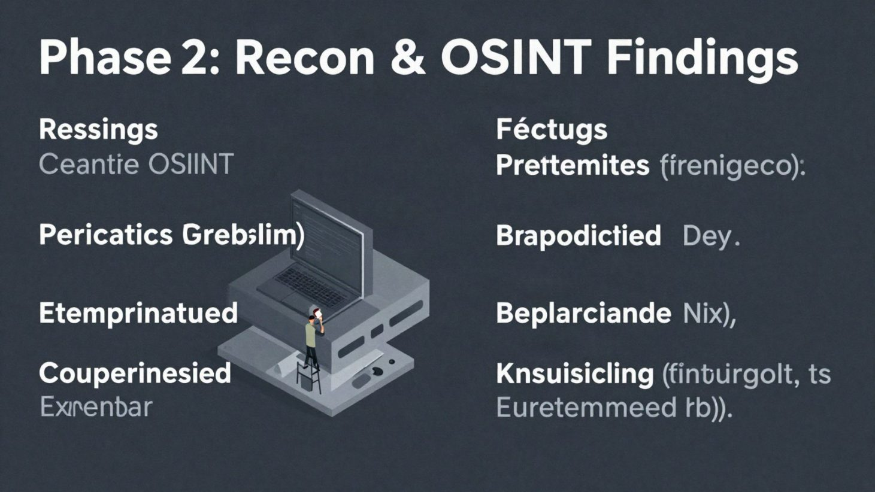

Slide 6
Nmap Scan Comparison
Scan Type
Speed
Detail
SYN Scan
Fast, stealthy
Ports only
Connect Scan
Slower, full handshake
Ports + state
Version Scan
Slowest, deep probe
Ports, versions, banners

Slide 7
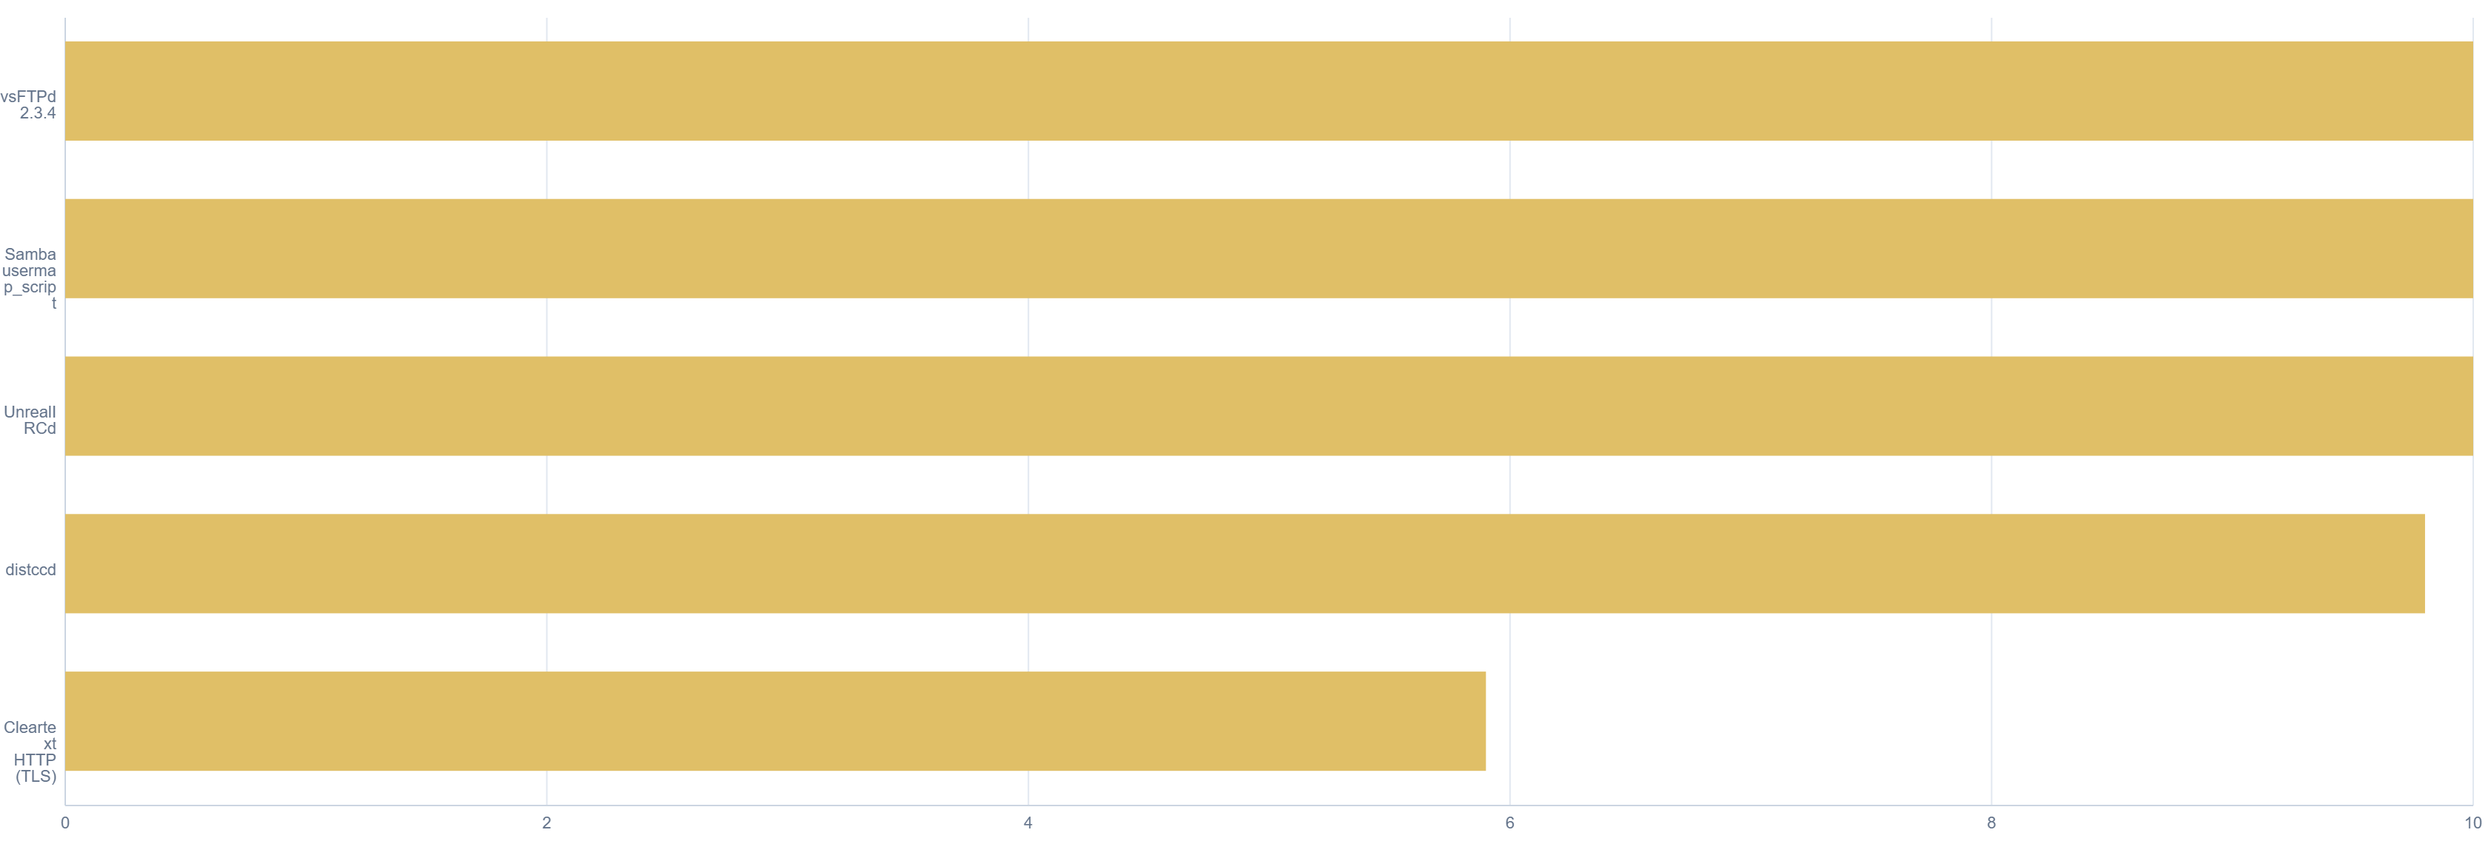
Critical CVEs by CVSS Score

Slide 8
Remediation Strategy
vsFTPd: Patch/upgrade, remove backdoored binary — Critical
Samba: Patch, disable usermap_script — Critical
UnrealIRCd: Replace service entirely — Critical
distccd: Disable or restrict to localhost — High
TLS: Deploy HTTPS redirection and HSTS — Medium

Slide 9

Incident Response
Detect: monitor port 6200 and shell activity. Contain: isolate host, revoke credentials, block malicious IPs. Eradicate: remove persistence mechanisms, patch vsFTPd, sweep for IOCs. Recover: restore from clean backups and notify stakeholders promptly.

Slide 10

Summary & Next Steps
Go-Live Status
Remediation Path
Architecture
Critical vulnerabilities remain unresolved and are blocking for go-live approval. These must be remediated before Nimbus Retail Co. can proceed to production launch.
Fixes are straightforward and fully vendor-supported, requiring no custom development. Final verification testing is required post-patching to confirm closure.
Maintain the current segmented DMZ network design, which has proven effective at containing exposure and limiting lateral movement risk.

