Slide 1

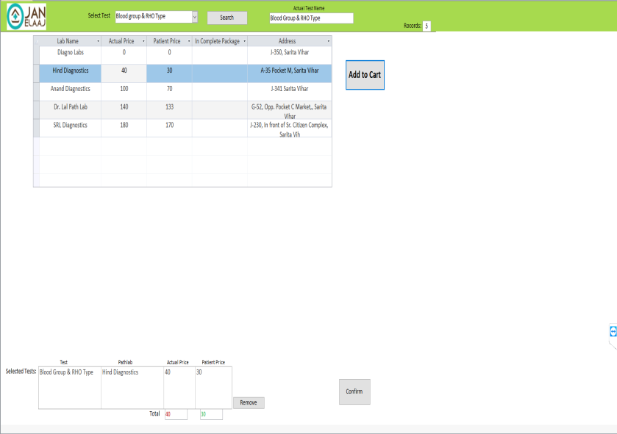
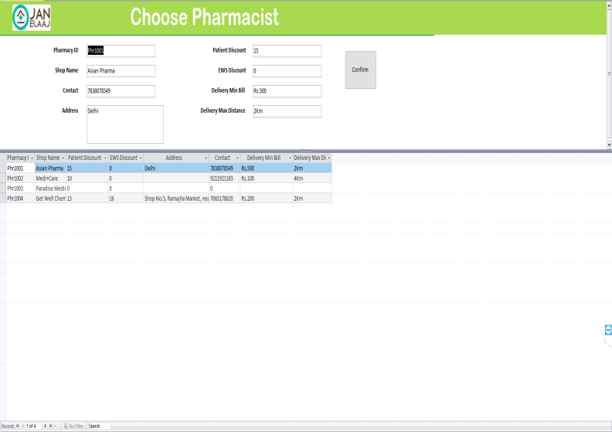
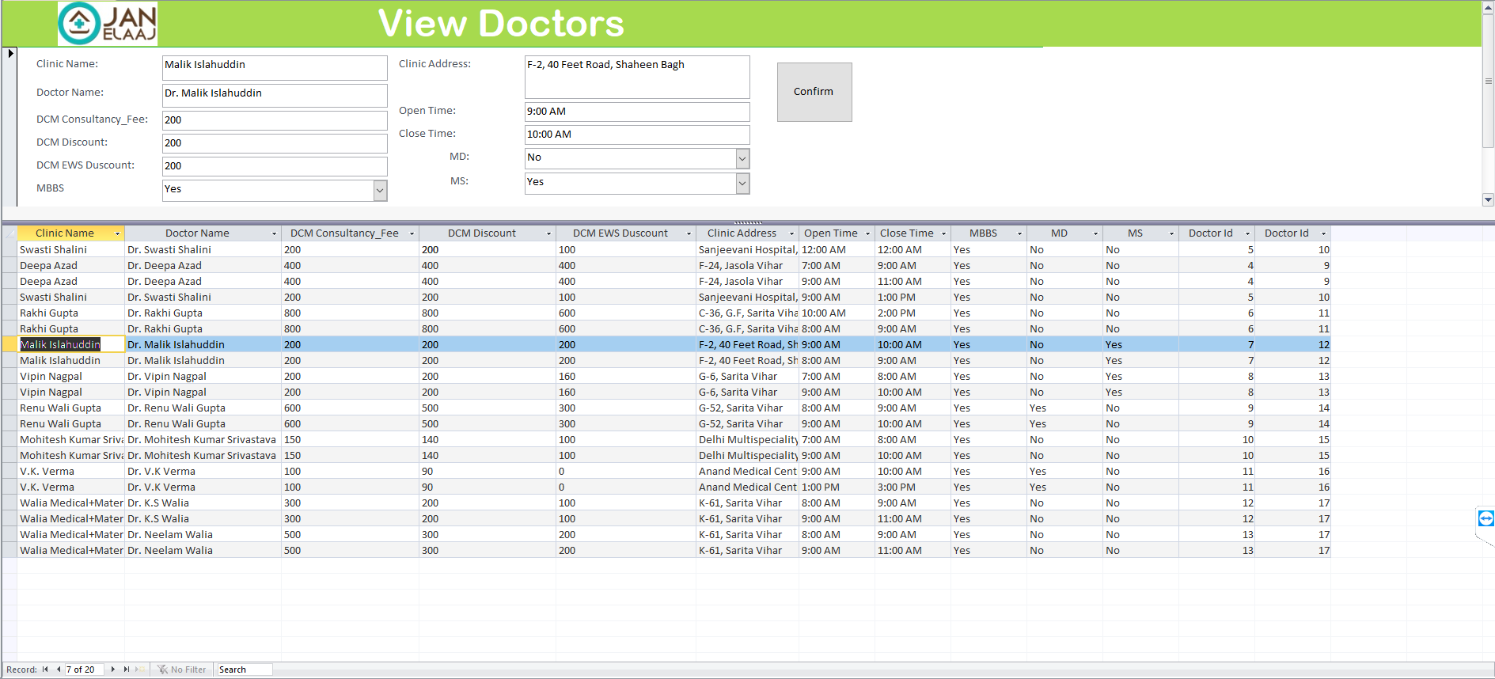
Offline Appointments Booking System

Slide 2
Why Desktop Application?
Privacy
Large Databases
Multi Users
Cost
Data Safety

Slide 3
Abstract
Register new Patients, Doctors, Pathlabs and Pharmacy.
Listing of Doctors,Pathlabs and Pharmacy
Compare prices
Reports generations
Send SMS
Simple Interface
Intelligent Search for Test alias.
Easy modification of the data for Admin.

Slide 4


Technology Used

Slide 5
Process Flow
User
Patient Calls JanElaaj Operator
Operator open Application and ask patient details for registration
Operator asks for service type
Patient choose Doctor
Patient choose Pathlab
Patient choose Pharmacy

Slide 6
Process Flow
Patient choose Doctor
Patient choose Pathlab
Patient choose Pharmacy
Operator asks for Test name
Operator tells patient about different pathlabs and prices for searched tests
Operator tells patient about different pathlabs and prices for searched tests
Operator tells patient about different pathlabs and prices for searched tests
Patient choose from available options to confirm appointment
SM S with OTP get send to both patient and doctor/pathlab/pharmacy with appointment details
End

Slide 7
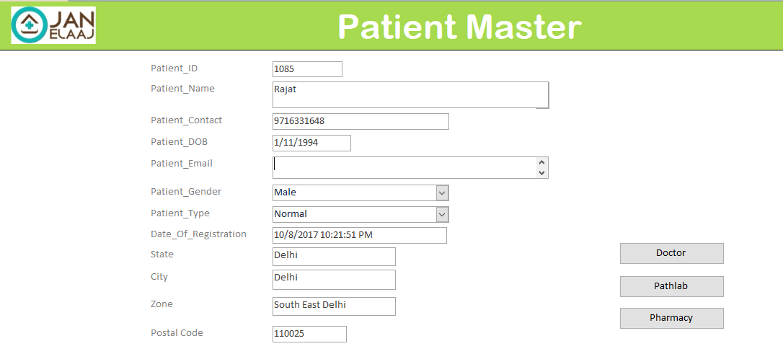
Application Flow: Doctor
1

Slide 8
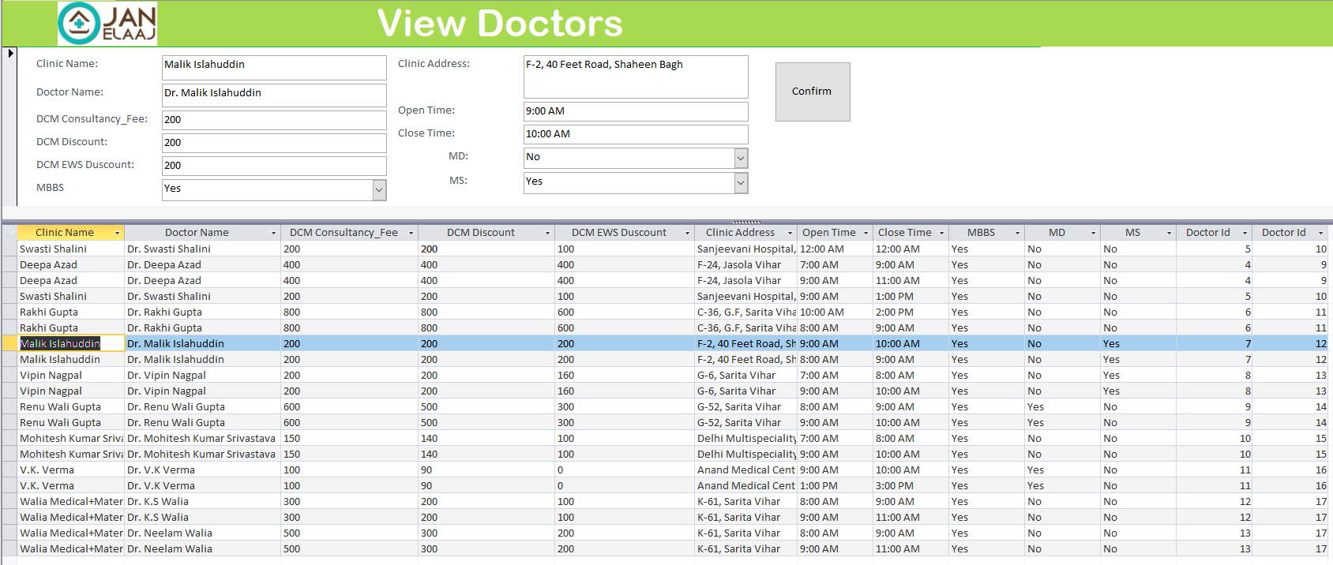
Application Flow: Doctor
2

Slide 9
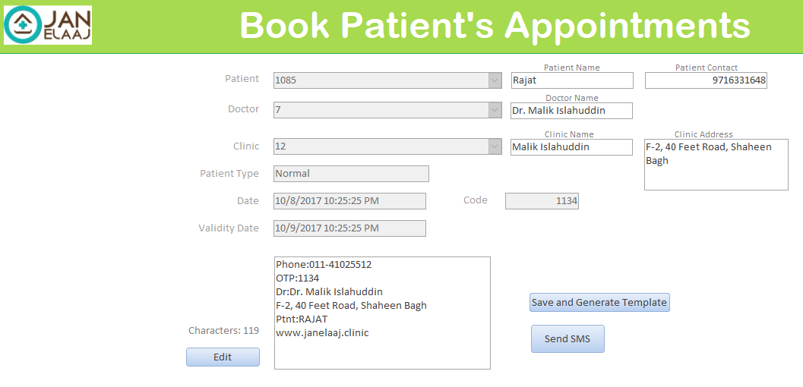
Application Flow: Doctor
3

Slide 10
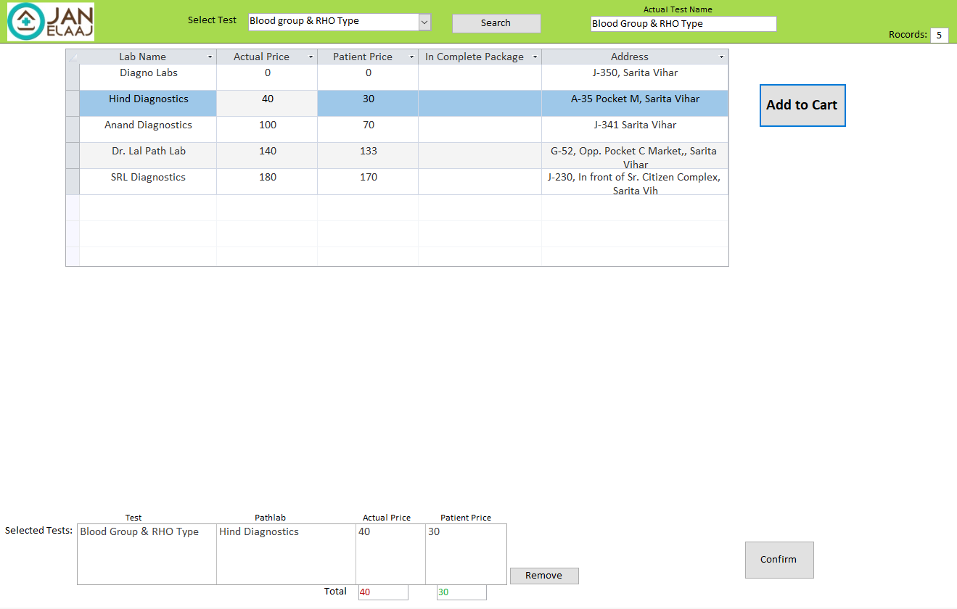
Application Flow: Pathlab
2

Slide 11
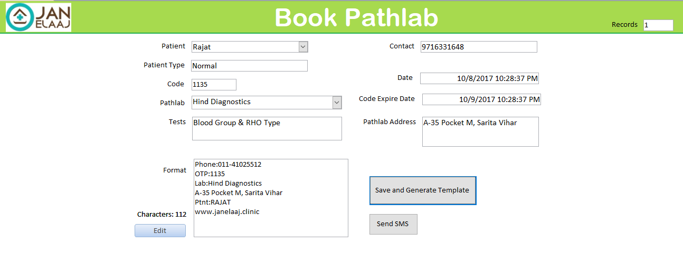
Application Flow: Pathlab
3

Slide 12
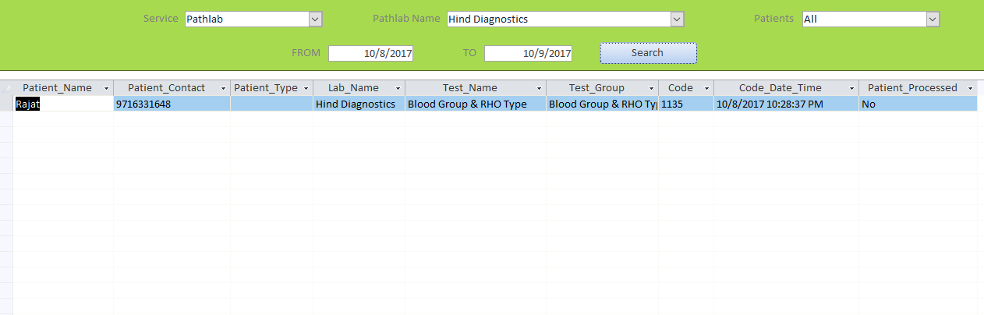
Application: Reports

Slide 13
Thank You

