Slide 1
New Java 6/7/8 features
Tools Innovation Architecture Meeting
July 8, 2015
Vladimir Hirsl Kai Honsel Roman Mitin
Avaloq Evolution AG | Allmendstrasse 140 | 8027 Zurich | Switzerland
T +41 58 316 10 10 | F +41 58 316 10 19 | www.avaloq.com

Slide 2
Section
Java 6

Slide 3
Java 6 highlights
@Override annotation for interface methods
Mix JavaScript with Java code
JDBC 4.0
API for XML
Derby is available with standard Java
Further new things in standard library
Keep using H2
Derby looses to H2 in fair comparison

Slide 4
@Override for interface methods
Use it to annotate methods that implement interface methods
interface IChannel {
void send(int value);
}
class MyChannel implements IChannel {
@Override
public void send(int value){ }
public void send(float value) { }
}

Slide 5
Scripting Languages
ScriptEngineManager manager = new ScriptEngineManager();
ScriptEngine engine = manager.getEngineByName("js");
engine.put("cost", 1000);
String decision = (String) engine.eval(
"if ( cost >= 100){ "
+ " decision = 'Ask the boss'; "
+ "} else {"
+ " decision = 'Buy it'; "
+ "}");
System.out.println(decision);

Slide 6
JDBC 4.0
No more explicit driver loading
Drivers have META-INF/services/java.sql.Driver which is found by ServiceLoader
BLOB support improved
RowID data type support (Oracle, DB2)
Annotation-based SQL Queries
New exceptions and casual relationship
SQLXML data type with string or StAX API
DataSet introduced
ASMD can now use
setBinaryStream(int parameterIndex, InputStream x)

Slide 7
New in Standard Library
ServiceLoader now a standard and hence replaces ServiceLocator
Compiler API to call Java Compiler programmatically
Common Annotations
Used a lot in ASMD standalone builder
Standard API for managing command-line tools

Slide 8
Streaming API for XML (StAX)
StAX was part of web services and now moved to SE
Now SE has all models to work with XML
DOM Parser loads the whole XML Document Tree in memory
SAX follows the Push-Parsing Model.
SAX Parser takes the control.
StAX is a Pull-Parsing model meaning that
Application keeps the control.
Allows skipping parts of the document when reading

Slide 9
Java API for XML Binding
JAXB (Java API for XML Binding) technology which was included as part of JWSDP (Java Web Services Developer Pack) before, is now included in Standard Library
@XmlRootElement()
public class Person {
…
@XmlElement() public String getName() { return name; }
In ASMD we use EMF for modeling XML sources, nothing changes here

Slide 10
Section
Java 7

Slide 11
Java SE 7 Language Highlights
Strings in Switch
Underscores in Numbers
Binary Literals
Multi-Catch and more precise re-throw
Try-with-resources
Type Inference for Generic Instance Creation

Slide 12
Java 7 Highlights: Strings in Switch
String str = getSomeString();
switch (str) {
case "Option A":
doSomethingWithOptionA();
break;
case "Option B":
doSomethingWithOptionB();
break;
default:
doDefault();
}

Slide 13
Java 7 Highlights: Underscores in Numbers
public void underscoresInNumbers() {
// THE NEW WAY
int borrowABillion = 1_000_000_000;
// THE OLD WAY
int returnABillion = 100000000;
}

Slide 14
Java 7 Highlights: Binary Literals
public void binaryLiterals() {
// THE OLD WAY
int oldBinary1 = 153;
int oldBinary2 = 128 ^ 0 ^ 0 ^ 16 ^ 8 ^ 0 ^ 0 ^ 1;
// THE NEW WAY
int newBinary = 0b1001_1001;
}

Slide 15
Java 7 Highlights: Multi-Catch and more precise rethrow
public void multiCatch() {
try {
rethrowException(true);
} catch (ExceptionA | ExceptionB e) {
LOGGER.log(Level.WARNING, "Error", e);
}
}
public void rethrowException(boolean aNotB) throws ExceptionA, ExceptionB {
try {
if (aNotB) {
throw new ExceptionA();
} else {
throw new ExceptionB();
}
} catch (Exception e) {
throw e;
}
}
Notes:
This examples's try block could throw either ExceptionA or ExceptionB. Suppose you want to specify these exception types in the throws clause of the rethrowException method declaration. In releases prior to Java SE 7, you cannot do so. Because the exception parameter of the catch clause, e, is type Exception, and the catch block rethrows the exception parameter e, you can only specify the exception type Exception in the throws clause of the rethrowException method declaration.
However, in Java SE 7, you can specify the exception types ExceptionA and ExceptionB in the throws clause in the rethrowException method declaration. The Java SE 7 compiler can determine that the exception thrown by the statement throw e must have come from the try block, and the only exceptions thrown by the try block can be ExceptionA and ExceptionB. Even though the exception parameter of the catch clause, e, is type Exception, the compiler can determine that it is an instance of either ExceptionA or ExceptionB:
public void rethrowException(String exceptionName) throws ExceptionA, ExceptionB {
try { // ...
} catch (Exception e) {
throw e;
}
}
This analysis is disabled if the catch parameter is assigned to another value in the catch block. However, if the catch parameter is assigned to another value, you must specify the exception type Exception in the throws clause of the method declaration.

Slide 16
Java 7 Highlights: Try with resources (finally block)
public void tryWithFinally(String path)
throws FileNotFoundException, IOException {
BufferedReader br = new BufferedReader(new FileReader(path));
try {
br.readLine();
} finally {
br.close();
}
}

Slide 17
Java 7 Highlights: Try with resources
public void tryWithResources(String path)
throws FileNotFoundException, IOException {
try (BufferedReader br = new BufferedReader(new FileReader(path))) {
br.readLine();
} catch (Exception e) {
Throwable[] suppressed = e.getSuppressed();
for (Throwable t : suppressed) {
LOGGER.log(Level.WARNING, "Suppressed", t);
}
}
}
Notes:
In a try-with-resources statement, any catch or finally block is run after the resources declared have been closed.

Slide 18
Java 7 Highlights: AutoCloseable and Closeable
package java.lang;
public interface AutoCloseable {
void close() throws Exception;
}
package java.io;
import java.io.IOException;
public interface Closeable extends AutoCloseable {
public void close() throws IOException;
}

Slide 19
Java 7 Highlights: “Diamond” operator
// WITHOUT INFERENCE
Map<String, List<String>> oldMap = new HashMap<String, List<String>>();
// WITH INFERENCE
Map<String, List<String>> newMap = new HashMap<>();
Notes:
Improved type inference for generic instance creation

Slide 20
Java SE 7 API Highlights
NIO 2
Concurrency API
Unicode and Extensible Currency Codes
InvokeDynamic bytecode
VM Optimizations
Will be discussed in separate session
Unicode 6 with full regexp supoprt
Much faster dynamic languages

Slide 21
Java NIO aka JSR51
java.nio.*
The new Input/Ouput introduced in 1.4
APIs for
scalable I/O,
fast buffered binary and character I/O
regular expressions
charset conversion
improved filesystem interface
NIO2 in Java 7
Methods throw exceptions when fail
Support for symbolic links (in tree walking too)
Efficient and extended meta data access
Scalable file methods
Path and Files became link-aware

Slide 22
NIO2 Helper Types
Class java.nio.file.Paths
Static methods to return a Path from a string or URI
Interface java.nio.file.Path
Represents location of a file (replaces File objects)
Class java.nio.file.Files
Static methods to operate on files, directories and other types of files
Class java.nio.file.FileSystem
Provides information about the file system
// Copy files with fine grain control
Path src = Paths.get("readme.txt");
Path dst = Paths.get("copy_readme.txt");
Files.copy(src, dst, StandardCopyOption.COPY_ATTRIBUTES, StandardCopyOption.REPLACE_EXISTING);

Slide 23
NIO2 Directories
https://docs.oracle.com/javase/tutorial/essential/io/dirs.html
DirectoryStream iterate over entries
Scales to large directories
Uses less resources
Smooth out response time for remote file systems
Implements Iterable and Closeable for productivity
Build-in support for glob, regex and custom filters
Path srcPath = Paths.get(".");
// List all text and XML files in the directory
try ( DirectoryStream<Path> dir =
Files.newDirectoryStream(srcPath, "*.{txt,xml}") )
{
dir.forEach(file -> System.out.println(file.getFileName()));
}

Slide 24
NIO2 Walking a File Tree
A FileVisitor interface makes walking a file tree for search, or performing actions, trivial.
Path startingDir = Paths.get(".");
Files.walkFileTree(startingDir, new SimpleFileVisitor<Path>(){
@Override
public FileVisitResult visitFile(Path file,
BasicFileAttributes attrs) throws IOException
{
System.out.println(file.getFileName());
return FileVisitResult.CONTINUE;
}
});

Slide 25
NIO2 Watching a Directory
Watch the file system changes is now easy with WatchService
Must not be used for disk-indexing scale purposes
Path watchDir = Paths.get(".");
WatchService watcher = FileSystems.getDefault().newWatchService();
watchDir.register( watcher, StandardWatchEventKinds.ENTRY_CREATE,
StandardWatchEventKinds.ENTRY_DELETE, StandardWatchEventKinds.ENTRY_MODIFY );
while (true) {
WatchKey key;
// wait for a key to be available
key = watcher.take();
for (WatchEvent<?> event : key.pollEvents()) {
WatchEvent.Kind<?> kind = event.kind();
WatchEvent<Path> ev = (WatchEvent<Path>) event;
Path fileName = ev.context();
System.out.println(kind.name() + ": " + fileName);
}
boolean valid = key.reset(); // The key must be reset after processed
if (!valid) { break; }
}

Slide 26
NIO Custom File Systems
FileSystems is a factory to FileSystem interface
Java 7 allows for developing custom FileSystems, for example:
Memory based or zip file based systems
Fault tolerant distributed file systems
Replacing or supplementing the default file system provider
Two steps:
Implement java.nio.file.spi.FileSystemProvider
URI, Caching, File Handling, etc.
Implement java.nio.file.FileSystem
Roots, RW access, file store, etc.

Slide 27
Mapping java.io.File to java.nio.file (I)
java.io.File | java.nio.file
java.io.File | java.nio.file.Path
File.canRead File.canWrite File.canExecute | Files.isReadable Files.isWritable Files.isExecutable
File.isDirectory() File.isFile() File.length() | Files.isDirectory(Path, LinkOption...) Files.isRegularFile(Path, LinkOption...) Files.size(Path)
File.lastModified() File.setLastModified(long) | Files.getLastModifiedTime(Path, LinkOption...) Files.setLastModifiedTime(Path, FileTime)
File methods: setExecutable, setReadable, setReadOnly, setWritable | Files method: setAttribute(Path, String, Object, LinkOption...)
new File(parent, "newfile") | parent.resolve("newfile")
Notes:
There is no one-to-one correspondence between the two APIs, but the following table on the next two slides gives a general idea of what functionality in the java.io.File API maps to in the java.nio.file API

Slide 28
Mapping java.io.File to java.nio.file (II)
java.io.File | java.nio.file
File.renameTo | Files.move
File.delete | Files.delete
File.createNewFile | Files.createFile
File.deleteOnExit | DELETE_ON_CLOSE option in createFile
File.exists | Files.exists and Files.notExists
File.compareTo and equals | Path.compareTo and equals
File.getAbsolutePath and getAbsoluteFile | Path.toAbsolutePath
File.getCanonicalPath and getCanonicalFile | Path.toRealPath or normalize
File.isHidden | Files.isHidden
File.mkdir and mkdirs | Files.createDirectory
File.listRoots | FileSystem.getRootDirectories

Slide 29
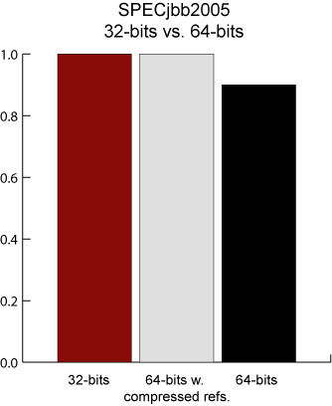
VM: Compressed OOPS by Default
Going from 32bit to 64bit system will grow the heap by ~1.5x simply because of bigger ordinary object pointers
Memory is cheap, but bandwidth and cache is not
Compressed OOPS:
Managed 32 bit pointers (similar heap sizes for 32/64 bit apps)
Scaled (8 x 4GB chunks) added to a 64 bit base
Useful for heaps up to 32GB
Compressed OOPS will turn off when –Xmx > 32g

Slide 30
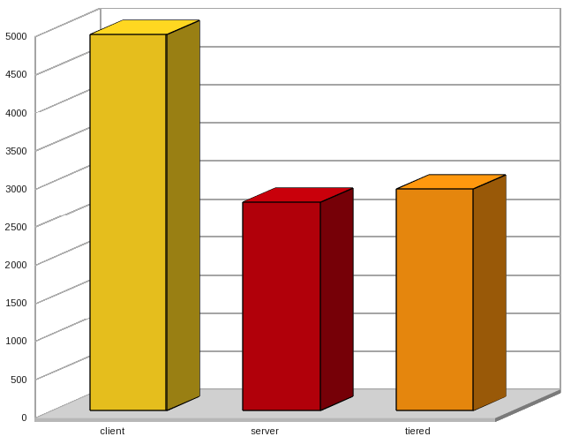
VM: Tiered Compilation
Hotspot has 2 JIT’s “client” and “server”
Client starts fast, but let optimizations – best for clients
Server starts slower, but provides better optimizations
Java 7 adds Tiered Compilation
JIT the code first with “client”, and if it’s really hot code, recompile with “server”
Has been around for a while, but not with a great implementation -server -XX:+TieredCompilation
Image from Rémi Forax showing the
DaCapo Jython benchmark.
http://www.java.net/blogs/forax

Slide 31
Section
Java 8

Slide 32
Java SE 8 Language Highlights
Lambda Expressions
Method References
Default Methods
Type Annotations and Pluggable Type Systems
Repeating Annotations
Improved Type Inference

Slide 33
Lambda Motivation: Functional Programming in Java
Use functions instead of objects
pass (as arguments)
execute
combine and concatenate
Execute Around Pattern
Extract common constant part into helper method
Pass variable part as argument
Classic Java: anonymous inner types
Java 8
Lambdas
Method references
Notes:
Helper: Utilities.forEach (external iteration)
Interface: Consumer
Example 1: classic
Example 2: execute around pattern
Example 3: lambdas
Example 4: method reference
Interface: Iterable (internal iteration)
Example 5: default methods (extensions of collection framework)

Slide 34
Example: Classic Java
List<Integer> numbers = new ArrayList<>();
// populate list
Iterator<Integer> iter = numbers.iterator();
while(iter.hasNext()) {
Integer elem = iter.next();
System.out.println(elem);
}

Slide 35
Example: Helper Class (External Iteration)
public class Utilities {
public static <E> void forEach(Iterable<E> seq, Consumer<E> block) {
Iterator<E> iter = seq.iterator();
while (iter.hasNext()) {
E elem = iter.next();
block.accept(elem);
}
}
}

Slide 36
Example: Functional Interface
public interface Consumer<T> {
void accept(T t);
}

Slide 37
Example: Execute Around Pattern
List<Integer> numbers = new ArrayList<>();
// populate list
Utilities.forEach(numbers, new Consumer<Integer>() {
public void accept(Integer elem) {
System.out.println(elem);
}
});

Slide 38
Example: Lambda
List<Integer> numbers = new ArrayList<>();
// populate list
Utilities.forEach(numbers, e -> System.out.println(e));

Slide 39
Example: Method Reference
List<Integer> numbers = new ArrayList<>();
// populate list
Utilities.forEach(numbers, System.out::println);

Slide 40
Example: Interface (Internal Iteration)
public interface Iterable<T> {
Iterator<T> iterator();
default void forEach(Consumer<? super T> action) {
for(T t : this) {
action.accept(t);
}
}
}

Slide 41
Example: Default Methods
List<Integer> numbers = new ArrayList<>();
// populate list
numbers.forEach(System.out::println);

Slide 42
Lambda
Supports functional style programming
Focus on functionality (variable part)
Readability
Supports parallel execution
No need to care about threading
Less advanced and error-prone than java.util.concurrent
Syntax
(param-list) -> { body }

Slide 43
Lambda: Examples
Parameter lists
Body examples
(int x) -> x+1
int x -> x+1
(x) -> x+1
x -> x+1
() -> 42
use () with param types
(int x,int y) -> x+y
int x,int y -> x+y
(x,y) -> x+y
x,y -> x+y
(x,int y) -> x+y
use () with param types
use () with > 1 param
mix of params w/o type
(int x) -> x+1
(int x) -> { return x+1; }
() -> System.gc()
(String[] args) -> (args != null) ? args.length : 0
(String[] args) -> {
if(args != null)
…
}
Notes:
No { } if body is a single expression
Use { } for statements and blocks
Demo:
ex02_removeOddLengthWords
ex03_upcaseAllWords

Slide 44
Lambda II
Allowed locations of lambda expressions
Right side of assignment
Argument in method call
Return value of return statement
Cast expression
Variable binding
Lambda parameters
Everything effective final from method
Everything from class
Notes:
Lambda expression may only be at locations that have a deduction context that compiler can resolve (needs to do target typing)

Slide 45
Lambda: More Examples
@FunctionalInterface
public interface IntUnaryOperator {
int applyAsInt(int operand);
}
private static void multiply() {
int factor = 100;
IntUnaryOperator multiply = (int x) -> { return x * factor; };
IntStream
.range(1,10)
.map(multiply)
.forEach(System.out::println);
}
IntUnaryOperator multiply = x -> x * factor;

Slide 46
Function Types and Target Typing
No changes to type system
Type of lambda expressions and method references is classic Java type
No notion of types describing functions
Target Typing: Compiler deduces target type of expression or reference from context
Target type is functional interface (aka SAM type)
Describes functionality: @FunctionalInterface
Contains only one single abstract method
No other types can be used as target types
SAM type always set by compiler on target typing
Notes:
Classic Java Type: class or interface
Target Typing: strategy to map lamdba expressions to interface

Slide 47
Target Typing: Examples
@FunctionalInterface
public interface BiPredicate<T, U> {
boolean test(T t, U u);
}
@FunctionalInterface
public interface BiFunction<T, U, R> {
R apply(T t, U u);
}
private void testTargetTyping() {
BiPredicate<String,String> sp1 = (s,t) -> s.equalsIgnoreCase(t);
BiFunction<String,String,Boolean> sp2 = (s,t) -> s.equalsIgnoreCase(t);
}

Slide 48
Method and Constructor References
Use if nothing else done than calling a method
Comparison
More compact than lambda
Everything said for lambdas also valid for method references
Syntax
Receiver: object or type
Method-name: existing method or new (keyword)
No parameters
Powerful: references a bunch of methods and compiler selects right one
Target Typing more advanced, not only type but also parameters are missing
receiver::method-name
Notes:
Refer to methods or constructors without invoking them
Receiver
- When referencing constructor receiver must be type
- Use of object as receiver (in method reference) only possible with non-static methods, static methods are called using type as receiver

Slide 49
Examples: Method and Constructor References
Kind of Method Reference | Syntax | Example
Reference to a static method | className::staticMethodName | String::valueOf
Reference to a bound non-static method | objectName::instanceMethodName | s::toString
Reference to an unbound non-static method | className::instanceMethodName | Object::toString
Reference to a constructor | className::new | String::new

Slide 50
Method Reference: Example
List<Integer> numbers = new ArrayList<>();
// populate list
numbers.forEach(System.out::println);
public interface Stream<T> {
void forEach(Consumer<? super T> action);
}
@FunctionalInterface
public interface Consumer<T> {
void accept(T t);
}

Slide 51
Constructor Reference: Example
char[] suffix = new char[] {'.','t','x','t'};
Arrays.stream(new String[] {"readme", "releasenotes"})
.map(StringBuilder::new)
.map(s -> s.append(suffix))
.forEach(System.out::println);
}
public interface Stream<T> {
<R> Stream<R> map(Function<? super T, ? extends R> mapper);
}
@FunctionalInterface
public interface Function<T, R> {
R apply(T t);
}
Notes:
Examples contains everything: lambdas, method/constructor references, target typing, streams
Compiler deduces that constructor reference StringBuilder::new is of type Function<String,StringBuilder> = constructor of StringBuilder that accepts String as argument

Slide 52
Method References compared to alternatives
public class MethodRefDemo {
public static void main(String[] args) {
new Thread(new Runnable() {
@Override
public void run() {
doWork();
}
}).start();
new Thread(() -> doWork()).start();
new Thread(MethodRefDemo::doWork).start();
}
static void doWork() {
}
}

Slide 53
Default Methods
Method provides implementation in interface
Inherited by subtypes if not overridden
Motivation
Interface evolution
Extension of collections framework
Syntax: default
First modifier
Keyword technically superfluous but for
Safety reasons
Readability
Still not allowed
Non static methods
Non static final fields
Notes:
Problem: If method is added to interface, it must be implemented in all subclasses
Developer extending the interface may not even have the opportunity to adopt classes
Summary: Default methods enable to implement functionality at the very top of the hierarchy (done like this in Java 8)

Slide 54
Example: Interface with default method
public interface Iterable<T> {
Iterator<T> iterator();
default void forEach(Consumer<? super T> action) {
for(T t : this) {
action.accept(t);
}
}
}

Slide 55
Multiple Inheritance
Class inherits same (default) method from super class and multiple interfaces
Rules
Method implementation from class takes precedence over interface
Implementation in nearest interface in super hierarchy has priority over others
Multiple direct interfaces: manual definition with super call necessary
I1
default void foo() {…}
I
default void foo() {…}
public class C3
implements I1, I2 {
@Override
public void foo() {
I2.super.foo();
}
}
I2
default void foo() {…}
C
public void foo() {…}
C1
C2
Notes:
There is still no multiple inheritance from classes (especially no inheritance of state)

Slide 56
Static Methods
Now allowed also in interfaces
Same behaviour like in classes
No inheritance: not handed down to subtypes
Usages?
Notes:
Not clear how to use yet
Replacement for utilities that only contain static methods (avoid private constructor)

Slide 57
Streams
Extension of collection framework to support functional programming style
Simplifies parallel access of collection elements
Stream types
Sequential: stream()
Parallel: parallelStream()
Collection vs. Stream
Collection stores elements
Stream references collection (underlying stream source) and stores pending operations
Concurrent operations in Stream interface: forEach(), count(), sorted(), etc.
Intermediate operations (e.g. filter(), map())
Support fluent programming
Lazy: execution starts with terminal operation, done in pipeline (per element, “vertically”)
Terminal operations (e.g. forEach(), reduce())
Consume stream, not useable anymore afterwards
Eager: execution
Notes:
Separation of what and how (use forEach method of List instead of explicit for each loop)
Example: Don’t confuse forEach of stream (abstract method) with foreach of list (default method)
Lazy: more efficient (visit every element only once, no need to store interims results, no sync between threads as they can work on subset -> spliterator) and supports parallel execution

Slide 58
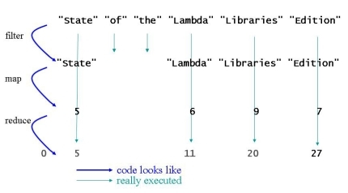
Streams: Example
String[] txt = { "State", "of", "the", "Lambda", "Libraries", "Edition"};
int sum = Arrays.stream(txt)
.filter(s -> s.length() > 3)
.map(String::length)
.reduce(0, Integer::sum);
Notes:
Demo: Use peek() to demonstrate effect (C. debugStream())

Slide 59
Streams: Creation
Creation of streams
Collection based streams
Array based streams
Factory methods in Stream interface
List<String> stringList = …
Stream<String> sequentialStringStream = stringList.stream();
Stream<String> parallelStringStream = stringList.parallelStream();
String[] array = …
Stream<String> sequentialStringStream = Arrays.stream(array);
Stream<String> parallelStringStream = Arrays.stream(array).parallel();
Stream<String> sequentialStringStream = Stream.of(
"Ich", "ging", "im", "Walde",
"so", "für", "mich", "hin",
"und", "nichts", "zu", "suchen",
"das", "war", "mein", "Sinn");
Stream<String> emptyStringStream = Stream.empty();
Notes:
Demo:
ex01_accumulateFirstLetters

Slide 60
Stream Operations
Short-circuiting operations
Don’t visit all elements, stop as soon as possible
Examples: limit(), skip(), allMatch(), anyMatch(), noneMatch()
State
Stateful operation: needs to store and consider context information (e.g. limit(), sorted())
Stateless operations: (e.g. filter(), map())
Notes:
Operations with state can be expensive as sequence or elements might need to be buffered (stored in between)

Slide 61
More Types of Streams
Primitive streams
More efficient, no autoboxing
Types: IntStream, LongStream, DoubleStream
Infinite streams
Without any length restriction
Use generate() and iterate() instead of underlying data source
Other
Streams of random values (java.util.SplittableRandom)
Character-based streams (chars(), codePoints())
java.util.regex.Pattern
java.nio.file.Files

Slide 62
Streams: Collectors
collect()
Collects elements of a stream into a collection
Terminal operation
Collectors are used to do the work (use factory methods in Collectors)
Grouping (Collectors.groupingBy())
Group elements according to classifier (key)
Result is Map<K,List<T>>
Partitioning (Collectors.partitioningBy())
Special form of grouping
Classifier is function (evaluates elements, returns true or false)
Result is Map<Boolean,List<T>>
Notes:
Demo:
- ex06_upcaseOddLengthWords

Slide 63
Example: String Collector
List<String> streamSource = …
String resultString = streamSource
.stream()
. …
.collect(Collectors.joining());
Notes:
Always take care of writing operations so that they run on sequential and parallel streams (sb might change sequential into parallel stream)
String Collector joining(): Most efficient way to concatenate String
Alternative reduce(“”, (s1,s2) -> s1+s2) slow because of many temporary String objects
Alternative StringBuilder is stateful (unpredictable result with parallel stream) and not thread-safe
Alternative StringBuffer is thread-safe but slow

Slide 64
Example: Collection Collector
List<String> streamSource = …
Set<String> resultSet = streamSource
.parallelStream()
.filter(w -> w.length() > 0)
.filter(w -> Character.isUpperCase(w.charAt(0)))
.collect(Collectors.toSet());
…
.collect(Collectors.toCollection(TreeSet::new));
Notes:
Note that (collection and other) collectors also work on parallel streams although JDK collection we collect into is not thread-safe (cf. TreeMap)

Slide 65
Example: Map Collector
Collection<Person> people = …
Map<Integer,String> idToName = people
.stream()
.collect(Collectors.toMap(Person::getTIN, Person::getName));
Map<Integer,Person> idToPerson = people
.stream()
.collect(Collectors.toMap(Person::getTIN, Function.identity()));

Slide 66
Example: Grouping Collector
Collection<Person> people = …
Map<Address,List<Person>> addressToPerson = people
.stream()
.collect(Collectors.groupingBy(Person::getAddress));
List<String> streamSource = …
Map<Character,List<String>> resultMap = streamSource
.stream()
.filter(w -> w.length() > 0)
.distinct()
.collect(Collectors.groupingBy(w -> w.charAt(0)));

Slide 67
Side Effects
Functional programming: no side effects allowed
Function never modifies but only produces new data
May be called on elements in any order and arbitrary often
Java: no means to prevent modifications of fields or variables
Function passed (lambda or method reference) needs to meet certain requirements
Stateless
Executions of function on different elements must not depend on/affect each other
Data must not be modified or accumulated
Required by most operations except forEach(), forEachOrdered() and peek()
Non-interfering
Function must not modify underlying stream source
General requirement
Notes:
Forbidden side effects are described in javadoc of operation for function parameter
Function should always be stateless so that it can be used both for sequential and parallel streams
Often there are alternative stream operations that can be used
forEach(), forEachOrdered() and peek()
Don’t produce anything (void)
Are there to produce side effects
Developer is responsible to make it thread-safe
Modify underlying stream source = add/remote while stream operation is running

Slide 68
Side Effects: Examples
List<String> streamSource = …
StringBuffer sb = new StringBuffer();
streamSource.parallelStream().forEach(s -> sb.append(s));
String resultString = sb.toString();
List<Integer> underlyingList =
Arrays.asList(1,2,3,4,5,6,7,8,9);
underlyingList
.stream()
.map(i -> 2*i)
.forEach(underlyingList::add);
List<String> streamSource = …
streamSource
.parallelStream()
.filter(w -> w.length() > 0)
.map(w -> w.charAt(0))
.forEach(System.out::print);
Notes:
One is good, two are bad

Slide 69
Java 8: Type annotations
Before Java 8 annotations could only be applied to declarations
As of Java 8 release, annotations can be applied to any type use
@Retention(RetentionPolicy.SOURCE)
@Target({ ElementType.TYPE_USE, ElementType.TYPE_PARAMETER })
@TypeQualifier
public @interface NonNull {
}
@NonNull String str;
public void receive(@ReadOnly Message msg) throws @Critical Exception {
new @Immutable Response();
}
Notes:
Oracle created type annotations to improve the analysis of Java programs through stronger type checking. Java 8 doesn't provide a type-checking framework, but you can create one of your own (or even download a framework created by someone else) that's implemented as one or more pluggable modules for use with the Java compiler.

Slide 70
Java 8: Repeating annotations
Definition
Use
public @interface Schedules {
Schedule[] value();
}
import java.lang.annotation.Repeatable;
@Repeatable(Schedules.class)
public @interface Schedule {
String dayOfMonth() default "first";
String dayOfWeek() default "Mon";
int hour() default 12;
}
@Schedule(dayOfMonth="last")
@Schedule(dayOfWeek="Fri", hour="23")
public void repeatingAnnotation() { … }

Slide 71
Java 8: Improved type inference
The Java compiler takes advantage of target typing to infer the type parameters of a generic method invocation
public void targetTypeInference() {
List<String> stringList = new ArrayList<>();
stringList.add("A");
// Java SE 8 target type inferred
stringList.addAll(Arrays.asList());
The method addAll(Collection<? extends String>) in the type
List<String> is not applicable for the arguments (List<Object>)
// Java SE 7 target type specified explicitly
stringList.addAll(Arrays.<String>asList());
}

Slide 72
Java 8: Garbage Collection and GC1
Remove Permanent Generation
Converges HotSpot (HotSpot7 and previous had PermGen) and JRockit (never had PermGen) JVMs.
Class metadata is now stored in native memory while interned Strings and statics are moved to heap space.
Some old GC strategies are retired
DefNew+CMS is obsolete: ParNew+CMS is used
ParNew+SerialOld is obsolete: ParallelScavenge+SerialOld is used
iCMS (incremental) is obsolete: Normal CMS is in use
Long term G1 will replace CMS (Concurrent Mark Sweep) http://www.oracle.com/webfolder/technetwork/tutorials/obe/java/G1GettingStarted/index.html
To enable the G1 Collector use: -XX:+UseG1GC

Slide 73
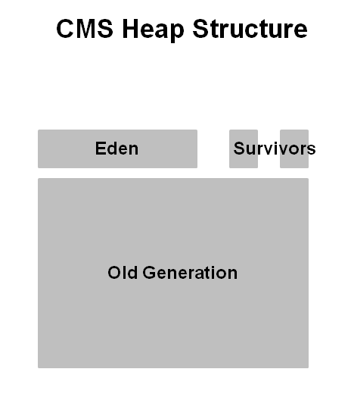
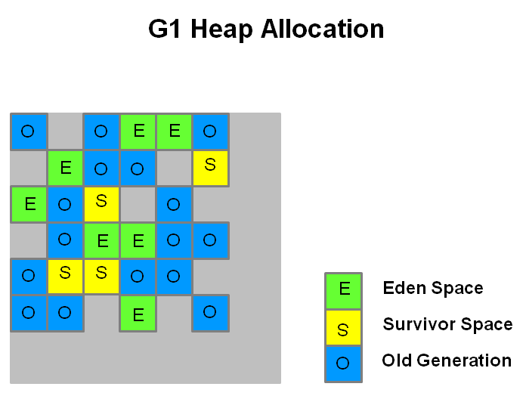
Java 8: CMS vs. G1
http://www.oracle.com/webfolder/technetwork/tutorials/obe/java/G1GettingStarted/index.html
More predictably “soft real-time” – temporal configuration
High throughput
For hotspot sample command line
java -XX:+UseG1GC -XX:MaxGCPauseMillis=200 -XX:InitiatingHeapOccupancyPercent=45
Sets a target for the maximum GC pause time
Percentage of the (entire) heap occupancy to start a concurrent GC cycle

Slide 74
Any fool can write code that a computer can understand. Good programmers write code that humans can understand.
Martin Fowler
Tools Innovation Architecture _P.PO.TI.ARCH@avaloq.com

