Slide 1
SSL Man in the Middle Proxy
Srinivas Inguva
Dan Boneh
Ian Baker
Stanford University

Slide 2
Overview
Normal SSL
  SSL encrypted data routed like normal TCP/IP data over the internet
SSL Web Server
Internet

Slide 3
Proxy Server
Browser connects to proxy
Proxy connects to web server and forwards between the two
SSL Web Server
Internet

Slide 4
Man in the Middle
Instead of forwarding encrypted data between the two hosts, our proxy will set up two DIFFERENT SSL connections between the two.
Proxy<->Remote Server
  Sets up a normal SSL client connection to requested remote site
Proxy<->Browser
  Sets up a SSL server connection to the browser, using its own certificate, generated as a copy of the remote host’s cert
If the browser accepts this fake cert, the proxy has access to the data in the clear!

Slide 5
Proxy Server
Listens for the browser CONNECT request and sets up the needed SSL connections
Obtains the remote server cert from the remote SSL connection
Creates a forged cert using the remote server cert and proxy credential:
  SubjectDN, Serial Number, Extensions, … same
  Issuer, Public Key, Signature changed
The browser sees this forged cert as the SSL server cert

Slide 6
Getting Started
Start proxy server
  Java command line application
  Java 1.5+ runtime environment
Configure Browser to use this SSL proxy
  Browser specific
Add proxy’s certificate to the browser trusted CA store
  Otherwise, “certificate not trusted” warnings

Slide 7
Proxy Server Usage
java mitm.MITMProxyServer <options>
[-localHost <host name/ip>] Default is localhost
[-localPort <port>] Default is 8001
[-keyStore <file>] Key store details for
[-keyStorePassword <pass>] certificates. Equivalent to
[-keyStoreType <type>] javax.net.ssl.XXX properties
[-keyStoreAlias <alias>] Default is 'mykey'
[-outputFile <filename>] Default is stdout
[-v ] Verbose proxy output
keyStore is the Java KeyStore file containing the proxy cert
outputFile contains the plaintext of all proxied HTTP requests

Slide 8
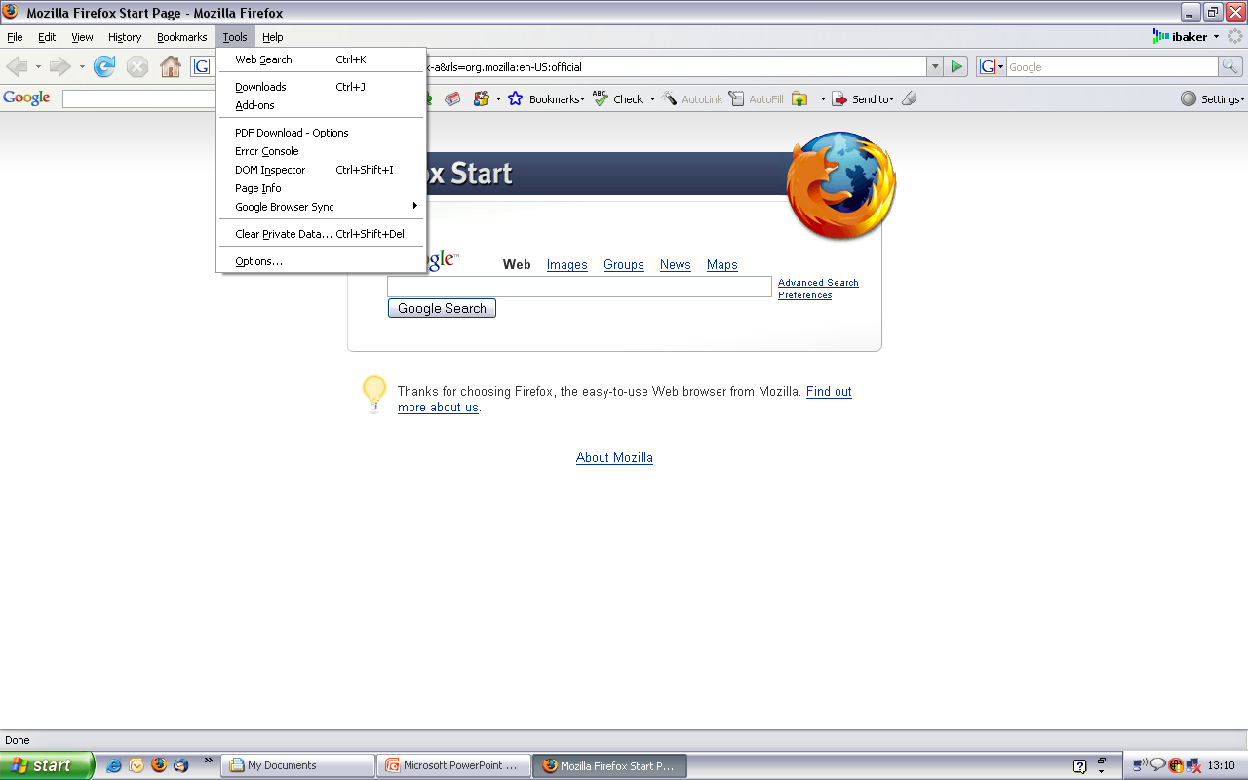
Configuring an SSL proxy in Firefox

Slide 9
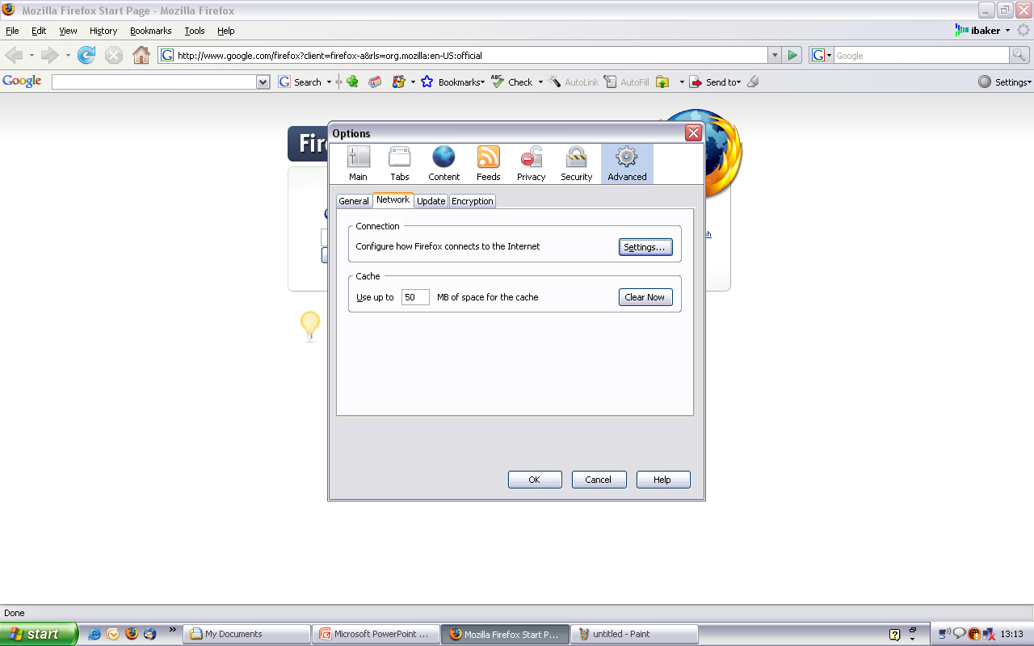

Slide 10
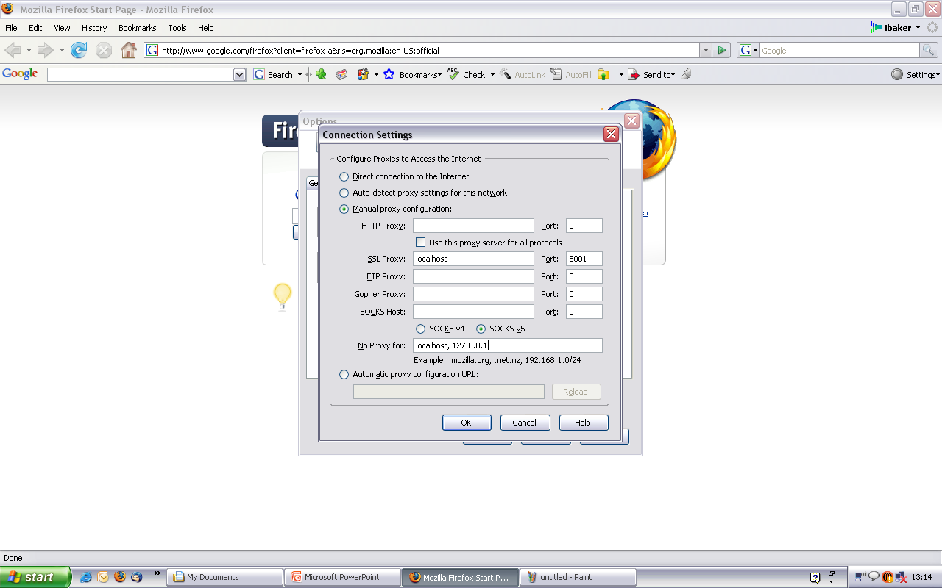

Slide 11
Possible Problems
You should be able to start up the proxy server and connect to it “out of the box”
If you are having problems
  Is someone else using the port? (default 8001)
    Try a different port on the command line
  Firewall problems?
    Try opening the needed port 8001
    Or using SSH port forwarding
  Try running your browser on the same machine and setting the proxy as localhost

Slide 12
Questions?
Project home page
  http://crypto.stanford.edu/ssl-mitm/

