Slide 1
Salaries Data

Slide 2
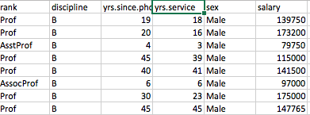
BACKGROUND INFORMATION
Salaries of Professors
Goal:
What factors effected the salaries of professors?
Predictor variables:
year of service, years since PhD and the sex of the professor.
Response variable:
the salary of the professor

Slide 3
Salaries
Data Preparation: I had to split the sex column into two separate columns so I can use it as a factor in my predictor variables
I constructed various models but the best was the baseline model
Baseline model:
Mean squared error: 715433702.27623689,
Median absolute error: 20859.891470482231,
R^2: 0.21227970848099043,
Explained variance score: 0.22737164083309114

Slide 4
Cross Validation
Basic idea:
Spilt the data into multiple train test splits - for each split build a model on each training data and evaluate the model on the test data. Finally you combine all the scores for a better performance score.
My findings with a shuffle split were : [ 0. 0.025 0.0125 0.025 0.0125]
(scoring criteria was accuracy)

Slide 5
Grid Search + Cross Validation with Random Forest
The point of grid search is to find the settings so that the production model is as gooad as possible
The settings I used was:
param_grid = {'n_estimators':[5, 10, 50, 100], 'max_depth':[3, 6, None]}
I found the best RF and did a 3-fold Cross Validation and score with f1
macro.optimized_rf = GridSearchCV(ensemble.RandomForestClassifier(), param_grid, cv=3, scoring='f1_macro')
I fitted the optimized RF just like it is a single model
optimized_rf.fit(x_train, y_train)
Grid Search Test Score (Random Forest): 0.0127226463104

Slide 6
Model ensemble
Combine multiple models together to achieve better results.
I did both methods(Voting and Bagging) but I will talk about the bagging method
BAGGING method is used for classification and regression
The point of it is to take many random subsamples and generate different models for each.
My score was : [ 0.00430108 0. 0. 0.00643382 0. ]

Slide 7
Freedman Data

Slide 8
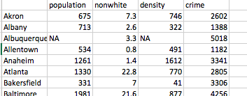
BACKGROUND INFORMATION
Crime rate of popular cities in the mid 1900's.
GOAL:
I want to explore what factors contributing to the crimes in these major cites. Also, I would want to use model building to predict the number of crimes.
Predictor variables: the population of that city, the number of non-whites in that city, the density of that city
Response variable: crime rate of that city.
All these variables could be a causing factor in the amount of crime the cities contain and that is my end mission to find out.

Slide 9
Models
The only preparation I had to perform on this data set was take out the NA’s which I did with
freedman = freedman.fillna(method ='ffill')
This method just basically fills the NA spots with the previous value in the data set
BASELINE MODEL
MSE, MAE, R^2, EVS: [1350469.8871711888, 712.69331662228842, -0.20270274643912134, -0.20001700896834906]
Why negative R^2?
R2 is negative only because chosen model does not follow the trend of the data

Slide 10
Predictions
Some predictions were as followed:
Actual Predicted
1434 2355.839752
5018 2402.941622
3077 2304.500219
2130 2235.994342
1877 2265.509454
1753 3988.757570
2805 3131.353195
5441 3339.008207
1780 2798.125555

