Slide 1
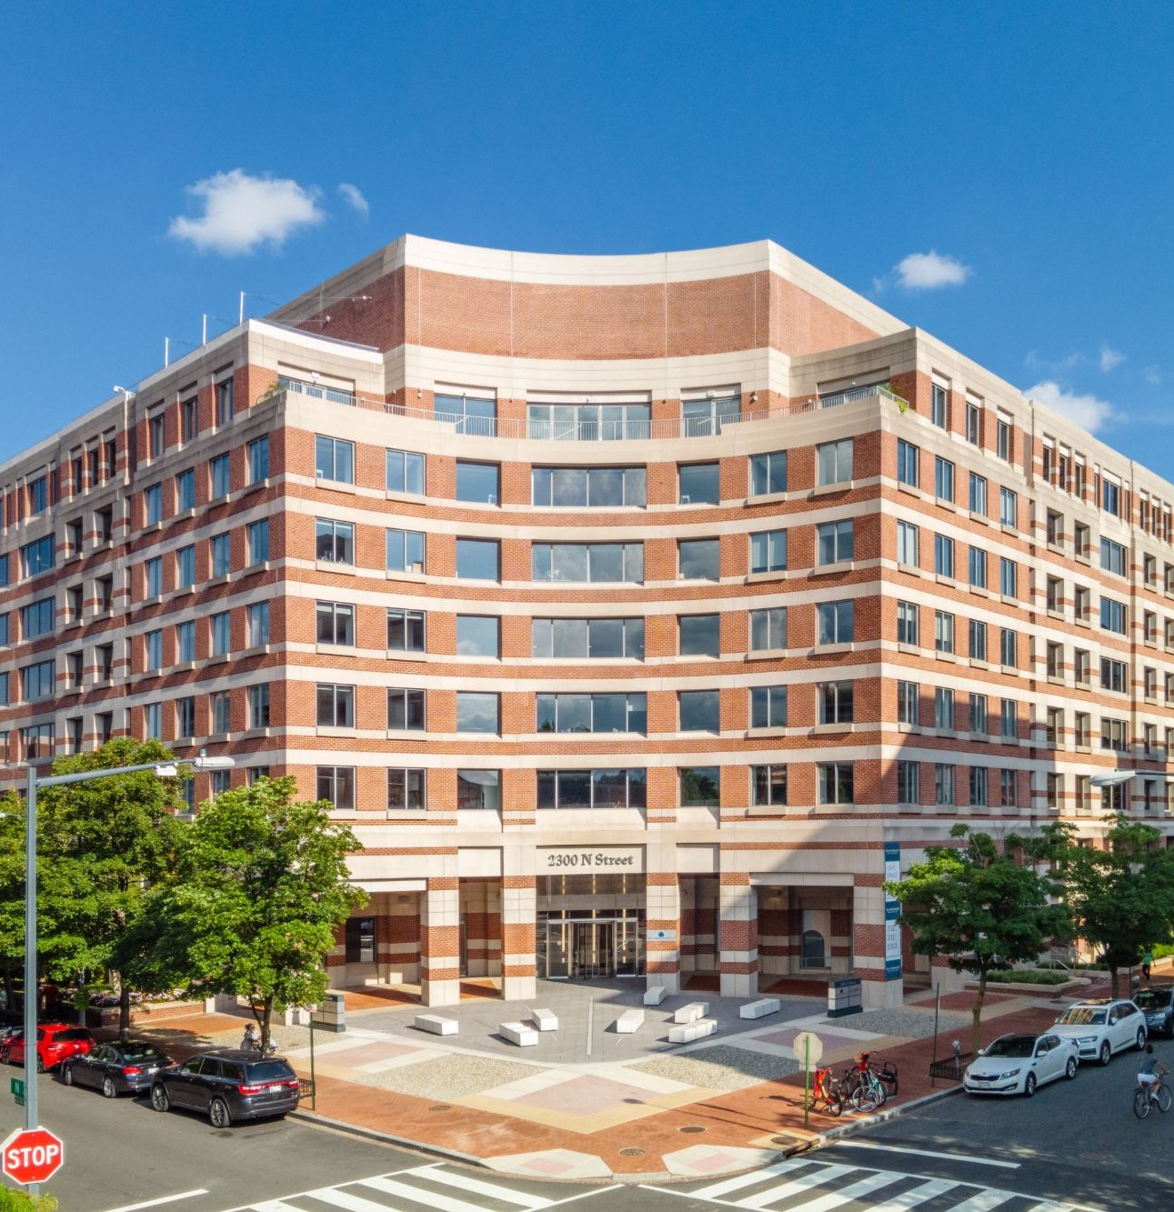
Lincoln
Investment Overview
2300 N Street, NW
Washington, DC
West End Submarket
Lincoln Property Company | Oaktree Capital Management
Confidential Equity Memorandum

Slide 2
Contents
Property Overview
03
Tenancy
08
Market
12

Slide 3
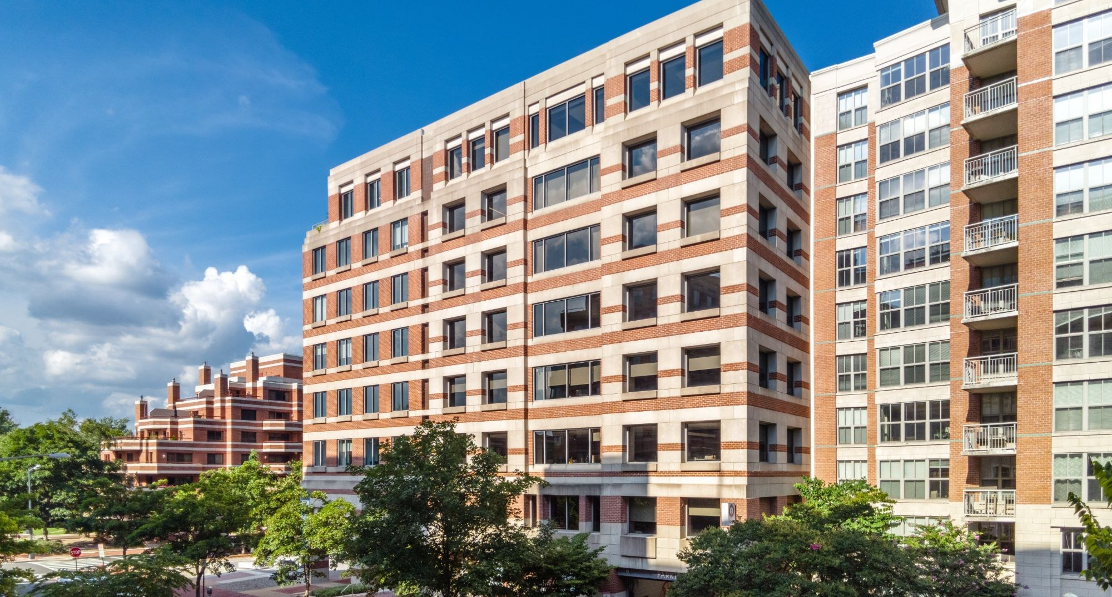
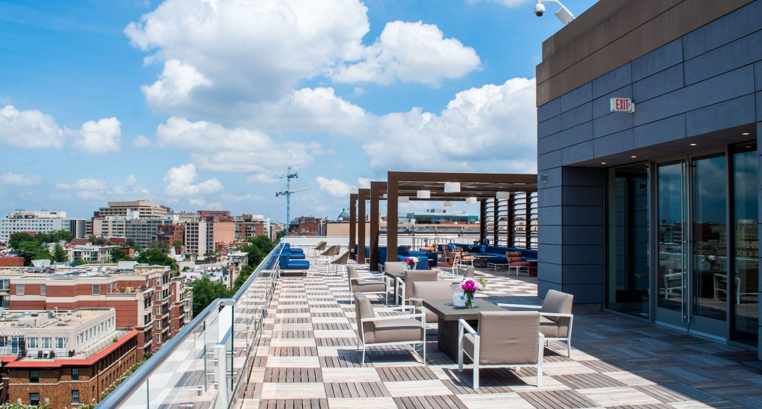
Property Overview
2300 N Street is a 282,943 SF, 8-story Class A office building in Washington, DC's supply-constrained West End submarket. Built in 1986 and renovated in 2018, the asset is 87.8% leased with 9.4 years of WALT and best-in-class amenities.
Property Description
Size (SF): | 282,943 | Submarket: | West End
Stories: | 8 | % Leased: | 87.8%
Year Built / Reno: | 1986 / 2018 | In-Place WALT: | 9.4 Years
Typical Floor: | 38,391 SF | Parking: | 300 spaces (0.98/1,000 SF)
Building Class: | Class A | Zoning: | MU-10
Land Area: | 1.13 AC | Metro: | Foggy Bottom-GWU (9-min walk)
Amenities: | Fitness, Roof Terrace, Conferencing, Restaurant | Ownership: | Lincoln Property Co. / Oaktree
Lincoln Property Company
Confidential: Not For Distribution | 3

Slide 4
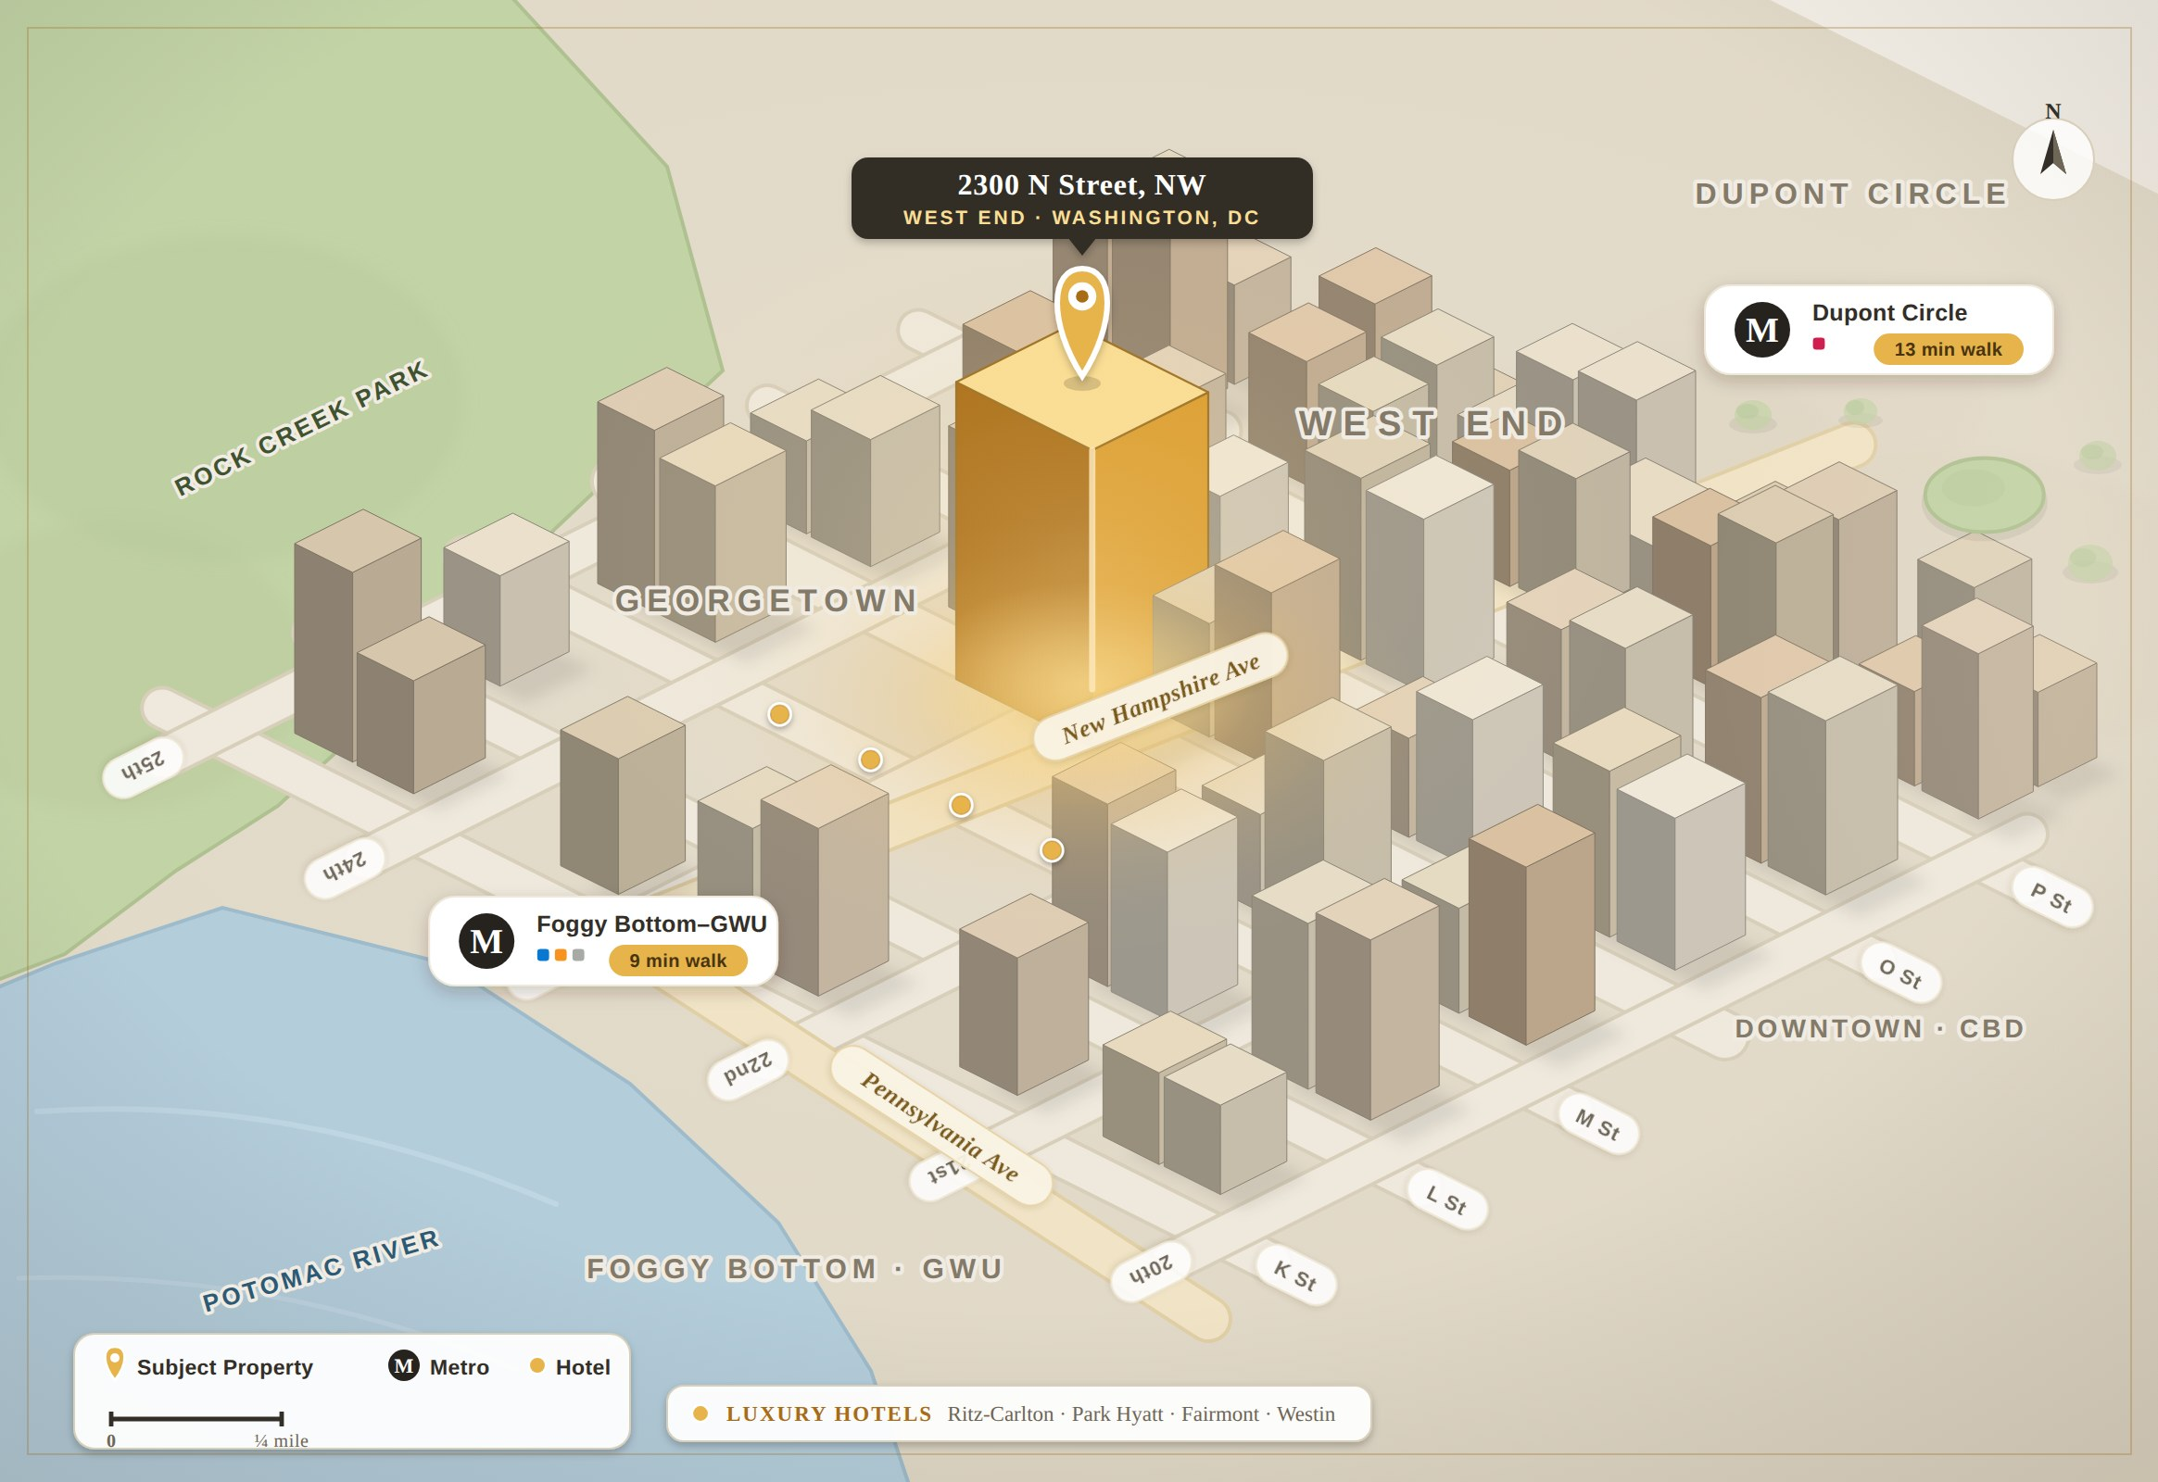
Location Overview
Location Highlights
▪ West End — DC's premier office submarket, bordering Georgetown, Foggy Bottom and the CBD.
▪ Metro — Foggy Bottom-GWU (9-min walk), Dupont Circle (13-min), Farragut North (15-min).
▪ Walkability — Walk Score 100, Transit 90, Bike 90 (“Exceptionally friendly”).
▪ Hotels — Fairmont, Park Hyatt, Westin Georgetown, Ritz-Carlton and Marriott within 2–3 blocks.
▪ Regional access — Reagan National 12-min drive; Union Station / L'Enfant ~6–7 min.
Location highlights per CoStar (7/1/2026). Map is a schematic for orientation, not to scale.
Lincoln Property Company
Confidential: Not For Distribution | 4

Slide 5
Value Considerations
▪ Hold Period: A 5-year hold is consistent with target investment horizons for active office capital and aligns with available financing.
▪ Return Metrics: With material near-term leasing and capital, investors are likely to solve for an 18–20% levered IRR and a 12–14% stabilized return on cost.
▪ Capital Projections: Prior ownership invested ~$22.0M ($76 PSF) in base-building and amenity upgrades; $1.3M ($5 PSF) of outstanding TI/LCs is credited at closing; ES assumes a buyer underwrites $3.0M ($10 PSF) of near-term capital following sale.
▪ Market Rents: Eastdil is underwriting typical office rents of $55.00–63.50 FSG, building on recent leasing at the asset.
▪ Stabilized Occupancy: Occupancy steps to 77% after Aspen's downsize and Plan International's 2027 termination; ~40,000 SF of leasing in the first three years stabilizes occupancy at 90%.
▪ Real Estate Taxes: ES assumes a 20% decrease in assessed value following sale, to $104.6M ($370 PSF), growing at inflation thereafter.
▪ Market Financing: The most efficient structure is a floating-rate execution — 65% Initial LTV with 65% Future Funding for leasing/capex at SOFR + 3.75%.
▪ Exit Cap Rate: ES underwrote a 9.5% exit cap, a $100.9M ($357 PSF) residual; absent clarity on Jackson & Campbell, investors underwrite a vacate (~50 bps of residual impact).
Source: Eastdil Secured Opinion of Value (Jun-2026).
Lincoln Property Company
Confidential: Not For Distribution | 5

Slide 6
Valuation
Levered-IRR sensitivity — 5-year hold beginning October 2026; 65% LTV / 65% future funding at SOFR + 3.75% (7.43% coupon).
Levered IRR | Exit Cap Rate
Price | 9.00% | 9.25% | 9.50% | 9.75% | 10.00%
$75,000,000 | 17.51% | 16.37% | 15.24% | 14.12% | 13.01%
$72,500,000 | 19.33% | 18.22% | 17.12% | 16.03% | 14.96%
$70,000,000 | 21.19% | 20.10% | 19.03% | 17.97% | 16.93%
$67,500,000 | 23.08% | 22.02% | 20.98% | 19.95% | 18.93%
$65,000,000 | 25.02% | 23.99% | 22.96% | 21.96% | 20.97%
At ~$70.0M / $247 PSF
In-Place Cap Rate (87.8% occ)
11.93%
Adjusted Cap Rate (76.8% occ)
8.86%
Stabilized Return on Cost (Yr 5)
12.04%
Average Cash Yield
9.42%
Levered IRR
19.03%
Equity Multiple
2.14x
Reversion PSF (9.50% exit)
$357
Loan balance of $100M implies a ~25–35% discount to par at the ES value range. Source: Eastdil Secured Opinion of Value (Jun-2026).
Lincoln Property Company
Confidential: Not For Distribution | 6

Slide 7
Operating Cash Flow
Eastdil Secured five-year projection (years ending September 30). In-place NOI at 10/1/2026 is $8.35M; near-term dips reflect lease-up downtime and abatement before stabilization.
($) | FY 2027 | FY 2028 | FY 2029 | FY 2030 | FY 2031
Effective Gross Income | 13,455,822 | 13,177,239 | 13,974,199 | 15,774,954 | 16,704,339
Total Operating Expenses | (6,942,899) | (6,538,241) | (6,703,809) | (6,904,521) | (7,083,080)
Net Operating Income | 6,468,929 | 6,472,555 | 7,032,831 | 8,616,206 | 9,367,363
Total Capital (TI/LC + CapEx) | (1,748,577) | (4,070,547) | (3,217,200) | (71,398) | (215,515)
Net Cash Flow | 4,720,352 | 2,402,008 | 3,815,631 | 8,544,808 | 9,151,849
Capital reflects ~$3.0M ($10 PSF) of building CapEx (front-loaded FY27–29) plus tenant TI/LCs. Source: Eastdil Secured Opinion of Value (Jun-2026).
Lincoln Property Company
Confidential: Not For Distribution | 7

Slide 8
Lincoln
Tenancy

Slide 9
Tenant Overview
Tenant Summary
Tenant | Floors | SF | % NRA | Expiration | Gross Rent ($/SF)
Aspen Institute ¹ | 6-8 | 91,395 | 32.3% | May-41 | $71.56
BlackIvy / CINQCARE | 2 & 6 | 25,720 | 9.1% | Aug-34 | $55.87
Bezos | 4-5 | 23,874 | 8.4% | May-32 | $28.31
Jackson & Campbell ² | 3 | 23,735 | 8.4% | Aug-35 | $51.47
Two Birds | 1 | 17,275 | 6.1% | Jun-38 | $52.53
Holtzman Vogel | 6 | 16,722 | 5.9% | Nov-36 | $57.32
Plan International ³ | 3 | 15,485 | 5.5% | Oct-27 | $67.03
Compass Point | 4 | 10,034 | 3.5% | Sep-37 | $53.50
Capital Power | 5 | 6,562 | 2.3% | Jun-31 | $55.00
Bar Angie | 1 | 4,435 | 1.6% | Mar-40 | $44.25
Total Leased | – | 248,300 | 87.8% | 9.4 yrs | $58.26
Key Considerations
▪ 88% leased today, stepping to 77% after Aspen's 6th-floor downsize — nearly 10 years of WALT.
▪ 65,000+ SF (23% of NRA) of new leasing since Q4 2024; ~$1.3M of TI/LCs credited to a buyer at close.
▪ Anchor Aspen Institute extended through May-2041 across floors 6–8.
▪ Roll risk to watch: Plan International termination (Nov-2027) and Jackson & Campbell sublease marketing ahead of its Aug-2035 expiry.
¹ Gives back 15,536 SF Dec-2026, extends through May-2041. ² 100% of space on sublease market; ES assumes vacate at expiry. ³ Subleased; termination effective Nov-2027.
Lincoln Property Company
Confidential: Not For Distribution | 9

Slide 10
Recent Leasing Activity
2300 N STREET, NW
Lincoln
Executed Leasing — Trailing 24 Months
Tenant | Suite | NRA | % NRA | Commence | Rent ($/SF) | Term | Free Rent | TI ($/SF) | Reimb.
Aspen Institute (Renewal) | 0700-0800 | 75,859 | 26.8% | 1/1/2027 | $63.50 | 14 Yr 5 Mo | 9 Mo | $0.00 | FSG
Compass Point (New) | 0450-0460 | 10,034 | 3.5% | 6/1/2026 | $53.50 | 11 Yr 4 Mo | 16 Mo | $100.00 | FSG
Capital Power (New) | 0520 | 6,562 | 2.3% | 1/1/2026 | $55.00 | 5 Yr 6 Mo | 6 Mo | $0.00 | FSG
Bar Angie Storage (Exp.) | 0210 | 2,841 | 1.0% | 6/20/2025 | $25.34 | 8 Yr 10 Mo | 0 Mo | $0.00 | NNN
Jackson & Campbell (Renewal) | 0300 | 23,735 | 8.4% | 3/1/2025 | $50.00 | 10 Yr 6 Mo | 0 Mo | $0.00 | FSG
Holtzman Vogel (Exp.) | 0610 | 10,280 | 3.6% | 3/1/2025 | $55.50 | 12 Yr | 20 Mo | $135.00 | FSG
Bezos (New) | 0400-0500 | 23,874 | 8.4% | 2/1/2025 | $27.35 | 7 Yr 4 Mo | 3 Mo | $0.00 | FSG
Global Impact (New) | 0501A | 4,039 | 1.4% | 2/1/2025 | $44.00 | 7 Yr 4 Mo | 2 Mo | $0.00 | FSG
Timmons (New) | 0410B | 3,755 | 1.3% | 2/1/2025 | $46.51 | 1 Yr 9 Mo | 0 Mo | $0.00 | FSG
Bar Angie (New) | 0100 | 4,435 | 1.6% | 10/1/2024 | $41.71 | 15 Yr 6 Mo | 6 Mo | $281.85 | NNN
Total / Avg. |  | 165,414 | 58.5% |  | $52.80 | 139 Mo | 7.2 Mo | $22.01
Source: Eastdil Secured Opinion of Value (Jun-2026). Rents shown gross.
Lincoln Property Company
Confidential: Not For Distribution | 10

Slide 11
Market Leasing Assumptions & Capital
Market Leasing Assumptions
Capital Plan
Space Type | Rent | Renew | Down | Term | TI (N/R)
Office (Floors 7-8) | $63.50 | 70% | 18 mo | 11 Yr | $120/$80
Office (Floor 6) | $59.00 | 70% | 18 mo | 11 Yr | $120/$80
Office (Floors 4-5) | $57.50 | 70% | 18 mo | 11 Yr | $120/$80
Office (Floor 3) | $55.00 | 70% | 18 mo | 11 Yr | $120/$80
Town Hall Suites (4-5) | $54.00 | 70% | 12 mo | 8 Yr | $75/$25
Spec Suite (Floor 6) | $52.00 | 70% | 12 mo | 5.7 Yr | $50/$35
$36 Gross (Fl 2, 4-6) | $36.00 | 70% | 18 mo | 8 Yr | $100/$30
Retail | $45.00 | 75% | 12 mo | 10 Yr | $95/$20
Project | Amount | PSF
Prior Ownership Renovation | $21.5M | $76
Roof Terrace | $4.6M | $16
Common Areas | $2.3M | $8
Main Lobby / AC Units | $4.0M | $14
Fitness / Elevators / Garage | $4.0M | $14
Other base-building | $6.6M | $23
Future Capital Plan (2026-28) | $3.0M | $11
RE taxes: ES assumes a 20% assessment reduction post-sale to $104.6M ($370 PSF), growing at inflation. $1.3M of outstanding TI/LCs credited at close.
Global: 2.5% inflation, 3.0% mgmt fee, $0.25 PSF reserves, 2.5% in-term bumps. Source: Eastdil Secured Opinion of Value (Jun-2026).
Lincoln Property Company
Confidential: Not For Distribution | 11

Slide 12
Lincoln
Market

Slide 13
Washington, DC Metro Office Market
The Good
What's Challenging
▪ Office trade volume is accelerating — 3rd-highest 2025 US volume and 2nd-highest number of transactions.
▪ The return-to-office mandate has increased DC activity and added contractor demand.
▪ Pricing bands for office have formed.
▪ Newer-vintage product outperforms — nearly all net absorption is in post-2010 built/renovated space.
▪ Record rents are being achieved for new construction and high-quality space.
▪ Minimal new supply plus 6.9 MSF of office→residential/hotel conversions will keep improving fundamentals.
▪ DC headlines (DOGE, GSA footprint, tariffs, National Guard, shutdown) create hurdles for investors.
▪ Headline vacancy above 20% in most submarkets is forcing heightened concessions, especially for commodity product.
▪ Leasing velocity remains mixed outside of Class-A space.
▪ Investors are underwriting significant capital amid escalating costs for non-trophy assets.
Source: Eastdil Secured Opinion of Value (Jun-2026).
Lincoln Property Company
Confidential: Not For Distribution | 13

Slide 14
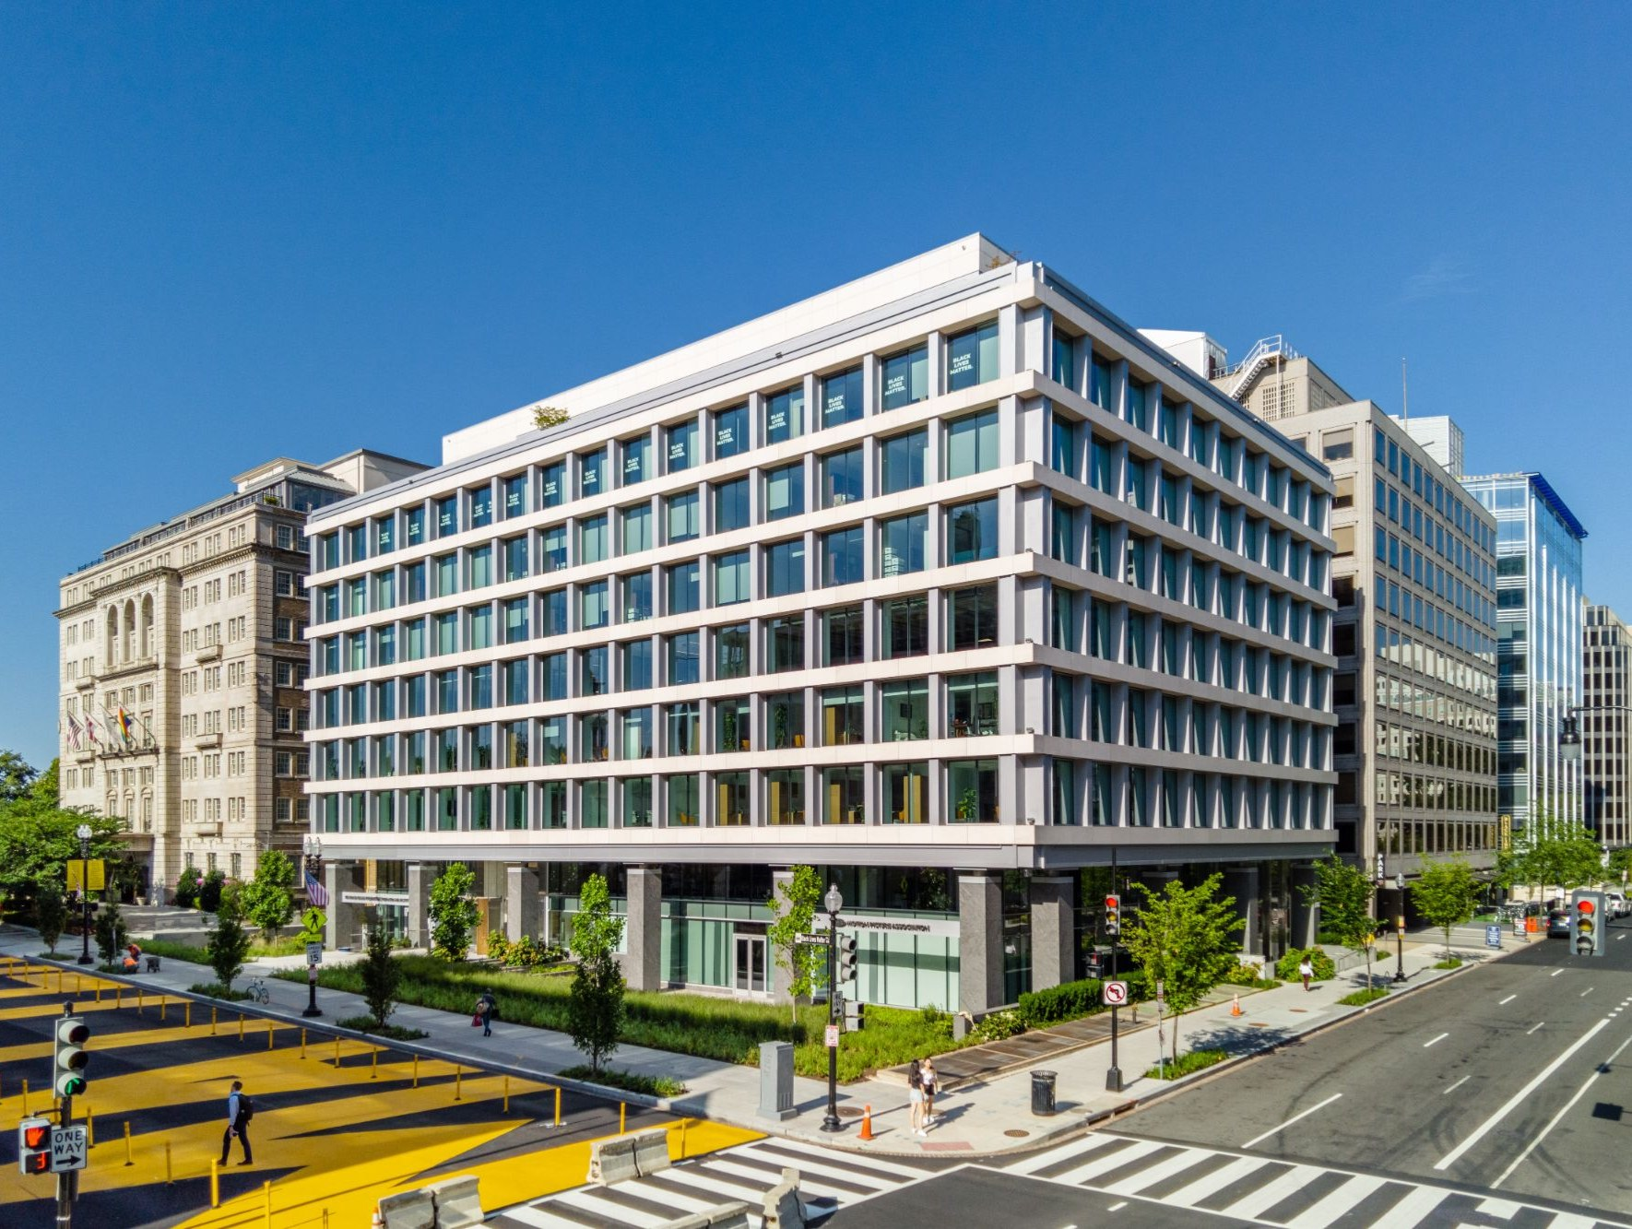
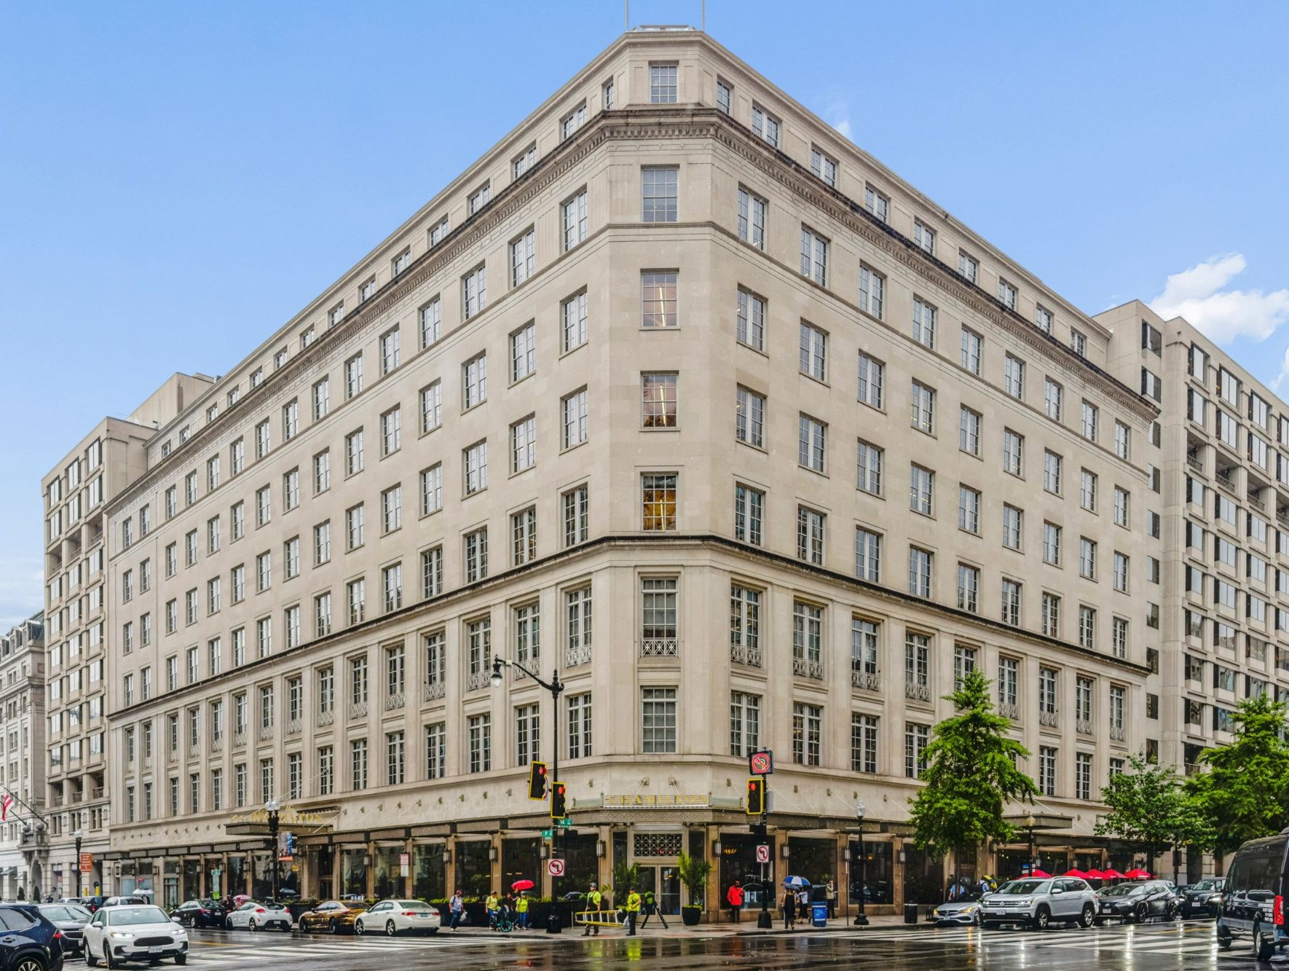
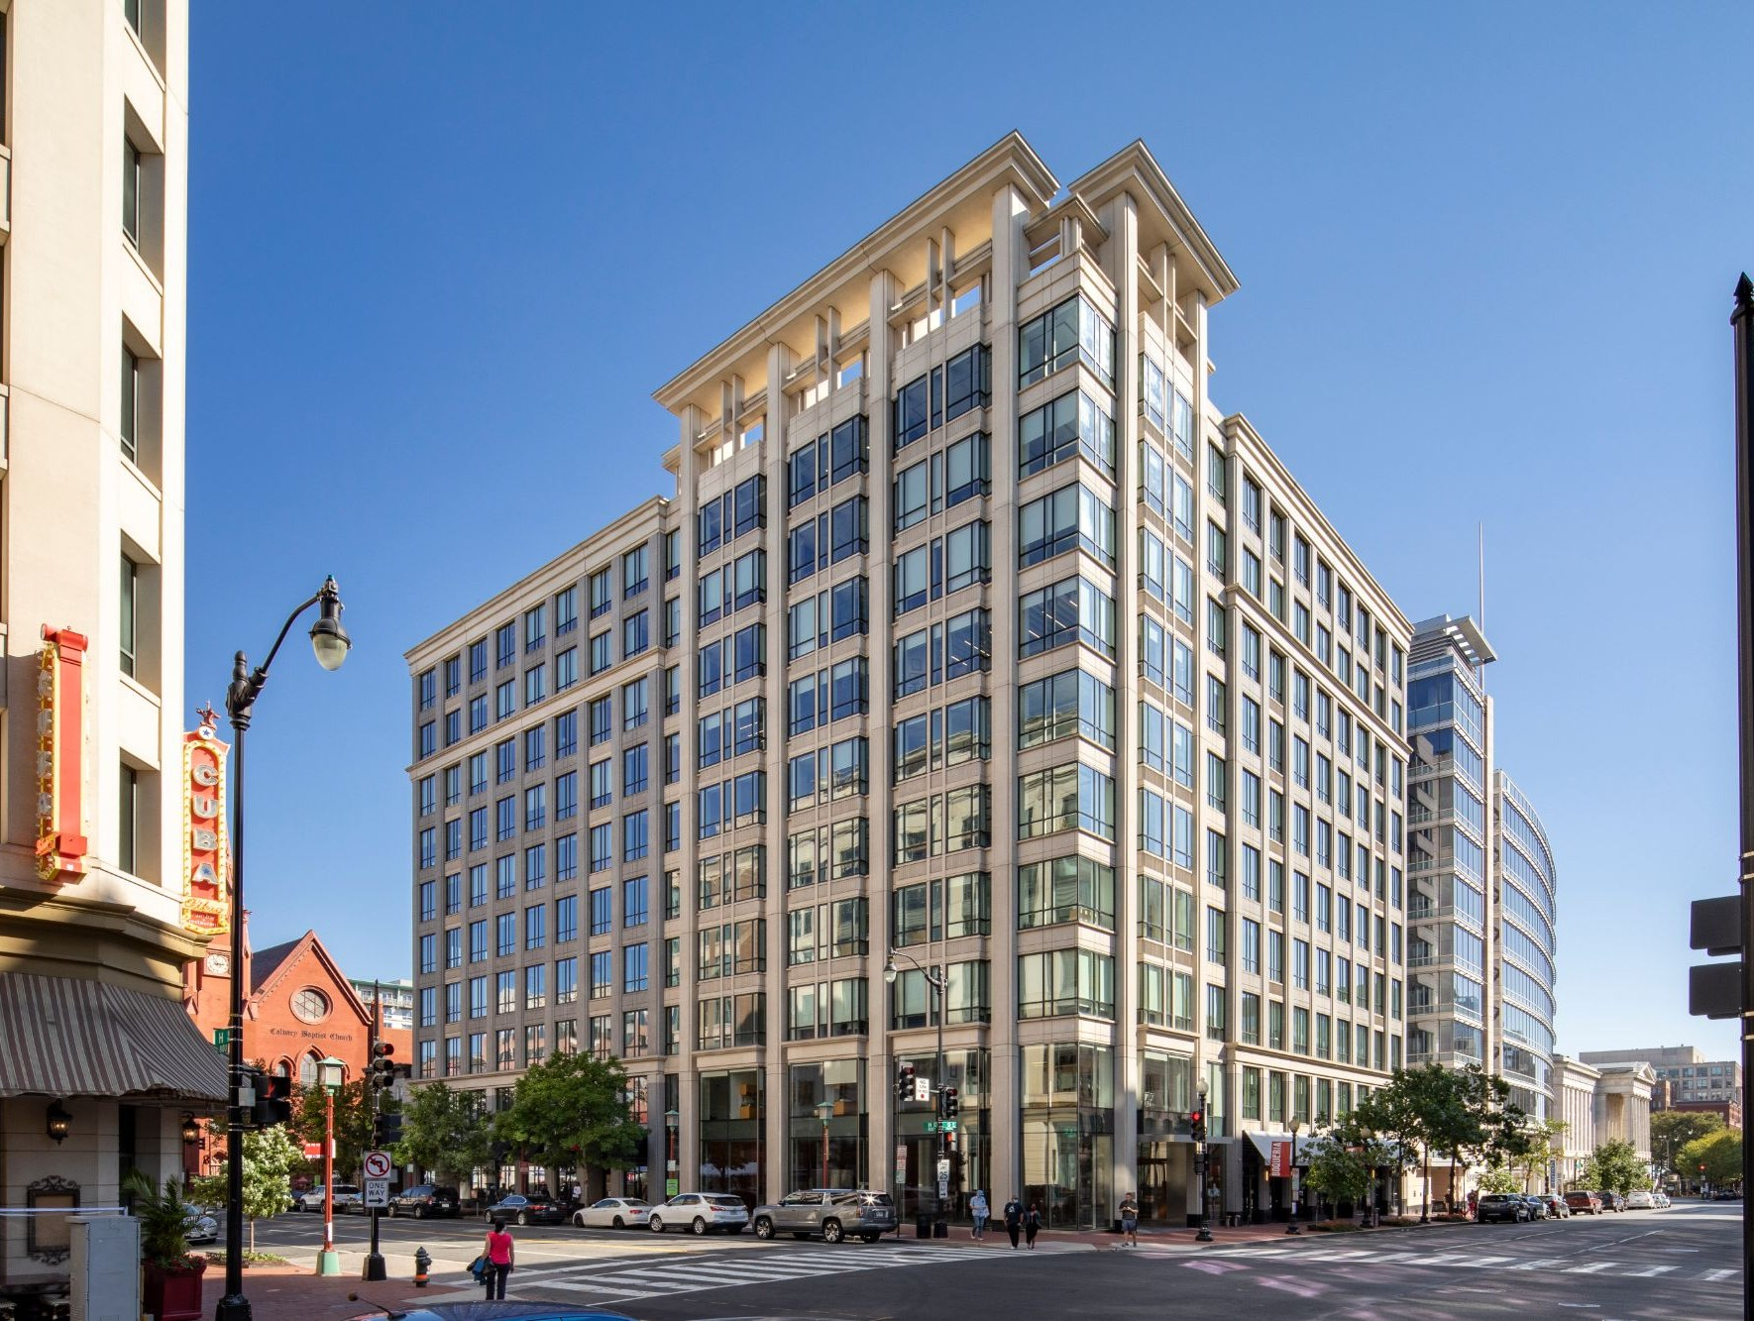
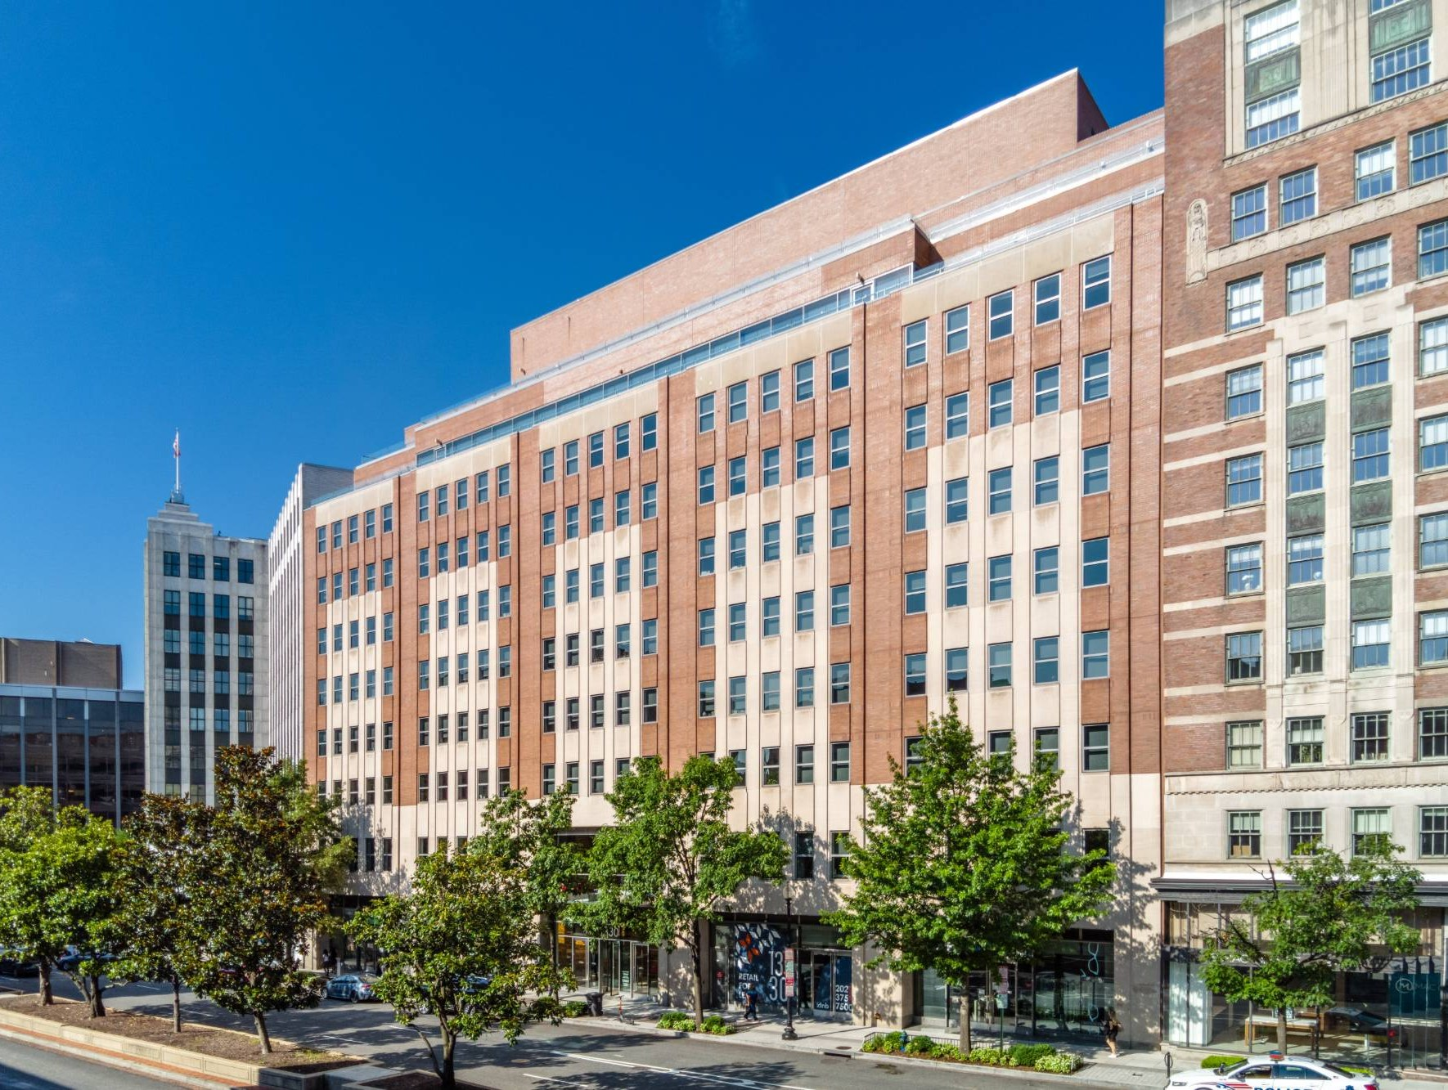
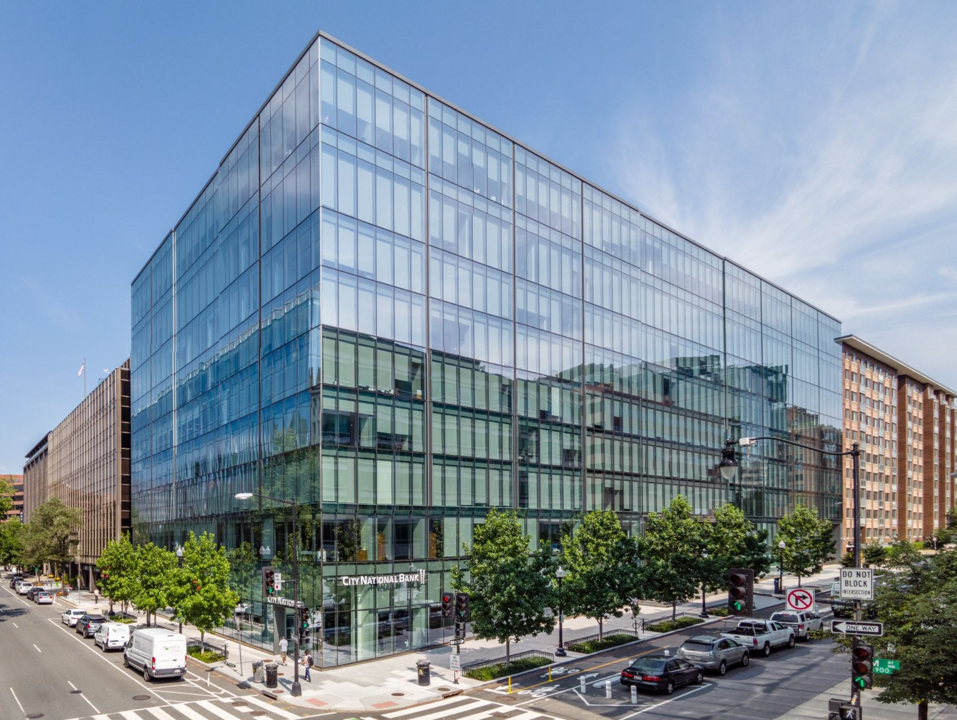
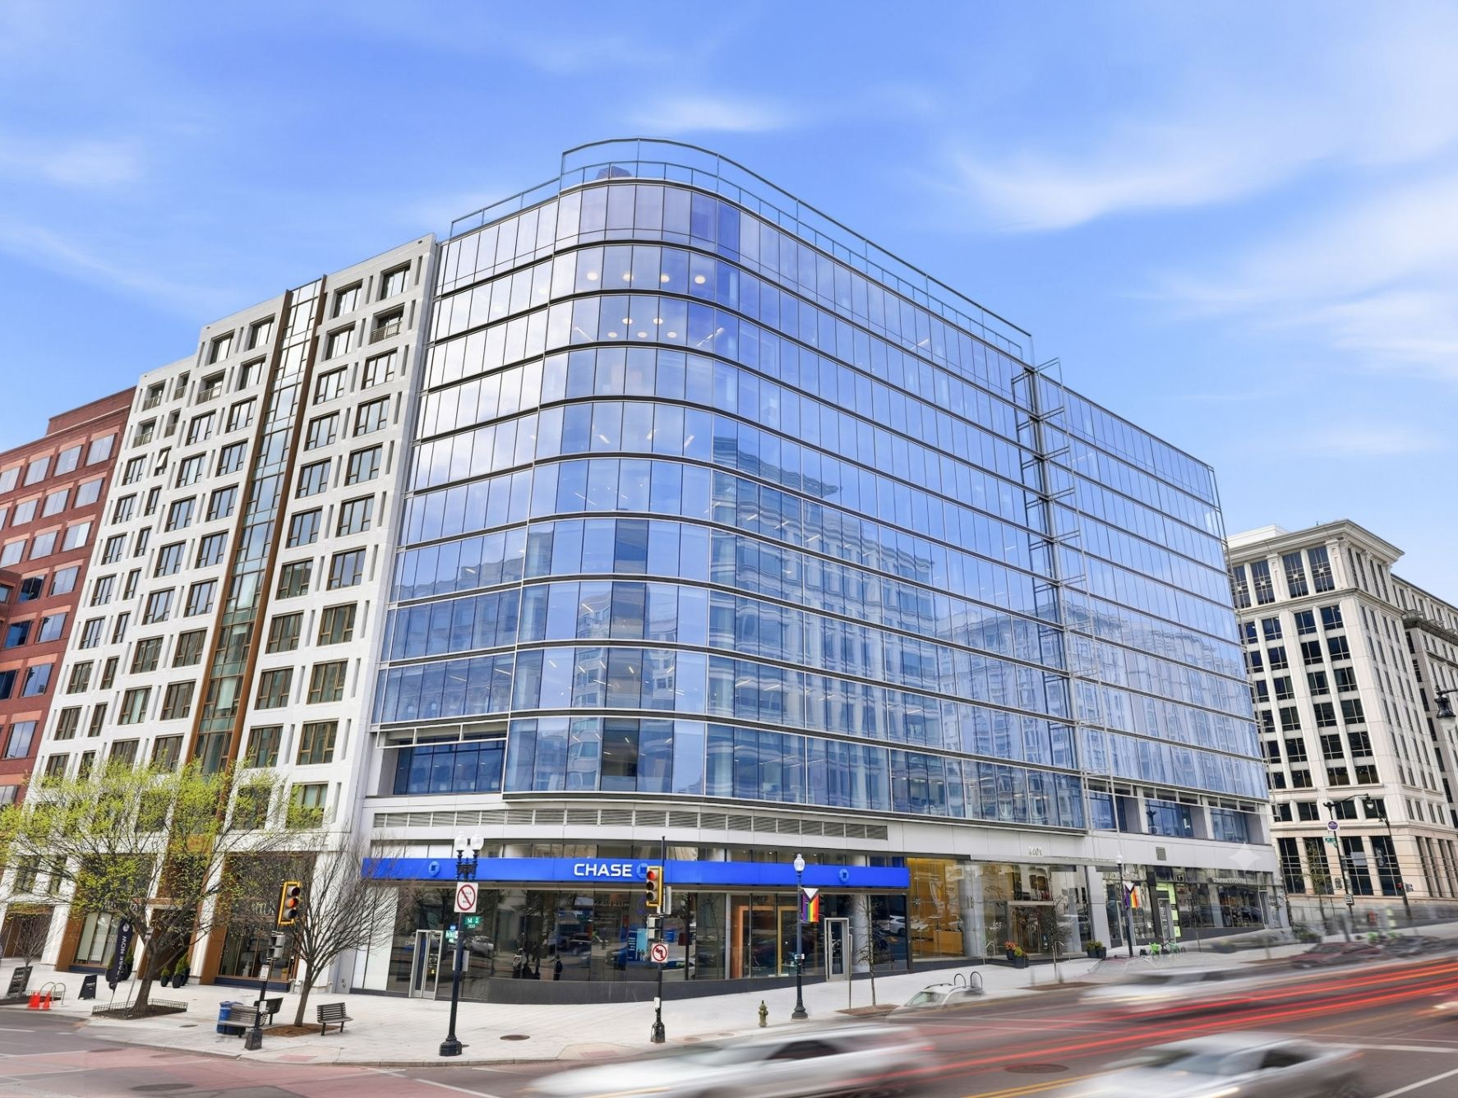
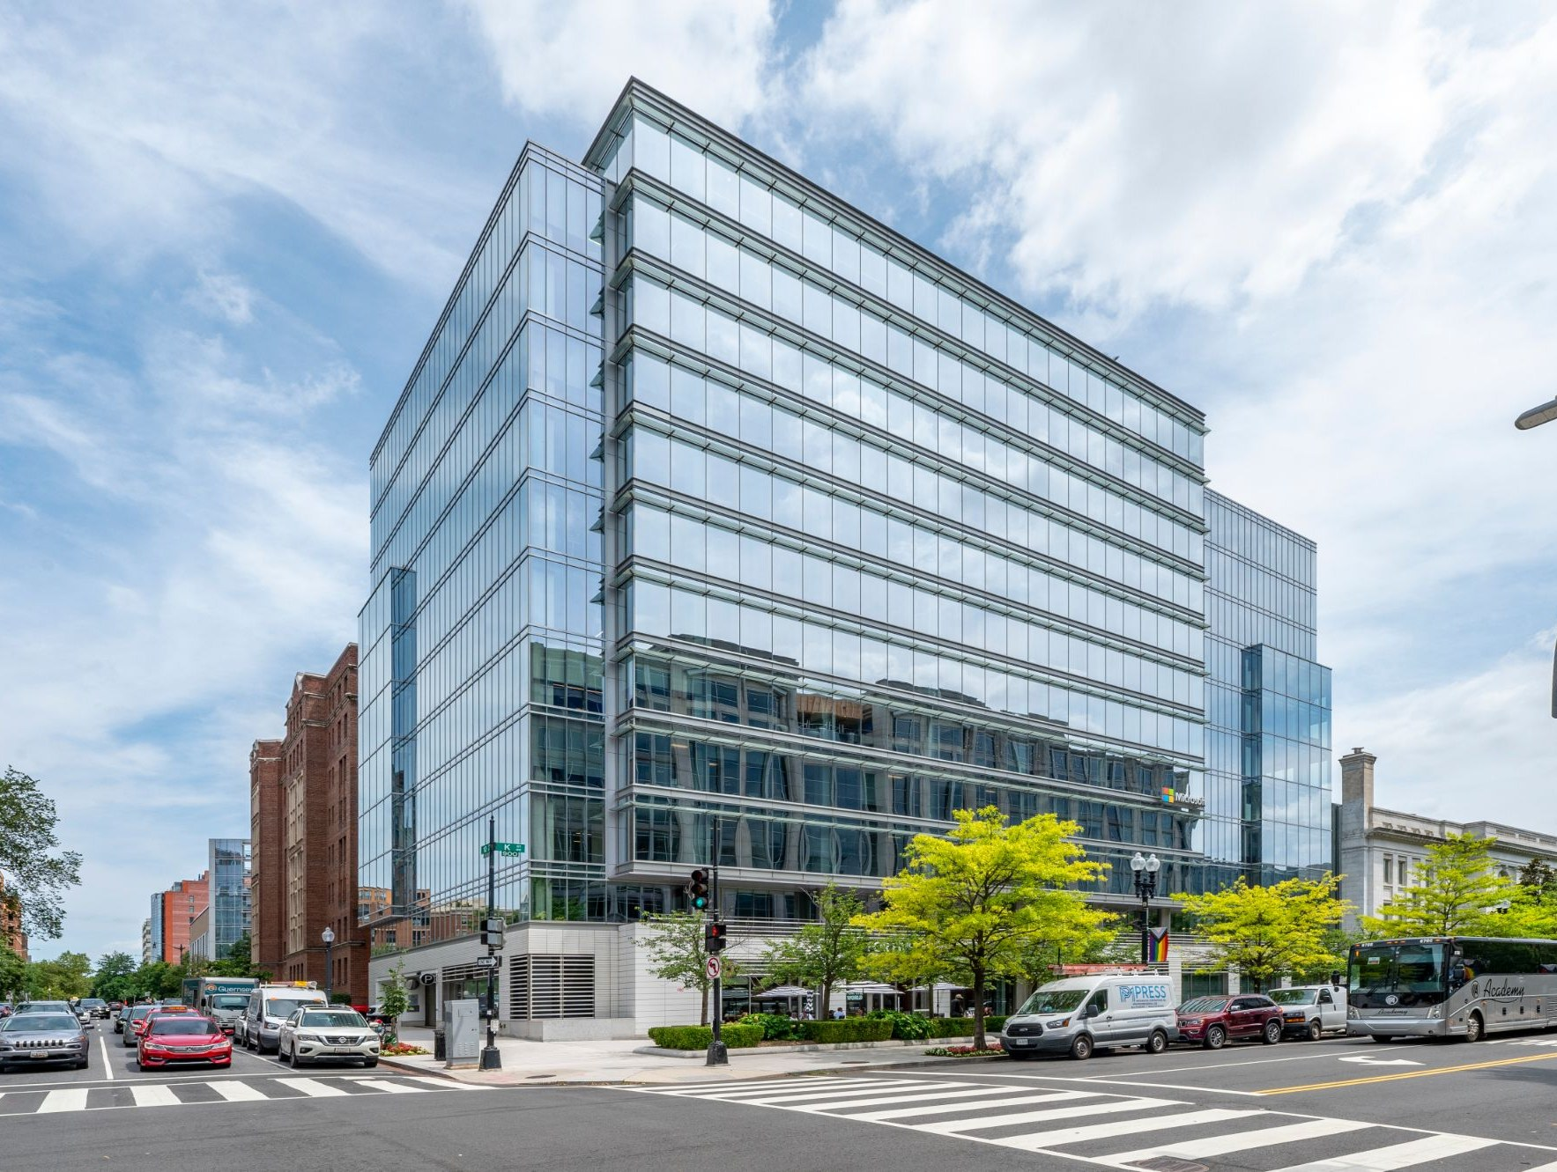
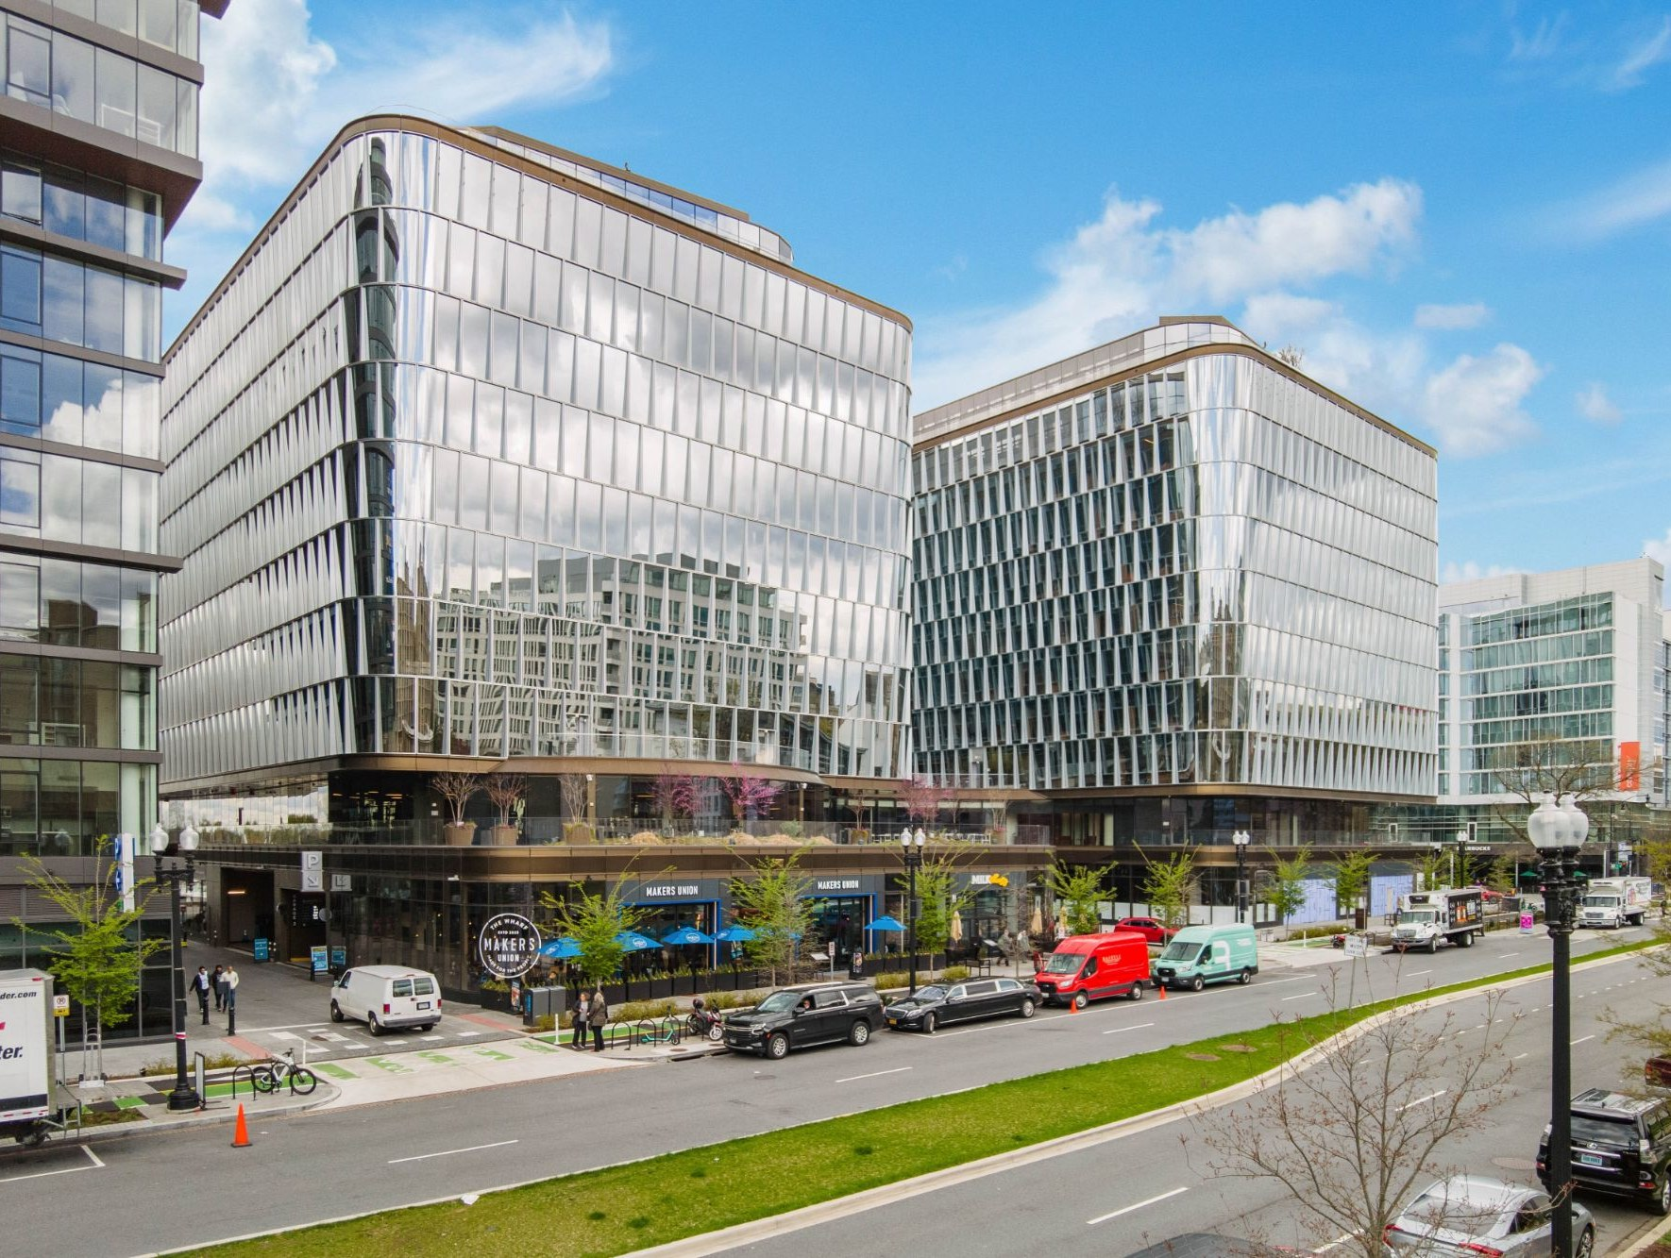
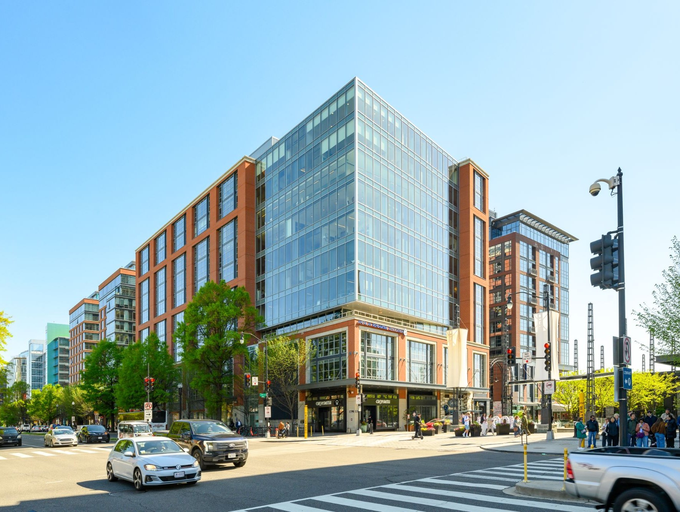
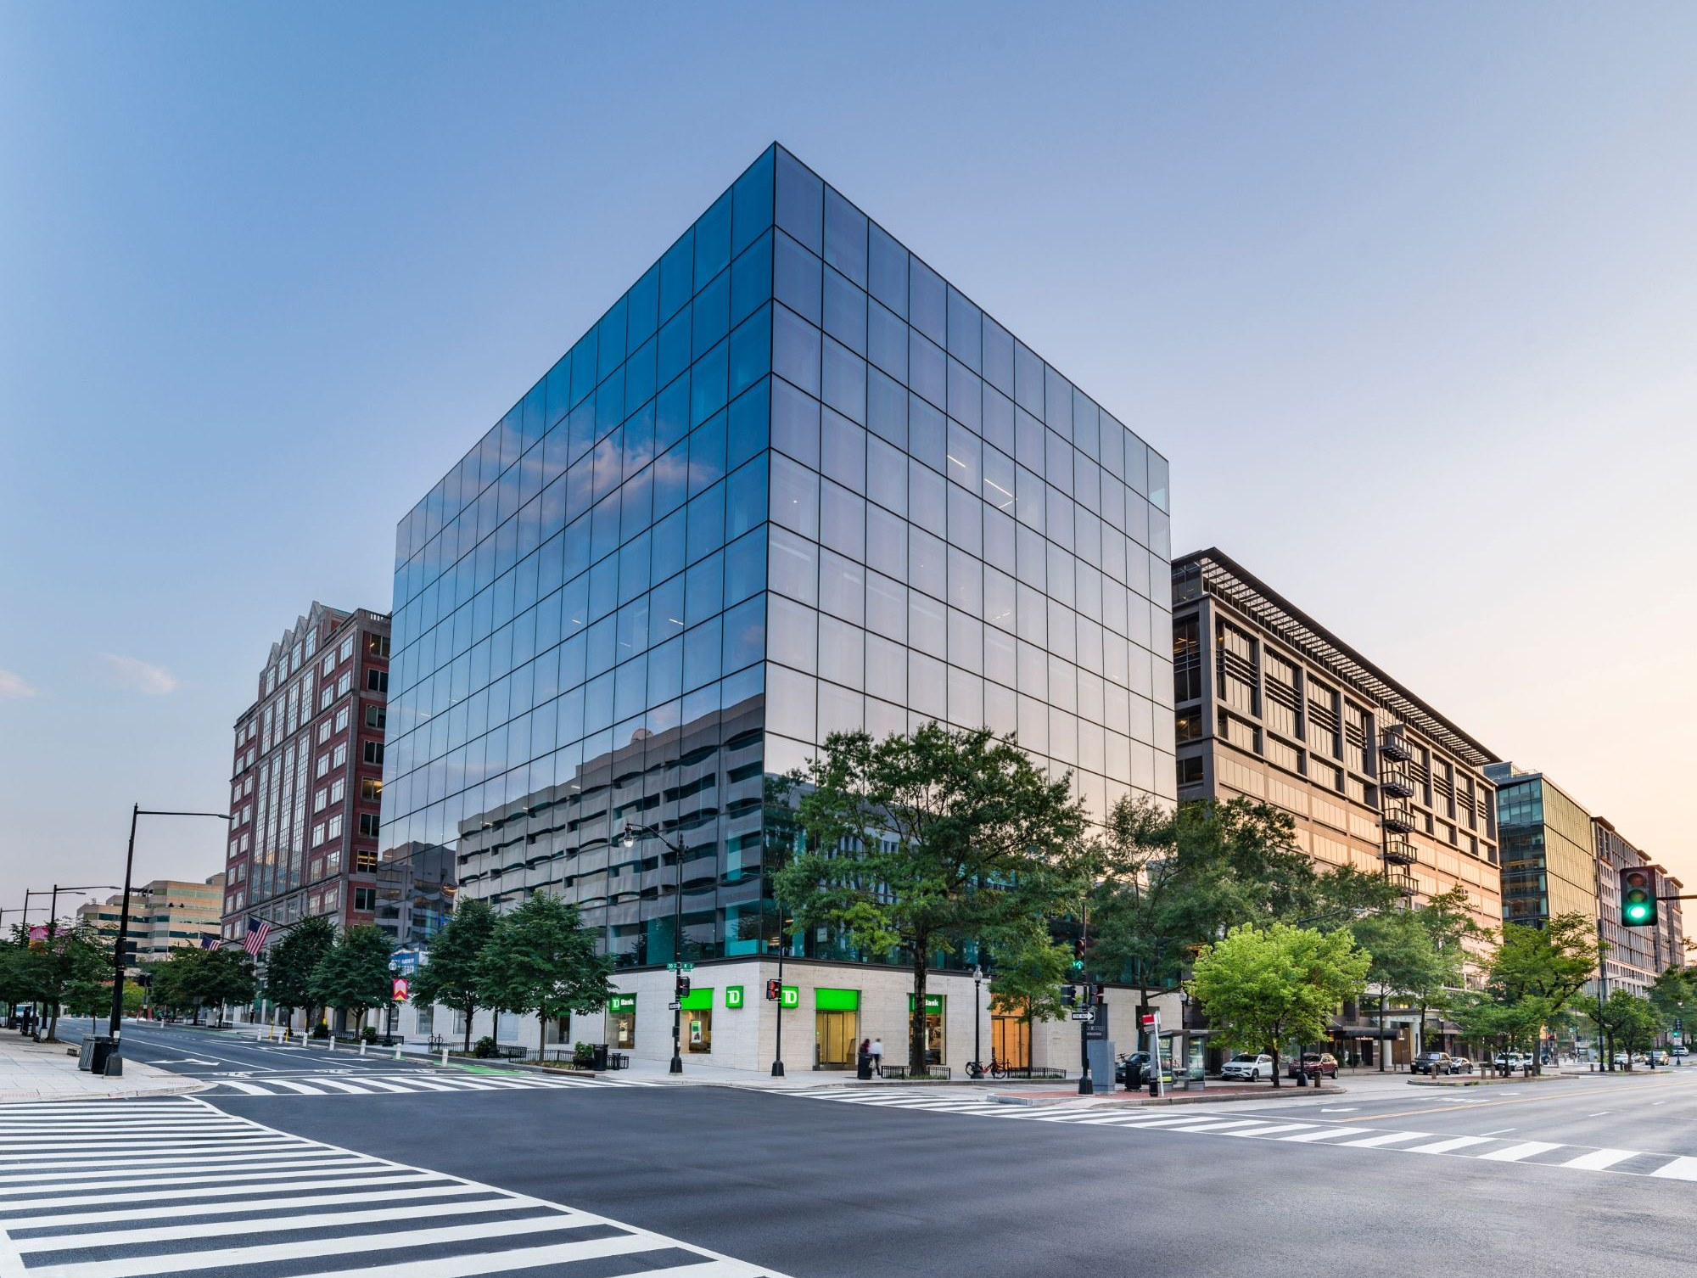
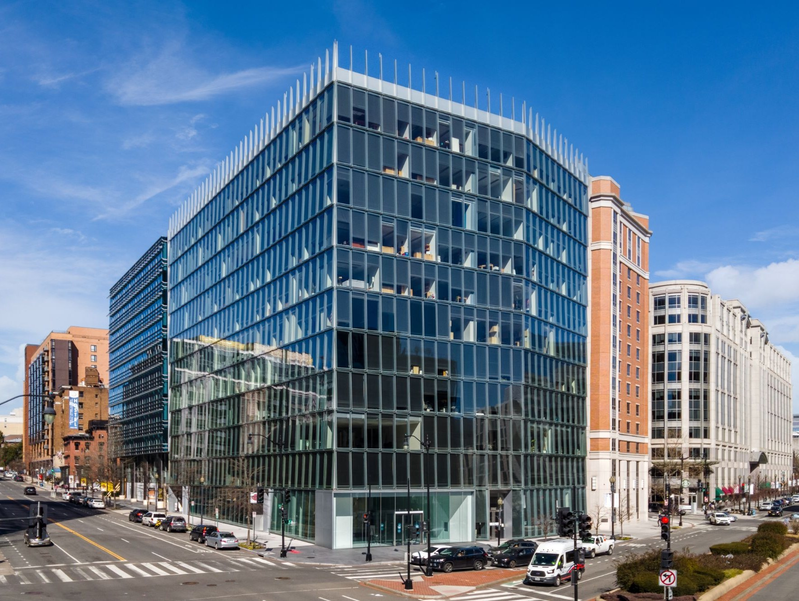
Recent Data Points
WASHINGTON, DC — CLASS-A SALES
Lincoln
Recent & Active Comparable Transactions
 | 888 16th | Hamilton Square | 799 9th | 1330 Connecticut | 2001 M | 1401 New York | 901 K | District Wharf (670/680/1000 Maine) | District Wharf (800 Maine) | 2000 K | 1099 New York
 | Bidding | Awarded | Awarded | Awarded | Closed Jan-26 | Closed Jan-26 | Closed Jun-25 | Closed May-25 | Closed May-25 | Closed Jul-24 | Closed Mar-24
Size (SF) | 107,000 | 248,000 | 205,000 | 259,000 | 284,000 | 211,000 | 220,000 | 750,000 | 150,000 | 233,000 | 181,000
% Leased | 95% | 100% | 82% | 80% | 93% | 94%→81% | 68% | 92% | 100% | 88% | 95%
WALT | 8.6 Yr | 6.6 Yr | 6.6 Yr | 11.1 Yr | 9.0 Yr | 4.7 Yr | 6.3 Yr | 13.0 Yr | 8.5 Yr | 7.0 Yr | 9.0 Yr
Cap Rate | 8.50% | 8.90% | 9.75% | 9.00% | 8.90% | 11.50→9.00% | 8.00% | 6.50% | 8.00% | 8.00% | 9.25%
Price (PSF) | $75.0M $700 PSF | $127.5M $514 PSF | $100.0M $488 PSF | $92.5M $358 PSF | $163.3M $577 PSF | $85.0M $402 PSF | $85.0M $386 PSF | $628.0M $835 PSF | $63.2M $425 PSF | $140.2M $600 PSF | $95.0M $525 PSF
Buyer | TBD | Confidential | Confidential | Confidential | Stream Realty | Carr / Barings | Shorenstein | PSP | PSP | Spear Street | FarmView / Quadrangle
Seller | Trammell Crow / Meadow | CommonWealth / CalPERS | Brookfield / AussieSuper | BXP | Brookfield | AXA | Carr Properties | Hoffman / Madison | Hoffman / Madison | Tishman / Deka | Credit Suisse
Notes | Condo Regime | – | – | – | Market Debt (Debt Fund) | Market Debt (Debt Fund) | Market Debt (Debt Fund) | Market Debt (CMBS) | Market Debt (CMBS) | Seller Financing | Market Debt (CMBS)
Lincoln Property Company
Confidential: Not For Distribution | 14

Slide 15
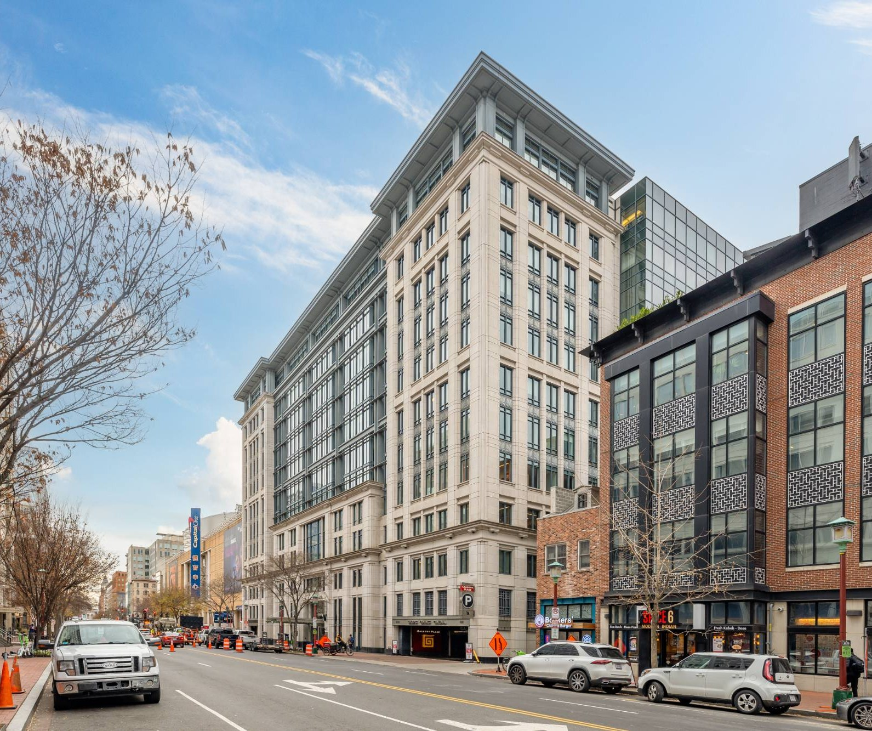
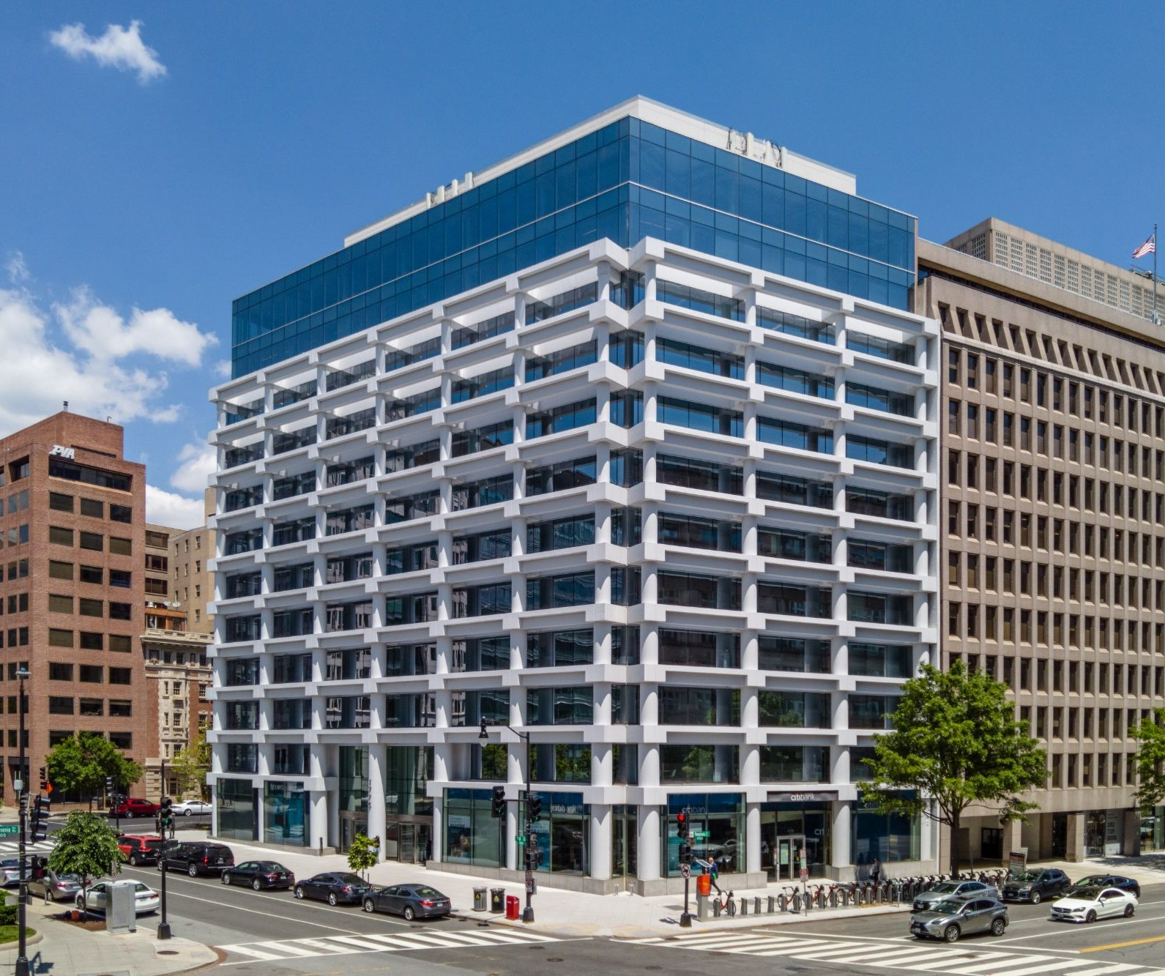
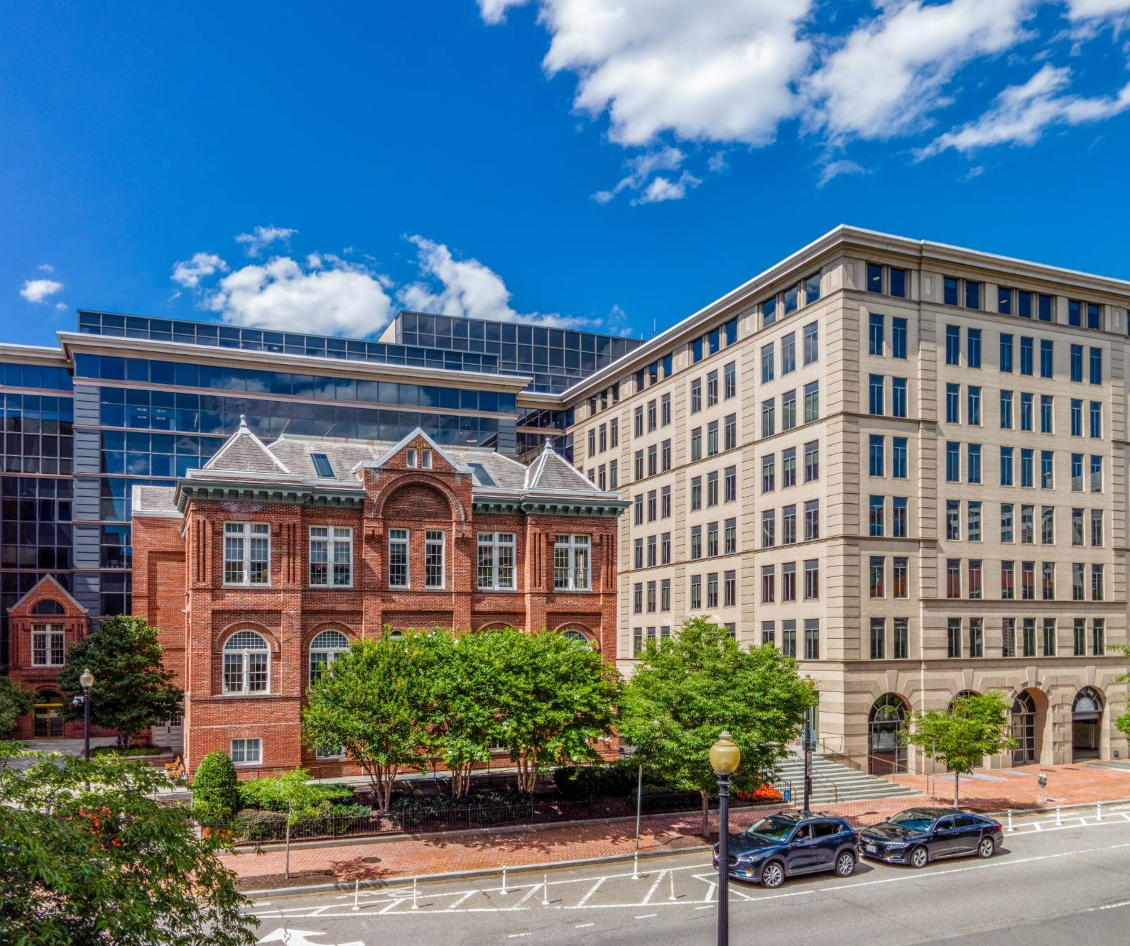
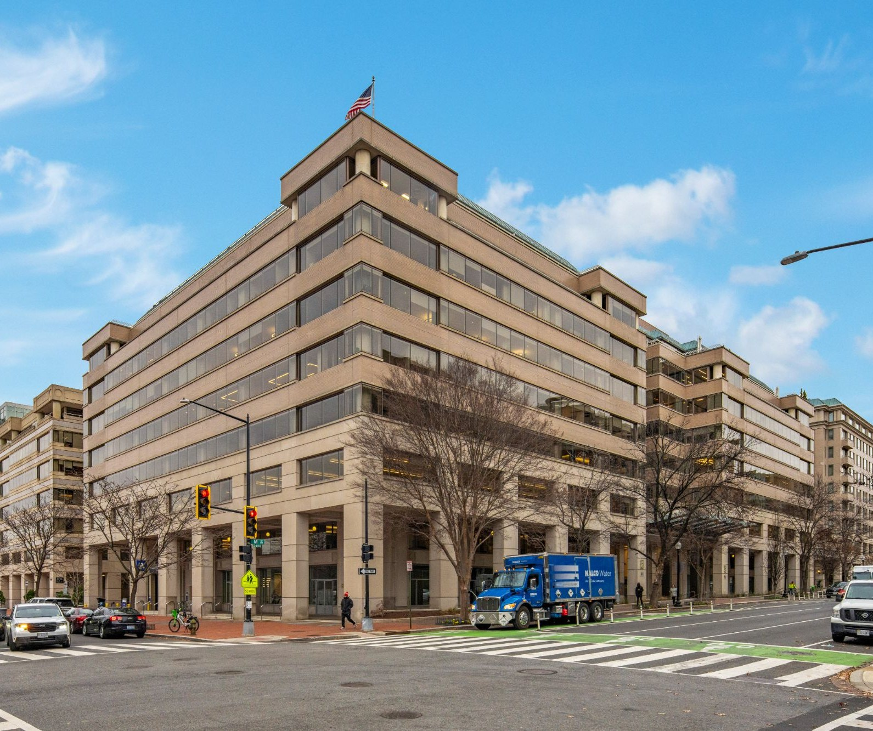
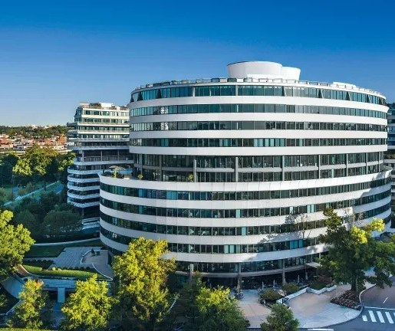
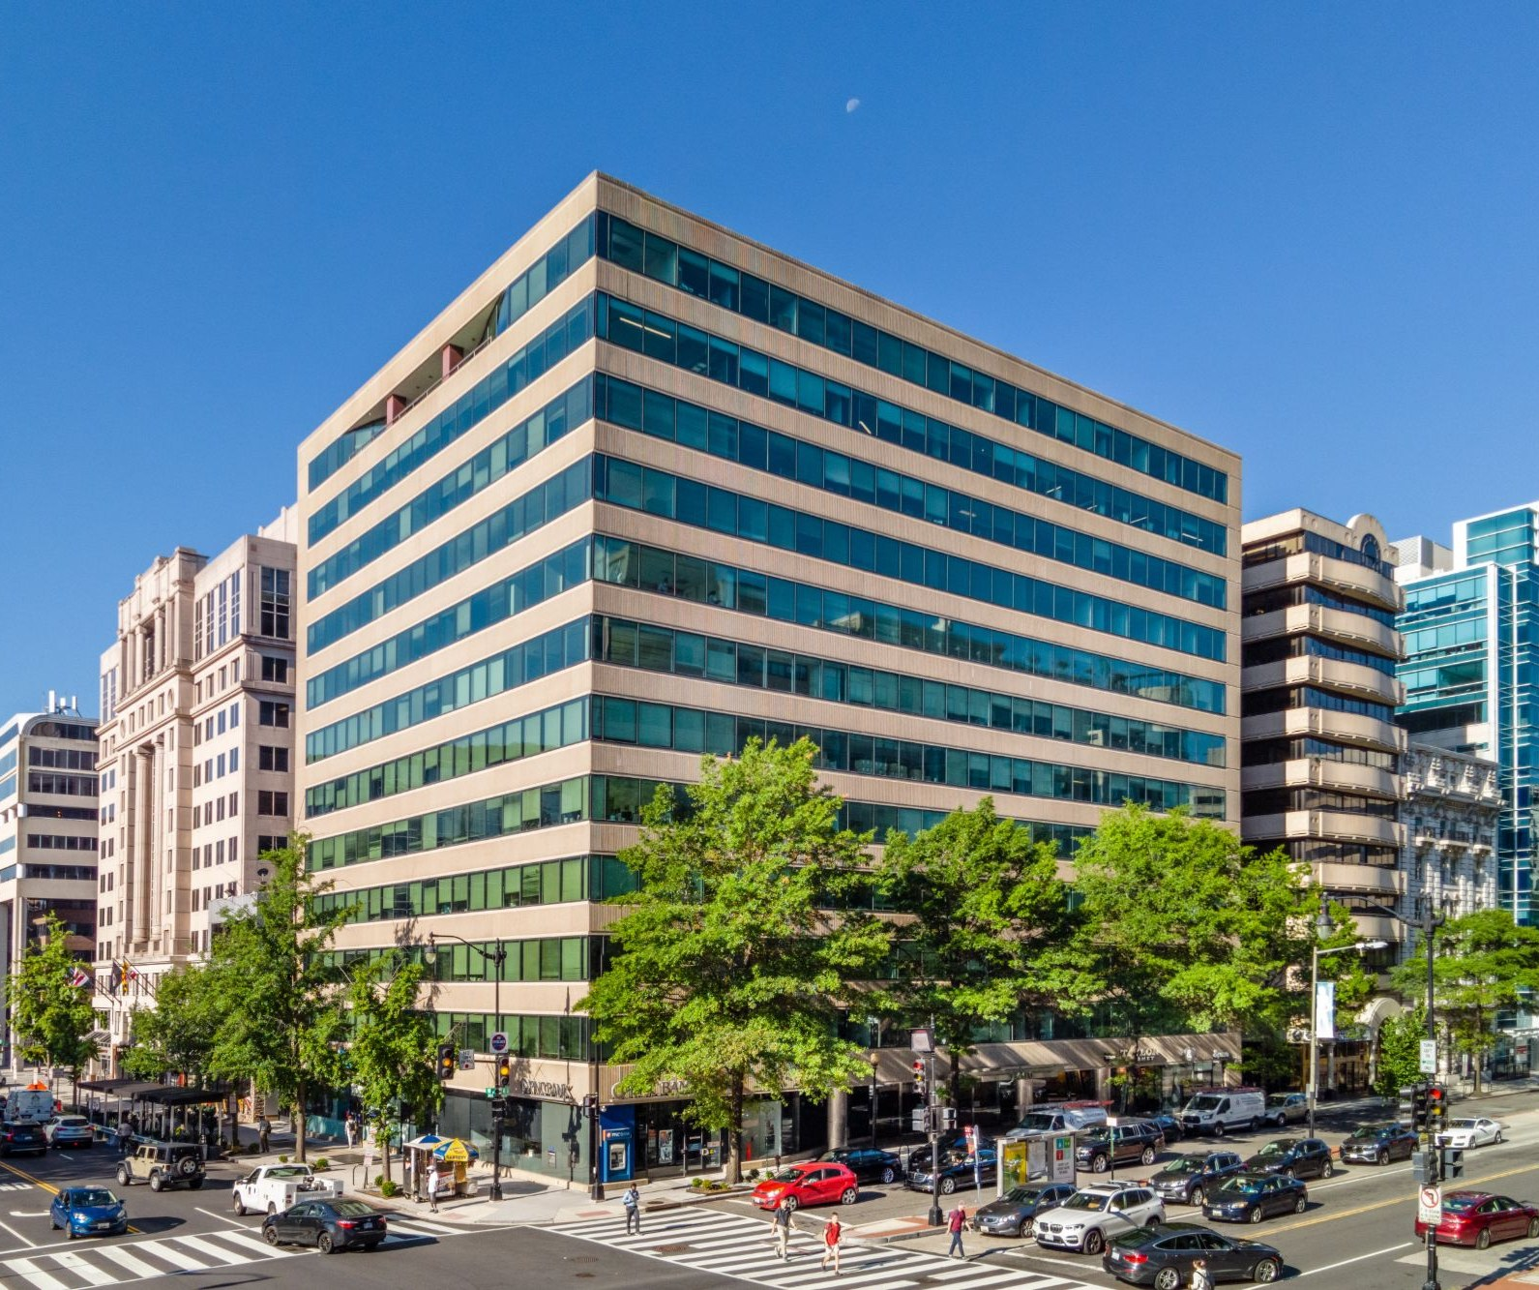
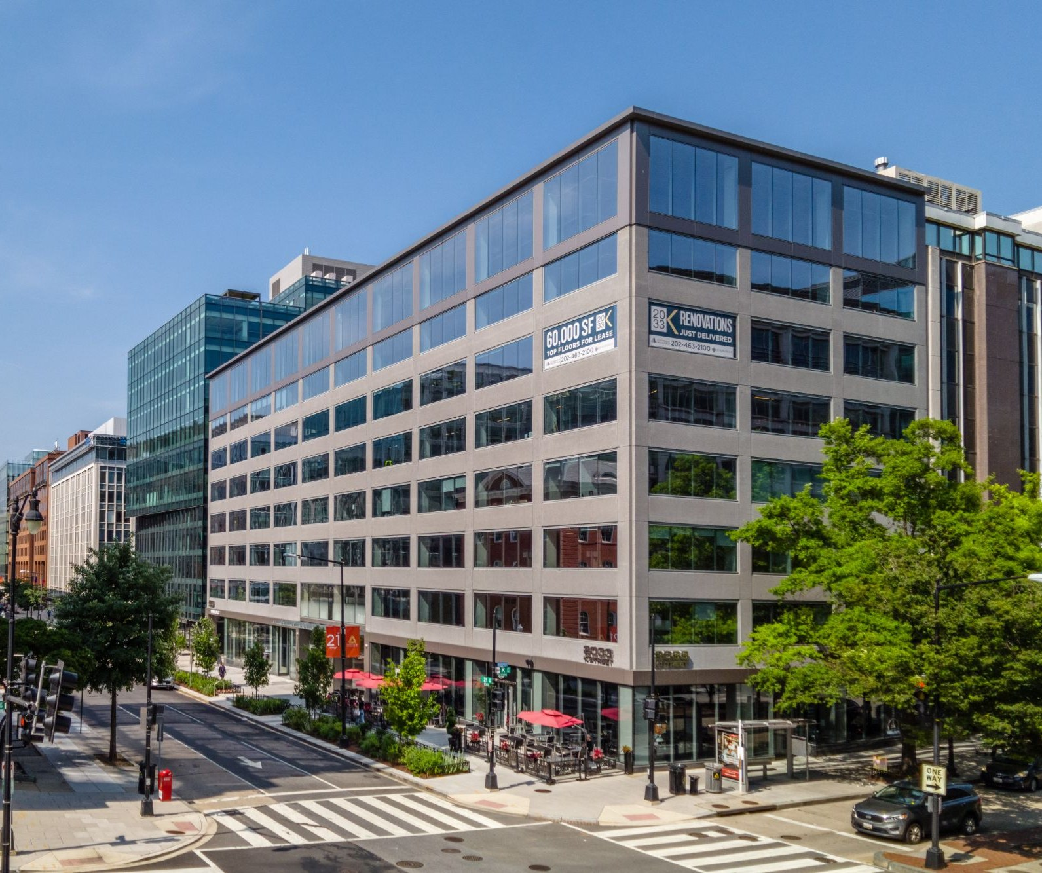
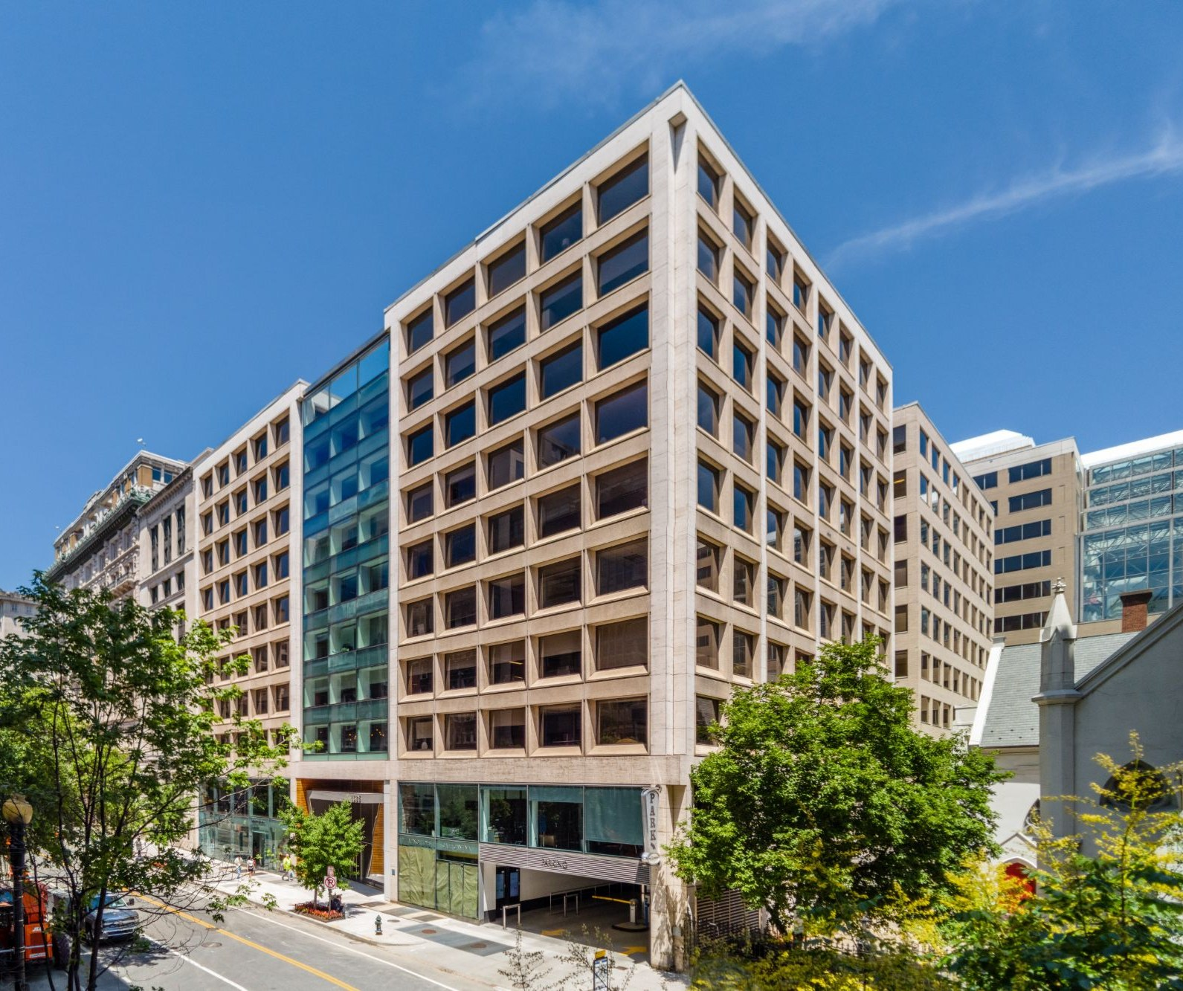
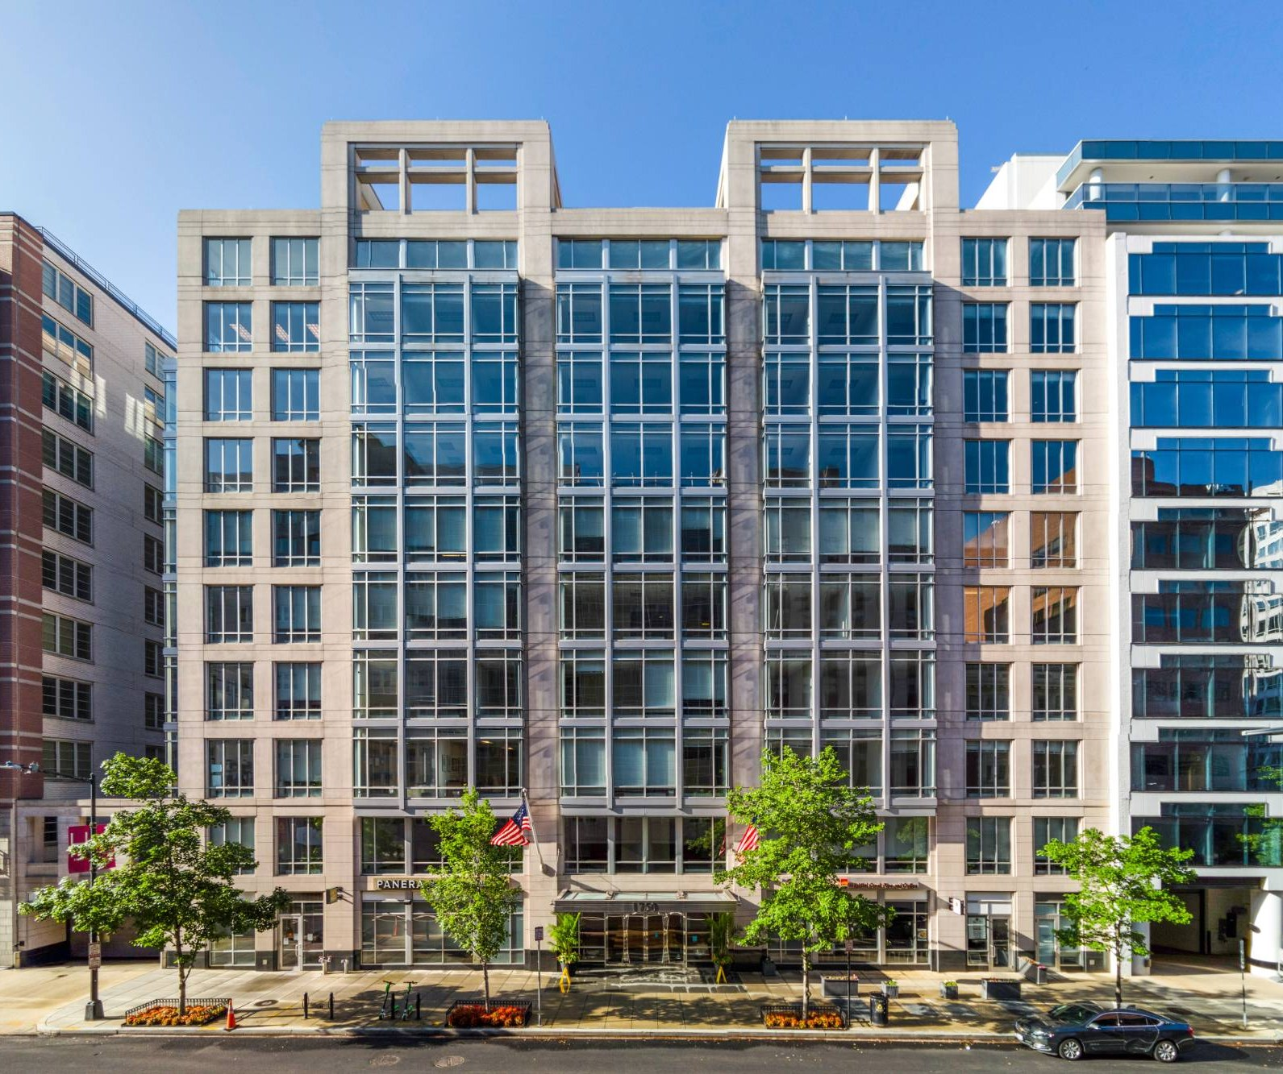
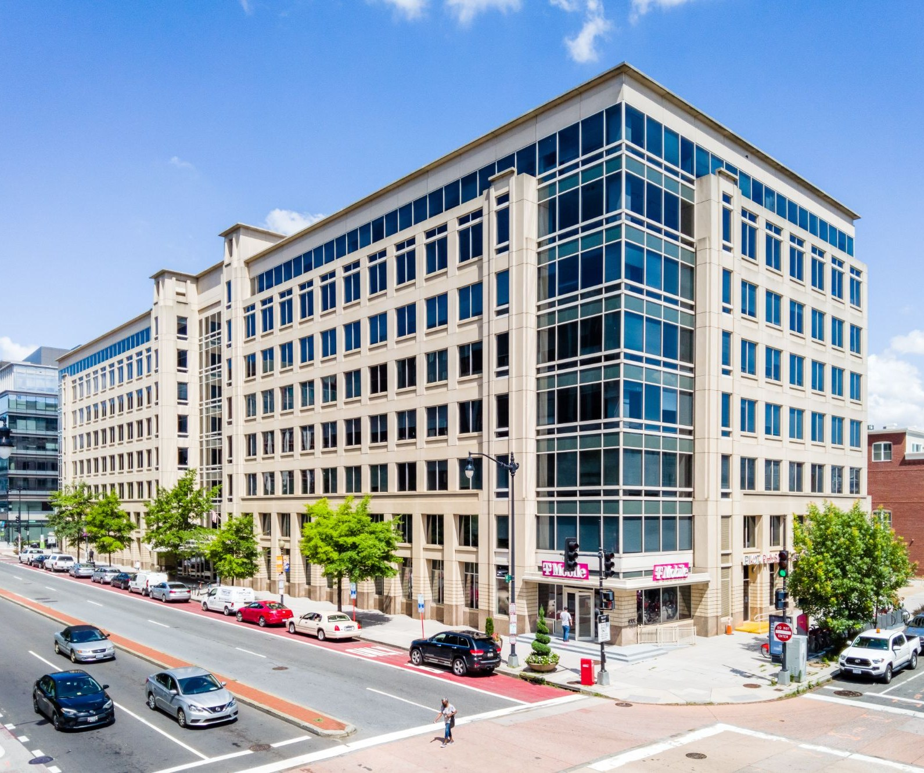
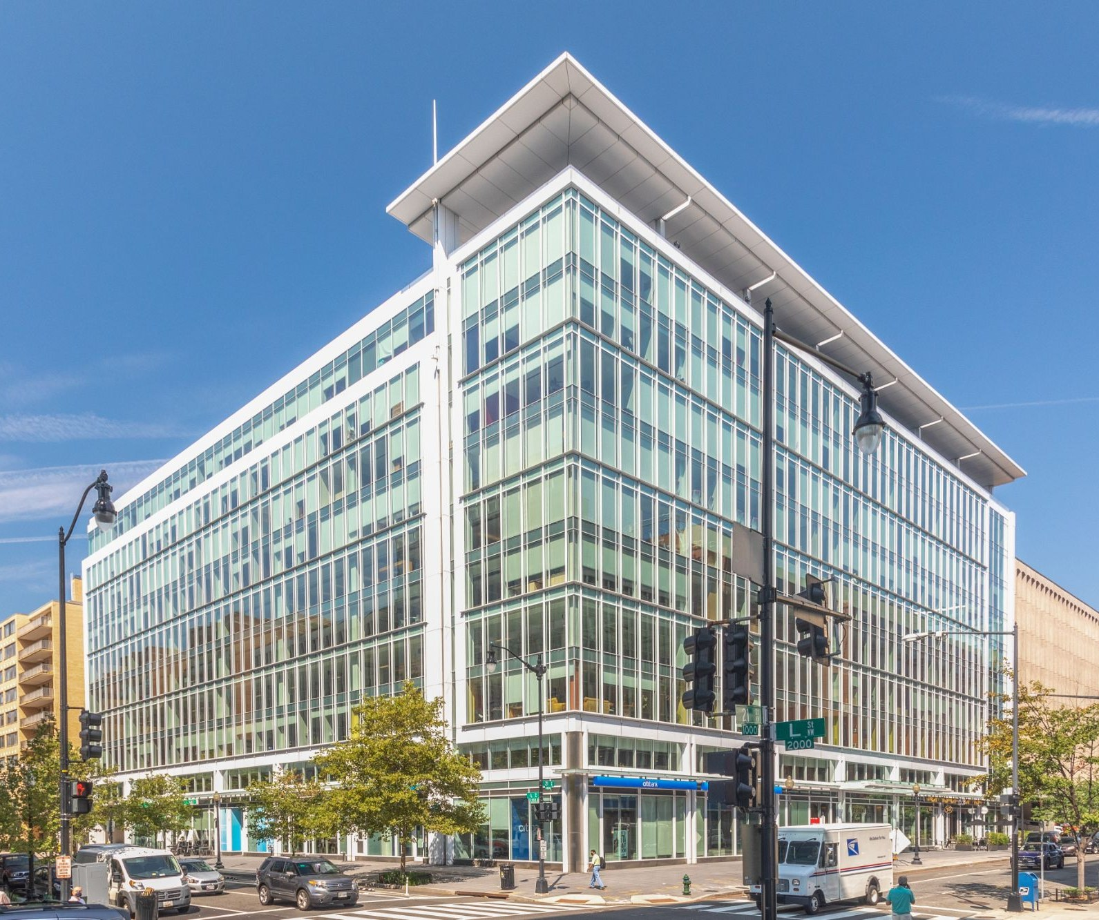
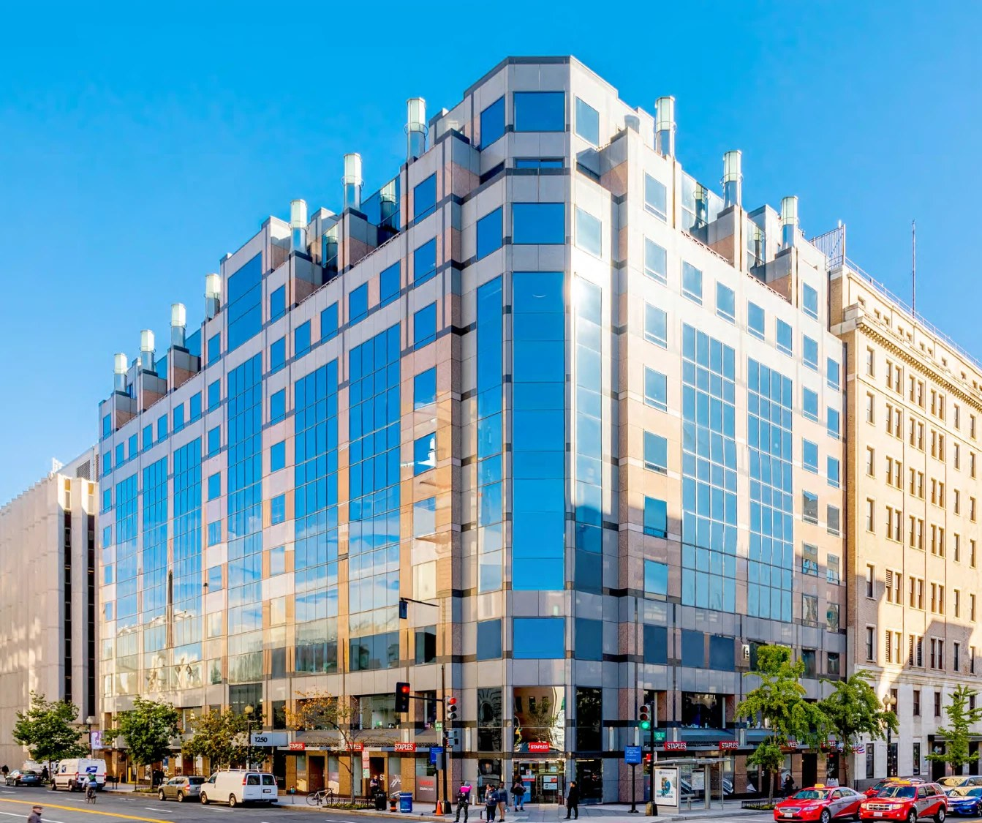
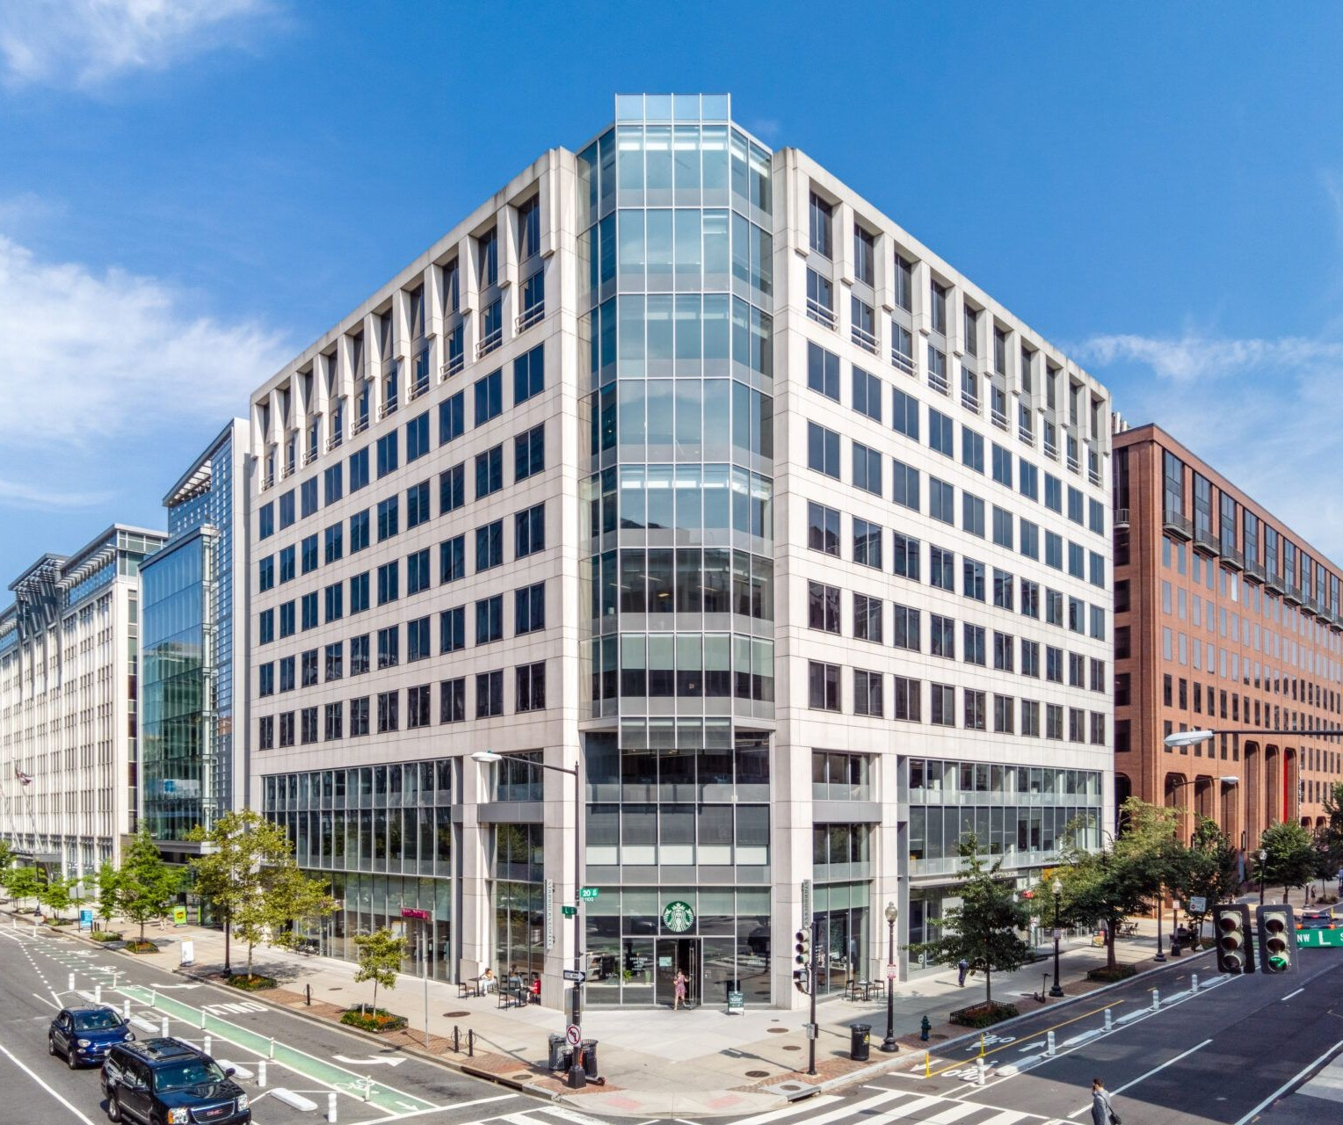
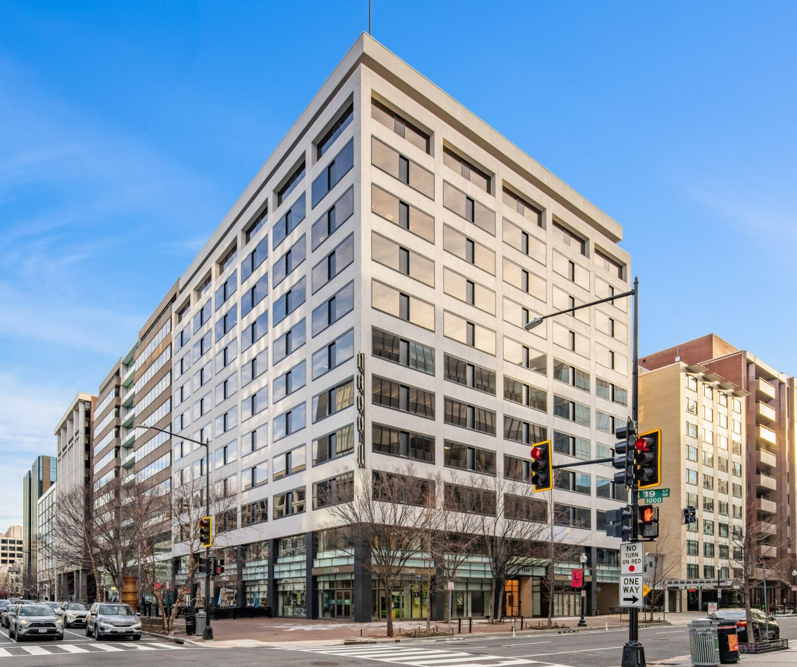
Recent Data Points
WASHINGTON, DC — COMMODITY SALES
Lincoln
Recent & Active Comparable Transactions
 | 700 6th | 1350 Eye | 1775 Penn | Sumner Square | 2445 M | Watergate | 1400 K | 2033 K | 1325 G | 1750 H | 300 M | 2101 L | 1250 H | 2001 L | 1899 L
 |  | [ photo ]
 | Bidding | Bidding | Awarded | Under Contract | Closed Apr-26 | Closed Mar-26 | Closed Oct-25 | Closed Jul-25 | Closed Jun-25 | Closed Jun-25 | Closed Jun-25 | Closed Dec-24 | Closed Nov-24 | Closed Oct-24 | Closed Mar-24
Size (SF) | 306,000 | 415,861 | 156,482 | 242,000 | 300,000 | 309,000 | 200,000 | 128,767 | 305,259 | 124,000 | 282,354 | 375,000 | 196,490 | 172,135 | 150,502
Year Built | 2009 | 1989/14 | 1975/09 | 1985 | 1986/19 | 1972/02 | 1982/24 | 1975/19 | 1969/04 | 2002 | 2001 | 1975/07 | 1992 | 1986/14 | 1978/22
% Leased | 79% | 75% | 41% | 100% | 80→75% | 93→20% | 65% | 38% | 62% | 55% | 50% | 75% | 53% | 66% | 56%
WALT | 7.8 Yr | 8.0 Yr | 5.5 Yr | TBD | 7.7 Yr | N/A | 5.3 Yr | – | 2.5 Yr | 3.8 Yr | 3.8 Yr | 8.0 Yr | 7.4 Yr | 6.3 Yr | 4.5 Yr
Cap Rate | 11.8% | 10.0% | 12.8% (ROC) | TBD | 9.0→8.5% | N/A | 9.5% | N/A | TBD | TBD | 11.5% | 10.0% | 10.7% | 10.7% | 9.5%
Price (PSF) | $85M $278 | $130M $348 | $37.5M $240 | $63.0M $261 | $101.0M $337 | $52.5M $170 | $35.5M $180 | $20.3M $170 | $25.0M $82 | $28.8M $232 | $28.0M $100 | $110.0M $293 | $27.5M $137 | $30.55M $180 | $26.65M $180
Buyer | TBD | TBD | Confid. | Vireon | Eagle Cliff | JetSet | Taicoon | In-Rel | Farmview | Douglas | Confid. | ELV | Banyan | Melrose | Taicoon
Seller | Principal (Lender) | MetLife | Woodwind | BXP | Mesa West | Elme | Brookfield | ARA | US Bank | State Farm | Potomac | JBGS / NW Mutual | Equity CW | AEW / Swiss RE | BlackRock
Lincoln Property Company
Confidential: Not For Distribution | 15

Slide 16
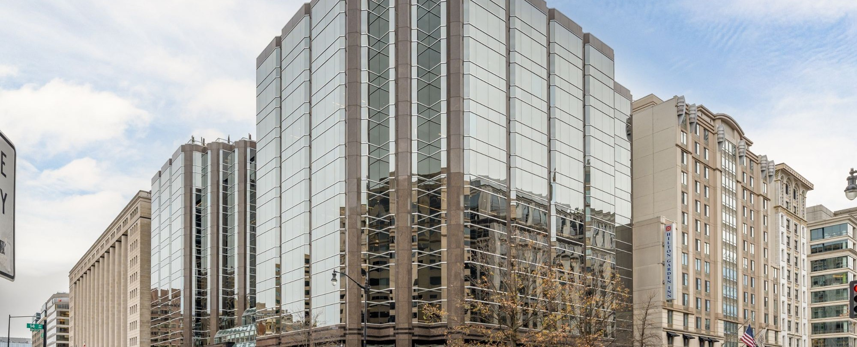
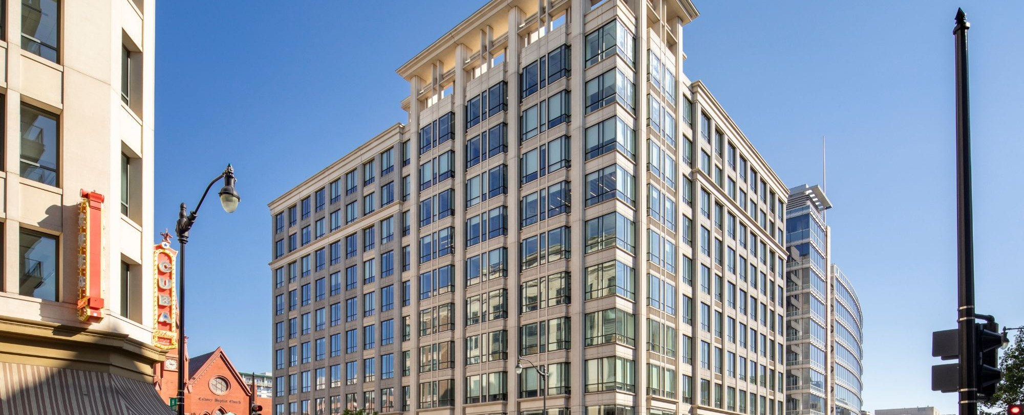

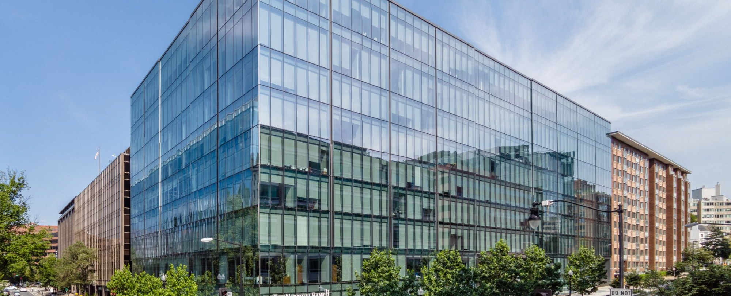
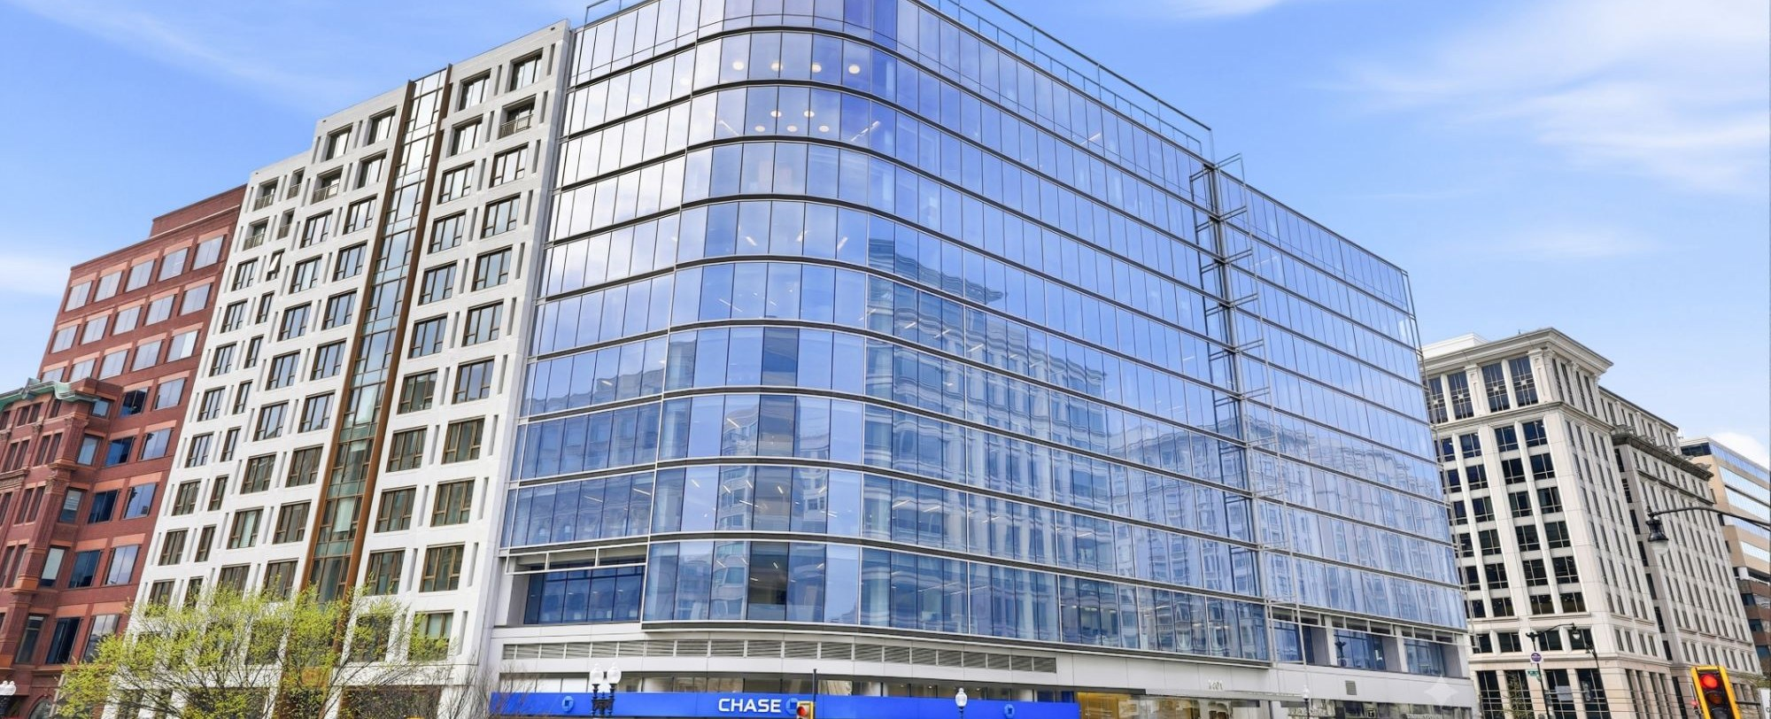

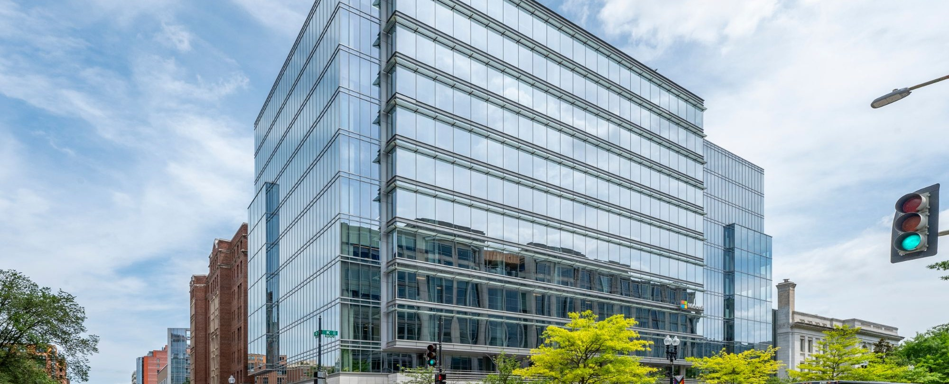
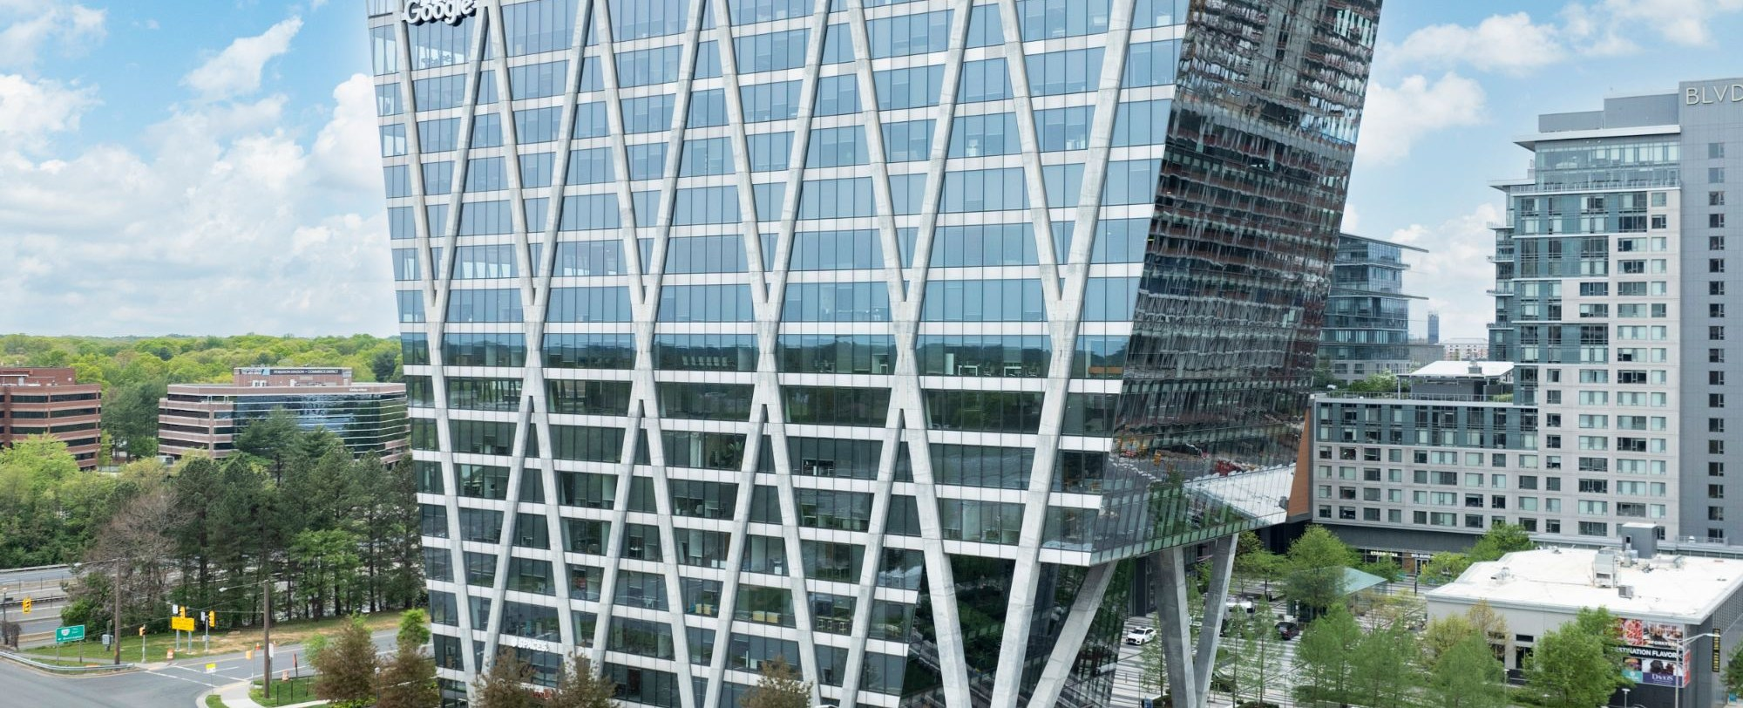
Recent Data Points
WASHINGTON, DC METRO — DEBT DATA POINTS
Lincoln
Recent Eastdil Secured Office Financings
 | Reston Metro Plaza | 799 9th St, NW | Market Square | 2001 M | 1401 New York | Three-Asset Portfolio | 901 K St | Boro Tower
 | Marketing | Awarding | Under Contract | Closed Jan-26 | Closed Jan-26 | Closed Jul-25 | Closed Jun-25 | Closed May-25
Sponsor | Comstock | Jemal Equities | Elliott / MC / PRP | Stream Realty | Carr / Barings | Carr Properties | Shorenstein | Rockefeller / TMG
SF | 769,830 | 203,329 | 694,436 | 283,190 | 201,976 | 791,098 | 220,000 | 436,795
WALT | 8.3 Yr | 6.5 Yr | 5.3 Yr | 9.0 Yr | 4.7 Yr | 9.3 Yr | 6.3 Yr | 7.3 Yr
% Leased | 99% | 82% | 90% | 93% | 94→81% | 89% | 68% | 98→88%
Loan Amount | $299.1M | $83.1M | $340.0M | $118.5M | $73.4M | $278.3M | $76.1M | $175.0M
Loan PSF | $389 | $409 | $490 | $418 | $344 | $352 | $346 | $401
LTV / LTC | 75% LTV | 75% LTC | 70% LTV | 69% LTC (68%I/75%FF) | 68% LTC (65%I/84%FF) | 60% LTV | 67.5% LTC (60%I/100%FF) | 70% LTV
In-Place DY | 9.6% | 13.4% | 12.0% | 13.3% | 13.9% | 12.0% | 12.6% | 11.5→10.0%
Lender | TBD | Debt Fund | SASB | Debt Fund | Debt Fund | Bank Balance Sheet | Debt Fund | Debt Fund
Pricing | TBD | SOFR + ~4.25% | SOFR + ~2.75% | SOFR + 2.90% | SOFR + 4.05% | SOFR + 3.25% | SOFR + 4.15% | SOFR + 4.75% (+4.40% b/d)
Lincoln Property Company
Confidential: Not For Distribution | 16

Slide 17
Contact
Matt Nicholson
Jake Guttman
Jackson Coviello
Jared Hicks
Executive Vice President
Director
Assistant Vice President
Analyst
mnicholson@lpc.com
jguttman@lpc.com
jcoviello@lpc.com
jahicks@lpc.com
Lincoln Property Company
101 Constitution Ave. NW, Suite 325 East
Washington, DC 20001
www.lpc.com

