Slide 1
HYPERLEDGER Fabric - Ledger v1 Data Architecture

Slide 2
Ledger v1 Objectives
Support v1 endorsement/consensus model - separation of simulation (chaincode execution) and block validation/commit
Chaincode execution simulated on ‘endorsing’ peers (subset of ‘committing’ peers)
Transaction validated and committed on all ‘committing’ peers
Parallel simulation enabled on endorsers for improved concurrency and scalability
Persist transaction read/write sets on the blockchain
Immutability, Auditing, Provenance
Remove dependence on RocksDB
Utilize LevelDB instead, due to RocksDB licensing issues
Optimize data storage for blockchain use patterns
New file-based blockchain ledger for immutable transaction log
LevelDB indexes against file-based ledger for efficient lookups
LevelDB key/value state database for transaction execution (by default)
Enrich query capability of data in the blockchain
Efficient non-key queries
Historical queries (simple provenance scenarios)
Support for plugging in external state databases
First external database is CouchDB – supports rich data query when modeling chaincode data as JSON

Slide 3
Ledger v1
Blockchain
(File system)
Txn
Reads[]
Writes[]
State Database
key:marble1
value:
History index
LevelDB
(embedded KV DB)
‘Index’ of the blockchain to track history of a key
{
"asset_name":"marble1",
"owner":”jerry",
"date":"9/6/2016",
}
Txn
Reads[]
Writes[]
Block index
LevelDB
(embedded KV DB)
‘Index’ of the blockchain for fast block/tran lookups
Latest written key/values for use
in transaction simulation
Txn
Reads[]
Writes[]
Indexes point to block storage location
blockNum → block file + offset
blockHash → block file + offset
txId → block file + offset
blockNum:txNum→ block file + offset
‘Materialized view’ of the blockchain data,
organized by key for efficient queries.
Two options:
LevelDB (default embedded KV DB) supports keyed queries, composite key queries, key range queries
CouchDB (external option) supports keyed queries, composite key queries, key range queries, plus full data rich queries
Txn
Reads[]
Writes[]
Beta in v1
Immutable source of truth

Slide 4
v1 Transaction lifecycle
Client application creates tran proposal (chaincode function and arguments) and sends to endorsing peer(s).
Endorsing peer executes chaincode, generates ReadWriteSet based on keys that were read and written.
Endorsing peer(s) send back proposal response (including response payload and ReadWriteSet) to client application
Client application may or may not submit as a transaction to ordering service. Transaction includes ReadWriteSet from proposal response
If client application submitted as transaction, ordering service packages the transaction into a block of ordered transactions.
Blocks are delivered to all peers (including the original endorsing peers).
Peers validate and commit block trans:
runs validation logic (VSCC to check endorsement policy, and MVCC to check that ReadSet versions haven't changed in State DB since simulation time)
indicates in block which trans are valid and invalid
commits block to blockchain on file system, and commits valid transactions within block to state database ‘atomically’
fires events so that application client listening via SDK knows which transactions were valid/invalid

Slide 5
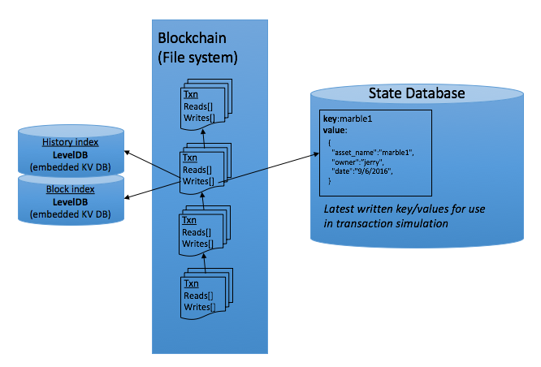
v1 Transaction Lifecycle
Application (SDK)
4) Submit transaction (includes RWSet)
Transaction
Reads[]
Writes[]
Transaction
Reads[]
Writes[]
Transaction
Reads[]
Writes[]
Transaction
Reads[]
Writes[]
3) Send proposal response back (includes RWSet)
6) Receive batch (block) of transactions from Ordering Service
1) Submit proposal
Ordering Service
5) Ordering service creates batch (block) of transactions
Endorsing Peer (subset of peers)
Committing Peer (all peers)
2) Execute chaincode to simulate proposal in peer
Query State DB for reads
Build RWSet
7) Validate each transaction and commit block
Validate endorsement policy (VSCC)
Validate ReadSet versions in State DB (MVCC)
Commit block to blockchain
Commit valid trans to State DB

Slide 6
Scenario: Channels for bilateral trades
Chaincode1 installed on all 4 peers.
Chaincode1 instantiated on all 3 channels*
*Different chaincodes could be instantiated on different channels.
*Multiple chaincodes can be instantiated on each channel.
One distributed ledger per channel.
Bank A cannot see transactions between B and C.
Blocks from different channels can be processed in parallel.
➔ Privacy + increased throughput
Orderer(s)
Channel A-B
Channel A-C
Channel B-C
Clearinghouse/
Auditor Peer(s)
Bank A Peer(s)
Bank B Peer(s)
Bank C Peer(s)
CC1
CC1
CC1
CC1
CC1
CC1
CC1
CC1
CC1
B-C
B-C
B-C
A-B
A-B
A-B
A-C
A-C
A-C
CC1 installed
CC1 installed
CC1 installed
CC1 installed

Slide 7
Logical structure of a ReadWriteSet
Block{
Transactions [
{
"Id" : txUUID2
"Invoke" : “Method(arg1, arg2,..,argN)"
“TxRWSet" : [
{ ”Chaincode” : “ccId”
“Reads”:[{"key" : “key1", "version” : “v1” }]
“Writes”:[{"key" : “key1", ”value" : bytes1}]
} // end chaincode RWSet
] // end TxRWSet
}, // end transaction with "Id" txUUID2
{ // another transaction },
] // end Transactions
}// end Block
Endorsing Peer (Simulation):
Simulates transaction and generates ReadWriteSet
Committing Peer (Validation/Commit):
Read set is utilized by MVCC validation check to ensure values read during simulation have not changed (ensures serializable isolation).
Block is added to chain and each valid tran’s Write Set is applied to state database

Slide 8
Chaincode data patterns
Single key operations
GetState()/PutState() - Read and Write a single key/value.
Key range queries
Can be used in chaincode transaction logic (e.g. identify keys to update).
Fabric guarantees result set is stable between endorsement time and commit time, ensuring the integrity of the transaction.
GetStateByRange()
Read keys between a startKey and endKey.
GetStateByPartialCompositeKey()
Read keys that start with a common prefix. For example, for a chaincode key that is composed of K1-K2-K3 (composite key), ability to query on K1 or K1-K2 (performs range query under the covers). Replacement for v0.6 GetRows() table api.
Non-Key queries on data content beta in v1
Available when using a state database that supports content query (e.g. CouchDB)
Read-only queries against current state, not appropriate for use in chaincode transaction logic, unless application can guarantee result set is stable between endorsement time and commit time.
GetQueryResult()
Pass a query string in the syntax of the state database
See example chaincode:
https://github.com/hyperledger/fabric/blob/master/examples/chaincode/go/marbles02/marbles_chaincode.go
Notes:
Would require much investment to invent our own database, query language, etc
Enriched Query API without introducing yet another paradigm to application development.
Already existing, well understood impedance mismatch between application and data store that NoSQL, JSON and XML extensions already address. Why introduce yet-another-paradigm and associated query language and administration.
Allow new R&D to focus on added value prop of blockchain (trust, privacy, and inter-organization shared ledger)

Slide 9
Pluggable state database - Objectives
Rich Query API for Blockchain (non-key query on data content)
Leverage state-of-the-art database engines to extend query capabilities against blockchain data.
Ensure interface supports plugging in different state database, for example by a vendor building on top of fabric
To the degree possible, embed database and maintain within fabric, rather than requiring DBA skills
Notes:
Would require much investment to invent our own database, query language, etc
Enriched Query API without introducing yet another paradigm to application development.
Already existing, well understood impedance mismatch between application and data store that NoSQL, JSON and XML extensions already address. Why introduce yet-another-paradigm and associated query language and administration.
Allow new R&D to focus on added value prop of blockchain (trust, privacy, and inter-organization shared ledger)

Slide 10
State Database options - Queryability
In a key/value database such as LevelDB, the content is a blob and only queryable by key
Does not meet chaincode, auditing, reporting requirements for many use cases
In a document database such as CouchDB, the content is JSON and fully queryable
Meets a large percentage of chaincode, auditing, and simple reporting requirements
For deeper reporting and analytics, replicate data to an analytics engine such as Spark (future)
Id/document data model compatible with existing chaincode key/value programming model, therefore no application changes are required when modeling chaincode data as JSON
SQL data stores would require more complicated relational transformation layer, as well as schema management.

Slide 11
State Database options - Queryability
In a key/value database such as LevelDB, the content is a blob and only queryable by key
Does not meet chaincode, auditing, reporting requirements for many use cases
In a document database such as CouchDB, the content is JSON and fully queryable
Meets a large percentage of chaincode, auditing, and simple reporting requirements
For deeper reporting and analytics, replicate data to an analytics engine such as Spark (future)
Id/document data model compatible with existing chaincode key/value programming model, therefore no application changes are required when modeling chaincode data as JSON
SQL data stores would require more complicated relational transformation layer, as well as schema management.
Default in v1
Beta in v1
Potentially
Future

Slide 12

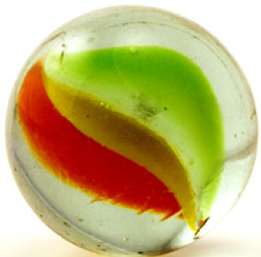
Marbles Chaincode Demo
Marble modeled as JSON Scenario: Transfer marble from Tom to Jerry
Update ledger:
PutState(marbleId, marbleJSON)
Ledger key-based queries (supported on LevelDB and CouchDB state databases):
GetState(marbleId) // Key-based query
GetStateByRange(startMarble, endMarble) // Key range query
GetStateByPartialCompositeKey(marbleColorIndex, []string{“blue”}) // Composite key query, e.g. find all ‘blue’ marbles
GetHistoryForKey(marbleId) // History of key values for data provenance
Ledger rich data query (additional support on CouchDB state database):
queryString = {"selector":{"owner":"tom", "size": {"$gt": 30}} } // Utilize CouchDB JSON query language, e.g. large marbles owned by Tom
GetQueryResult(queryString) // Query JSON content
{
"asset_name": "marble1",
"color": "blue",
"size": 35,
"owner": “jerry”
}
Tom
Jerry
https://github.com/hyperledger/fabric/tree/master/examples/chaincode/go/marbles02

Slide 13
CouchDB state database details
Single CouchDB instance under each peer
Redundancy provided by peer ‘replicas’ rather than database replicas
Normal blockchain model – peer with dedicated local data store
Since no database replicas, writes to database are guaranteed consistent and durable (not ‘eventually consistent’, as would be the case if there were database replicas)
Same basic model as when using local LevelDB state database
Except that CouchDB runs in separate local process, rather than embedded in peer process
Configure for only local peer connections to CouchDB
Disable remote connections
Committing peer is only process that writes to state database
All queries go through peer authentication and authorization
Again, same interaction patterns as when using local LevelDB state database, but with more powerful query capability
CouchDB will be made available as Docker image. Docker compose will configure communication between peer container and couchdb containers (coming Feb 2017)

Slide 14
Pluggable state database - The Challenges
How to support v1 endorsement/simulation model, when most databases do not support simulation result sets?
That is, how to make uncommitted updates against an arbitrary database and determine the ReadWriteSet that is required for endorsement and commit validation? Not possible with most databases…
Solution:
Query database for key values during endorser simulation, using database’s rich query language
Perform simulation updates in private workspace (peer memory) using normal chaincode APIs, e.g. PutState()
Get ReadWriteSet from endorser simulation (Reads come from DB queries, Writes come from simulation in private workspace)
Endorsement, Consensus, Validation use transaction ReadWriteSet Simulation Results as normal
Apply Writes to database during Commit phase
Peer maintains data integrity across blockchain file storage and state database
Transaction simulation is a proposal only. Updates are not yet applied to database. Implications:
Transaction simulation does not support Read Your own Writes. GetState() always retrieves from state database.
At commit time, validation is required to ensure conditions at simulation time (ReadSet) are still valid.
For key-based queries (GetState), validation step does a simple MVCC check on the ReadSet versions
For key-based range queries (GetStateByRange, GetStateByPartialCompositeKey) validation step re-queries to ensure result set is same – e.g. no added (phantom) items since simulation time
Non-key queries – Read-only queries against current state, not appropriate for use in chaincode transaction logic, unless application can guarantee result set is stable between endorsement time and commit time.

Slide 15
GetQueryResult() API
Enabled when using a queryable state database such as CouchDB
Accepts a query string that gets passed to CouchDB state database /_find API, returns a set of key/values (documents)
Utilizes CouchDB /_find API query syntax
Query API available in application chaincode
Read-only queries - e.g. find all assets owned by Alice
Client SDK invokes chaincode on an endorsing peer
Endorser returns response with ReadSet
Client does NOT submit transaction to ordering service (technically they could submit to ordering service to log the read, but this is not typical)
Queries as part of write transactions - e.g. find all assets owned by Alice and transfer them to Bob
Client SDK invokes chaincode on N endorsing peers
Endorser(s) return response with ReadWriteSet
Client SDK submits endorsed transaction to ordering service
Application must guarantee that result set will be stable between transaction simulation and commit time. If application cannot guarantee, structure data to use range queries or partial composite key queries instead
Access control enforced at either application or chaincode level

Slide 16
GetQueryResult() API- Indexes
Indexes can be created in CouchDB to accelerate queries
Initially, create indexes by calling CouchDB APIs from peer machine, e.g. via curl utility.
Evaluating options to create indexes upon chaincode deployment and/or via peer APIs

Slide 17
GetHistoryForKey() API
GetHistoryForKey() API uses LevelDB history index to return history of values (states) for a key.
Used for simple lineage/provenance scenarios.
Available in application chaincode (similar to GetQueryResult)

Slide 18
Query System Chaincode (QSCC)
New system chaincode deployed by default in v1 to query blockchain
Client can invoke against any peer, using same endorser request/response model that is used for application chaincode calls
QSCC includes the following APIs (chaincode functions):
GetChainInfo
GetBlockByNumber
GetBlockByHash
GetTransactionByID – returns the processed transaction as well as valid/invalid indicator

Slide 19
Side-by-side comparison of table approach and JSON approach for modeling chaincode data

Slide 20

Comparison of table-based and JSON-based chaincode
Table-based approach Relational database table metaphor Requires schema definition up front Difficult to change schema in later chaincode versions Does not support hierarchical data Not aligned with underlying ledger data layer, therefore metaphor inconsistent with fabric functional capabilities - e.g. Can’t query on table columns as expected More code layers, more complex chaincode | JSON-based approach NoSQL metaphor: key/value (LevelDB), document db (CouchDB) Does not require schema definition step Easy to add JSON fields in later chaincode versions Supports hierarchical data Aligned with underlying ledger data layer, therefore metaphor consistent with fabric functional capabilities Query based on key or partial key range Less code, use built-in structure ⬄ JSON marshaling Compatible with next-generation ledger capabilities Query ledger on ANY field, within or outside chaincode Powered by JSON state database (CouchDB)

Slide 21
Remove Table API from Hyperledger Fabric in v1
Remove Table API from Hyperledger Fabric in v1 (FAB-1257)
The v0.5/v0.6 Pseudo-table API does not map well to current or next generation Fabric capabilities
Project teams have been confused and frustrated with table API limitations
Encourage all new chaincode to use JSON-based data structures
Additional query benefits when using CouchDB state database
Provide JSON-based samples to help community update table-based chaincode
marbles02 sample: /fabric/examples/chaincode/go/marbles02
In the future Fabric may add support for relational state databases
At that time it will make sense to introduce a ‘real’ table API without the limitations of the current pseudo-table API

Slide 22
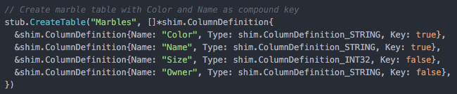
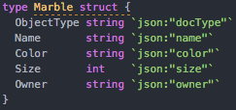
Setup
Table-based approach | JSON-based approach
Define schema and persist to ledger
Annotate chaincode structures for JSON marshaling
See latest code sample at:
/fabric/examples/chaincode/go/marbles02

Slide 23
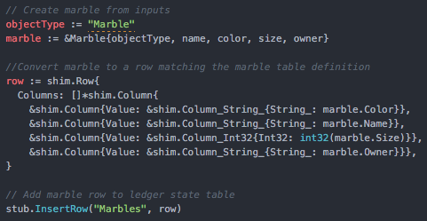
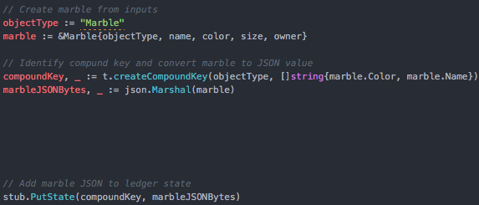
Add marble
Table-based approach | JSON-based approach
Insert marble row into ledger table
Add marble JSON to ledger, use objectType as key namespace
See latest code sample at:
/fabric/examples/chaincode/go/marbles02

Slide 24
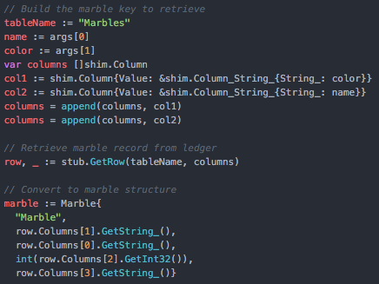
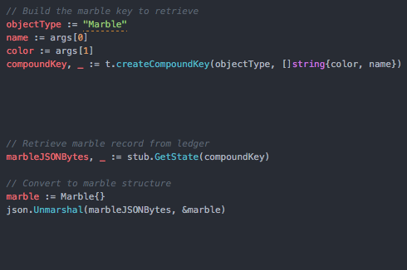
Get marble
Table-based approach | JSON-based approach
Get marble based on key columns
Get marble based on compound key
See latest code sample at:
/fabric/examples/chaincode/go/marbles02

Slide 25
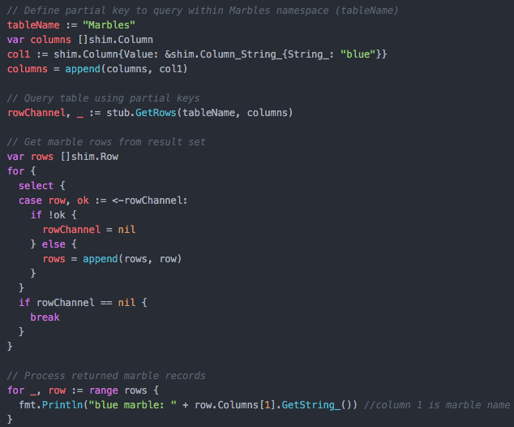
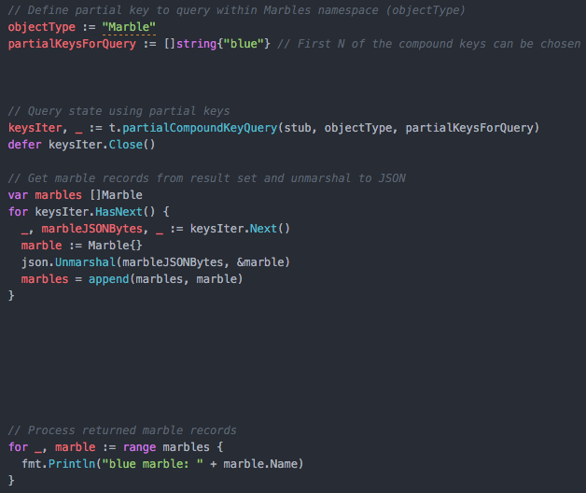
Scenario: Query for blue marbles Enabled in key/value state database by using an intelligent compound key ‘Marble:color:name’ and doing partial range key query on ‘Marble:color’ only
Table-based approach | JSON-based approach
GetRows() using first N key columns (left to right)
partialCompoundKeyQuery() using first N keys (left to right)
See latest code sample at:
/fabric/examples/chaincode/go/marbles02

