Slide 1
Privacy Enabled Ledger
David Enyeart, Manish Sethi, Senthilnathan Natarajan, Troy Ronda

Slide 2
Overview
Motivation for Privacy Enabled Ledger
Problem Statement
Existing techniques
Proposed Solution (high level overview)
Simple scenario
Complex scenario

Slide 3
Motivation for Privacy Enabled Ledger
Fabric 1.0 has privacy across channels, but not within channels
Read/write set and sensitive data in transaction proposal are visible in the chain of blocks.
Ordering service doesn’t parse transaction, but still has access to transaction, including read/write set (Orderer ledger stores blocks with transactions)
All peers in a channel have access to the transaction data.
Data privacy is required in many use cases such as
Health Care
KYC

Slide 4
Problem Statement
How can we provide privacy for certain sensitive/private data within a channel?
Sensitive data on the ledger should remain private from the
chain of blocks
ordering service, and
a subset of the peers in a channel
Only evidence needs to be
on the chain of blocks
sent to ordering service and distributed to all peers
Chaincode should be able to perform query/update of private data on authorized peers.

Slide 5
Well Known Techniques for Data Privacy
Why can’t we encrypt/decrypt data?
Key maintenance and sharing of key is overhead.
Even encrypted data is not completely safe – keys can be leaked, and tomorrow’s computing advances may crack today’s encryptions.
Why can’t we use channel between peers who are taking part in the transaction?
No sharing of data between channels (single tx cannot modify two or more channel’s ledger).
Still the data would be visible to ordering service.
How about storing data in a separate data store and include only hashes on chain?
Requires management of a separate data store
Data synchronization and access control issues
Need a different solution

Slide 6
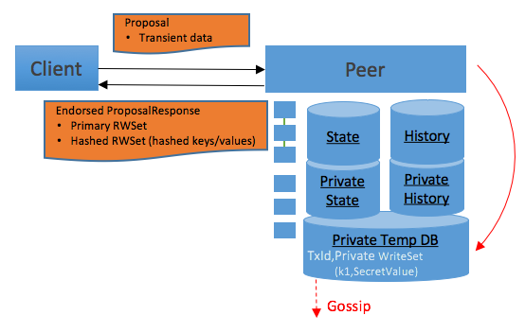
Private Data Solution
Exclude private data from transaction, do not sent through ordering service.
Private data is shared peer-to-peer with a subset of authorized peers
Hash of private data included in transaction and stored in public state database
Hash serves as evidence of the private data
Hash is used for state validation
Endorsement Phase
Public State
Public block storage
Private State
Private writeset storage
Public Read/Write Set (in public transaction)
Hashed Read/Write Set (in public transaction)
Private Write Set (stored in Transient Store and distributed to authorized peers)
Transient Store
Private Write Set

Slide 7
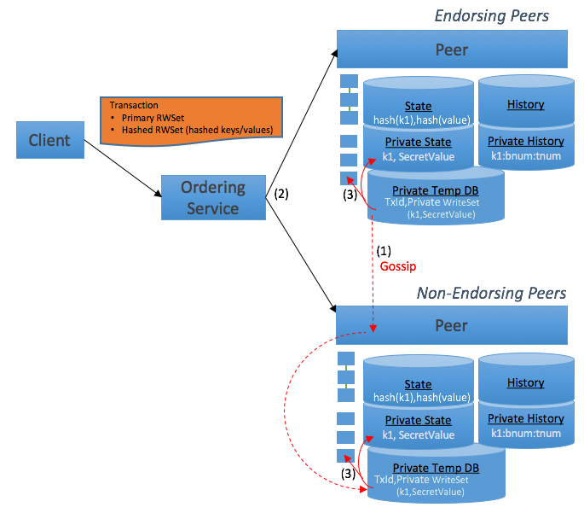
Private Data Solution
Validation/Commit Phase
Private data shared with authorized peers upon endorsement and stored in each peer’s transient store.
Public channel data and hashes of private data included in transaction and distributed to all peers.
Upon validation/commit, private data moved to private state database and private writeset storage.
Public State
Public
Private State
Transient Store
Public block storage
Public State
Private State
Private writeset storage
Transient Store

Slide 8
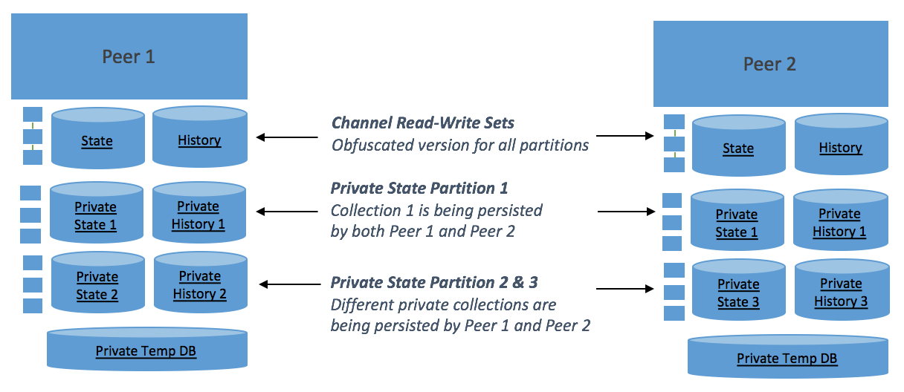
Private Data Collections
GetPrivateData(collection, key)
PutPrivateData(collection, key, value)
DelPrivateData(collection, key)
Private data is stored in a ‘collection’
Each collection has a policy which specifies which organization’s peers can persist the collection data
Public State
Public State
Public State
Private State Collection 1
Private State 1
Private State 1
Private
State 2
Private State Collection 2 & 3
Private
State 3
Transient Store
Transient Store

Slide 9
Sample Scenario
Marbles asset scenario
Privacy Requirements
No marble data should go through ordering service as part of transaction
All peers have access to general marble information
Name, Size, Color, Owner
Only a subset of peers have access to marble pricing information

Slide 10
Sample Scenario
Transaction
Public channel data
- data goes to orderer and all peers
Transaction
Primary RWSet (if exists)
Hashed Pvt RWSet (hashed keys/values)
Collection: Marbles
Private Write Set
Name, Size, Color, Owner
Policy: Org1, Org2
"requiredPeerCount": 1,
"maxPeerCount":2,
"blockToLive":1000000
Collection: Marbles
Private data for channel peers
- data goes to all peers, not orderer
Collection: Marble Private Details
Private Write Set
Price
Policy: Org1
"requiredPeerCount": 1,
"maxPeerCount": 1,
"blockToLive":3
Collection: Marbles Private Details
Private data for subset of channel peers
- data goes to subset of peers only

Slide 11
Step 1: Client sends proposal to endorsing peer(s)
Ordering
Service
Client
Peer
Peer
State
State
Private State
Private State
Private Transient DB
Private Transient DB
Peer
Peer
State
State
Private State
Private State
Private Transient DB
Private Transient DB
Org1
Org2

Slide 12
Step 2a: Endorsing peer simulates transaction and distributes marbles collection data based on policy
Ordering
Service
Client
Peer
Peer
Collection: Marbles
Private Write Set
Name, Size, Color, Owner
Policy: Org1, Org2
"requiredPeerCount": 1, "maxPeerCount":2, "blockToLive":1000000
State
State
Private State
Private State
Private Transient DB
✓
✓
Private Transient DB
TxId,Private WriteSet
(k1,PrivateValue)
TxId,Private WriteSet
(k1,PrivateValue)
Peer
Peer
Missing
Private Data
State
State
Private State
Private State
Private Transient DB
✓
Private Transient DB
TxId,Private WriteSet
(k1,PrivateValue)
Org1
Org2

Slide 13
Step 2b: Endorsing peer distributes marbles private details collection data based on policy.
Peers store received data in Transient DB.
Ordering
Service
Client
Peer
Peer
Collection: Marbles
Private Write Set
Name, Size, Color, Owner
Policy: Org1, Org2
"requiredPeerCount": 1, "maxPeerCount":2, "blockToLive":1000000
State
State
Private State
Private State
✓
Private Transient DB
✓
✓
Private Transient DB
TxId,Private WriteSet
(k1,PrivateValue)
Collection: Marble Private Details
Private Write Set
Price
Policy: Org1
"requiredPeerCount": 1, "maxPeerCount": 1, "blockToLive":3
TxId,Private WriteSet
(k1,PrivateValue)
Peer
Peer
Missing
Private Data
State
State
Private State
Private State
✓
Private Transient DB
✓
Private Transient DB
TxId,Private WriteSet
(k1,PrivateValue)
Org1
Org2

Slide 14
Step 3: Endorsing peer sends proposal response back to client with public data.
Client submits tran with public data to ordering.
Block with tran gets distributed to all peers.
Transaction
Primary RWSet (if exists)
Hashed Pvt RWSet (hashed keys/values)
Ordering
Service
Client
Peer
Peer
Collection: Marbles
Private Write Set
Name, Size, Color, Owner
Policy: Org1, Org2
"requiredPeerCount": 1, "maxPeerCount":2, "blockToLive":1000000
State
State
Private State
Private State
✓
Private Transient DB
✓
✓
Private Transient DB
TxId,Private WriteSet
(k1,PrivateValue)
Collection: Marble Private Details
Private Write Set
Price
Policy: Org1
"requiredPeerCount": 1, "maxPeerCount": 1, "blockToLive":3
TxId,Private WriteSet
(k1,PrivateValue)
Peer
Peer
Missing
Private Data
State
State
Private State
Private State
✓
Private Transient DB
✓
Private Transient DB
TxId,Private WriteSet
(k1,PrivateValue)
Org1
Org2

Slide 15
Step 4: Peers validate private data against public hashes. Missing privata data resolved with pull requests to other peers.
Transaction
Primary RWSet (if exists)
Hashed Pvt RWSet (hashed keys/values)
Ordering
Service
Client
Peer
Peer
Collection: Marbles
Private Write Set
Name, Size, Color, Owner
Policy: Org1, Org2
"requiredPeerCount": 1, "maxPeerCount":2, "blockToLive":1000000
State
State
Private State
Private State
✓
Private Transient DB
✓
✓
Private Transient DB
TxId,Private WriteSet
(k1,PrivateValue)
Collection: Marble Private Details
Private Write Set
Price
Policy: Org1
"requiredPeerCount": 1, "maxPeerCount": 1, "blockToLive":3
TxId,Private WriteSet
(k1,PrivateValue)
Peer
Peer
Missing
Private Data
Resolved
State
State
Private State
Private State
✓
Private Transient DB
✓
✓
Private Transient DB
TxId,Private WriteSet
(k1,PrivateValue)
TxId,Private WriteSet
(k1,PrivateValue)
Org1
Org2

Slide 16
Step 5:
Commit private data to private state db.
Commit hashes to public state db.
Commit public block and private write set storage.
Delete transient data.
Transaction
Primary RWSet (if exists)
Hashed Pvt RWSet (hashed keys/values)
Ordering
Service
Client
Peer
Peer
✓
✓
✓
✓
✓
✓
✓
✓
✓
✓
Collection: Marbles
Private Write Set
Name, Size, Color, Owner
Policy: Org1, Org2
"requiredPeerCount": 1, "maxPeerCount":2, "blockToLive":1000000
State
State
H
H
H
H
H
H
H
H
✓
✓
✓
✓
✓
✓
Private State
Private State
Private Transient DB
Private Transient DB
Collection: Marble Private Details
Private Write Set
Price
Policy: Org1
"requiredPeerCount": 1, "maxPeerCount": 1, "blockToLive":3
Peer
Peer
✓
✓
✓
✓
✓
✓
✓
✓
✓
✓
State
State
H
H
H
H
H
H
H
H
✓
✓
✓
✓
✓
✓
Private State
Private State
Private Transient DB
Private Transient DB
Org1
Org2

Slide 17
Backup – Simulation Implementation Details
Defining Private Collections for a Chaincode per Organization
Transaction Simulation (3 steps)
Collection of
public read/write set
hashed read/write set
private write set
Transient Store for Private Write set
Dissemination of Private Write set by Gossip

Slide 18
Defining Collections for a Chaincode Per Organization
A list of private collections and organization mapping per chaincode
Upon chaincode instantiation, define collection membership policies
Successful endorsement requires two conditions
Peer executing chaincode has access to collection data that is retrieved in the chaincode (data availability based based on collection mapping)
Client (transaction proposal submitter) has access to data based on client identity, enforced through your chaincode logic as usual, e.g. GetCreator()

Slide 19
Transaction Simulation
Client submits transaction proposal to endorser peers
Client can submit private data in Transient field (doesn’t get included transaction)
Endorser peer acquires a read lock on the state DB
Invokes the chaincode as per the transaction content
Chaincode uses shim API to access ledger data
Chaincode → Shim layer –grpc()→ Endorser peer → Ledger
Shim APIs: publicData and privateData access APIs
Existing APIs to access public data
New APIs to access private data:
GetPrivateData(collection, key)
PutPrivateData(collection, key, value)
DelPrivateData(collection, key)
GetPrivateDataByRange() and GetPrivateDataQueryResult()
Transactions that perform query and update not allowed – Impossible to deterministically validate queries for phantoms, since not all peers have access to the private data.

Slide 20
Transaction Simulation: Public Read/Write Set
Read/Write set for public data is collected as normal in Fabric v1.0.
Ledger intercept the query to collect read/write set.
GetState():
add <key, version> read to the read set map.
PutState() & DelState():
add <key, value> to the write set map.
GetStateByRange():
add <keys read, startKey, endKey> to range query info (for phantom read validation).

Slide 21
Transaction Simulation: Private Read/Write Sets
Read/Write set for each private data collection
Hashed read/write set – Includes hash of private key and hash of private value
Private write set – Includes private data, won’t be included in transaction
Ledger intercept the private data APIs to collect required rw set.
GetPrivateData(collection, key):
add <H(key), version> read to the hashed private read set map of the `collection`.
PutPrivateData() & DelPrivateData():
add <key, value> to the private write set map of the `collection`.
add <H(key), H(value)> to the hashed write set of the `collection`.

Slide 22
Transaction Simulation: End of Simulation
Endorser peer collects read/write set from ledger
Public read/write set
Hashed read/write set of private data per collection
Private write set of private data per collection
Stores the private write set of each collection in transient store (with txId, currentBlockHeight)
Endorser peer releases read lock and perform the following tasks:
Initiate Gossip layer to deliver collection private write set to other peers (who have access to this collection)
Gossip on the receiving peer stores pvt write set in its transient store with txid and currentblockHeight.

Slide 23
Backup – Validation/Commit Implementation Details
Transaction Validation
Validation in Fabric v1.0
Changes for private data validation
Validation of public read/write set & hashed read/write set
Construction of update set for both public and private data
Transaction Commit
Block storage
StateDB

Slide 24
Transaction Validation in v1.0
Validator creates an updateBatch per block (to contain valid writeSets)
For each transaction in block, ensure readset keys are still valid
Check whether the read key is not present in the updateBatch already.
Check whether the read key version matches current state db.
If above two condition succeeds, transaction is valid and updateBatch is updated.
Version of each key in a transaction read set is verified serially.
Each transaction in a block is verified serially.
For CouchDB, limit roundtrips by using bulkDoc API to retrieve and cache readset key versions (new in 1.1), and to update state in bulk.

Slide 25
Transaction Validation for Private Data
Ledger block validation:
Validates public and hashed read set against public state
Construct Valid write set for both public and private state
Create an updateBatchPublic for public write set and hashed write set
Create an updateBatchPrivate if authorized to private data collection
Fetch private data from transient store
Do a gossip pull if private data not available in transient store
Verify transient private data against hashed write set.

Slide 26
Transaction Validation for Private Data
Ledger block validation:
For each transaction in block, ensure any public and hashed readset keys are still valid
Check whether the read key is not present in the updateBatchPublic already.
Check whether the read key version matches current state db
If above two condition succeeds, transaction is valid
updateBatchPublic is updated (contains both public & hashed write set. value in hashed write set is set to nil).
updateBatchPrivate is updated (contains private write set)

Slide 27
Transaction Commit
Combine UpdateBatchPublic and UpdateBatchPrivate into single UpdateBatch
Update the transaction filter and update the (public) block.
Commit public block and corresponding private data to peer’s block storage.
Acquire write lock and Commit UpdateBatch to stateDB (including public keys, hashed keys, and private keys for authorized private data collections.

Slide 28
Others Points
Option to commit even if transient private data cannot be found at commit time
Peer will not be able to endorse transactions for these keys going forward
Purge of private data from transient store as blocks get committed.
Also, cleanup old transient store entries for transactions that never got submitted/committed (e.g. Time-to-live policy, Block-to-live policy)
Option to purge private block storage and associated keys in state database
Block-to-live policy
From chaincode perspective, it will look like a traditional Delete (key/value doesn’t exist)
Hashes are still available in the block transaction, if you need to check off-chain data validity in future
HistoryDB for the secret data.
Like public data, private data operations are atomic from client perspective
Peer handles recovery logic to ensure block storage (public and private) and state DB are in sync

Slide 29
Thank You

