Slide 1
01 / BACKGROUND & GOAL
TAIsty: Faster to the First Formulation
AI-assisted flavor development - vision, approach, and strawberry pilot
THE PROBLEM
OUR APPROACH
Developing an initial formulation today is a manual, experience-driven process. Every new customer brief essentially starts from scratch, without systematically leveraging the knowledge embedded in hundreds of historical formulations already in our portfolio.
1
Cluster historical formulations
Group 130+ strawberry recipes into 7 sensory archetypes, defined and validated by flavorists.
2
Extract cluster fingerprints
THE GOAL
Identify the key raw materials that characterize each archetype, using statistical analysis of validated recipes.
TAIsty analyzes historical formulations, identifies sensory archetypes, and derives standardized building blocks validated by our flavor experts. Objective: a well-grounded first-formulation proposal at the push of a button, significantly reducing development cycles and reliance on individual memory.
3
Embed expert knowledge
Encode flavorist rules and threshold knowledge for automatic, transparent recipe classification.
4
Generate first-formulation proposals
PILOT SCOPE
Customer brief matched to archetype. Skeleton formulation and building blocks generated automatically.
We started with strawberry, our most complex and highest-priority fruit, with 130 historical formulations, 7 sensory archetypes, and a 4-person sensory panel for validation. Once the strawberry pilot is proven, the same framework scales to apricot, and other fruits.
TAIsty | AI-Assisted Flavor Development | Status July 2026 | Confidential
1 / 5

Slide 2
02 / METHODOLOGY: DATA QUALITY
Building a Clean Foundation for Classification
Iterative framework to remove noise before clustering and scoring
Raw Portfolio Data
Carrier Removal
Normalization
Cluster & Validate
Clean Label Set
130+ strawberry recipes with full ingredient composition
→
Solvents and carriers without sensory value are zeroed out
→
Ingredient amounts normalized per recipe for fair comparison
→
Multiple classification strategies applied; 28 recipes blind-tasted
→
Only panel-confirmed recipes used to build final ingredient profiles
ITERATIVE OUTLIER REMOVAL
Carrier and Solvent Exclusion
Building a Reference Recipe for Each Flavor Type
Panel Disagreement as a Quality Signal
Raw recipes contain propylene glycol, water, ethanol and other carrier substances that dominate volume but carry no sensory information. These are identified and excluded before any analysis begins, preventing the system from clustering around carrier composition rather than aroma.
For each flavor type, we define a reference recipe based on the typical ingredient amounts from panel-confirmed examples. This ensures each type is defined by what makes it truly distinctive, not by what all recipes share in common.
Recipes where our two classification methods disagree, or where the sensory panel returned a split verdict, are flagged and excluded when building the ingredient profiles. This iterative loop, classify then taste then refine, progressively improves the quality of cluster definitions over time.
WHY IT MATTERS
Analyzing only panel-confirmed recipes produces clearer ingredient profiles and more reliable formulation proposals. The better our input labels, the better our first formulation.
TAIsty | AI-Assisted Flavor Development | Status July 2026 | Confidential
2 / 5

Slide 3
03 / METHODOLOGY: EXPERT KNOWLEDGE
Embedding Flavorist Expertise into Automated Classification
How expert rules and sensory intuition are structured into the system
RULE-BASED CLASSIFICATION
STATISTICAL LABEL PROPAGATION
Flavorist expertise is translated into a structured rule library, maintained and updated directly by flavor experts. Any rule change takes effect immediately across the entire portfolio without system intervention.
Flavorist-validated anchor recipes are pinned to their archetype. Labels then propagate through a similarity network built over all 130 formulations, without assuming round or uniform cluster shapes. Recipes near multiple archetypes are assigned based on their full neighborhood context, mirroring how a flavorist would perceive a complex borderline case.
Concentration Threshold Rule (highest priority)
A marker ingredient must exceed a defined concentration level. Fires when a signature compound is clearly present. Example: key strawberry ester above threshold unambiguously signals the warm archetype.
All-Present Rule
Every ingredient in a defined compound group must be present. Captures multi-compound cluster signatures where the combination matters, not any single ingredient alone.
THE 7 SENSORY ARCHETYPES
Warm:
Caramel and jam character
Floral:
Delicate floral note
Any-Present Rule (soft signal)
Any one of a list of characteristic ingredients triggers the rule. Used for optional markers that strengthen an archetype signal without being mandatory.
Wild Strawberry:
Berry and methyl notes
Green:
Fresh, grassy, leafy
Centroid Fallback
Dairy:
Buttery and creamy
Unpleasant:
Musty, overripe (reference class)
Recipes matching no explicit rule are assigned by proximity to the nearest archetype reference point, ensuring every recipe receives a classification.
Fruity:
Fruity ester character
KEY RESULT
Both methods agree on over 90% of the recipes our sensory panel tasted with unanimous verdict. The rare cases of disagreement between the two methods serve as a flag: those recipes are borderline cases that benefit from expert re-evaluation.
TAIsty | AI-Assisted Flavor Development | Status July 2026 | Confidential
3 / 5

Slide 4
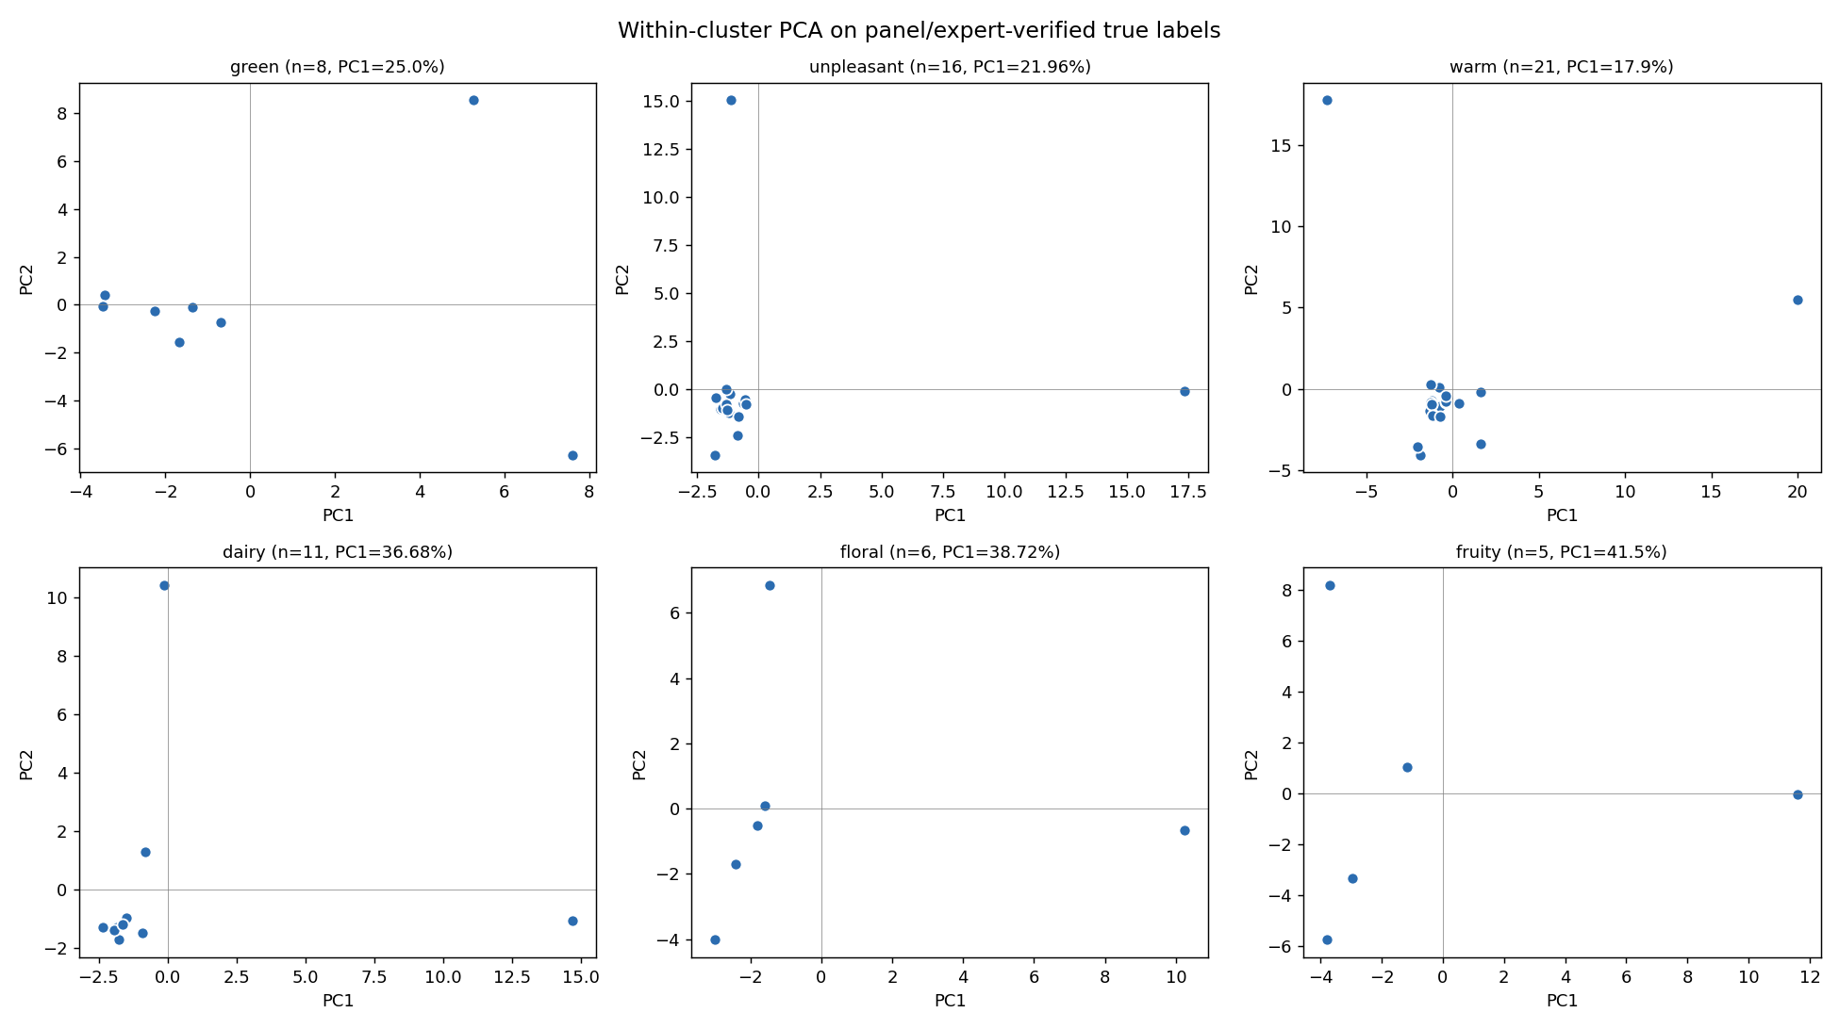
04 / FROM INGREDIENT ANALYSIS TO SCORING
How ingredient analysis guided the design of the scoring system
Per-flavor-type ingredient analysis, panel-verified recipes only
WHAT THE ANALYSIS REVEALS PER ARCHETYPE
We run a principal component analysis separately on each archetype using only panel-confirmed true-label recipes. The first component captures the main axis of ingredient variation within each archetype and reveals which raw materials most strongly define it, its chemical fingerprint.
EXAMPLE INGREDIENT SIGNATURES
Warm:
Furaneol, Maltol, Vanillin
Floral:
Jasmin Absolute, Linalool
Green:
cis-3-Hexenol, trans-2-Hexenal
Dairy:
Diacetyl, Acetoin
Unpleasant:
Hexanoic acid, sulfurous compounds
Fruity:
Isoamyl acetate, ethyl esters
Per-archetype ingredient fingerprints (panel-verified recipes only)
HOW THIS CONNECTS TO THE SCORING FRAMEWORK
The statistical fingerprints directly informed the design of the expert scoring system: ingredients with strong archetype-specific signals received higher weights, while ubiquitous background ingredients received zero weight. This transforms qualitative flavorist knowledge into a quantitative, reproducible scoring formula.
TAIsty | AI-Assisted Flavor Development | Status July 2026 | Confidential
4 / 5

Slide 5
05 / RESULTS & NEXT STEPS
Where We Stand and What Comes Next
Classification results, scoring calibration in progress, and the path forward
Rule-Based - Expert Rule Classification
Statistical - Similarity-Based Classification
Expert Scoring - Calibration Ongoing
90%
90%
In Progress
on recipes where all 4 panelists agreed
on recipes where all 4 panelists agreed
A continuous weighted scoring system assigns each recipe a profile across all 7 archetypes, revealing degree of membership rather than a binary label. Active calibration of ingredient weights is underway with flavor experts.
"This recipe is 80% Warm, 15% Green, 5% Floral." If a single label is needed, we simply pick the highest score — Warm in this case.
Transparent and auditable. Every decision can be traced back to a specific flavorist rule. Rules are maintained directly by the flavor team and take effect immediately.
"If it smells strongly of caramel and jam → it's Warm."
Flavorist-confirmed recipes anchor the system. Every other recipe is classified by how similar it is to those anchors, making it well-suited for borderline cases.
"This new recipe looks most like the ones we already know are Green."
NOTE ON ACCURACY SCORES
The 90% accuracy figures above reflect the subset of tasted recipes where all four panelists agreed on the correct archetype. A second group of recipes produced split verdicts among panelists, meaning no single ground truth could be established. Classification accuracy on this contested group is currently lower, and increasing it is an active focus. We are working with flavorists on additional tasting sessions to resolve the ambiguous cases and expand the reliable evaluation set.
NEXT STEPS
1. Fine-tune the scoring system
2. Define the key ingredients per flavor type
Align ingredient weights with flavorist expertise and fill in missing signature compounds.
Lock in the top characteristic ingredients for each flavor type, ready to use in new formulations.
3. Build the first working prototype
4. Scale to Further Fruits
Brief in, skeleton formulation out. First complete TAIsty prototype, validated by the flavor team.
Cherry and other fruits follow once the strawberry pilot is validated.
TAIsty | AI-Assisted Flavor Development | Status July 2026 | Confidential
5 / 5

