Slide 1
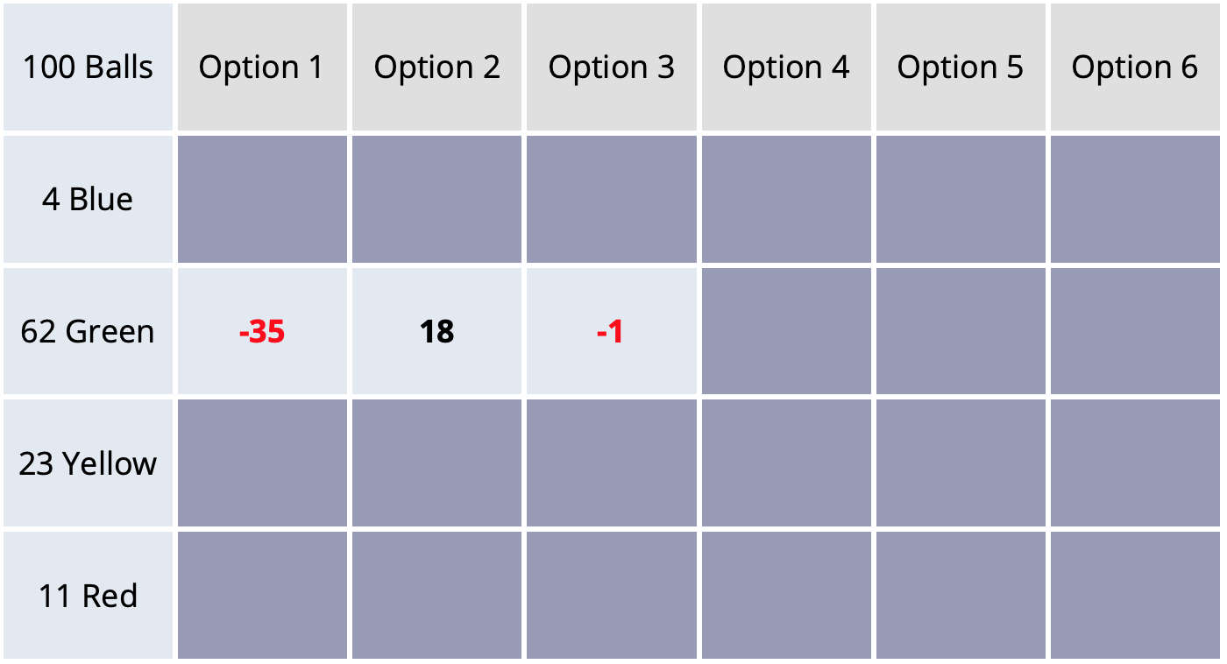

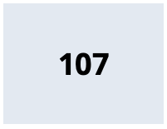
Gambles
Click #4
Outcomes
Click #1
Click #2
Click #3
Prob. in %

